Slide 1
European Education and Culture Executive Agency Pilot Projects and Preparatory Actions 2021-2027 Learning from the Extremes Project AGREEMENT n° LC-01760255/10105266 LfE
Presentation 2 - March 2023
School Name: Lisvernane NS
County: Tipperary
Lisvernane Learning Without Limits 2023

Slide 2
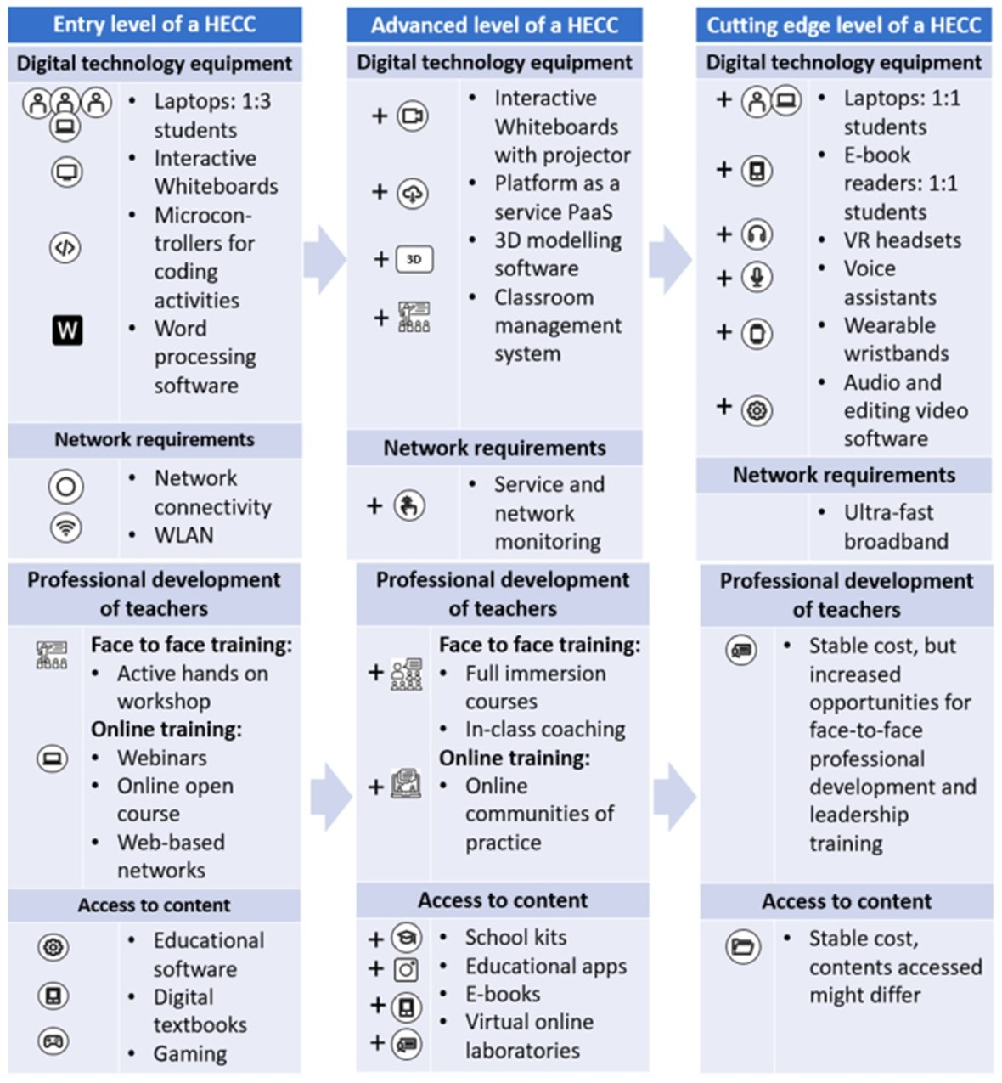
Our HECC Level
in nov 2022
Today Mar 21st 2023 In XXX 2023 level ?

Slide 3
Our PROJECT Aims
The primary aims in Our LfE Project:
1. Enhancing and Developing our ICT Department.
2. With a population of 116 students we need to be able to cater for all needs and giving more opportunities in Digital learning.
3. Clustering and developing with other schools and the school community.
4. Opportunity for all stakeholders to develop and learn within our school community.

Slide 4
How have we SPENT THE €10,000 EU GRANT
towards achieving our project aims?
Purchase: we have purchased 30 x Chromebooks.
Purchase: LocknCharge Joey cart x 1.
Purchase: Chrome for education upgrade licences x 30.
Cpd: Teachers have been exposed to continual Cpd within our school.
Awaiting Lego technology to enhance learning.

Slide 5
Progress to-date re. PROJECT Aims
1. Enhancing and Developing our ICT Department – Complete overhaul and functional ICT department for all.
2. With a population of 116 students we need to be able to cater for all needs and giving more opportunities in Digital learning- Every child has been given the opportunity to use individual technology (2nd class – 6th class) and guided from junior- 1st class.
3. Clustering and developing with other schools and the school community- We have engaged in training with Mount Bruis ns and will have online connection in Term 3 of this year.
4. Opportunity for all stakeholders to develop and learn within our school community-Senior class children are being afforded the opportunity to develop ICT skills, Teachers are taking on CPD courses, and soon Parents/grandparents will be afforded opportunity to learn collaboratively in school.

Slide 6
School: Term 3 Staff Training to be completed with Wriggle. Podcasting to be introduced in School. Opportunities for wider school community For developmental links. Further connection with local schools to be enhanced.
Plan going forward from March 2023 to ensure aims are achieved

