Slide 1

Content:
Message from Our Leadership Team…
Featured classes of the week…
In the Spotlight…..
Did you know...
Reminders…
What’s coming up…?
Commitment Aspiration Resilience Empathy

Slide 2
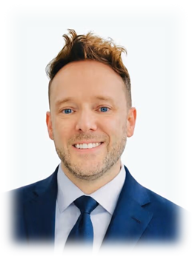
Dear Parents and Guardians,
It was wonderful to see so many families attend last weeks Art Exhibition and celebrate the creativity and hard work of our students. The exhibition showcased not only the children’s artistic talents, but also their confidence, imagination, and individuality through a wide range of exciting pieces across the school.
Events such as these are incredibly important in helping children develop self-expression, resilience, and pride in their learning. We are extremely proud of all of our students for the effort they put into their artwork and the enthusiasm they showed when sharing it with others.
A huge thank you must also go to our staff for their support and preparation, and to our parents for continuing to encourage and celebrate the children’s achievements.
We look forward to many more opportunities to showcase the fantastic learning taking place across our school community.
Commitment Aspiration Resilience Empathy

Slide 3

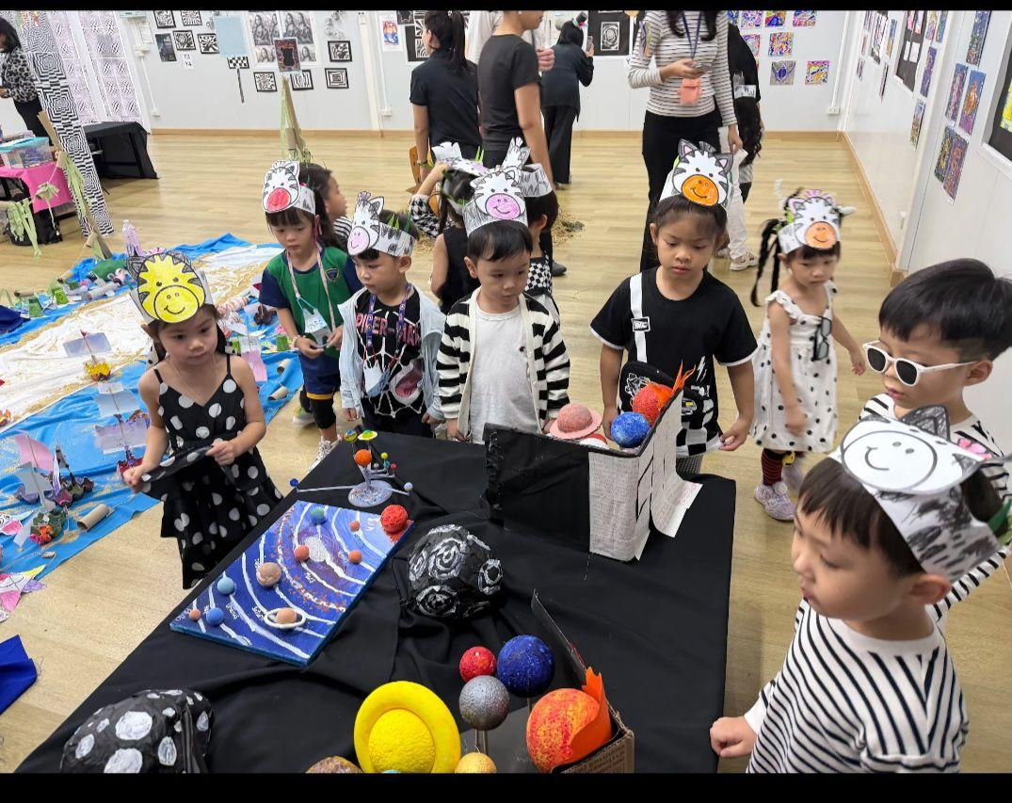
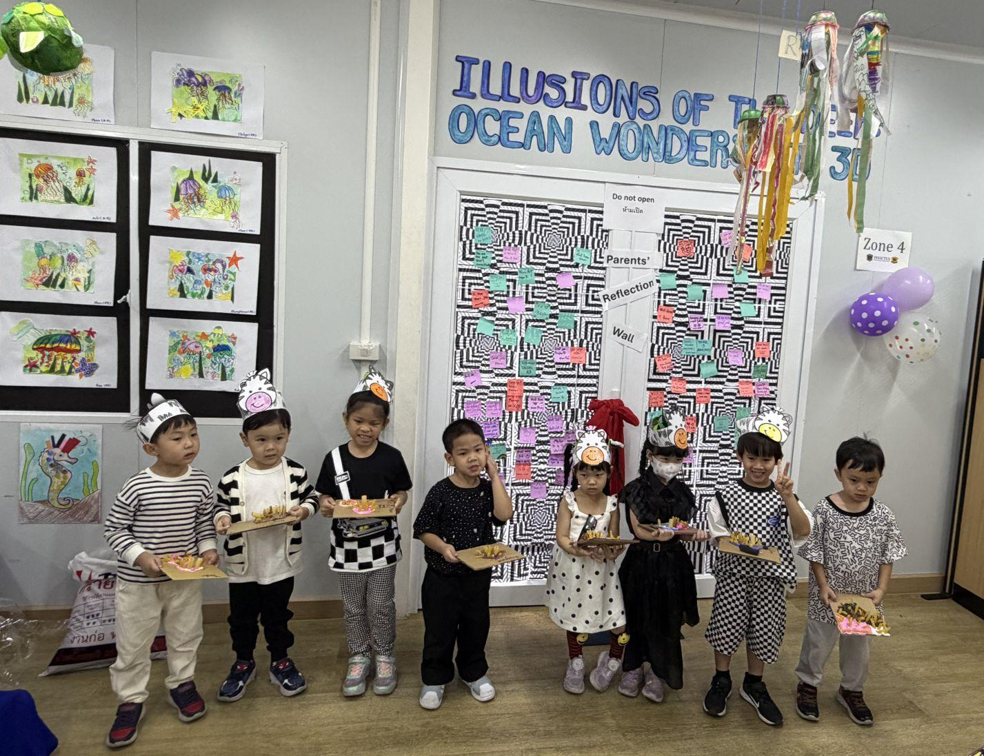
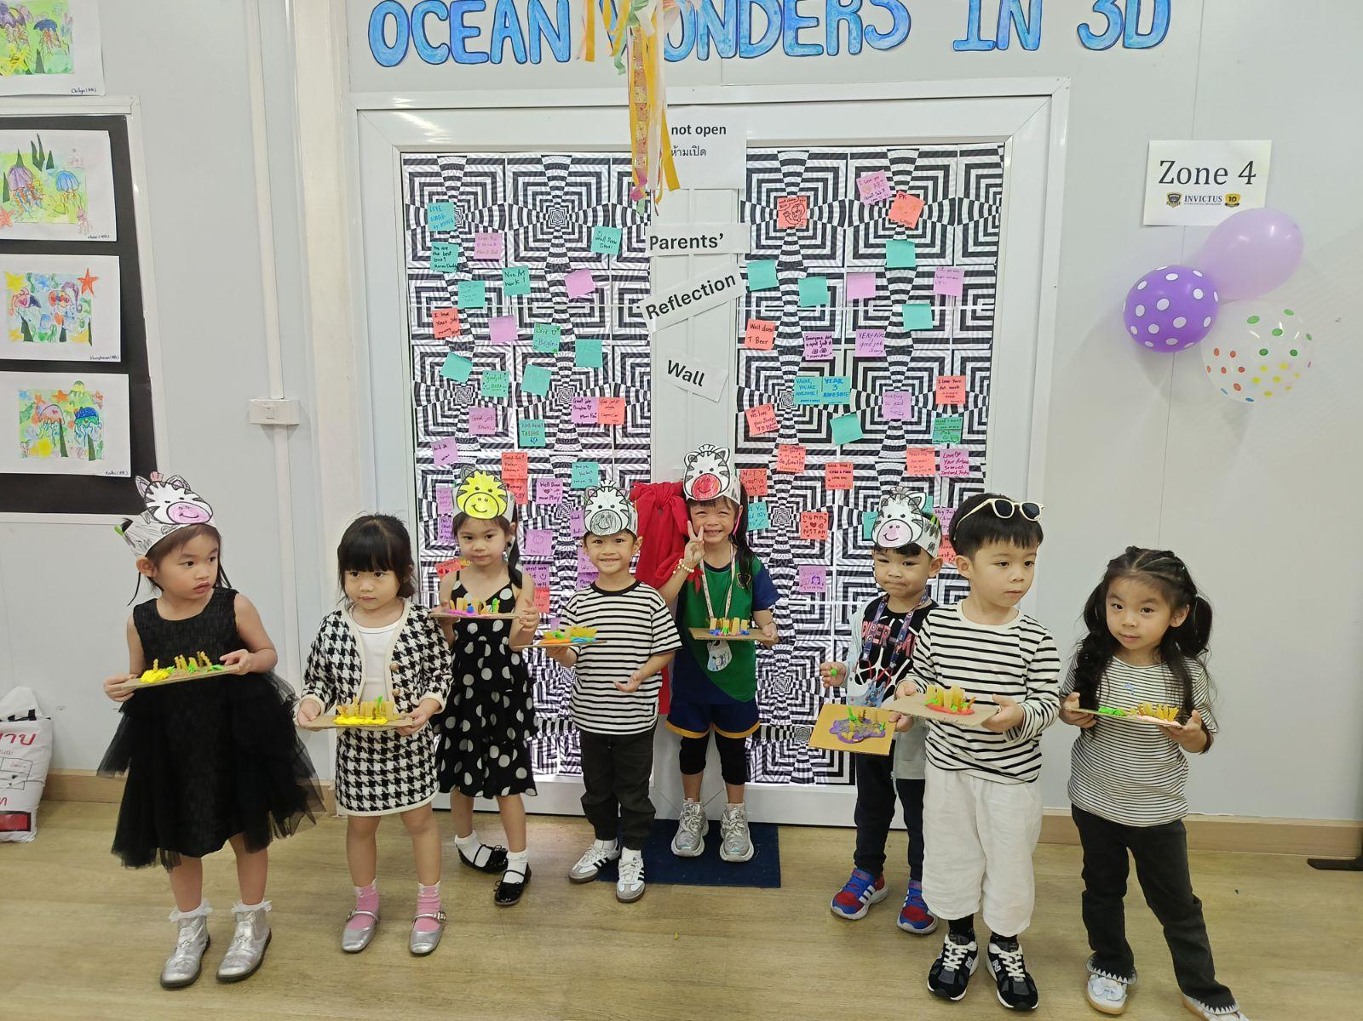
🎨🌊 What an incredible celebration of creativity at the Invictus Programme Art Exhibition 2026 — Illusions of the Deep: Ocean Wonders in 3D!
Our students proudly showcased their imaginative artworks, transforming recycled materials into stunning ocean-inspired 3D creations filled with colour, illusion, and creativity. 🐠✨
Thank you to all the parents and families who joined us in celebrating the students’ artistic growth, hard work, and dedication throughout their learning journey. We are so proud of every young artist! 💙

Slide 4
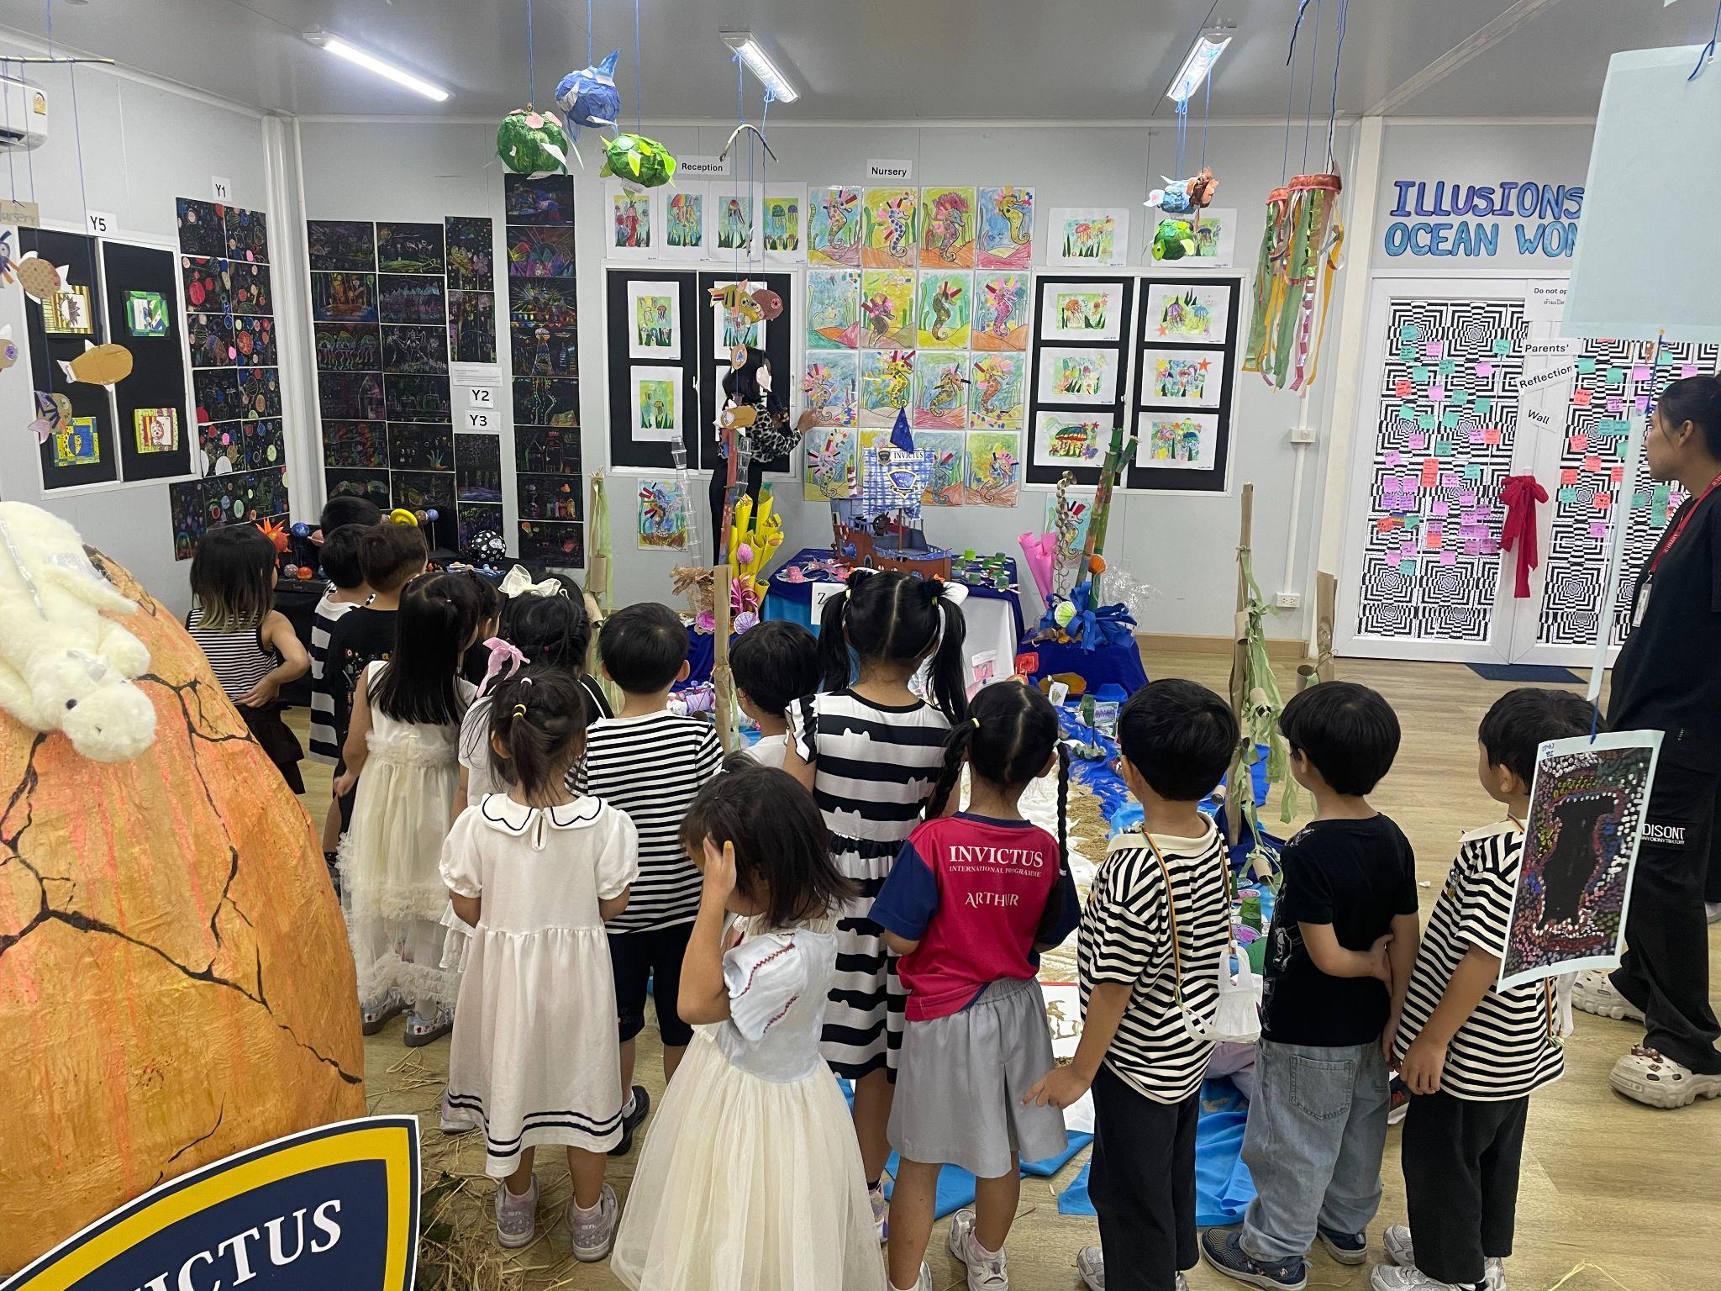
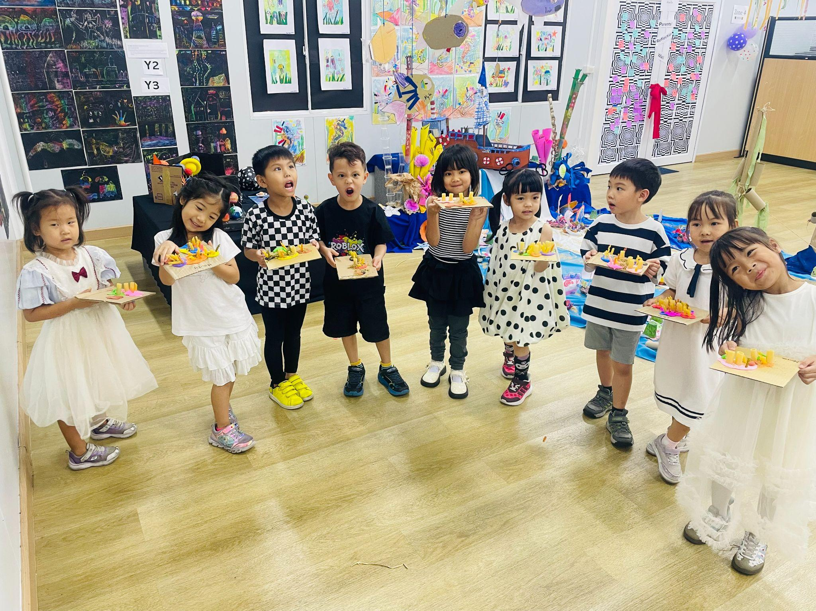
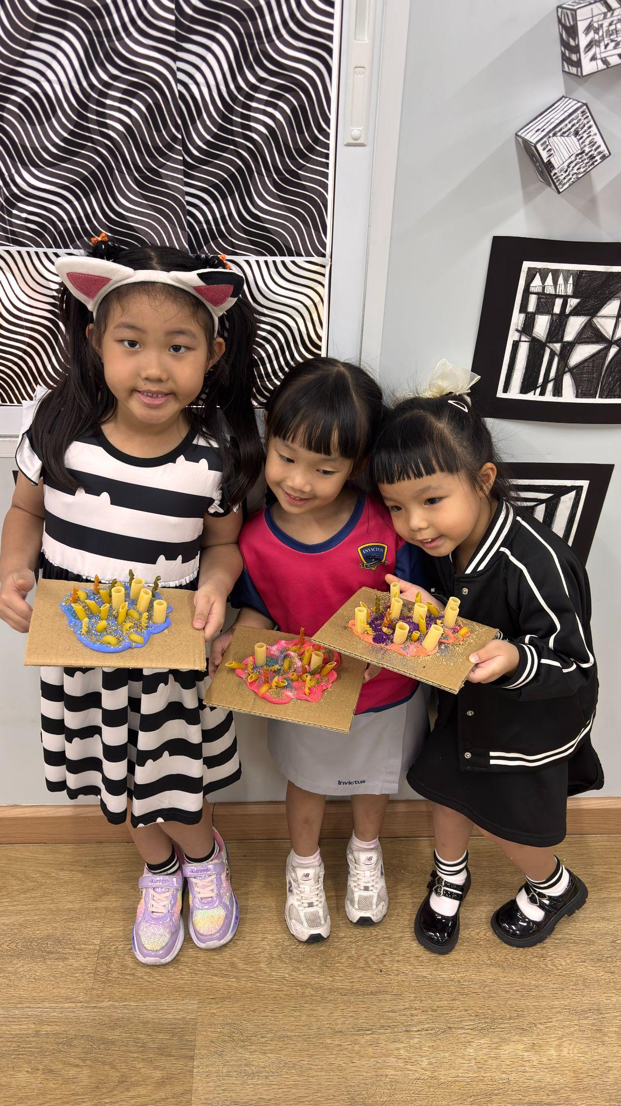
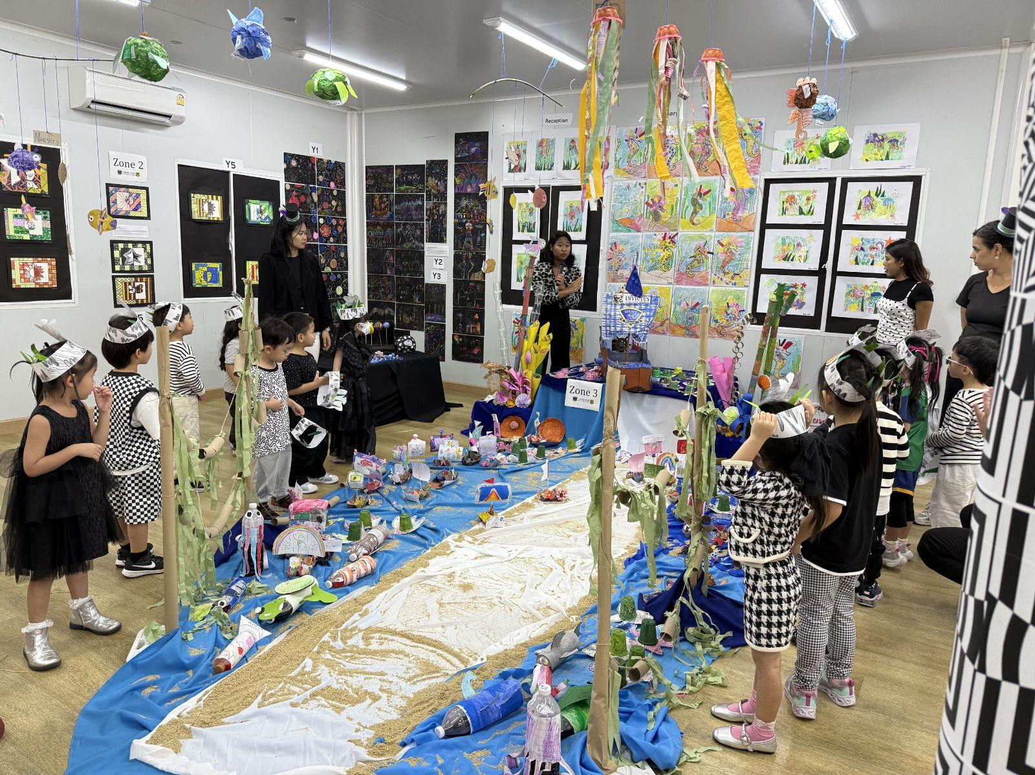
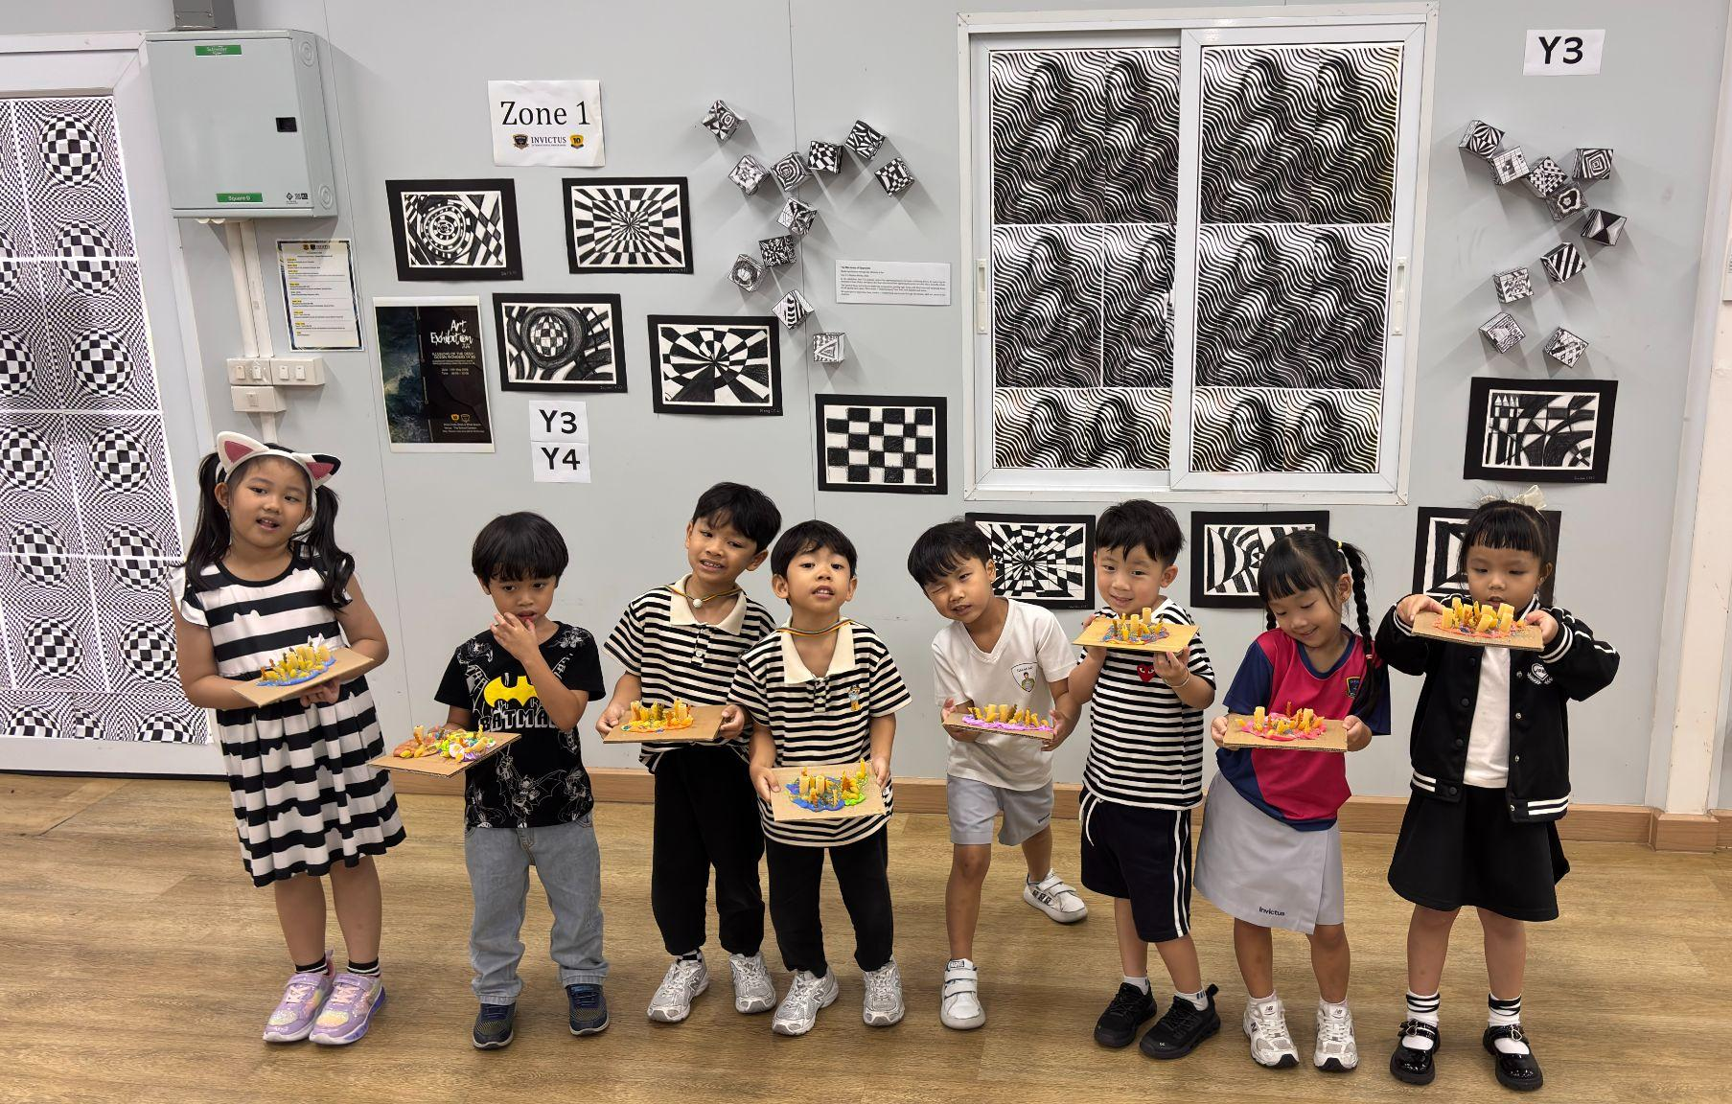

Slide 5
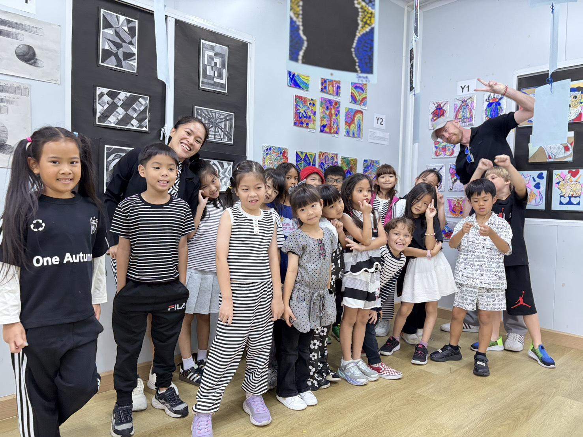
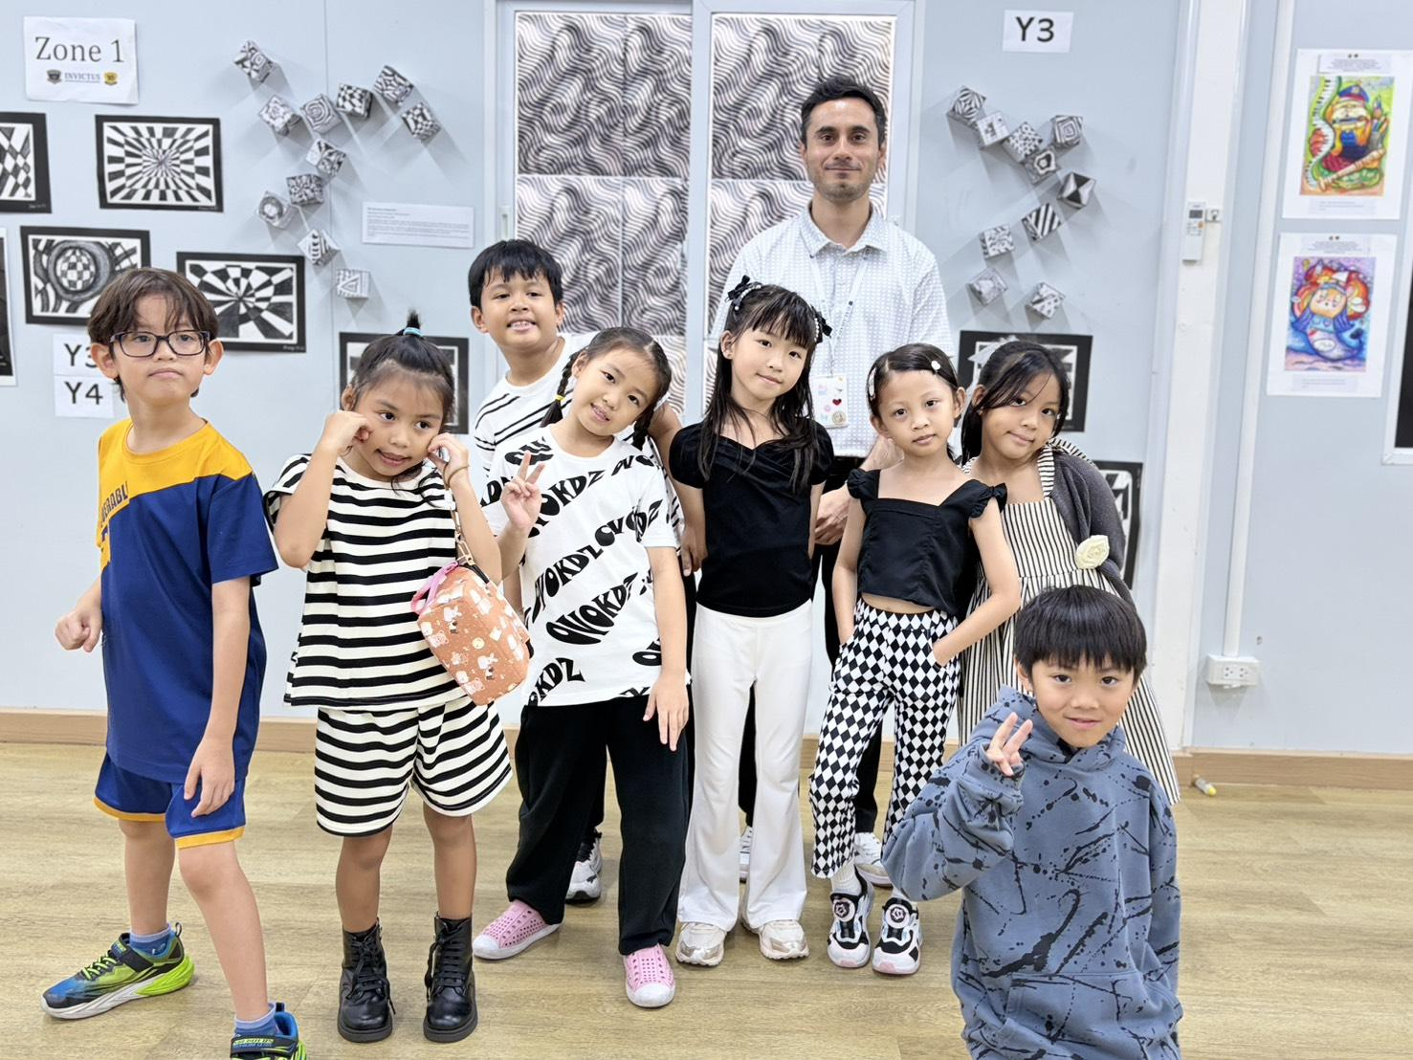
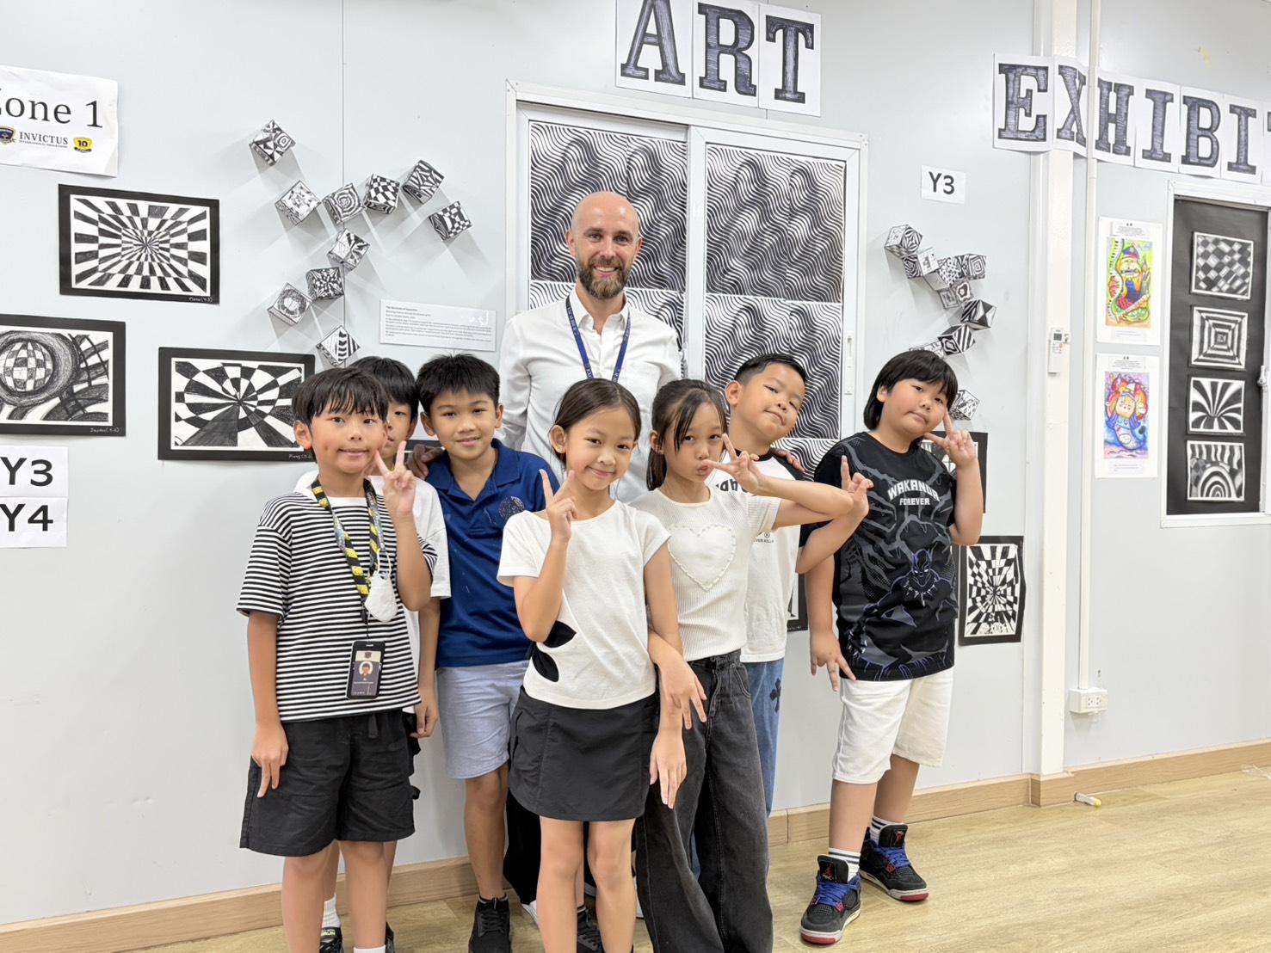
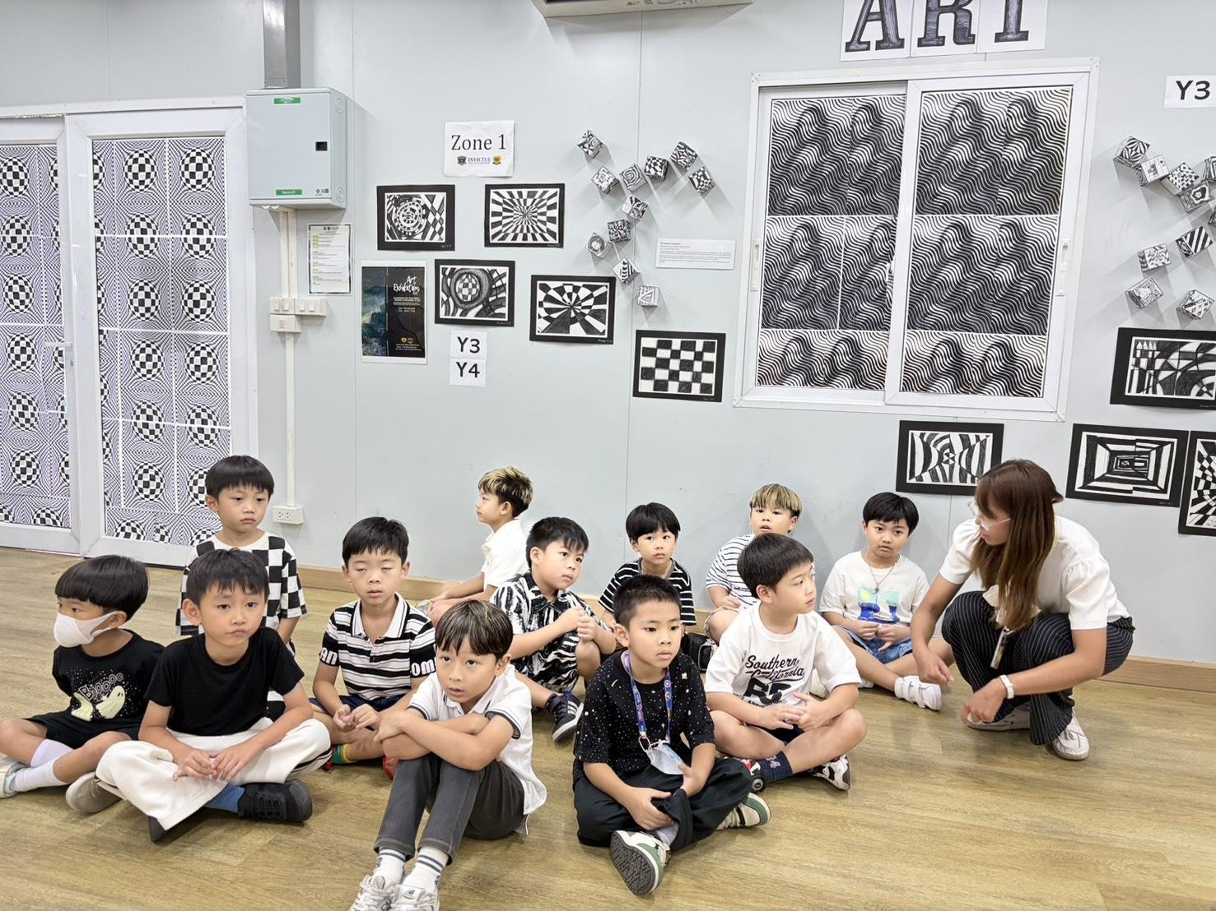
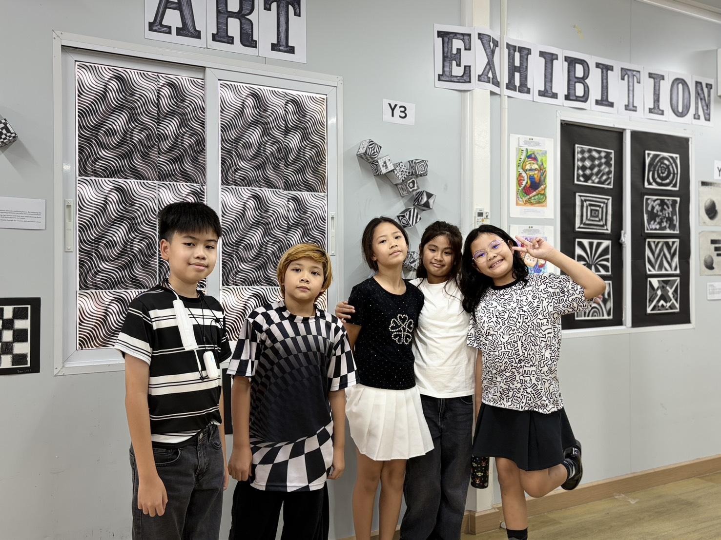
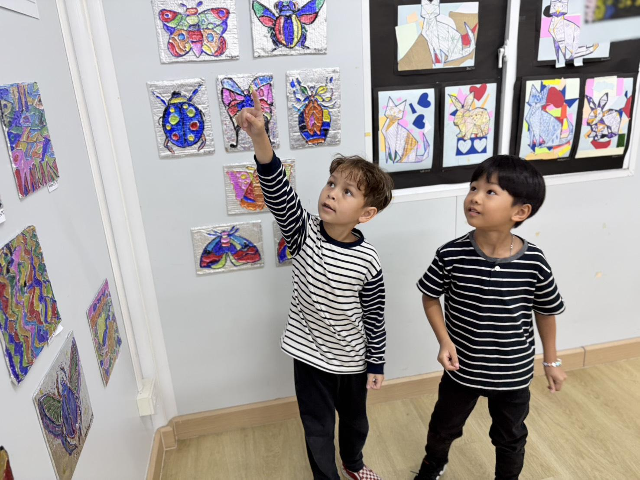

Slide 6
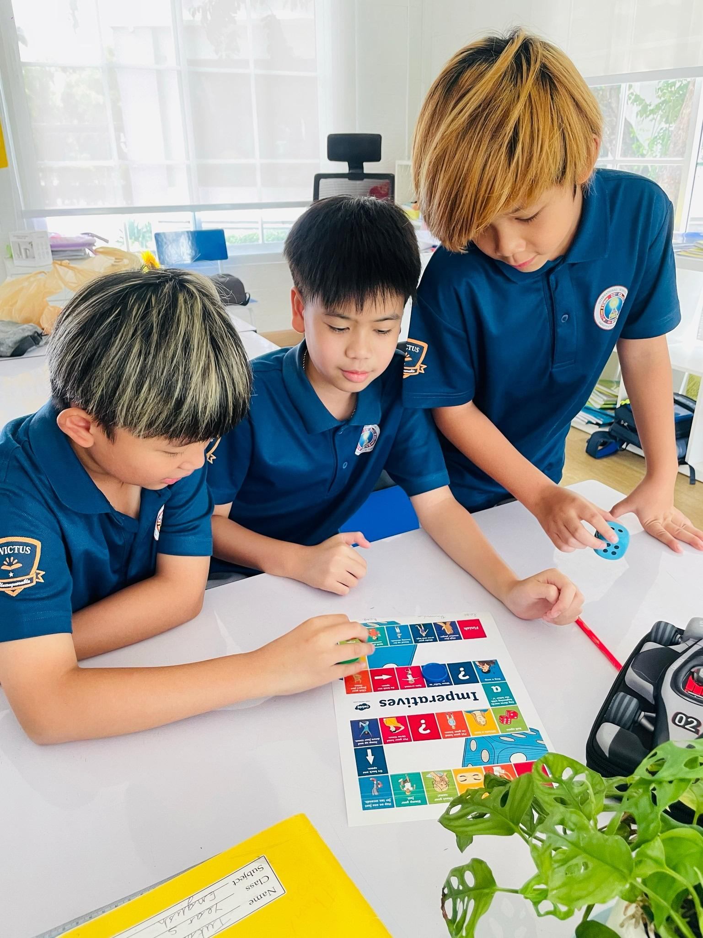
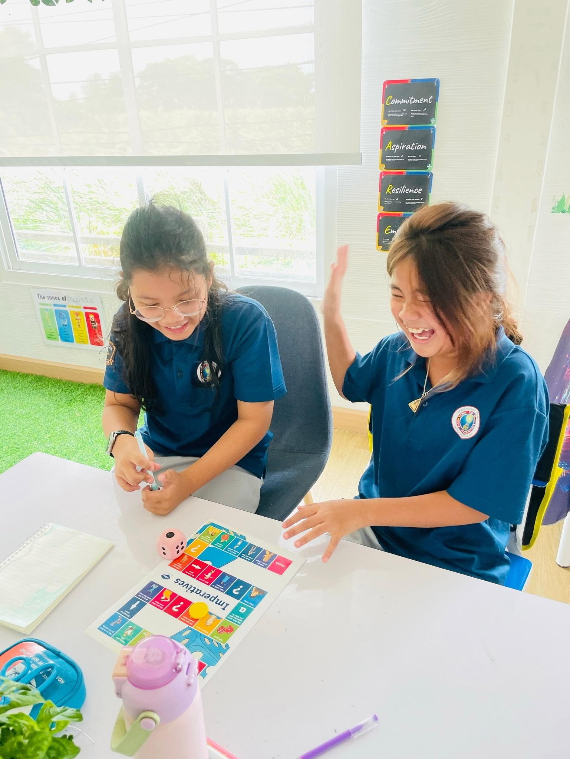
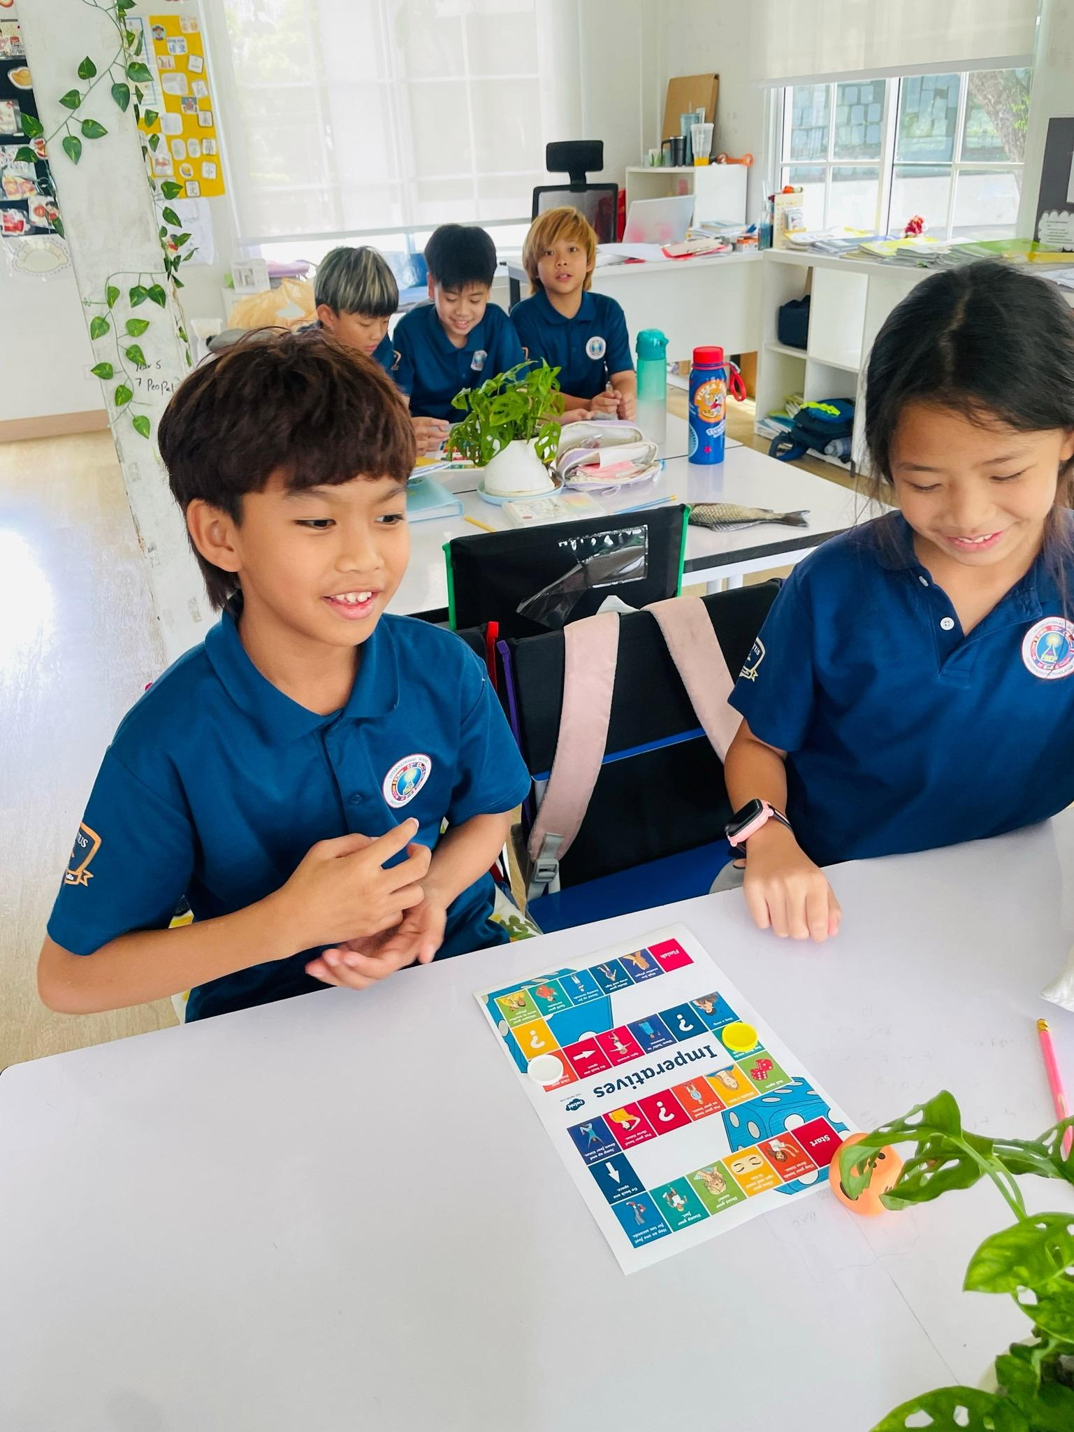
In English this week, Year 5 have been learning about imperative verbs, also known as “bossy words”, and how they are used when writing instructions. The children then enjoyed playing an interactive board game, acting out commands allowing their learning to become an immersive experience.
.

Slide 7
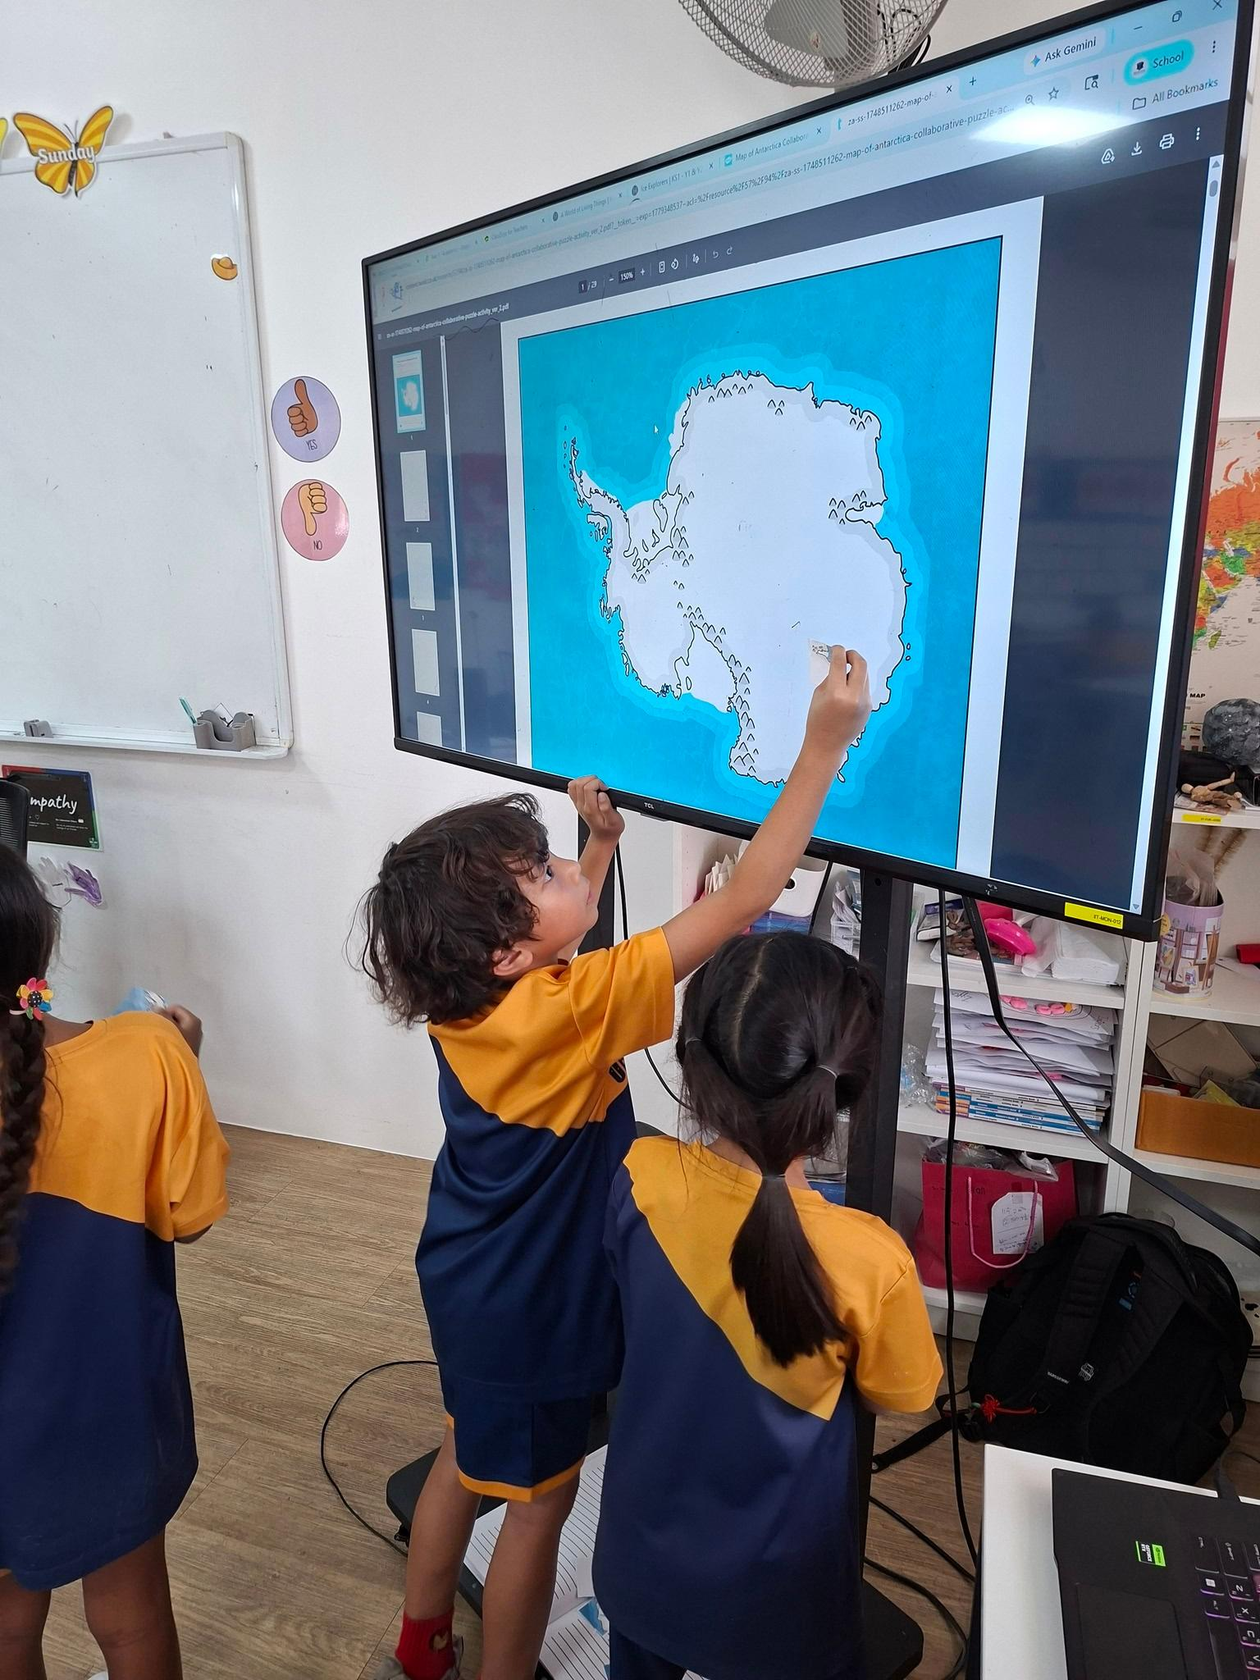
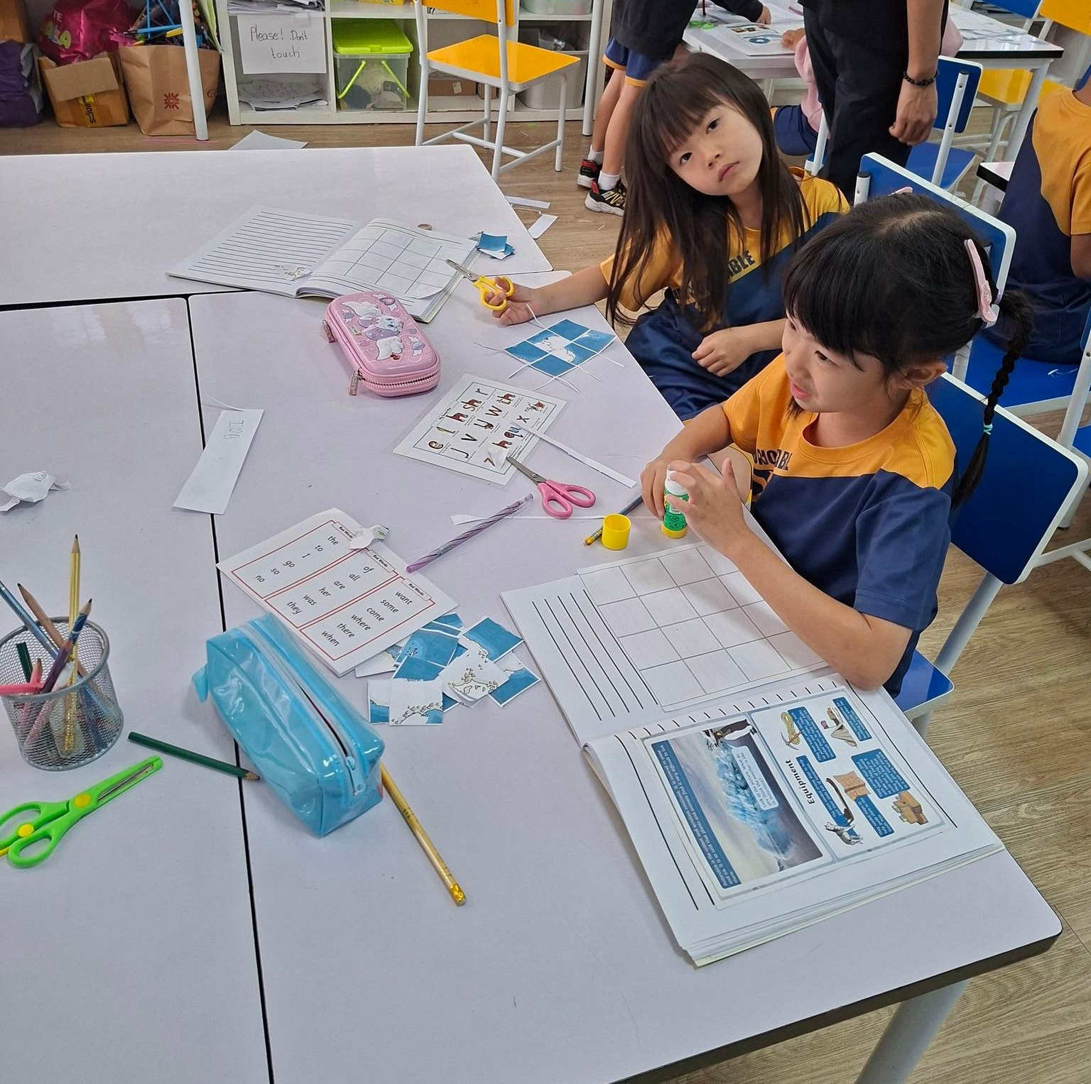
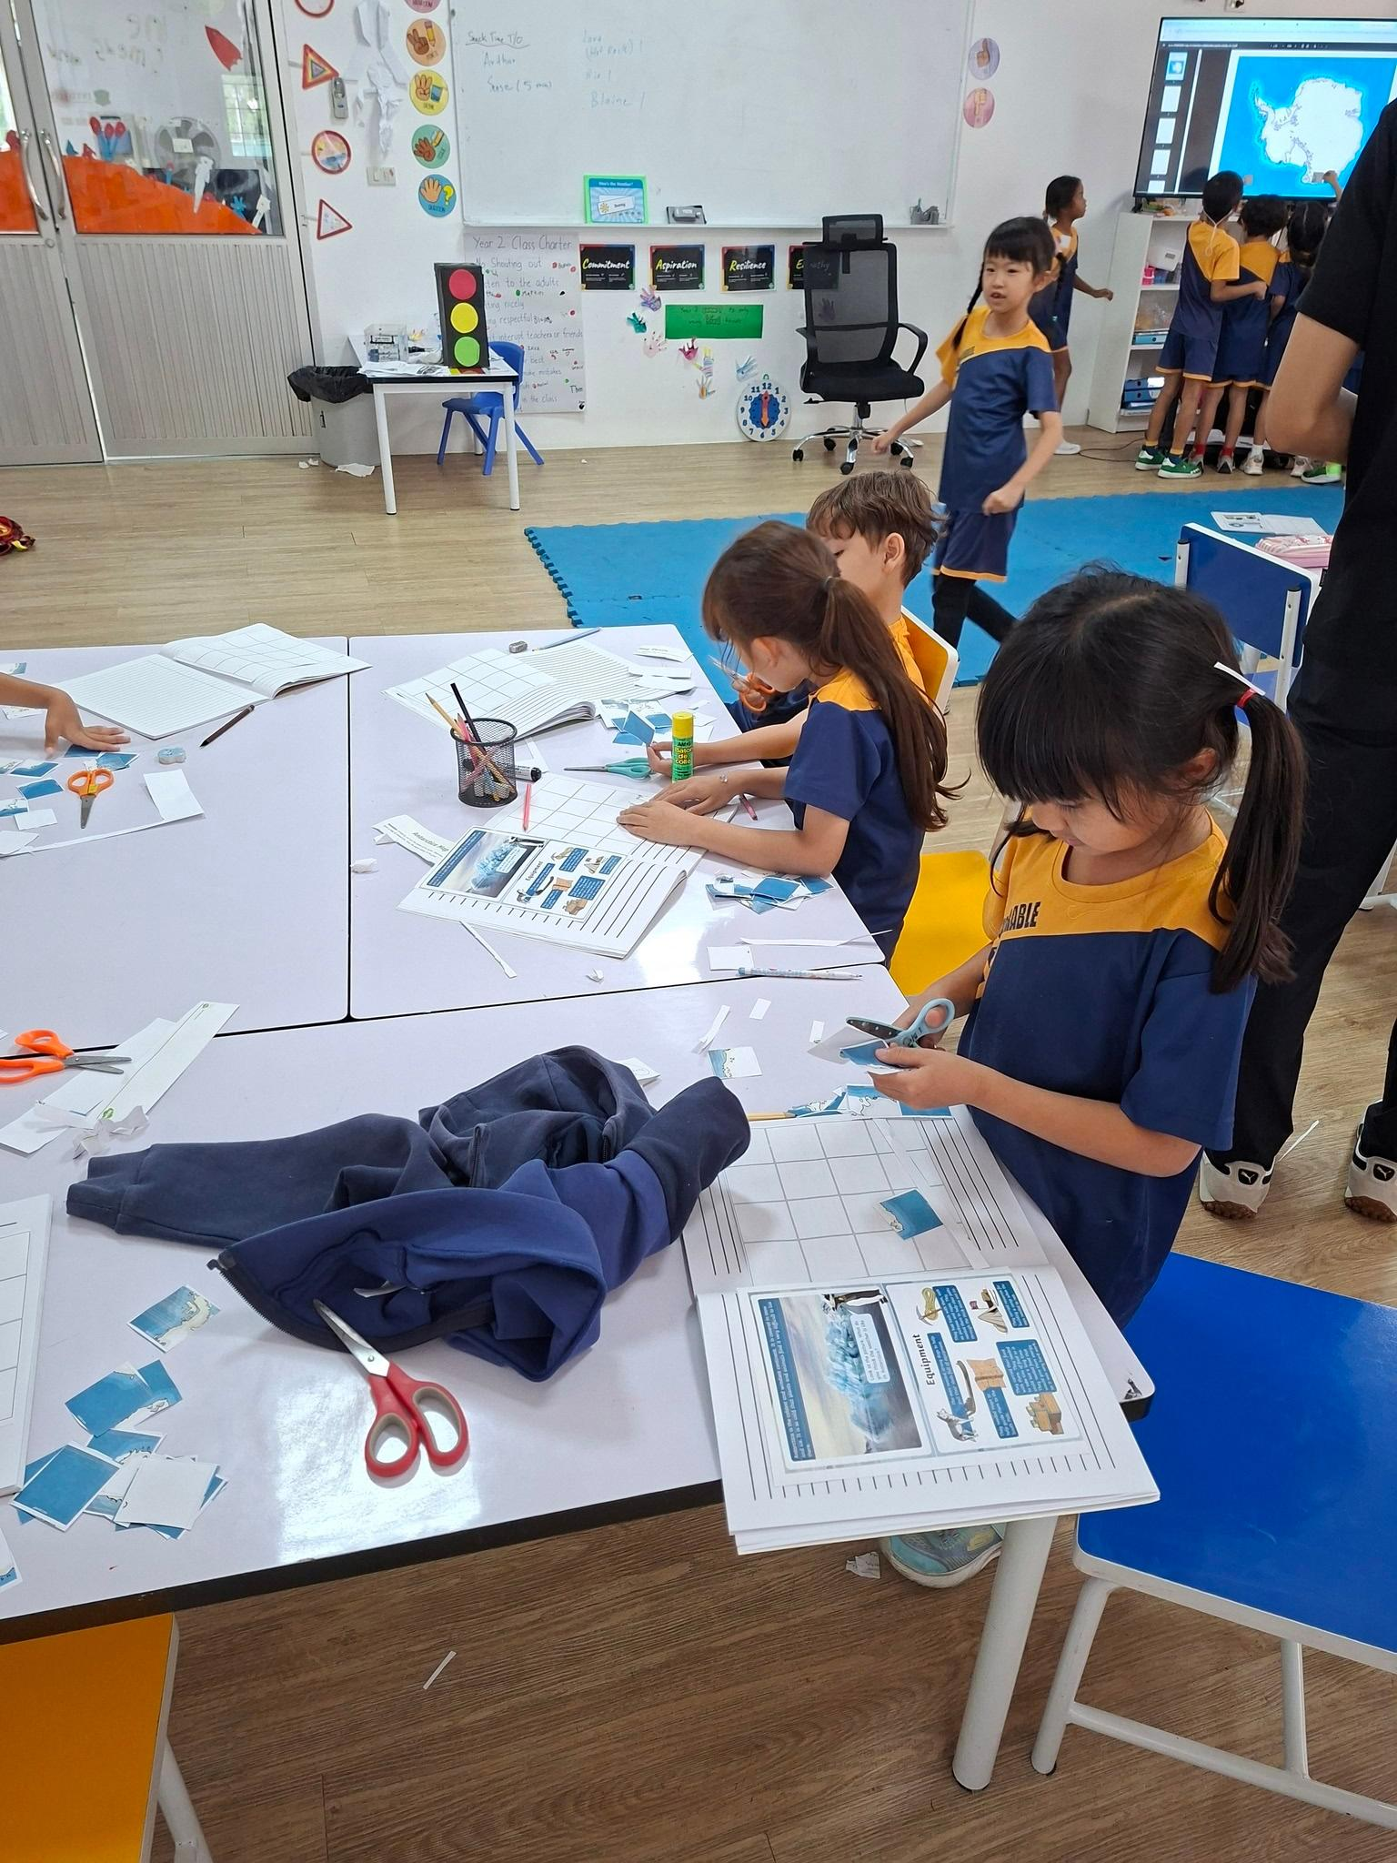
In Humanities, Year 2 have been exploring Antarctica by learning about its extreme weather conditions, the challenges of travelling there, and the importance of food and supplies for survival. The children enjoyed discovering what life is like in one of the coldest and most remote places on Earth.

Slide 8
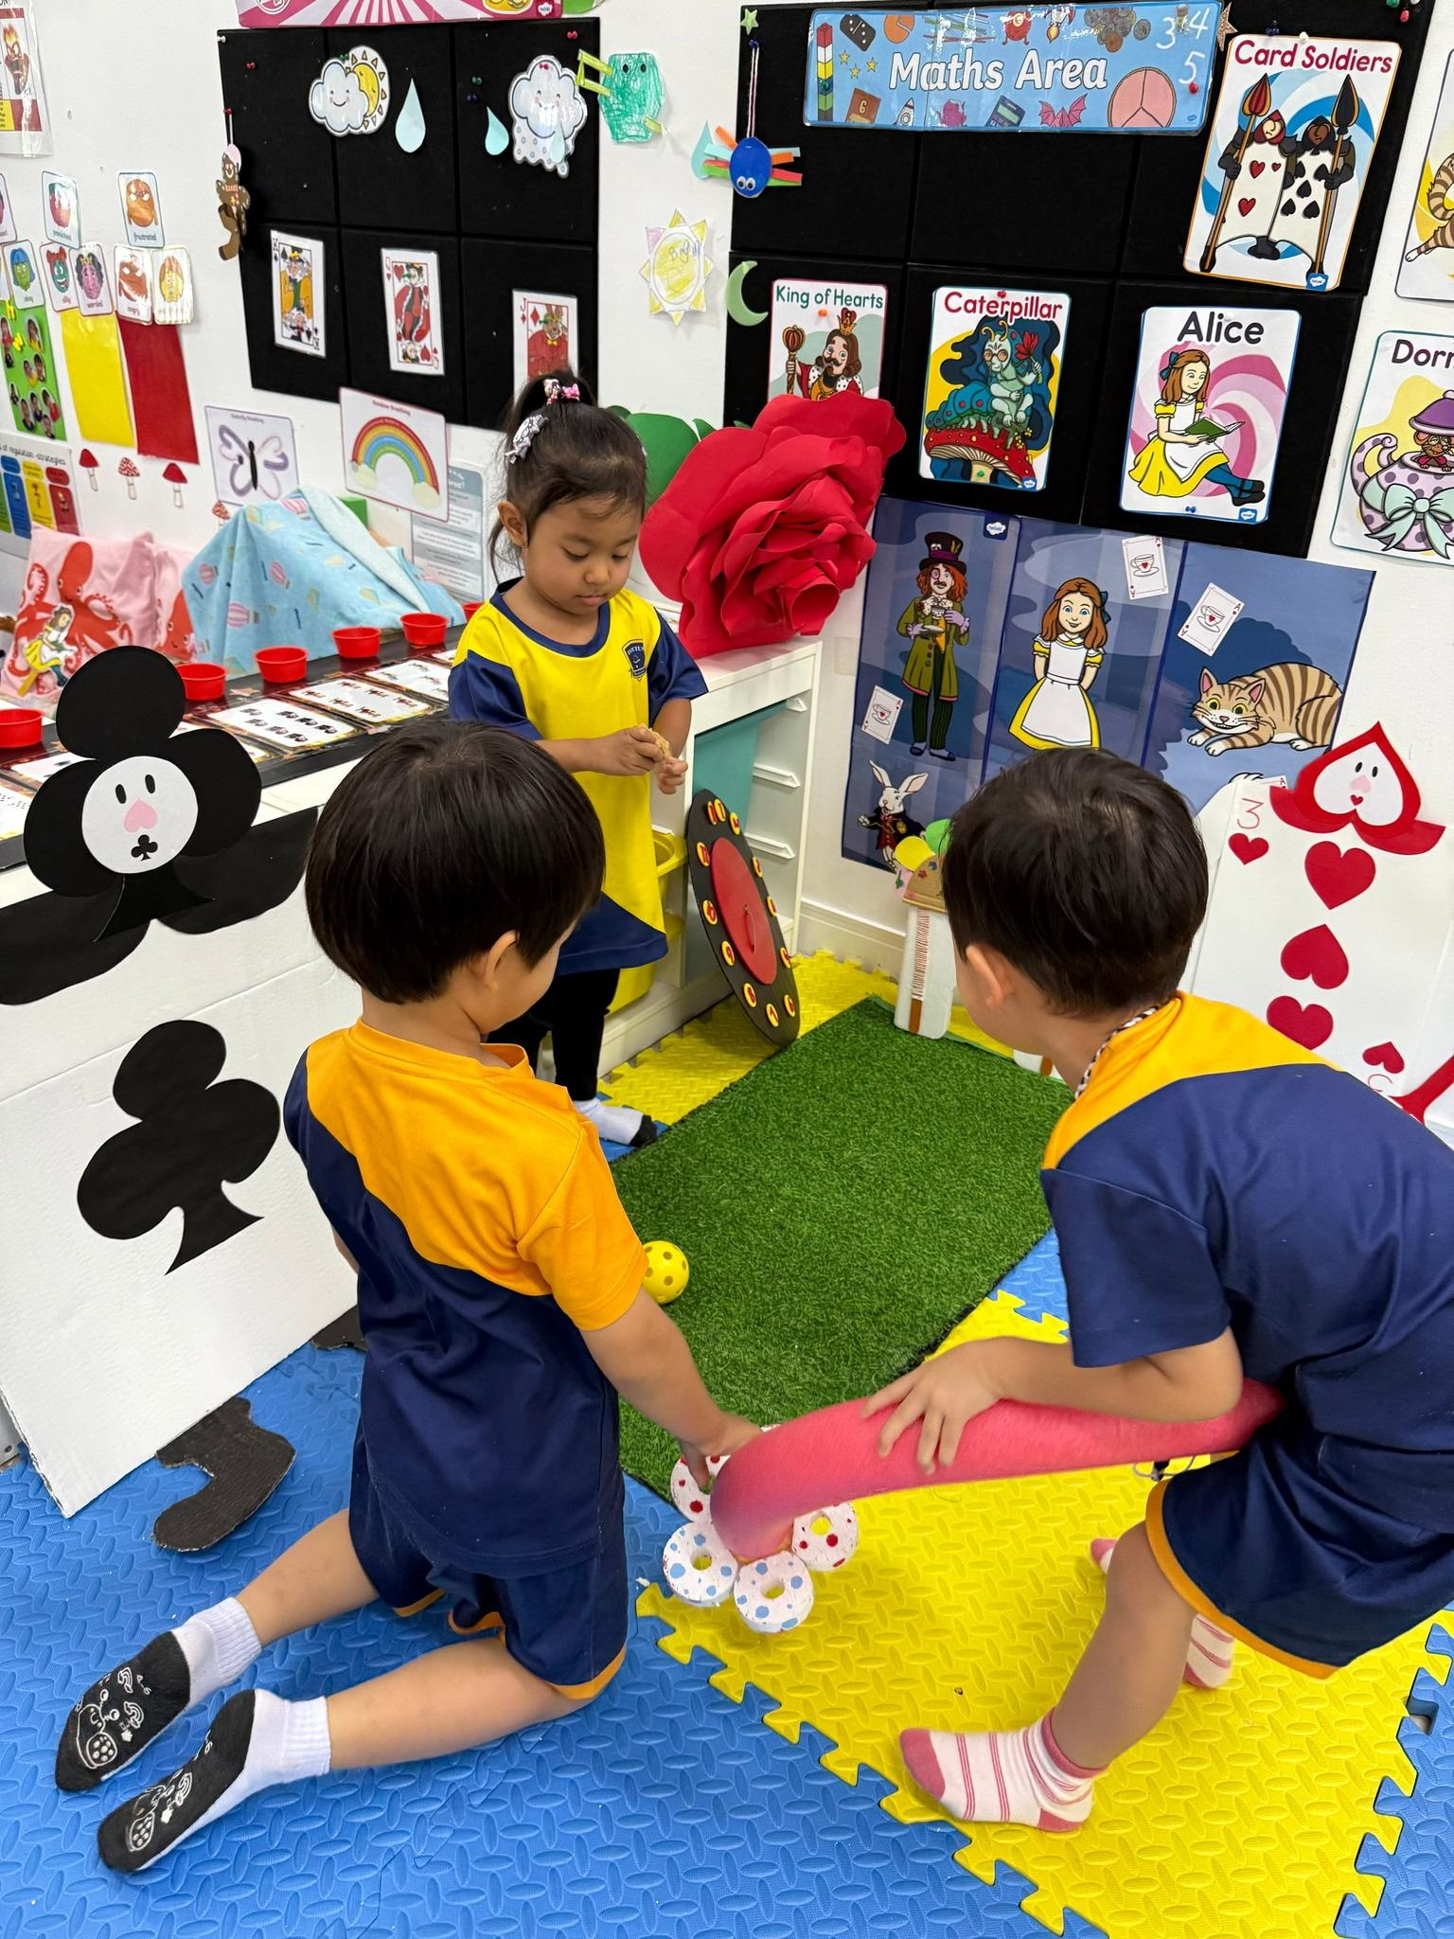
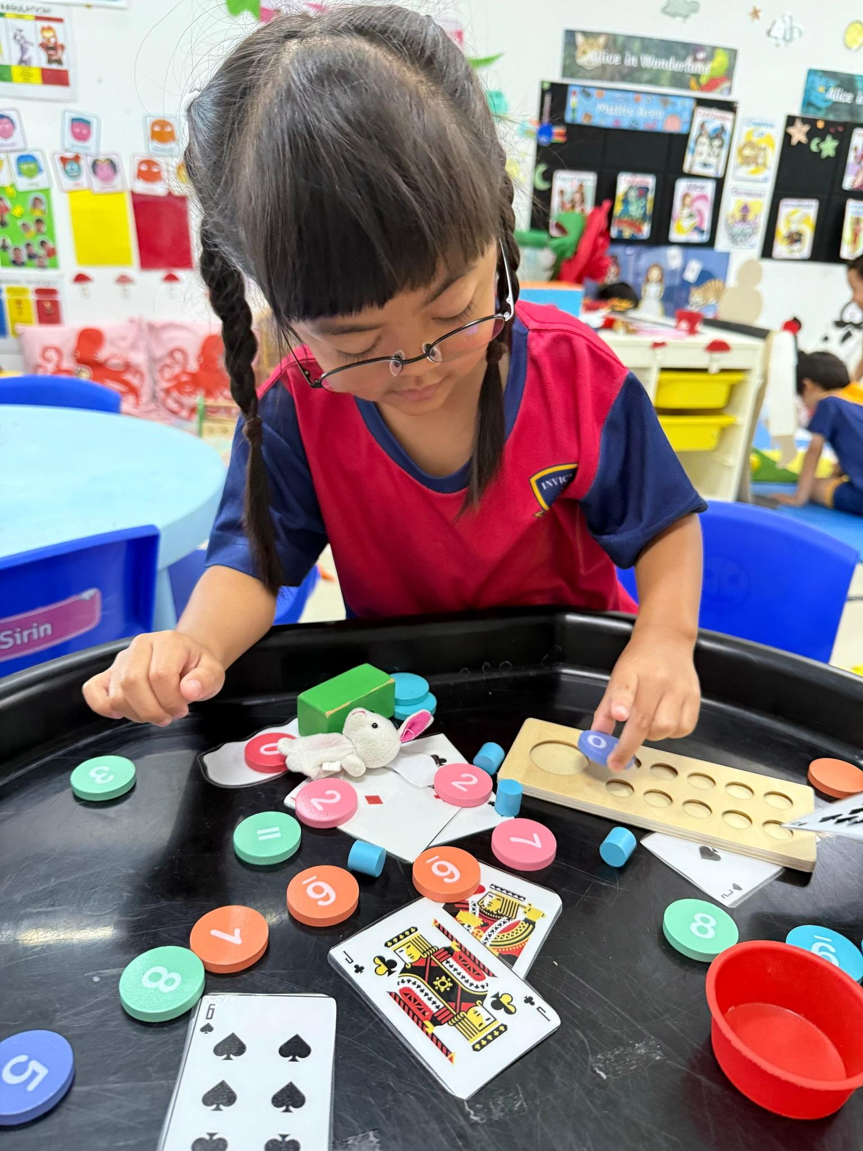
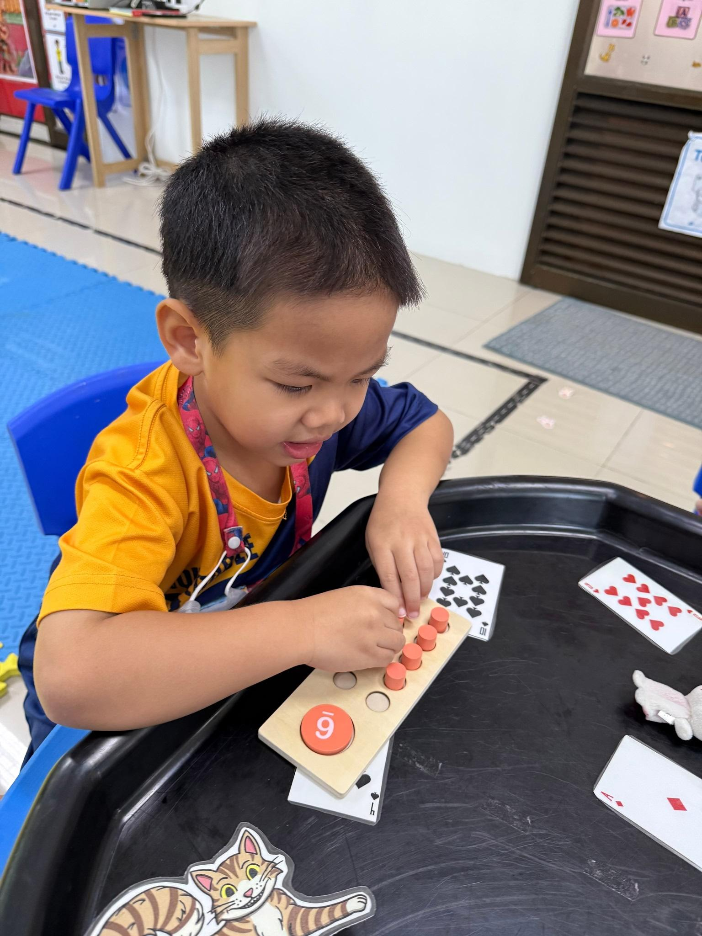
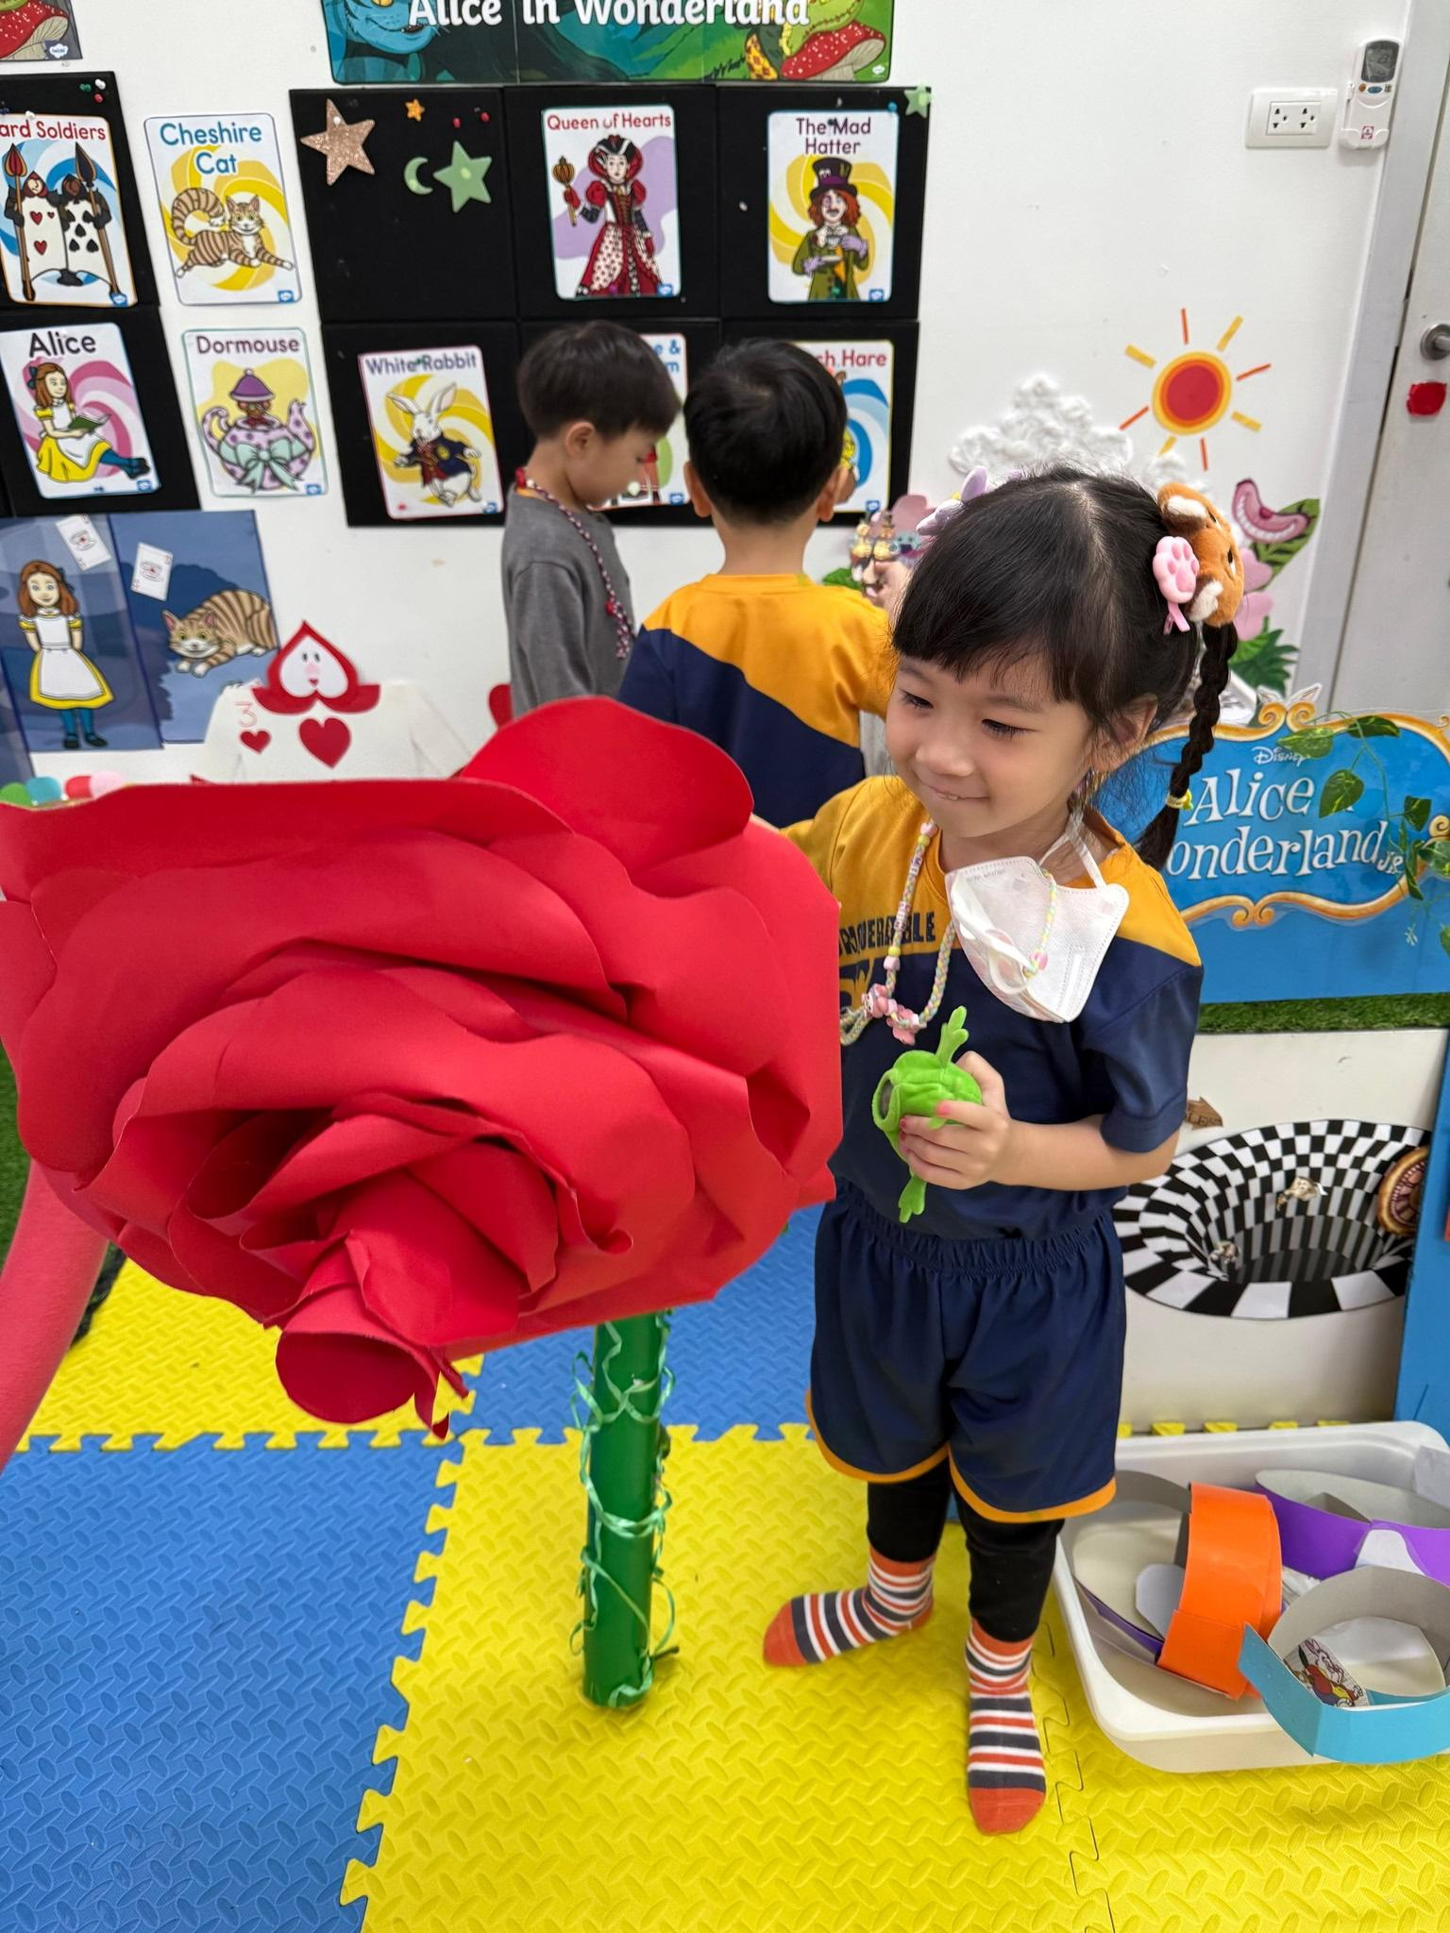
This week, the Cheetahs continued their Alice in Wonderland adventure through curriculum areas such as English, Maths, and Understanding the World, exploring “Why” questions, number recognition, and light and shadows. ✨🐰📚🔦

Slide 9
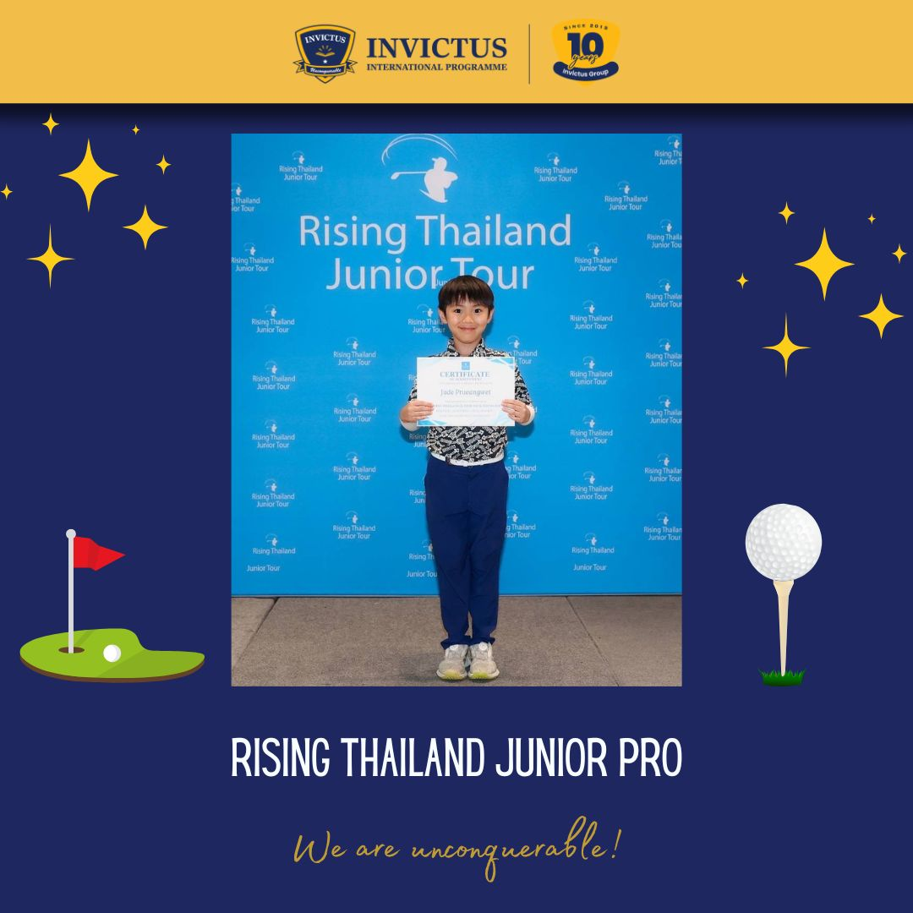
⛳🌟 Congratulations to Jayden on an amazing achievement!
Jayden secured a brilliant Top 5 finish at the Rising Thailand Junior Pro at Dynasty Golf & Country Club, as well as winning the Chip-In Prize! 🎯🏆
A wonderful reward for all the hard work, determination, and focus shown throughout the journey. Keep up the fantastic effort and continue reaching for greatness! 💪✨

Slide 10
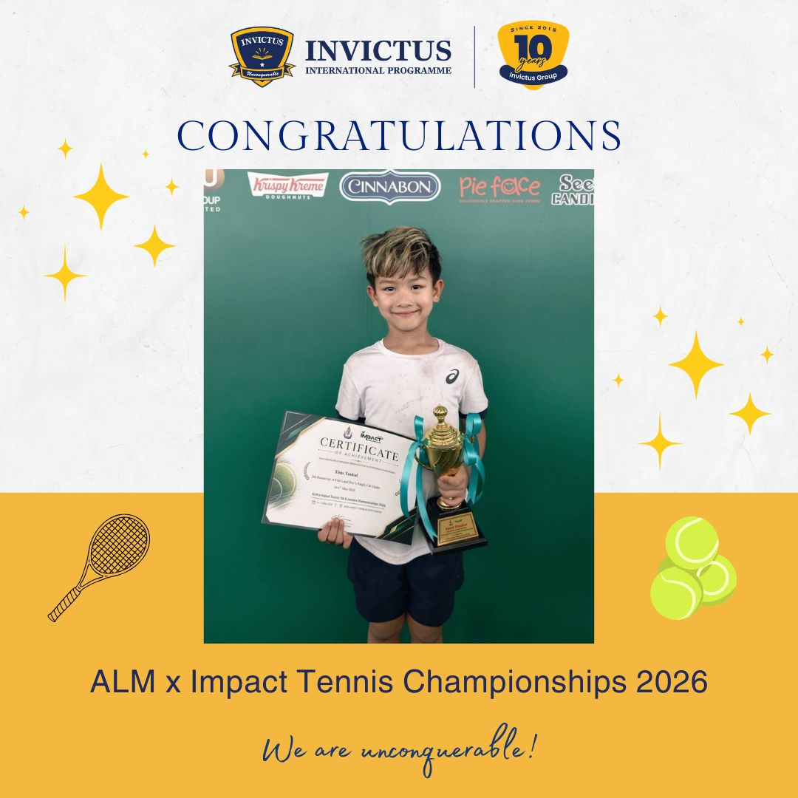
🎾 Congratulations to Titus! 🏆
We are proud to celebrate Titus for achieving 2nd Runner-Up in the Under 6 Category at the ALM x Impact Tennis Championships 2026! 🌟 Your hard work and determination on the court are truly inspiring. Keep shining and aiming higher! 🎉👏

Slide 11

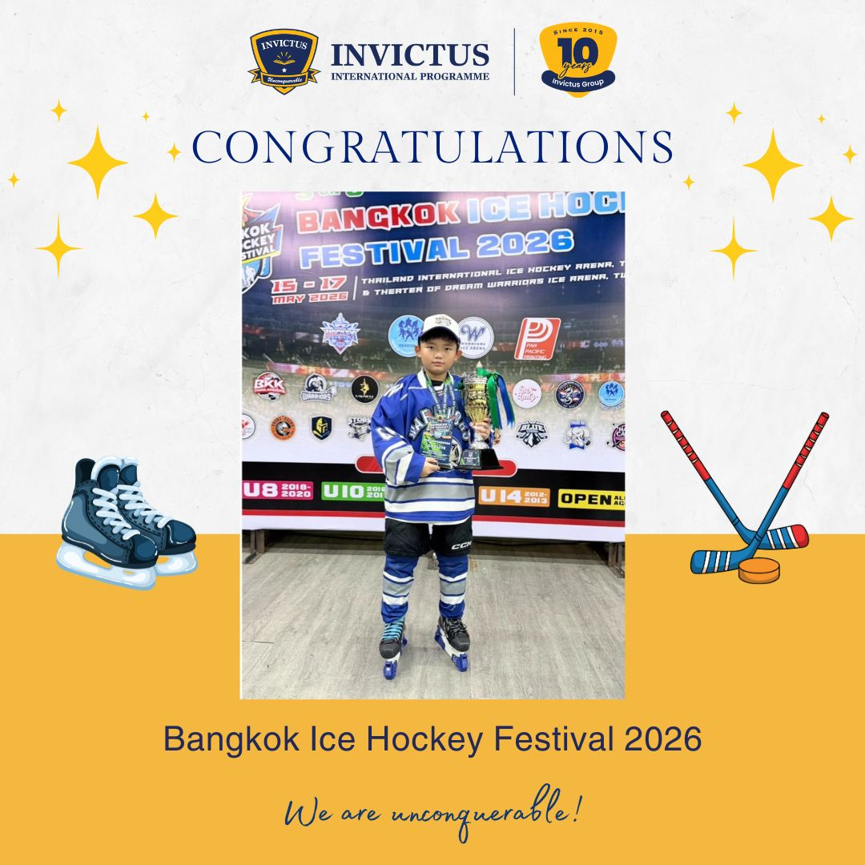


🏒 Congratulations to our students on their amazing achievements at the Bangkok Ice Hockey Festival 2026! 🏆🌟We are so proud of your hard work, determination, and teamwork on the ice! 👏
Tutor 🥈 Silver Medal – Bangkok Warriors Team (U10 Elite) ⭐ MVP of Game 122 🛡️ Awarded Best Defender 🥇🏆 Gold Medal – TIIHA Select Team (U10 Elite)
🥇 Thea Gold Medal (U8 Elite) ⭐ MVP in Game 1
🥇 Martin Gold Medal (U8 Elite) ⭐ MVP in Game 106
Je t'aime
🥇Gold Medal in the U12 Division

Slide 12

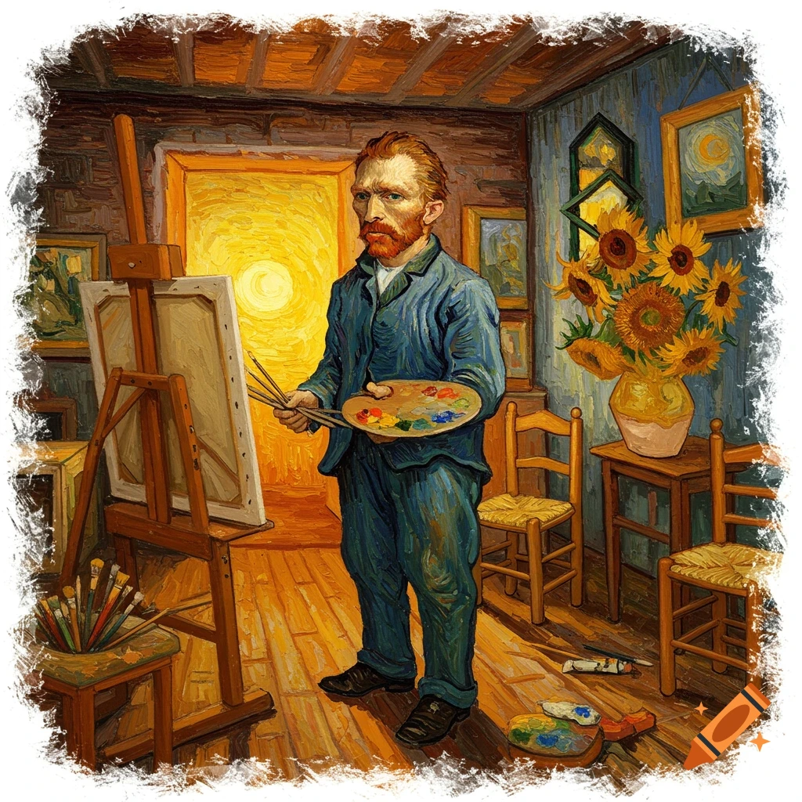
Did You Know?
Art is not just about creating beautiful pictures — it plays a huge role in a child’s development! Through art, children build creativity, confidence, fine motor skills, problem-solving abilities, and emotional expression.
Research also shows that engaging in art activities can help improve focus, communication, and resilience, while encouraging children to think independently and share their unique ideas with the world.
The Invictus Art Exhibition was a wonderful celebration of our students’ imagination, effort, and creativity. We are incredibly proud of the confidence and enthusiasm they showed in sharing their work.
Thank you to all families who supported and celebrated our young artists!

Slide 13

1st June - Substitution for Visakha Bucha Day
3rd June - H.M. Queen Suthida Bajrasudhabimalakshadana’s Birthday
5th June - Invictus Got Talent
12th June Sports Day
17th June Last Day of Term 4 – Dismissal at 12pm

Slide 14
🌟🎤 Invictus Got Talent 2026 Finalists Announcement! 🎤🌟
We are excited to officially announce the finalists for Invictus Got Talent 2026!
After a very difficult selection process, we are pleased to introduce the 10 acts who will perform live at the Invictus Got Talent 2026 Final Show on Friday, 5 June 2026.
🎭 Finalists:
Tara & Friends — Year 2
The Year 3 Girls (Anta, Vavar & Pleng) — Year 3
Anta — Year 3
IQ & Jayden — Year 3
The Your Idol Boys — Year 4
Denim — Year 4
Sense — Year 1
Korn — Year 1
Jordan & Jackson
Trin — Year 5
We cannot wait to see these amazing performers take to the stage and showcase their talents to the Invictus community.
Good luck to all of our finalists, and thank you once again to everyone who auditioned and supported the event! 💙

Slide 15

🌟 Make this school break truly unforgettable at Invictus Summer Camp 2026!
Designed for children aged 3–10, our premium summer programme blends creativity, exploration, teamwork, and hands-on learning in a warm, safe, and inspiring environment ✨
From farm adventures 🐄 and magical storytelling 📚 to Minecraft creativity ⛏️ and pirate expeditions ☠️, each week is thoughtfully crafted to spark curiosity, confidence, and joy.
📅 June 29 – July 24, 2026 (Monday–Friday)
⏰ 9:00 AM – 3:00 PM
🍱 Lunch & snacks included
📍 Ages 3–10 years

Slide 16


Slide 17
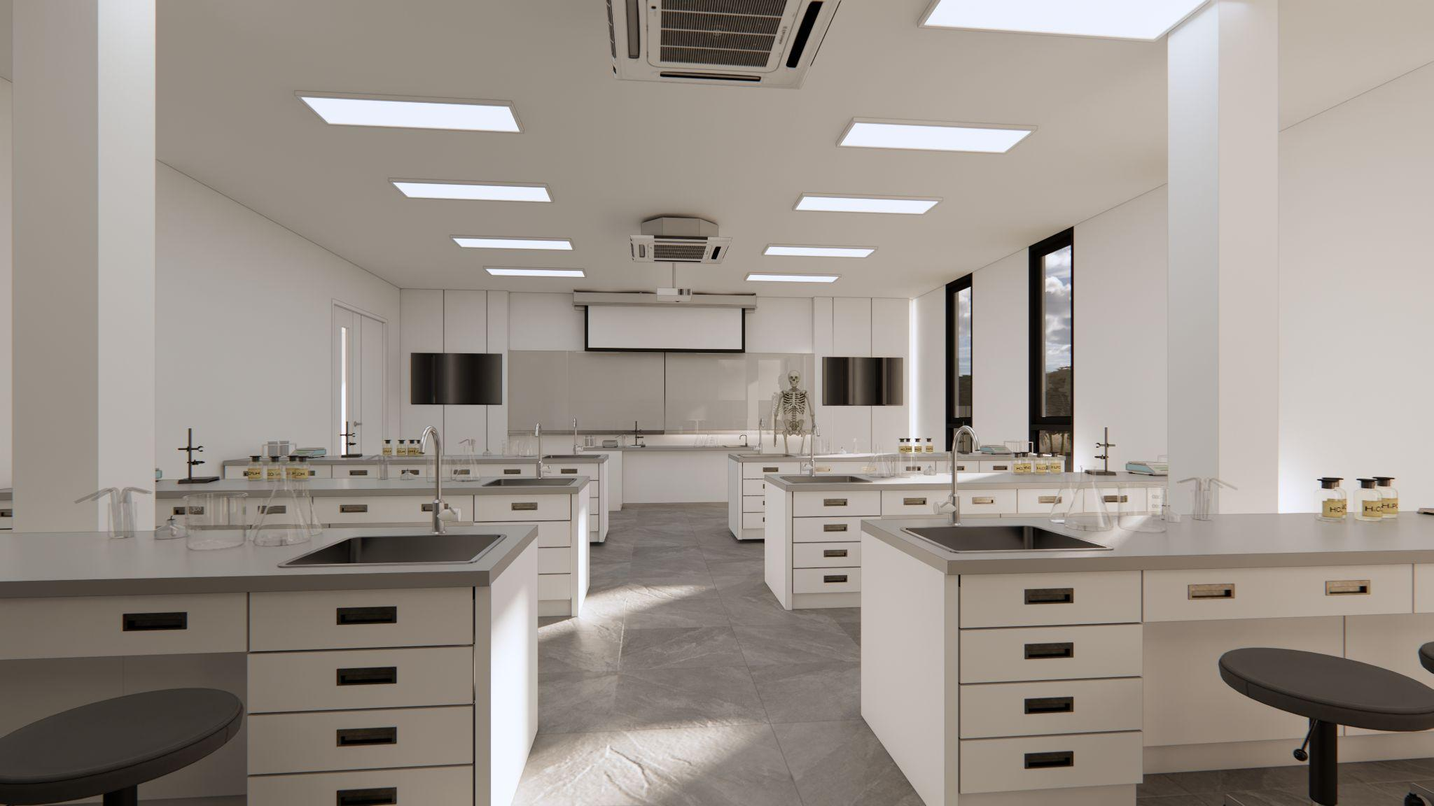

Slide 18
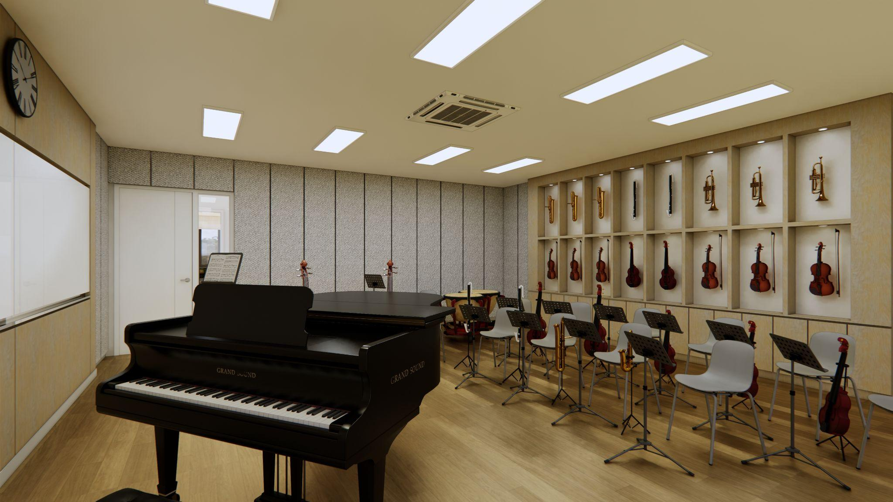

Slide 19
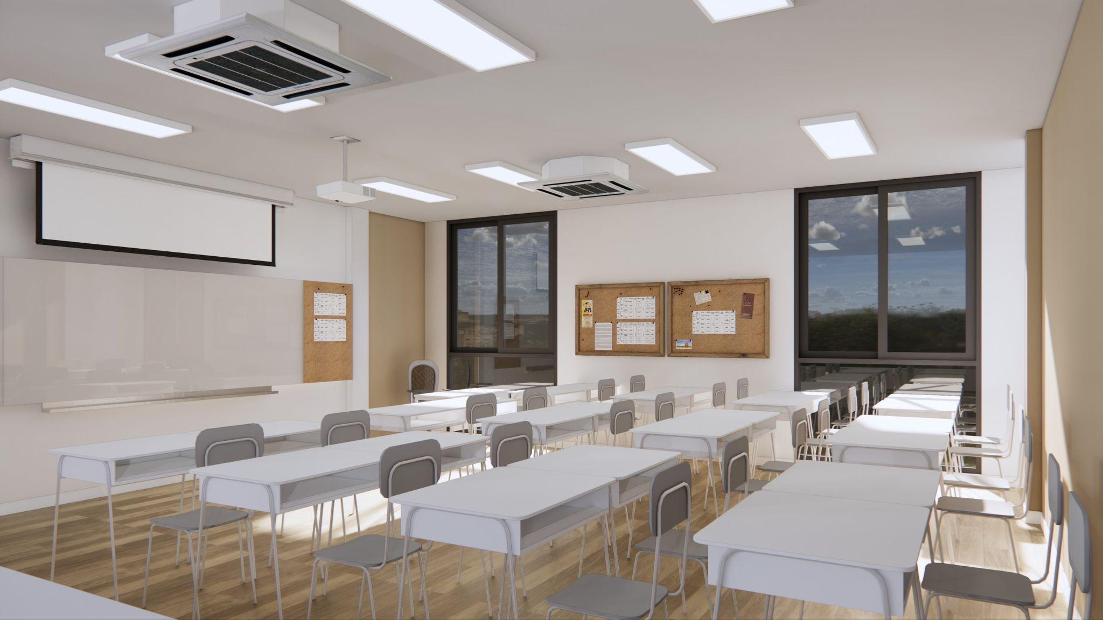

Slide 20
