Slide 1
MODULE 3 Harm reduction advocacy

Slide 2
Aim and learning objectives
AIM: To build strategies and arguments that promote the existence, or support the adoption, of drug policies that protect people who use drugs from infections, discrimination, overdose and other preventable harms.
LEARNING OBJECTIVES: Participants will be able to:
Understand and explain the meaning and principles of the harm reduction approach
Recognise how harm reduction principles can contribute to an effective, balanced drug policy
Identify potential opportunities for policy development and barriers to success
Agree short, medium, and long term actions to encourage a harm reduction approach in their own countries

Slide 3
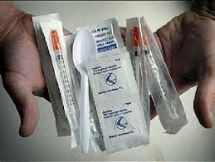
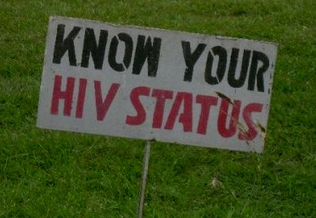
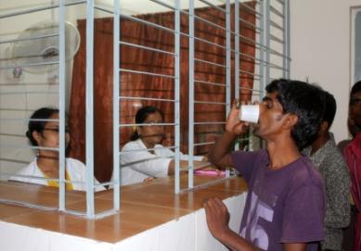
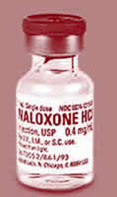
Session 3.1: Harm reduction hand
Sort your cards into three categories:
the United Nations “comprehensive package” of harm reduction interventions
other harm reduction services
non-harm reduction services

Slide 4
Session 3.1: Harm reduction definition
“Harm Reduction refers to policies, programmes and practices that aim primarily to reduce the adverse health, social and economic consequences of the use of legal and illegal psychoactive drugs without necessarily reducing drug consumption.”
“Harm reduction benefits drug users, their families and the community. The harm reduction approach to drugs is based on a strong commitment to public health and human rights.”
http://www.ihra.net/what-is-harm-reduction

Slide 5
Session 3.1: Harm reduction principles
Harm reduction is targeted at risks and harms
Harm reduction is evidence based and cost effective
Harm reduction is incremental
Harm reduction is rooted in dignity and compassion
Harm reduction acknowledges the universality and interdependence of human rights
Harm reduction challenges policies and practices that maximise harm
Harm reduction values transparency, accountability and participation
Harm reduction responds to the specific needs of a diverse range of vulnerable groups
http://www.ihra.net/what-is-harm-reduction

Slide 6
Session 3.1: UNODC, UNAIDS, WHO comprehensive package of interventions
1. Needle and syringe programmes
2. Opioid substitution therapy / other drug treatment
3. HIV testing and counselling
4. Antiretroviral therapy
5. STI prevention and treatment
6. Condom distribution
7. Targeted information / education
8. Hepatitis vaccination, diagnosis and treatment
9. TB prevention, diagnosis and treatment
http://www.who.int/hiv/pub/idu/targets_universal_access/en/index.html

Slide 7
Session 3.2: Why is harm reduction important
Drug use in society is unavoidable
For some, their drug use leads to preventable harms
Infections, overdose, illnesses…
For many, there are also preventable harms caused by drug policies and law enforcement
Criminalisation, incarceration, discrimination, denial of health care
Harm reduction is both a public health and a human rights approach that seeks to minimise these harms

Slide 8
Session 3.2: Why is harm reduction important
Around 16 million people inject drugs worldwide
Around 10 million of them are living with hepatitis C
Around 3 million of these people are living with HIV
Drug overdose is a major cause of mortality in the EU, the USA, Russia and elsewhere
Non-injecting drug use is also associated with increased risks of HIV and hepatitis transmission

Slide 9
Session 3.2: Why is harm reduction important
Yet global access to evidence-based services is too low for the 16 million people who inject drugs:
Just 2 needles/syringes distributed per person per month
Just 8% have access to opioid substitution therapy
Just 4% of those in need are receiving ART
This shortage of harm reduction services is driving HIV epidemics and other harms around the world.

Slide 10
Session 3.3: Prioritising harm reduction
Note as many harm reduction interventions as you can think of
Rate them from 1 – 5 in terms of how effective they would be in your country
Then rate them from 1 – 5 (in a different colour) in terms of how feasible they would be to start in your country
Which interventions would you select as a policy-maker?

Slide 11
Session 3.4: Road blocks
Identify two barriers to the adoption of harm reduction interventions in your country/region
Identify two barriers that people who use drugs might face even when these services are available
Write each barrier onto a piece of card

Slide 12
Session 3.4: Policy and legislative barriers
The UNODC’s Legal Affairs Section (LAS) confirmed the legality of harm reduction interventions in 2002
They pointed to the flexibility within the international drug control treaties, and found that opioid substitution therapy, drug consumption rooms, and needle and syringe programmes were within the UN treaties and resolutions

Slide 13
Session 3.4: Policy and legislative barriers
Harm reduction is now accepted in policy or practice by 97 countries, as well as all of the key international agencies
Yet some countries continue to face barriers:
overregulation of methadone and buprenorphine
laws prohibiting the possession of needles
lack of national political and financial commitment
criminalisation and discrimination of people who use drugs

Slide 14
Session 3.4: Other barriers
Cultural and ideological assumptions about drug use
Common myths that are not supported by evidence
Prejudicial, stereotypical images of people who use drugs
Funding shortages – domestic and international
Lack of awareness of (or unwillingness to accept) the proven cost-effectiveness of harm reduction

Slide 15
Session 3.5
CRIMINALS PARTNERS
PATIENTS
What words and images do these terms create in your mind?
Which other terms are commonly used in your country?
How might these ‘labels’ impact on a person’s self-image and their likelihood to access services?

Slide 16
Session 3.6: Role-play exercise
Your organisation are invited to meet with [NAME THE TARGET]. They want to know more about your organisation and about some harm reduction interventions that are being implemented. They have some concerns about the concept of harm reduction and ask some questions. You have a short amount of time to answer the questions below:
Doesn’t harm reduction send out the wrong message – promoting drug use or making it look safe?
Surely we must enforce the law, and that means that drug users have to be punished?
I hear that the outreach workers help people use drugs. Are outreach workers assisting and encouraging illegal acts?
Why do we need NSPs when we have methadone programmes?

Slide 17
The IDPC Drug Policy Advocacy Training Toolkit is available here:
http://idpc.net/publications/2013/06/training-toolkit-on-drug-policy-advocacy
Contact us at contact@idpc.net

