Slide 1
MODULE 8 Decriminalisation and diversion in Asia

Slide 2
Aim and learning objectives
Aim:
To identify the gold standard of decriminalisation and develop effective advocacy interventions to promote both decriminalisation and diversion programmes.
Learning objectives:
Participants will gain an understanding of:
The key components of an effective decriminalisation model
The diverse ways of diverting people away from prison and towards effective and humane health and social services
How to effectively advocate for decriminalisation and diversion.

Slide 3
Module 8 SESSION 8.1
The rationale for promoting decriminalisation

Slide 4
Session 8.1: Cause and effects exercise
Further effect
Further effect
Further effect
Further effect
Effect
Effect
Punishment/
criminalisation of PWUD
Cause
Cause
Cause
Cause of this cause?
Cause of this cause?
Cause of this cause?

Slide 5
Session 8.1: The rationale for decriminalisation in Asia
Harsh punishment has no deterrent effect
High level of stigma and discrimination
HIV epidemic driven by injecting drug use
Abuses perpetrated by law enforcement officers against PWUD
Prison overcrowding
Adverse human security outcomes

Slide 6
Session 8.2: What is decriminalisation?
Definition: Removal of criminal penalties for the following activities:
Drug use
Possession of drugs for personal use
Cultivation and purchase for personal use
Possession of drug use paraphernalia
Objective: Ending the punishment and stigmatisation of PWUD & promote access to health and social services

Slide 7
Session 8.2: What is decriminalisation?
De jure decriminalisation: removal of criminal sanctions takes place through a legislative process (repeal of criminal legislation, creation of civil law, constitutional court decision leading to legislative review). E.g.: Portugal.
De facto decriminalisation: drug use remains a criminal offence in law, but in practice people are no longer prosecuted. E.g.: The Netherlands.
Decriminalisation ≠ Legalisation

Slide 8
Session 8.3: The gold standard of decriminalisation
Session to be conducted in 3 steps:
STEP 1: Differentiating between possession for personal use and possession with intent to supply
STEP 2: Identifying who is responsible for determining whether is for personal use
STEP 3: Identifying the adequate response to drug use.

Slide 9
Session 8.3: The gold standard of decriminalisation STEP 1: Differentiating between personal use and intent to supply
What tools could be used to differentiate between personal consumption and commercial purposes?

Slide 10
Session 8.3: The gold standard of decriminalisation STEP 1: Differentiating between personal use and intent to supply
Some have used quantity thresholds:
Positive aspects: can clearly distinguish between use and dealing
Negative aspects:
no international standard to establish thresholds, lack scientific basis

Slide 11
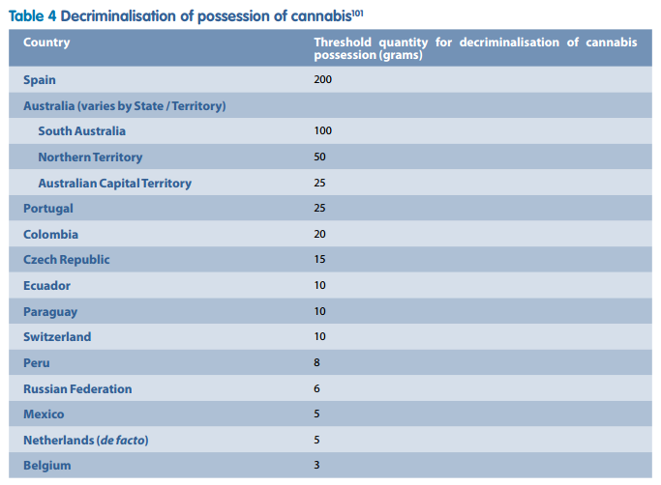
Session 8.3: The gold standard of decriminalisation Quantity thresholds for cannabis across the world

Slide 12
Session 8.3: The gold standard of decriminalisation STEP 1: Differentiating between personal use and intent to supply
Some have used quantity thresholds:
Positive aspects: can clearly distinguish between use and dealing
Negative aspects:
no international standard to establish thresholds, lack scientific basis
Quantity thresholds set too low leading to more people sent to prison (e.g. Lao PDR, Thailand, Vietnam)
Issue of people buying larger quantities for personal use
Others do not define ‘reasonable’/‘small’ amounts and use available evidence on a case-by case basis (money, firearms, drug dependency…). But risk of abuse and corruption

Slide 13
Session 8.3: The gold standard of decriminalisation STEP 1: Differentiating between personal use and intent to supply
The gold standard:
Indicative quantity thresholds
Combined with discretionary powers for police/prosecutor/judge to decide on a case-by-case basis using all available evidence at hand.

Slide 14
Session 8.3: The gold standard of decriminalisation STEP 2: Who is responsible to determine personal use/intent to supply?
Identify the entities that may be able to determine whether possession is for personal use or intent to supply
What are the positive and negative aspects associated with each entity’s power to decide?

Slide 15
Session 8.3: The gold standard of decriminalisation STEP 2: Who is responsible to determine personal use/intent to supply?
 | POLICE | PROSECUTOR | COURT | HEALTH/SOCIAL WORKERS
PROS
CONS

Slide 16
Session 8.3: The gold standard of decriminalisation STEP 2: Who is responsible to determine personal use/intent to supply?
Leave the role of determination to the police to avoid lengthy pre-trial detention
But there are also risks: harassment, racial discrimination, excessive fines, net-widening
Always need to keep in mind that the objective is to reduce the number of people punished for drug use
Need to adopt solid prosecutorial guidance, tight scrutiny of police behaviour, guidance on how to assess quantity thresholds, how to exercise police discretion, train police on harm reduction and drug use. Need to engage PWUD
Important role played by health, legal and community workers

Slide 17
Session 8.3: The gold standard of decriminalisation STEP 3: Identifying the adequate response
Draft a diagram showing the various steps of an effective decriminalisation model from the moment is stopped in possession of drugs and what comes next (penalties? referrals? entity responsible and for what?)

Slide 18
Session 8.3: The gold standard of decriminalisation STEP 3: Identifying the adequate response
Significant difference around the world on the response given to drug use within a decriminalisation model
Critical to remove all punitive sanctions for drug use (e.g. CCDUs, compulsory registration, urine testing, etc.)
Ensure that referral mechanisms are in place to access harm reduction and treatment services, but these should be voluntary and focused on addressing the health and social needs of PWUD.
Treatment failure should not lead to the imposition of criminal sanctions
Avoid excessively high fines or seizure of passport or driver’s licence

Slide 19
Session 8.4: Advocating for decriminalisation Role-play exercise
Scenario: Your NGO is invited at a national drug policy conference organised by the government. You know that the event will involve high-level influential policy makers and police officers, as well as religious leaders and other NGO colleagues. The media will also be present to report on the outcomes of the event.
The conference’s agenda is mainly focused on drug law enforcement and criminal justice issues, it will therefore be the perfect opportunity for you to highlight the need for decriminalisation of drug use.
On the day of the conference, you are among 200 attendees. At the coffee break, you manage to get the attention of your target and have 3 minutes to convince them about the need to decriminalise drug use in the country.

Slide 20
Session 8.5: Promoting diversion mechanisms
Mechanisms to divert PWUD away from the criminal justice system and, where appropriate, towards treatment, harm reduction, counselling, etc.
Focus: drug use, possession, possession of drug use equipment, non-violent offences related to use, low-level dealing
Authorities responsible: police, prosecutors or courts, as well as community-based health and social workers
Important health benefits and can enhance human security
Can be implemented in contexts where drug use is decriminalised, or continues to be criminalised

Slide 21
Session 8.5: Promoting diversion mechanisms Case studies exercise
What is the rationale behind this diversion model?
What do you think are the positive/negative impacts of such a model for people who use drugs and low-level drug offenders?
How could the model be improved?

Slide 22
Session 8.5: Promoting diversion mechanisms: Diversion by the police
Effective if police can build trust with communities of PWUD and when corruption levels are low
Diversion should include a decision to take no further action, issue a caution and/or refer to health & harm reduction services
When people are found in possession of small amounts of drugs or paraphernalia, diversion should occur before a charge is entered
Diversion should involve an educational component on harm reduction or information on existing health, treatment, harm reduction or community support services
Arrest quotas for drug use should be abolished

Slide 23
Session 8.5: Promoting diversion mechanisms: Diversion by the prosecutor
Include the option not to prosecute PWUD in prosecutorial guidelines
Prosecutor should have the option to take no further action, or take no further action conditional upon an offender attending a harm reduction service, a treatment programme if required or other social services
Decisions should be based on a solid understanding of the distinction between occasional use and drug dependence

Slide 24
Session 8.5: Promoting diversion mechanisms: Diversion by the court
Include the option to impose no penalty and not to enter a conviction for PWUD
If court diversion programmes operate, they should supplement police and prosecutors’ diversion schemes and also focus on more serious drug-related offences committed by PWUD (not only drug use)
Sentencing guidelines should support use of non-custodial sentences including treatment in the community
Decisions should be based on multi-disciplinary advice and offer:
Pre- and post-sentencing referrals to voluntary, community-based treatment, harm reduction and social services
Individualised treatment, harm reduction and social support options

Slide 25
Session 8.5: Promoting diversion mechanisms: Legal aid and access to justice
PWUD should have access to independent legal advice and representation to ensure they are informed of their rights and are able to defend their case at all stages of the process

Slide 26
Session 8.5: Promoting diversion mechanisms: The role of healthcare workers
Intervene at community level to refer PWUD before any police contact
Provide health assessments to inform the decisions of police, prosecutors and courts in relation to diversion
Provide a holistic assessment and response to the needs of PWUD diverted away from the criminal justice system
Engage in partnerships with communities, police and justice sector to promote harm reduction and health approaches
Adopt minimum quality standards to ensure that treatment programmes are based on evidence and human rights
Monitor and evaluate the quality & effectiveness of diversion models

