Slide 1
MODULE 2 Effective drug policy What needs to change?

Slide 2
Aim and learning objectives
AIM: To introduce the principles of drug policy based on health, human rights and social inclusion.
LEARNING OBJECTIVES: Gain an understanding of:
The principles of cost-effectiveness
Evidence, human rights, development, health
Key barriers hindering implementation of such policies

Slide 3
Session 2.1: Objectives of effective drug policy
Promoting health
Protecting human rights
Preventing discrimination
Promoting socio-economic development
Ensuring social inclusion
Increasing citizens’ security
Ensuring adequate access to justice
Etc.

Slide 4
Session 2.2: ‘The tree of good drug policy’
Trunk: chosen policy
Roots: principles of good drug policy
Branches: examples of policies and programmes
Apples: results of the policy
Worms: threats and obstacles in achieving the policy

Slide 5
Session 2.3: Principles of effective drug policy
Developed through a structured assessment of priorities and evidence
In full compliance with human rights law
Focus on reducing the harmful consequences rather than the scale of drug use and markets
Promote the social inclusion of marginalised groups
Build open and constructive relationships between NGOs and governments

Slide 6
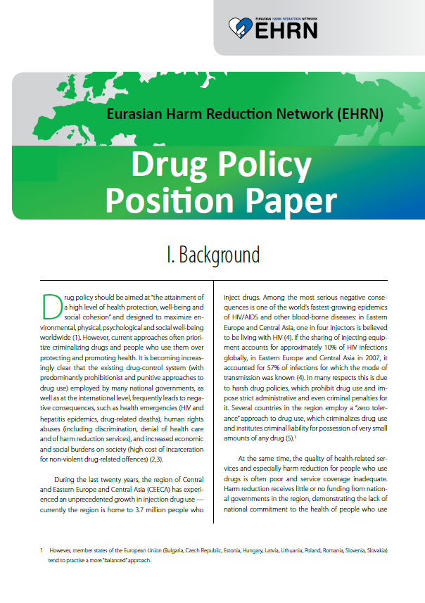
Session 2.3: Principles of effective drug policy

Slide 7
Session 2.4: Key elements of a balanced drug policy

Slide 8
Session 2.4: Key elements of a balanced drug policy – Case studies
What is the focus of this policy?
What are the positive elements of this policy?
What are the negative elements of this policy?
Do you think that the policy is respectful of the 5 IDPC policy principles?

Slide 9
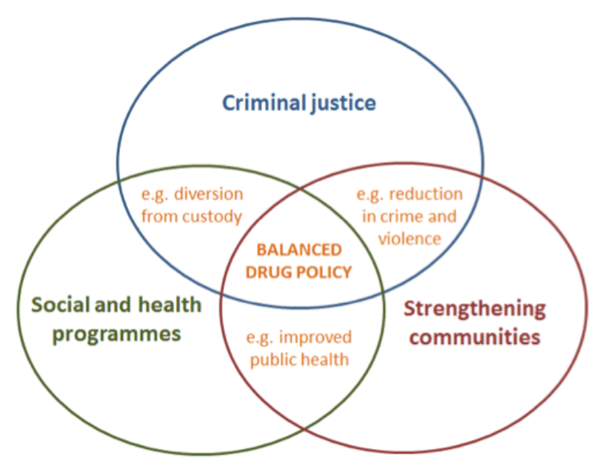
Session 2.4: Key elements of a balanced drug policy

Slide 10
Session 2.4: Key elements of a balanced drug policy
Criminal justice activities:
Re-focus activities to be more effective and less harmful
Remove criminal sanctions for drug use and subsistence farming
Integrates health and community strengthening components
Health and social programmes
Focused on people who use drugs
Harm reduction, counselling, evidence-based treatment, overdose prevention, etc.
Strengthening communities
Focus on wider social and economic development strategies
Move towards community policing, social and economic development programmes, employment, education, housing, etc.

Slide 11
Session 2.5: Flexibilities in the UN drug conventions
 | Consumption and possession for personal use Provision of harm reduction services (NSP, OST) Drug consumption rooms
 | Medical cannabis
 | Regulated market for non-medical purposes

Slide 12
The IDPC Drug Policy Advocacy Training Toolkit is available here:
http://idpc.net/publications/2013/06/training-toolkit-on-drug-policy-advocacy
Contact us at contact@idpc.net

