Slide 1

Our Mission: to make platelets safe, stable, and long-lasting to support everyday clinical care and simplify supply logistics
Rich Ganz, CEO, rganz@orangegrovebio.com Aubrey Smith, Operations Manager,
asmith@orangegrovebio.com

Slide 2
Our Mission: to make platelets safe, stable, and long-lasting to support everyday clinical care and simplify supply logistics
Rich Ganz, CEO, rganz@orangegrovebio.com Aubrey Smith, Operations Manager,
asmith@orangegrovebio.com

Slide 3

IMPROVING PLATELET STORAGE
Clinical Need & Market Demand
Technology Advantages
Proven Translational Team
Addresses unmet need for supply and safety of platelets
>2x increase in longevity
increases platelet availability
Strong Management Team > 70 years of combined expertise
Improves safety from bacterial contamination
Academic founders are world-renowned platelet experts
$3.65B global market (2020)
Streamlines the supply chain with other refrigerated blood products
Partnered with critical stakeholders – blood centers, clinicians, and NHLBI, ARC, Bloodworks NW
Overlaps with BARDA preparedness mandate for AOI 4.2

Slide 4
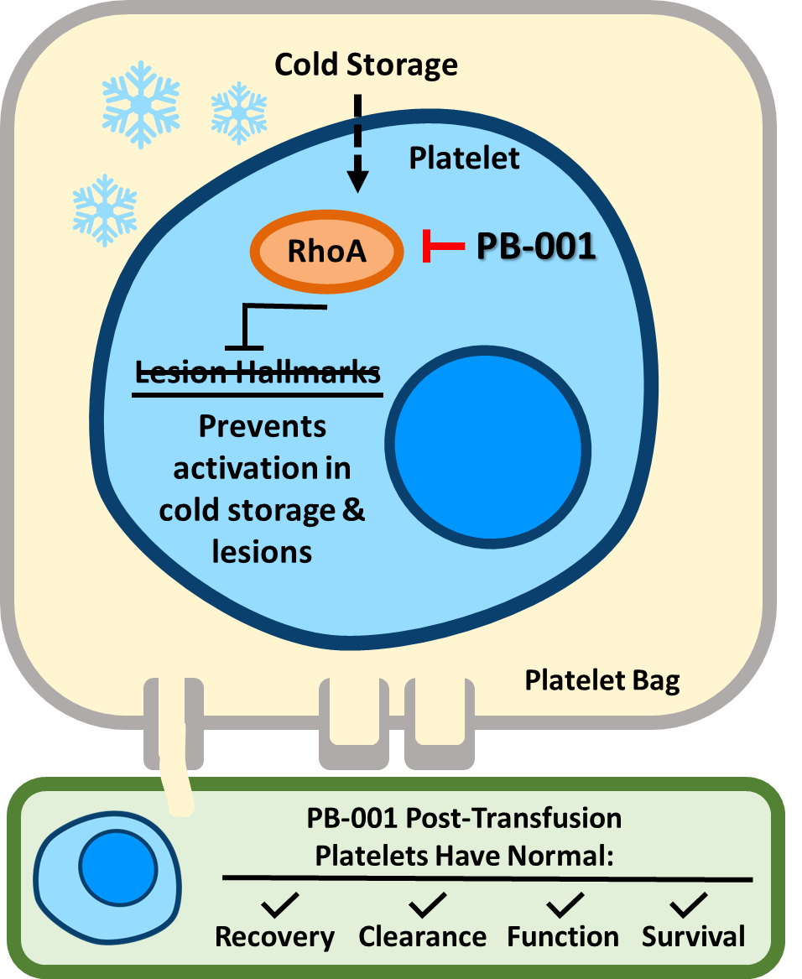

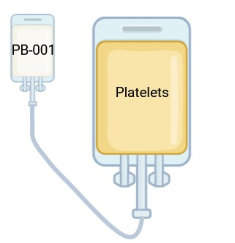
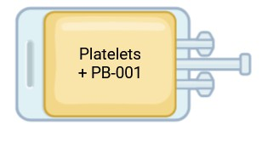
PROBLEM: ONCOLOGY PATIENTS DON’T HAVE
COLD PLATELETS (2/3 OF ALL PLATELETS)
SOLUTION: PB-001 inhibits RhoA-driven damage, enabling effective cold-stored platelets
Mechanism of Action: Hegde et al. Blood. 2024 | Commercial & MCM Implementation: Drug in single flexible bag. No specialized equipment. Single step transfer with tube sealers available at blood centers. PB-001 added to platelets suspended in FDA-approved platelet storage solution. Improves safety of platelet product via enabling cold storage. Further simplified logistics Safe shipping & storage in cold Remove dual inventory Cold storage ✓Reduce bacterial mitigation cost & transfusion ✓Ability to stock-pile PB-001

Slide 5

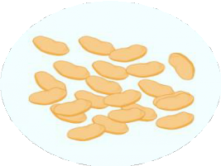
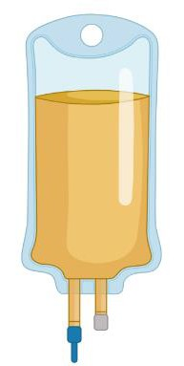
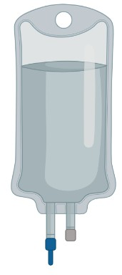






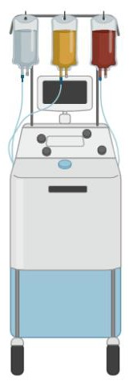

SIMPLE TECHNOLOGY IMPLEMENTATION
Donor
Blood (minus platelets) Returned to Donor
Whole Blood
Platelet Additive Solution (PAS)
PB-001
Platelets ready for
cold storage
Blood separation PAS added to platelets
>2X Storage Time
PB-001 is added
to Platelet Additive Solution + Platelets
Current Blood Bank Workflow

Slide 6
BENEFIT TO BLOOD CENTERS, HOSPITALS/CLINICS, & PATIENTS
Blood Centers (Customer)
Maintains high-quality platelets across shelf life without added PRT infrastructure, reducing operational burden while streamlining collection, processing, shipping, and storage.
Hospitals/Clinics (End Users)
Reduces platelet waste and inventory burden while stabilizing supply, helping hospitals avoid care delays, surgery rescheduling, and transfusion triage.
Elimination of platelet expiration waste = decrease in platelet purchasing needs
by 5-15%.
Patients Treated
Consistent platelet supply protects cancer patients receiving prophylactic transfusions (70% of platelet recipients) and ensures timely care for trauma, urgent, and elective surgeries.

Slide 7
OPEN IND WITH RAPID CLINICAL PATH
Today
Q1 | Q2 | Q3 | Q4 | Q1 | Q2 | Q3 | Q4 | Q1 | Q2 | Q3 | Q4
‘26 | ‘26 | ‘26 | ‘26 | ‘27 | ‘27 | ‘27 | ‘27 | ‘28 | ‘28 | ‘28 | ‘28
Regulatory
~EOP1
~PreNDA
~NDA Sub.
~Approval
Phase 1
Phase 2
/Pivotal
Clinical
Non-Clinical
ADME
28 Day GLP Tox
Drug substance and process phase 2 development
Manufacturing
Drug Substance ADME
Drug Product Manufacturing in Pouch
Recent Government Funding: SBIR Phase 2a awarded in 2023 (all funds expended); Phase 2b under review

Slide 8



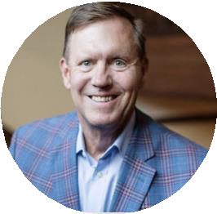
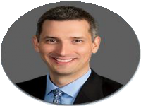
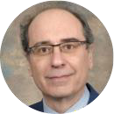


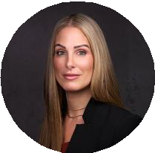
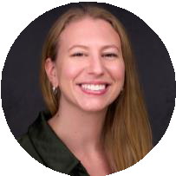

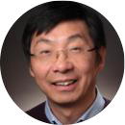


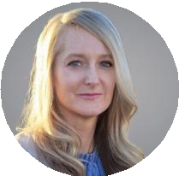
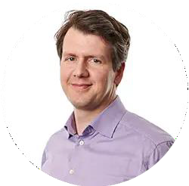
EXPERIENCED MANAGEMENT & OPERATIONS TEAM
MANAGEMENT & OPERATIONS
RICH GANZ
President and Chief Executive Officer
Life sciences executive with over 40 years of
experience
40 years of experience with organizations including Abbott, Baxter, OmniSonics, Founder of RGA LifeSciences, and Executive in Residence roles with Kairos Ventures and Orange Grove Bio
ACADEMIC FOUNDERS
JOSE CANCELAS, MD, PhD
Founder
CHRIS RYAN, PHD
Head of CMC
10+ years of experience managing drug development, quality control, and manufacturing
Authored CMC sections for pre-INDs, INDs, and IMPDs
Executive Director, Connell and O’Reilly Families Cell Manipulation Core, Dana-Farber Cancer Institute; expert in transfusion medicine, cell and gene therapy, and stem cell biology
Current AABB President
Pioneered mechanisms of hematopoietic regulation via Rho GTPases and developed novel blood cell preservation and platelet stabilization technologies translated to clinical use
LAURA CRAWFORD, PHD, DABT, RAC-DRUGS
Sr. Dir. Drug Development
10+ years of experience in preclinical drug
development and clinical pharm.
Prior Sr. Dir. Drug Development at Nirogy Therapeutics; Associate Principal Consultant, SciLucent
AUBREY SMITH, PHD
Operations Manager
4+ years in biotech company creation
Classically trained immunologist
Author on 10+ publications on cancer immunotherapy
YI ZHENG, PHD
Founder
Co-Executive Director, Cancer and Blood Diseases Institute; Director, Experimental Hematology and Cancer Biology; Marjory Johnson Endowed Chair of Drug Discovery, University of Cincinnati
Leads discovery of Rho GTPase and mTOR signaling mechanisms in hematopoiesis advancing rational design of small molecule inhibitors
PHASE 1 CLINICAL TRIAL PIS
BETHANY BROWN PHD, MSCS
Sr. Dir., Transfusion Innovation and Product Development, American Red Cross
Principal Investigator for American Red Cross, Norfolk, VA trial site
MORITZ STOLLA, M.D., PH.D.
Assistant Member,
Bloodworks Northwest Research Institute
Principal Investigator for Bloodworks Northwest, Seattle, WA trial site

