Slide 1
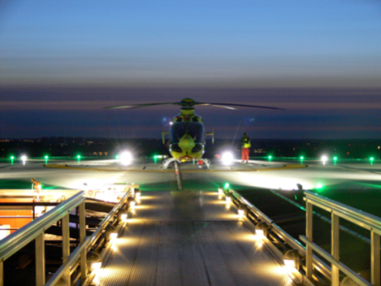
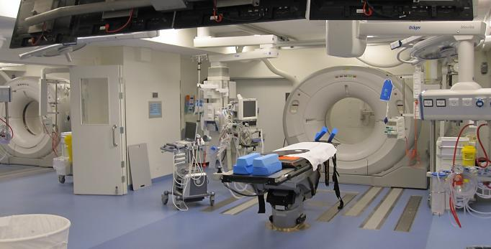
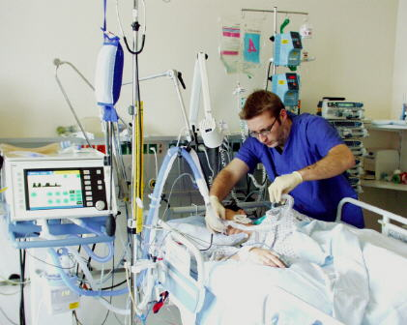
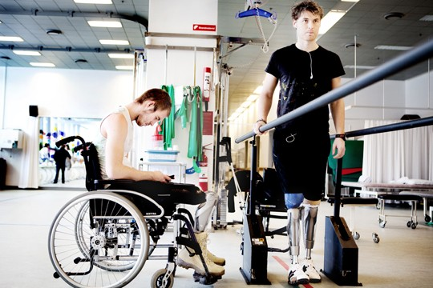
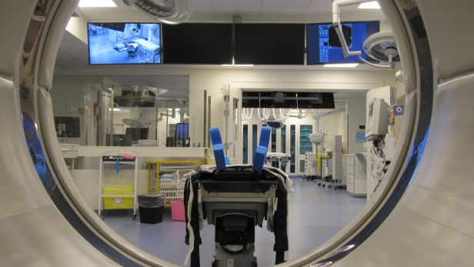

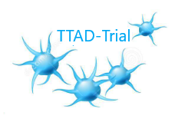


Freeze-Dried Platelet Derived Hemostats
in Severe Surgical Bleeding:
Results of a Pilot Randomized Clinical Trial
Jakob Stensballe
Professor of Anesthesiology with Special Focus on Trauma, MD, PhD
Department of Anesthesia, Surgery and Trauma Centre
Copenhagen University Hospital - Rigshospitalet
&
Department of Clinical Medicine, Faculty of Health & Medical Science, University of Copenhagen

Slide 2
COI
Unrestricted research grant
Cellphire Therapeutics, Inc.
Copenhagen University Hospital – Rigshospitalet
None of the authors received personal income

Slide 3


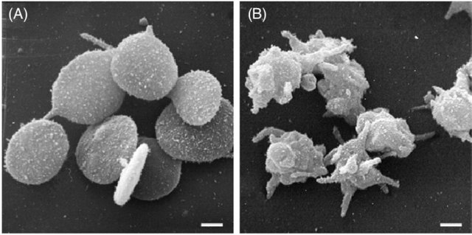
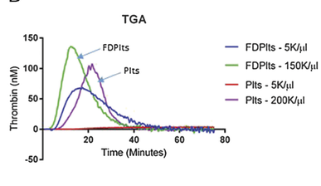
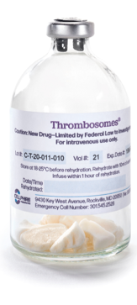
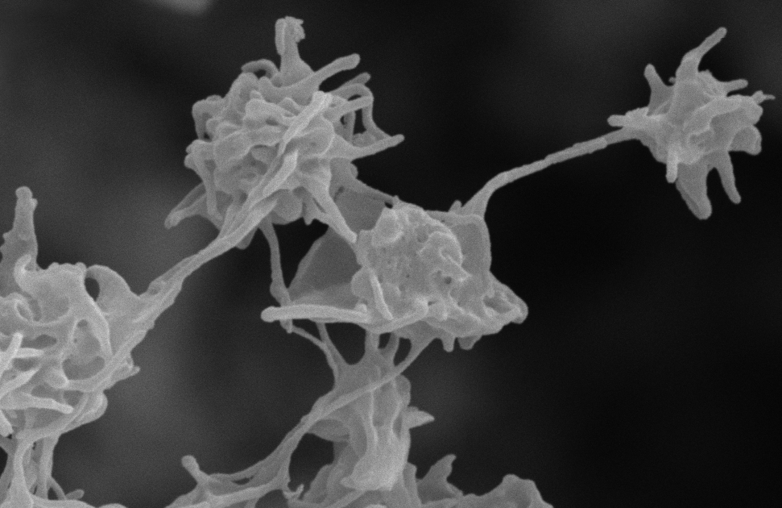
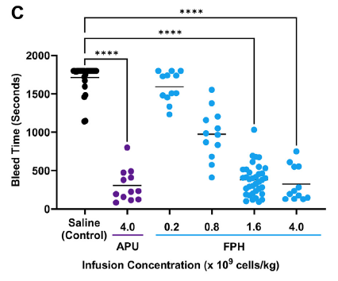
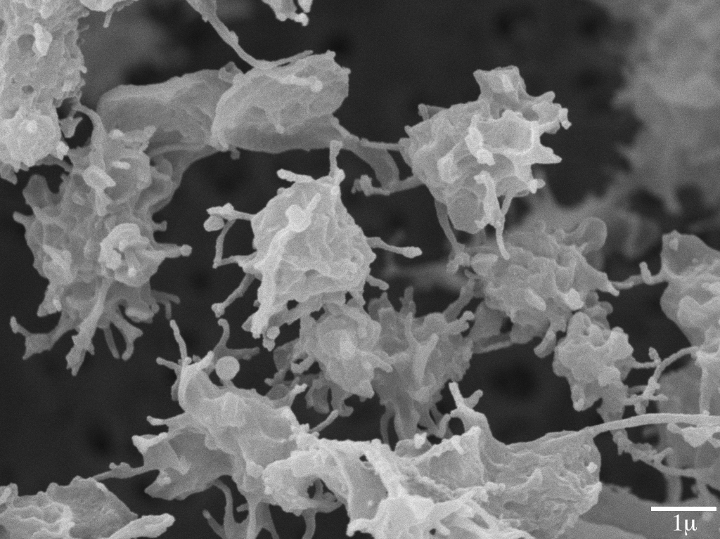
Freeze-dried Platelet-derived Hemostats (FPH)
Trivedi A et al. J Trauma Acute Care Surg 2021
Kuhn etal. JTH.2024

Slide 4
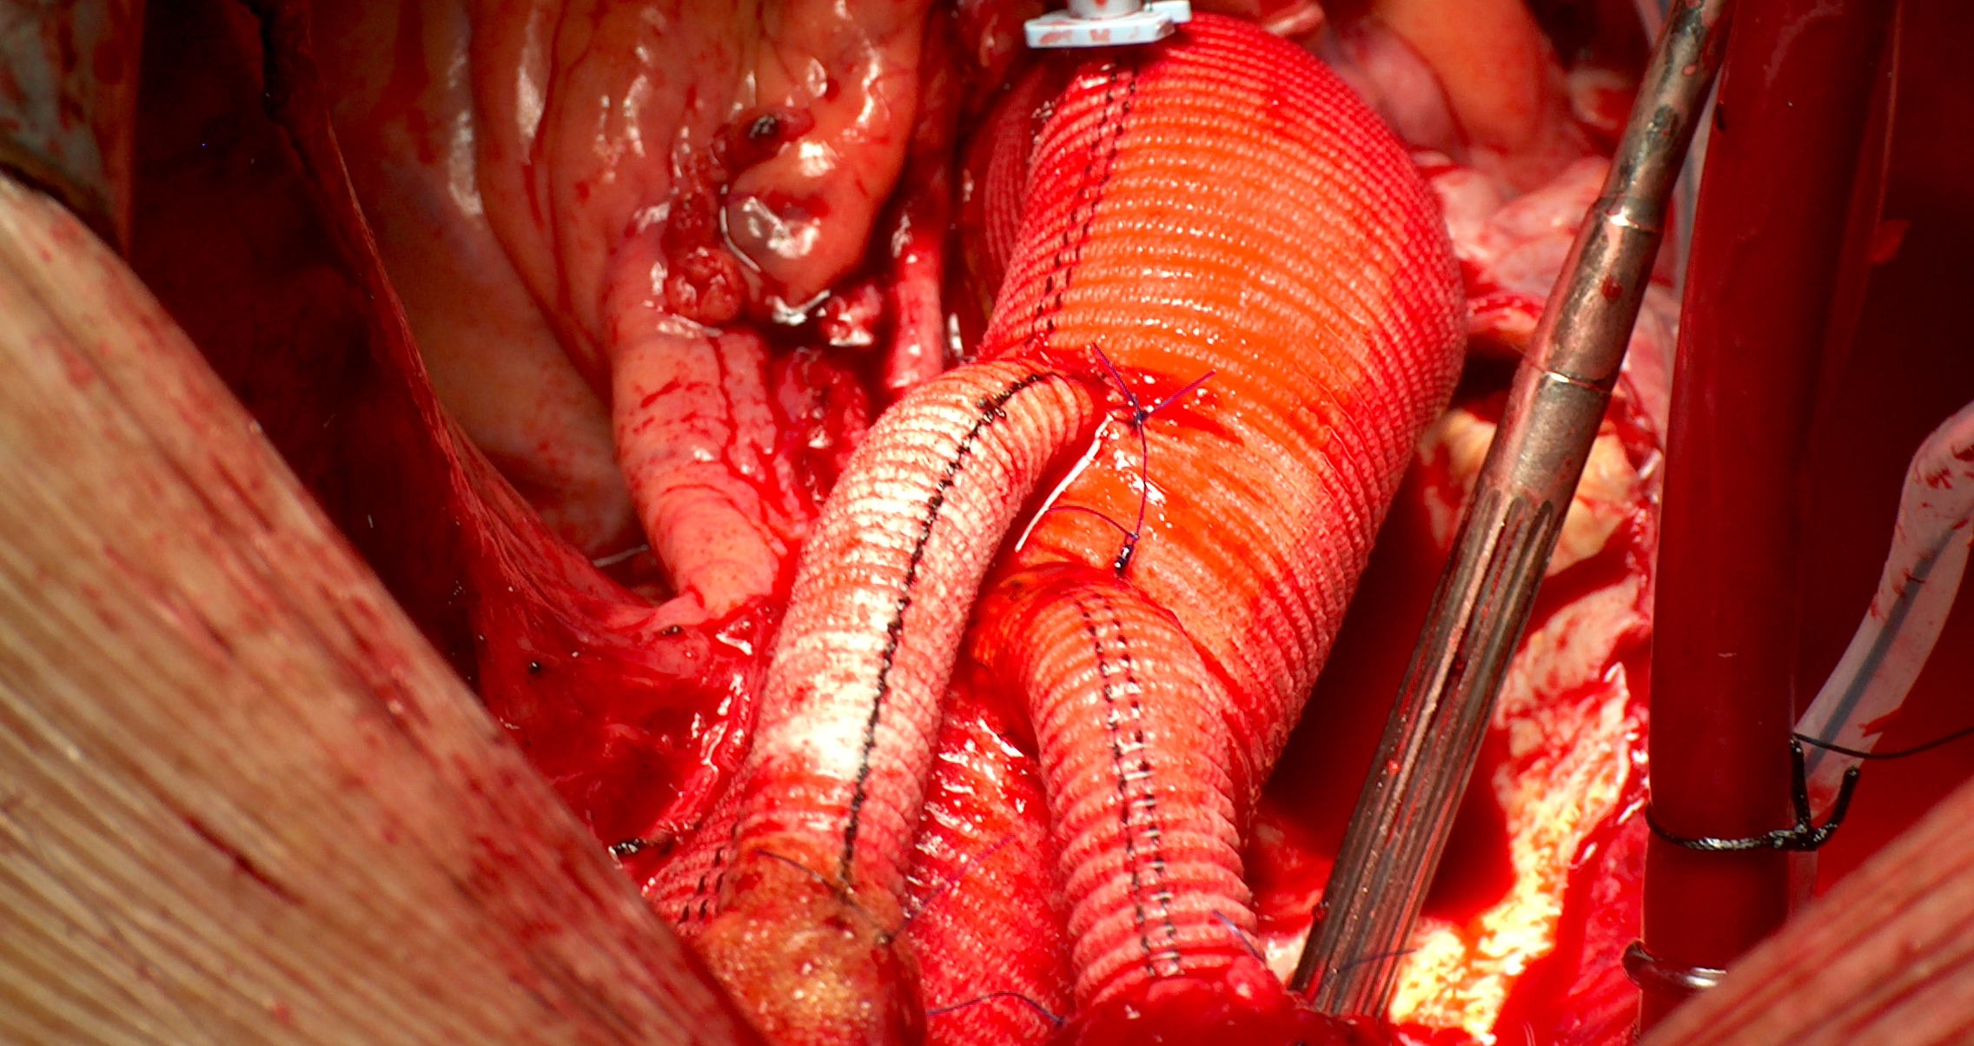
Hemorrhage & Coagulopathy fatality rate 25%
>2.5L bleeding
Erdoes et al. 2023

Slide 5
TTAD trial ClinicalTrials.gov ID NCT05771831
Freeze-dried Platelet-derived Hemostats (FPH)
in Acute Thoracic Aortic Dissections
Investigator-Initiated
Randomized, Open label, Pragmatic, Clinical Pilot Trial
Ulrich A, Carranza CL, Nilsson JC, Schnack T, Gybel-Brask M, Johansson PI, Stensballe J

Slide 6
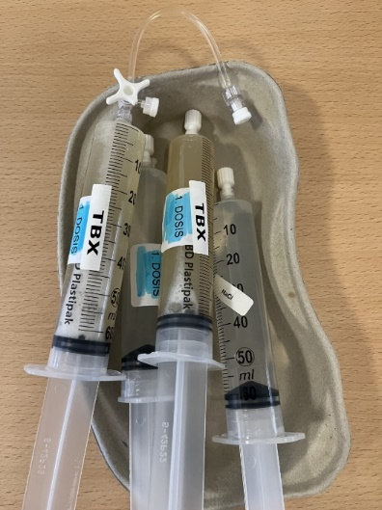
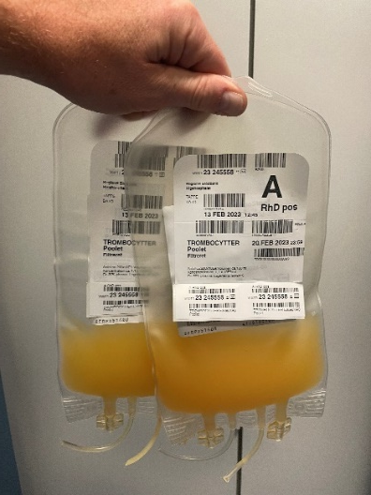

Comparison
Liquid platelet concentrates FPH
6 donors 6 vials 30mL
2 doses 2 doses

Slide 7

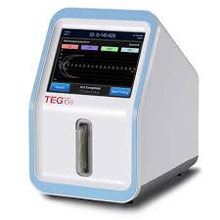
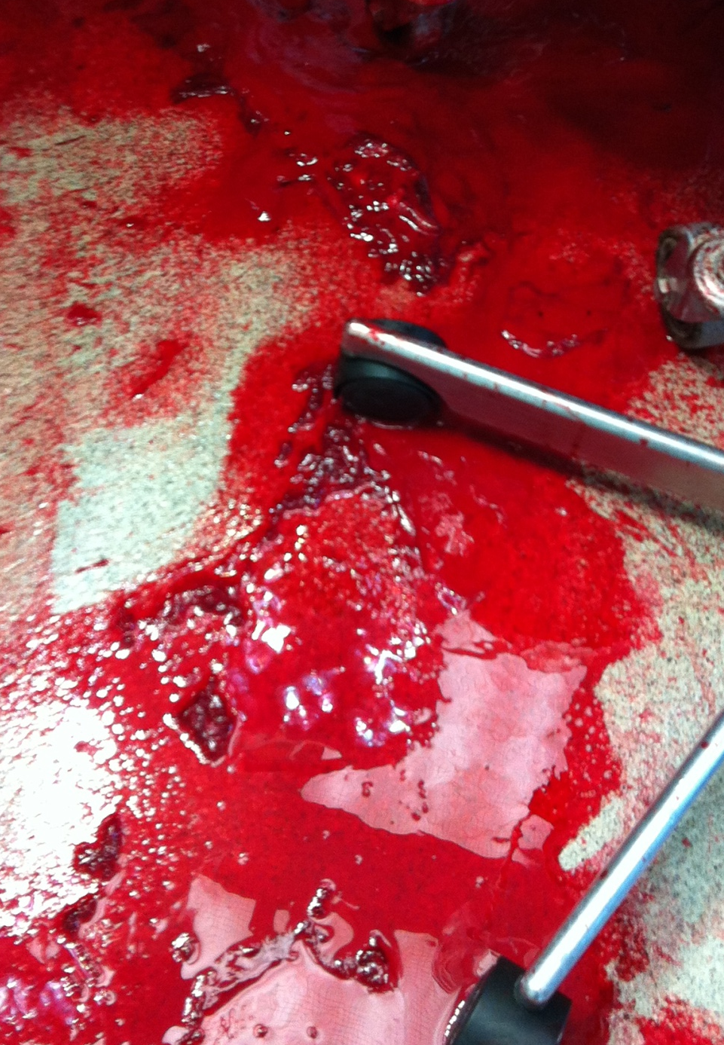
Scheduled Exsanguination
Up to 3 doses
On pump
Off pump
Follow up

Slide 8
Time-to-hemostasis in min
Freeze-dried platelet-derived hemostat (FPH) (n=20) | Standard platelet concentrate (n=21) | Estimated difference in medians (95% CI) | P value
78 (58 to 167) | 79 (57 to 92) | -10 (-55 to 15) | 0.47

Slide 9
Bleeding in mL during surgery & 24h
Freeze-dried platelet-derived hemostat (FPH) (n=20) | Standard platelet concentrate (n=21) | Estimated difference in medians (95% CI) | P value
2785 (2115 to 4175) 610 (379 to 992) | 2510 (1900 to 3100) 415 (195 to 690) | -286 (-1300 to 560) -219 (-447 to 90) | 0.51 0.17

Slide 10
Transfusions
Outcome | Freeze-dried platelet-derived hemostat (FPH) (n=20) | Standard platelet concentrate (n=21) | Estimated difference in medians (95% CI) | P value
Total number of blood product use during surgery Total number of blood product use first 24 hours in ICU | 14 0 | 10 0 | -5 (-1 to 0) 0 (-1 to 0) | 0.06 0.47

Slide 11
Transfusions in detail
Freeze-dried platelet-derived hemostat (FPH) (n=20) | Standard platelet concentrate (n=21) | Estimated difference in medians (95% CI) | P value
RBC concentrates Plasma Standard PLTs/FPH, intervention Received 1st dose of intervention Received 2nd dose of intervention Received 3rd dose of intervention Standard PLTs conc, post-intervention | 1 (0 to 4) 4 (4 to 8) 4 (4 to 6) 20 (100) 15 (75) 6 (30) 0 (0 to 2) | 0 (0 to 1) 2 (2 to 4) 2 (2 to 4) 21 (100) 9 (43) 1 (5) 0 (0 to 0) | 0 (-2 to 0) -2 (-4 to 0) -2 (-2 to 0) 0 (0 to 0) | 0.29 0.08 0.02 0.34

Slide 12
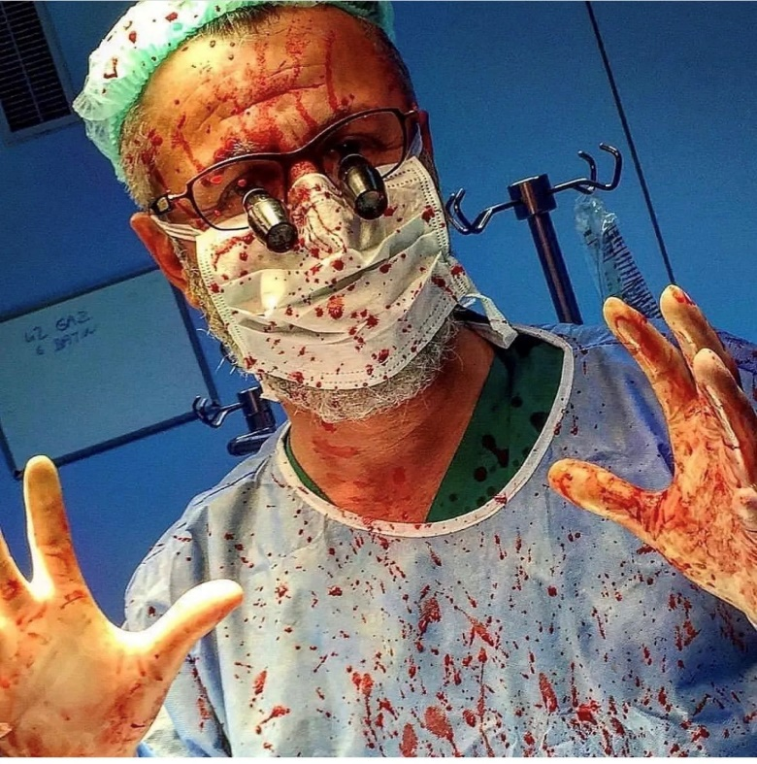
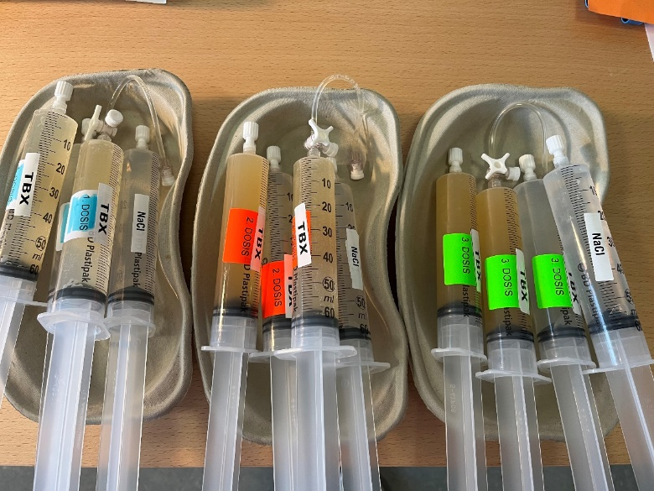
Conclusion
In severe bleeding, we found no significant difference between standard platelet concentrates and freeze-dried platelet-derived hemostats (FPH).
Perspectives are promising
More research in clinical trials with clinical endpoints is needed.

