Slide 1
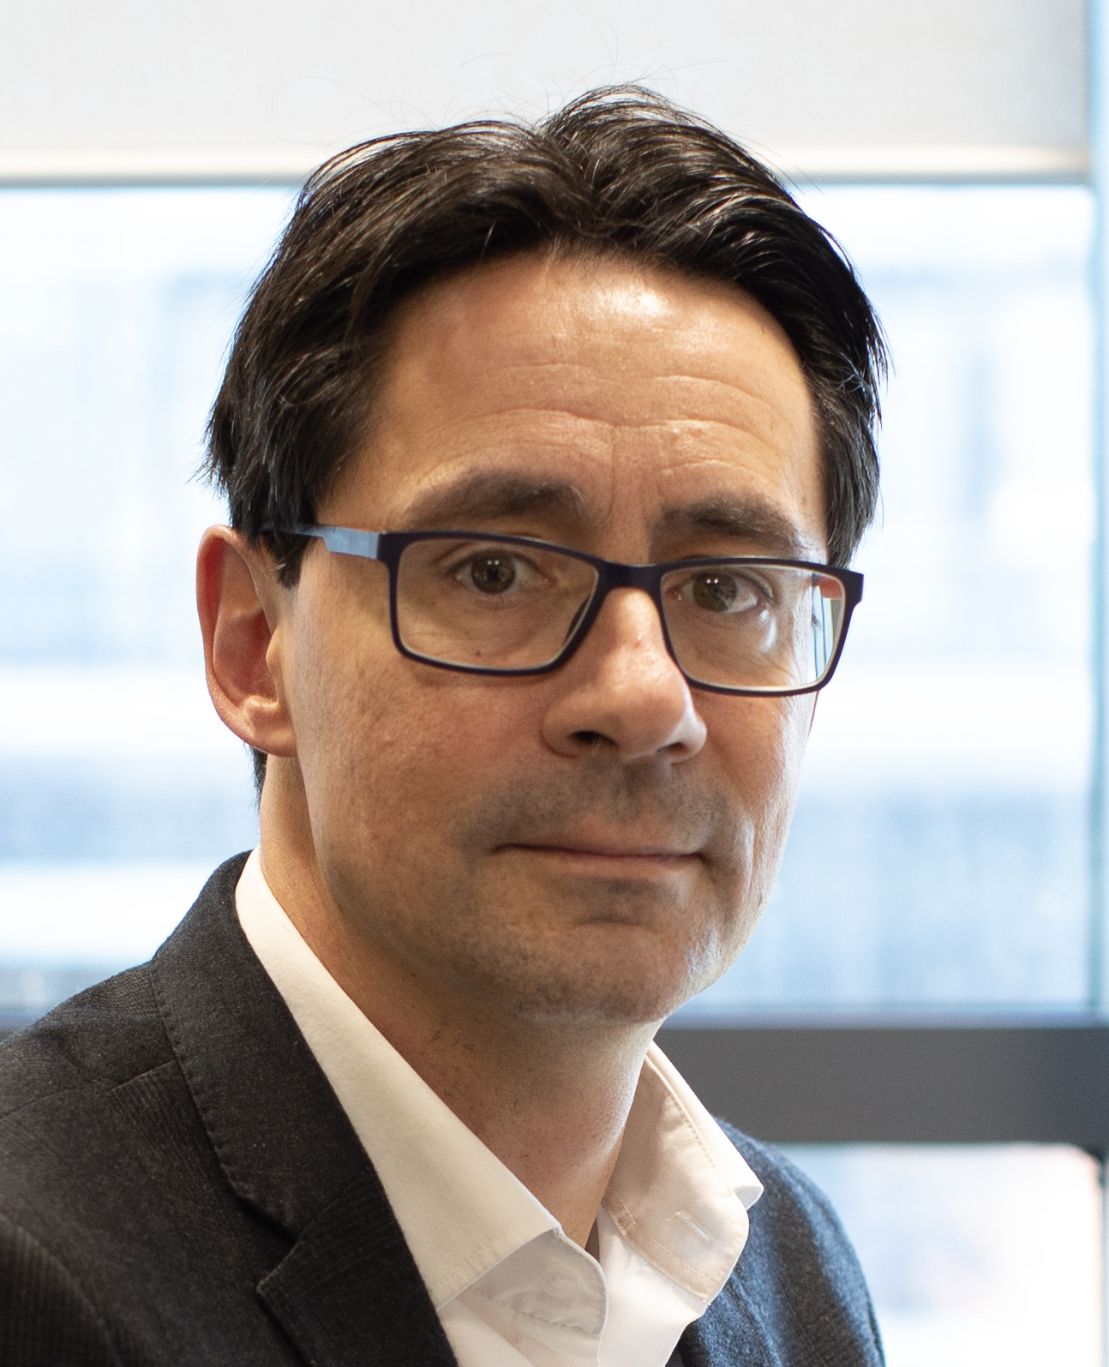
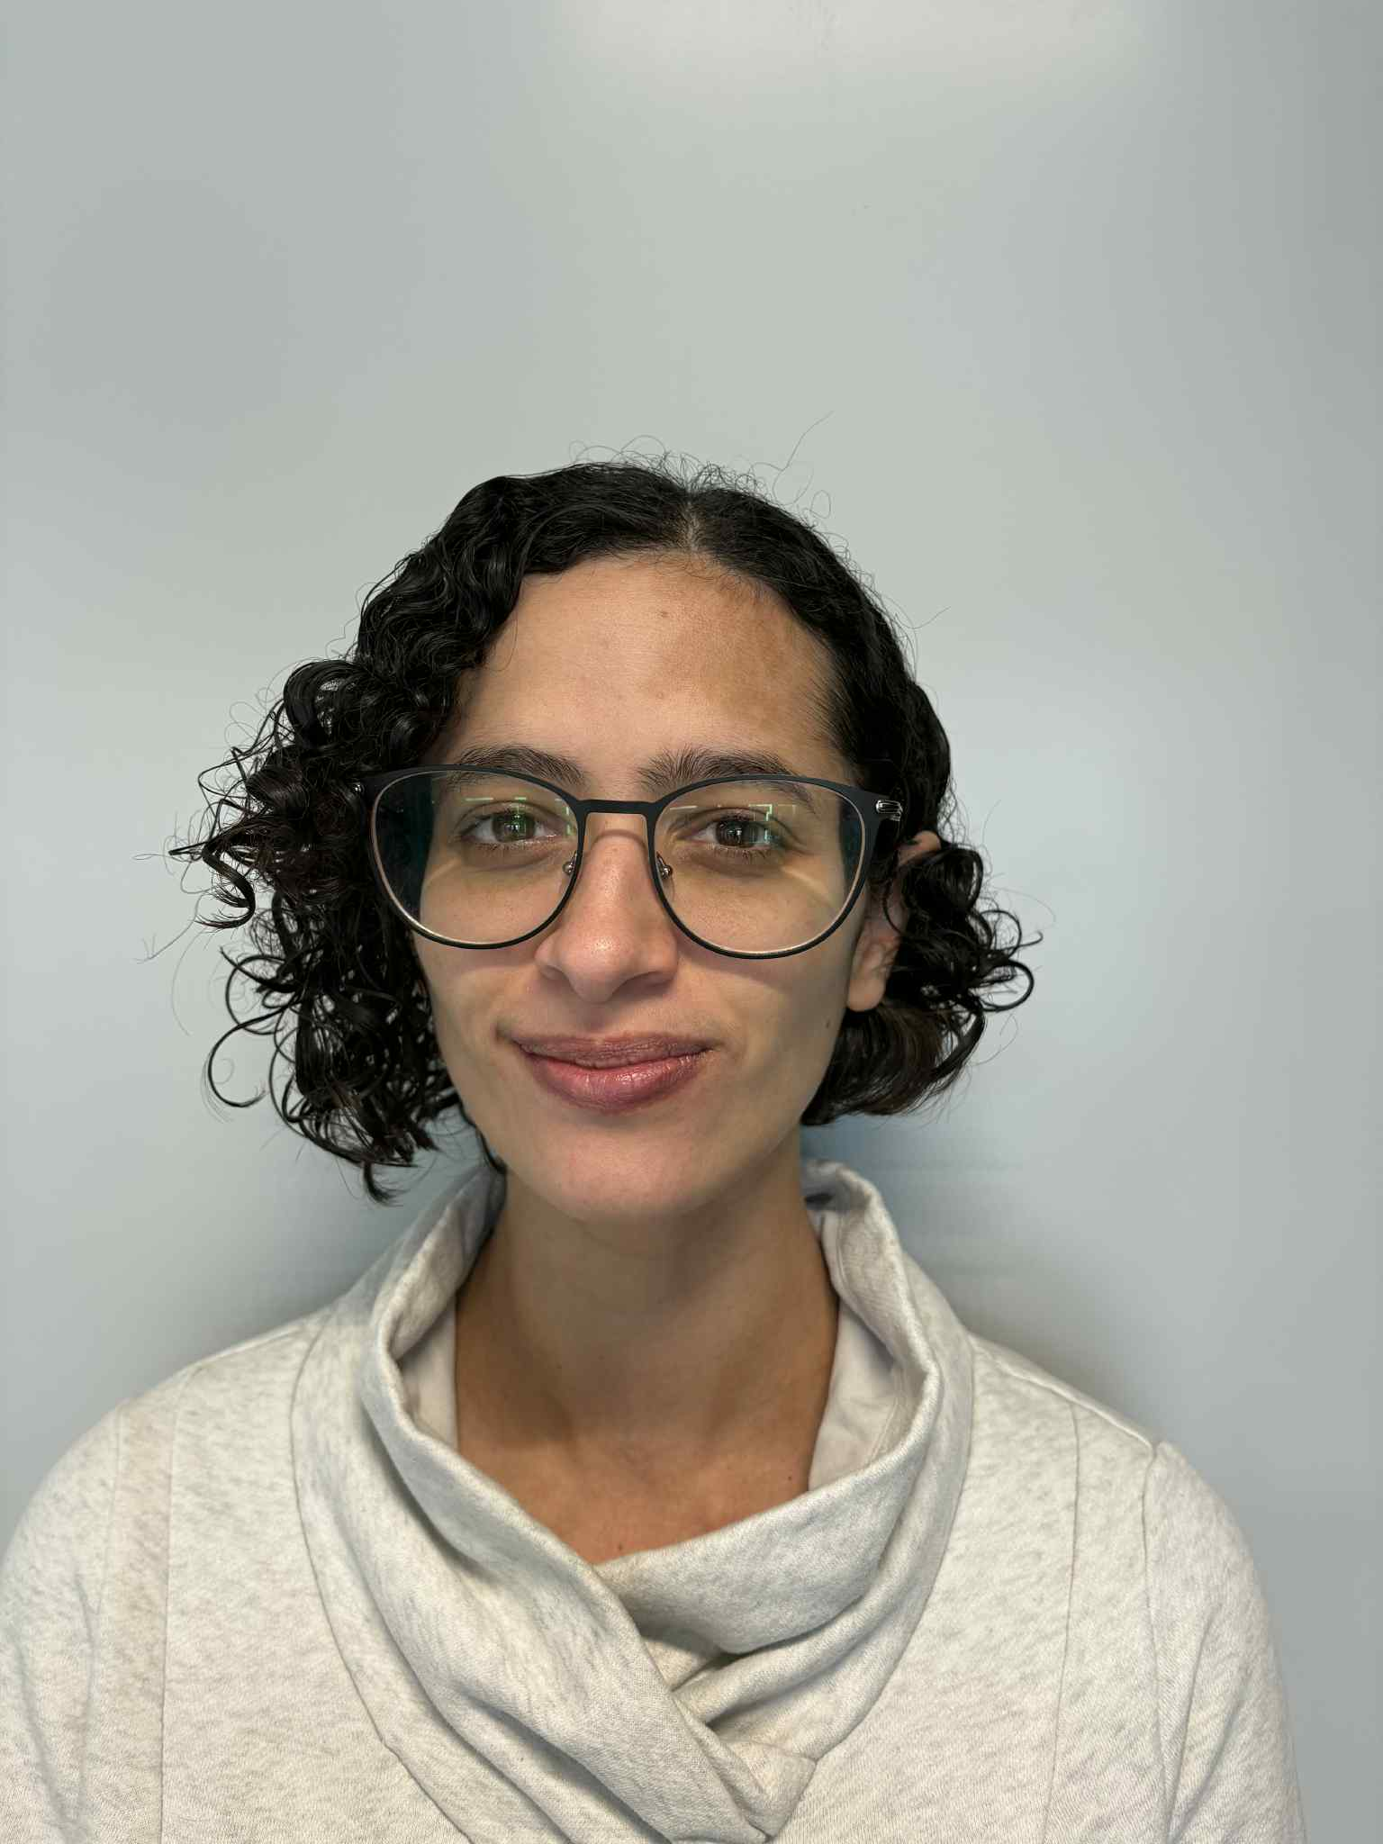





Ex Vivo Platelet Manufacturing: Panel Discussion
Dr Cedric Ghevaert
University of Cambridge Stem Cell Institute
New Platelet Company Ltd
Dr Anais Pongerard
HemostOD
Dr Asano Asami-Odaka
Megakaryon Corporation

Slide 2
Overarching Topics
•Linking functionality to purpose (tissue repair vs hemostasis).
•Is it appropriate to judge ex vivo platelets against donor platelets?
•What would the target product profile look like?
•Guidelines need to be tuned to end product.
Source material
Cell line stability and safety:
When do we test?
How do we test?
We have an irradiated final product
Product characterisation
What do we count and define as a platelet?
Can we step away from comparing to donor platelets depending on the indication?
What percentage of non-platelet particles and nucleated cells can be included in the formulation?
What global assay should be used and animal models?
Regulatory/Clinical
What category does this fall under: Blood Product, Cell and Gene Therapy, both?
Recovery and survival studies: are they relevant for a product aimed at acute bleeding control?
What is required in studies from outside US so that data can support FDA approval?
What parameters constitute efficacy for prophylactic platelets?

