Slide 1



Regulation of Transfused and Circulating Platelet Clearance
Karin Hoffmeister
Khoffmeister@versiti.org
Notes:
Good morning – First I would like to thank the organizers for the kind invitation to present

Slide 2
Outline
  Introduction to platelet lifespan
  Platelet clearance mechanisms
  Role of sialic acid in platelet clearance
  Transfused platelet clearance
Notes:
A brief into to PLT Clearance and production
Platelet clearance and the role of

Slide 3
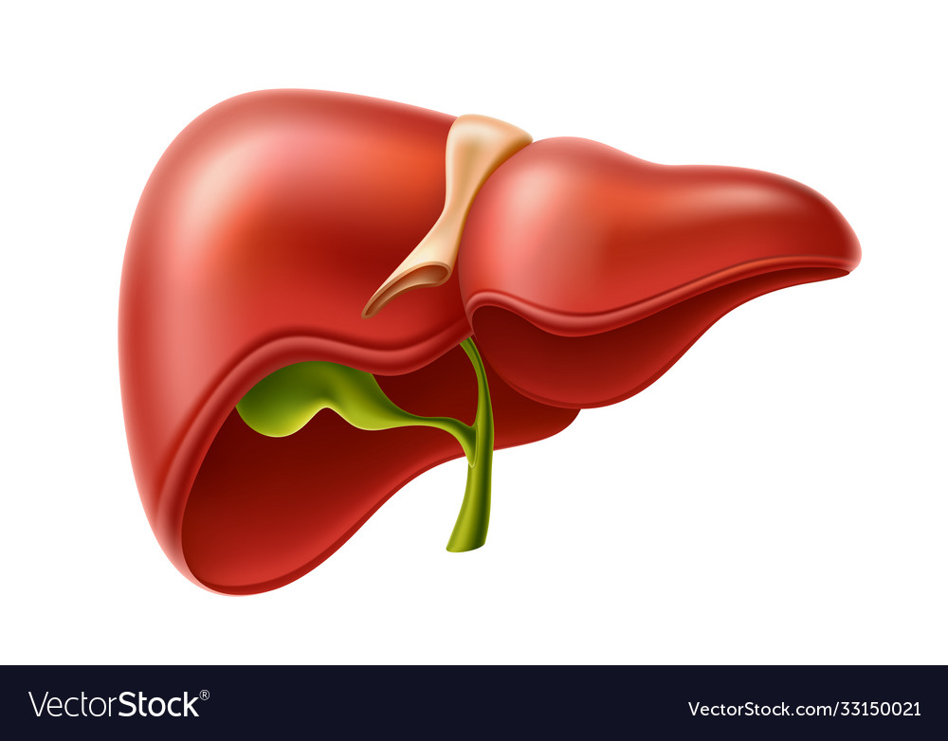
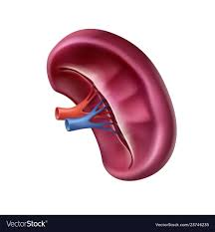
Liver
Spleen
Sialic acid loss
Apoptosis
hemostasis
tissue remodeling
Platelets circulate for ~10 days in humans, 5 days in mice
Adapted from Platelets. 2024 Dec;35(1):2433750.

Slide 4
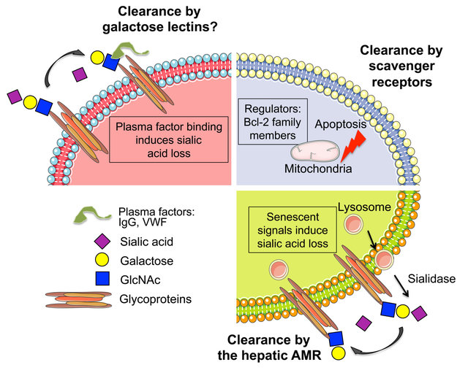
Major Clearance Mechanisms
Platelet lifespan is controlled by multiple mechanisms:
Apoptotic signaling: Balance of Bcl-2 family proteins (pro-survival vs. proapoptotic).
Glycan remodeling: Sialic acid and galactose loss
Immune recognition: Immune thrombocytopenia with autoantibodies IgG
Temperature-Induced Clearance (Cold storage Lesion)
which direct clearance to hepatic and macrophage systems in liver and spleen.
4
Are they interconnected?

Slide 5
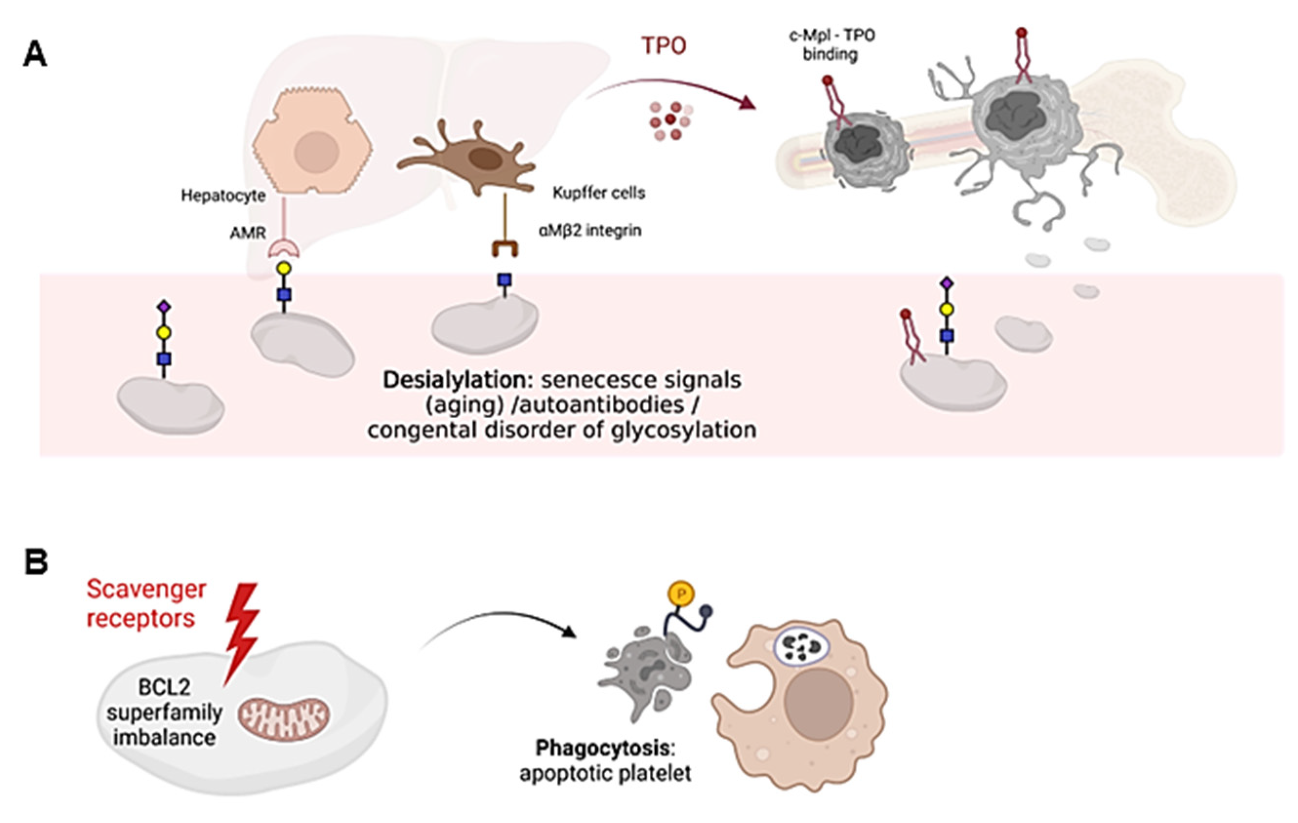
Apoptotic signaling
Apoptosis inducing signal
Macrophage
Phagocytosis: Apoptotic platelet
Platelet
BCL-2 Is Dispensable in Platelets
Unlike most cells, platelets do not depend on BCL-2 for survival
Platelet survival is primarily controlled by BCL-XL
Genetic evidence: Platelet/MK-specific Bcl2 deletion → no change in platelet count or lifespan
“Molecular clock” model: BCL-XL restrains Bak; as BCL-XL declines over time, Bak triggers apoptosis
Clinical BCL-XL inhibitors (e.g., navitoclax) → thrombocytopenia; BCL-2–selective drugs (e.g., venetoclax) largely spare platelets
Gain-of-function: BCL-2 overexpression can modestly extend platelet lifespan ( 60 h → 75 h)
Benjamin Kile and Emma Josefsson

Slide 6
Apoptotic Signaling and Glycan Related Platelet Clearance are Interconnected
Apoptosis inducing signal
Macrophage
Mammalian scavenger receptors are divided into 11 classes
Phagocytosis: Apoptotic platelet
Platelet
Class E scavenger receptors: SR-E:
C-type lectin-like domains with scavenger receptor activity
Sequence homology alone is not sufficient to include a protein in this class of receptors
Belong to the CLEC receptor family
SR-E1 = CLEC8A/LOX-1
SR-E2 = CLEC7A/Dectin-1
SR-E3 = CD206/Mannose receptor 1
SR-E4 = CELC4H1/Asialoglycoprotein receptor 1/ASGPR1/H1
CAVE: HL1 is NOT Ashwell Morell Receptor
J Immunol 2017; 198:3775-3789

Slide 7

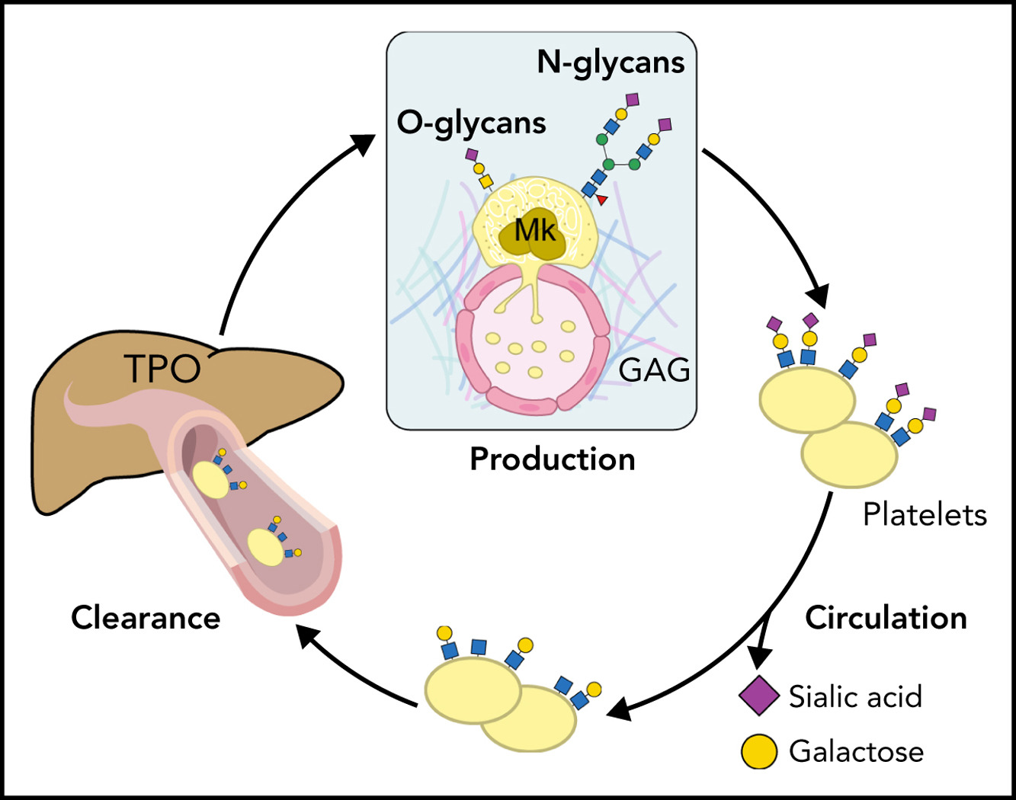
Platelet Life Cycle:
Focus on Glycan Mediated Clearance
Bone Marrow
Hematopoietic stem cell
Young platelets
ECM
Production
ECM: Extracellular Matrix
Mk: Megakaryocyte
TPO: Thrombopoietin
Aged platelets
Clearance
R
α2,3 Sialic acid
Man—GlcNAc—Gal—Sia
β1,4 Galactose
Cell, 2003; Science 2003; Nature Med. 2015, Nature Med. 2009; Blood 2009; JEM 2020; CDD 2021
Notes:
Depicted is a a simplistic version of the platelet life cycle with focus on glycan mediated platelet clearance. Platelets are produced in the bone marrow by megakaryocytes. Newly produced platelets are fully glycosylated –contain high levels of sialic acid – INDICATE – and circulate for 10 days in humans. Upon aging platelet loose sialic acid and galactose residues - INDICATE- and are cleared by the end of their life span by multiple liver receptors – studied and discovered by many investigators – who are in this audience. CLICK Platelet production and destruction must be tightly balanced to maintain a constant platelet pool..

Slide 8
Apoptotic Signaling and Glycan Related Platelet Clearance are Interconnected
Apoptosis inducing signal
Macrophage
Phagocytosis: Apoptotic platelet
Platelet
?
Desialylation: senescence/aging/congenital disorders of glycosylation/antibodies
Take home message: Glycan aging and apoptosis are linked processes — desialylation increases BCL-XL dependence and drives platelet death.

Slide 9
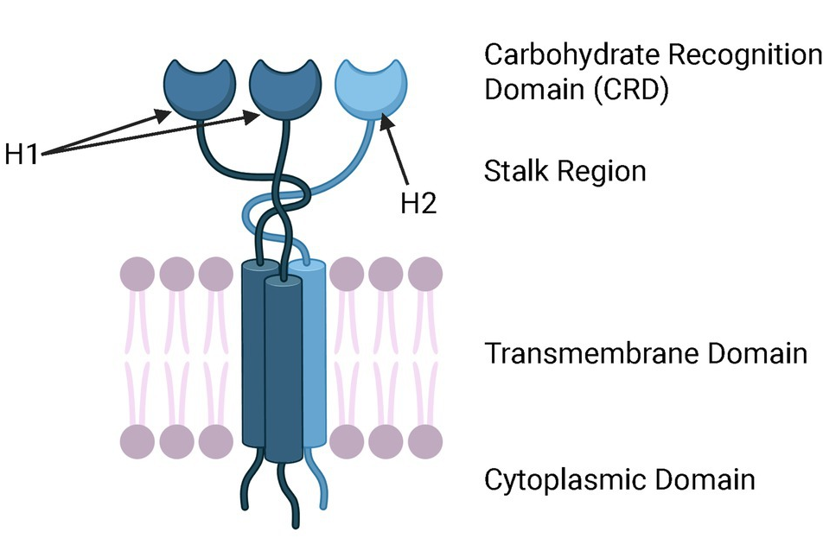
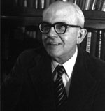
AMR – is a trimer!
Hepatic Ashwell–Morell Receptor (AMR) Pathway — Glycan Aging Sensor
MPL
Hepatocyte
AMR
Kupffer Cell
α_{M}β₂
?
De-sialylation = AMR
De-galactosylation = α_{M}β₂
G. Ashwell
Loss of either HL1 or HL2 domains renders AMR afunctional
Aging platelets lose terminal sialic
AMR removes desialylated platelets
AMR trimer presence in monocytes/macrophages has not been established
Genetic evidence: HL2 deletion → increases platelet count (30%) and desialylated circulating platelets →
Clinical loss of HL1: Emerging role in cardiovascular disease (NEJM, 2016; Atherosclerosis; 2020);
Gain-of-function: Loss of AMR function extends platelet half-life (48 h → 68 h)

Slide 10
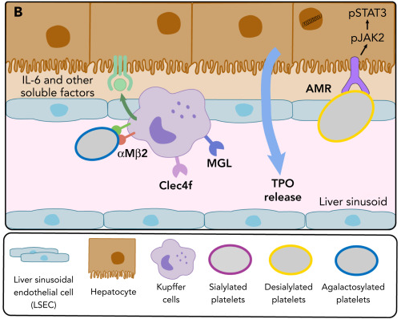
Glycan Remodeling in Platelet Clearance is Complex
Blood; 2022 Jun 2;139(22):3255–3263
R
Man—GlcNAc—Gal—Sia
Desialylation:
Senescence/aging in vivo and in vitro
Congenital disorders of glycosylation
Autoantibodies
R
Man—GlcNAc—Gal—Sia
De-galactosylation:
Senescence/aging in vivo and in vitro
Congenital disorders of glycosylation
MGL = Macrophage Galactose Lectin
R
Man—GlcNAc—Gal—Sia
Cell, 2003; Science 2003; Nature Med. 2015, Nature Med. 2009; Blood 2009; JEM 2020; CDD 2021

Slide 11
What about transfused platelet clearance?
Temperature-Induced Clearance (Storage Lesion)
Refrigeration or prolonged storage causes:
  Membrane glycan and receptor (GPIbα) clustering
  Desialylation & Degalactosylation
  Shape change & cytoskeletal stress
  Apoptotic signals?
Promotes rapid clearance after transfusion via:
  AMR pathway
  Macrophage aMb2 recognition of cold-stred platelets platelets
Cold storage shortens in-vivo survival

Slide 12
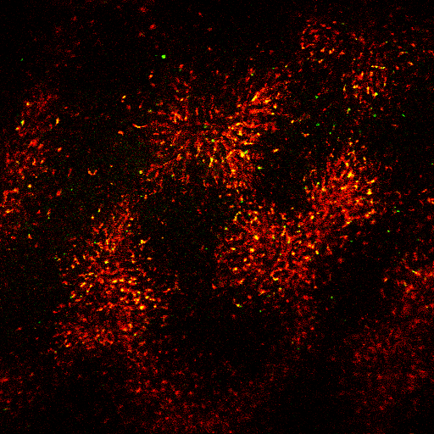
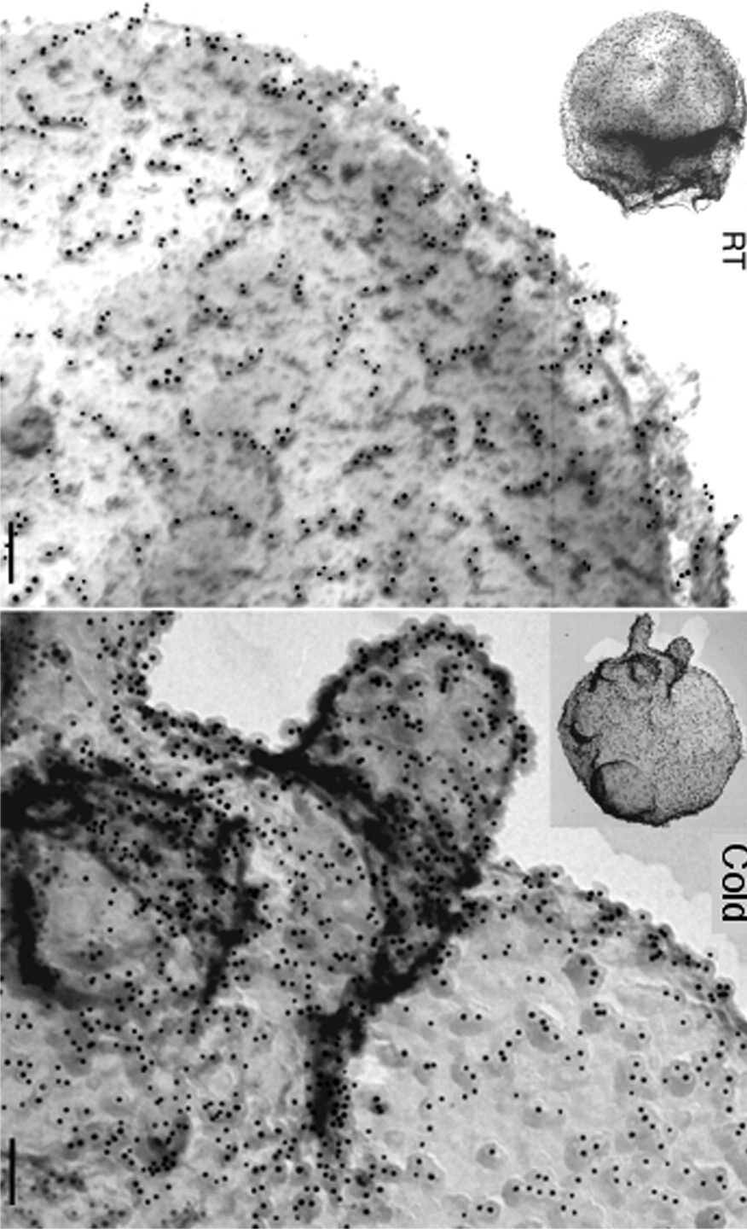
Cold stored (hours) platelets are cleared via α_{M}β₂ receptors on liver macrophages
Liver macrophages: red Cold Platelets: green
Platelet GPIbα electron microscopy
22°C
Circulate
22°C
4°C
βGlcNAc
4°C
α_{M}β₂
GPIba clustering at 4°C
Macrophage
R
Macrophage α_{M} Lectin Domain
Man—GlcNAc
Liver intravital microscopy of transfused platelets
(Hoffmeistet el at Cell 2003; Hoffmeister et al Science 2003; Josefsson et al, JBC, 2005)

Slide 13
Galactosylation does not prevent the rapid clearance of 4°C-stored human platelets
Solution: Cover GlcNAc with galactose (Gal)
Human platelets stored for days
Short term cooling
Platelet treatment | Platelet Recovery (%) | Platelet Survival (days)
4°C/UDP-Galactose | 46 ± 16 | 2.1 ± 0.7
4°C | 53.5 ± 5 | 2.9 ± 0.1
22°C | 47 ± 13 | 6.9 ± 0.1
Man – GlcNAc
R
Man - GlcNAc – Gal
Data reported as average ± S.D.
R
Wandal et al, Blood, 111: 3249, 2008

Slide 14
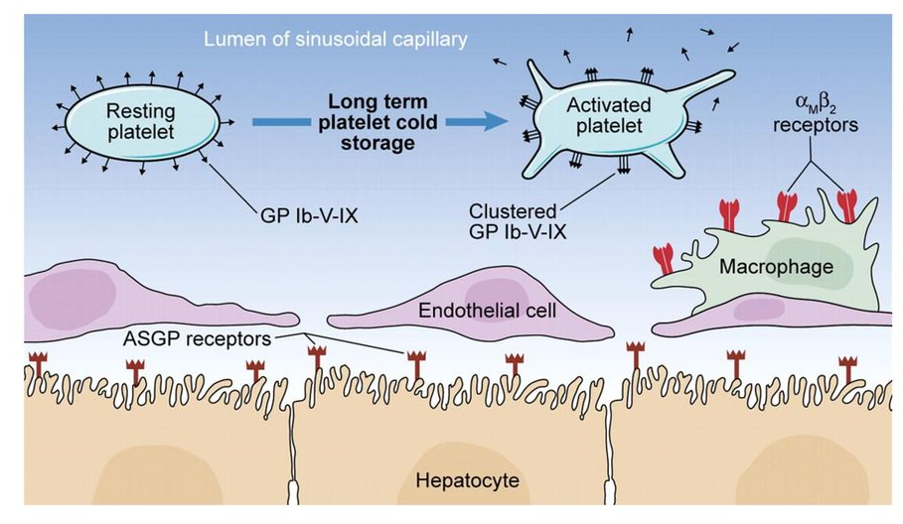
The Ashwell Morell Receptor mediates the clearance of cold stored (days) platelets
140
WT/22 ºC
Asgr2^{-/-}/22 °C
120
Asgr1^{-/-}/22 ºC
WT/4 ºC
100
Asgr2^{-/-}/4 ºC
Asgr1^{-/-}/4 ºC
80
Circulating
Platelets (%)
60
40
20
0
0
12
24
36
48
60
72
Time (h)
Blood, 2008
Rumjantseva et al Nat Med. 2009.
Asgr1 and 2: Asialoglycoprotein receptor 1 and 2 = Ashwell Morell Receptor

Slide 15
Macrophage depletion improves the circulation of 2h chilled and transfused platelets, does not prevent the clearance of 48h chilled platelets.
Macrophage
40% of fresh transfused platelets are cleared rapidly by macrophages
Platelet recovery in macrophage depleted mice was set to 100%

Slide 16
Glycan-Lectin Mechanisms Regulate Platelet Life Span
Short term cooling
Man – GlcNAc
Degalactosylated platelets are cleared by hepatic macrophages via αMβ2 receptors
(Hoffmeister et al, Cell 2003, Hoffmeister et al, Sicence 2003; Josefsson et a, JBC 2005)
R
Long term cooling
Man - GlcNAc – Gal
Desialylated platelets are cleared by hepatic Ashwell Morell (asialoglycoprotein) receptors
(Rumjantseva V et al., Nat Med 2009; Sørensen AL et al., Blood 2009,
Grozovsky, et al. Nat Med 2015)
R
Man - GlcNAc - Gal - Sia
Platelets lose sialic acid and galactose during refrigerated platelet storage
(Jansen et al, Blood 2011; Rumjantseva et al., Nat Med 2009)
R

Slide 17
Take-Home Model
Mechanism | Trigger | Recognition System | Primary Clearance Site
Glycan aging | Loss of sialic acid | AMR/MGL/Clec4f | Liver
GPIb signaling | VWF/antibody binding | AMR (via desialylation) | Liver
Immune (ITP) | Autoantibodies | Fcγ receptors | Spleen
Apoptosis | Mitochondrial stress | PS receptors | Spleen & Liver
Storage lesion | Cold/handling stress | AMR + macrophages | Liver

Slide 18
Some Future Directions
1. How are Glycan Aging and Apoptosis Mechanistically Linked?
2. What Sets the Platelet “Molecular Clock”?
3. Are Young Platelets Biologically Distinct?
4. Do Disease States Reprogram the Lifespan Pathway?
5. Need for high-quality, well-controlled in vivo investigations of cold-stored platelets (CSP) to definitively clarify the posttransfusion function of CSP.
Chilling controversy: cold-stored platelets for prophylactic transfusions
Moritz Stolla, Andrew P. Cap, Phillip C. Spinella;
Blood (2025) 146 (17): 2023–2028.

Slide 19




Versiti Blood
Research Institute
Versiti Blood Research Institute:
Hervé Falet
Demin Wang
Renren Wen
Tongjun Gu
Boston Children’s Hospital:
Martha Sola-Visner
Roswell Park Caner Institute, NY:
Joseph Lau
Mike Nemeth
Virginia Commonwealth University
Umesh Desai
Adam Hawkridge
Tufts University / University of Pavia, Italy
Alessandra Balduini
University of Freiburg, Germany
Barbara Zieger
Childrens Hospital Los Angeles
Taylor Kim
Emily Diaz
Renee Hill
Alyssa Ottum
Kate Rosenbalm
Alejandro Roisman
Agata Steenackers
Natalia Weich
Mark Zogg
K12 HL141954
Financial
support
PO1 HL151333
RO1 HL089224
Key collaborators
Hauske Foundation
Advancing a Healthier
Wisconsin
Versiti Blood Research Institute Shared resources.

