Slide 1


Cerus Corporation
Copany Logo
Pathogen Inactivation: A Standard of Care for Blood Transfusion Safety
Laurence Corash, MD
Founder and Chief Scientific Officer
Professor, Laboratory Medicine, UC San Francisco

Slide 2
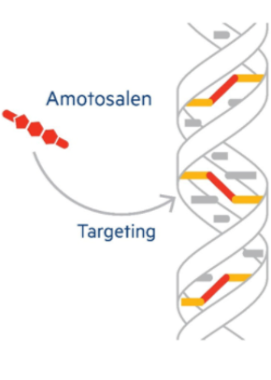
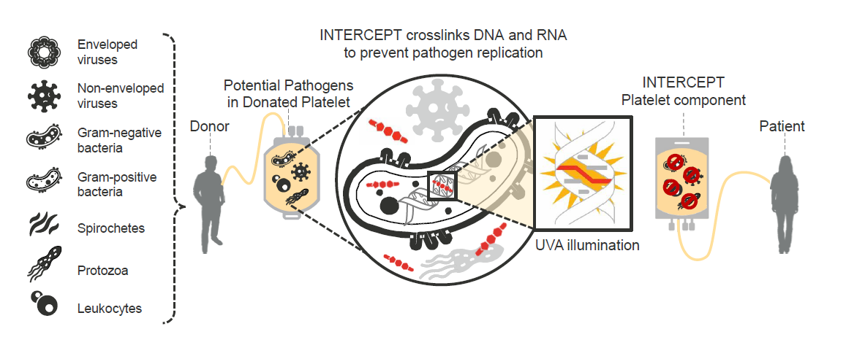
Psoralen Nucleic Acid Targeted Pathogen and T Cell Inactivation to
Prospectively Reduce the Risk of Transfusion Transmitted Adverse Events
Platform Technology Applicable to Platelets and Platelet Like Products
State of the Technology Meeting: Platelets and Platelet Like Products

Slide 3
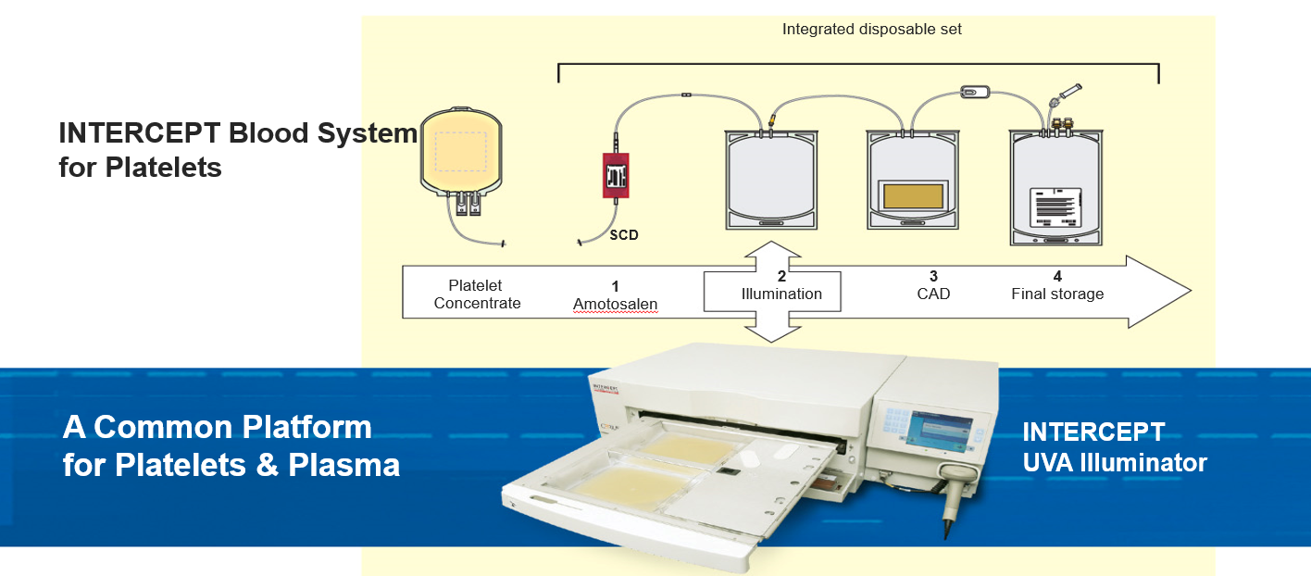
Indication: Risk Reduction of Transfusion Transmitted Infection and TA-GVHD for Transfusion of Patients with Thrombocytopenia or Qualitative Platelet Disorders
State of the Technology Meeting: Platelets and Platelet Like Products

Slide 4
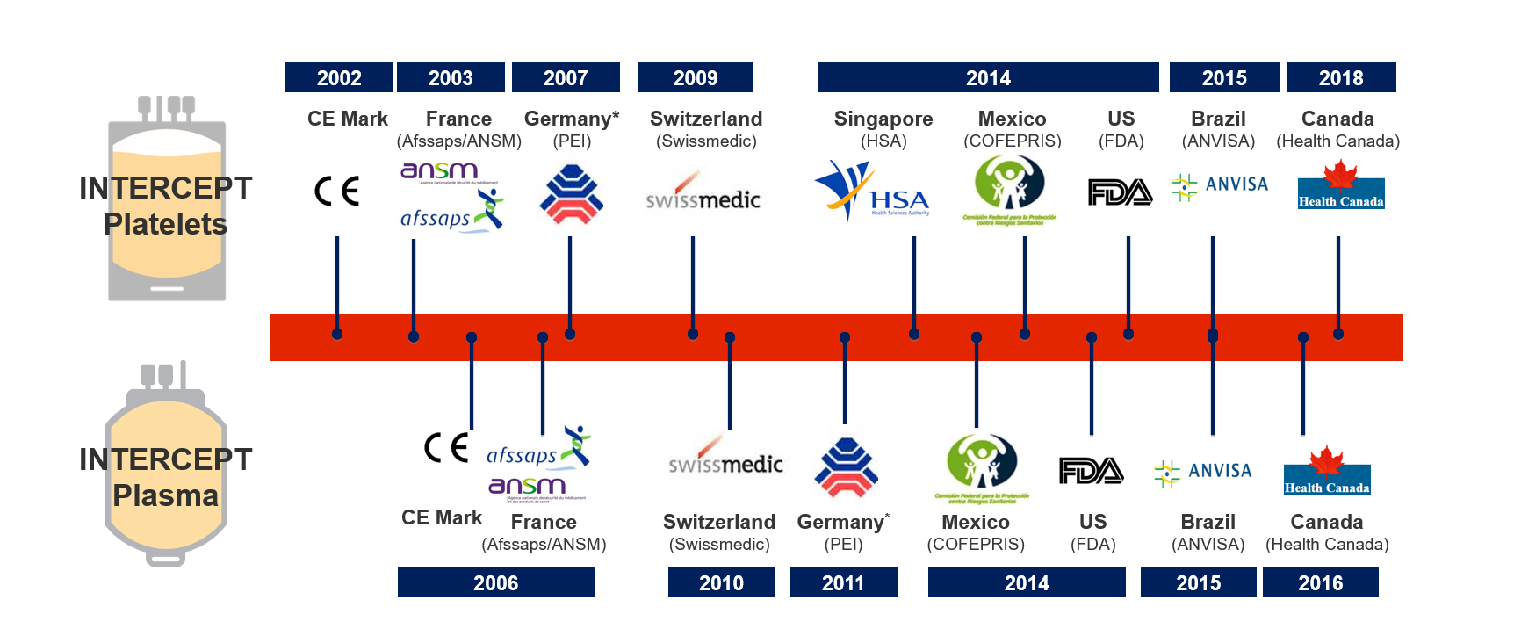
Global Product Maturity and Regulatory Status
State of the Technology Meeting: Platelets and Platelet Like Products

Slide 5

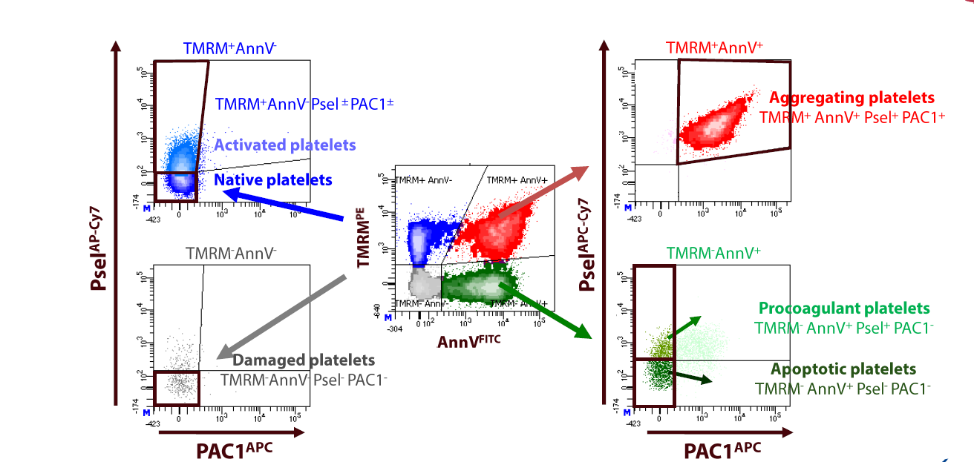
New Assays to Define Platelet Subpopulations In Cold Stored Platelets
Hechler et al
State of the Technology Meeting: Platelets and Platelet Like Products

Slide 6
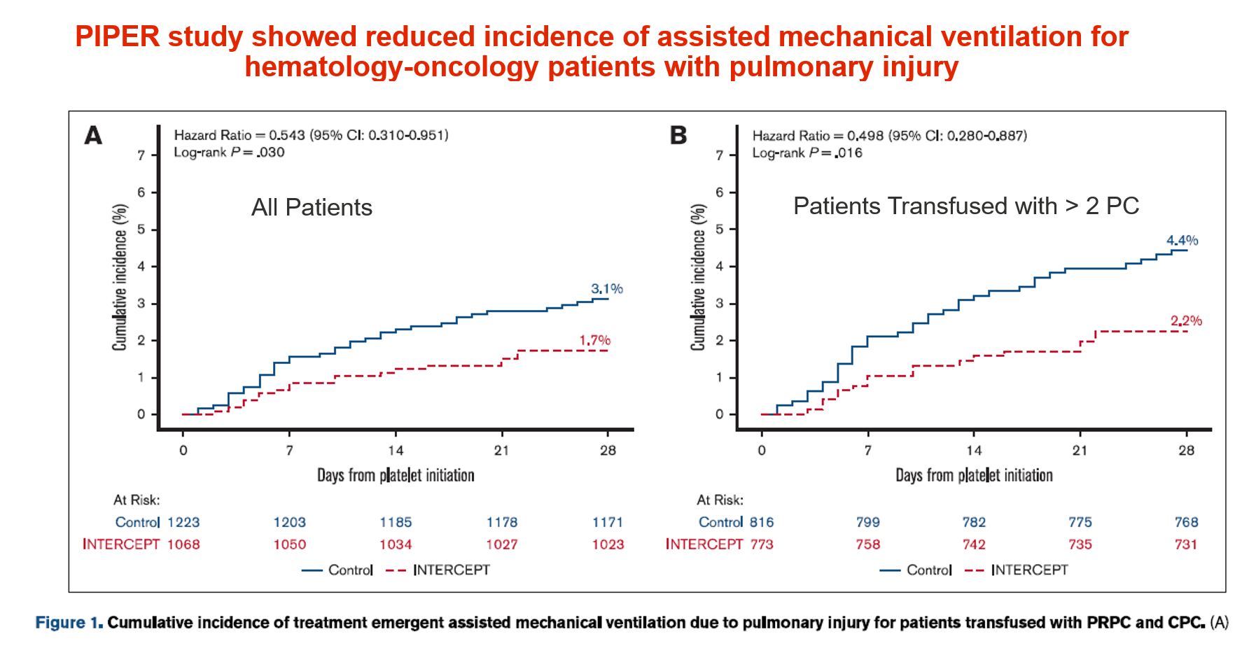
Improved Patient Outcomes for Patients Supported with Pathogen Reduced Platelets
Wheeler et al. Blood Advances. 2024;8(9 ):2290-9.
State of the Technology Meeting: Platelets and Platelet Like Products

Slide 7
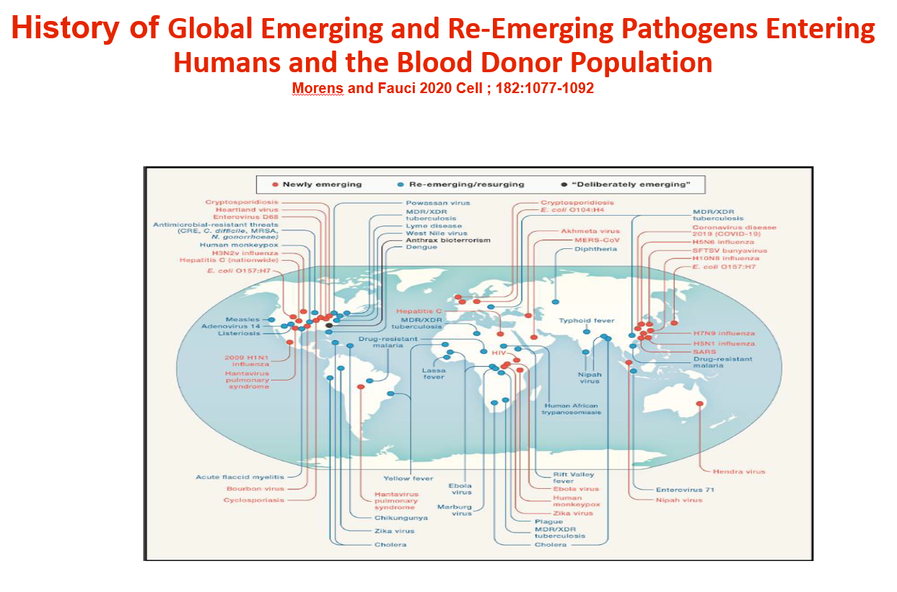
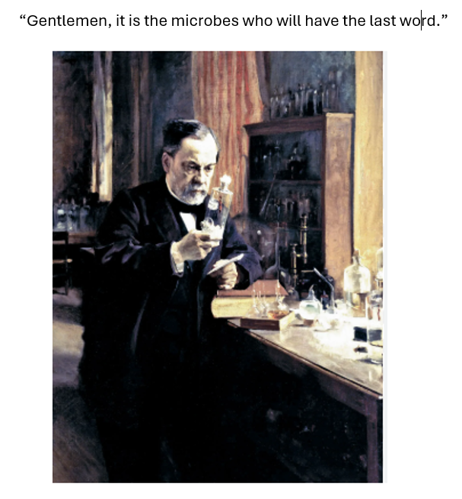
State of the Technology Meeting: Platelets and Platelet Like Products

