Slide 1
THE FUTURE OF WARFIGHTER PERFORMANCE
THE HUMAN EDGE
JUNE 17, 2026
Dr. Theresa Santo, WPO Director (Acting)

Slide 2
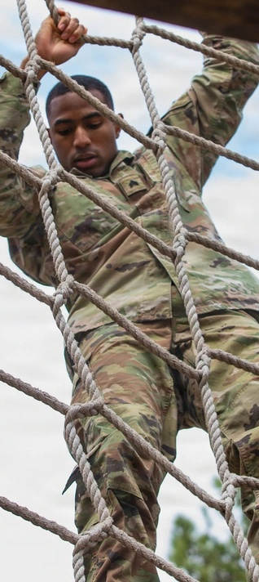
Today’s Agenda
10th Annual MTEC Membership Meeting
01
The Warfighter Imperative
02
Path to Warfighter Performance Optimization (WPO)
03
Modernized Total Force Fitness (TFF) Framework
04
WPO Way Ahead
05
Accelerating the Future of Warfighter Performance
06
Discussion & Questions

Slide 3
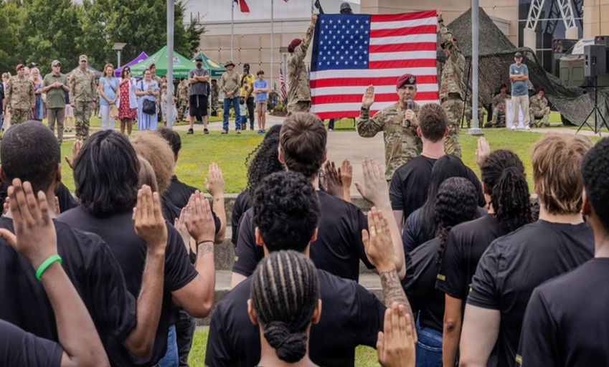
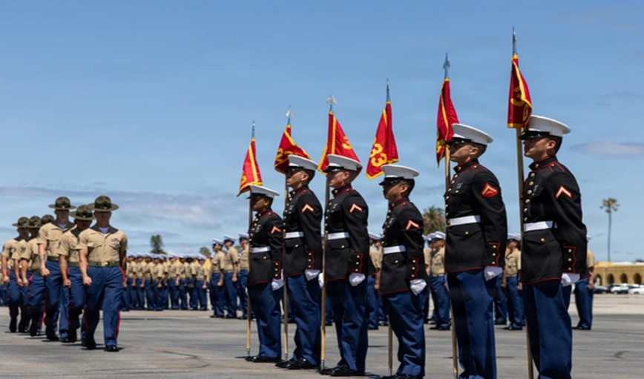
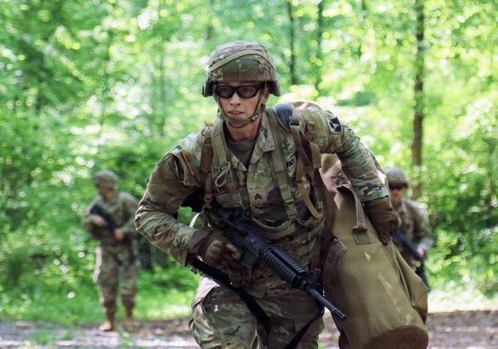
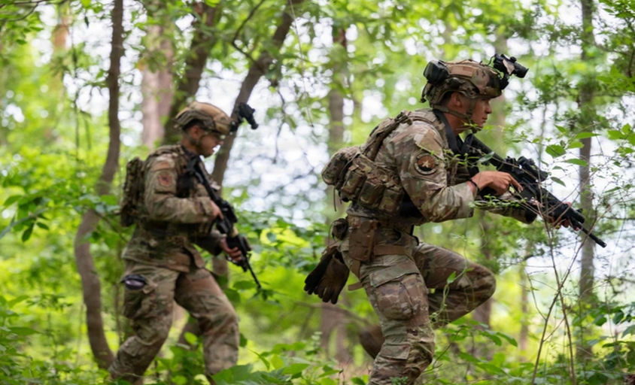
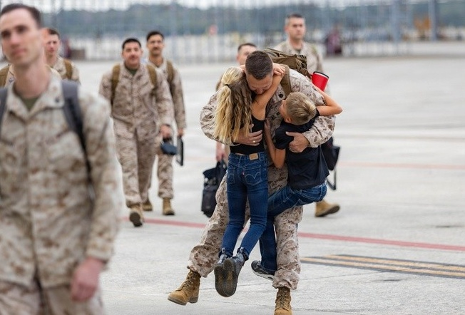
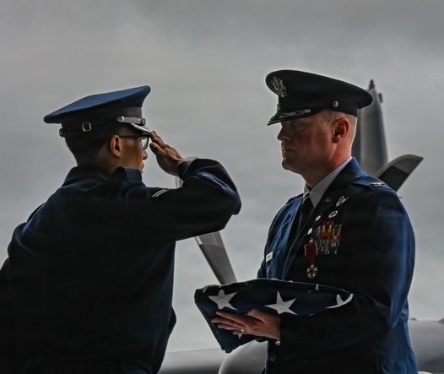
The Warfighter Imperative
Forging the Future Warfighter
ONE FORCE, ONE STANDARD, OPTIMIZED FOR LETHALITY
POTENTIAL
High commitment
to serve
DEVELOPMENT
Systematic, Multi-Domain Intervention
READINESS
Built for longevity, optimized
for lethality
`
3
3

Slide 4

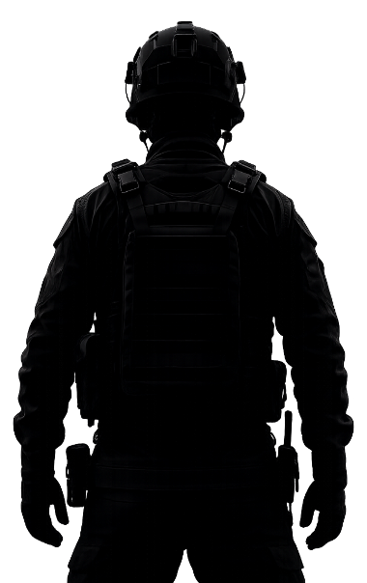
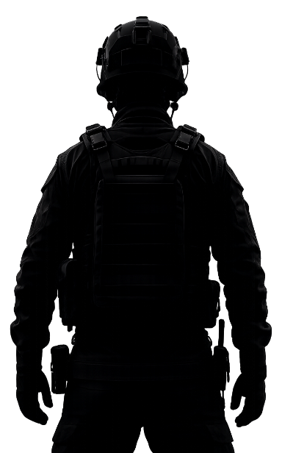
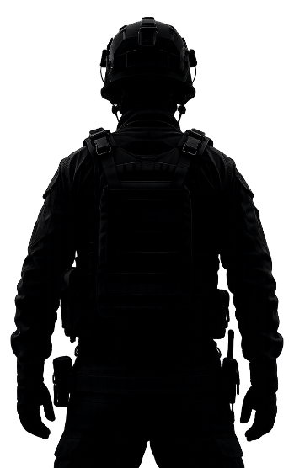







Warfighter Performance Optimization (WPO)
The Strategic Integrator
THE WARFIGHTER
WARFIGHTER PERFORMANCE OPTIMIZATION
A highly trained, predominantly young population with a 3:1 male-to-female ratio. Warfighters routinely operate under immense physical and psychological stress.
The continuous, integrated conditioning of the cognitive, physical, psychological, social, and spiritual dimensions of the Warfighter to sustain and maximize performance.
WPO Directorate
DOW-LEVEL ENABLING
READINESS PROGRAMS
SERVICE-LEVEL WPO PROGRAMS
Warfighter First
Operational Agility
Military Dominance
Air Force
Army
Marine Corps
Navy
Space Force
Warfighters sustain cognitive, physical, psychological, social, and spiritual dominance across operational cycles, enabled by cohesive teams, performance support systems, and a sense of purpose. Command teams can assess, predict, and optimize performance to maintain readiness and overmatch.
END STATE

Slide 5
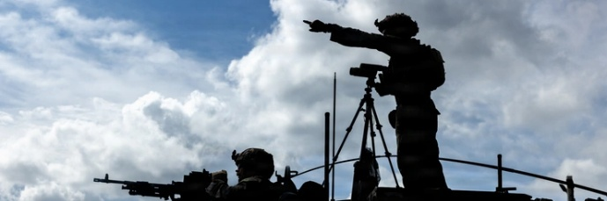
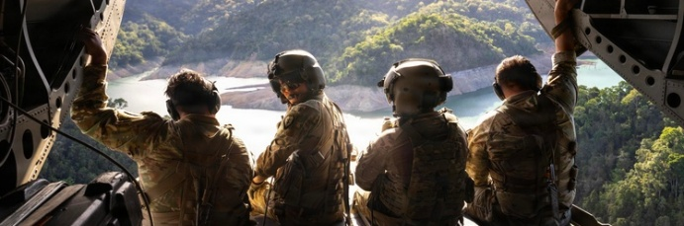
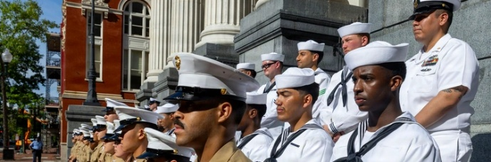
From Silos to Strategy
Building the Foundation for Warfighter Performance Optimization
After over a decade of siloed efforts and organizational instability, recent, decisive realignments have established the stability and strategic alignment required to execute a unified WPO strategy.
2011
FOUNDATION
2025
REALIGNMENT
2026
UNIFIED STRATEGY
A Comprehensive Readiness Vision is Formed
Leadership Creates
Stability
WPO Aligns Efforts Across the Force
The Total Force Fitness Framework (TFF) becomes the Department’s multi-domain approach to warfighter performance.
TFF lands a permanent organizational home within the Department.
The WPO Directorate is established to drive strategy, policy, innovation, and scale.
WHAT CHANGED?
WPO is transforming warfighter performance optimization from a collection of siloed efforts into a synchronized, enterprise-wide strategy.
DURING THIS TIME, Components also advanced warfighter performance optimization programs and capabilities independently to meet their unique mission needs and requirements.
5

Slide 6

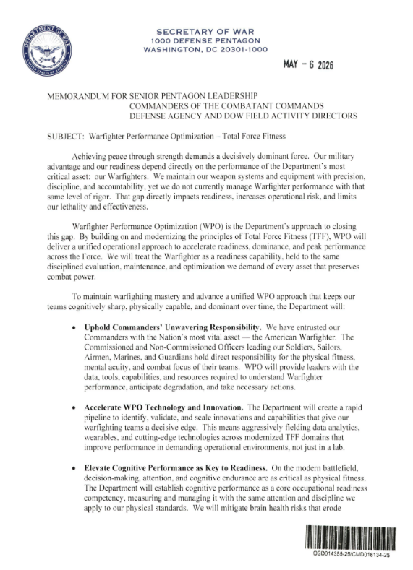
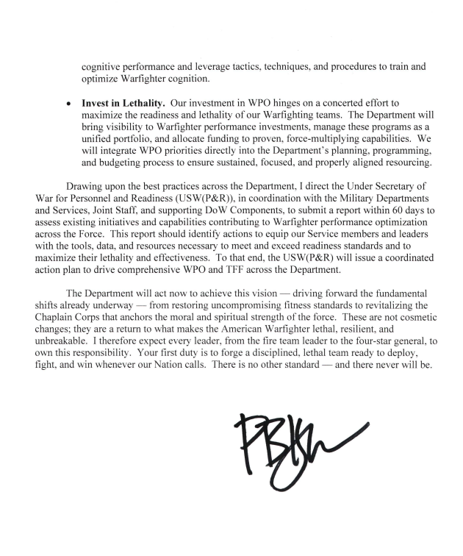
The Strategic Mandate
The Secretary of War’s Memorandum
We maintain our weapon systems and equipment with precision, discipline, and accountability, yet we do not currently manage Warfighter performance with that same level of rigor. That gap directly impacts readiness, increases operational risk, and limits our lethality and effectiveness. Warfighter Performance Optimization (WPO) is the Department’s approach to closing this gap.
THE REQUIREMENTS
UPHOLD Commanders’ Unwavering Responsibility | ACCELERATE WPO Technology and Innovation | ELEVATE Cognitive Performance as a Central Readiness Enabler | INVEST In Warfighter Lethality

Slide 7
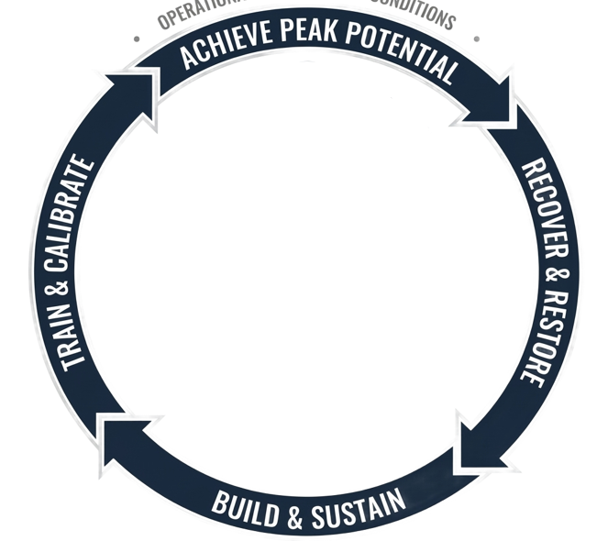

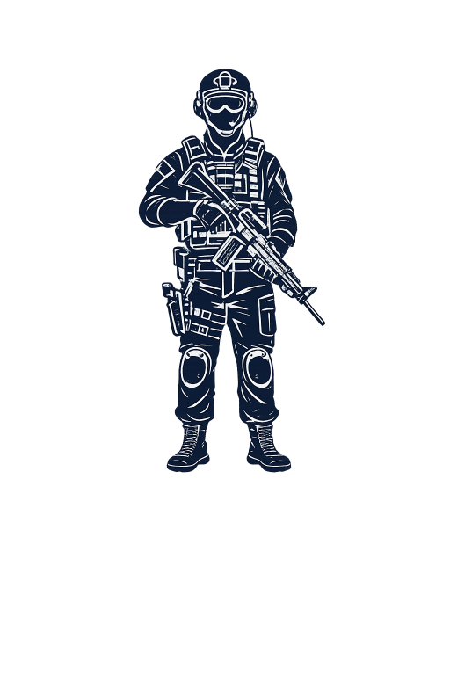





Modernized Total Force Fitness (TFF) Framework
The Operational Model for WPO
WARFIGHTER PERFORMANCE OPTIMIZATION
DEFEND • DETER • PREVAIL
• OPERATIONAL PERFORMANCE CONDITIONS •
COGNITIVE
PHYSICAL
SPIRITUAL
SOCIAL
PSYCHOLOGICAL
PERFORMANCE IS MULTIDEMENSIONAL

Slide 8
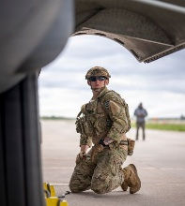
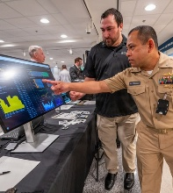
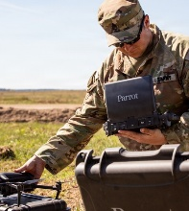
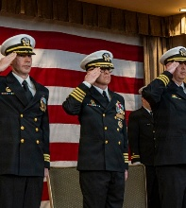
WPO Way Ahead: Coordinated Action Plan
Bridging the Innovation Gap
WPO is turning four critical action areas into tangible operational capabilities that create clear on-ramps for external partnership.
Next 90 Days
BY SEPT 2026
Operational Impact
UNIFIED STARTING POINT
WPO Implementation Guidance and
60 Day Assessment Report
ESTABLISHED FOUNDATION
Coordinated roadmap for enterprise-wide execution and alignment
DATA STRATEGY
WPO Data Management and
Analytics Strategy
NEAR REAL-TIME INSIGHTS
Field dashboards, data-informed insights and decisions
TECHNOLOGY INTEGRATION
Human Performance Technologies Data Call and Prioritized Pilot Funding
FASTER INNOVATION
Validated tools and capabilities scaled for the Total Force
ENTERPRISE GOVERNANCE
Modernized TFF Framework and
Resource Lists
ONE READINESS LANGUAGE
Shared understanding of WPO mission, capabilities, and responsibility

Slide 9

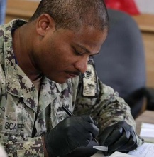
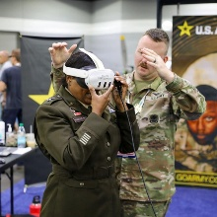
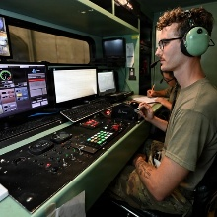
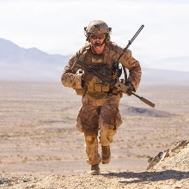

Accelerating the Future of Warfighter Performance
Opportunities for Partnership
Optimizing our warfighters is a shared responsibility. It requires a unified effort across the DoW, industry, and academia to ensure we provide the Joint Force with every possible advantage. WPO is committed to this partnership, and we welcome your input.
RESEARCH
TECHNOLOGY
VALIDATION
SCALE
Human Performance
Cognitive Performance
Sleep & Fatigue
Recovery Science
Brain Health
Wearables & Sensors
Data Integration
Decision Support
Predictive Analytics
Evaluation Design
Human Subject Research
Biostatistical Analysis
ROI Modeling
Implementation Science
Logistics & Fielding
Best Practice Generation
Ready to Engage? Please fill out our vendor intake form via the QR code
or email OSD-WPO-TFF@mail.mil for other partnership interests.
9

Slide 10
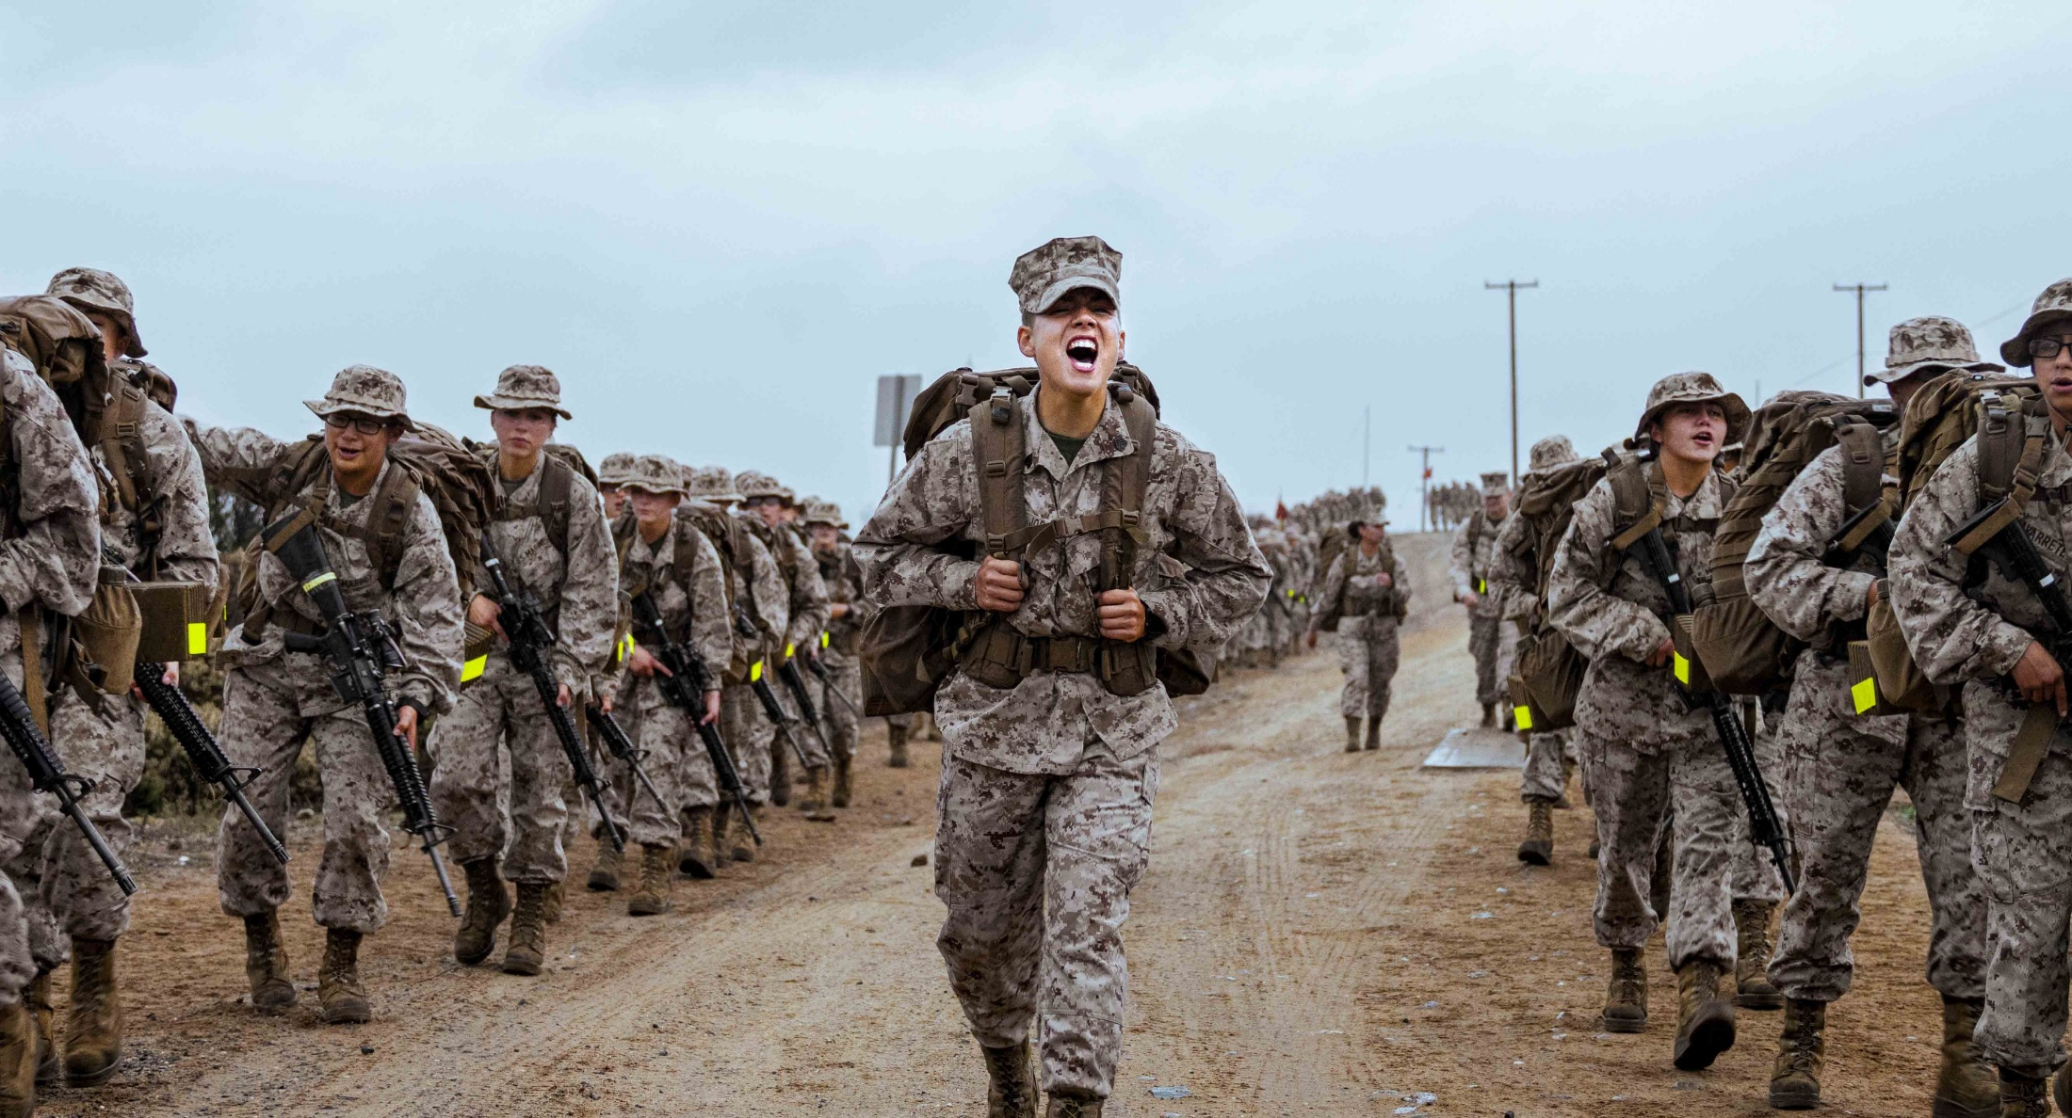


Discussion & Questions
10th Annual MTEC Membership Meeting
These are not cosmetic changes; they are a return to what makes the American Warfighter lethal, resilient, and unbreakable. I therefore expect every leader, from the fire team to the four‑star general, to own this responsibility. Your first duty is to forge a disciplined, lethal team ready to deploy, fight, and win whenever our nation calls. There is no other standard – and there never will be.
— Secretary of War Pete Hegseth
Contact: OSD-WPO-TFF@mail.mil
Vendor Intake Form:

