Slide 1


Transfusion in Hypo-proliferative and Functional Thrombocytopenia
Elisabeth M. Battinelli, MD/PhD Chief of Mass General Brigham Classical Hematology Division Feb 17, 2026

Slide 2
Learning Objectives
By the end of this talk, participants will be able to:
Distinguish hypo-proliferative from functional thrombocytopenia
Apply evidence-based platelet transfusion thresholds
Identify scenarios where platelet transfusion is ineffective or harmful
Use a practical clinical framework for transfusion decisions

Slide 3
Why This Matters
Platelet count alone is an imperfect surrogate for bleeding risk
Platelet transfusion is:
Common
Expensive
Not benign
Over-transfusion → harm
Under-transfusion → bleeding

Slide 4
Platelet Biology Review
Produced by megakaryocytes in bone marrow
Lifespan: ~7–10 days
Hemostasis depends on:
Platelet number
Platelet function
Vascular integrity
Coagulation factors

Slide 5
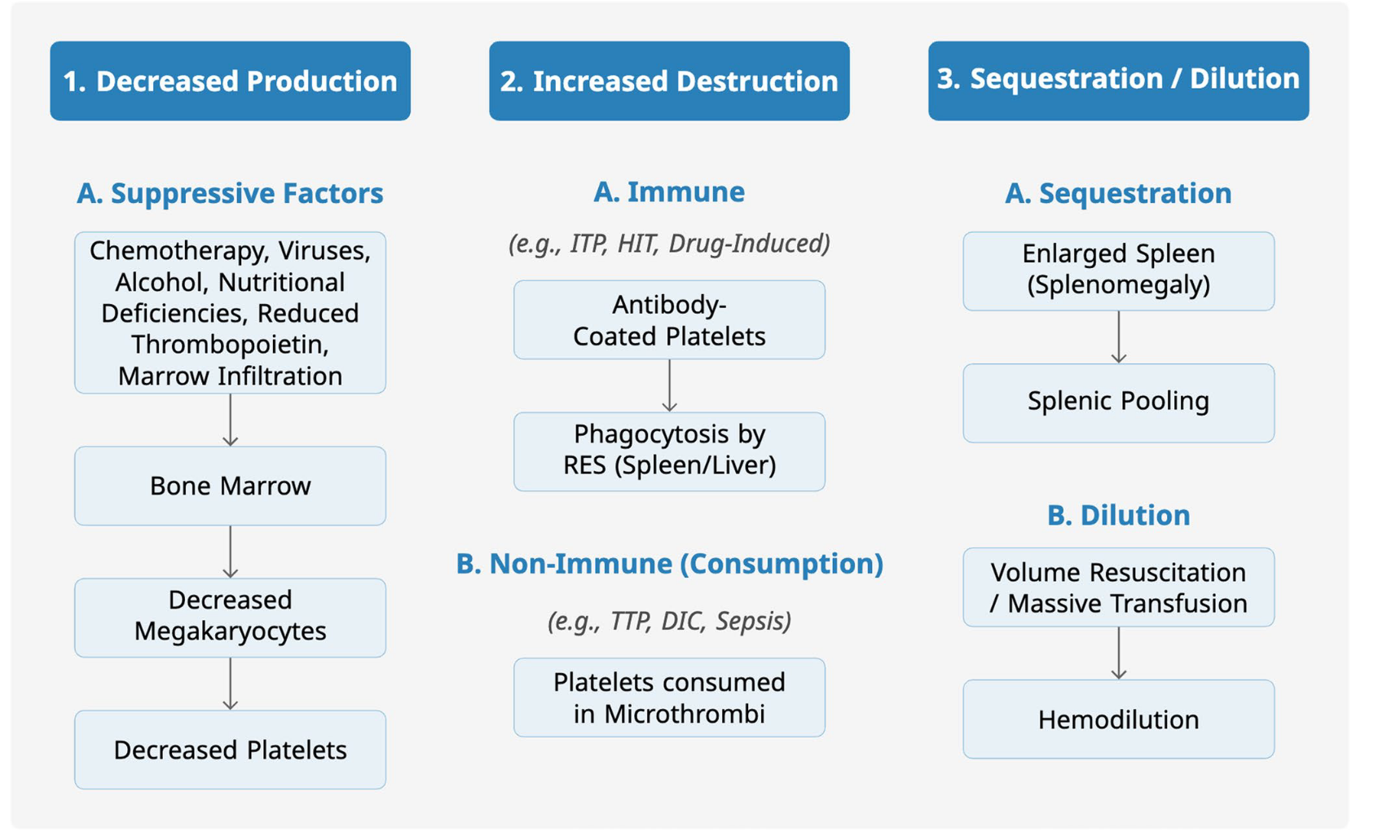
Ashorobi, 2023

Slide 6
Definitions
Thrombocytopenia
Platelet count <150 ×10⁹/L
Two major mechanisms of thrombocytopenia:
Hypo-proliferative: decreased platelet production
Functional Deficit: impaired platelet function (± low count)

Slide 7
Thrombocytopenia
Mechanism | Platelet Count | Function
Hypo-proliferative | ↓ | Normal
Destructive | ↓ | Normal
Functional | Normal or ↓ | Impaired

Slide 8
Hypo-proliferative Thrombocytopenia
Definition
Reduced platelet production from bone marrow
Key Clinical Feature
Transfused platelets usually function normally

Slide 9
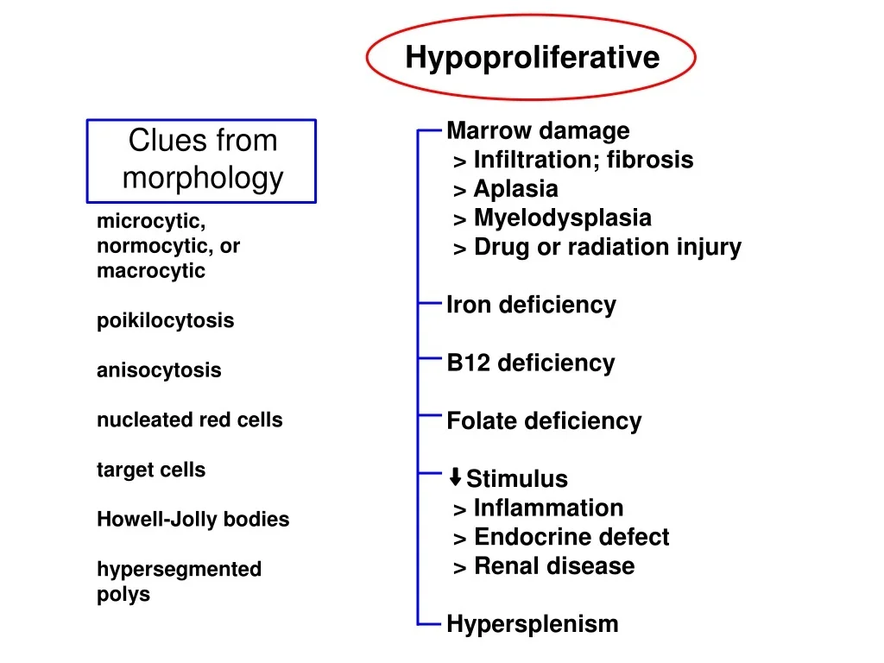
Common Causes of Hypo-proliferative Thrombocytopenia
Aplastic anemia
Myelodysplastic syndromes
Acute leukemia
Chemotherapy-induced thrombocytopenia
Post–stem cell transplant
Radiation therapy

Slide 10
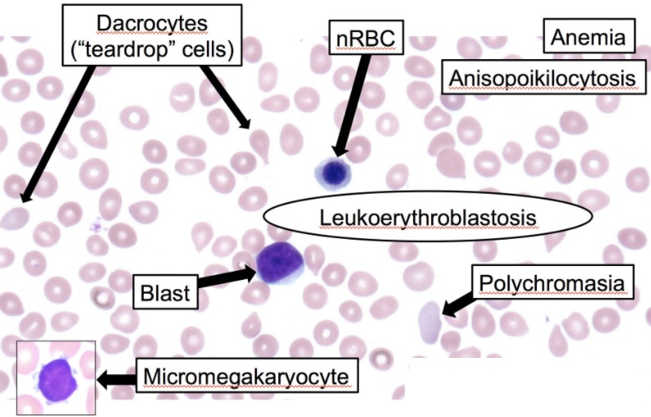
Clues from Smear Morphology
Ashorobi, 2023

Slide 11
Bleeding Risk Is Multi-factorial
Platelet count alone is insufficient metric
Additional risk factors
Fever / sepsis
Mucositis
Coagulopathy
Anticoagulants / antiplatelet drugs
Recent bleeding

Slide 12
Prophylactic Platelet Transfusion
Stable, non-bleeding patients
<10 ×10⁹/L → transfuse
<20 ×10⁹/L → if additional risk factors
Rationale
Randomized trials show reduced spontaneous bleeding

Slide 13
Prophylactic Transfusions: Evidence-Based Approach
Demonstrated the safety and efficacy of a “no-prophylaxis” or therapeutic-only approach compared to a standard prophylactic transfusion strategy (at a 10 ×10³/μL trigger) in patients with thrombocytopenia.
Reported more frequent minor bleeding events (WHO Grade 2) in the no-prophylaxis arms; critically, there was no significant increase in major or life-threatening hemorrhage (WHO Grade 3 or 4).
These studies showed a risk of minor bleeding translated to approximately 33–50% fewer platelet transfusions for patients in the no-prophylaxis groups, a pivotal finding that informed the conditional recommendation in the 2025 guidelines for a no-prophylaxis strategy in adult patients with aplastic anemia or those undergoing autologous stem cell transplant, thus representing a significant advancement toward high-value, patient-centered care

Slide 14
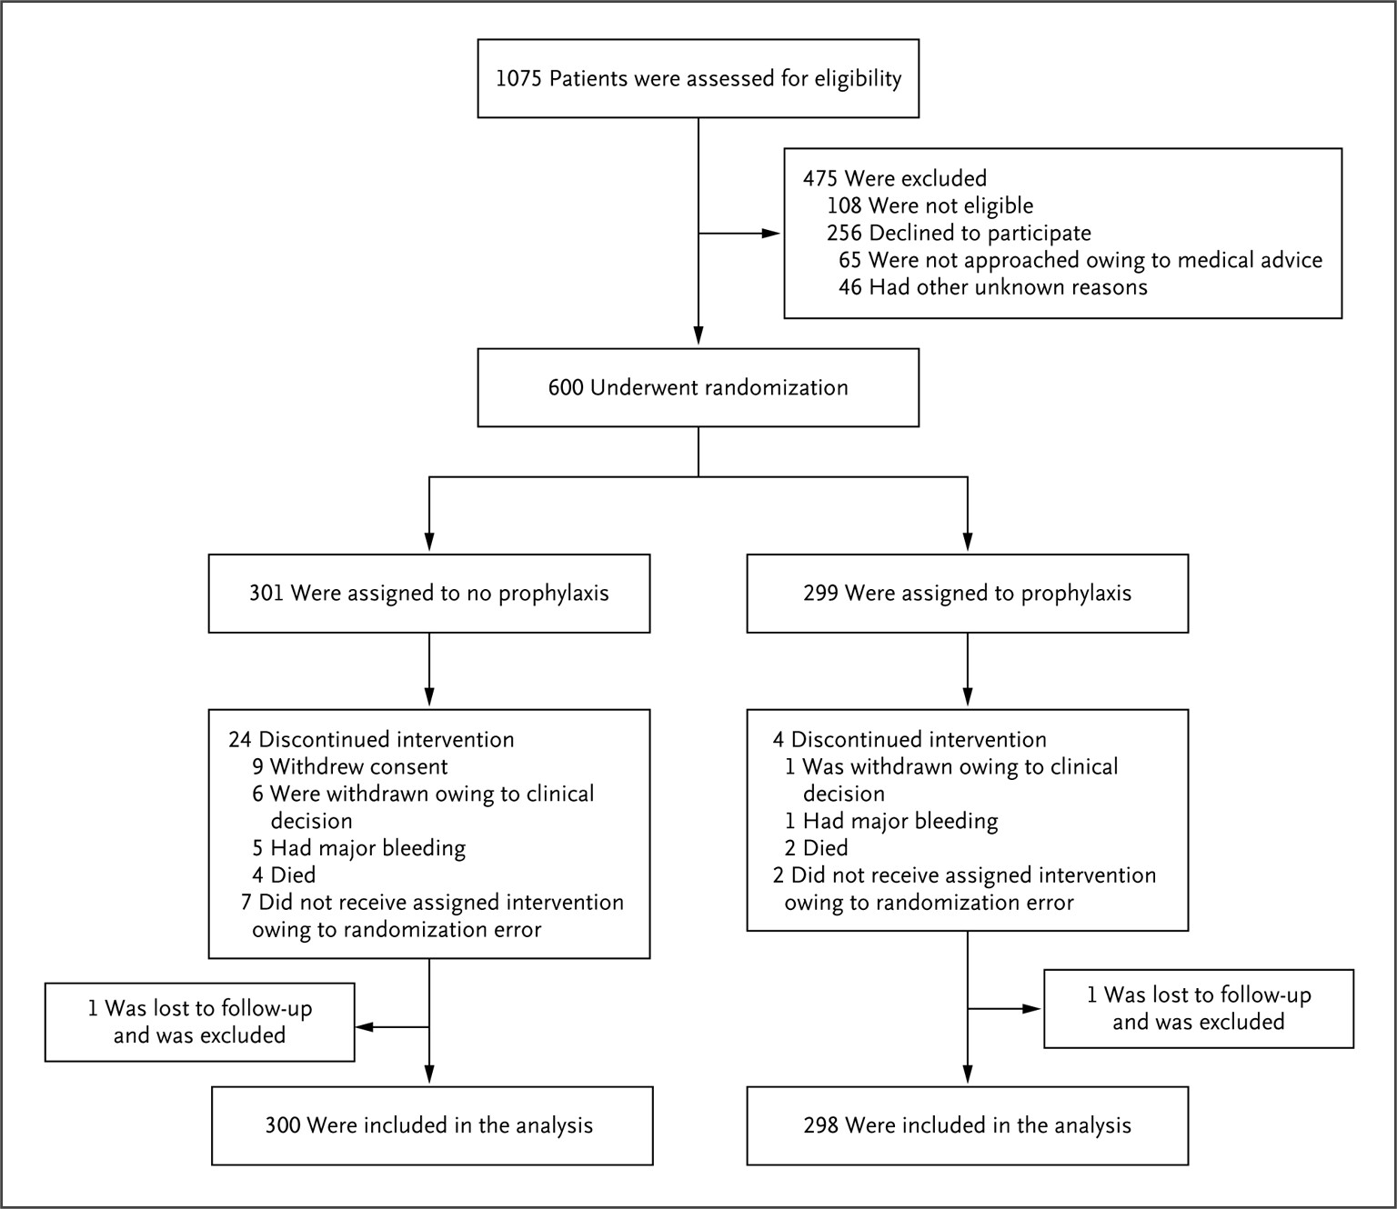
TOPPs Trial
In the TOPPS trial, 50% of patients in the no-prophylaxis group experienced WHO grade 2, 3, or 4 bleeding, compared to 43% in the prophylaxis group (P = 0.06 for non-inferiority), with no significant difference in major bleeding rates.
Stanworth et al 2013

Slide 15
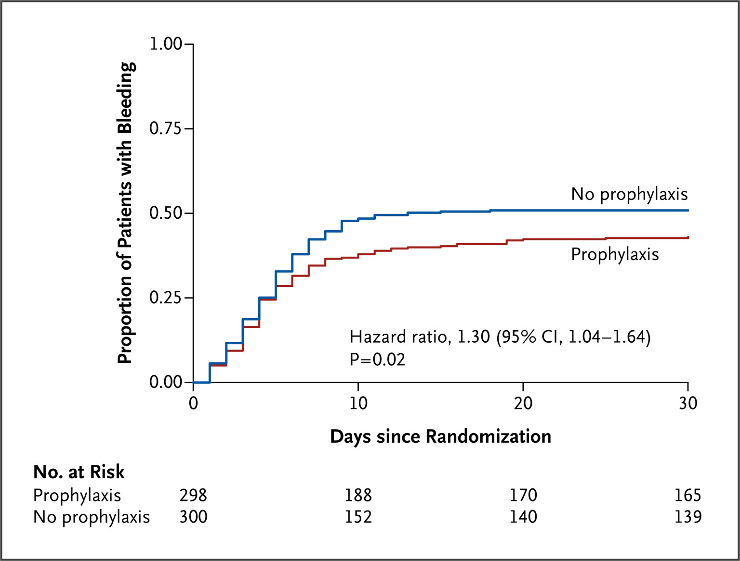
TOPPs Trial
Stanworth et al 2013
Notes:
The primary outcome was a bleeding episode of grade 2 (moderate; red-cell transfusion not needed immediately), grade 3 (severe; requiring red-cell transfusion within 24 hours), or grade 4 (debilitating or life-threatening), according to the World Health Organization grading scheme. The time to the first bleeding episode was significantly shorter in the no-prophylaxis group than in the prophylaxis group.

Slide 16
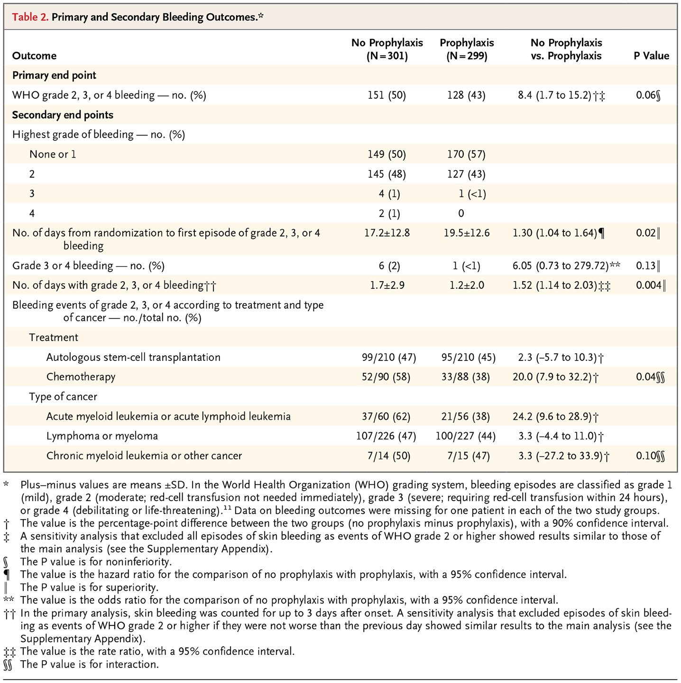
TOPPs Trial
Stanworth et al 2013

Slide 17
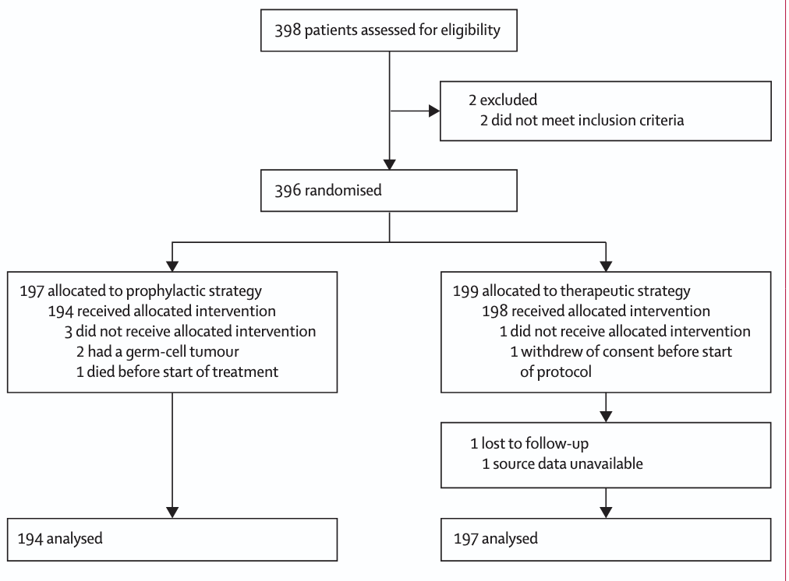
Wandt et al Trial
Found increased grade 2 or greater bleeding in the therapeutic-only group (42% vs. 19% in the prophylactic group, P < 0.001), but significant (grade 3/4) bleeding was rare and not significantly different in autologous transplant recipients
Wandt et al 2012

Slide 18
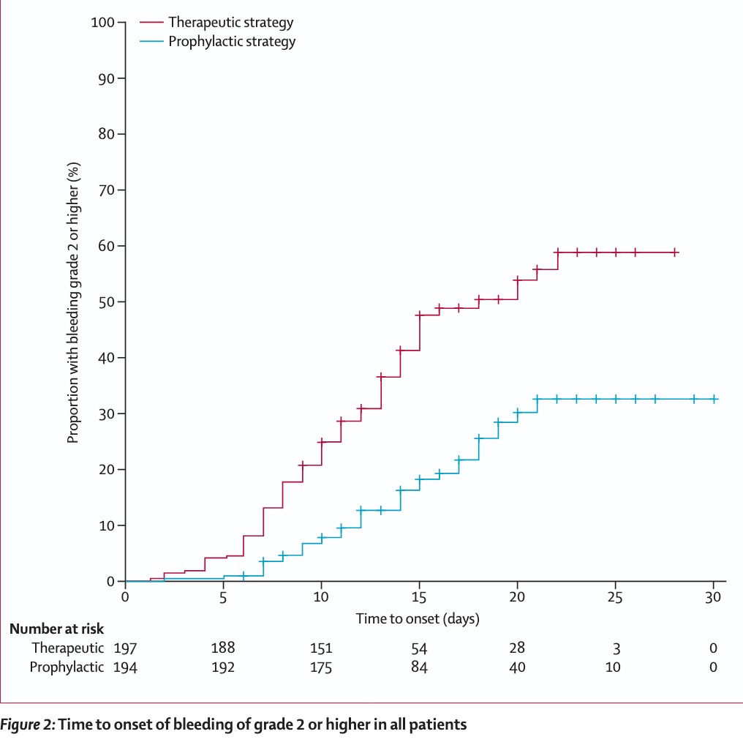
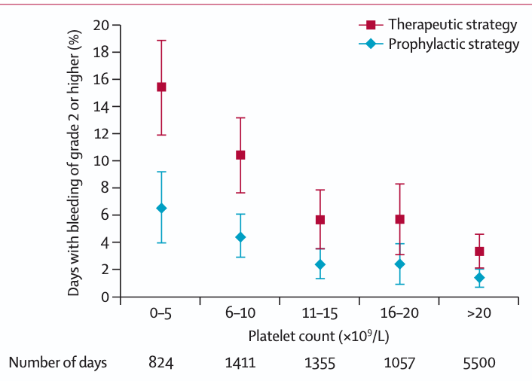
Wandt et al Trial
Wandt et al 2012
Notes:
Days with bleeding of grade 2 or higher in both transfusion groups
by categories of morning platelet count
Error bars show 95% CI. Data are based on the 10 147 days during the study
period in which patients had a morning platelet count, and on information
about bleeding of grade 2 or higher

Slide 19
Prophylactic platelet transfusions in critically ill patients yields suboptimal responses
Overall poor incremental platelet response in 73.9% of cases, with maximum storage duration independently associated with poor outcomes.
PLOT-ICU study, a multicenter study in the U.S. and Europe in ICU patients with thrombocytopenia (platelet count < 150 ×10⁹/L) found that approximately 21% of patients received transfusions, with prophylactic transfusions demonstrating limited increases in platelet count.
PlaNet-2/MATISSE trial looked at platelet transfusion thresholds in preterm neonates showing a surprising restrictive threshold of < 25 × 10⁹/L was associated with significant reductions in major bleeding and mortality compared to a threshold of < 50 × 10⁹/L, resulting in a 7% absolute risk reduction
Notes:
Annals of Hematology (2026) 105:14Prophylactic platelet transfusions in critically ill patients
often yield suboptimal responses. For example, a study
reported a poor incremental platelet response in 73.9%
of cases, with maximum storage duration independently
associated with poor outcomes [83]. The response was par-
ticularly poor in patients with hematological malignancies
receiving chemotherapy, occurring in 93.5% of cases. The
PLOT-ICU study, a multicenter investigation across the
U.S. and Europe, assessed platelet transfusion practices in
ICU patients with thrombocytopenia (platelet count < 150 ×
10⁹/L). The study found that approximately 21% of patients
received transfusions, with prophylactic transfusions dem-
onstrating limited increases in platelet count. Additionally,
wide variations in dosing highlighted the need for standard-
ization and further research [84].
The PlaNet-2/MATISSE trial explored platelet transfusion
thresholds in preterm neonates, revealing surprising results. A
restrictive threshold of < 25 × 10⁹/L was associated with sig-
nificant reductions in major bleeding and mortality compared
to a threshold of < 50 × 10⁹/L, resulting in a 7% absolute risk
reduction [85]. These findings suggest that a lower threshold
of < 25 × 10⁹/L may benefit all preterm neonates, regardless
of predicted bleeding or mortality risk [86, 87].
Evidence continues to evolve regarding optimal thresh-
olds for prophylactic platelet transfusions in various patient
populations. Current research highlights the need for better
standardization of transfusion practices and further investi-
gation into subgroup-specific risks and benefits. Addition-
ally, emerging data suggest that restrictive thresholds may
be advantageous in specific populations, such as preterm
neonates, underscoring the importance of tailoring transfu-
sion strategies to individual patient needs.

Slide 20
Prophylactic Transfusions: Evidence-Based Approach
AABB 2025
platelet counts < 10 × 10⁹/L for nonbleeding patients with hypoproliferative thrombocytopenia actively receiving chemotherapy or undergoing allogeneic stem cell transplant
< 10 × 10⁹/L for central venous catheter placement at anatomic sites amenable to manual compression
< 20 × 10⁹/L for lumbar punctures
major non-neuraxial surgeries < 50 × 109/L
no transfusions for non-thrombocytopenic patients undergoing cardiac surgery
Metcalf et al 2025

Slide 21
Pre-procedural Thresholds (General Guide)
Procedure | Suggested Threshold
Central line | ≥20 ×10⁹/L
Lumbar puncture | ≥50 ×10⁹/L
Major surgery | ≥50–100 ×10⁹/L
Neurosurgery | ≥100 ×10⁹/L
(Institution-specific policies may vary)

Slide 22
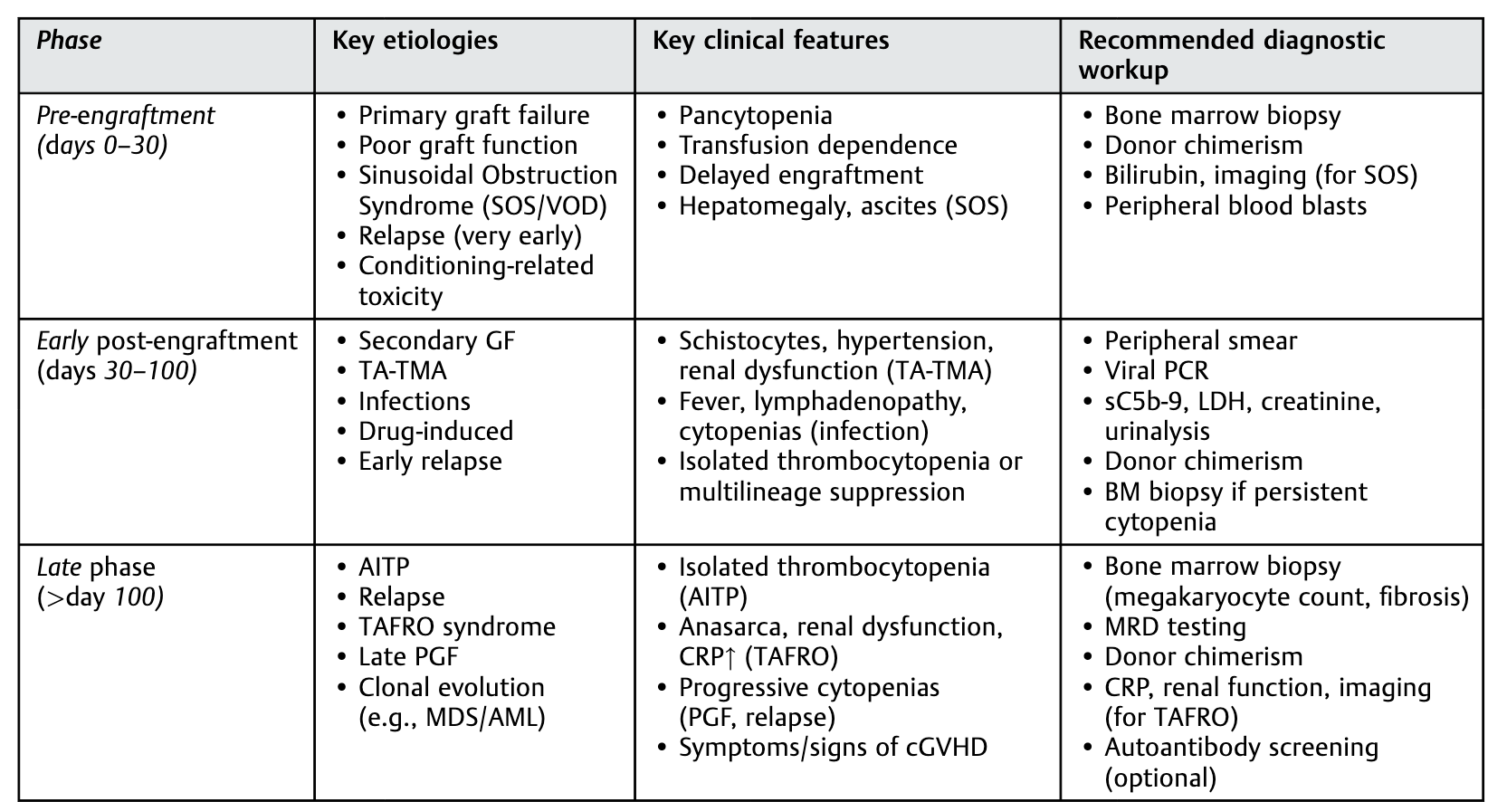
Platelet Transfusions in SCT
Kalantari et al 2026

Slide 23
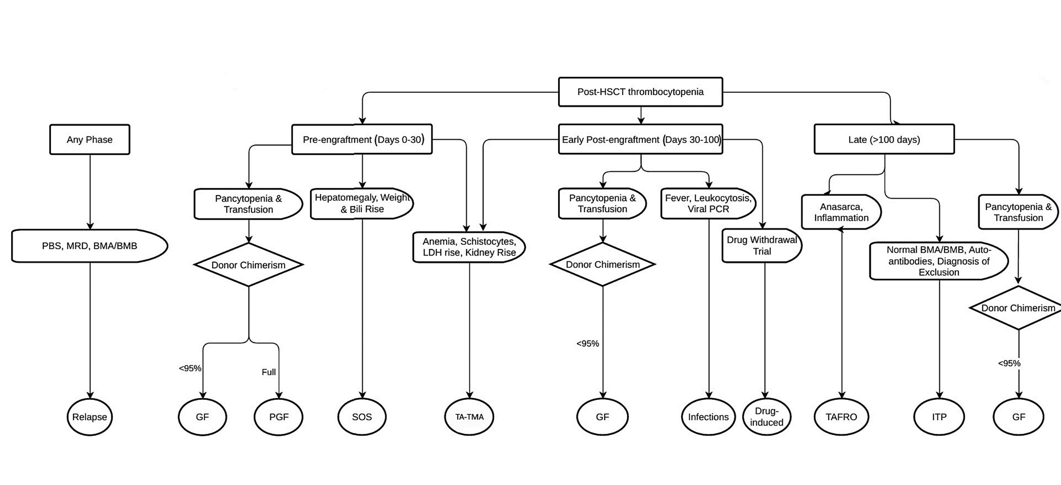
Platelet Transfusions in SCT
Kalantari et al 2026
Notes:
Fig. 3 Diagnostic approach to post-HSCT thrombocytopenia based on posttransplant phase. This unified algorithm applies to both pediatric and adult patients. GVHD is not directly listed in the algorithm
but may underlie both immune-mediated thrombocytopenia (e.g., post-HSCT ITP) and consumptive mechanisms (e.g., TA-TMA or marrow involvement), depending on the clinical context. BMA, bone
marrow aspiration; BMB, bone marrow biopsy; GF, graft failure; ITP, immune thrombocytopenic purpura; LDH, lactate dehydrogenase; MRD, minimal residual disease; PBS, peripheral blood smear; PCR,
polymerase chain reaction; PGF, poor graft function; SOS, sinusoidal obstruction syndrome; TAFRO, thrombocytopenia, anasarca, fever, reticulin fibrosis, renal dysfunction, organomegaly; TA-TMA,
transplant-associated thrombotic microangiopathy

Slide 24
Therapeutic Transfusion
Active life-threatening bleeding
Transfuse regardless of count to achieve hemostasis
Combine with:
Local hemostasis
Correction of coagulopathy
RBC transfusion as needed

Slide 25
Therapeutic Transfusions: An Approach
Therapeutic threshold of <50 ×10⁹/L
Safe
Reduces transfusion exposure
For high-risk anatomical sites (CNS or Neurosurgical procedures) <100×10⁹/L
In DIC or other high-risk bleeding cases 30-50×10⁹/L
Liberal transfusion:
↑ alloimmunization
↑ transfusion reactions
No bleeding benefit
Reversal of any bleeding agents

Slide 26
Functional Thrombocytopenia
Definition
Platelet dysfunction despite adequate or low platelet count
Key concept
Transfused platelets may also become dysfunctional

Slide 27
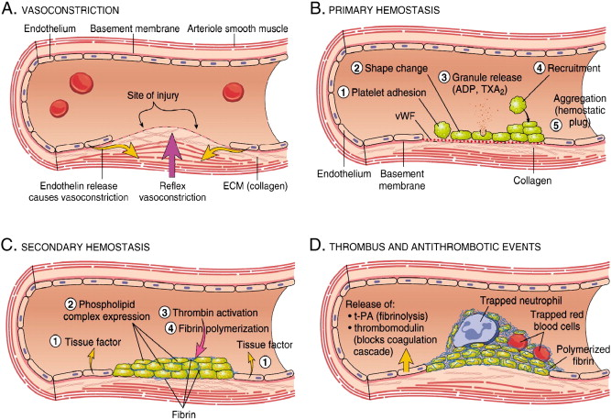
Why Platelet Count Misleads
Normal count ≠ effective hemostasis
Bleeding risk depends on:
Platelet adhesion
Aggregation
Secretion

Slide 28
Common Causes
Uremia
Liver disease
Sepsis
Cardiopulmonary bypass / ECMO
Antiplatelet drugs (aspirin, P2Y12 inhibitors)
Inherited platelet function disorders

Slide 29
When Platelet Transfusion MAY Help
Life-threatening bleeding
Urgent invasive procedure
Drug-induced platelet dysfunction
Severe thrombocytopenia with functional impairment

Slide 30
When Platelet Transfusion Often Fails
Uremia
Sepsis
DIC
ECMO
Reason
Rapid platelet consumption or dysfunction

Slide 31
ICH with normal platelet count but dysfunctional platelets
PATCH Trial: Platelet transfusions in patients with ICH with normal platelet counts led to worse functional outomes and increased death.
Meta-analysis by Lin et al confirmed that platelet transfusions do not improve outocmes or decrease mortality
AABB 2025:Recommend against platelet transfusions in non-operative ICH patients with normal platelet counts even if on an anti-platelet therapy

Slide 32
Risks of Platelet Transfusion
Febrile reactions
Allergic reactions
TRALI
TACO
Infection transmission
Thrombosis

Slide 33
Adjunctive Therapies
DDAVP (uremia, liver disease)
Antifibrinolytics (TXA)
Dialysis (uremia)
TPO-mimetics—delayed onset of action
Correct to improve platelet function:
Hypocalcemia
Acidosis
Hypothermia
Coagulopathy

Slide 34
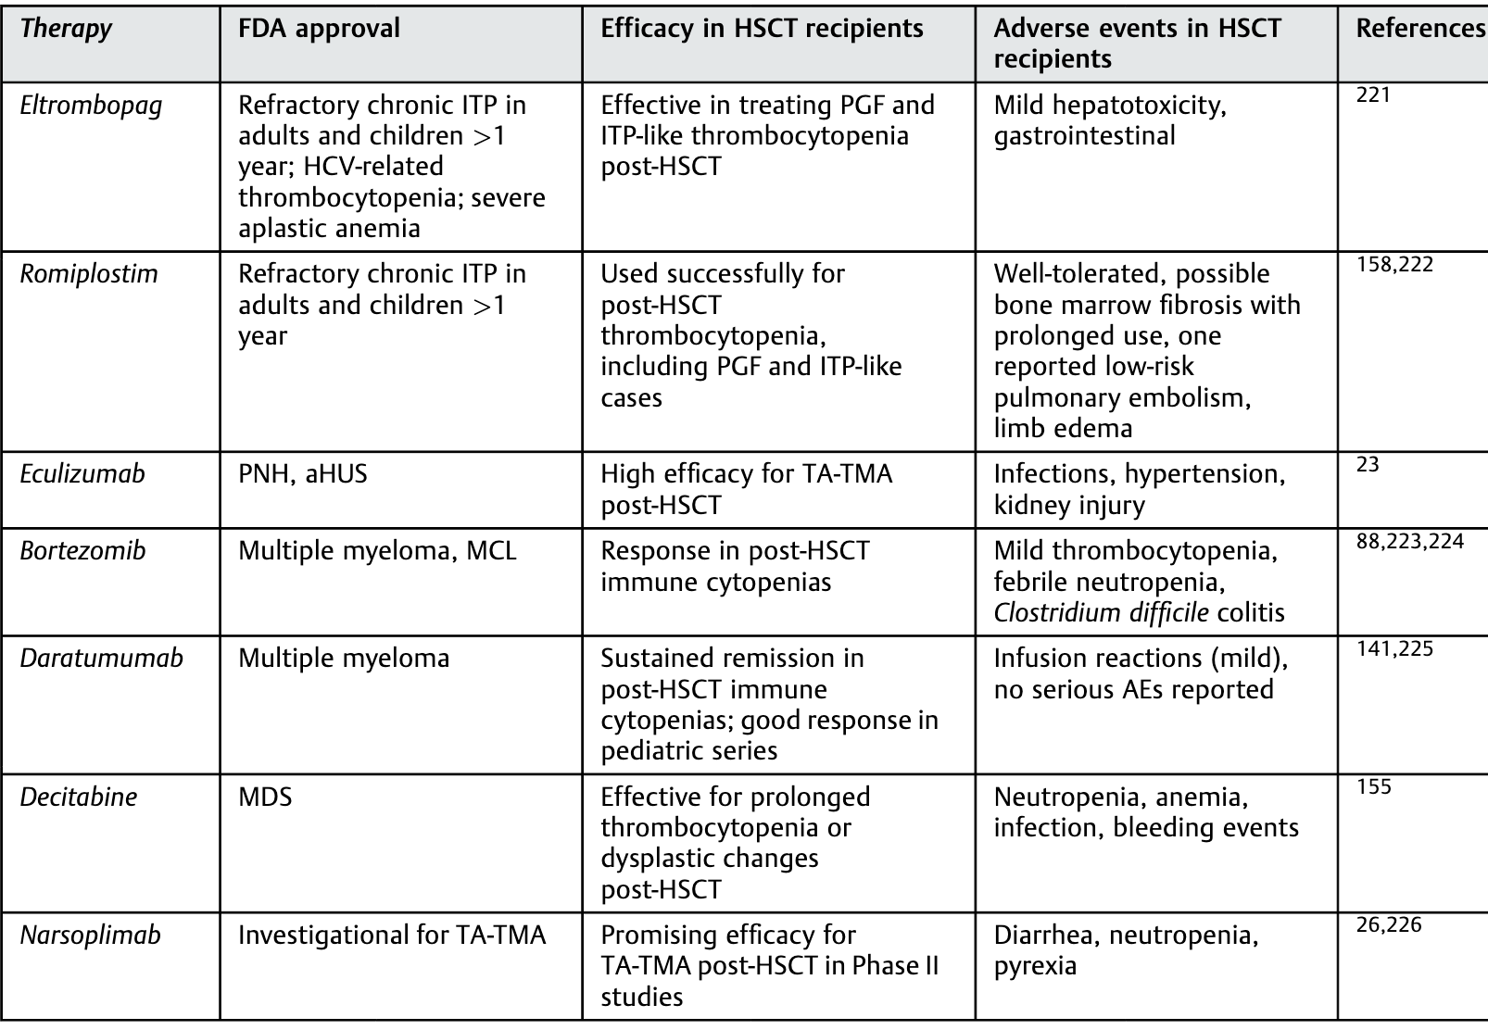
Management in SCT patients
Kalantari et al 2026

Slide 35
Platelet Refractoriness
Poor post-transfusion increment
Corrected Count Increment of less than 5×10⁹/L at one hour post-transfusion on two occassions
Causes
Non-immune (sepsis, splenomegaly, fever, bleeding)
Immune (HLA antibodies)
Management
Address underlying cause
HLA-matched platelets if immune

Slide 36
Clinical Decision Framework
Ask:
Is thrombocytopenia quantitative or functional?
Is the patient bleeding or at high risk?
Will transfused platelets be functional?
Are adjunctive therapies more effective?

Slide 37
Treat the Patient, Not the Number
Platelet count is a guide only
Context matters:
Diagnosis
Bleeding risk
Transfusion risks

Slide 38
Key Take-Home Messages
Hypo-proliferative thrombocytopenia → transfusion often effective
Functional thrombocytopenia → benefit is context-dependent
Platelet transfusion is not benign
Use evidence-based thresholds and individualized assessment

