Slide 1
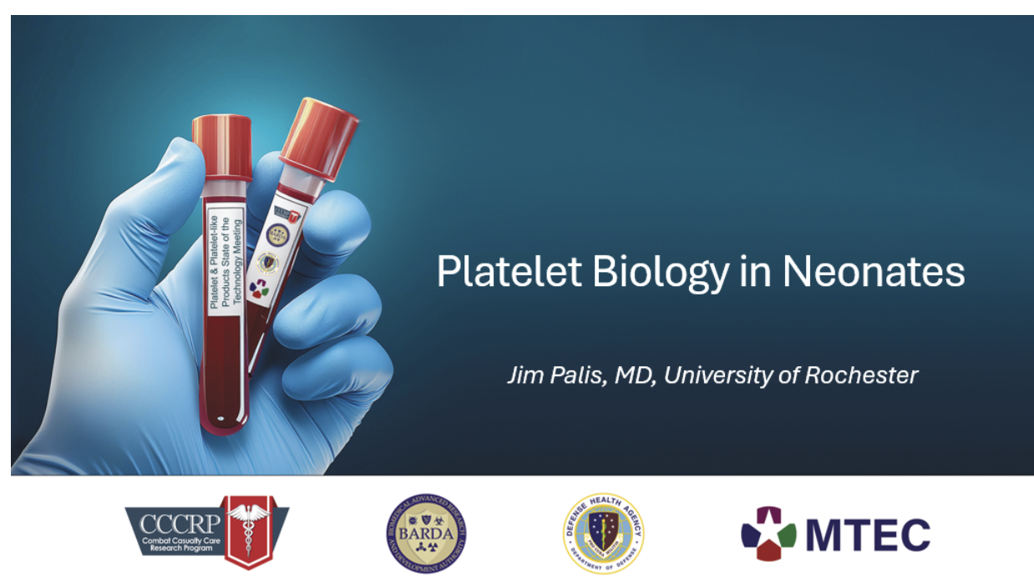

Slide 2
Outline
1. Ontogeny of the megakaryocyte (MK) lineage
2. Characteristics of embryonic/fetal Mks and platelets
3. Neonatal MKs and platelets
4. Why we care…..

Slide 3
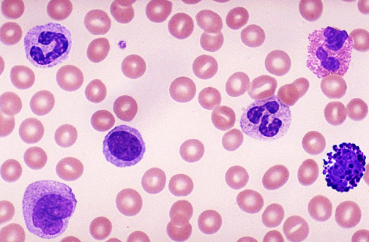
Hematopoiesis in the adult
HSC
dogma: all blood cells come from HSCs
MKP
progenitors
MEP
LMPP
mature blood cells
MK
Ery
NK
platelets
RBCs
gran
B-cells
NK
mono
T-cells
(Pellin, Nat Comm 2019)

Slide 4
1
What is the developmental origin of the Mk lineage?

Slide 5
Hematopoiesis shifts in embryonic
time and space
yolk
sac
liver
marrow
100
50
0
0
3
6
Birth
Time (months)

Slide 6
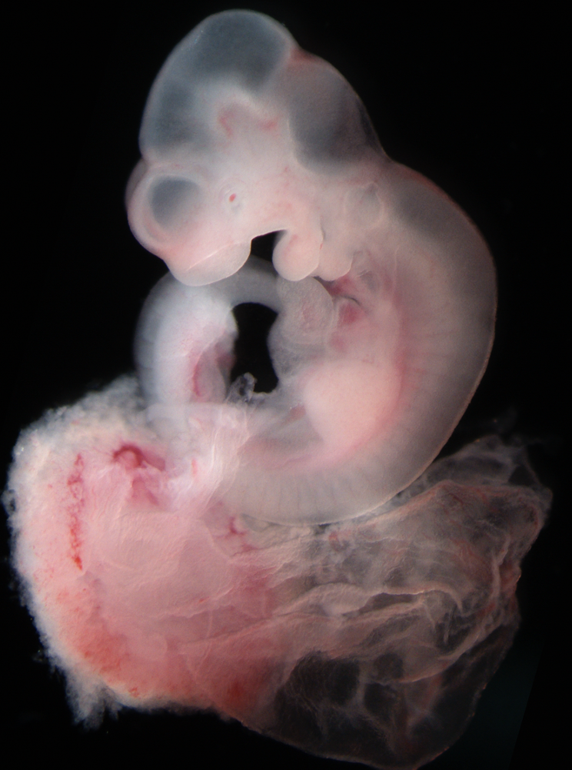
The mouse conceptus serves as a useful model of mammalian development
yolk sac
placenta
yolk
sac
fetal liver
bone marrow

Slide 7
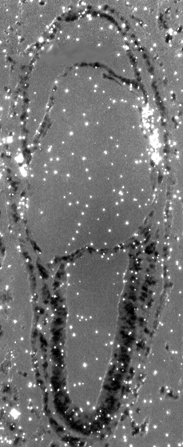
Mk progenitors first emerge in the yolk sac soon after gastrulation
βH1-globin
E9.5
Mk-CFC 9±1
EryP-CFC 75±6
Mac-CFC 3±1
BFU-E 0
HPP-CFC 0
yolk
sac
embryo
proper
no CFC
E7.5
(Palis, Dev 1999; Palis, PNAS 2001; Tober, Blood 2007)

Slide 8
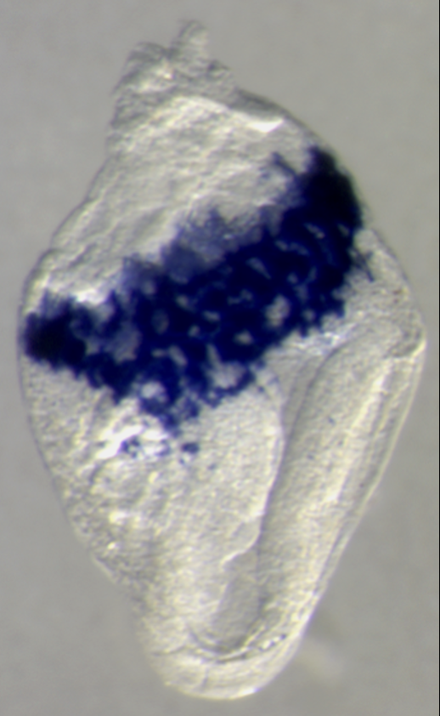
Definitive erythroid and multipotential progenitors subsequently emerge in the yolk sac
βH1-globin
4 sp
Mk-CFC 132
EryP-CFC 396
Mac-CFC 59
BFU-E 21
HPP-CFC 1
yolk
sac
embryo
proper
No CFC
E8.25
(Palis, Dev 1999; Palis, PNAS 2001; Tober, Blood 2007)

Slide 9
Two waves of hematopoietic progenitors emerge in the yolk sac before HSCs
Erythro-myeloid
Progenitors (EMP)
500
Primitive
400
BFU-E
Mk
EryP-CFC
Mk
Mac
300
Erythroid progenitors
per yolk sac
Mac
GM
200
Mast
NK
100
HPP
*
0
6.5
7.5
8.5
9.5
10.5
11.5
Days of mouse gestation
(Palis, Dev 1999; Palis, PNAS 2001; Tober, Blood 2007; Dege, Dev Cell 2020)
Notes:
Erythro-myeloid progenitors (Bertrand, et al)

Slide 10
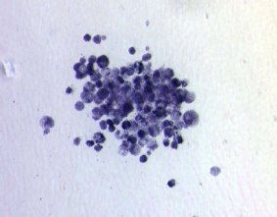
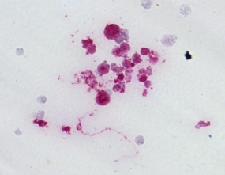
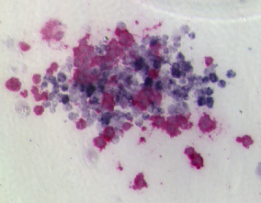
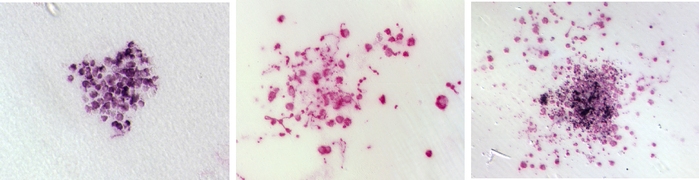
In both waves, the Mk and erythroid lineages emerge from common bipotential MEPs
Erythroid
Mk
MEP
Primitive
(E7.5-8)
βH1-globin
40x
GP1bβ
40x
βH1/GP1bβ
40x
EMP
(E9-11.5)
Ter119
40x
GP1bβ
20x
Ter119/GP1bβ
10x
(Tober, Blood 2007)
Notes:
Double staining permitted the identification of double+ colonies, c/w their cell of origin being a bipotential MEP.

Slide 11
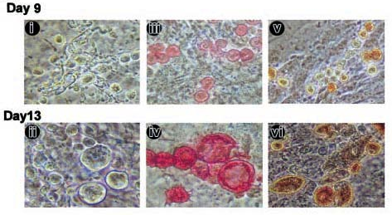
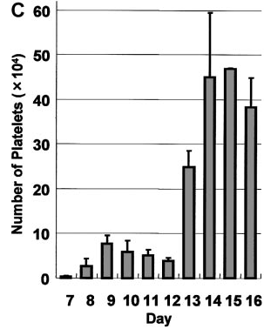
Two waves of Mks and platelet-like cells emerge from differentiating mESCs
“Mks”
“Platelets”
phase CD41 AChE
(Fujimoto, Blood 2003)

Slide 12
Mk progenitors transition from yolk sac -> bloodstream -> fetal liver
Yolk sac
Bloodstream
Embryo proper
Liver
Mk-CFC per tissue
stage
time
E9.0 E9.5 E10.5 E11.5
(Tober, Blood 2007)

Slide 13
HSC emerge
at E10.5
in the mouse embryo
embryo
proper
Transplantation studies into adult mice
AGM
EHT
1-2
HSC
placenta
yolk sac
(Muller, Immunity 1994; de Bruijn, EMBO J 2000)

Slide 14
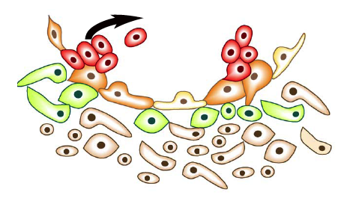
HSCs emerge at E10.5 from the aorta
(endothelial to hematopoietic transition, EHT)
vessel lumen
HSC
“hemogenic”
endothelium
endothelium
mesenchyme
(Jeffredo, Exp Hematol 2005)

Slide 15
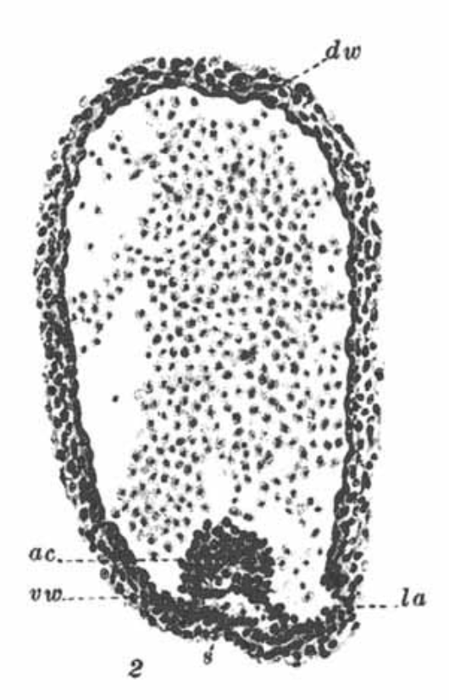
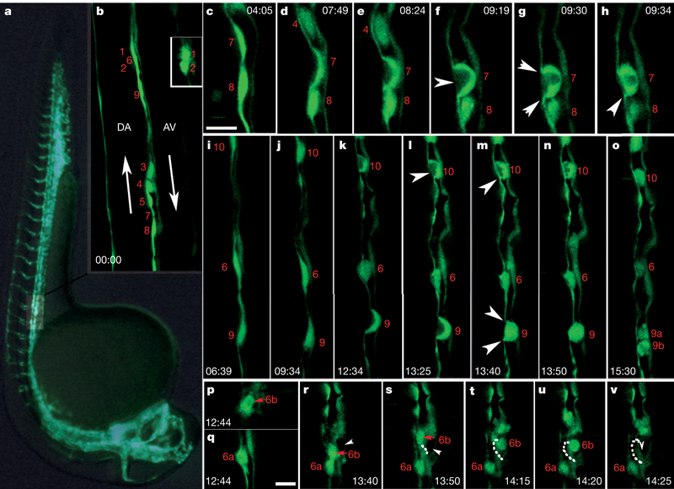
HSC emergence from hemogenic endothelium in the aorta
pig embryo
zebrafish embryo
Time-lapse video
Transient cell clusters provide evidence for the “hemogenic capacity of young endothelium”
(Jordan, Anat Rec 1916 )
(Emmel, Am J Anat 1916 )
(Kissa, Nature 2010)
Notes:
Transplantation studies focused on the ventral endothelium of the aorta as the source of HSCs, it was the same time and place that cell clusters had been seen by Victor Emmel and HE Jordon, who describethe “hemogenic capacity of young endothelium”. In 1916. Jordan went on to say: “the supporter of endothelial hemogenesis is apparently helpless, even with a complete series of drawings, at the hands of the dissenter.”
Seeing is believing

Slide 16
Summary 1: Mks arise from 3 distinct but overlapping sources during development
AGM
yolk
sac
HSC
BM
HE
HSC
EMP
Primitive
HE
liver
HA
circulation
7.5
8.5
9.5
10.5
11.5
12.5
14.5
16.5
Birth
Adult
Embryonic day (murine embryo)

Slide 17
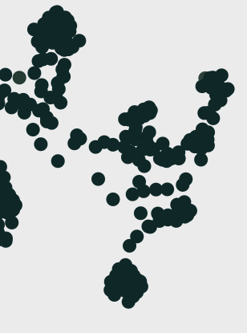
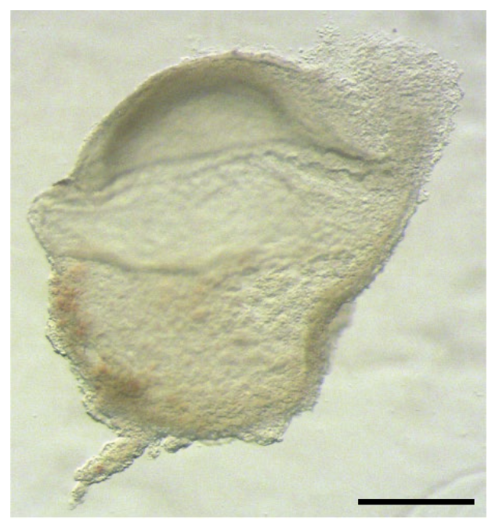
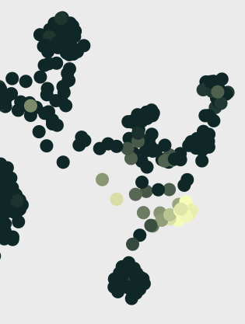
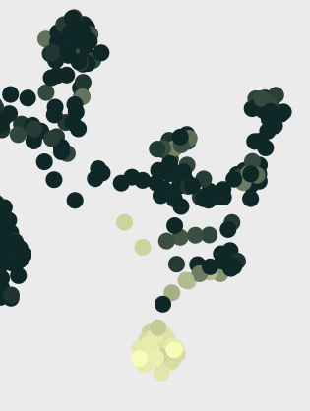
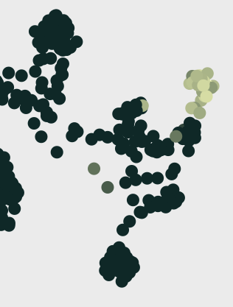
Primitive hematopoiesis in a human 16-19 d. human embryo
Mac
Mk
EryP
yolk sac
(human-gastrula.net)
PF4
HBZ
IRF8
(Tyser, Nature 2021)

Slide 18
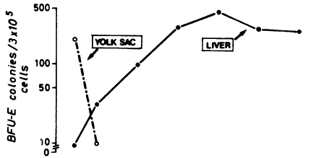

Definitive erythroid progenitors emerge in the yolk sac of human embryos before HSCs arise in the aorta (at 5 weeks)
LIVER
HSC
(Migliaccio, JCI 1986)
(Ivanovs, JEM 2011)

Slide 19
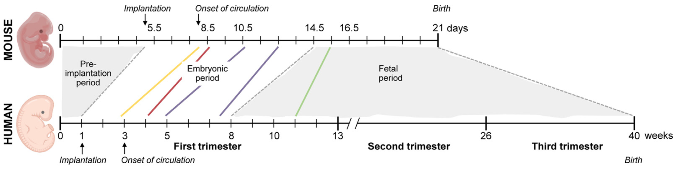
Parallel salient events occur in the mouse and early human conceptus
Initial seeding of the BM
Transplantable HSCs in the fetal liver
HSCs emerge in the aorta
EMP emerge in the yolk sac
Primitive hematopoiesis emerges in yolk sac blood islands
(de Bruijn & Palis, Kaufman’s Atlas of Mouse Development 2025)

Slide 20
2
What are the characteristics of embryonic/fetal Mks and platelets?
Notes:
Shifts in developmental time and space

Slide 21
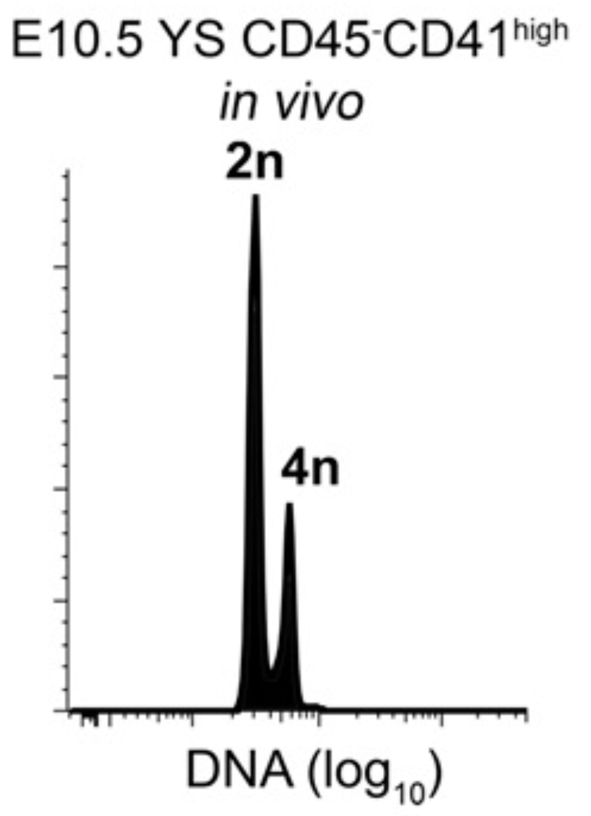
Primary murine Mks are low ploidy
(Potts, Blood 2014)

Slide 22
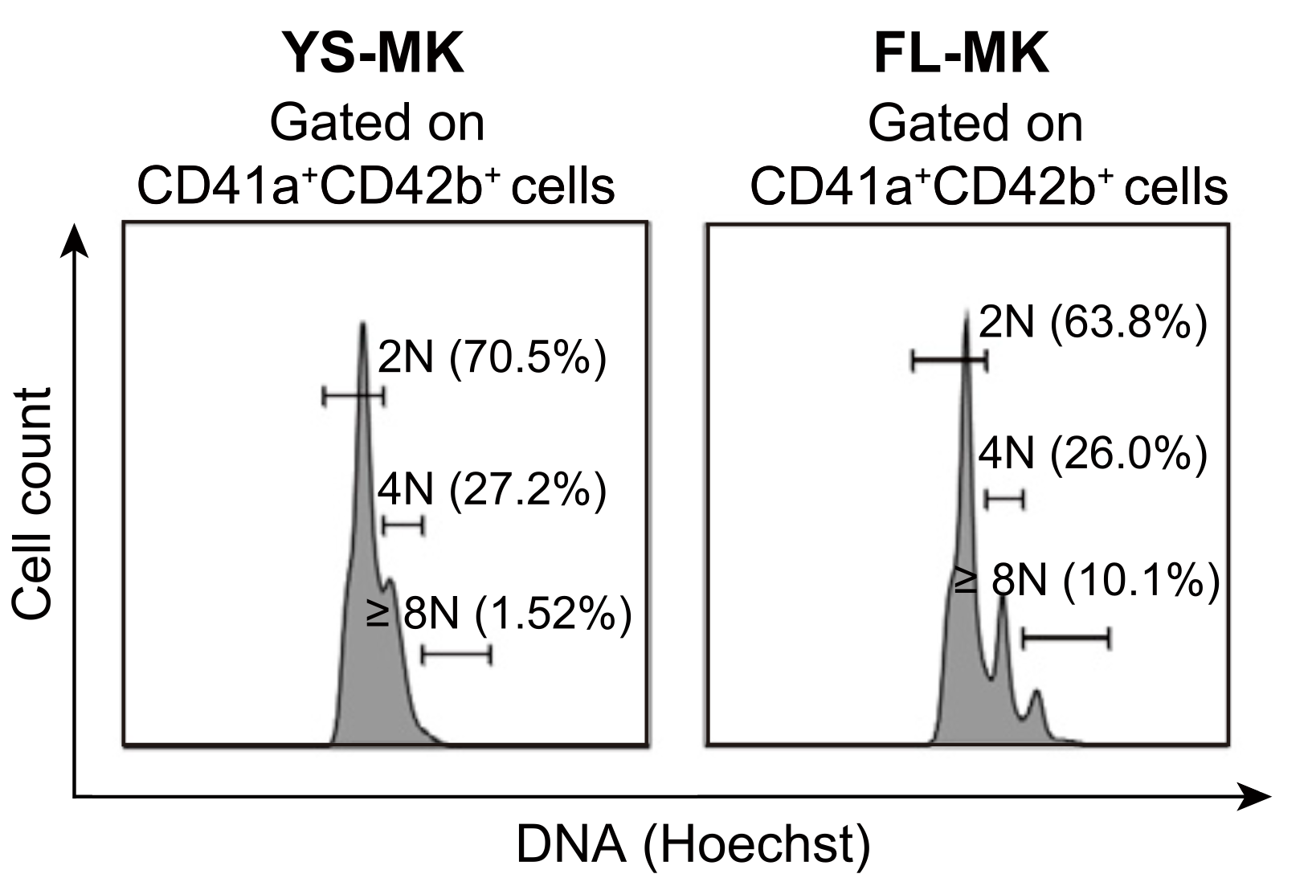
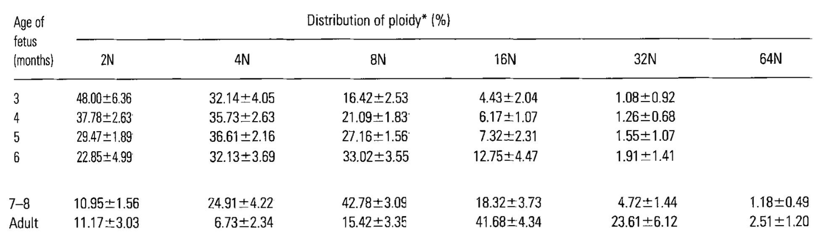
Human embryonic and fetal Mks are low ploidy
4-week
8-week
80%
FL
55%
BM
18%
2N+4N
(Ma, Eur J Haematol 1996)
(Wang, Cell Stem Cell 2021)

Slide 23
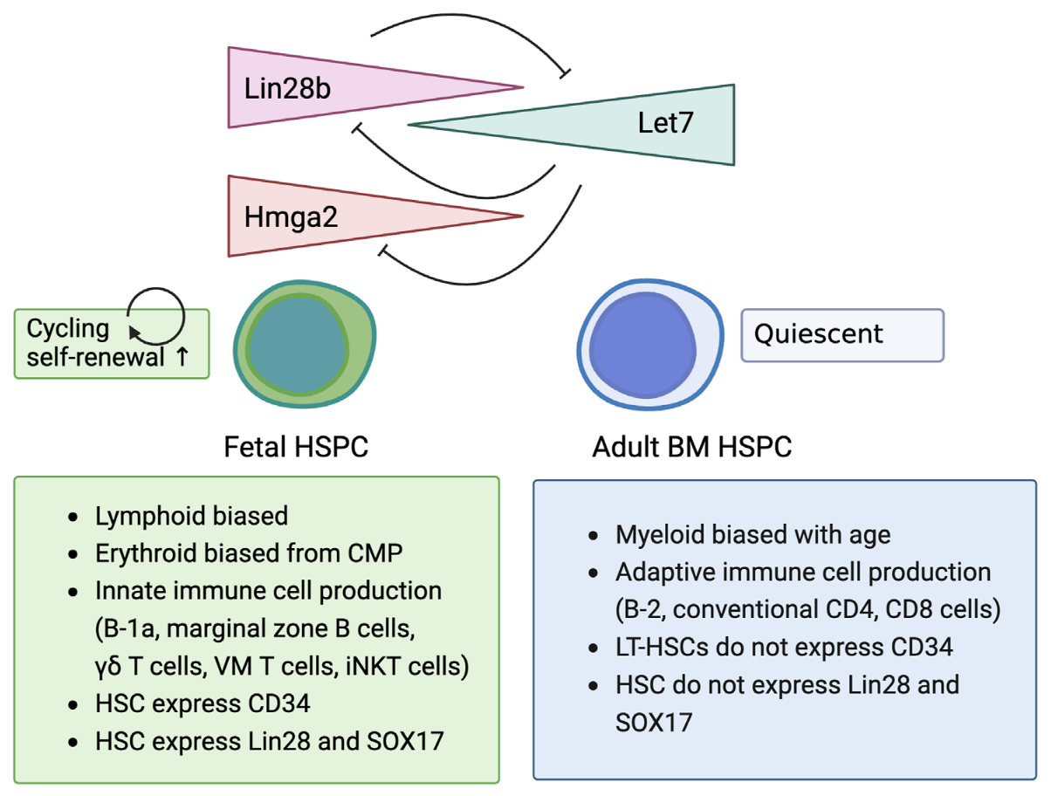
Gene expression differences of fetal- and adult-derived Mks
Fetus /
Neonate
Lin28a/b
Let7 miRNA
Let7 targets
(e.g. Hmga2, Arid3, Igf2bp’s)
adult
phenotype
fetal
phenotype
(reviewed by Cox, Frontiers Cell Dev Biol 2025)

Slide 24
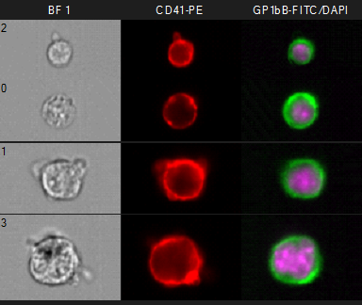
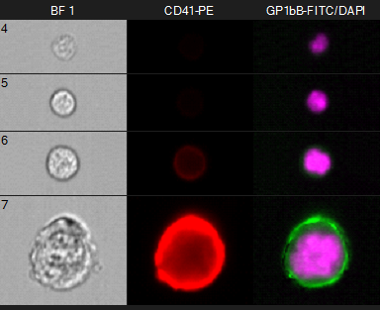
Fetal murine Mks mature at a lower ploidy
E12.5 Fetal Liver
Adult Bone Marrow
BF CD41 GP1bβ/DNA
BF CD41 GP1bβ/DNA
2N
2N
4N
4N
8N
8N
>8N
>8N
(Palis lab, unpublished)

Slide 25
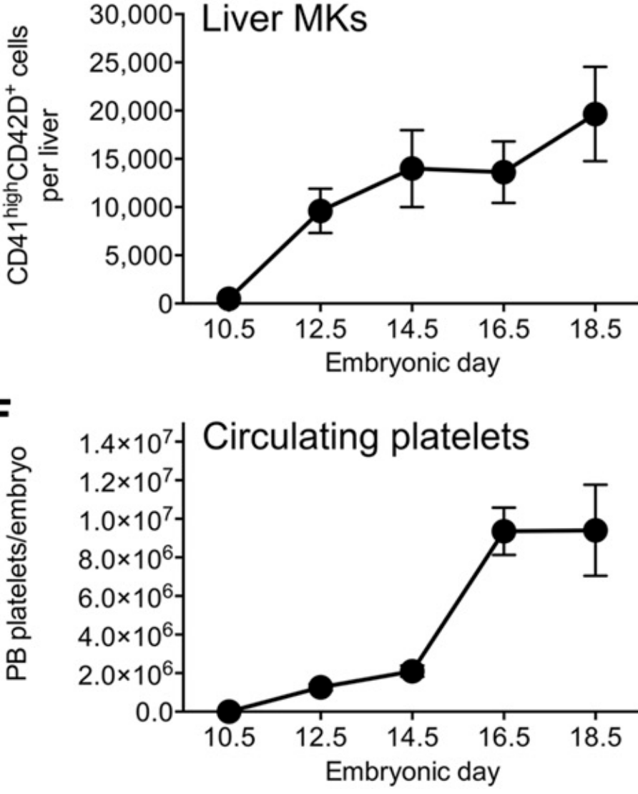
Platelet size decreases and platelet count increases during mouse embryogenesis
12
4.5
10
4.0
8
Mean diameter (μm)
PB platelets/embryo (x10⁶)
6
3.5
4
3.0
2
0
2.5
10.5
11.5
13.5
15.5
NB
Adult
Embryonic day
Embryonic day
(Tober, Blood 2007)
(Potts, Blood 2015)

Slide 26
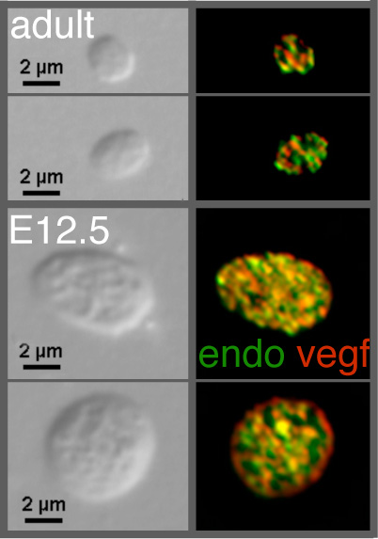
Fetal murine platelets have α-granules containing VEGF and endostatin
4.5
4.0
Mean diameter (μm)
3.5
3.0
2.5
10.5
11.5
13.5
15.5
NB
Adult
Embryonic day
(Tober, Blood 2007)

Slide 27
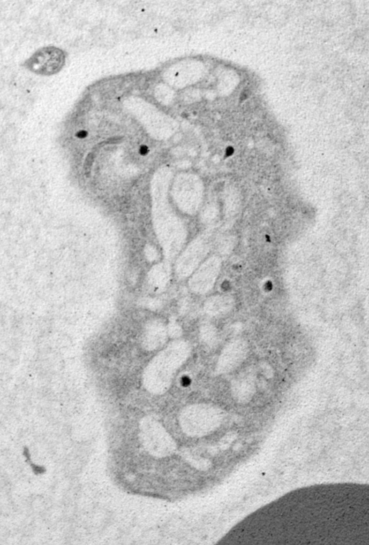
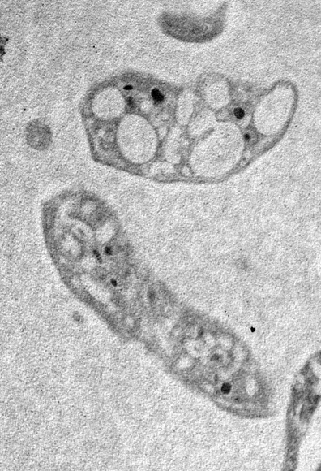
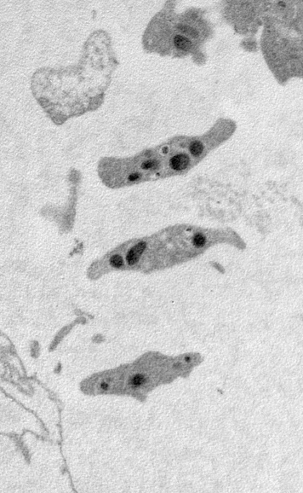
Mouse platelet ultrastructure (EM 10,000x))
E11.5
E15.5
Adult
α
α
α
SCCS
SCCS
(Tober, Blood 2007)

Slide 28
Differences in the transcriptome of
fetal and adult murine platelets
Upregulated in adult platelets
cell morphology
immune-related
cell movement
cancer
cell cycle
cell death/survival
(Palis lab, unpublished)

Slide 29
Summary 2: Characteristics of fetal Mks and platelets (compared to adult)
Fetal Mks
- low ploidy distribution
- can mature even as 2N cells
- Lin28b serves as a master regulator of fetal hematopoiesis, including megakaryopoiesis
Fetal platelets
- large size, with ultrastructural differences
- less immune gene expression
- functional properties are poorly understood

Slide 30
3
Do neonatal Mks and platelets
differ from their adult counterparts?

Slide 31
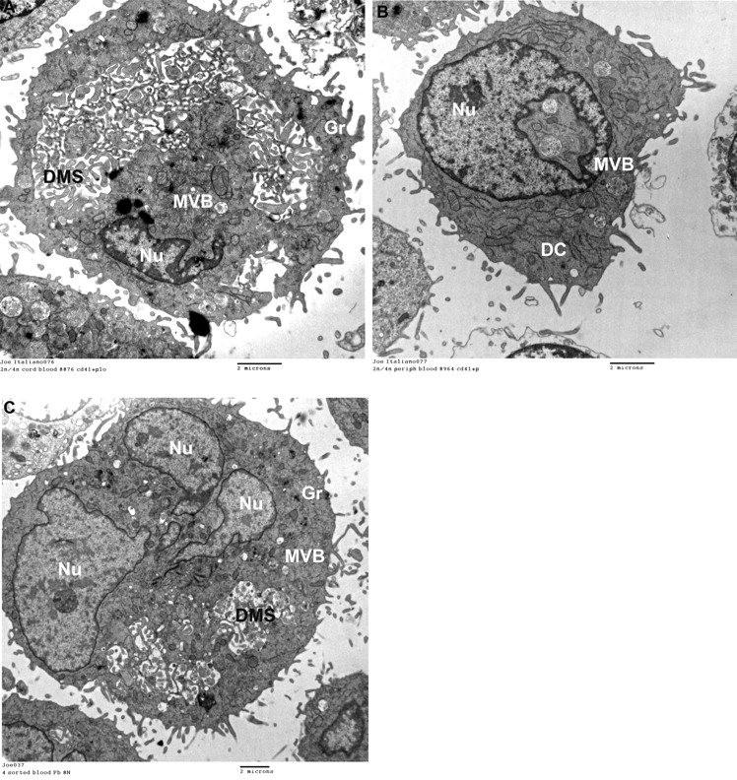
Cytoplasmic maturation occurs at lower ploidy in human cord blood-derived Mks
2N/4N CB-derived
2N/4N Adult-derived
8N Adult-derived
Cord blood CD34-derived Mks have lower ploidy, are more sensitive to TPO, and generate fewer platelets compared to adult peripheral blood CD34-derived Mks.
(Liu, Blood 2011)

Slide 32
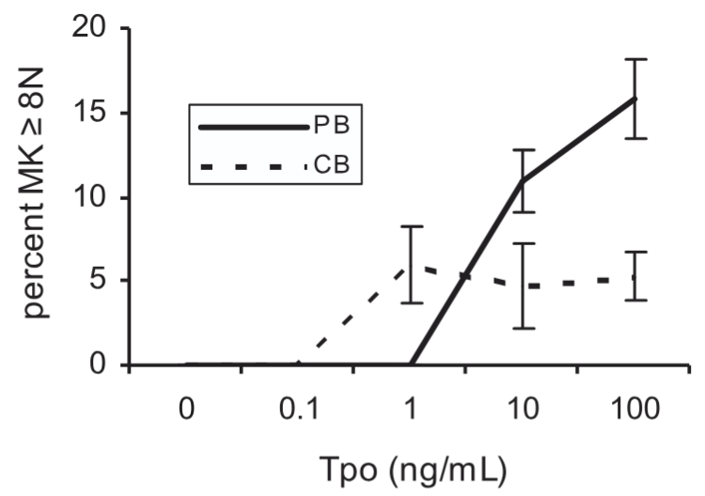
Human CD34 cord blood- and adult-derived Mks differ in TPO responsiveness
Adult (PB)
Neonatal
(CB)
(Pastos, Blood 2006)

Slide 33
Human neonatal platelets are hypo-responsive to multiple agonists
Decreased responsiveness to: | due to:
Epinephrine | decreased a-adrenergic receptor expression
Thrombin | decreased PAR1, PAR4 expression
ADP | impaired GTP signaling
Thromboxane | impaired GTP signaling
Collagen | decreased GPVI expression
Rhodocytin (CLEC2 ligand) | decreased CLEC2 expression
(reviewed in Davenport, RPTH 2022; Ferrer-Marin, Platelets 2022)

Slide 34
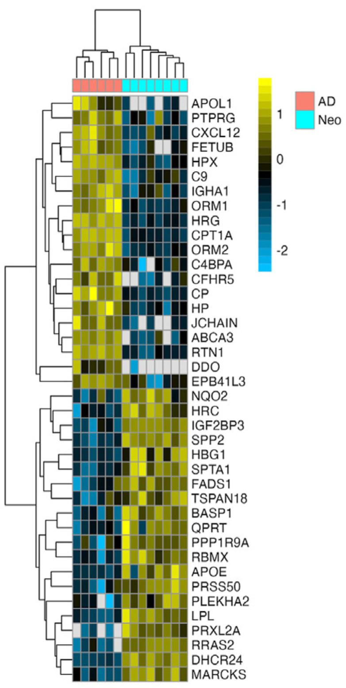
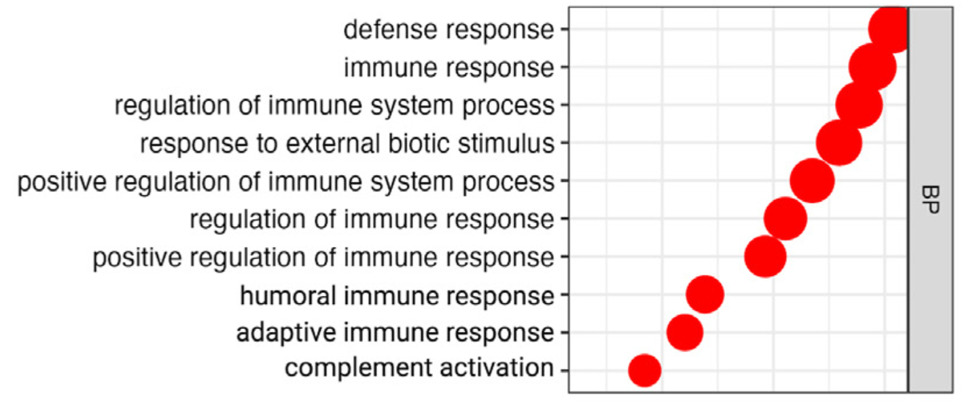
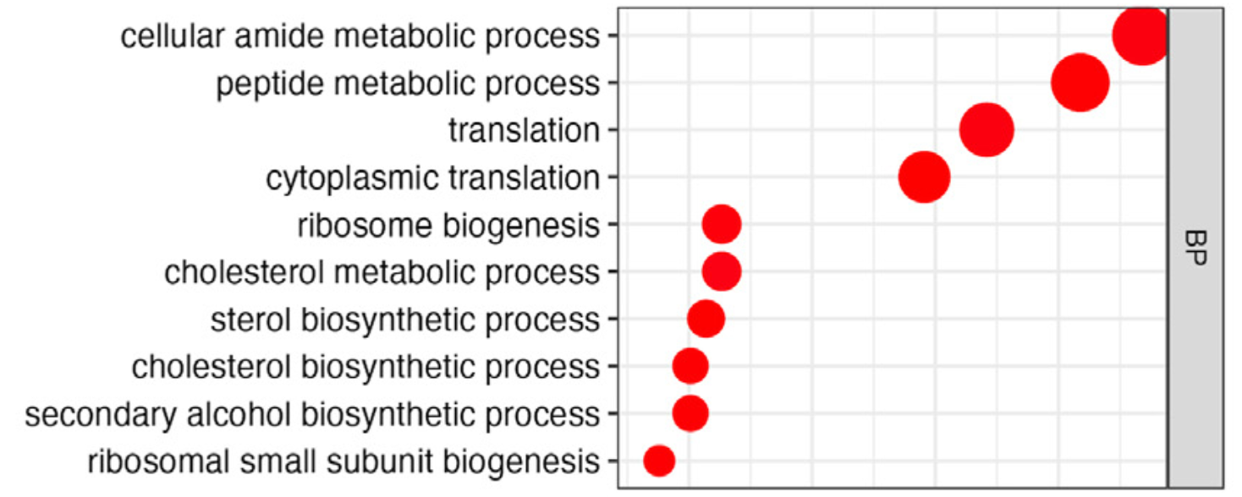
Adult human platelets have a more
immune-responsive proteome
Adult
Platelets
Neonatal
Platelets
(Thom, JTH 2023)

Slide 35
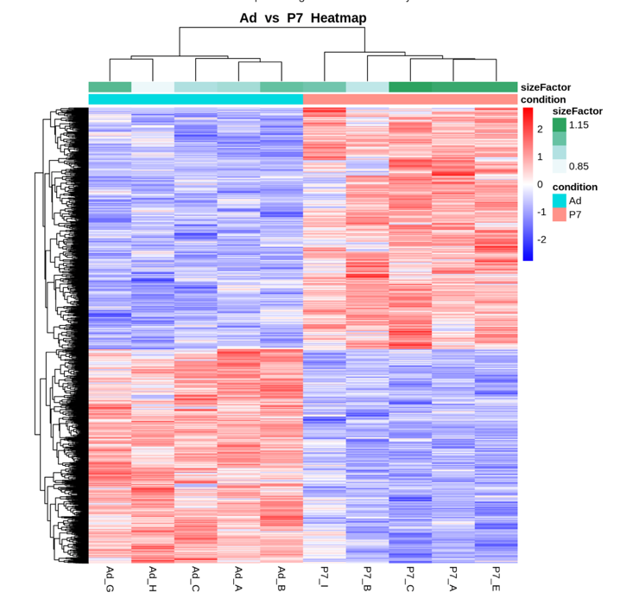
Differences in the transcriptome of
P7 and adult murine platelets
Adult vs P7 platelets Heatmap
Down-regulated in adult platelets
- ribosome biogenesis
- translation
- mitotic cell cycle
Up-regulated in adult platelets
- immune-related genes
- ubiquitin-mediated catabolism
Adult
P7
(Maurya, ATVB 2023)

Slide 36
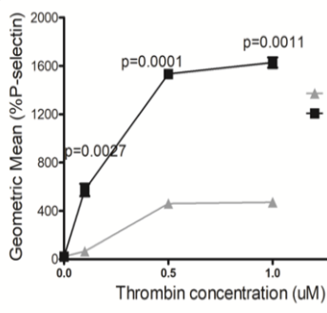
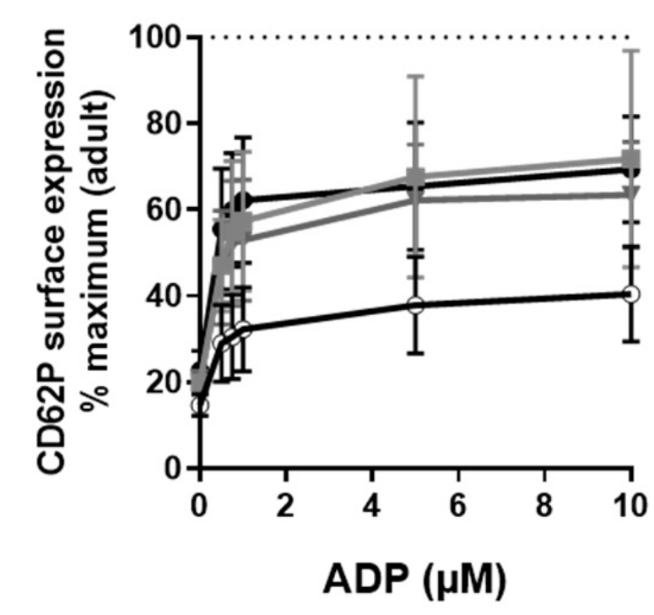
Neonatal human and murine platelets display less P-selectin upon activation
Mouse
Human
Adult
1 mo-5 yrs
11-18 yrs
6-10 yrs
< 1 mo
Neonatal
(Maurya, ATVB 2023)
(Herkin, Int J Mol Sci 2021)

Slide 37
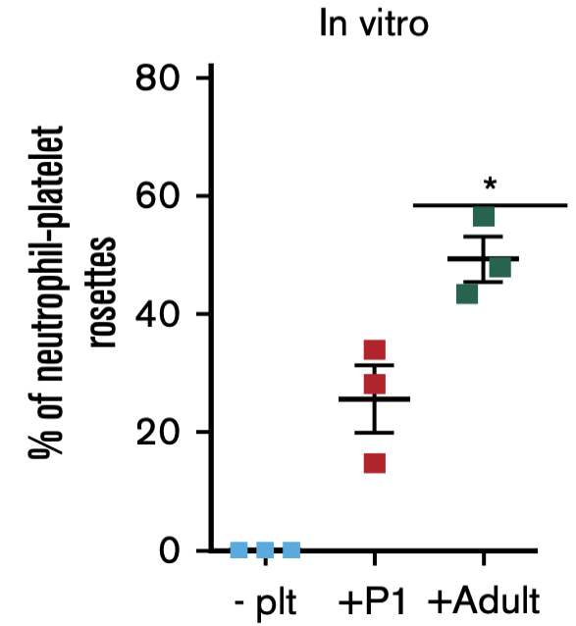
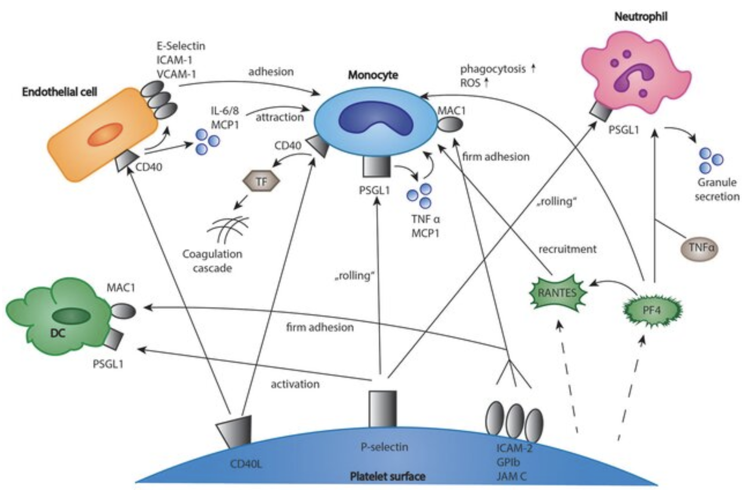
Neonatal murine platelets have reduced platelet-neutrophil interactions
P-selectin – PSGL1
Neutrophil
Monocyte
DC
Platelet
(Eisinger, Frontiers Med 2018)
(Stolla, Blood Adv 2023)

Slide 38
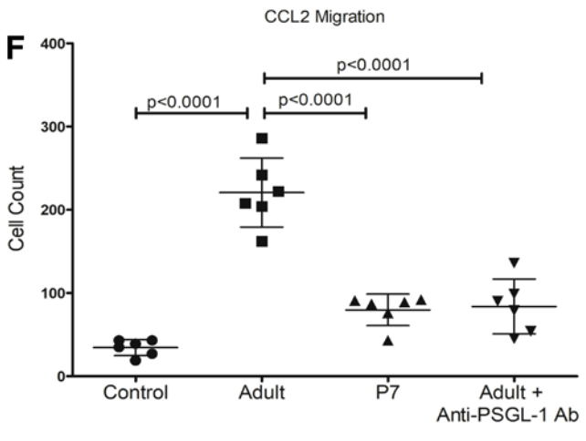
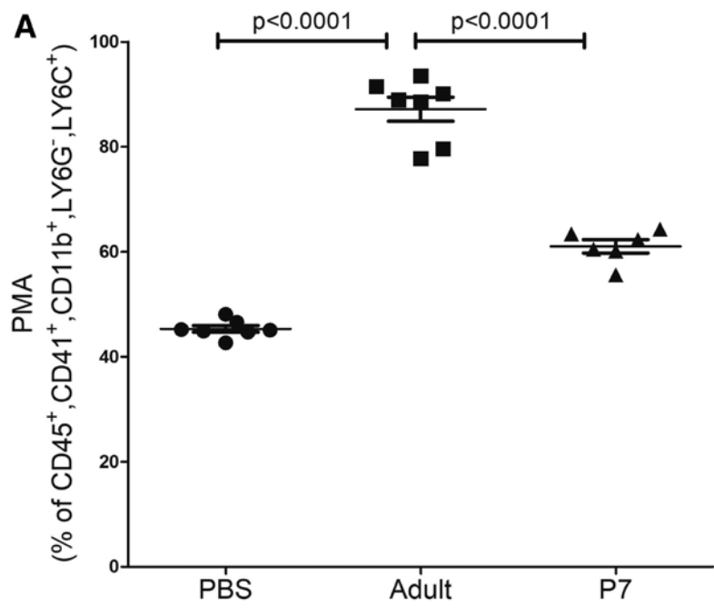
Adult murine platelets induce monocytes to adopt a trafficking phenotype
Platelet-monocyte
aggregates
Transwell migration assays
neonatal or
adult platelets
monocytes
CCL2
Control
Adult
P7
Control
Adult
P7
Adult +
anti-PSGL
ab
(Maurya, ATVB 2023)

Slide 39
Summary 3: Differences in neonatal vs adult Mks and platelets
Neonatal MKs
- lower ploidy distribution
- can mature even as 2N cells
- more sensitive to TPO
Neonatal platelets
- hyporeactive in response to multiple agonists
- decreased expression of immunomodulatory genes
- decreased ability to interact with leukocytes
Neonatal hemostasis is normal, since platelet hyporeactivity is balanced by increased circulating vWF. Decreased immune-modulatory activity may facilitate commensal bacterial colonization.

Slide 40
4
Why do we care?
Platelet function(s) during embryonic and fetal life.
Platelet transfusions in thrombocytopenic neonates.
Using iPSCs as a source of platelet-like particles.
Delayed platelet recovery post CB transplantation.
Transient myeloid “leukemia” of Down Syndrome.
Changes in platelet function with aging.

Slide 41
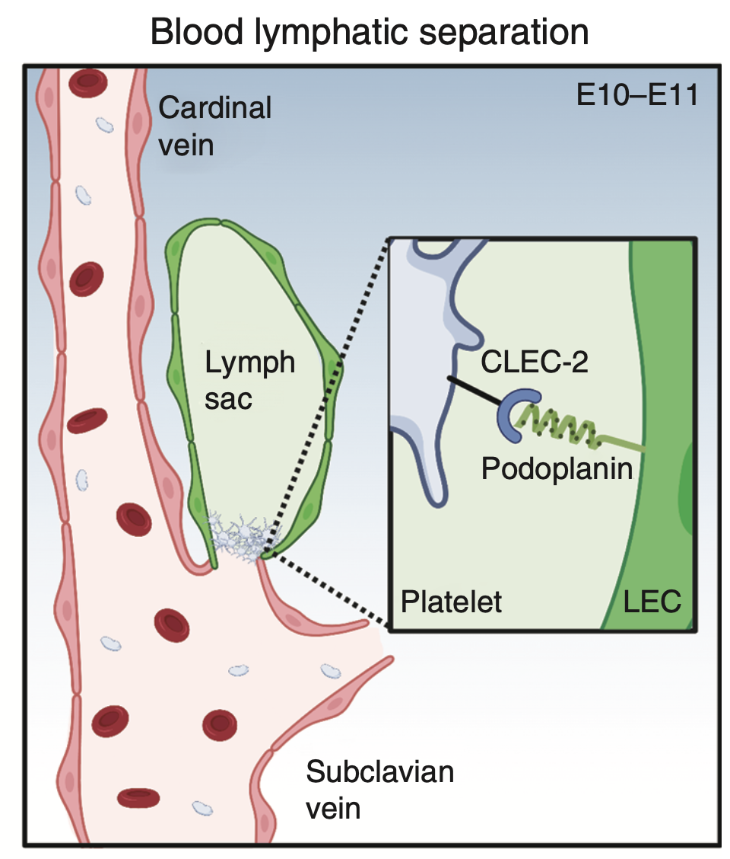
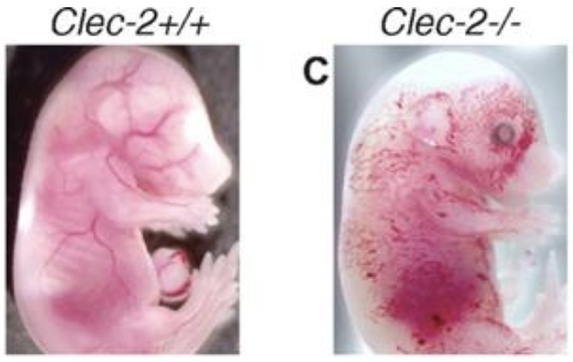
Clec2-expressing embryonic platelets are necessary for lymphangiogenesis
(Bertozzi, Blood 2010)
(Rowath, Cold Spring Harbor Perp Med 2023)

Slide 42
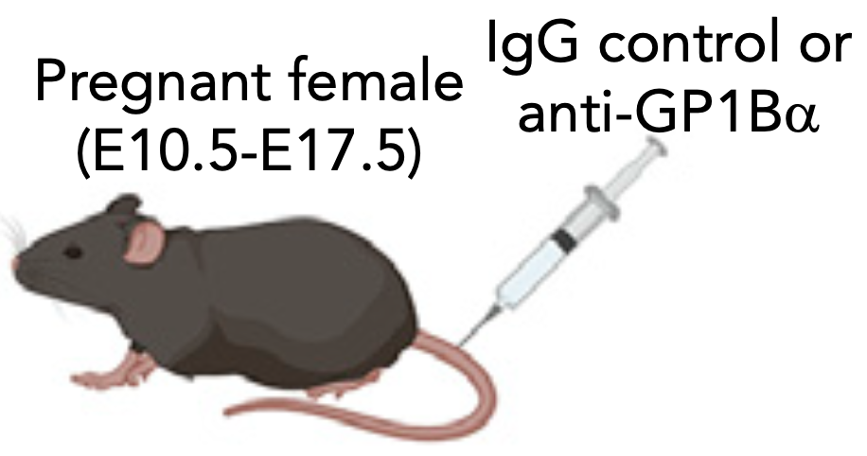
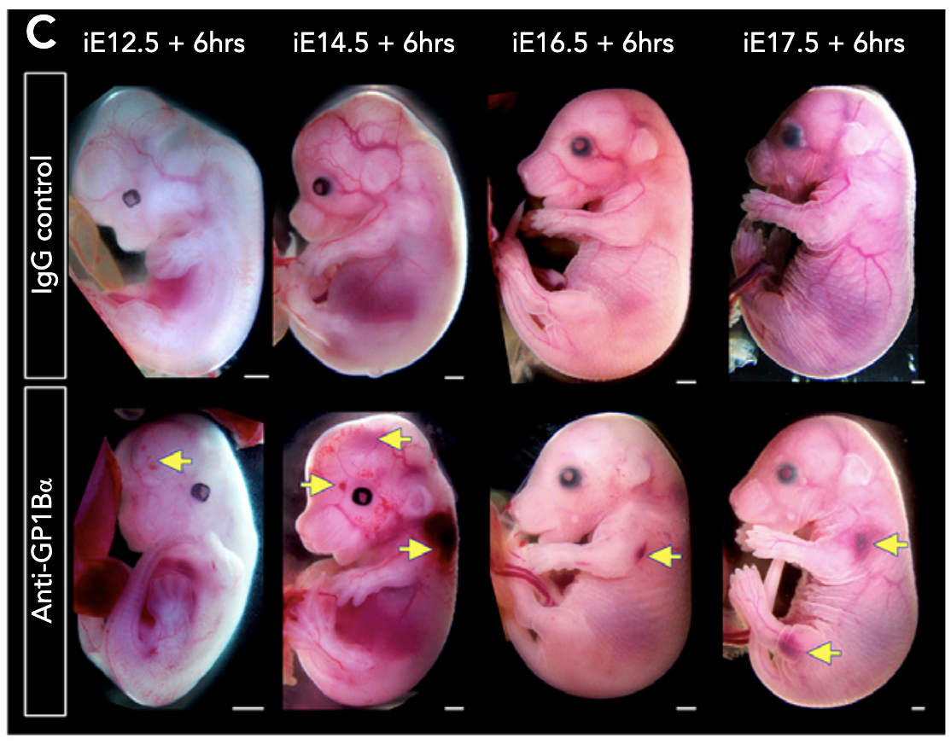
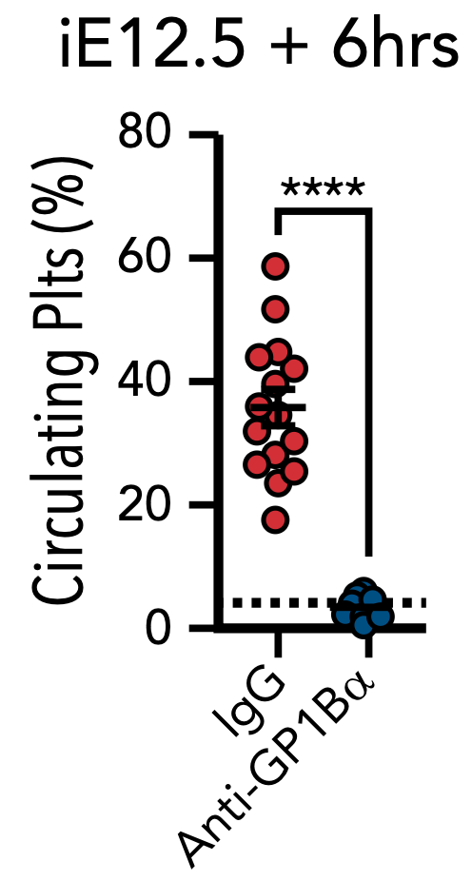
Platelets are necessary to prevent hemorrhage in fetal mice
(Farley, Blood 2010)

Slide 43
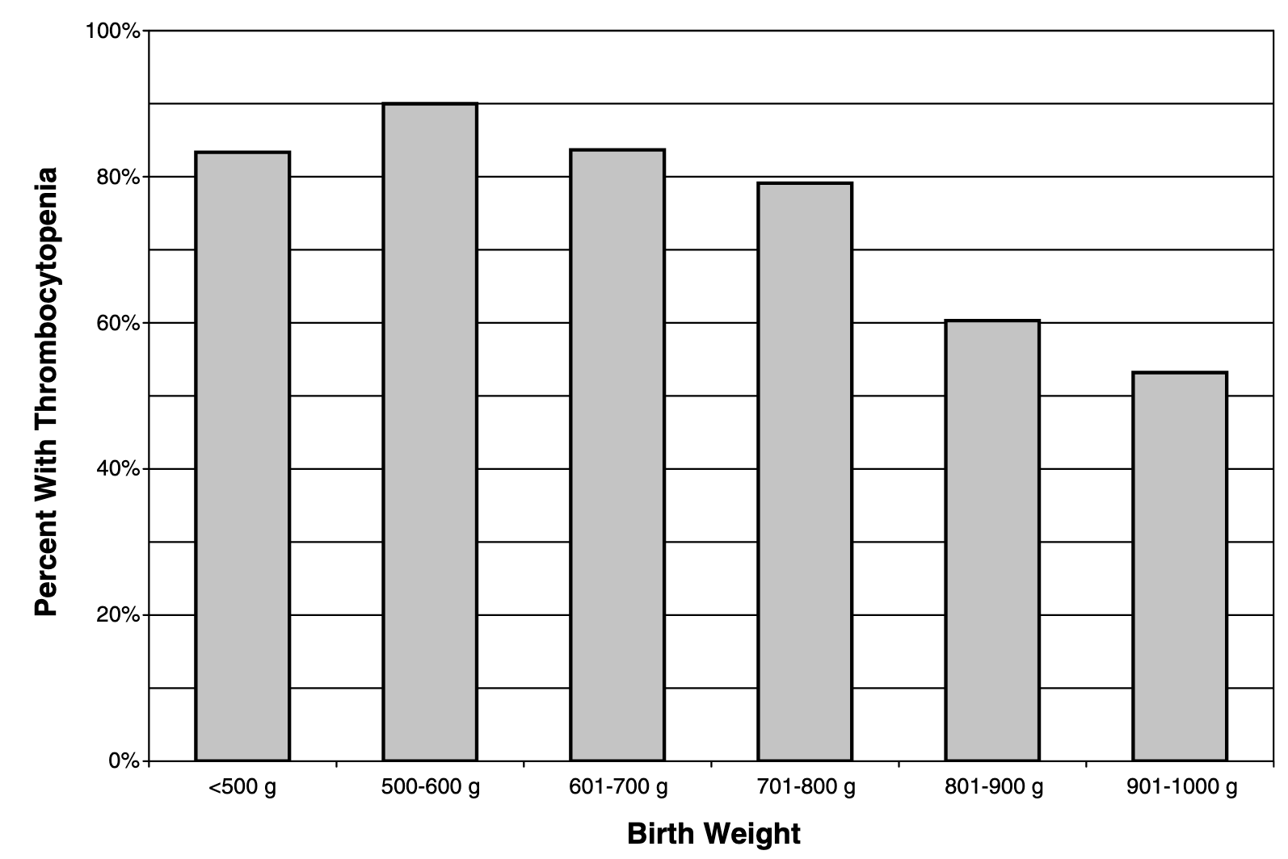
Thrombocytopenia is extremely common in low birthweight neonates
(Christensen, J Perinatol 2006)

Slide 44

Probability of death or adverse neurodevelopmental outcomes in neonates is associated with number of platelet transfusions
(PENUT study)
- 819 extremely premature infants
- outcomes at 2 yrs
(Davenport, JAMA 2024)

Slide 45

Outcomes of neonates randomized to 25,000 (low) vs 50,000 (high) platelets/mm³ threshold for platelet transfusions (PlaNeT-2 Study)
(Curley, NEJM 2019)
day 28 / 36 weeks

Slide 46
It is unclear why the transfusion of adult human platelets into thrombocytopenic neonates is so deleterious.
It is hypothesized that the increased immune gene expression of adult platelets may dysregulate neonatal immunity.

Slide 47


Transfusion of adult, but not neonatal (P7), platelets induces monocyte trafficking in vivo
model
TPOR-null
P14 mice
transfuse with P7 or adult (± anti-PSGL1 ab) platelets
inject CCL2
(CCR2 ligand) IP
evaluate number of monocytes in the peritoneal cavity
Control
Adult
P7
Adult +
anti-PSGL
ab
(Maurya, JCI 2024)

Slide 48

Since platelet transfusions are necessary for thrombocytopenic neonates with active bleeding, requiring surgery, or platelet counts <25,000/mm³ (who are at increased risk of spontaneous bleeding),
are their alternative sources?
(Christensen, Neoreviews 2026)

Slide 49
hES/iPSC differentiation currently recapitulates the first 5 weeks of human ontogeny
neonatal
HSC emergence
(Ng, Nat Biotechnol 2025)
EMP emergence
(Sturgeon, Nat Biotechnol 2014)
Primitive hematopoiesis
(Zambidis, Blood 2005; Kennedy, Blood 2007)
hES/iPSC
(Thompson, Science 1998; Takahashi, Cell 2007)

Slide 50

hPSC-derived developmentally appropriate transfusion products
understanding embryonic and fetal development
HSC
EMP
molecular and cellular
engineering
Primitive
hPSC
Newbornposing.com

Slide 51
Two differentiation pathways from HSC -> Mk
HSC
“Canonical” pathway
(Flk2-dependent)
HSC->MPP->MEP->MkP->Mk
“Alternate” pathway
(Flk2-independent, “Direct”)
HSC->MkP->Mk (?)
- contributes platelets in aged mice, which are more responsive to thrombin
MKP
progenitors
MEP
LMPP
MK
Ery
NK
platelets
RBCs
gran
B-cells
NK
mono
T-cells
(Poscablo, Cell 2025)
(Pellin, Nat Comm 2019)

Slide 52

Acknowledgements
Palis lab
Kathleen McGrath
Paul Kingsley
Anne Koniski
Joanna Tober
Massiel Stolla
Collaborators
Craig Morrell (UR)
Preeti Maurya
Michael Malloy
Martha Sola-Visner (Harvard)
Patti Davenport
Chris Thom (Penn)
George Daley (Harvard)
Funding
NHLBI R01
NIDDK R01
NIAID U19

