Slide 1
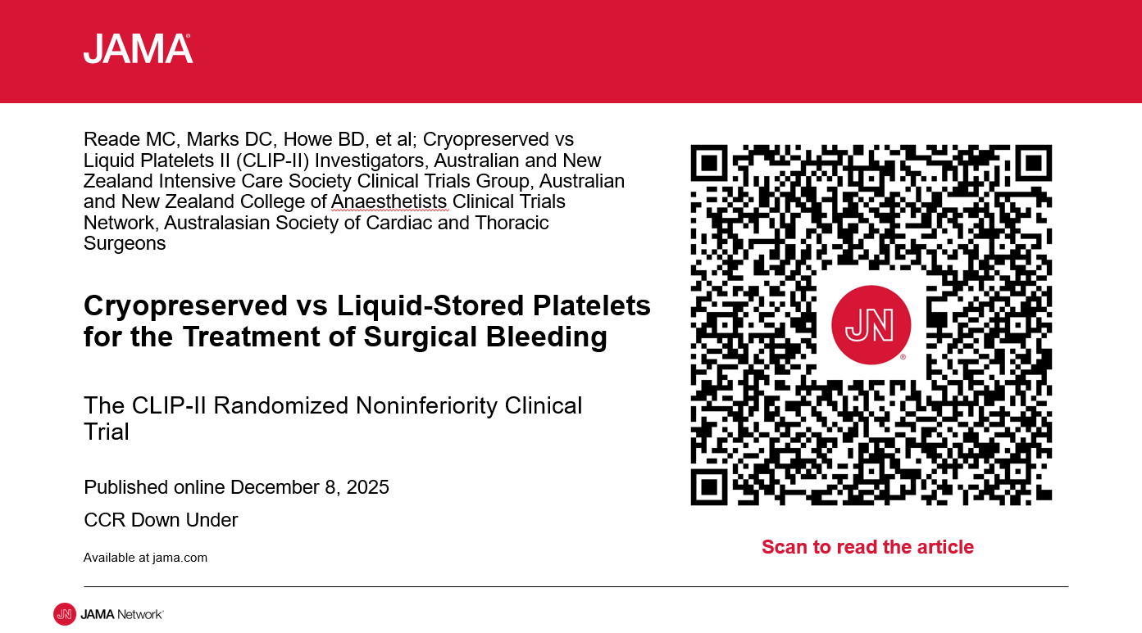



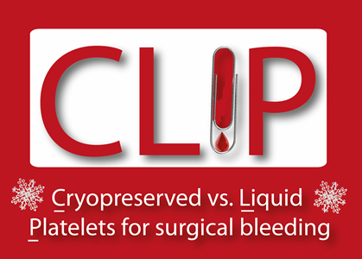
Translational Challenges in Product Development of Platelet and Platelet-like Products: experience of the CLIP-II trial
Michael Reade
Australian Defence Force &
University of Queensland
for the CLIP-II Investigators
Notes:
30 min

Slide 2


Disclosures
CLIP-II trial
Funded by National Health and Medical Research Council (Australia)
Registered as a Collaborative Project in the Five-Eyes Science and Technology Program (TTCP)
Serving officer, Australian Army
Notes:
I have no financial disclosures, but note that this project was supported by the ADF, which is appropriate given our first exposure to frozen platelets was with the Dutch military in Afghanistan.

Slide 3

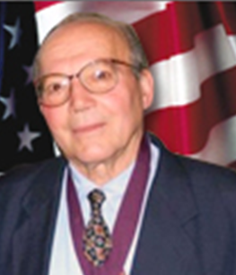
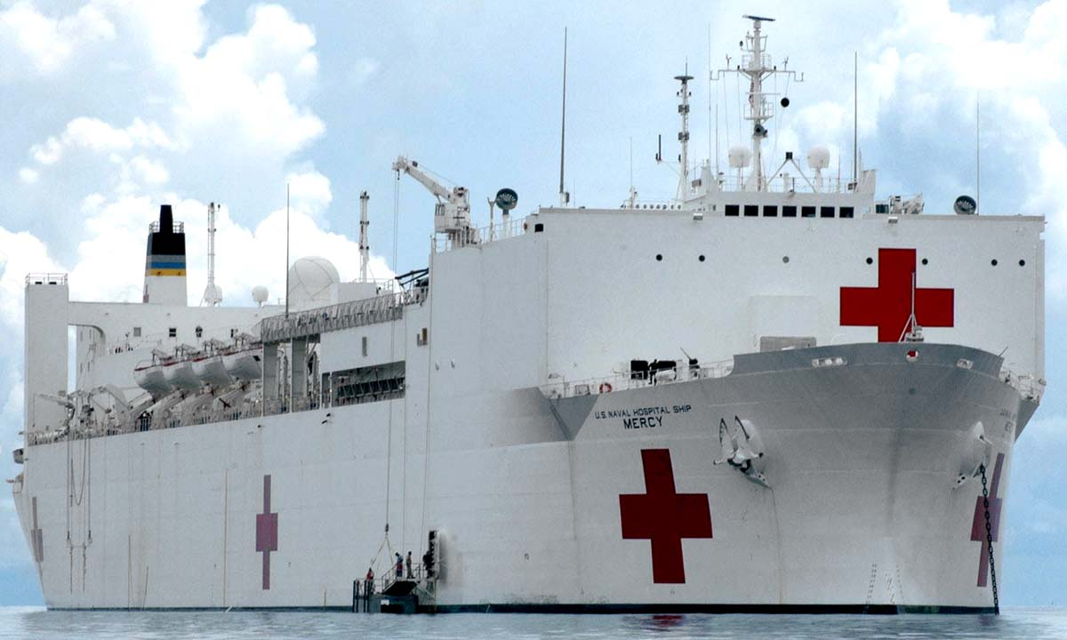
Cryopreserved platelets: origin
US Navy 1970s technology:
Dr Robert Valeri MD FACP
Vale 8 May 2025 aged 93
Several trials leave theoretical risks untested:
Thrombosis
ARDS
Infection
Renal failure
DMSO toxicity
Late bleeding
Notes:
The US Navy addressed the need for platelets on their hospital ships and aircraft carriers in the 1970s, developing a method to freeze at -80C platelets in DMSO as a cryoprotectant. However, this process comes with several theoretical risks, which have never been quantified in a sufficiently large trial. Therefore, cryopreserved platelets are not in common use in most parts of the world – including the US military

Slide 4
CLIP-II: study intervention
Thawed cryopreserved group O apheresis platelets in ABO group-matched plasma
OR
Liquid-stored platelets (usually ABO type-specific, but as per hospital practice)
Up to 3 blinded units of study platelets:
Primary outcome
Notes:
I am not planning to present the results of the CLIP-II trial in detail, but rather use it as an example of the methodological choices that must be made in this sort of trial & the downsides of the (sensible!) choices we made.
In CLIP-II:
Patients could receive up to 3 units of study platelets
Blinding was accomplished by providing the platelets in an opaque shroud
The first unit of study platelets had to be commenced either in OT or in the first 24hr postop, as the primary outcome was bleeding in that first 24hr.
The 2nd and 3rd unit could be given any time up to ICU discharge

Slide 5
Bleeding: difference?
Primary outcome
 | Cryo n | Liquid n | Cryo geo. mean (ml) | Liquid geo. mean (ml) | Ratio | P (1 side t test)
Blood loss in the 1st 24 hr in ICU | 103 | 98 | 605 (532-688) | 535 (480-596) | 1.13 (0.96-1.34) | 0.07
Not significant
Adjusted for patient severity (EuroSCORE II) and hospital site.
597 (531-670) | 543 (482-611) | 1.11 (0.94-1.31) | 0.13
BUT “Absence of evidence does not constitute
evidence of absence”
Notes:
The primary outcome was no different between groups
But in a non-inferiority design, this does not mean they were the same.
Absence of evidence does not constitute evidence of absence of a difference

Slide 6
Non-inferiority trial: possible results
Notes:
A non-inferiority trial can have 5 possible outcomes, as shown

Slide 7
Bleeding: non-inferiority?
Primary outcome
The 95% CI exceeds the 20% non-inferiority limit.
Therefore, cannot conclude cryopreserved platelets are non-inferior to liquid-stored platelets.
Superiority of cryopreserved platelets is still within the range of 95% possibility
Notes:
While the diffs in primary outcome were NS, the more important analysis in a non-inferiority trial is whether the primary outcome could plausibly have been inferior in the intervention group.
So THIS is the most important result slide.
The CI around the point estimate of the primary outcome DID cross the non-inferiority boundary.
Therefore, cannot conclude cryopreserved platelets are non-inferior to liquid-stored platelets.
Superiority of cryopreserved platelets is still within the range of 95% possibility

Slide 8
However….
Notes:
So, might be a little inferior, but not by much (best estimate 13% inferior)

Slide 9
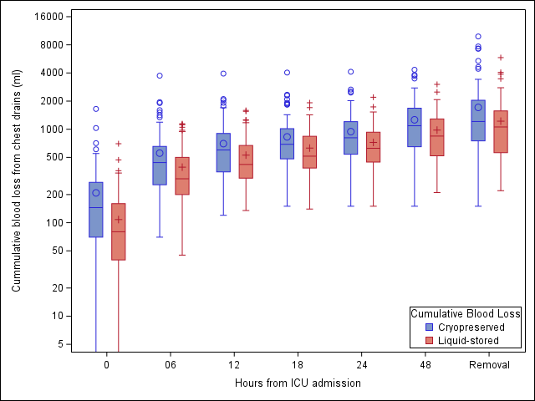
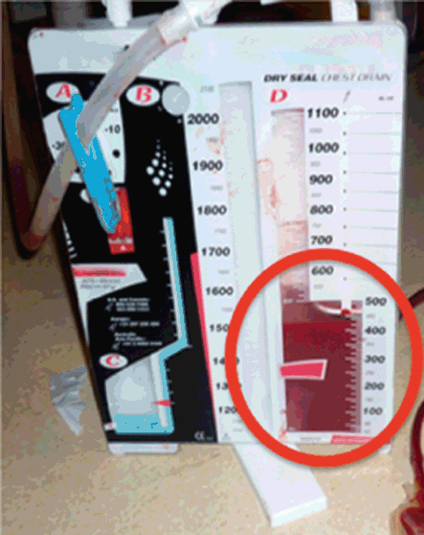
Bleeding
_NAME_ | Cryo geo. mean (ml) | Liquid geo. mean (ml) | Ratio | P value
ICU blood loss at admission | 113 (82-156) | 46 (28-73) | 2.48 (1.40-4.38) | <0.001
Total Post Op Blood Loss (as shown on this graph) | 1273 (1096-1479) | 972 (848-1114) | 1.31 (1.07-1.60) | 0.01
Note log scale
blood loss at time of ICU admission and
total post-op blood loss
were higher with cryopreserved platelets
Total Post Op blood loss was 31% higher
Time | ICU admission | 6hrs | 12hours | 18hrs | 24hrs | 48hrs | Drain removal
Cryopreserved, n | 103 | 103 | 103 | 102 | 98 | 94 | 57
Liquid-stored, n | 97 | 98 | 98 | 98 | 91 | 78 | 53
Notes:
When look at bleeding at other time points, was sig higher in the cryo group.
The best estimate of total post op blood loss was 31% higher in the cryo group

Slide 10
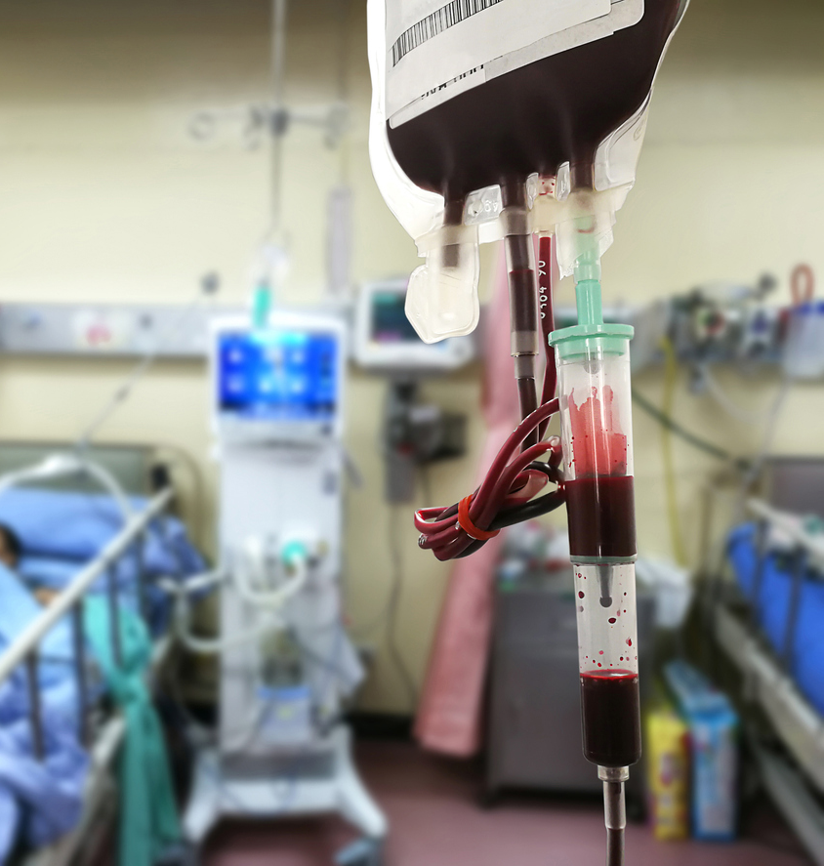
Safety and surrogate bleeding outcomes
The incidence of adverse events was low and not different between groups
But surrogates of bleeding all looked worse in the cryo group:
More cryo patients met the BARC definition of “significant” bleeding
More cryopreserved platelet patients received red cells, FFP, and cryoprecipitate
Cryo patients had less IV crystalloid in the 1st 6hr of ICU
More Liquid-stored patients had drains removed by 24hr
…. All suggesting cryo. platelets were not as haemostatically effective
Notes:
What’s more, several other surrogate outcomes of bleeding all suggested cryo plts were worse at controlling bleeding.
Clinicians start aspirin & heparin when they think the risk of bleeding has diminished
This was later in the cryo group, although not meeting stat sig

Slide 11
Problems with designing such a trial
Notes:
So, might be a little inferior, but not by much (best estimate 13% inferior)

Slide 12
1. Conflicting evidence standard care is better than nothing
Platelets are beneficial
Platelets are harmful
“PLT transfusion in the perioperative
period of CABG was associated with increased risk for
serious adverse events”
“In cardiac surgery patients, perioperative platelet transfusion was associated with reduced operative and 90-day mortality”

Slide 13
1. Conflicting evidence standard care is better than nothing
So should the control group receive:
nothing?
Liquid-stored platelets?
“standard care” (leaving the decision to the clinician)
In CLIP-II:
The indication for platelet transfusion was clinician judgement, not an arbitrary indication, so “c.” did not apply
“a.” was thought to lack equipoise .. despite agreed lack of evidence

Slide 14
2. Where to set the non-inferiority limit?
A relative amount (which can be based on an absolute value). E.g. in CLIP-II, used 1U RBC (258ml) to justify a non-inferiority limit of +20% control bleeding. The numerical value equating to 20% will depend on the control bleeding actually observed.
An absolute value? E.g. bleeding volume equivalent to one unit RBC. BUT – if the control group value is not confidently known & is over- or under-estimated, this risks setting a value too strict or liberal

Slide 15
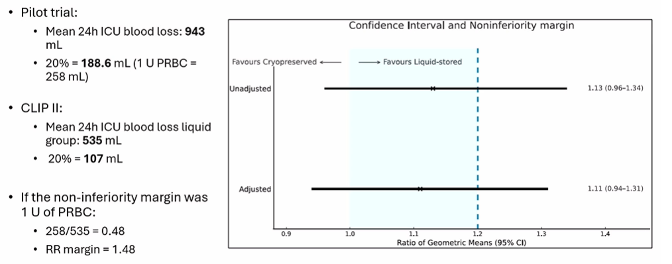
2. Where to set the non-inferiority limit?
Not surprising that 95% CIs overlapped this small value
(used for planning)
(as it turned out)
Which would have led to a “certain” conclusion of non-inferiority
With thanks to MAJ Elissa Milford, trial editorialist

Slide 16
3. Relationship of the primary outcome to the intervention
Primary outcome
The primary outcome was measured before the intervention had to have finished. SO different patients received different intensity interventions
If platelets started AFTER blood collection started, some bleeding would not have been amenable to the intervention.

Slide 17
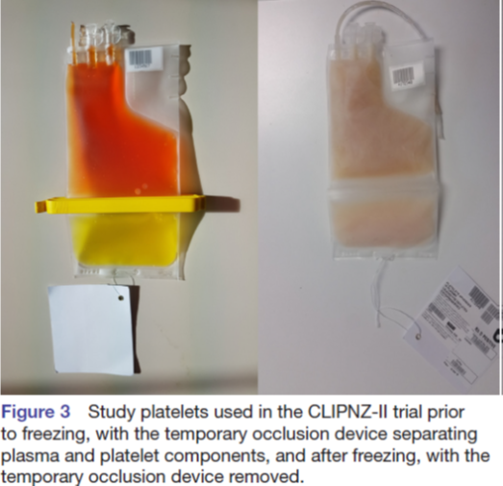
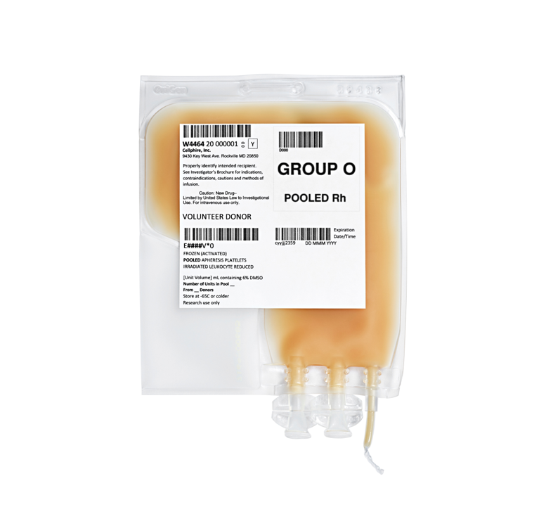
4. There are similar, but different, cryo. platelet products
New Zealand (CLIPNZ-II): single donor group O apheresis platelets resuspended in their own plasma, separated during storage in solid frozen phase (&hence different temperature profile to CLIP-II upon rewarming)
USA (CRYPTICS): Pooled donor(up to 10 donors) irradiated group O leukocyte reduced apheresis platelets resuspended 25ml saline
Are these three methods comparable?

Slide 18
5. Other problems in retrospect …
Maintaining blinding.
  Why did CLIP-II cryo patients receive more open-label platelets? Because they were less effective? Caused lower plt count increments? Loss of clinician blinding?
Dose equivalence.
  Would the cryo group have done better (or worse??) had there not been a dose limit of 3 units trial platelets?
Imbalance between sites due to premature randomisation (i.e. not all randomised patients were transfused; only the transfused patients were analysed)

Slide 19
So what next?
Is a placebo-controlled trial
Possible?
Necessary?
Or is a plausible range of effectiveness 0.94 – 1.31 x control (i.e. up to 6% better or 31% worse) along with no suggestion of harm sufficient evidence to implement into practice?

Slide 20
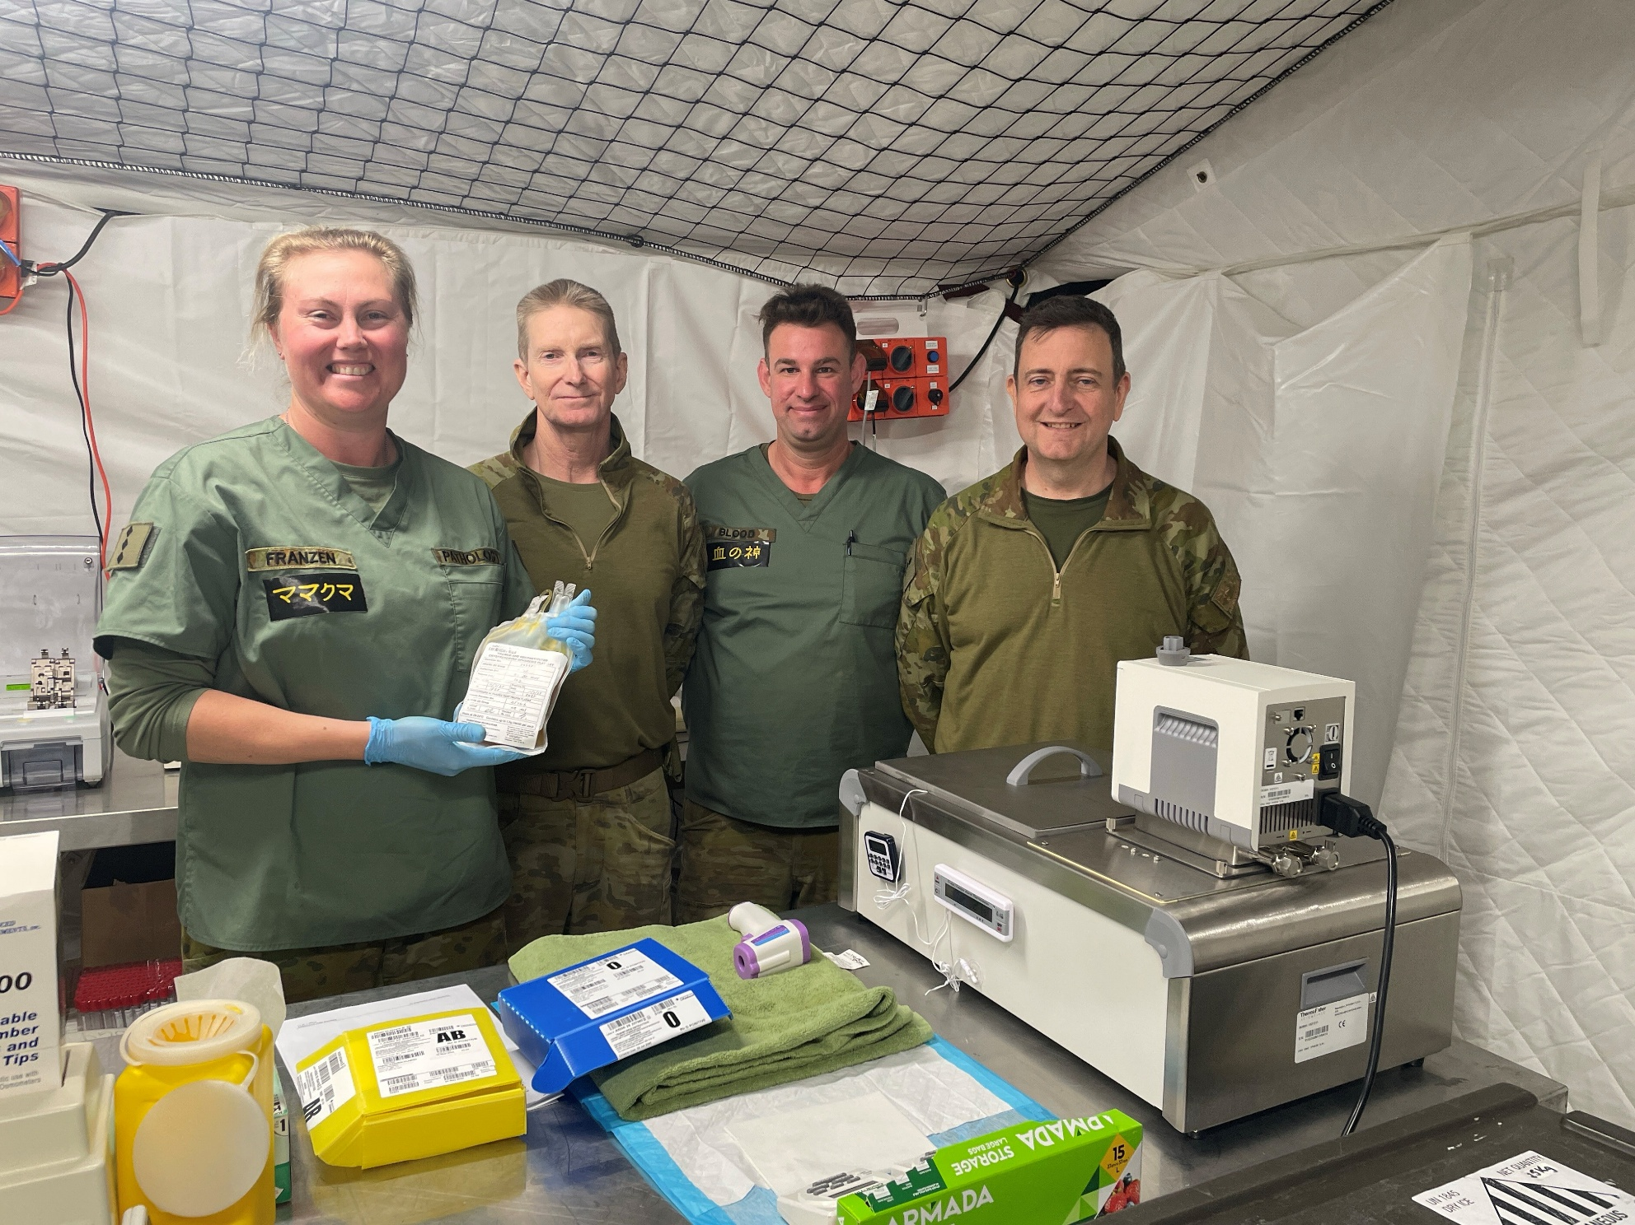

Next steps
First unit of cryopreserved platelets prepared by the ADF
Australian Army Role 2E hospital,
Shoalwater Bay, Queensland
July 2025

