Slide 1
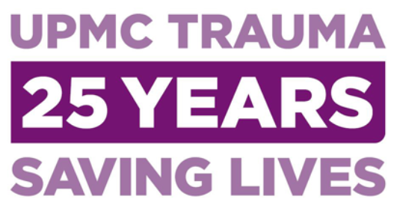



Cold Stored Platelets for Transfusion in Hemorrhagic Shock
35 YEARS
Matthew D. Neal, MD FACS
Watson Chair and Professor of Surgery
Vice Chair of Surgery, Academic Training Director of Emergency General Surgery Co-Director of the Pittsburgh Trauma and Transfusion Medicine Research Center University of Pittsburgh and UPMC
@macky_neal
nealm2@upmc.edu

Slide 2
Disclosures
Chief Medical Officer, Haima Therapeutics
Research funding: NIH, DoD, DARPA, Haemonetics, Instrumentation Laboratories, Takeda
Honoraria: Haemonetics, Takeda, Octapharma, Cellphire
US Patents: DIELECTRIC SENSING TO CHARACTERIZE HEMOSTATIC DYSFUNCTION Serial Number: 16/837,704; NOVEL TLR4 INHIBITORS FOR THE TREATMENT OF HUMAN INFECTIOUS AND INFLAMMATORY DISORDERS Serial Number: 17/174,018

Slide 3
Outline
Problems with platelet transfusion
Cold-stored Platelet Early Intervention in Hemorrhagic Shock (CriSP-HS)

Slide 4
Time of the essence in trauma
Notes:
Unbridled hemorrhage remains one of the leading causes of death following traumatic injury second only to traumatic brain injury
A significant increase in our understanding of the processess that are promoting on going hemorrhage has occurred, mostly in the hospital after the patients has arrived.
Resuscitation practice has dramatically changed and these changes apply to and may be inherently beneficial if they are brought to the prehospital environment

Slide 5
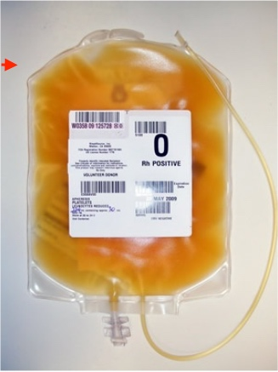
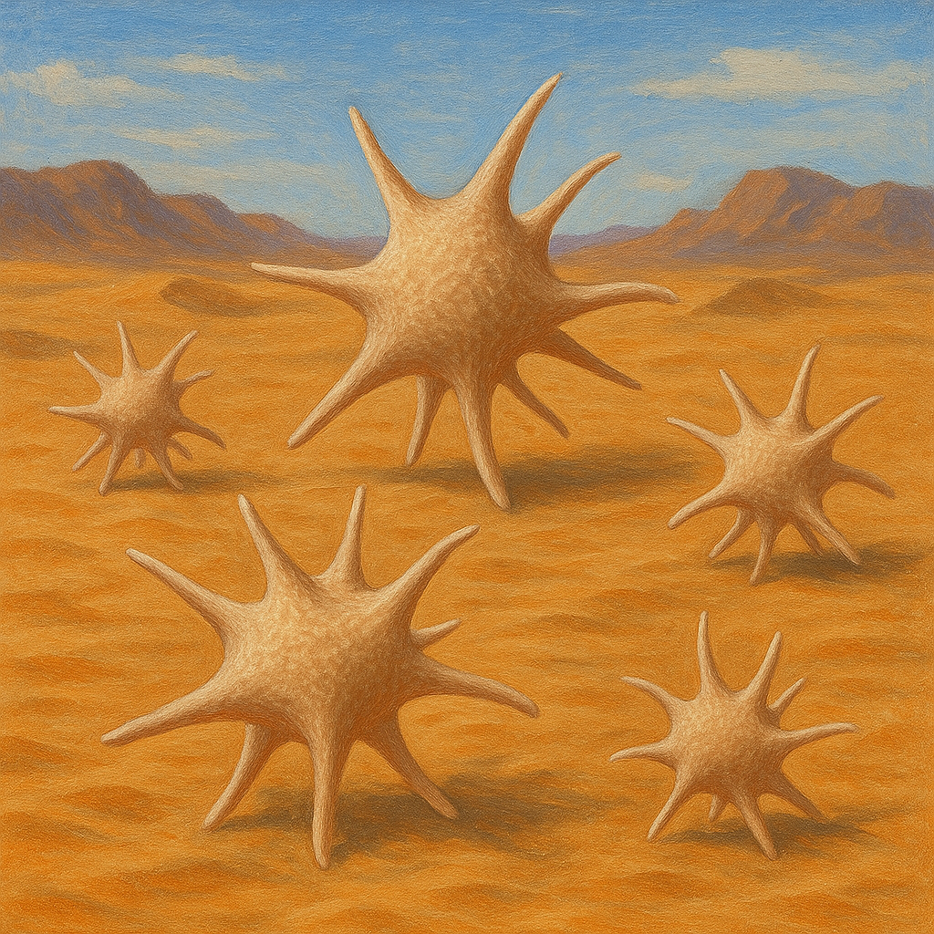
An Imperfect Product
Platelet problems!
Issues:
High risk of pathogenic contamination
Short shelf life (e.g. platelets ~5 days at RT)
Limited availability especially pre-hospital
Multiple biologic side effects
Special storage requirement/not easily portable
Variability in hemostatic output
Donor variability

Slide 6
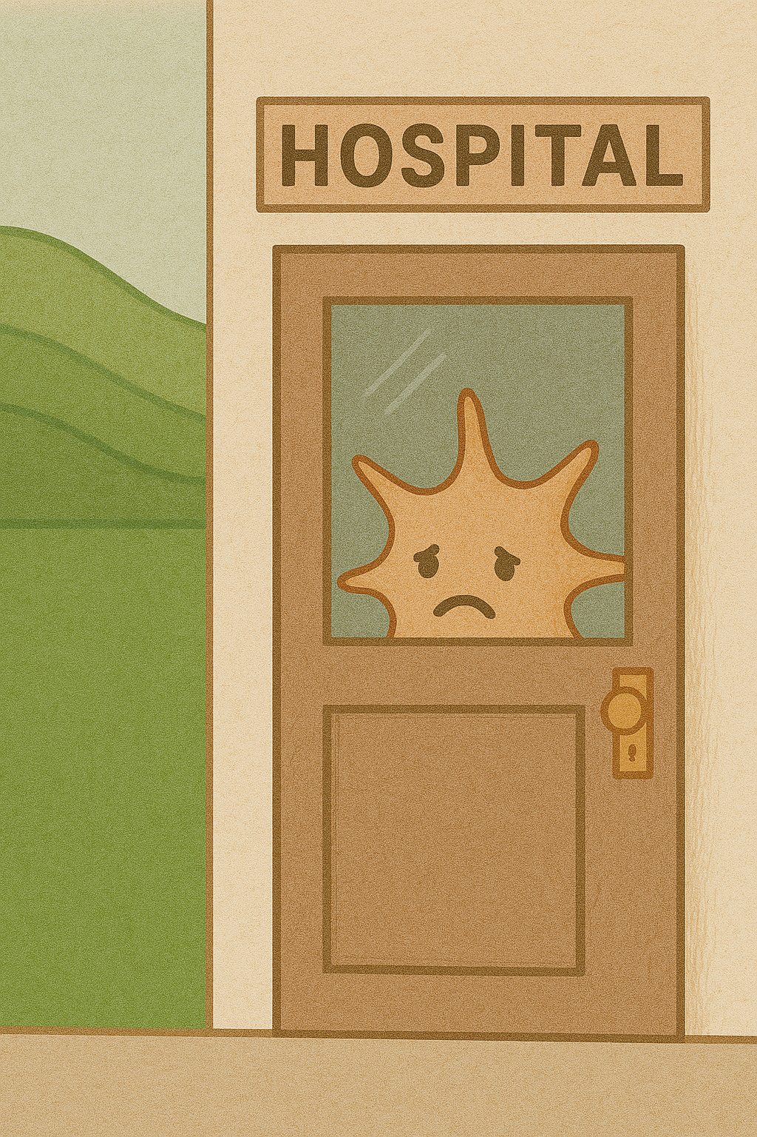
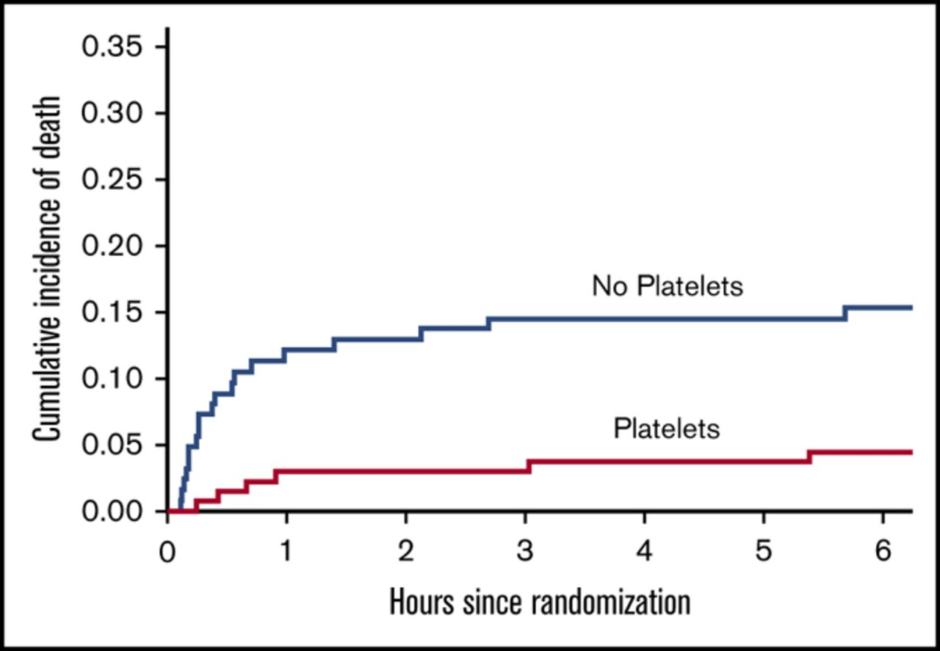
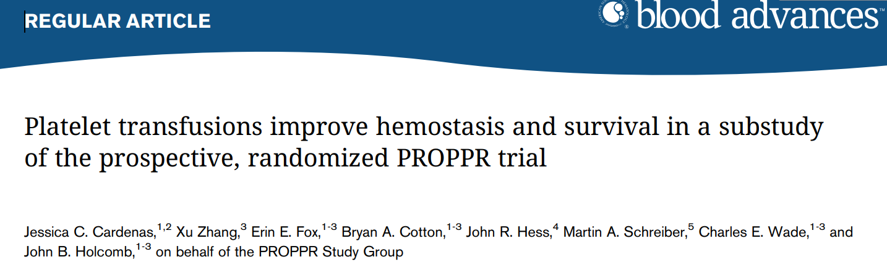
After Trauma + Hemorrhage, Platelets Save Lives!

Slide 7
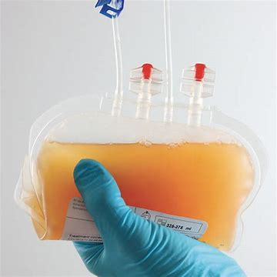
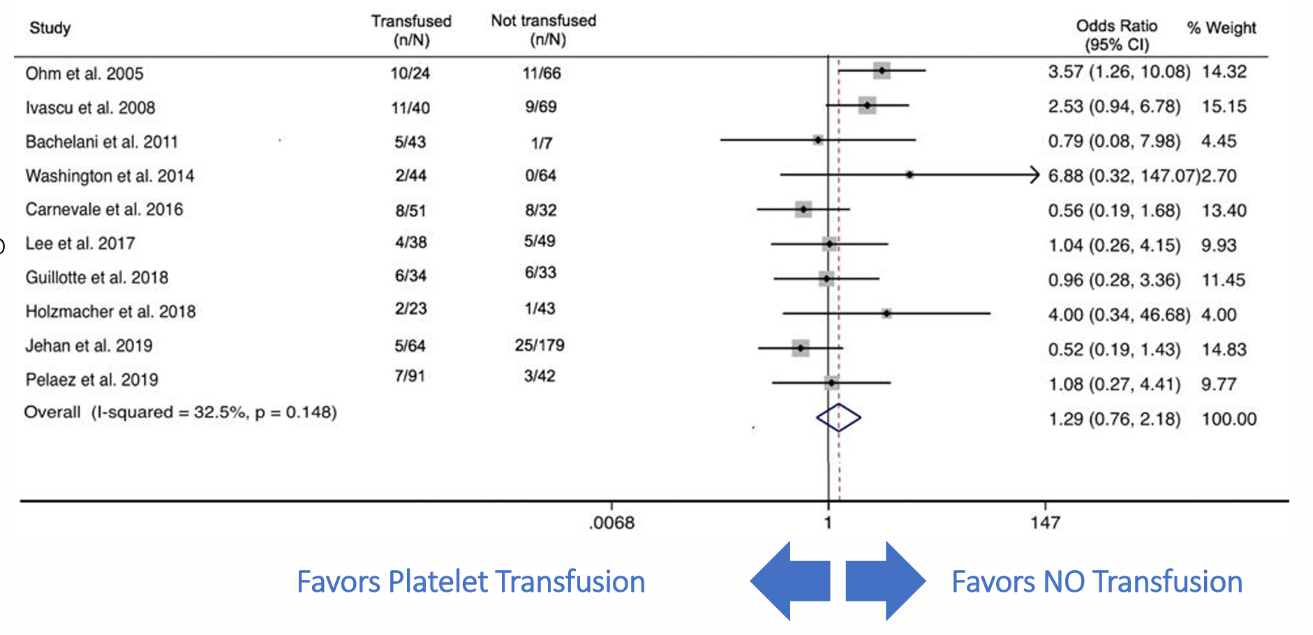
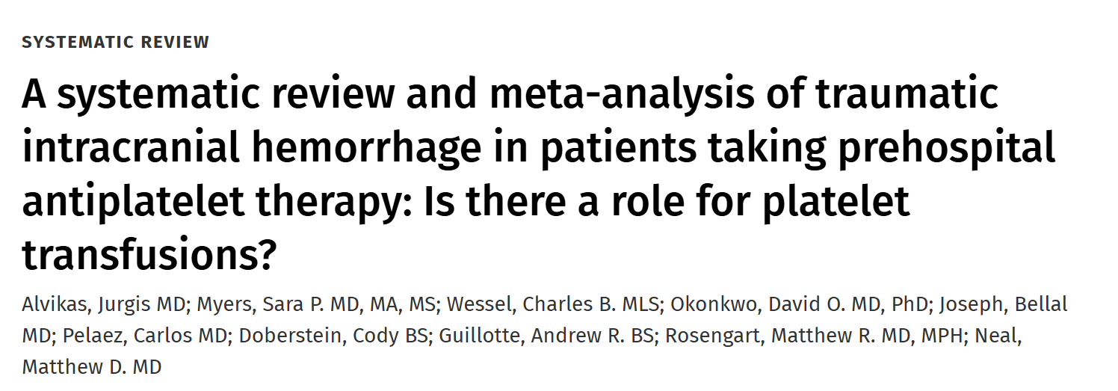
Do platelet transfusion to “reverse” bleeding from anti-platelet agents?
Mortality
Alvikas, et al JTACS 2020

Slide 8

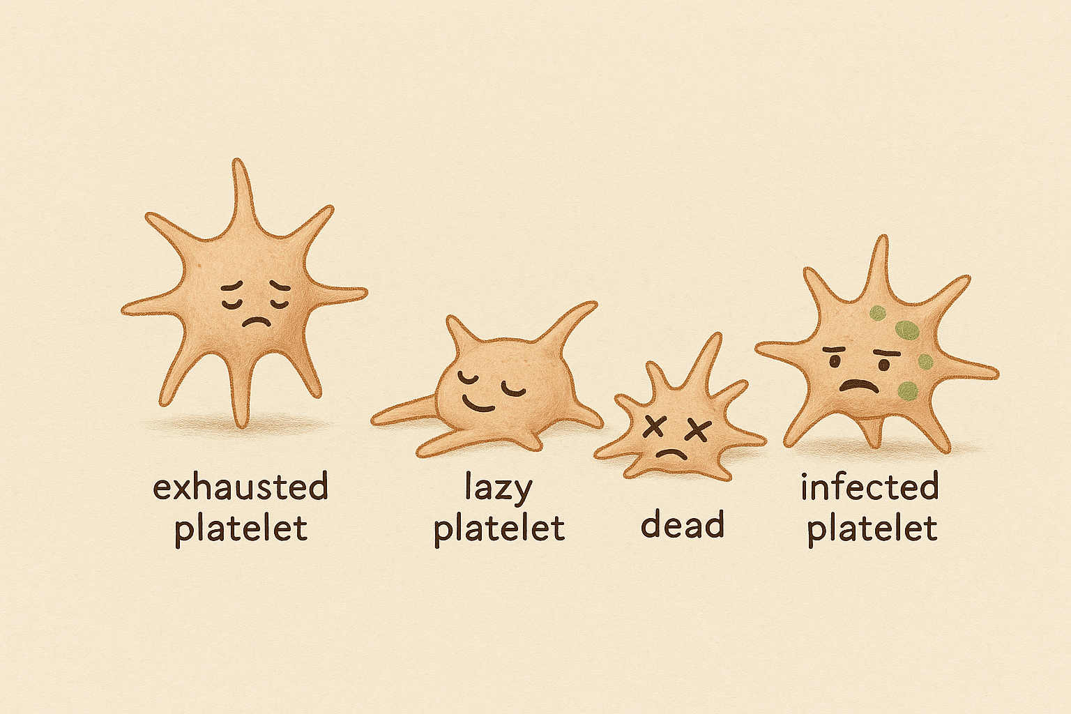
Don’t have ‘em
Can’t get ‘em where we need ‘em
Don’t work
Searching for the “Oasis”

Slide 9
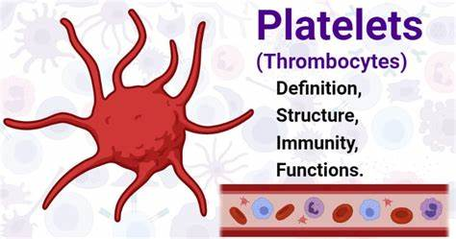
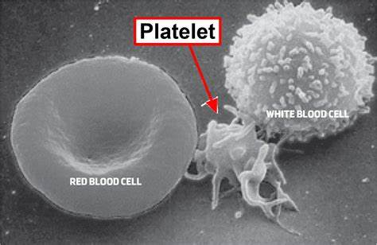
Cold stored – more “hemostatic” (?), longer storage
Notes:
Unbridled hemorrhage remains one of the leading causes of death following traumatic injury second only to traumatic brain injury
A significant increase in our understanding of the processess that are promoting on going hemorrhage has occurred, mostly in the hospital after the patients has arrived.
Resuscitation practice has dramatically changed and these changes apply to and may be inherently beneficial if they are brought to the prehospital environment

Slide 10
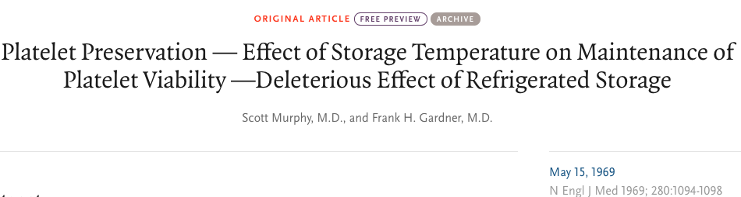
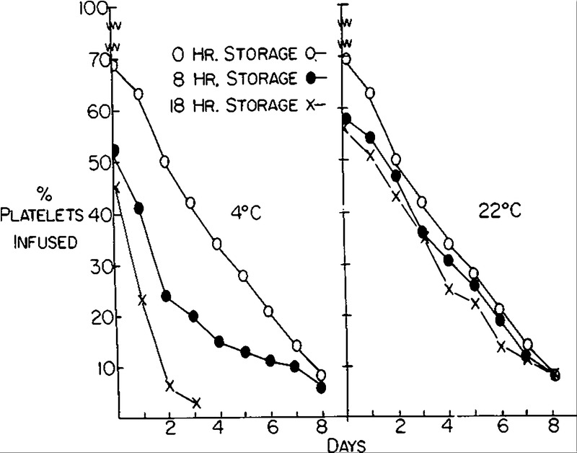
Platelet Storage Temp Change
“The use of cold platelets should be abandoned…for transfusion purposes”

Slide 11
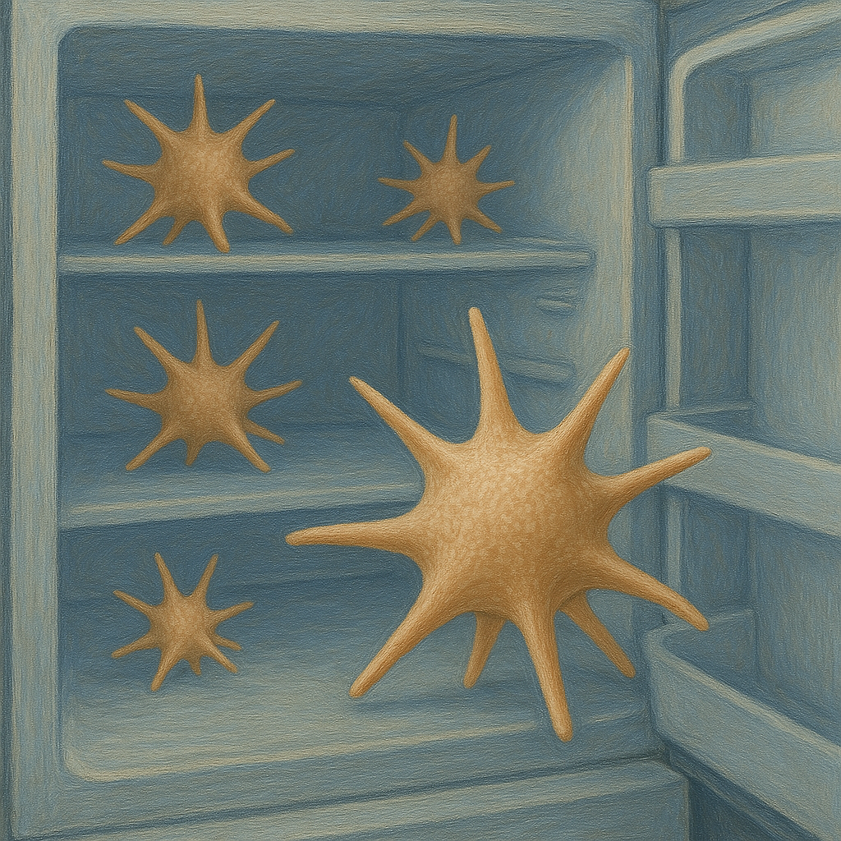
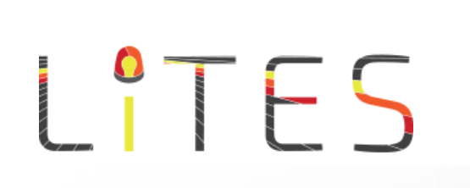
Cold stored platelet trials
Cold-stored Platelet Early Intervention in Hemorrhagic Shock CriSP-HS
Cold-stored Platelet Early Intervention in Traumatic Brain Injury CriSP-TBI

Slide 12
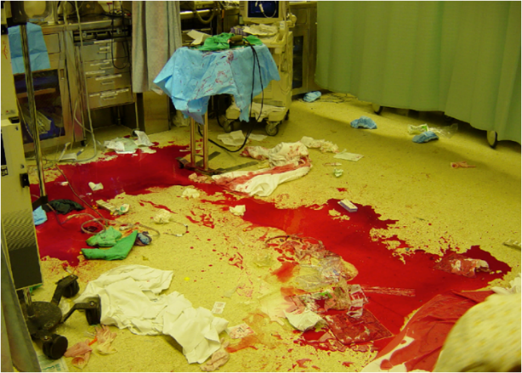
CriSP-HS Trial
Study Design
Open label, Phase 2, Multi-center, Randomized trial designed to determine the efficacy and safety of incorporating early CSPs into early trauma resuscitation vs. standard of care resuscitation in patients at risk of hemorrhagic shock.
University of Mississippi; University of Texas Houston; University of California, San Francisco; Baylor College of Medicine; University of Southern California, LA
Sperry et al, Ann Surg, 2024
Notes:
Unbridled hemorrhage remains one of the leading causes of death following traumatic injury second only to traumatic brain injury
A significant increase in our understanding of the processess that are promoting on going hemorrhage has occurred, mostly in the hospital after the patients has arrived.
Resuscitation practice has dramatically changed and these changes apply to and may be inherently beneficial if they are brought to the prehospital environment

Slide 13
CriSP-HS Trial
Eligibility Criteria
Assessment of Blood Consumption Score (ABC):
SBP <90mmHg; Penetrating mechanism; Positive FAST; HR >120
AND
Hemorrhage control procedure in 60 minutes (OR/IR)
Exclusion:
Wearing “NO CRISP” opt-out bracelet
Age > 90 or <15 years of age
Isolated fall; known prisoner; known pregnancy; Isolated burns
Traumatic arrest with >5 min of CPR without return of vital signs
Brain matter exposed or penetrating brain injury (GSW)
Isolated drowning or hanging victims
Objection to study voiced by subject or family member at the scene
Sperry et al, Ann Surg, 2024
Notes:
Unbridled hemorrhage remains one of the leading causes of death following traumatic injury second only to traumatic brain injury
A significant increase in our understanding of the processess that are promoting on going hemorrhage has occurred, mostly in the hospital after the patients has arrived.
Resuscitation practice has dramatically changed and these changes apply to and may be inherently beneficial if they are brought to the prehospital environment

Slide 14
CriSP-HS Trial
Intervention / Comparison Arms
OPEN LABEL
CSP arm
Single apheresis unit cold stored platelets (1-6 ℃) stored local refrigerator
Out to 14 days from donation
Transfused as soon as feasible
Concomitant standard site resuscitation
Standard Care arm
Standard care prehospital resuscitation using room temperature (22 ℃) platelets if transfused
Sperry et al, Ann Surg, 2024
Notes:
Unbridled hemorrhage remains one of the leading causes of death following traumatic injury second only to traumatic brain injury
A significant increase in our understanding of the processess that are promoting on going hemorrhage has occurred, mostly in the hospital after the patients has arrived.
Resuscitation practice has dramatically changed and these changes apply to and may be inherently beneficial if they are brought to the prehospital environment

Slide 15
CriSP-HS Trial
Outcomes
Primary Outcome: Feasibility
Safety / Efficacy: 24-hour mortality
Additional Secondary Outcomes: Mortality time points; death from hemorrhage; time to hemostasis; ARDS; thromboembolic events; coagulation measures, transfusion requirements
Sperry et al, Ann Surg, 2024
Notes:
Unbridled hemorrhage remains one of the leading causes of death following traumatic injury second only to traumatic brain injury
A significant increase in our understanding of the processess that are promoting on going hemorrhage has occurred, mostly in the hospital after the patients has arrived.
Resuscitation practice has dramatically changed and these changes apply to and may be inherently beneficial if they are brought to the prehospital environment

Slide 16
CriSP-HS Trial – Enrollment
Notes:
Unbridled hemorrhage remains one of the leading causes of death following traumatic injury second only to traumatic brain injury
A significant increase in our understanding of the processess that are promoting on going hemorrhage has occurred, mostly in the hospital after the patients has arrived.
Resuscitation practice has dramatically changed and these changes apply to and may be inherently beneficial if they are brought to the prehospital environment

Slide 17
CriSP-HS Trial – Cohort
Enrolled Cohort Characteristics
Age- 34 ± 13 years
Sex- 85% male
ISS- median 17 [9-28]
Mechanism- 78.5% penetrating
24-hour mortality- 8%
30-day mortality
Standard Care Arm: 48% receive platelet transfusion
Notes:
Unbridled hemorrhage remains one of the leading causes of death following traumatic injury second only to traumatic brain injury
A significant increase in our understanding of the processess that are promoting on going hemorrhage has occurred, mostly in the hospital after the patients has arrived.
Resuscitation practice has dramatically changed and these changes apply to and may be inherently beneficial if they are brought to the prehospital environment

Slide 18
Mortality (24hr)
CriSP-HS Trial
CSP 5.9% vs. RT 10.2%;
Difference -4.3%; 95% CI, -12.8% to 3.5%, p = 0.26
Adjusted for site:
OR 0.6 (95%CI 0.2-1.6)
p=0.27
Sperry et al, Ann Surg, 2024
Notes:
Unbridled hemorrhage remains one of the leading causes of death following traumatic injury second only to traumatic brain injury
A significant increase in our understanding of the processess that are promoting on going hemorrhage has occurred, mostly in the hospital after the patients has arrived.
Resuscitation practice has dramatically changed and these changes apply to and may be inherently beneficial if they are brought to the prehospital environment

Slide 19
CriSP-HS Trial – No difference in thrombosis
 |  |  | Unadjusted analysis |  | Adjusted analysis
Clinical Outcomes | Standard Care (N = 98) | Cold Stored Platelets (N = 102) | Difference (95% CI) | p-value | OR/ difference (95% CI) | p-value
3-h mortality, No. % | 7 (7.1) | 6 (5.9) | -1.3% (-9.1, 6.3) | 0.72 | 0.9 (0.3, 2.9) | 0.86
In-hospital mortality ^{c}, No. % | 13/82 (15.8) | 12/91 (13.2) | -2.7% (-13.9, 8.2) | 0.62 | 0.8 (0.3, 1.9) | 0.62
30-day mortality ^{c,d}, No. % | 13/82 (16) | 12/91 (13) | -2.7% (-13.9, 8.2) | 0.62 | 0.8 (0.3, 1.9) | 0.62
Mortality from hemorrhage, No. % | 7 (7.1) | 7 (6.9) | -0.3% (-8.8, 7.4) | 0.89 | 1.0 (0.3, 3.1) | 0.99
ARDS, No. % | 3/93 (3.2) | 6/100 (6.0) | 2.8% (-4.0, 9.8) | 0.36 | 2.2 (0.6, 11.0) | 0.27
Allergic/transfusion reaction, No. % | 0 (0) | 0 (0) | - |  | -
Thromboembolic events, No. % | 10/93 (10.8) | 10/100 (10.0) | -0.8% (-10.2, 8.3) | 0.86 | 0.9 (0.4, 2.4) | 0.85
Achieve hemostasis, No. % | 91/98 (92.9) | 95/102 (93.1) | 0.3 (-6.8, 7.4) | 0.94 | 1.1 (0.4, 3.2) | 0.90
Sperry et al, Ann Surg, 2024
Notes:
Unbridled hemorrhage remains one of the leading causes of death following traumatic injury second only to traumatic brain injury
A significant increase in our understanding of the processess that are promoting on going hemorrhage has occurred, mostly in the hospital after the patients has arrived.
Resuscitation practice has dramatically changed and these changes apply to and may be inherently beneficial if they are brought to the prehospital environment

Slide 20
CriSP-HS Trial – No difference in AE
 | Standard Care (n = 98) | Cold Stored Platelets (n = 102)
Adverse Events Total | 68 | 61
Serious Adverse Events Total | 52 | 49
Individual Serious Adverse Events with Any Relatedness
Coagulopathy | 0 | 1
Pneumonia/VAP | 1 | 1
Arterial Thrombosis | 1 | 1
Deep Vein Thrombosis (DVT) | 0 | 2
Pulmonary Embolism (PE) | 2 | 3
Transfusion Associated Cardiac Overload (TACO) | 0 | 1
Serious Adverse Events with Any Relatedness Total | 4 | 9
Notes:
Unbridled hemorrhage remains one of the leading causes of death following traumatic injury second only to traumatic brain injury
A significant increase in our understanding of the processess that are promoting on going hemorrhage has occurred, mostly in the hospital after the patients has arrived.
Resuscitation practice has dramatically changed and these changes apply to and may be inherently beneficial if they are brought to the prehospital environment

Slide 21
CriSP-HS Trial – storage age
 | Cold Stored Platelets Shelf Time
Clinical Outcome | ≤ 7 days (n = 41) | 8 – 14 days (n = 57) | Difference (95% CI) | p-value
24-h mortality, No. % | 1 (2.4) | 2 (3.5) | -1.1% (-10.1,10.1) | 0.78
3-h mortality, No. % | 1 (2.4) | 2 (3.5) | -1.1% (-10.1, 10.1) | 0.78
In-hospital mortality, No. % | 4/39 (10.3) | 5/49 (10.2) | 0.1% (-13.5,15.7) | 0.99
30-day mortality ^{b,c}, No. % | 4/39 (10.3) | 5/49 (10.2) | 0.1% (-13.5, 15.7) | 0.99
Mortality from hemorrhage ^{b}, No. % | 3/40 (7.5) | 2/56 (3.6) | 3.9% (-6.2, 16.9) | 0.65
ARDS ^{b}, No. % | 3/40 (7.5) | 3/56 (5.4) | 2.1% (-8.7, 15.6) | 0.69
Allergic/transfusion reaction, No. % | 0 (0) | 0 (0) | -
Thromboembolic events ^{b}, No. % | 4/40 (10.0) | 6/56 (10.7) | -0.7% (-0.1, 0.2) | 0.91
Initial rapid thromboelastography measurements,^{d,e} median (IQR) |  |  |  | NS
24-hour rapid thromboelastography measurements |  |  |  | NS
Initial coagulation measurements |  |  |  | NS
24-hour coagulation measurements |  |  |  | NS
Transfusion requirements within 24-hours |  |  |  | NS
Notes:
Unbridled hemorrhage remains one of the leading causes of death following traumatic injury second only to traumatic brain injury
A significant increase in our understanding of the processess that are promoting on going hemorrhage has occurred, mostly in the hospital after the patients has arrived.
Resuscitation practice has dramatically changed and these changes apply to and may be inherently beneficial if they are brought to the prehospital environment

Slide 22
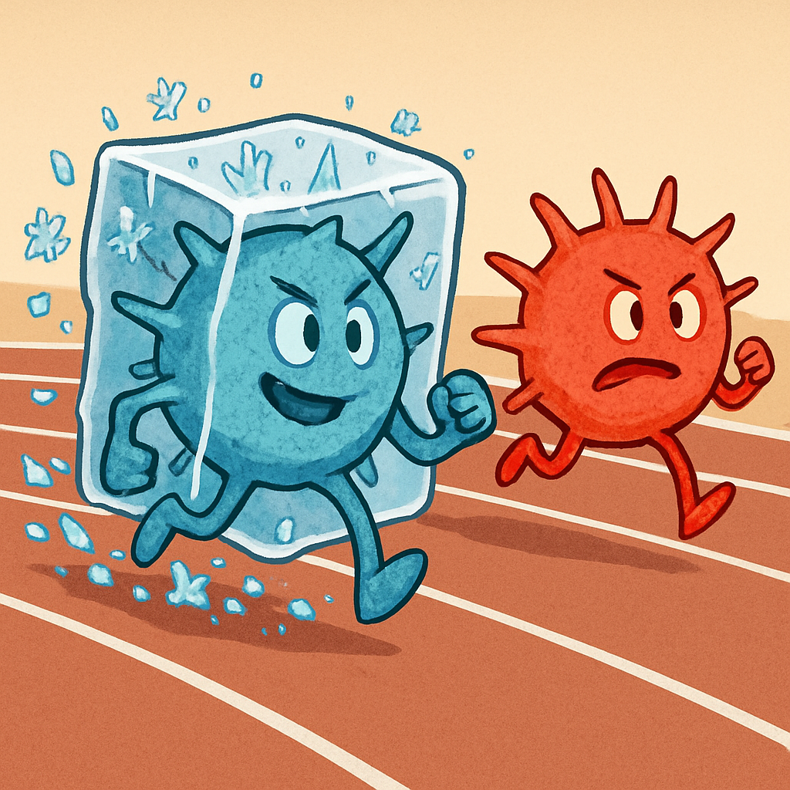

Time to platelet transfusion
CriSP-HS Trial
In those receiving platelets
Median time [IQR] to first platelet 31 [16, 53] mins vs 87 [45, 143] mins, p<0.01
Sperry et al, Ann Surg, 2024
Notes:
Unbridled hemorrhage remains one of the leading causes of death following traumatic injury second only to traumatic brain injury
A significant increase in our understanding of the processess that are promoting on going hemorrhage has occurred, mostly in the hospital after the patients has arrived.
Resuscitation practice has dramatically changed and these changes apply to and may be inherently beneficial if they are brought to the prehospital environment

Slide 23
Limitations for CriSP-HS
Phase 2, open label
Low mortality (standard T/HS trials ~20-25%)
Only 48% in SOC arm received RT platelets
Different number (and low number) of units
Time as a “limitation”

Slide 24
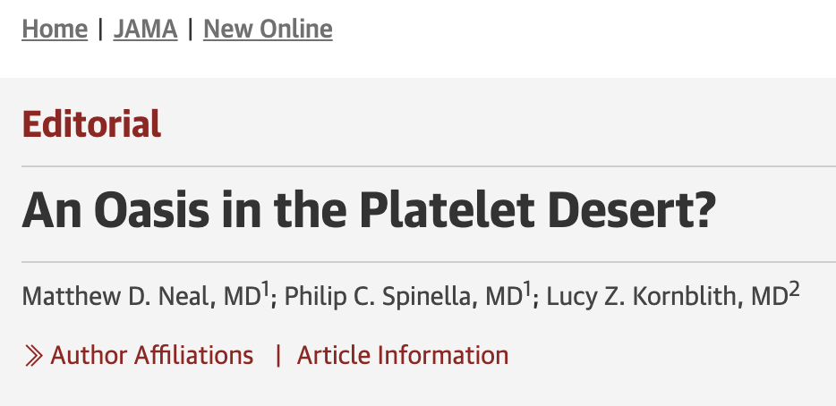
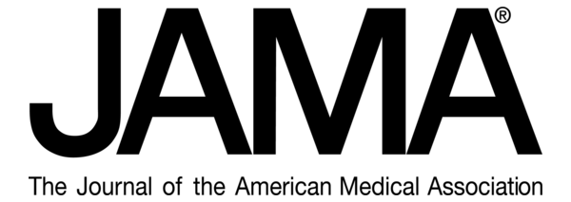
CriSP-HS Trial Conclusions
Cold stored platelets for hemorrhagic shock were feasible and safe
Lower absolute mortality (underpowered)
No signal for thrombosis
No difference out to 14 days
MUCH faster
Sperry et al, Ann Surg, 2024

Slide 25


Slide 26
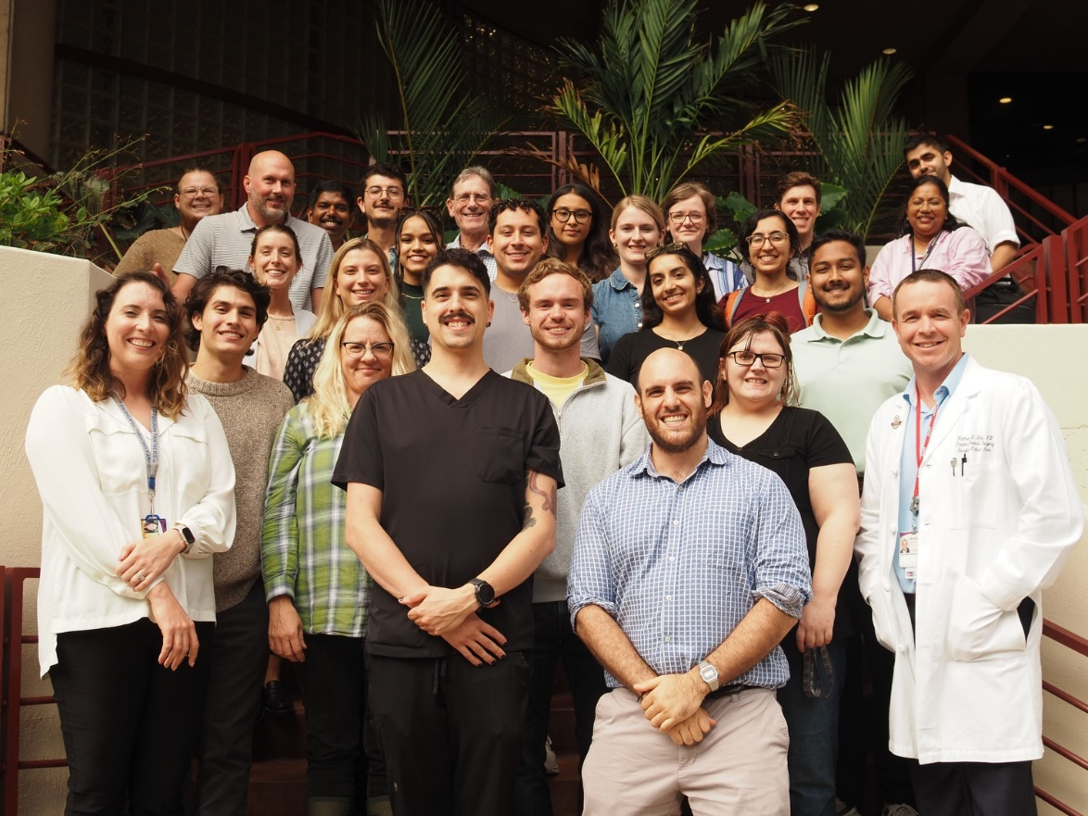




Questions?
Neal lab funding
R35GM119526-07 NIGMS
R01HL166944-01A1 NHLBI
OTA # 1OT2HL156812-01 NHLBI
DM160354 Department of Defense JPC-6 Combat Casualty Care Research Program
Department of Defense CDMRP JPC-6 Combat Casualty Care Research Program
Department of Defense W81XWH21107810
DARPA N66001-23-9-4005
nealm2@upmc.edu
@macky_neal
Cell: 412 848 2134

