Slide 1


HemostOD
Donor-free universal platelets
for transfusion
elodie.dahan@hemostod.com

Slide 2
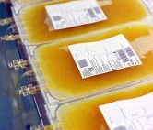



HemostOD develops a platform to provide unlimited supply of platelets with improved safety and lower costs
UNLIMITED
UNIVERSAL
HIGH QUALITY
COST EFFECTIVE
Rapid 2-hour production
Scalable technology for high demand indications
Innovating to increase scale and efficiency
Low immunogenicity
No need for HLA matching (targeted B2M knock down > 90%)
Sterile
Xeno-free
Extended Shelf-life (target > 12 days)
Reproducible characteristics and quality
Low projected COGS (target <$150 per bag vs $500-1,500 for donor platelets)

Slide 3
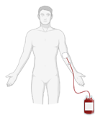
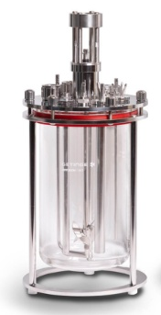





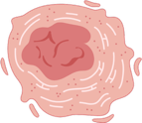


HemostOD can produce proprietary universal platelets on demand, combining engineering and biology
+
+
Immortalization and clone selection
Expansion and
differentiation
Donor*
CD34⁺
cells
LVs
MK progenitor
cell line
Master cell
bank
Mature MKs
Rotating
bed reactor
Platelets
2 Patent families
4 Patent families
Lentiviral (LV) transduction of CD34+ hematopoietic progenitor cells creates a master cell bank of immortalized megakaryocyte (MK) progenitor cells with new features
Platelets are manufactured on demand in 2 hours from expanded and differentiated MKs
One-time process
On demand
* 3-5 donors (genetically and functionally screened)

Slide 4
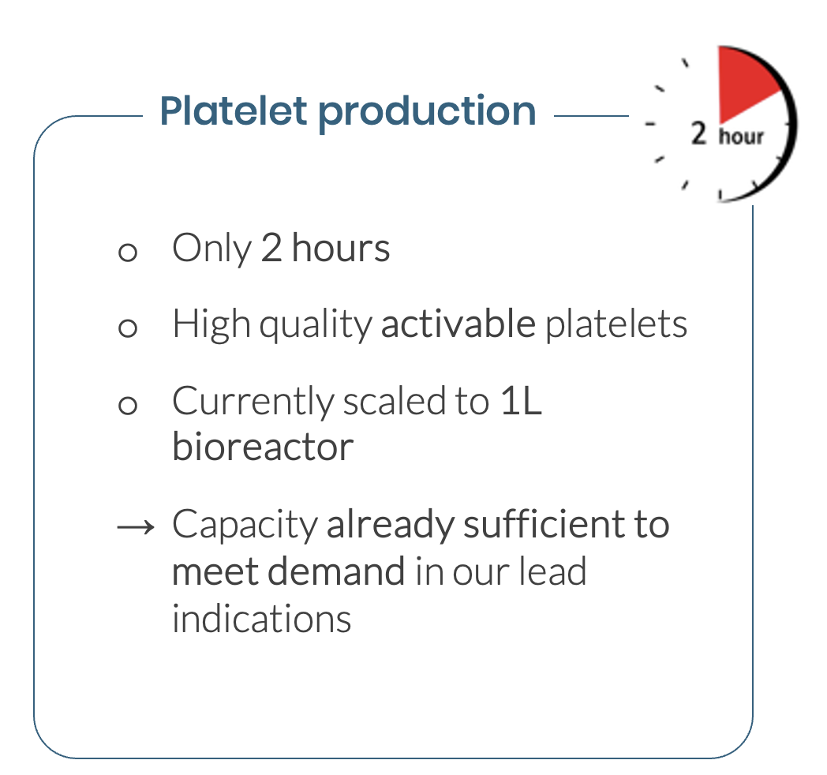
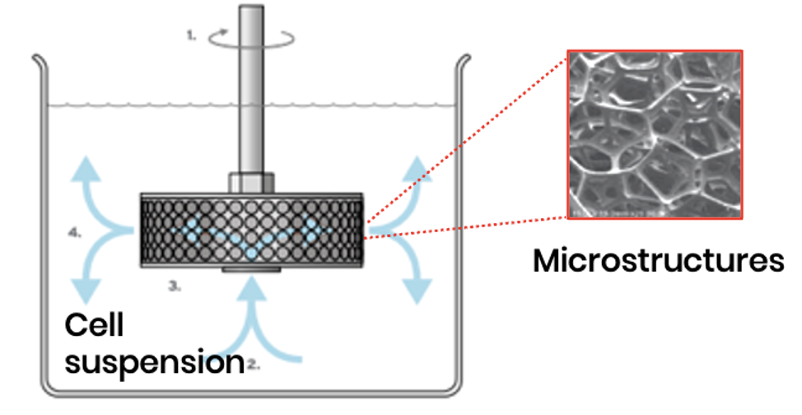
HemostOD proprietary bioreactor technology exploits a mechanical effect to mimic physiological platelet biogenesis
MKs are placed into a scalable rotating bed reactor.
Attached to microstructures, MKs are subjected to high shear stress,
inducing fragmentation into platelets
HemostOD proprietary bioreactor

Slide 5
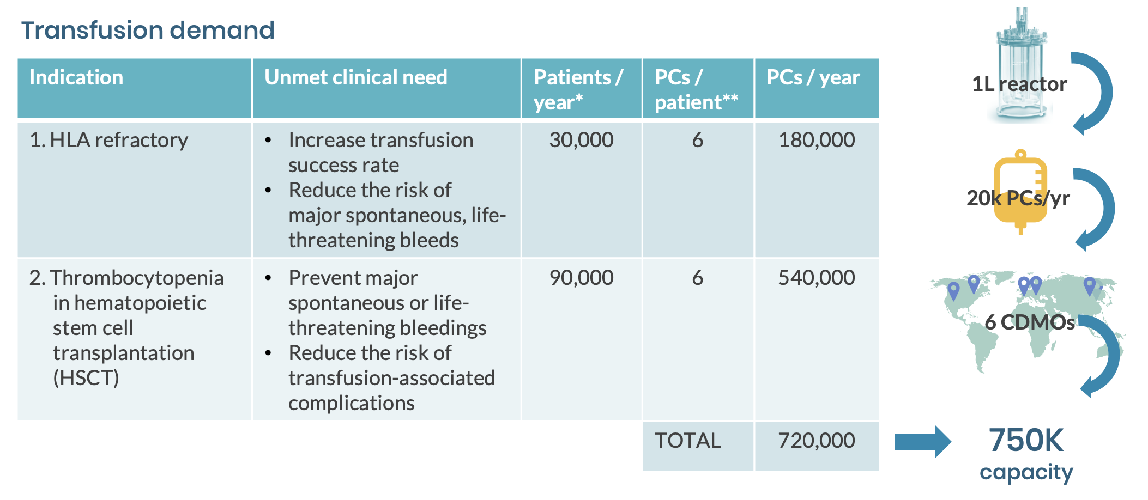
HemostOD targets lead indications in thrombocytopenia with an industrial vision to reach worldwide populations
* Per year worldwide; **Based on several external sources

Slide 6
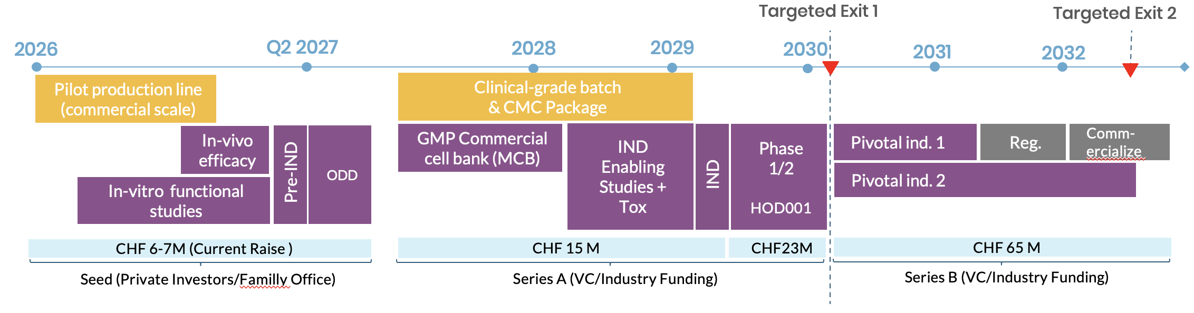
HemostOD recently raised funds to finalize a GMP production line and perform in-vitro / in-vivo studies for a Pre-IND by 2027

Slide 7
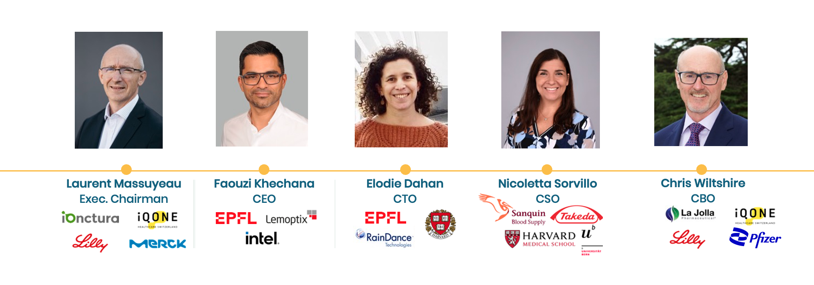
100+ YEARS of accumulated experience in the pharma. industry, entrepreneurship and innovation, including successful M&A exits

