Slide 1


New Platelet Company
Ensuring Lifesaving Continuity
A never ending supply of universal platelets to stop and prevent bleeding
c.j.g.ghevaert@gmail.com https://www.linkedin.com/company/new-platelet-company/

Slide 2
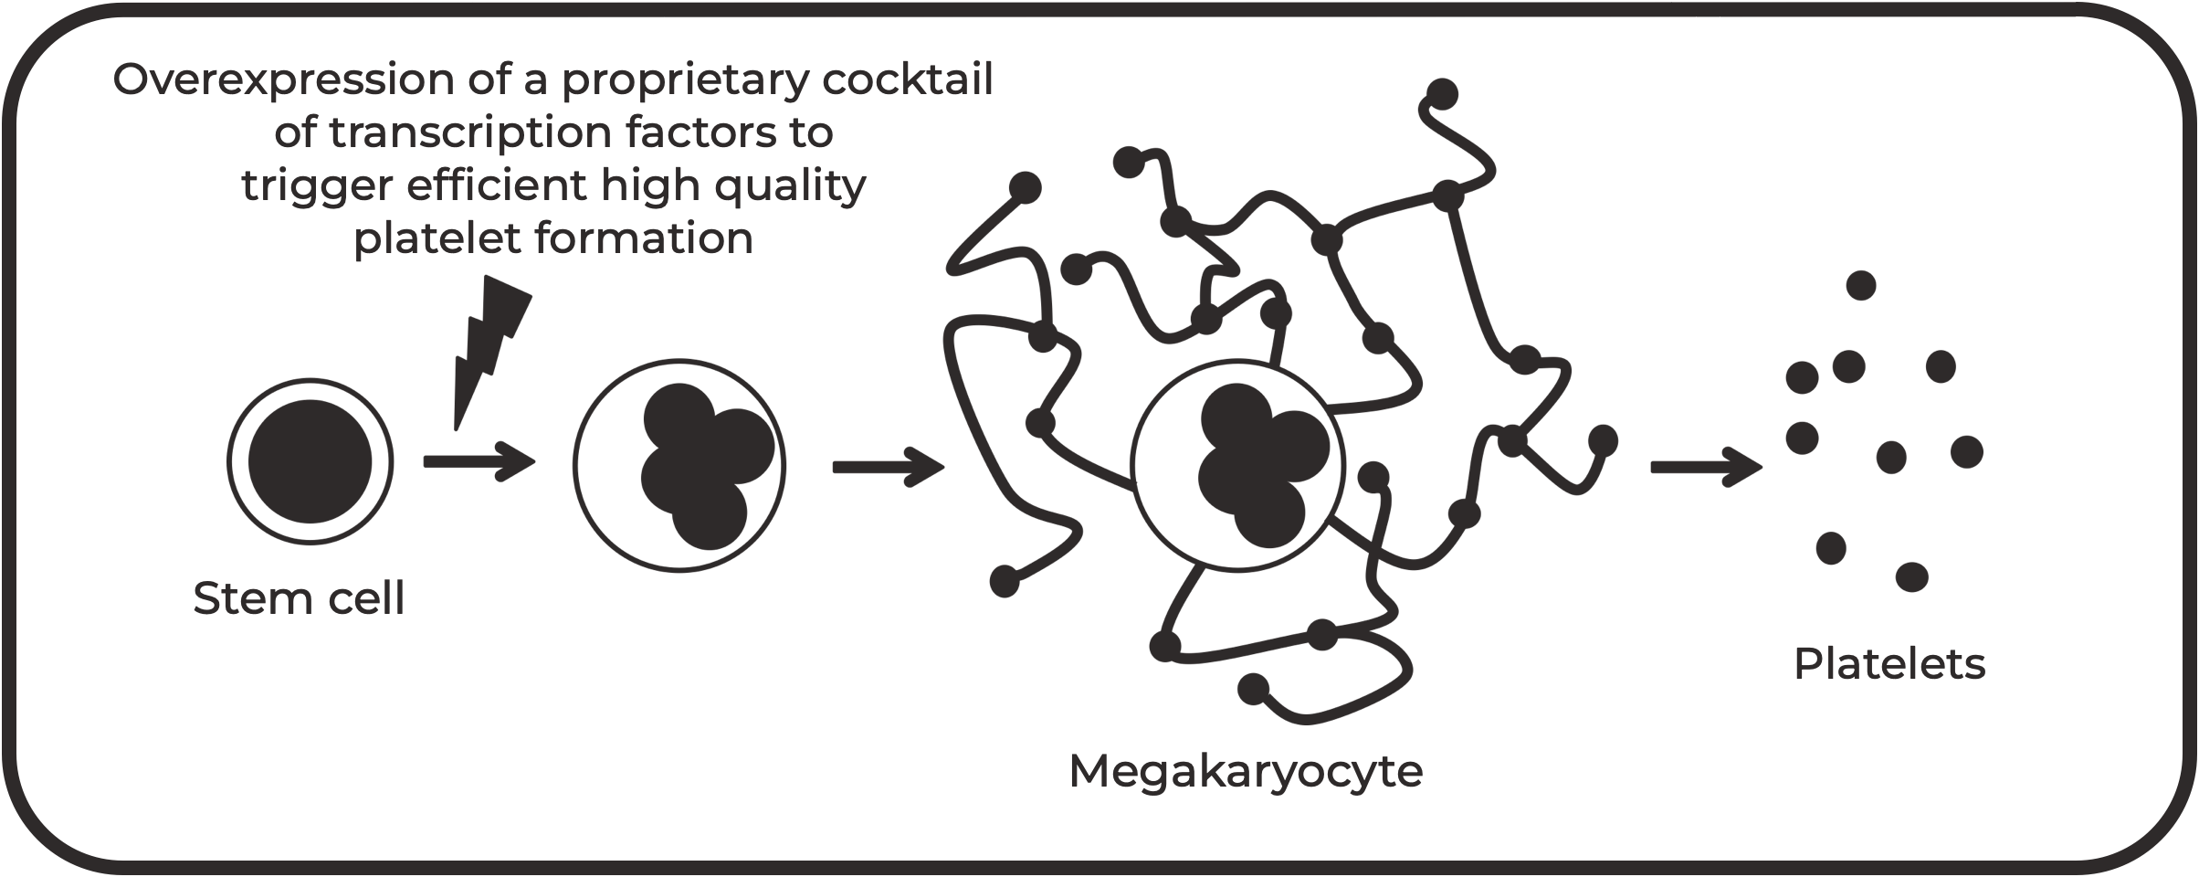


Technology
A never-ending safe supply platelets
An unlimited supply of stem cells can be used to continuously manufacture platelets
Our highly efficient method produces high quality platelets while keeping the costs of goods down compared to competitors’ methods

Slide 3
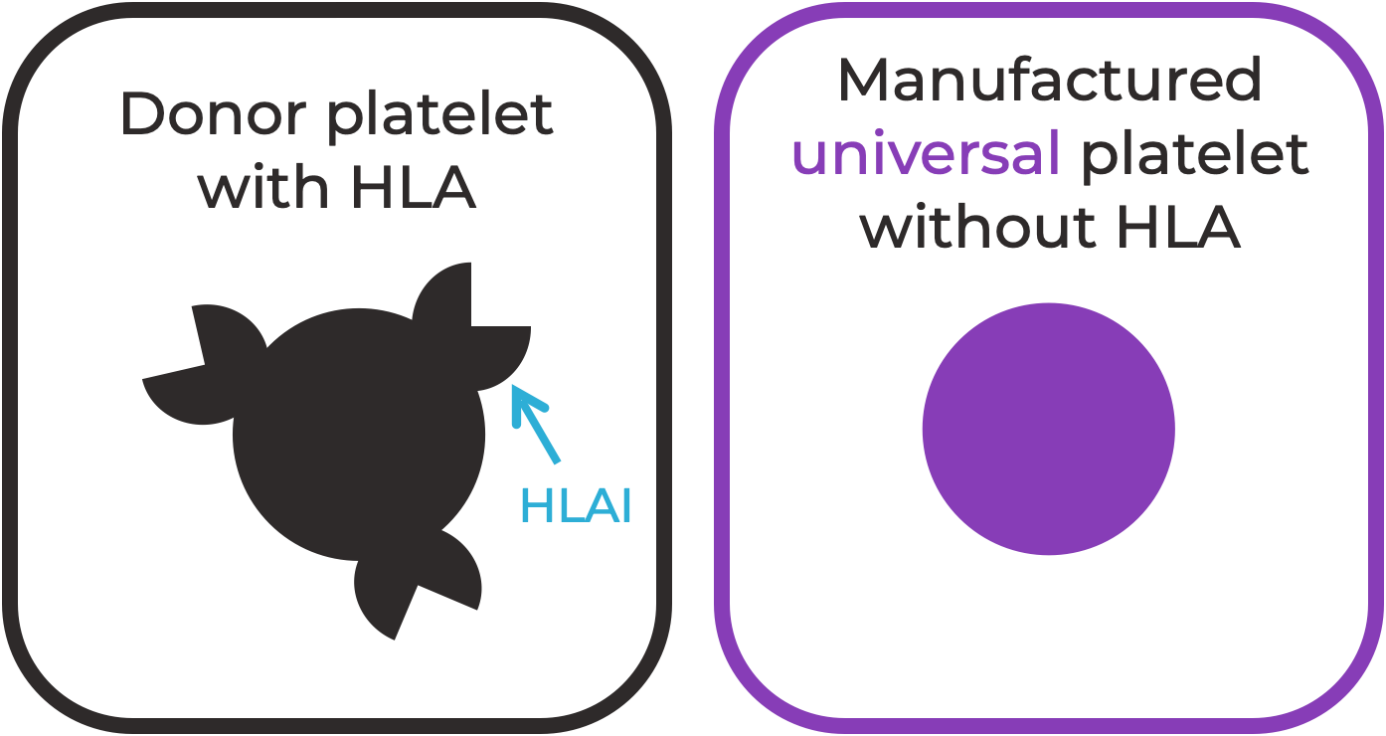
Technology
A never-ending safe supply of universal platelets
Just like red blood cell ABO groups,
HLAI on the surface of platelets can cause immune rejection Therefore we remove HLAI to make universal platelets

Slide 4
Indications and population
We produce platelets that can be used to treat AND prevent bleeding
Therapeutic use
Trauma
Front line injuries Burns
Prophylactic use in thrombocytopenia
Irradiation
Post-cancer treatment
Bone marrow disorders genetic or acquired
The dual use is the result of our unique technology generating RESTING platelets that are FULLY FUNCTIONAL
with a circulation time SIMILAR to donor platelets

Slide 5
Maturity
The technology is pre-clinical ready
GMP cell lines identified and CDMO for gene editing and master cell bank
Highly pure population of megakaryocytes from forward programming differentiation Bespoke technology to separate platelets from nucleated cells and concentrate the platelets Scaled-up culture for first-in-human recovery and survival studies
Regulatory team and GMP manufacturing lined up
We are aiming to raise funds to reach the first-in-human study

Slide 6
Platelets as delivery vehicle
Through a bespoke expression cassette we can package therapeutic CARGO into the platelets granules
FactorVIIa to enhance haemorrhage control
Growth factors to promote myocardial regeneration post infarct Proteins to reduce endotheliopathy in traumatic brain injury
The next generation of platelet-based therapeutic is enabled by the full functionality of the manufactured
platelets

