Slide 1


Cayuga Biotech, Inc.
Company Logo
Addressing hemorrhage by harnessing the body’s innate ability to stop bleeding
AAshford-Hicks@CayugaBiotech.com

Slide 2
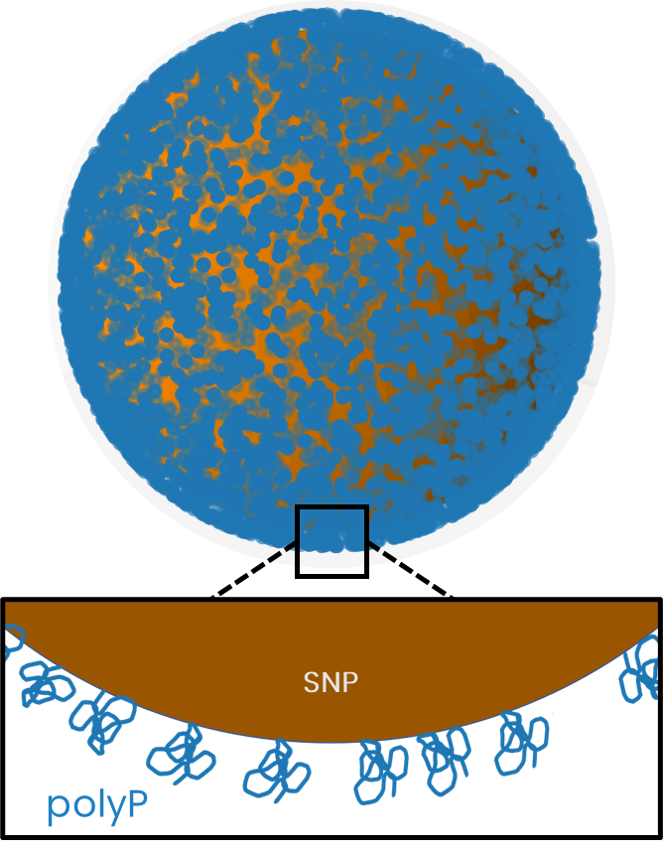
CAY001 is a clinical-stage, first-in-class systemic hemostat
CAY001
(polyP-SNP complex)
Injectable drug for non-compressible major hemorrhage
Fully synthetic; mass-produced / stocked

Slide 3
Potential to Address Three Platelet-Related Unmet Needs
Reduces demand
Compliments novel platelet strategies
Normalizes when platelets are compromised

Slide 4
Potential to Address Three Platelet-Related Unmet Needs
Reduces demand
Compliments novel platelet strategies
Normalizes when platelets are compromised

Slide 5
1. CAY001 reduces demand for platelets (and other) blood products
Standardized injury models (rat tail amputation / swine grade V liver injury)
Presented at the American Society of Hematology Congress, 2024

Slide 6
1. CAY001 reduces demand for platelets (and other) blood products
Standardized injury models (rat tail amputation / swine grade V liver injury)
Model induced severe blood loss for control-treated animals (>40% total blood volume)
Saline
CAY001
Mean bleeding time; Error bars=SD; n=23; 60 min study
Rat tail amputation
Presented at the American Society of Hematology Congress, 2024

Slide 7
1. CAY001 reduces demand for platelets (and other) blood products
91% Faster Hemostasis
Models induced severe blood loss for control-treated animals (>40% total blood volume)
CAY001-treated animals stopped bleeding in 5 minutes
p < 0.0001
Saline
CAY001
Mean bleeding time; Error bars=SD; n=23; 60 min study
Rat tail amputation
Presented at the American Society of Hematology Congress, 2024

Slide 8
Potential to Address Three Platelet-Related Unmet Needs
Reduces demand
Compliments novel platelet strategies
Normalizes when platelets are compromised

Slide 9
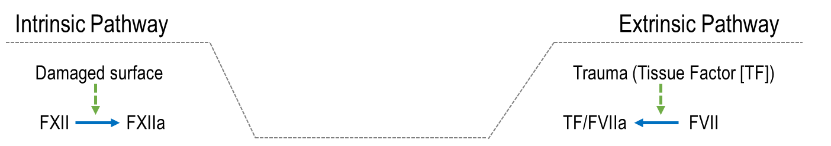

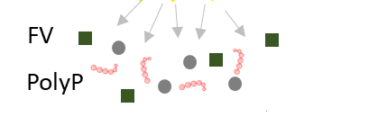
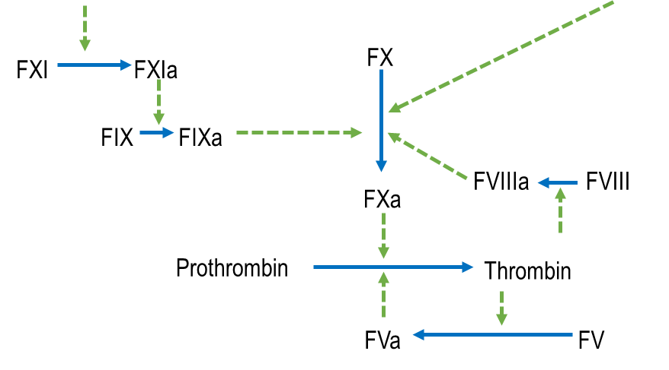
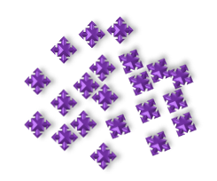
2. Compliments synthetic / preserved platelet strategies
Activated platelets
PolyP
PolyP Integral to the platelet – coagulation cascade interaction
  Released from platelets upon activation
  Feeds the coagulation cascade to produce thrombin
  Thrombin activates more platelets
  Cycle continues until a critical amount of thrombin is generated
Thrombin

Slide 10
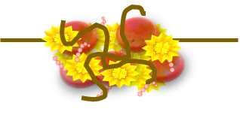
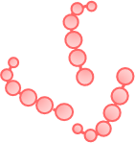
Platelet Dysfunction Associated with Impaired Thrombin Generation
Thrombin
Fibrin
Clot
Activated platelets

Slide 11
PolyP Optimizes Thrombin Generation and Clot Integrity
Activated platelets
PolyP Integral to the platelet – coagulation cascade interaction
PolyP is a co-factor that drives efficiency of FV, FXI and thrombin activation
PolyP also enhances clot structure
PolyP
Thrombin

Slide 12

PolyP Exerts A Concentration-Dependent Effect
Activated platelets
PolyP
PolyP exerts a concentration-dependent effect on the speed and efficiency of thrombin generation
Thrombin

Slide 13
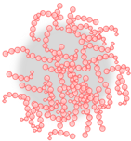
CAY001 Delivers A Concentration of PolyP which Accelerates Normalizes The Clotting Response
Drives 12x faster thrombin generation
CAY001 accelerates the clotting response
CAY001
delivers supplemental polyP
Normalizes thrombin generation
Restores the ability to clot
Kudela ISTH oral presentation 2024

Slide 14
Potential to Address Three Platelet-Related Unmet Needs
Reduces demand
Compliments novel platelet strategies
Normalizes when platelets are compromised

Slide 15
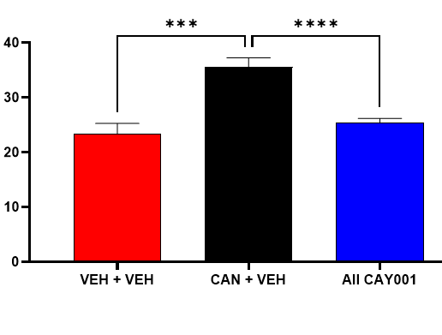
3. Normalizes hemostasis when platelets are compromised / deficient
33% reduction in blood loss
Normalized blood loss
Bypasses P2Y12 platelet inhibition
p < 0.001
p < 0.0001
blood loss (g/kg)
No P2Y12 / Saline
Control
Saline
Control (P2Y12 pre-treated)
CAY001
(P2Y12 pre-treated)
Saline
Control
Mean blood loss; Error bars=SD; n=94; 60 min study
Rat tail amputation

Slide 16
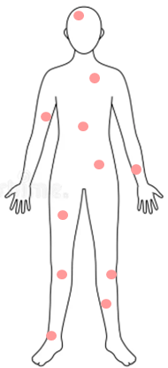
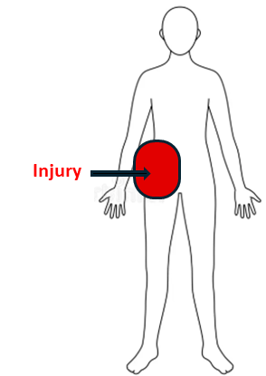
Very Low Thromboembolic Risk
No thrombosis until 800x effective dose
7 safety studies
Targeted effect
Does not initiate clotting
No “overshoot” in thrombin generation
Faster, not more clotting
PK/PD: Rapid onset of action and clearance
PolyP normally circulating in blood
Active only at bleeding site

Slide 17
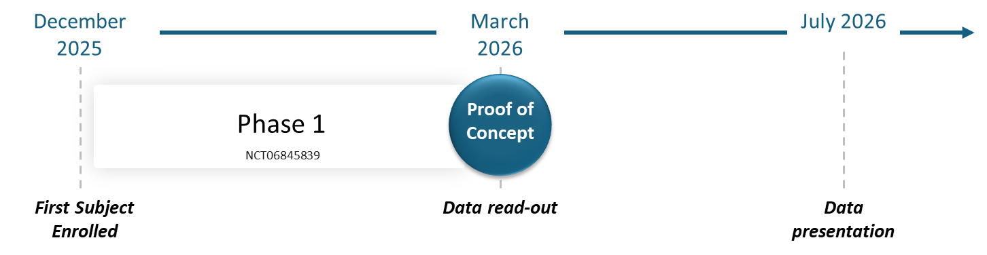
CAY001 Clinical PoC in Early 2026 (TRL 6c)
3:1 randomized placebo-controlled
Healthy Volunteers
SAD
10 minute IV injection
1 day to efficacy; 28 days to safety
Endpoints: Safety, PK and PD
Blood biomarkers predictive of bleeding outcomes
  Thrombin generation= hemostatic efficacy
  TEG= speed and quality of clotting
  Universal across bleeding types

Slide 18
Thank You
Phase 1 study supported by award: MTEC-21-06-MPAI-078
Previous support from DARPA, Army SBIR, JWMRP and Army xTechSearch

