Slide 1


Cellphire
Therapeutics
Saving Lives With Platelet Derived Therapeutics
Mike Gaffney, CEO – mgaffney@cellphire.com
Mike Fitzpatrick, CSO – mfitzpatrick@cellphire.com

Slide 2
Cellphire’s Vision – No-one Should Die from Controllable Hemorrhage
What We Are Solving
The Human Toll
Uncontrolled hemorrhage
is a leading cause of mortality and morbidity in the U.S.
and worldwide
Gaps in Current Treatment Options
Availability across system
Efficacy of rapid hemostasis
Safety from Thromboembolic Events
Chambers JA, Seastedt K, Krell R, Caterson E, Levy M, Turner N. "Stop the Bleed": A U.S. Military Installation's Model for Implementation of a Rapid Hemorrhage Control Program. Mil Med. 2019 Mar 01;184(3-4):67-71. and Hemorrhage Control - StatPearls - NCBI Bookshelf1 mm per year on anti platelet/anticoagulant medication with uncontrolled bleeding
3-5% of women giving birth in the U.S. experience bleeding after giving birth ; PPH causes 27% of maternal deaths worldwide and ~11% of U.S. maternal deaths
Traumatic Brain Injury with hemorrhage: 61k deaths per year in US and 150k to 350k annual cases in US and EU

Slide 3
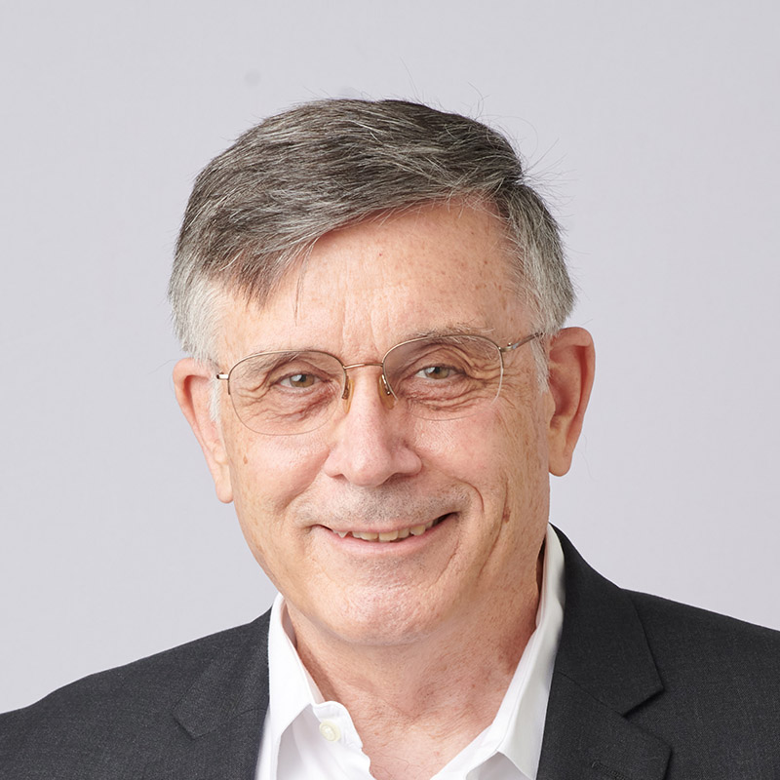

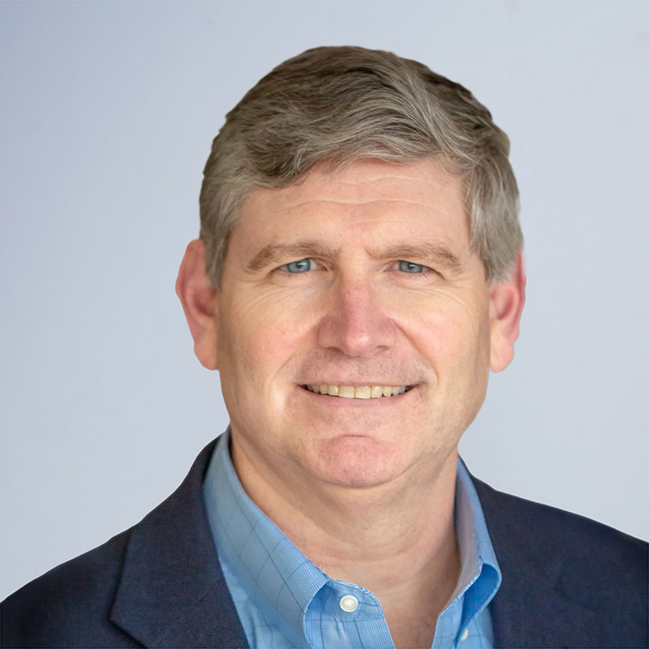





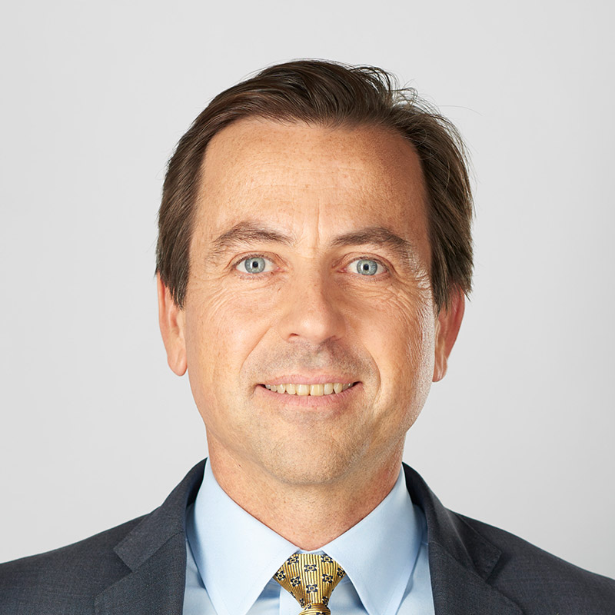
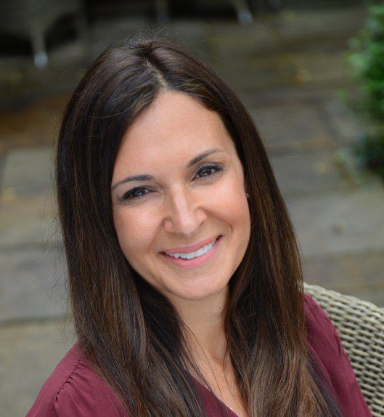






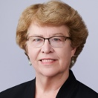







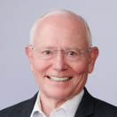
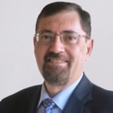








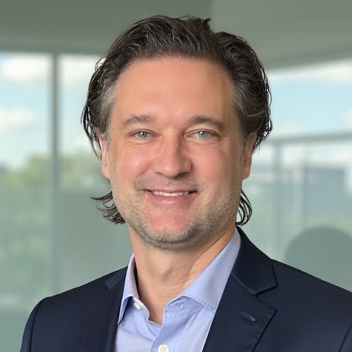





Right Combination of Biologic Development Experience
Cellphire’s Leadership and Advisors
XX
Executive Management Team
Advisors
Mike Gaffney
Chief Executive Officer, Board Director
Michael Fitzpatrick, Ph.D.
Chief Science Officer
Linda S. Barnes, DrPH, MHA
Blood & Biotherapies, Quality, Regulatory
Jose A. Cancelas, M.D., Ph.D.
Hemostasis, Transfusion Medicine, Cell Therapy
Damien Bates, M.D., Ph.D.
Chief Medical Officer
Shireen Bate, MBA
Chief Commercial Officer
Thomas G.Diacovo, M.D., Ph.D., FACMG
Pediatric Hematology
Non-Executive Board Directors
John B. Holcomb, M.D., FACS, COL (Ret)
Trauma, Combat Casualty Care
Tom Dubin, J.D., M.P.H.
Executive Chairman
Pamela B. Conley, Ph.D.
Manny Vacchiano, JD, Ph.D.
Intellectual Property
Louis M. Katz, M.D.
Blood Banking
James Peake, M.D.
Rafael Jorda
Shibani Pati, M.D., Ph.D.
Transfusion Medicine, Cell Therapies, TBI
Glenn Whitman, M.D., Prof.
Cardiac Surgery Quality, Safety
Derek Woods, Ph.D.
Randall Stanicky
Deborah Burrell, President & CEO
Burrell International Group Government Affairs Consulting

Slide 4
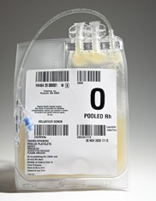
CLPH-511: Frozen Activated Apheresis Platelets TRL 8 – MRL 9
CLPH-511 Key Product Attributes
A platelet substitute, where platelets are in short supply or unavailable
  5-year shelf life vs. 7 days for RTPs
  Significant Commercial Unmet Need
  Military Role 2 and Above & All Acute Hospitals
  CRYPTICS trial stopped early for efficacy
  FastTrack & Medical Product Priority
  FDA support for CRYPTICS program
  Universal donor; <15 minutes freezer to treatment
  Significant DHA support to achieve TRL 8 and MRL 9
Source: FDA

Slide 5
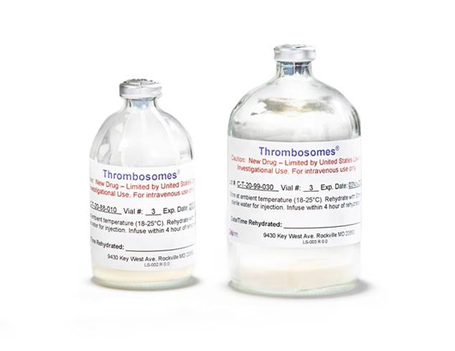
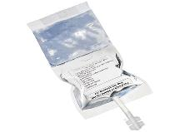
Freeze-dried Platelet Derived Hemostat (FPH): TRL-7 and MRL-7
FPH Key Product Attributes
  >75 Human subjects – including Aortic Dissection Phase 2 IIT minimal effective dose study demonstrating safety and efficacy
  Phase 2A dose finding to enable registration Phase 3 trial
  Clear regulatory pathway to approval
  Fully-activated, increased adhesion, rapid clearance hemostatic agent
  Significant commercial opportunity
  Current DHA and historical BARDA support to achieve TRL 7, MRL 7
First-line, first-in-class, fast-acting biologic with primary and secondary hemostatic effect

Slide 6
Thank You
Mike Gaffney, CEO
mgaffney@cellphire.com
Mike Fitzpatrick, CSO
mfitzpatrick@cellphire.com

