Slide 1


Who really needs a platelet transfusion?
Professor Simon J Stanworth
Consultant Haematologist
National Health Service Blood & Transplant; Oxford University Hospitals NHS Trust; University of Oxford

Slide 2
Disclosures
No direct financial conflicts but discussing trials/guidelines I have led

Slide 3

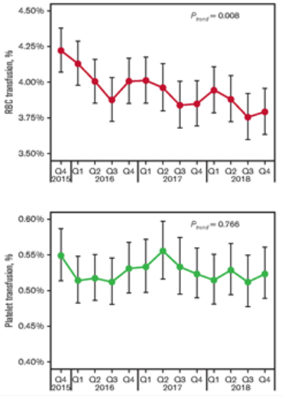

We like giving platelets
Goel, Blood Adv, 2021, Figure 1.

Slide 4
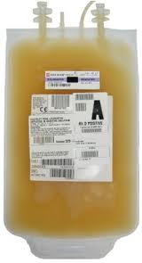

What does a patient ask about platelet transfusion?
What good will this transfusion do me?
Will the transfusion prevent bleeding?

Slide 5

What about questions from a clinician?
Assumptions for platelet transfusion practice
Thrombocytopenia predicts bleeding (prediction)
Platelet transfusions consistently raises platelet counts (efficacy)
Platelet transfusions prevent clinical bleeding (clinical/cost effectiveness), without causing harm (safety)

Slide 6
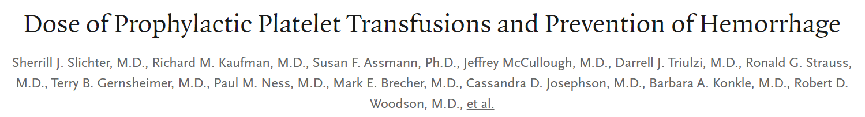

Platelet count: poor predictor of bleeding risk
NEJM 2010: 362; 600-13
Notes:
=General consensus morning platelet count used to guide usage of prophylactic platelet transfusion
BCSH guidelines threshold 10 for patients without additional risk factors and reversible cause BM failure
However, data from this recent large platelet dose study (1352 pts) showed no difference in the proportion of days (17%) in which WHO grade 2 or above bleeding occurred at platelet counts between 6 and 80.
Friedmann (2002) large retrospective study (nearly 3000 patients) showed no relationship between morning platelet count and WHO grade 3 or 4 bleeding
This raises question
Are we using right measure to guide use of prophylactic plt transfusions?
6

Slide 7
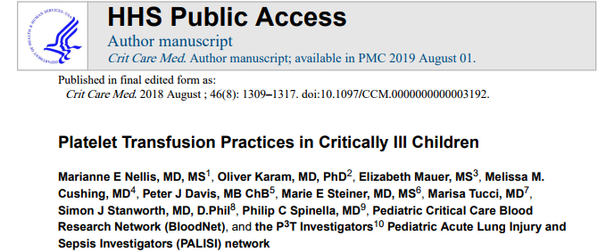
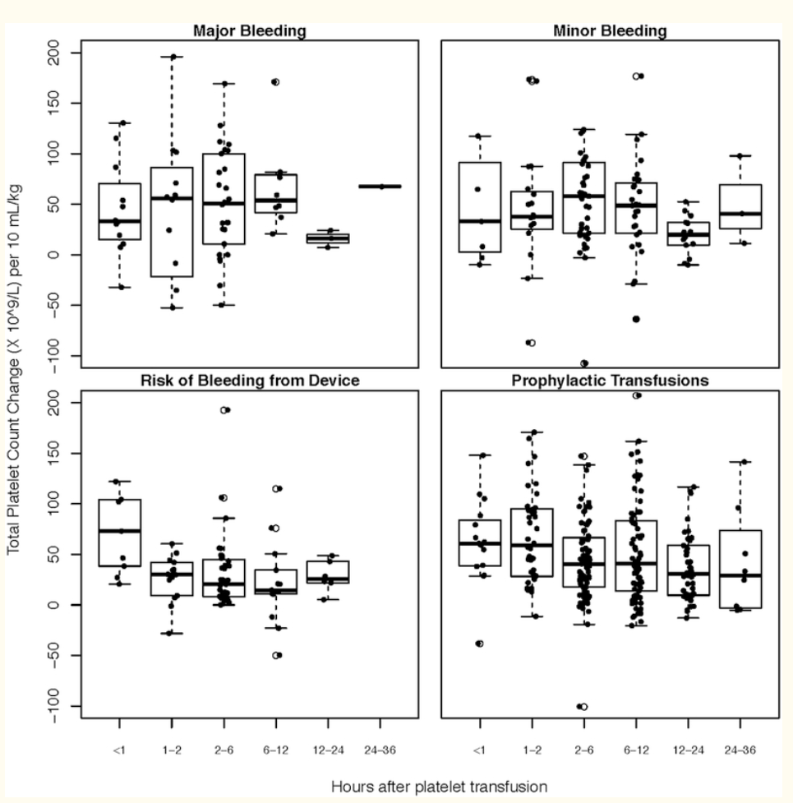
Do platelets consistently raise platelet count?
International prospective cohort study
82 PICU’s; 2017
Product characteristics:
content and function

Slide 8
Balancing benefits with risks
Clinical Benefits (presumed)
Harms (known)
  Patients with thrombocytopenia (or platelet dysfunction) platelet transfusions will prevent/treat bleeding
  Transfusion-related adverse events
      Highest risk of any component
  Alloimmunization
  Infectious disease transmission
  Others??

Slide 9

Harm: Reactions per 10,000 components, by component type
Febrile, non-haemolytic reactions: 1 in 14; Allergic reactions: 1 in 50; Most frequent infectious complications; Many under-recognised eg ICU patients - and passive haemovigilance
Platelets
2011-2024
Narayan, S. et al., 2024. The 2024 Annual SHOT Report, Manchester: Serious Hazards of Transfusion (SHOT) Steering Group.

Slide 10

The evidence base of randomised trials
Platelet transfusion threshold trials
Trials
21 randomized trials enrolled 4923 patients
Is this a sufficient evidence-base?
Jug et al, 2025

Slide 11
Widespread use of platelet transfusions
Often as prophylaxis to broad groups of recipients
Haematology/Oncology
Critical Illness
Patients undergoing “minor” procedures
  Key examples: lumbar puncture, central venous catheter placement, interventional radiology
Cardiovascular Surgery
Trauma & bleeding
Transplant Surgery
Neurosurgery
Obstetrics
Other Surgical Settings: General, Orthopedic, Surgical Oncology, Burn Surgery, Urology
General Medicine
Neonates/children with Critical Illness
R Metcalf
Notes:
Add image

Slide 12
The conundrum of prophylactic use
Risks (and expenses) need to be assessed against uncertain benefits for the patients: a biological ‘product’
Many patients may never experience bleeding events (or die due to bleeding) if prophylactic platelets were not given - but the patient has been exposed to risks

Slide 13
What is the basic trial design of these trials
Arm 1: liberal strategy e.g. threshold
Population
Group 1
Outcomes
Group 2
Arm 2: restrictive strategy
Two-arm
Which is standard arm?
Notes:
13
PICOT
Presume you will say about follow up for 30 days, kept bleeding diary if discharged etc – not practical to put it all on the slides, but will be important for the audience to understand

Slide 14
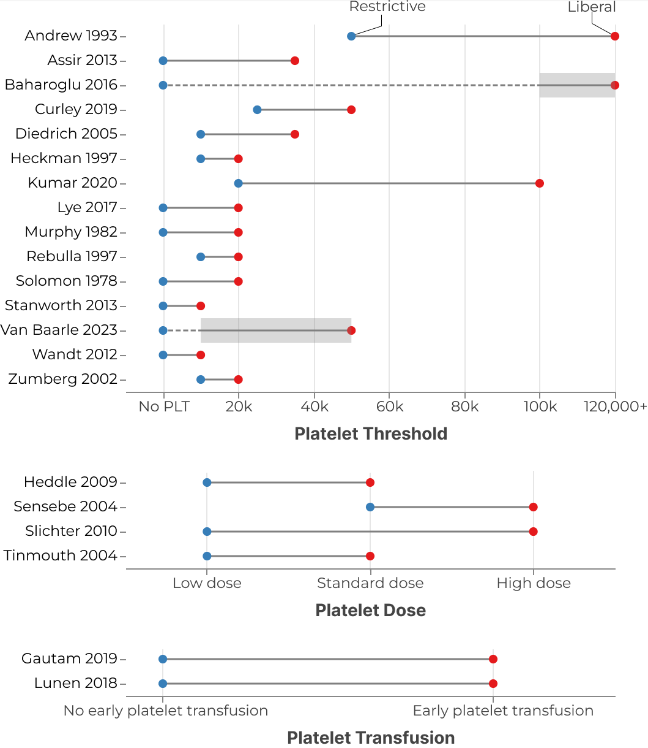

Restrictive vs liberal platelet strategies: Randomized trials
Generally, giving
fewer (restrictive) vs
more (liberal) platelets
eg by dose
R Metcalf

Slide 15

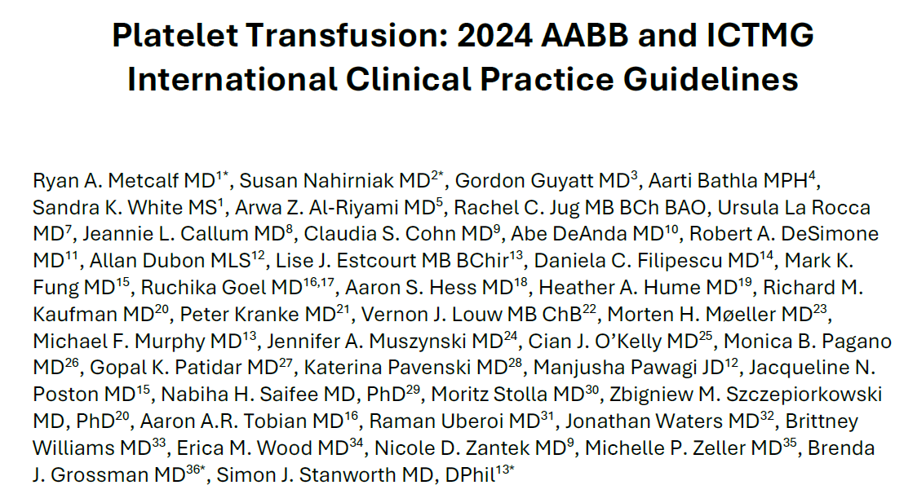
So, what practical advice do we give clinicians?
AABB & ICTMG International Clinical Practice Guidelines
Using randomized trials but recognise limitations

Slide 16

Methodology
2. The evidence (review)
1. The PICO question
3. Panel
Patient partners
6. Recommendations
4. Outcomes, Minimally important differences
5. Summary of findings tables

Slide 17
Overarching PICO Question
For patients in whom platelet transfusion might be considered, what is the impact of a restrictive versus a liberal strategy on mortality and bleeding?
Patients in specified clinical settings
Restrictive Strategy
Liberal Strategy
Mortality, Bleeding

Slide 18
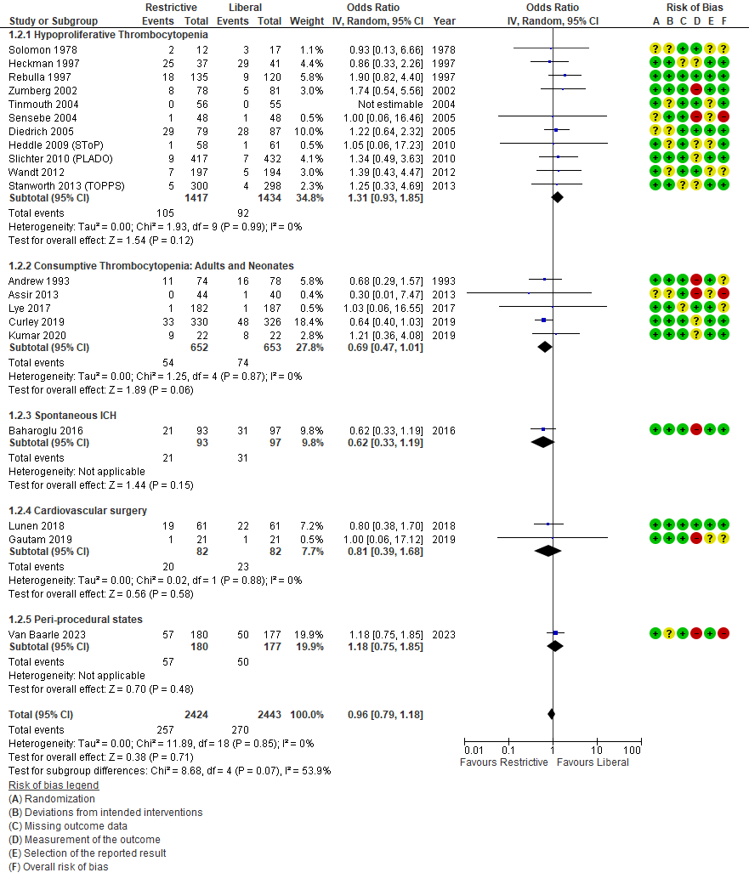
Analysis of all randomised trials across populations
Hypoproliferative Thrombocytopenia
Consumptive thrombocytopenia
Intracranial hemorrhage
Cardiovascular Surgery
Procedural States
Outcome: Mortality

Slide 19
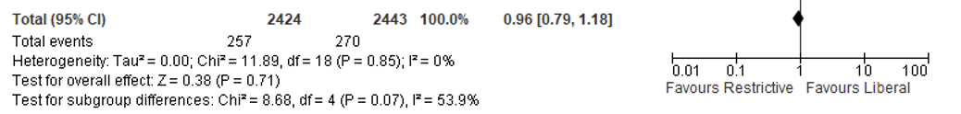
Meta-Analysis
Outcome: Mortality
Common rationale
Odds ratio
OR: 0.96 (CI 0.79 – 1.18)

Slide 20
Summary of Findings
Outcomes | Number of participants | Total events/Total patients |  | Relative effects Odds ratio (95% CI) | Absolute effects Risk differences (95% CI) | Certainty of the evidence (GRADE)
 |  | Restrictive | Liberal
All-cause mortality | 4867 (20 RCTs) | 255/2424 (10.5%) | 268/2443 (11.0%) | 0.96 [0.79, 1.18] | -0.4% [-2.2%, 1.7%] 22 fewer to 17 more deaths per 1000 | ⨁⨁⨁◯ Moderateª
WHO grades 2-4 bleeding or equivalent | 2860 (11 RCTs) | 589/1414 (41.7%) | 544/1446 (37.6%) | 1.32 [1.04, 1.68] | 6.8% [0.9%, 12.8%] 9 to 128 more patients per 1000 experiencing GRADE 2-4 bleeding with restrictive | ⨁⨁⨁◯ Moderateª
WHO grades 3-4 bleeding or equivalent | 3389 (10 RCTs) | 158/1683 (9.4%) | 154/1706 (9.0%) | 1.04 [0.81, 1.32] | 0.3% [-1.4%, 2.4%] 14 fewer to 24 more patients per 1000 experiencing GRADE 3-4 bleeding with restrictive | ⨁⨁⨁⨁ High
ªImprecision

Slide 21
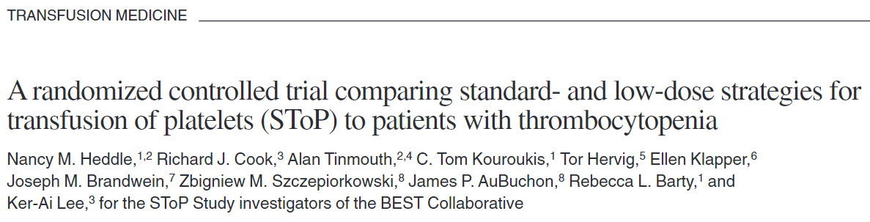

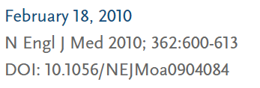

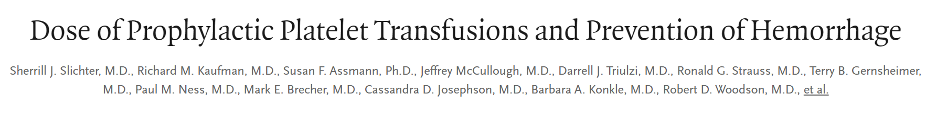
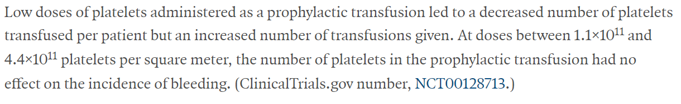
Examples

Slide 22
PLADO: No dose-effect, high rates of bleeding
platelets < 10,000 /µL
3 units
6 units
12 units
71%
69%
70%
Daily observation for WHO grade > 2 bleeding
NEJM 2010: 362; 600-13
S. Dzik

Slide 23
Many RCTs of different doses/thresholds in cancer
A general theme across platelet transfusion trials in haematology has been no difference in haemostatic outcomes between trial arms
No increased bleeding in the restrictive policy arms by lower threshold/dose: no evidence of superiority
Many patients experience bleeding despite prophylaxis

Slide 24




Platelets for Neonatal Transfusion Study-2
Research question: is prophylactic platelet transfusion in preterm babies at platelet count <50x10⁹/L superior to <25x10⁹/L for outcomes of mortality and major bleeding?
Test: liberal strategy 50 x10⁹/L
neonate
PlaNeT-2
Group 1
Bleeding
Survival
Group 2
(PlaNeT-2/Matisse)
Standard: restrictive strategy 25 x10⁹/L
Notes:
24
PICOT
Presume you will say about follow up for 30 days, kept bleeding diary if discharged etc. – not practical to put it all on the slides, but will be important for the audience to understand

Slide 25
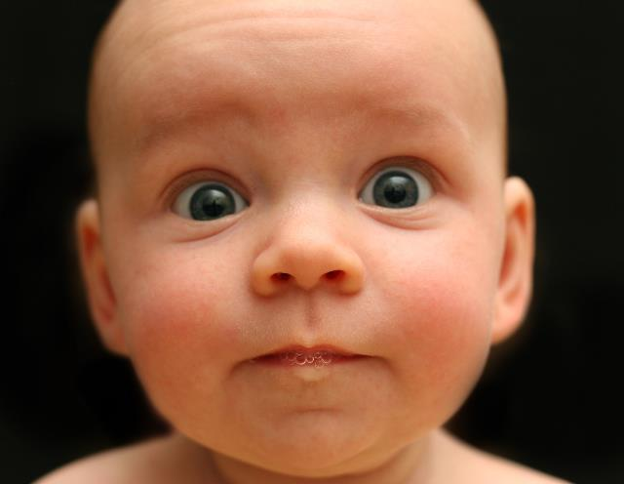
Primary outcome
 | <25 (n=331) | <50 (n=329) | Odds ratio (95% CI) | p-value
Major/severe bleed or mortality by day 28 | 61/329 (19%) | 85/324 (26%) | 1.57 (1.06 - 2.32)† | 0.02
Wait..WHAT?!?
Number needed to harm = 100/(26-19) = 14.3
For every 14.3 patients treated with <50 strategy, 1 extra MB or death would be expected
Limitations
PlaNeT-2
† Adjusted for gestational age, presence of IUGR and centre
Thanks Fustolo-Gunnink

Slide 26
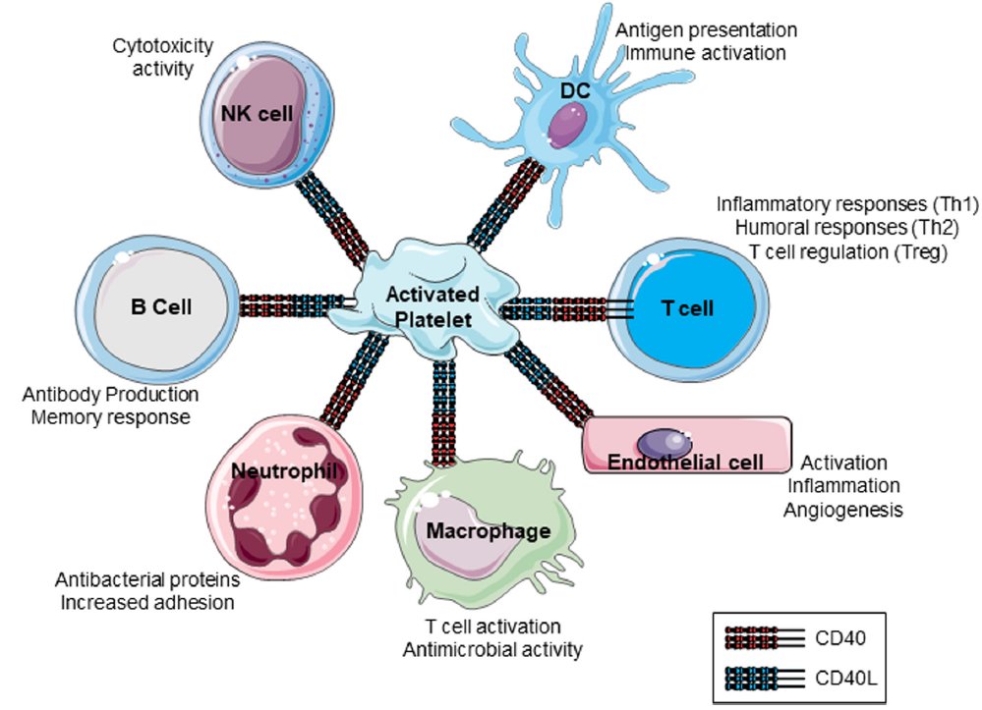
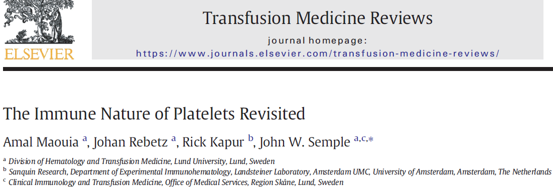
Platelets are ‘immune’ cells

Slide 27
Overall message of the Guideline
Pattern of evidence across populations
No clear evidence of harm using restrictive strategies
Advocates for restrictive platelet transfusion strategies with practical recommendations for implementation
Benefits of restrictive strategies:
  Minimizing transfusion-related adverse events
  Maintaining adequate platelet supply for situations likely to yield important benefits (e.g. major bleeding)
  Reducing healthcare expenditures

Slide 28
Strong recommendations based on high/moderate certainty evidence
PATIENT POPULATION | PRACTICAL RECOMMENDATION/THRESHOLD
Hypoproliferative thrombocytopenia, chemotherapy or undergoing allogeneic stem cell transplantation | <10,000/ul
Preterm neonates without major bleeding | <25,000/ul
Patients undergoing lumbar puncture | <20,000/ul
Patients with Dengue without major bleeding | No platelet transfusion

Slide 29
Conditional recommendations based on low/very low certainty evidence
POPULATION | PRACTICAL RECOMMENDATION/THRESHOLD
HPT, autologous SCT or aplastic anemia | No-prophylaxis
Consumptive thrombocytopenia, critical illness | <10,000/ul
Central line, compressible sites | <10,000/ul
Interventional Radiology | <20,000/ul (low risk); <50,000/ul (high risk)
Major nonneuraxial surgery | <50,000/ul
Nonthrombocytopenic patients undergoing cardiovascular surgery, including bypass | No platelet transfusion
Spontaneous or traumatic nonoperative ICH with platelet counts >100,000/ul including those on anti-platelet agents | No platelet transfusion
HPT = hypoproliferative thrombocytopenia; SCT = stem cell transplant; ICH = intracranial hemorrhage

Slide 30

Moving to next steps…

Slide 31
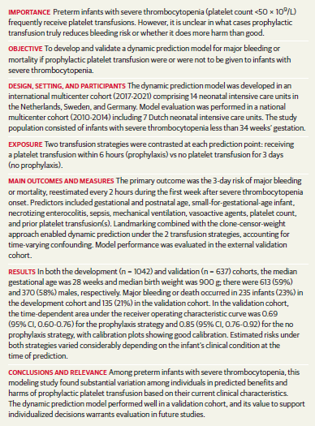
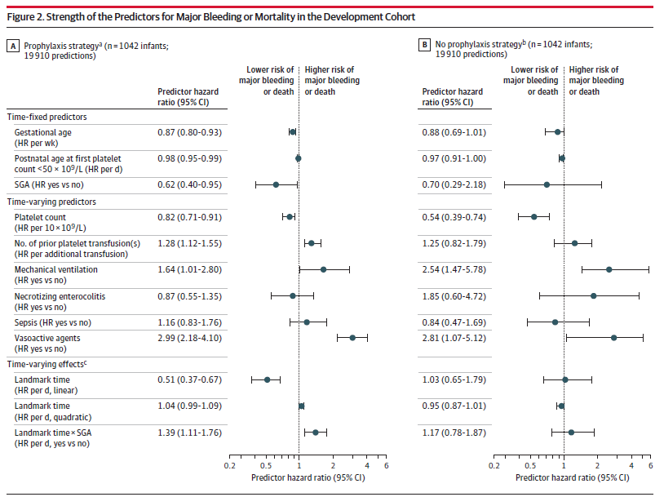


Dynamic prediction model

Slide 32
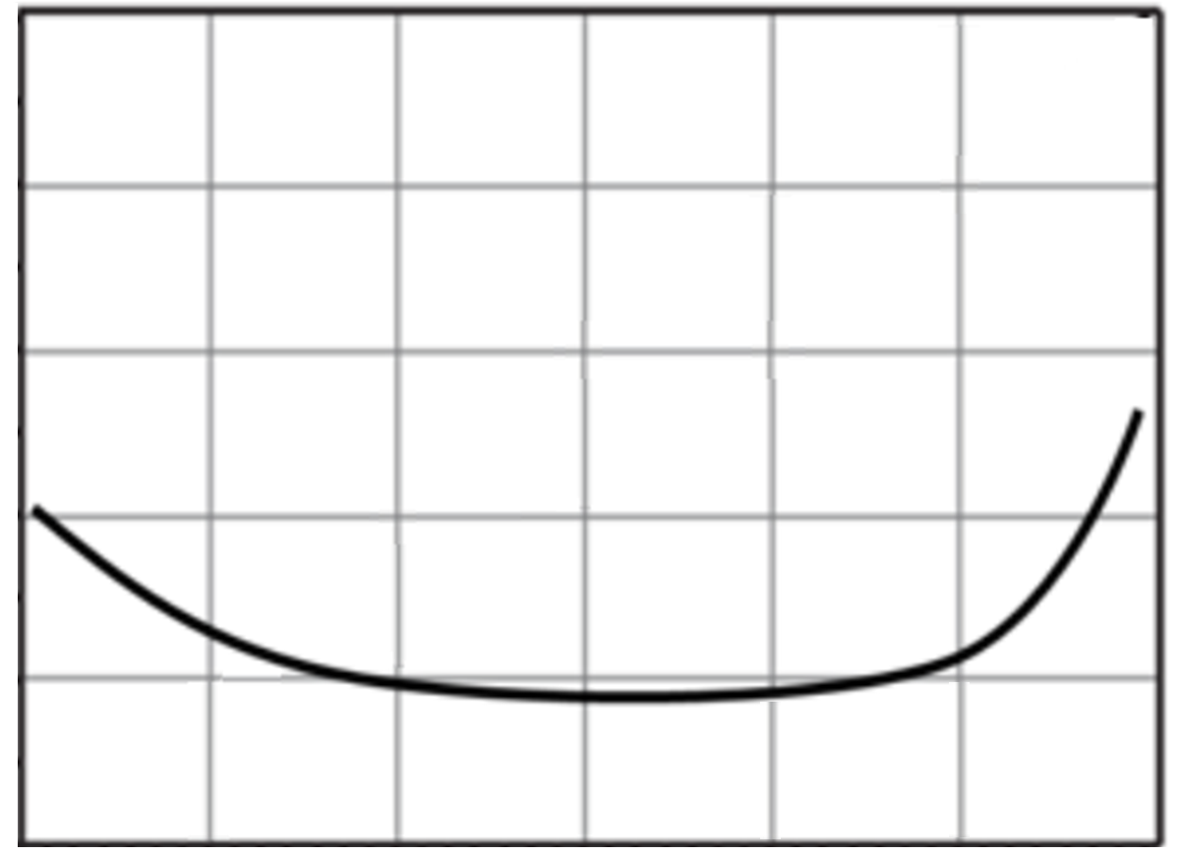
The uncertain relationship (response curve) between platelet transfusions and outcomes
Adverse
outcomes
What is the sweet-spot?
Where is the nadir?
Is it 25 x 10⁹/L?
Platelet
count
25
50

Slide 33
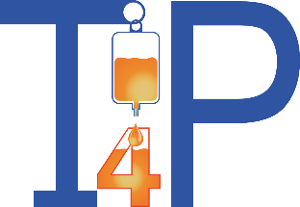



The ‘Threshold for Platelets’ study
An international randomised trial to define the platelet count below which critically ill patients should receive a platelet transfusion prior to invasive procedures
Define the optimum platelet threshold below which platelets should be transfused prior to an invasive procedure in critically ill patients for a primary outcome: 90-day all-cause mortality
Open label, randomised, Bayesian adaptive, comparative effectiveness trial across five equally-spaced thresholds of thrombocytopaenia:
  ▪ <10x10⁹/L ▪ <20x10⁹/L ▪ <30x10⁹/L ▪ <40x10⁹/L ▪ <50x10⁹/L
Notes:
Define the optimum platelet threshold below which platelets should be transfused prior to an invasive procedure in critically ill patients
Open label, randomised, Bayesian adaptive, comparative effectiveness trial across five equally-spaced thresholds of thrombocytopaenia:
▪ <10x10⁹/L ▪ <20x10⁹/L ▪ <30x10⁹/L ▪ <40x10⁹/L ▪ <50x10⁹/L
Primary Outcome: 90-day all-cause mortality

Slide 34

Who really needs a platelet transfusion?
Thanks & Questions
iStock

