Slide 1

Platelets: To Test or Not To Test The Real World Dilemma
Babak Sarani, MD, FACS, FCCM
Professor of Surgery and Emergency Medicine
Chief of Trauma/Acute Care Surgery
George Washington University

Slide 2
Disclosures
Consultant and speaker for Haemonetics
Consultant for Belmont
Author for UpToDate

Slide 3
Objectives
Review common clinical trauma scenarios involving platelet dysfunction
Review the literature related to platelet functioning test
Discuss application of platelet function testing at the bedside today

Slide 4
Another Day in The Trauma Center
72 year old fall from standing, on ASA. +LOC. CT: SAH
55 year old on Plavix for cardiac stents, fall with large flank ecchymosis
20 year old GSW to the spleen and liver. MTP. TEG shows decreased maximal amplitude

Slide 5
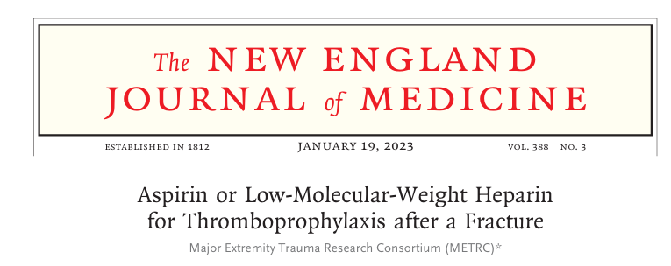
By The Way, Aspirin is an Effective Antithrombic agent
Your antithrombtic is my pro-hemorrhage
You say “antithrombotic”, but I hear “pro-bleeding”

Slide 6
The Clinical Dilemma
Notes:
Naidech articles use VerifyNow
JACS article uses TEG-PM and compares normal volunteers to major trauma pts. Finds a significant difference in %inh between groups. N=51
This generates a lot of angst with bedside clinicians, which usually results in empiric plt transfusion. Especially in the absence of lab data

Slide 7
What We Know About Trauma-Associated Thrombocytopathy
1. Worse with increasing injury severity
  Correlates with base deficit/shock index
  But is present with any degree of injury
2. Worse in those with hemorrhagic shock
  Correlates with need for emergency transfusion
3. Does NOT correlate with platelet count
  Need for functional testing

Slide 8
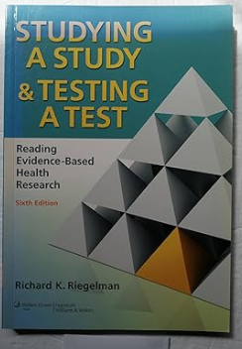
The Role of the Laboratory
Providers are expected to know how to interpret a test
Hemoglobin 7.3 = severe anemia → Transfuse?
Hepatitis B sAg vs Hepatitis B sAb
Notes:
We would not transfuse a Hg 7.3 even though it is definitely abnormal. We interpret the test. The same is true for Plt function

Slide 9
Test | Overall Cohort, n=459 (Average±SD) | TBI, n=102 (Average±SD) | No TBI, n=357 Average±SD
Platelet Count | 230±65 | 215±67 | 234±64
MA | 63±6 | 64±7 | 63±6
MA (AA) | 47±16 | 46±15 | 47±16
MA (ADP) | 32±17 | 32±16 | 32±17
% Inhibition AA | 30±26 | 32±25 | 30±26
% Inhibition ADP | 58±27 | 59±27 | 58±27
Red Blood Cell Transfusion | 3.5±2.3 (n=31) | 2.5±2.5 (n=6) | 3.8±2.5 (n=25)
Platelet Transfusion | 2.5±2.4 (n=28) | 2.6±0.8 (n=18) | 2.7±2.2 (n=10)
Notes:
ISS=6 +/- 6
Age 43 +/- 19
No one was on ASA or Plavix
Platelet “exhaustion” vs impaired calcium metabolism

Slide 10
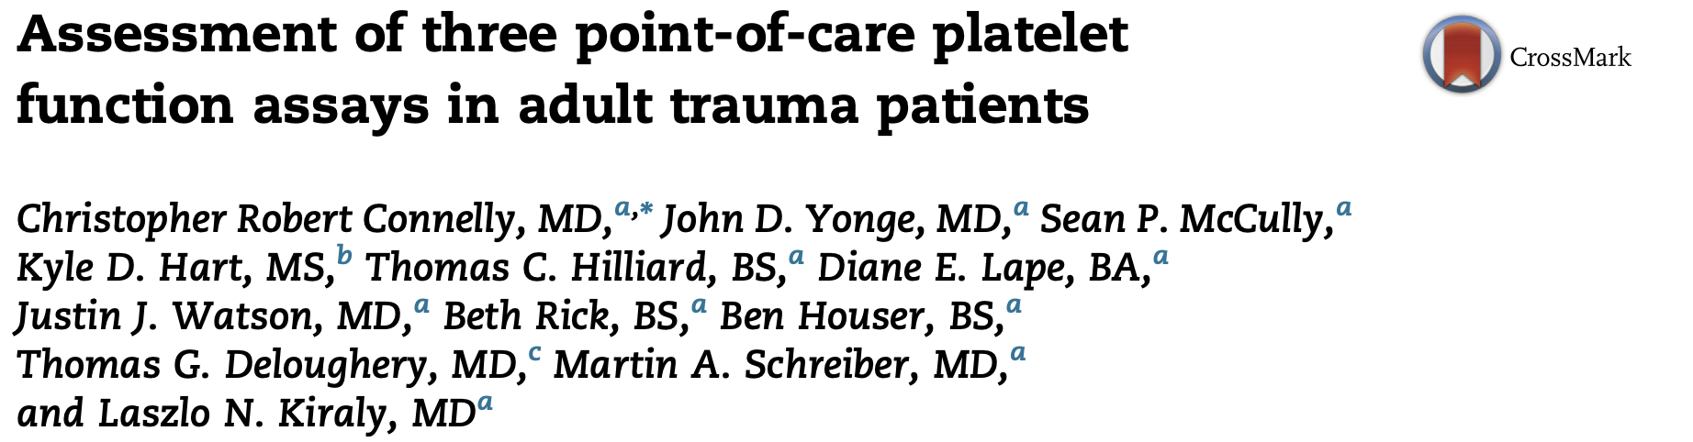
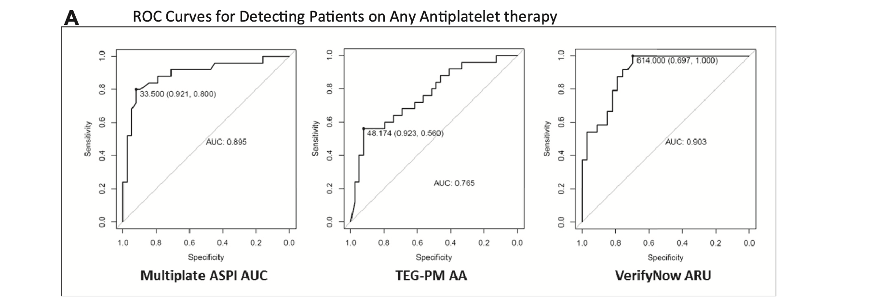
Platelet Inhibition
From Lucy Kornblith, MD
Notes:
Okay, MAYBE.
This is the best performance these platelet function tests have. You can see the → AUC for prediction of antiplatelet therapy for multiplate, TEG platelet mapping and verify now is reasonable.
I would say this is the only potential VALUE that the data supports in these patient populations, predicting anti-platelet medication use

Slide 11
Impact of Platelet Transfusion
N=32 | Before Plt transfusion | After Plt Transfusion | P-value
MA | 63±8 | 63±6 | NS
MA (AA) | 33±17 | 47±17 | <0.0001
MA(ADP) | 26±17 | 34±16 | 0.013
% inhibition AA | 54±30 | 32±30 | <0.0001
% inhibition ADP | 69±29 | 58±29 | 0.024
No dose response relationship found

Slide 12
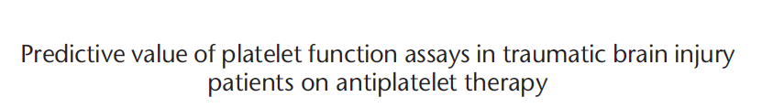

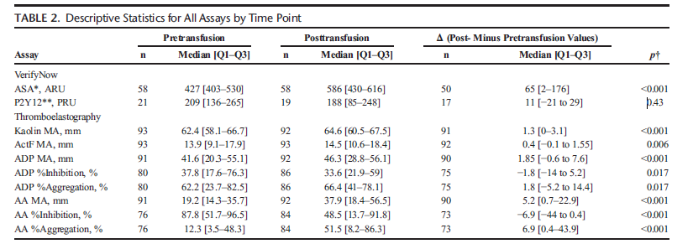
Notes:
TEG and VerifyNow both showed improvement in Plt function with transfusion. Neither was associated with improved clinical outcome – Small sample size or ineffective therapies?? TEG was predictive of adverse events
Macky’s Paper. Subanalysis of a RCT on Plt transfusion for TBI

Slide 13
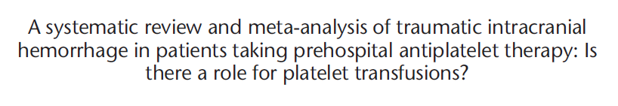

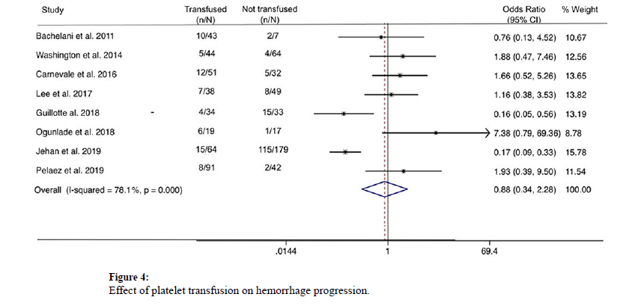
Notes:
Also no association with need for NSGY intervention or death

Slide 14
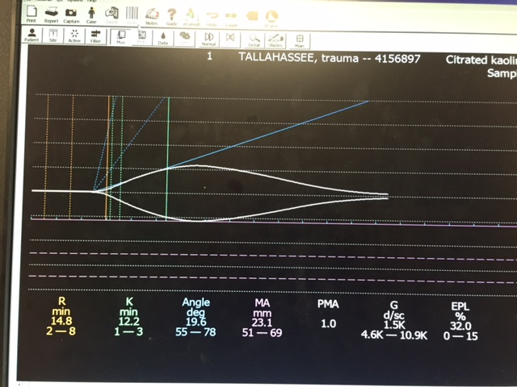
Real Life Case Examples of Platelet Testing

Slide 15
Case 4: 40 yo female MVC
Grade 5 spleen → splenectomy
Grade 3 liver laceration
Left ribs 3-12 fx, Left PTX
Descending thoracic aortic transection -> TEVAR
Bilateral pelvis fx
L5 Fx

Slide 16
“We conclude that platelet dysfunction is present early after injury, before substantial fluid or blood transfusion, and continues during the resuscitation period”

Slide 17
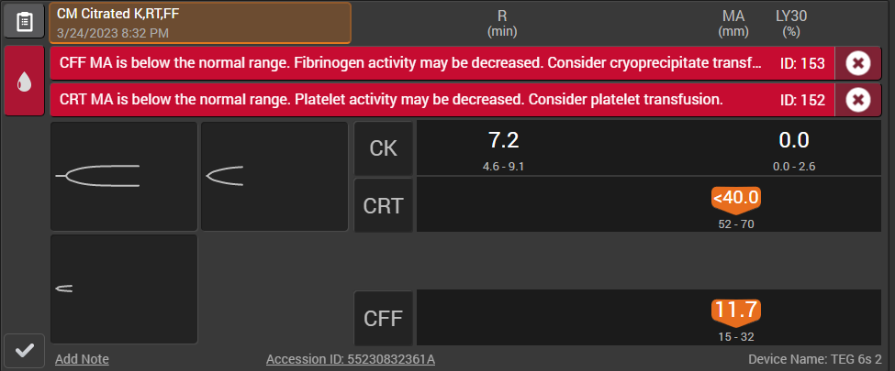
Removal of Arterial Sheath (Same Case)
REBOA max inflated 1741 – 1820
Partial REBOA to maintain a distal SBP 30-60 mmHg for ~ 30 min
REBOA catheter removed at completion of case but sheath kept in place

Slide 18

Conclusion
Platelet testing is NOT perfect and requires interpretation
  So do all other tests
Lack of information WILL result in excess platelet transfusion
Notes:
In the end, the physician needs to make a risk assessment and the consequences of not giving plts can be catastrophic so in the absence of data, the physician will lean towards empiric transfusion. BUT the problem is that the physician needs to understand how to interpret the data

