Slide 1


Cellphire Therapeutics
“Harnessing platelets' unique biology to save lives”.
Joseph Rappold, MD, FACS
jrappold@cellphire.com

Slide 2
The Critical Challenge: Platelet Shortages & Rationing Impacting Patient Care & Putting Strain on Hospitals
Inherent nature of RTP Short Shelf Life has broad implications
Impact on patient care¹
Systemic strains
The NEW ENGLAND JOURNAL of MEDICINE
>Every year, US hospitals waste more than $240M on expired platelets²
~33% of Hospitals have no platelets³
Clinical disparities in “trauma deserts”
Air transport of patients in severe bleeding situations
Eliminates participation in key lines of business (e.g., procedures, Labor & Delivery)
Rationing dynamics
Delayed prophylactic procedures⁴
Unpredictable supply from blood centers⁵
Patients receive lower-than-standard doses⁶
June, 2023
Higher use= bigger impact
Hospitals with medium platelet use vs. Hospitals with high platelet use
Current supply impacts clinical practice & can lead to suboptimal care
Source: NEJM - Riley, et al, “Ensuring a Reliable Platelet Supply in the United States.” NEJM. 2023, Gehrie, et al, Transfusion 2024, 64: 2001-2013.
NBCUS- 2023 NBCUS Data Findings on Blood Collection & Donation Trends
33% hospital Research shows U.S. ability to treat patients who require blood on any given day in peril | UAB News.
Delayed surgeries U.S. National Platelet Inventory and Transfusion Practice Survey - Transfusion News
Pandey S, Gelanger GA, Rajbhandary, Cohn CS, et al. A survey of US hospitals on platelet inventory management, transfusion practice, and platelet availability. Transfusion 2021
Doughty H, Green L, Callum J, Murphy MF; National Blood Transfusion Committee. Guidance from the National Blood Transfusion Committee. Br J Haematol. 2020;191(3):340-346. doi:10.1111/bjh.16736
Notes:
Source: NEJM - Riley, et al, “Ensuring a Reliable Platelet Supply in the United States.” New England Journal of Medicine. 2023, Gehrie, et al,“Addressing platelet insecurity – A national call to action” Transfusion 2024, 64: 2001-2013.; Fox 13 News, Florida; US Dept HHS, Adequacy of theNational Blood Supply, 2020
NBCUS- 2023 NBCUS Data Findings on Blood Collection & Donation Trends
33% hospital Research shows U.S. ability to treat patients who require blood on any given day in peril | UAB News "Meanwhile, 33 percent of hospitals themselves that received blood components from the American Red Cross in 2019 did not routinely have platelets ready to transfuse to bleeding patients."
Delayed surgeries U.S. National Platelet Inventory and Transfusion Practice Survey - Transfusion News
Pandey S, Gelanger GA, Rajbhandary, Cohn CS, et al. A survey of US hospitals on platelet inventory management, transfusion practice, and platelet availability. Transfusion 2021
Doughty H, Green L, Callum J, Murphy MF; National Blood Transfusion Committee. Triage tool for the rationing of blood for massively bleeding patients during a severe national blood shortage: guidance from the National Blood Transfusion Committee. Br J Haematol. 2020;191(3):340-346. doi:10.1111/bjh.16736

Slide 3
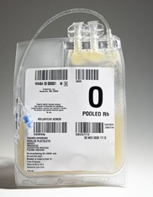
CLPH-511: Frozen Activated Apheresis Platelets
Commercially scalable, biologic quality platelets with a 5-year shelf life
CLPH-511 Key Product Attributes
5-year shelf life vs. 7 days for RTPs
Phase 2/3 CRYPTICS trial stopped early for efficacy
Fast Track designation (March 2025)
FDA/DoD Medical Product Priority designation (Oct2025)
Stored at ≤-65°C
Universal donor
15 minutes from freezer to treatment
A platelet substitute, where platelets are in short supply or unavailable
CLPH-511 manufactured from a pool of FDA-licensed, Group O, leukocyte reduced, irradiated apheresis platelet units (≤10 unique donors)​
Goal: Indicated for treatment of acute hemorrhage in adults and pediatrics
Source: CRYPTICS Investigator brochure and CLPH-511 Target Product Profile
© 2025 Cellphire Therapeutics, Inc. | Confidential

Slide 4
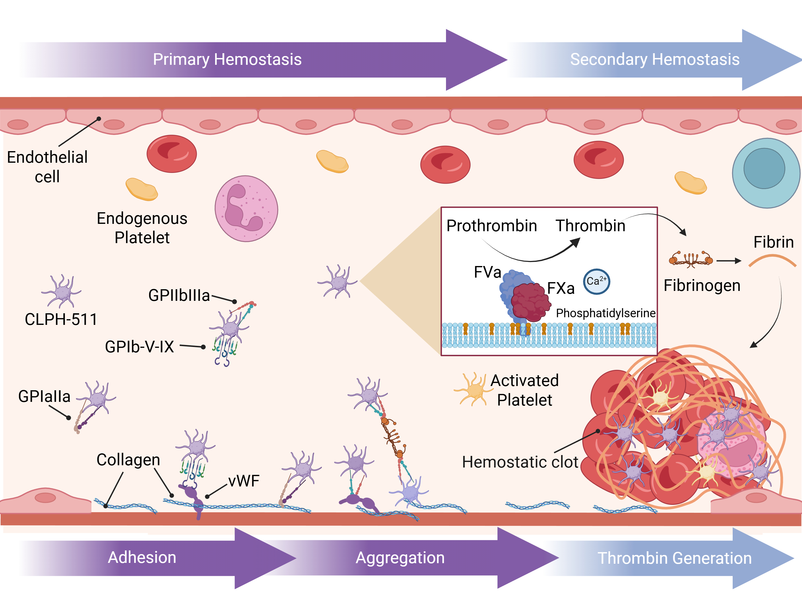
Mechanism of Action
The CLPH-511 activity is derived from the known hemostatic activity for platelets.
Adhesion receptors for aggregation, thrombin generation and promotion of secondary hemostasis have been characterized for CLPH-511 in vitro

Slide 5
Pivotal Trial – CRYPTICS Phase 2/3 Trial
Randomized Controlled Trial Comparing Dimethyl Sulfoxide Cryopreserved Platelets to Liquid Stored Platelets in Patients Undergoing Cardiopulmonary Bypass Surgery (CRYPTICS)
Study Design Overview
Design: Randomized, parallel-group, double-blind active comparator-controlled clinical trial
Study Conduct: March 14, 2022 – May 8, 2025 (study complete)
Study completed early due to meeting primary endpoint at interim analysis
Sites: 18 active sites in the United States
Enrollment Target: Up to 200 subjects (randomized 1:1, CLPH-511 or RTP)
Study Population: Adult subjects undergoing cardiac surgery with cardiopulmonary bypass with risk of post-surgical bleeding
Dose: 1 unit, CLPH-511 (≥1.7 × 10¹¹ platelets/unit) or RTP (≥3.0 × 10¹¹ platelets/unit); up to 3 units in 24 hours
Transfusion Criteria: Intraoperatively or post-operatively according a defined transfusion algorithm based on a combination of lab values, bleeding rate, and clinician’s judgement
Follow-up period: 30-days post-first study drug administration

Slide 6
CRYPTICS Topline Summary of Efficacy and Safety
Primary Efficacy Endpoint of Non-Inferiority has been met with favorable safety profile​
Efficacy data ​
Robust and supported by secondary endpoints​
Safety profile
CLPH-511 is favorable with no red flags in a priori FDA identified areas of risk
Populations well matched
Sensitivity analyses of primary endpoint appear consistent and supportive
Number of study doses used were equivalent
Similar proportion of pRBCs used
No statistically significant differences in:
Treatment failure
Re-exploration rates
Time to hemostasis
Adverse Events balanced between the 2 treatment groups
Thromboembolic complications appear fewer in CLPH-511
Acute kidney injury is similar in the 2 treatment groups
511 appears to have fewer cardiac and renal events leading to prolonged hospitalization
Similar proportion of death in the 2 treatment groups (4.4% vs 5.4%)

Slide 7
Key Takeaway: CLPH-511 is a Potential Alternative to RTPs in Acute Hemorrhage
Study
Randomized, blinded non-inferiority Phase 2/3 trial with active control known to reduce bleeding; N=161
Clinical setting of acute hemorrhage (reproducible high blood loss clinical scenario associated with thrombocytopenia and platelet dysfunction)
Objective endpoint: 24H CTD
Populations well matched
Funding
Supported by the US Army Medical Research and Development Command under Contract No. W81XWH20C0030.
© 2025 Cellphire, Inc. Confidential

