Slide 1

Future Directions of Platelet Function Testing
Emily Mihalko
University of Pittsburgh
Department of Surgery
Notes:
“Which Platelet Functions Matter,” scheduled Feb 19, 2026
After Carlos “regulatory perspective” talk.
Badak – platelet function testing at bedside. protocols, best practices. What are the limitations, where do we have no data to support (TBI). Real world applications of platelet function testing and how to interpret results and how do we use that to prescribe. What are the real-world gaps?
Mihalko 8 minute future directions talk/potential solutions.
Hello I’m Emily Mihalko. I’m a research assistant professor from the University of Pittsburgh and I work in the trauma and transfusion medicine research lab. Very excited to be here today. Thank you Dr. Badak for leading the discussion with real world applications on how we use platelet function testing and introducing some of the real world gaps. I’m here to give a brief talk on the future directions and potential solutions before we open up the floor for discussion.

Slide 2
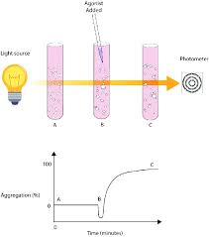
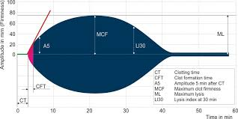
Current Landscape of Platelet Function Testing
Aggregation
Light transmission aggregometry
Impedance aggregometry
VerifyNow
Clot mechanics
ROTEM
TEG
Occlusion
PFA-100 (Platelet Function Analyzer)
Total Thrombus-Formation Analysis System (T-TAS)
Thrombin Generation
Notes:
I hope at this point we can all agree that platelet testing does matter and we use platelet function testing to guide high-stakes decisions.
At the same time, I think we can acknowledge that clinical outcomes remain heterogenous, suggesting a gap between what we measure and the biology that determines hemostatic success.
As for the current landscape of platelet function tests, beyond just platelet counts, you’ve heard about many if not all of these by this point.
Aggregation-based assays can include light transmission aggregometry or VerifyNow.
Viscoelastic platforms like TEG or ROTEM measure clot mechanics and strength.
There are also occlusion-based systems such as PFA-100 or T-TAS.
And thrombin generation assays evaluating plasma-based coagulation potential.
These tools provide valuable information, but most ultimately assess overall clot formation or specific agonist responses rather than defining platelet performance under physiologic conditions.

Slide 3
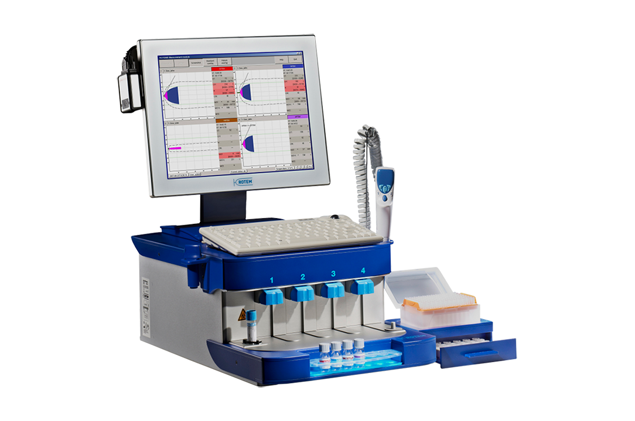
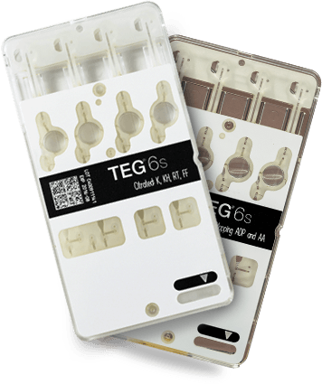
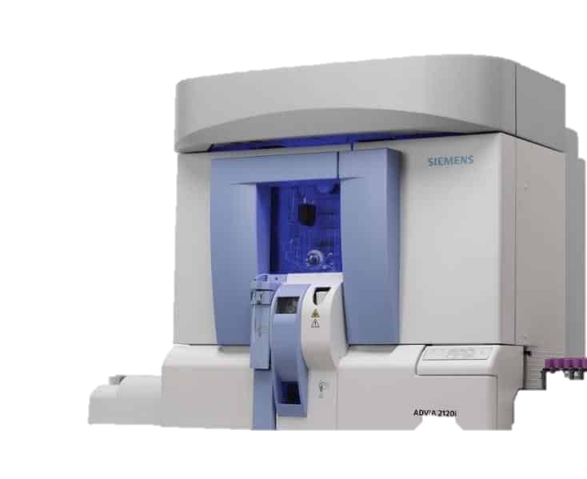
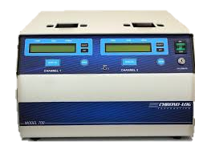
Improving Current Platelet Function Testing
Count → Aggregometry → Viscoelastic testing → Cartridge-based platforms
Notes:
If we look at the trajectory of platelet testing moving from cell count to light transmission aggregometry in plasma to viscoelastic testing in whole-blood to cartridge-based platforms, there’s considerable improvement. Automation and standardization has helped to improve the utility of these current platforms. However next generation testing may need to move even further toward improving physiologic relevance, particularly adding biological surfaces or flow and shear as we know platelets need to function in environments with biological surface and in flowing blood.
But incorporating these aspects may not be feasible in current devices. So at this point, do we keep learning how to best use the assays we currently have, or do we need to build something better. While there is validity and areas to explore using these current platforms, for the sake of discussion I’ll spend most of my time today talking about how we might build something better.

Slide 4
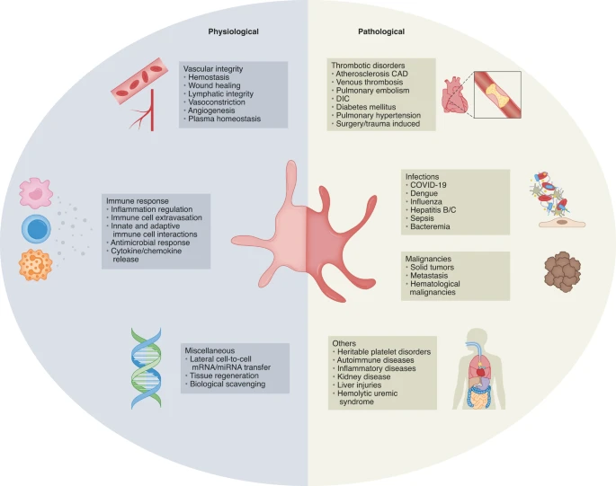
Future Directions and Emerging Technologies in Platelet Testing
Shear-dependent testing
From empirical thresholds to mechanistic failure points
Context-dependent assays
PMID: 37502132
Notes:
So what are important considerations if we want to build something better?
Perhaps an overarching consideration here is that there is still so much we do not know about how and why platelets function the way they do. We know there are a multitude of platelet functions depicted here in the image on the right. But how do we know when shifts in platelet function goes from being adaptive to maladaptive and what are the platforms we need to accurately assess this?
Continuing with the current landscape of platelet function testing may not be enough, so I’m going to highlight a few future directions and potential solutions here.
1st is utilizing shear-dependent testing
2nd is moving from empirically derived thresholds to mechanistic failure points
3rd is using context-dependent assays

Slide 5
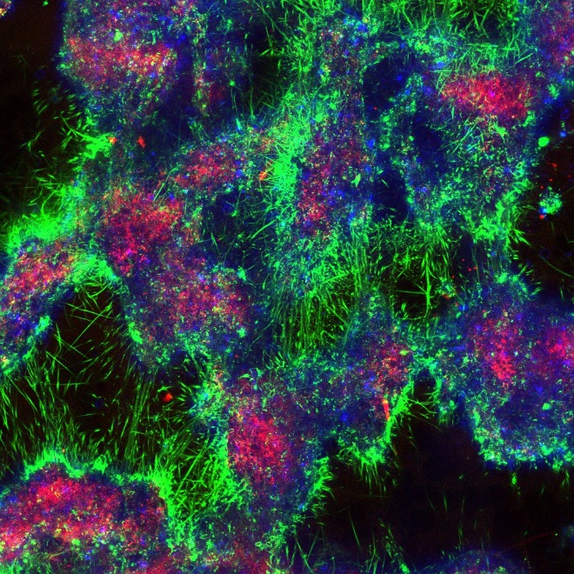
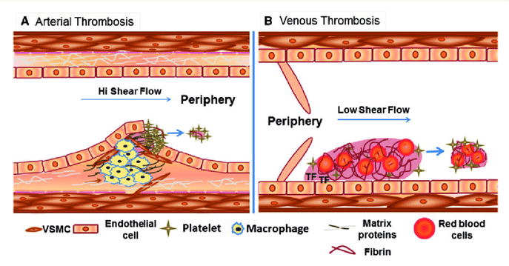
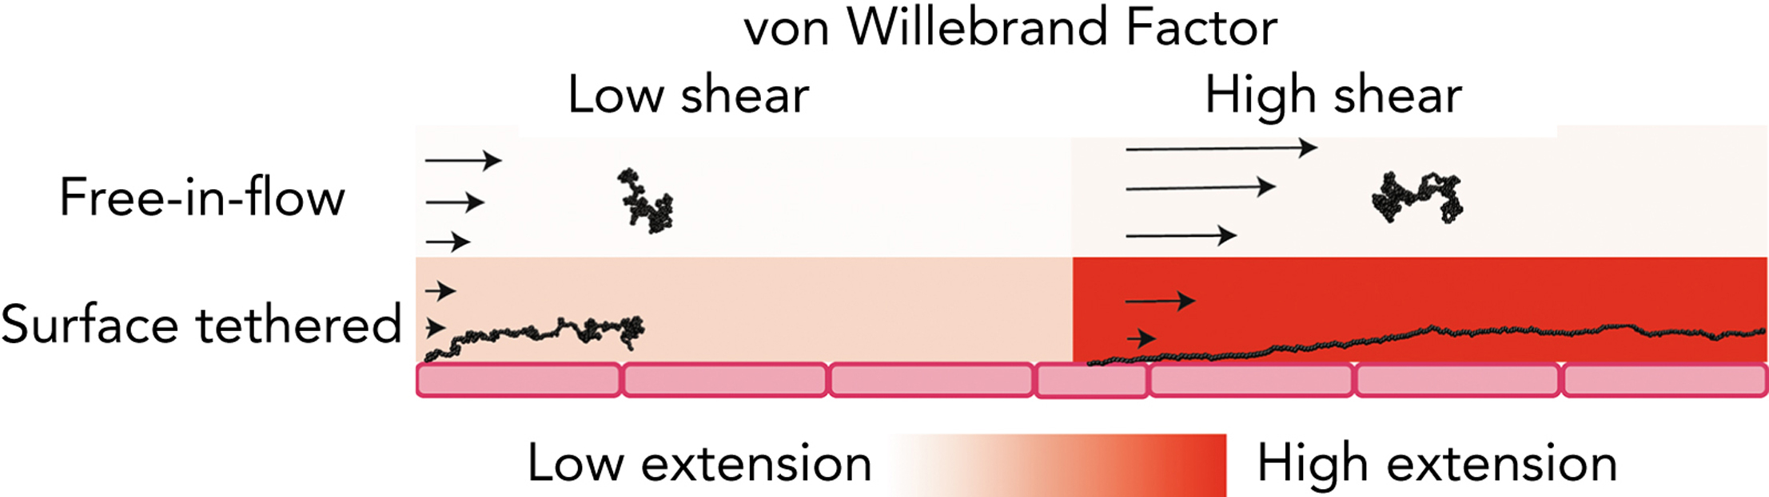
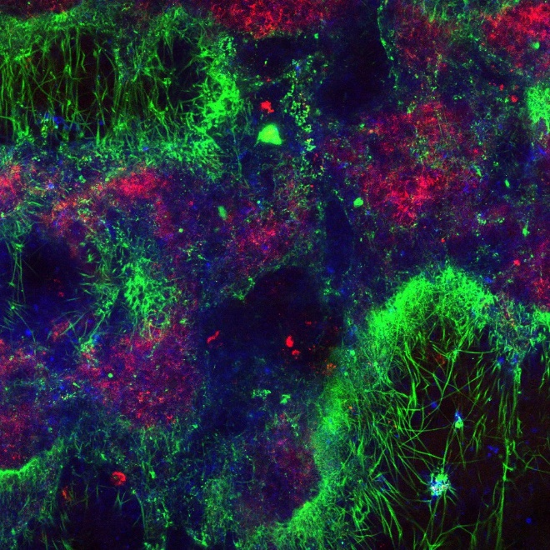
Flow-Dependent Mechanisms Recapitulated using Microfluidics
Customizable platforms
Recapitulates convection challenges, shear-mediated clot composition, and Von Willebrand Factor (VWF) activity
Multitude of outputs (blood loss, hemostatic seal, clot contraction, etc.)
Clot contraction dynamics
0 Hours
Shear-dependent clot composition
Shear-dependent VWF activity
Fibrin(ogen)
CD41
VWF
6 Hours
PMID: 36040485
PMID: 31798819
Notes:
The first approach or direction I’ll dive into is utilizing flow or shear-dependent assays with microfluidic platforms. While there are flow-based assays on the market, I want to highlight microfluidics in this presentation specifically as an engineered way to study platelets. Microfluidics are small, completely customizable devices that can be coated with biologic surfaces or even fabricated to completely mimic vascular morphology. They allow us to capture essential fluid dynamic properties, which is advantageous because we know flow-dependent mechanism that are critical to hemostasis are often overlooked in current platelet function testing. This includes convection challenges that wash away concentrated clotting factors away from the site of injury, clot composition dependent on shear stress and flow rates dictated by venous or arterial vascular beds, and von Willebrand factor activity which is shear-dependent and elicits rapid platelet capture at high shear once extended from its globule state to expose binding sites. Microfluidic platforms can also extract a multitude of mechanistic parameters using immunofluorescent microscopy and image analysis quantification.
In trauma, for example, where platelet dysfunction can occur, only using currently available tests would never allow us to probe into the flow-dependent platelet mechanisms and the true hemostatic effects. However, we may be able to do this with an appropriately designed and implemented microfluidic devices.

Slide 6
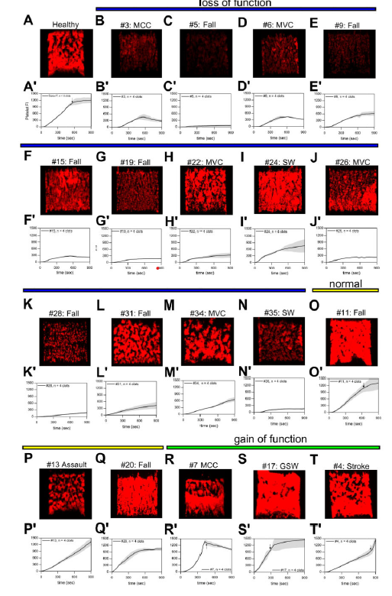
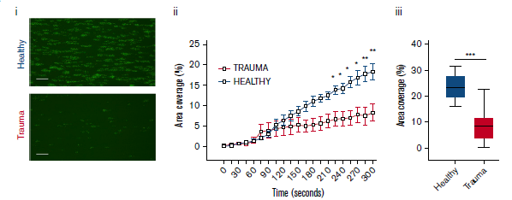
Platelet Function Testing in Trauma Using Microfluidics
Vulliamy et al. 2020
PMID: 32556282
Li et al. 2016
PMID: 27082706
Notes:
Here are two examples of microfluidics used to study platelet function in trauma. At left is a study that perfused samples at venous shear and found a mixed phenotype, with some patients having reduced adhesion and some having more as compared to healthy. Now the ISS in the patient population was relatively low (7.5). On the right is a collagen coated channel perfused at an arterial shear rate which had less platelet adhesion in trauma samples compared to healthy samples. These patients were significantly more injured than the study on the left with an ISS of 34. And they were able to link this response to shedding of platelet surface receptors GPVI and GPIb-alpha.
As this work identifies, there is clearly an unknown patient phenotype discovered using flow-based assays that could very much inform on the mechanisms of platelet dysfunction in trauma. And perhaps, as the study on the right suggests, there are biomarkers or shed receptors we are missing that may be easier to test for rapidly at point-of-care if we already know the hemostatic consequence.

Slide 7
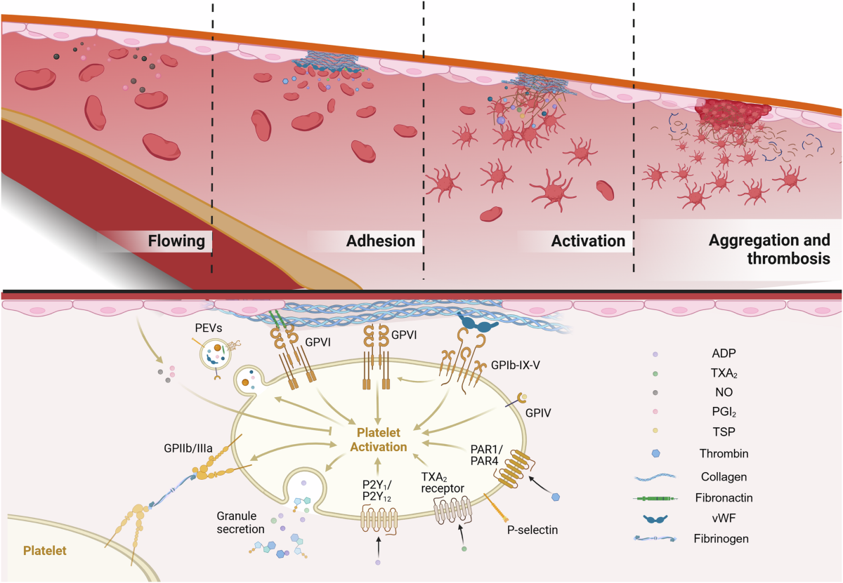
Mechanistic Threshold Determination
Mechanistically anchored thresholds, instead of association-based cutoffs
Not ROTEM parameter < X mm
Instead, an adhesion threshold, growth rate threshold, stability threshold, etc. below which hemostasis fails under physiologic conditions
PMID: 40374650
Notes:
This leads me into the next point on determining mechanistic thresholds to utilize in platelet function testing. Most current thresholds, such as ROTEM parameters, are based on where bleeding happened more often in patient datasets and calculated predictive capability. But that threshold does not necessarily represent the point at which platelet-mediated thrombus formation biologically fails.
Another approach is to define the biological failure point first. For example, can we define the GPIb receptor level at which thrombus formation fails, and then validate that threshold prospectively against clinical bleeding. This could be done for a variety of platelet mechanisms as well – we know there are many that contribute to global hemostatic function as depicted on the right. And using a physiologically relevant platform, such as a microfluidic hemostasis assays, with a quantitative readout for biological failure, such as occlusion time. This can give us the ability to define where hemostasis biologically fails and anchor clinical thresholds in platelet mechanisms.
This approach may not utilize point-of-care assays, but that certainly doesn’t mean it isn’t relevant. Defining these thresholds using standardized, shear-controlled assays relevant to the biology can still help us uncover what signatures lead to global loss of function and start to develop point-of-care tools that allow us to screen for it clinically.

Slide 8
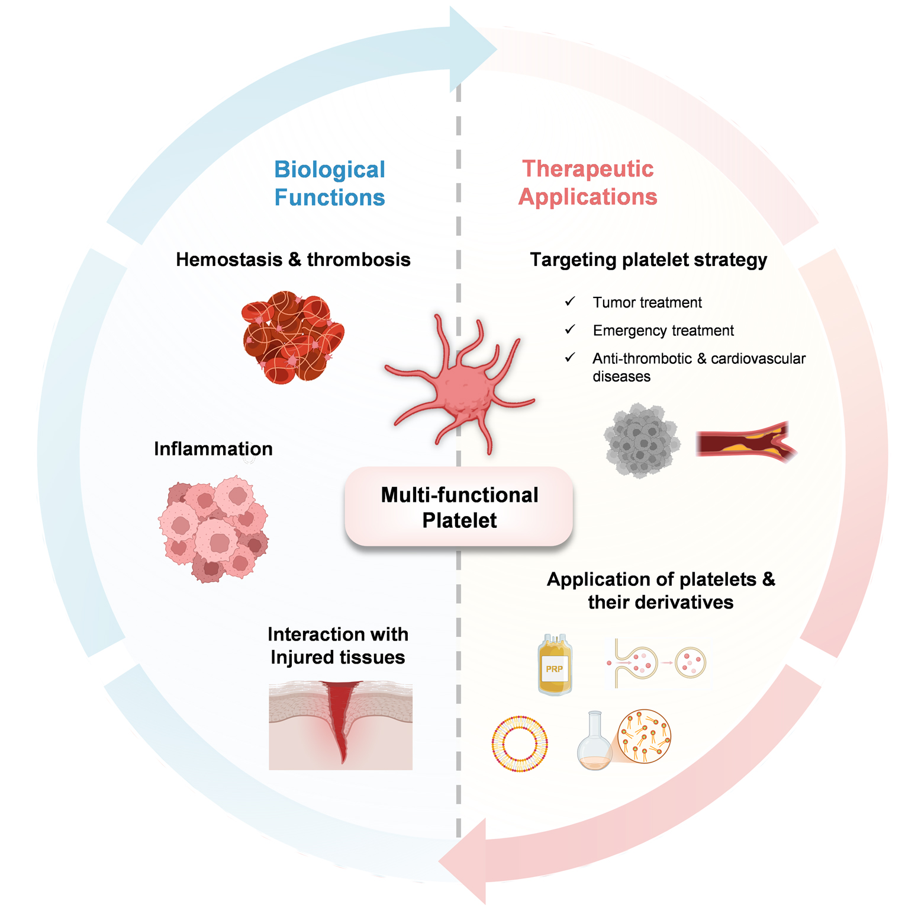
Context-dependent Assays
Zou et al. Vessel Plus. 2025;9:29.
Notes:
I also want to highlight context sensitivity. Platelet performance differs in trauma, sepsis, obstetrics, inflammation. So how do we know we are looking at the right biology?
An important consideration for the future of platelet function testing is context-specific phenotyping.
This might look like different flow-based assays depending on the type of injury in specific vascular beds. Or different screening tools for biomarkers relevant to myocardial infarction versus stroke versus microthrombi formation. Different screening tools for platelet-containing transfusion products. Or different point-of-care platelet function testing that’s relevant to penetrating injuries versus obstetric hemorrhage.
Overall, I think precision medicine in this space requires measuring platelet function in context and not in isolation.

Slide 9
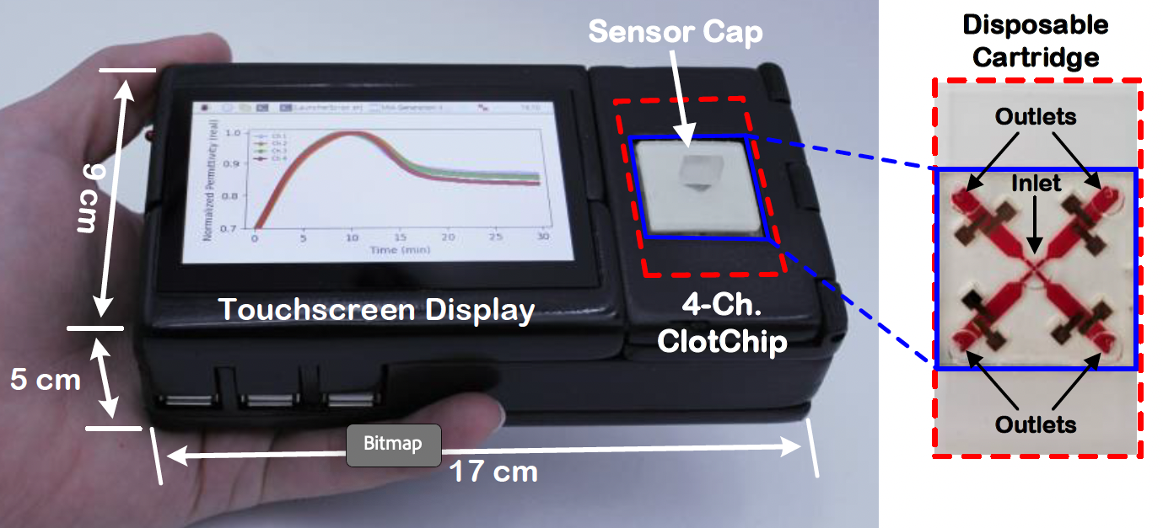
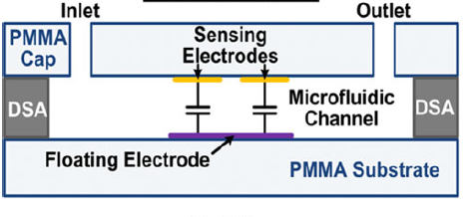
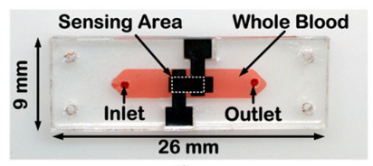
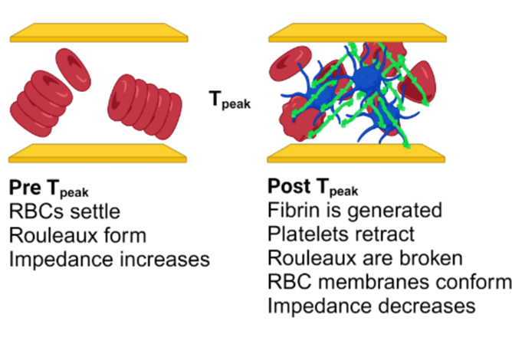
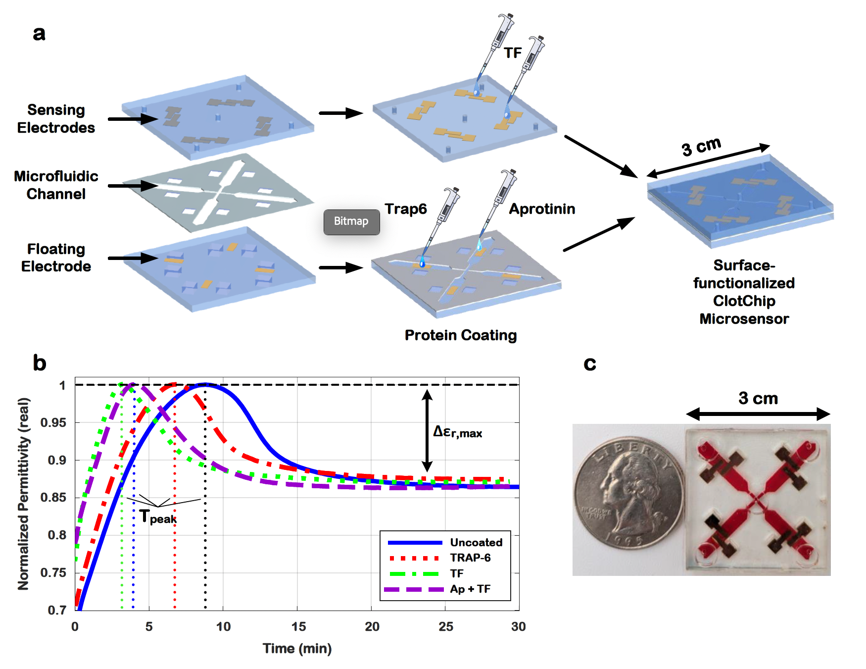
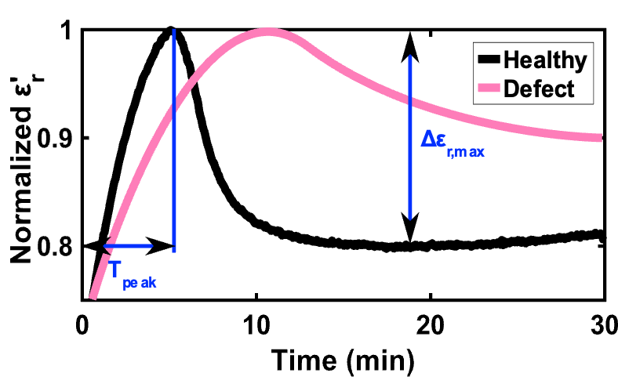
TraumaChek™
Compact Microfluidic Sensor
Non-contact Measurement
Real-time Multiparameter Readout
Slide courtesy of Matthew Neal
and Abiha Abdullah
Notes:
I want to wrap up by talking about a specific technology moving toward a point-of-care device to comprehensively assess trauma induced coagulopathy and guide hemorrhage control with transfusion and resuscitation management.
This technology has been developed into a handheld device known as Traumachek, and it was developed based on principles of electrical conduction. On the top you can see schematics of chip technology. This technology uses gold sensing electrodes on a plastic substrate that forms a microfluidic channel and a current across for dielectric sensing.. This gives you similar outputs to TEG and ROTEM. When a sample is injected and as clot progresses there is real-time tracking of the capacitance which leads to output curves that can be parameterized to gain insight into the speed and stability of clotting.
These chips have been further enhanced and miniaturized with multiple reagents added to gain deeper diagnostic insight.
Essentially this is allowing the user to look at specific platelet contributions to hemostasis with four individual channels with separate protein functionalized surfaces.
And so this device gives more than just a readout of normal or abnormal but enables pathway-level interrogation within a single assay and potential therapeutic responses before ever administering anything to a patient.

Slide 10
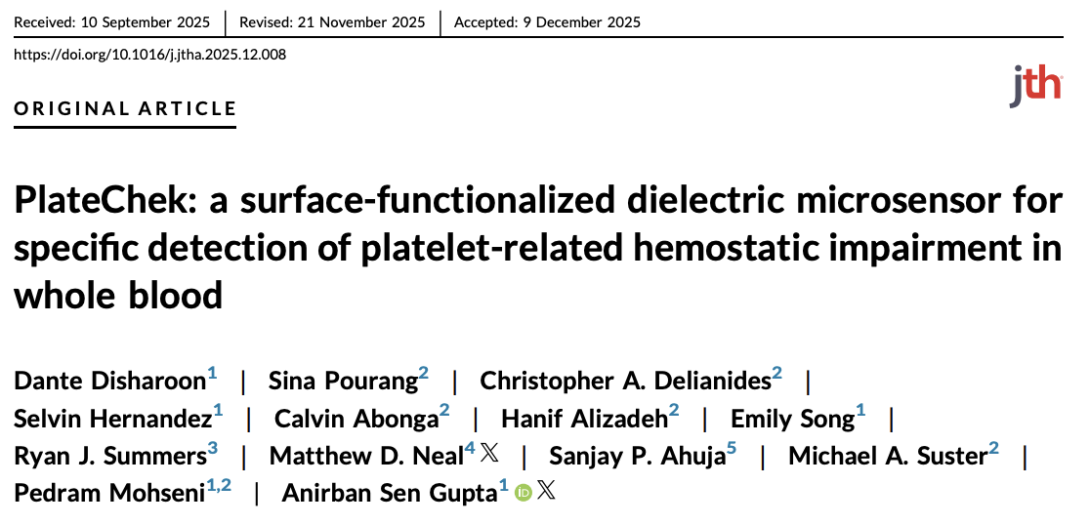
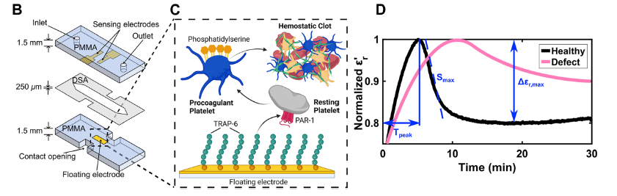
PlateChek
PMID: 41448540
Notes:
There have been recent advances in refining this dielectric coagulometry approach for platelet-specifity. I won’t go into too much detail here but I’ll highlight this recent publication I think what this device is showing the capability to do is move the needle toward specific detection of platelet-related hemostatic impairments in whole blood. It is proving to be readily translational using a small volume of blood and obviating the need for whole blood sample manipulation. And it has the capability to include a comprehensive assessment of platelet-associated hemostatic potential when using multiple bioactive coatings.

Slide 11
Summary and Future Implications
Research-based approaches improve our understanding of the (patho)physiology and pave the way for emerging technologies
Regulatory considerations (measured effects, effect size, etc.)
Platelet function testing beyond hemostatic assessment
Platelets and the immune system
Thromboinflammation
Platelets and the endothelium
Future implications
Improved diagnostics
Better informed therapeutic approaches
Drug development
Personalized care
Notes:
I want to end by saying platelet function testing is evolving but there is a gap in what current clinically available assays can offer and what we need to answer questions about platelet physiology and pathophysiology.
And approaches such as tailor-designed flow-based assays can potentially bridge that gap in understanding.
Of course, the regulatory considerations are something that should always be front of mind. We should be considering what the measured effects are and the effect size.
And I just want to add that while I focused mainly on the hemostatic function of platelets here, there’s also considerable room for advancement in areas such as the interaction of platelets and the immune system or platelets and the endothelium. And improving our understanding in those areas will only enhance our ability to accurate assess patient platelet profiles and design better point-of-care tests to improve diagnostics, therapeutic approaches, drug development and personalized patient care.

Slide 12
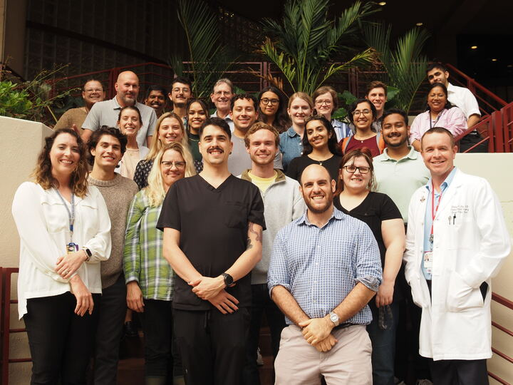



Acknowledgements
Trauma and Transfusion Medicine Research Lab (TTMRL)
Dr. Matthew Neal
Dr. Susan Shea
Lab members past and present
Ronit Kar
Jack Killinger
Garrett Campbell
Katelin Rahn
Kaelyn McClain
Kestrel Merritt
Nick Rocchio-Giordano
Laith Al Khraisat, MD
Jason Brandon
Juliana Briggs
Victor Young
Tirzah Griffin
Javonn Musgrove
Skye Clayton
Lisa Vavro
Dr. Ashley Brown | Brown Lab
Dr. Phil Spinella
Dr. Kim Thomas | Thomas Lab
Dr. Anirban Sen Gupta | Sen Gupta Lab
Dr. Shahid Nimjee
Basking Biosciences
UPMC Enterprises
TTMRL
Pearlson Prashanth, PhD
Irona Khandaker, MD PhD
Refael Munitz
Riya Sharma
Grace Ballentine
Rassam Rassam
Devin Dishong
Lauren Jackson
Fredy Velez Renteria
Amudan Srinivasan, MD
Elizabeth Andraska, MD
Nijmeh Alsaadi, MD
Reem Younes, MD
Abiha Abdullah, MD
Kelly Williamson, PhD
Emily Mihalko
epm35@pitt.edu
Notes:
And I’ll just close by acknowledging the people I am lucky enough to work with. There’s a host of wonderful people who are a part of the TTMRL, especially my mentors Dr. Neal and Dr. Shea. We have many exciting projects ongoing that work toward better understanding platelet function responses in trauma, transfusion medicine, postpartum hemorrhage, as well as in thrombotic disease states. And of course, we wouldn’t be able to work on those projects without some of the amazing collaborators you see listed here as well. I’m excited to continue the discussion.

