Slide 1


Beyond Donor Platelets:
A Shelf-Stable, Fully Synthetic Platelet Surrogate for Rapid Hemostasis
Michael Bruckman: mbruckman@haimatherapeutics.com

Slide 2

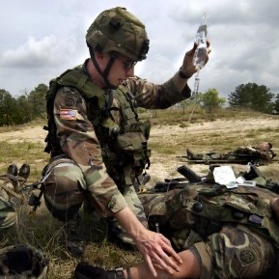

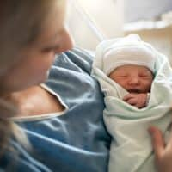
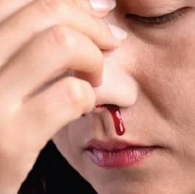
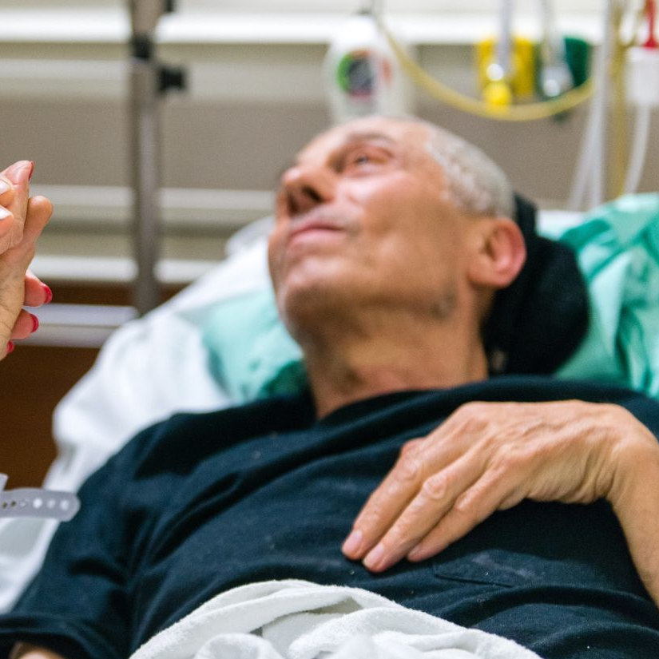
Bleeding is a Massive Problem
Hemorrhage is the leading cause of preventable death worldwide
Uncontrolled bleeding impacts 71M people worldwide
Civilian Trauma
Military Trauma
Surgery
Postpartum Hemorrhage
Bleeding Disorders
Antiplatelet and Anticoagulant use
Blood Products are the cornerstone of bleeding control; especially platelets
State of the Technology Meeting: Platelet and Platelet-like Products

Slide 3
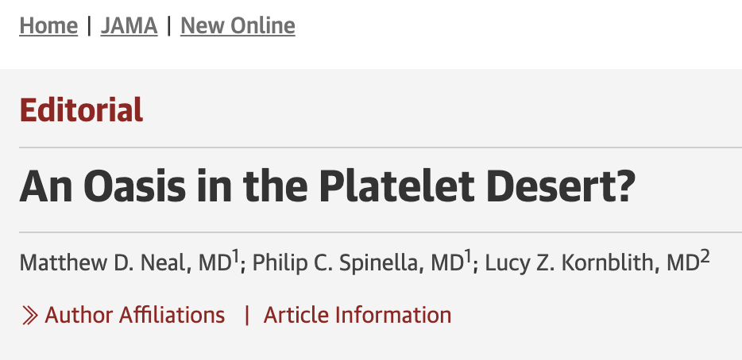
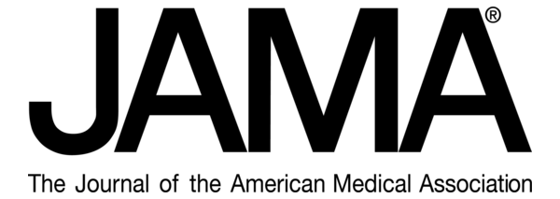
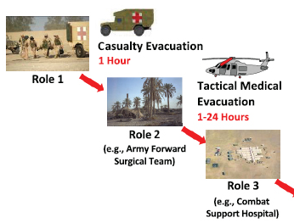



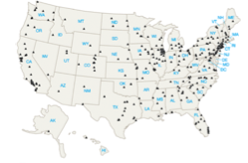


Problem: Access to Platelets
Military Access to Platelets
Shortcomings of Platelets
Civilian Level 1&2 Trauma Centers w/ Access to Platelets
Supply
Storage
Portability
Shelf-life
Infection Risk
Zero Platelets in Role 1
Minimal in Role 2/3
>2M Platelet Units Collected
20% Discarded
Solution: A shelf-stable, donor-independent, platelet-like product to mitigate bleeding
State of the Technology Meeting: Platelet and Platelet-like Products

Slide 4
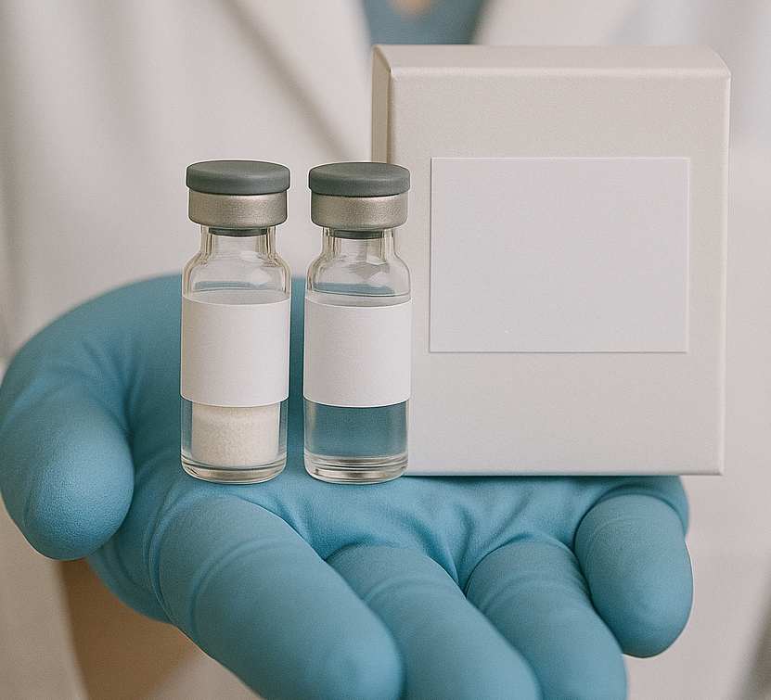
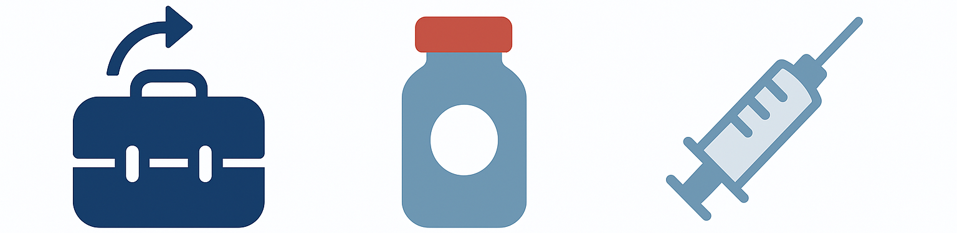
Haima’s Solution
Haima has developed a Synthetic Platelet product for Hemorrhage Control
SynthoPlate mimics platelet’s functions to form a clot only at sites of bleeding
SynthoPlate™ for Injection Kit
For Intravenous Use Only
Reconstitution and dilution required.
Each kit contains:
One 10mg single-dose vial of SynthoPlateTM
One single-dose vial with 10mL of diluent
Discard unused portion. Rx only.
10 mg/vial
SynthoPlateTM for Injection
Diluent
10 mg/vial
0.9% sodium chloride
SynthoPlate is a portable, shelf-stable IV/IO injectable hemostatic drug
FOR DISPLAY PURPOSES ONLY
State of the Technology Meeting: Platelet and Platelet-like Products

Slide 5
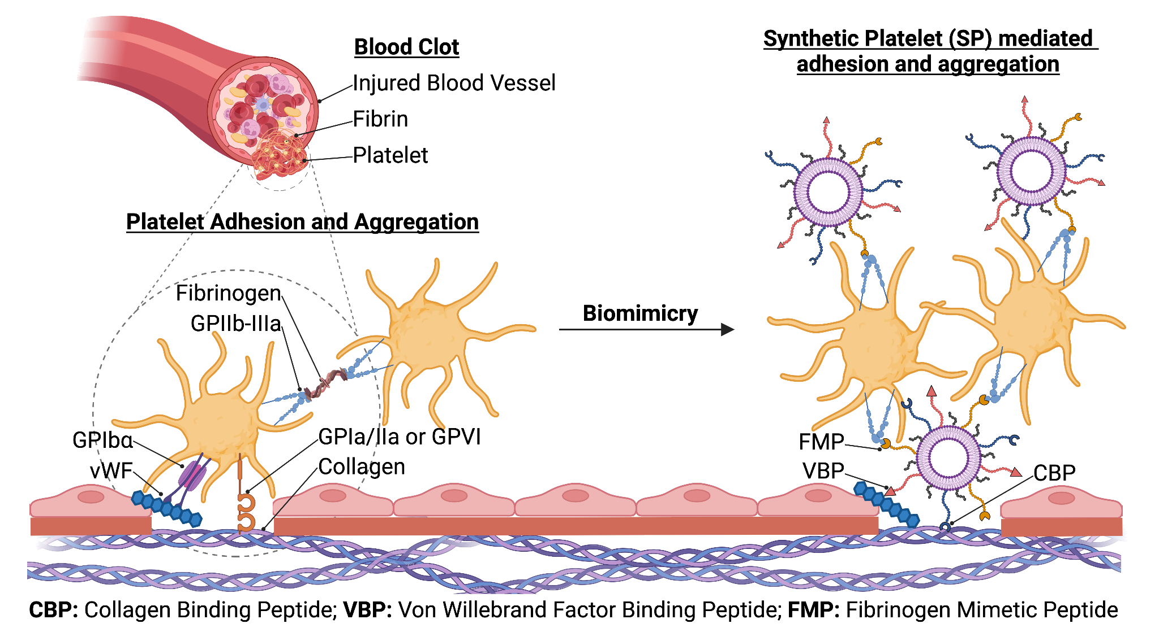
SynthoPlate Drives Platelet-Plug Formation for Hemorrhage Control
Unique MoA restores hemostasis in:
Major trauma/surgery
Low platelet counts
Presence of anti-platelet therapies
Bleeding disorders (e.g. Von Willebrand Disease)
SP
SP
Platelets
SP
Fully synthetic (scalable manufacturing)
Shelf-stable (>1 year), lyophilized formulation
Compact (10 mL vial), portable, & easy to use
Reproducible hemostatic function
No risk of infection or type-matching reactions
Low cost

Slide 6




SynthoPlate Reduces Blood Loss by up to 75%
Model |  | Admin. & Timing | Reduced Blood Loss By
Mouse Tail Transection in Thrombocytopenia |  | RO, Pre/Post | ~75%*
Mouse Tail Transection in Type 2B VWD |  | IV, Pre | ~35%
Mouse Tail Transection in Type 3 VWD |  | IV, Pre | ~65%
Mouse Tail Transection w/ Antiplatelet Therapy |  | IV, Pre | ~70%*
Rat Liver Laceration |  | IV, Post | ~25%
Rat Liver Laceration |  | IO, Post | ~45%
Rabbit Hemodilution + Kidney Incision |  | IV, Pre | ~55%*
Rabbit Polytrauma |  | IV, Post | ~50%
Rabbit Ear incision in Thrombocytopenia |  | IV, Pre | ~35%*
Pig Femoral Artery Punch Trauma |  | IV, Post | ~50%
Excellent Safety Profile
40
30
20
10
0
250X Margin of Safety
Dose (mg/kg)
Max Tolerated Dose
Active Dose
No signs of systemic clotting in all animals tested
*Shown to be as effective as a unit of platelets
State of the Technology Meeting: Platelet and Platelet-like Products

Slide 7
Seeking $10M to get clinical safety data and potential EUA
SynthoPlate Development Roadmap
2026 |  |  |  | 2027
Engineering Batch
IND-enabling studies
DARPA Funded
Clinical Batch
Clinical Ph 1 Healthy
Clinical Ph 2 Spine
Pre-IND Mtg
IND
EoP1 Mtg
Capital Program Needs
Contracted Non-Dilutive Funding
Potential VC + Fed Funds
$16M
$35M
$6M
EUA
US & Global Access
$10M
State of the Technology Meeting: Platelet and Platelet-like Products

Slide 8
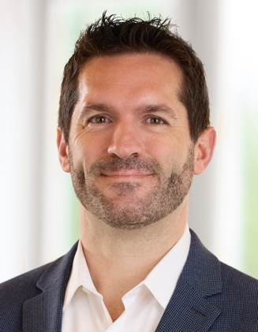
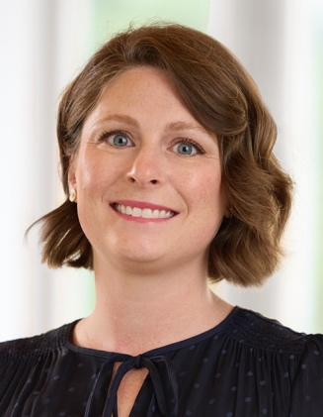
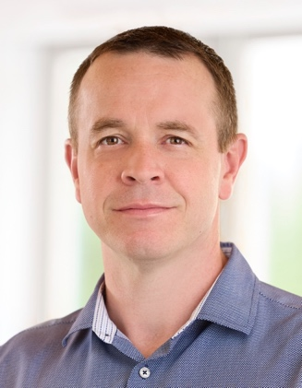
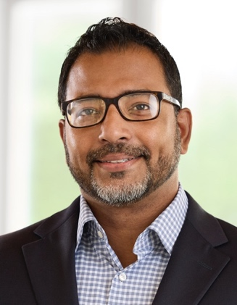
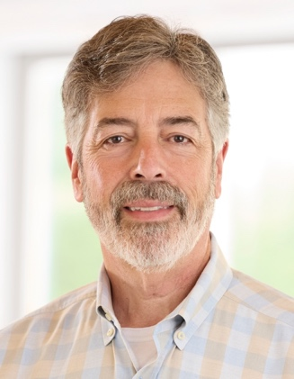









Executive Management Team
Michael Bruckman, PhD
CEO
Former Chief Technology Officer at NanoBio Systems
Christa Pawlowski, PhD
COO, Co-Founder
COO for Allinaire Therapeutics (partnered with Chiesi) and SapVax
Matthew Neal, MD
CMO
Trauma Surgeon
Dir. Pittsburgh Trauma and Transfusion Medical Research Center
Anirban Sen Gupta, PhD
CTO, Inventor, Co-Founder
Professor Biomedical Engineering
Timothy Pelura, PhD
Executive Chair
Serial life science entrepreneur, 40+ years experience
Scientific Advisory Board
Military Advisory Board
Anirban Sen Gupta, PhD
Matthew Neal, MD
Phil Spinella, MD
Jerry Levy, MD
Wolfgang Bergmeier, PhD
Capt. Travis Polk, MD
Col. Michael Policastro, MD
Lt. Col. Phil Spinella, MD
Brig. Gen. Mike Cornell, JD
Joe Palfini, MSN
State of the Technology Meeting: Platelet and Platelet-like Products

Slide 9
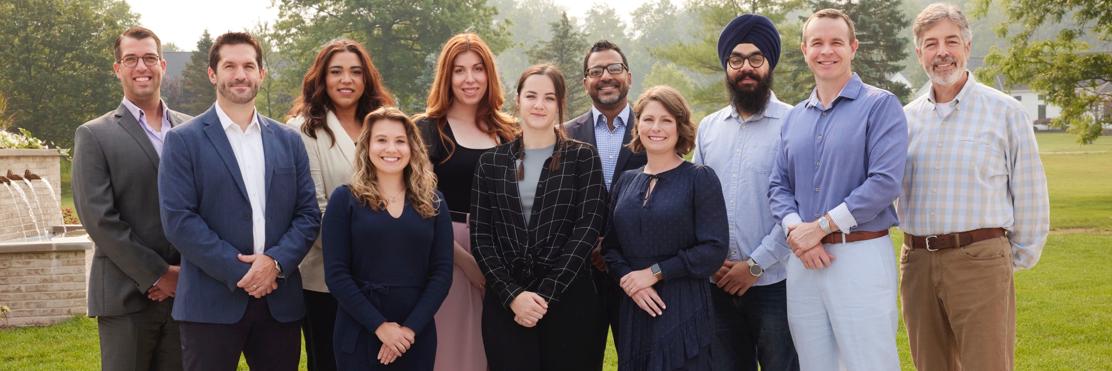









mbruckman@haimatherapeutics.com

