Slide 1
Genetically Modified Transfusable Platelets using mRNA
Toward New Platelet Functions in Donor Platelets
.
Christian Kastrup
Senior Investigator
Versiti Blood Research Institute
Professor
Departments of Surgery, Biochemistry, Biomedical Engineering, and Pharmacology and Toxicology
Medical College of Wisconsin
Affiliate Professor
Michael Smith Laboratories
University of British Columbia
ckastrup@versiti.org

Slide 2
Important Required Disclosures
I am a Co-Founder and Shareholder in:
NanoVation Therapeutics, Inc.
Provides lipids and LNP for partner companies
SeraGene Therapeutics, Inc.
RNA therapies for blood disorders
Syrina Therapeutics, Inc.
Self-amplifying RNA gene therapies for partner companies
CoMotion Drug Delivery Systems, Inc.
Device engineering for controlling traumatic hemorrhage
Consulting and/or Contract research and/or Patent income:
. Moderna . CSL Behring . Alnylam . Bayer . Acuitas . Novo Nordisk . Eli Lilly

Slide 3

Bleeding… It’s a problem.

Slide 4

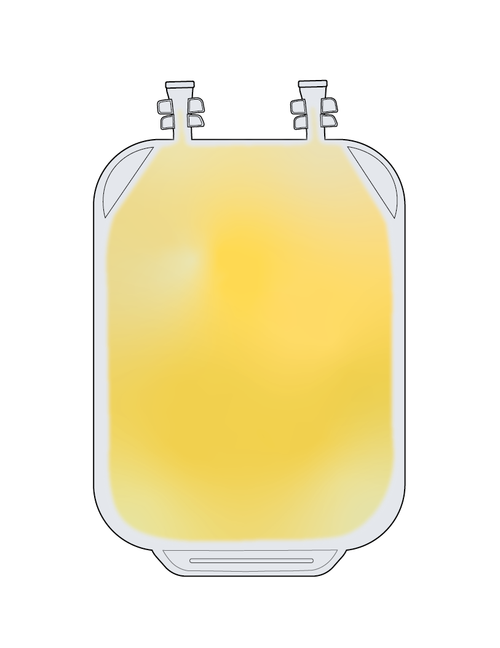
Bleeding… It’s a problem.
Bleeding is a leading cause of death worldwide
2 million platelet units transfused annually in US
Enhancing platelets is a potential solution
Platelets are challenging to genetically modify ex vivo

Slide 5
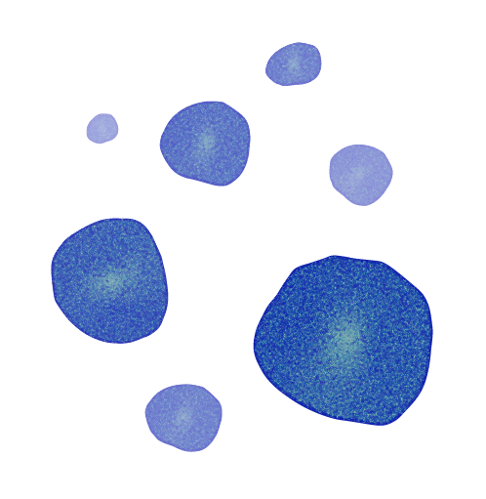

There are barriers to genetically modifying platelets
Platelets are highly sensitive to their environment
Platelets lack DNA
Platelets contain all the translational machinery required for protein synthesis
Resting
Platelets
(Low CD62P)
Environmental Signals
Sheer Stress
Chemical Exposure
Can platelets be genetically modify by transfection with mRNA?
Activated
Platelets
(High CD62P)

Slide 6
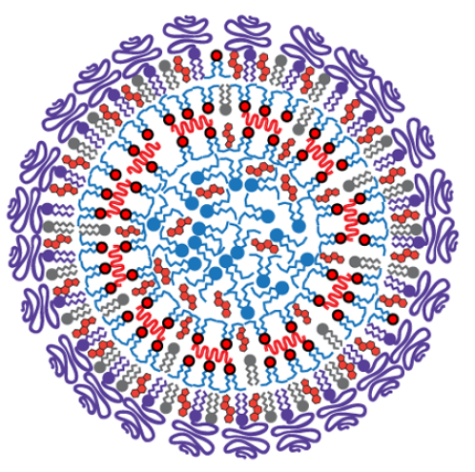
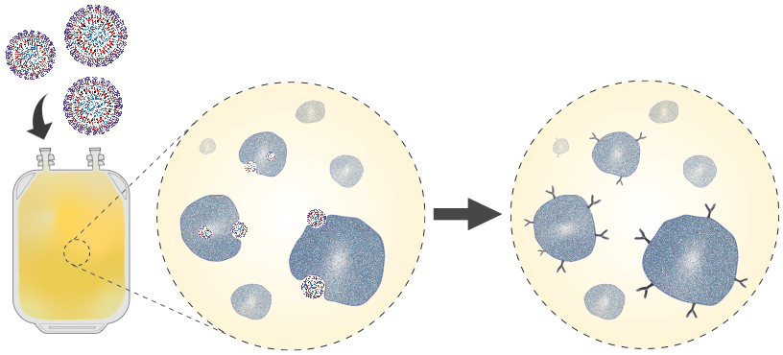

Platelet engineering to create cell therapies
using mRNA-lipid nanoparticles
Hypothesis:
Platelets transfected with optimized mRNA elements will express exogenous protein.
mRNA - Lipid Nanoparticles (LNP)
Modification by delivery of nucleic acids
(Transfection)
Donor platelets expressing
Exogenous protein
Donor platelets
J. Leung*, C. Strong*, KE Badior*, M Robertson, X Wu , MA Meledeo, E Kang, M Paul, Y Sato, H Harashima, Cap AP, D Devine, E Jan, PR Cullis, CJ Kastrup, Science Advances, 2023

Slide 7
Direct transfection of donor platelets has advantages compared to approaches using stem cells
Compatible with blood banking processes
More available and similar to circulating platelets, than platelet-like particles produced in vitro from stem cells production
Faster to administer than bone marrow transplant

Slide 8
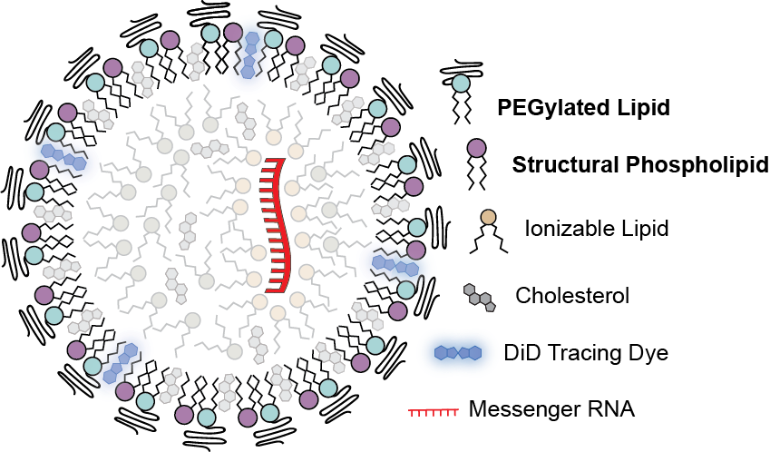
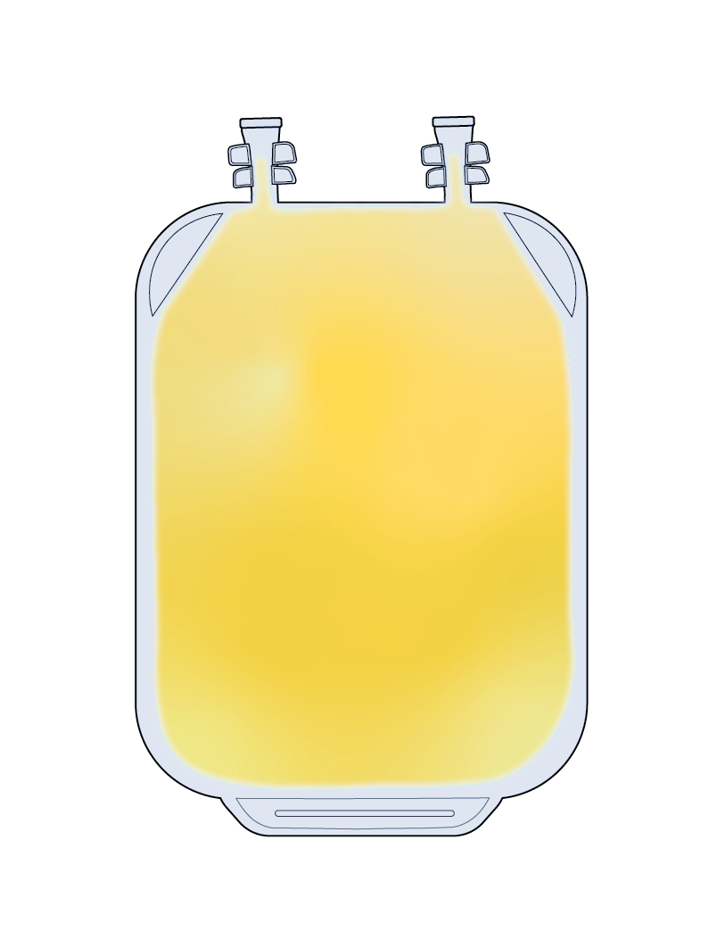
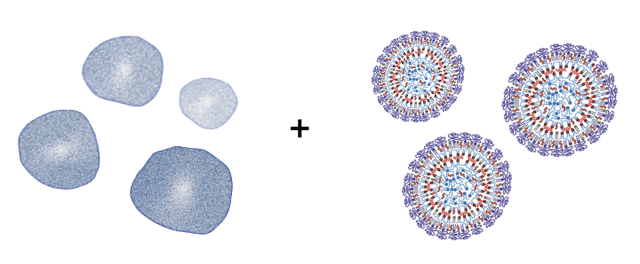
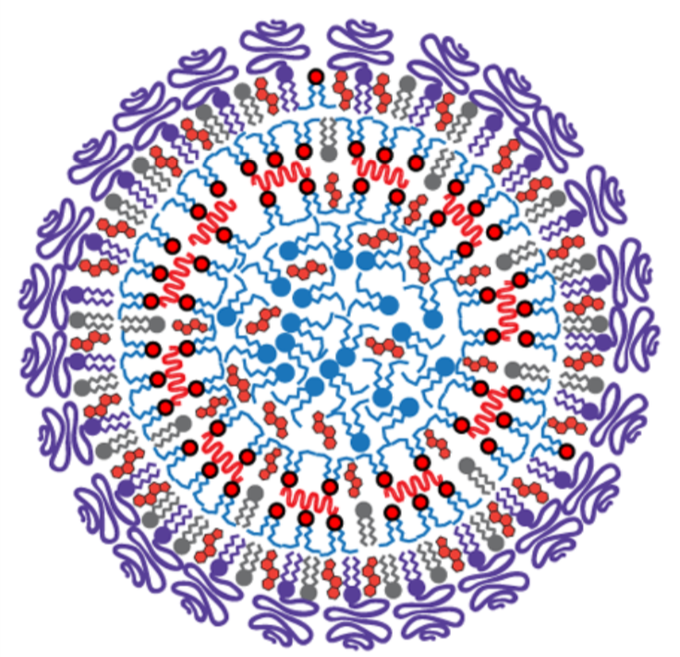
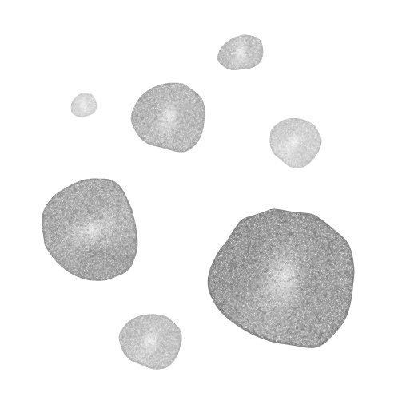

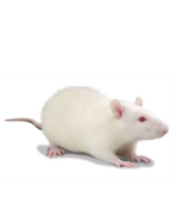
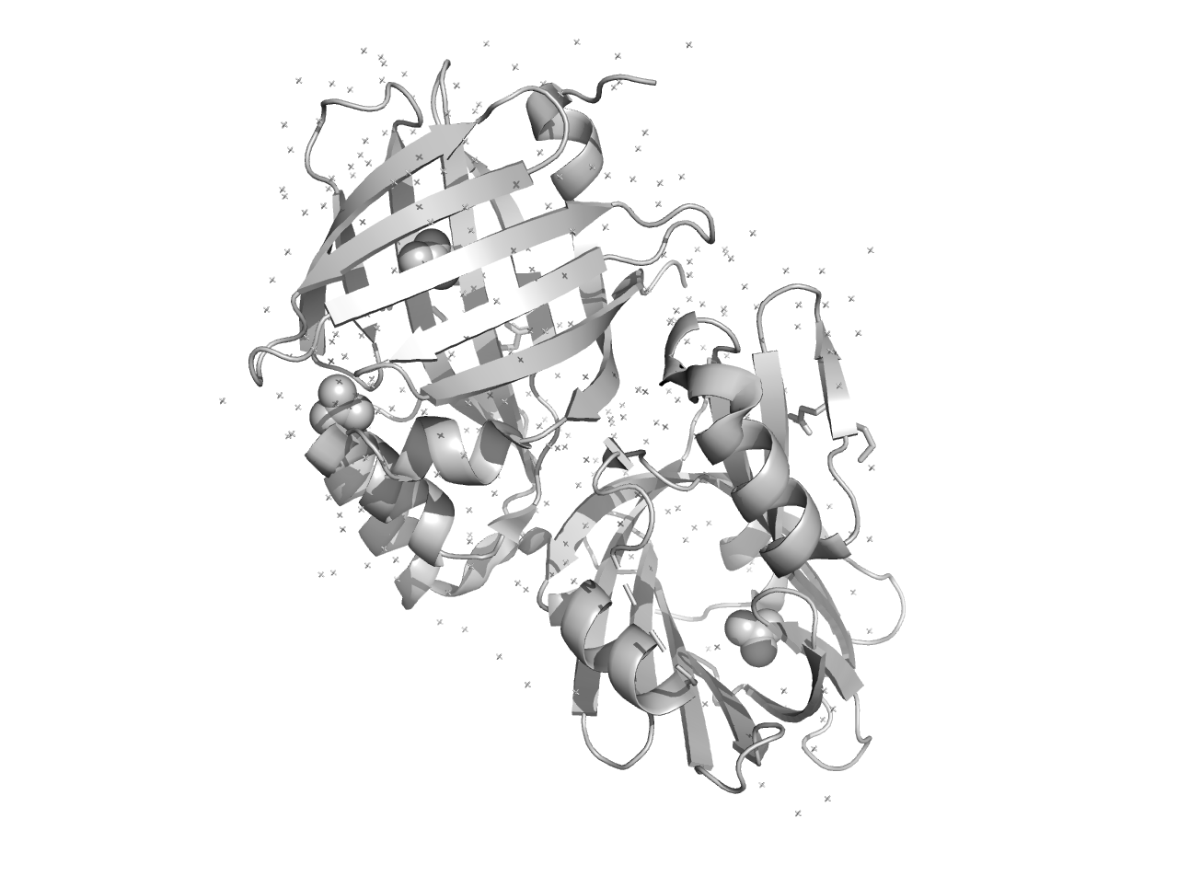

Our approach to creating platelet cell therapies
Optimize mRNA-LNP Composition for Platelet Transfection
Characterize transfected platelets and optimize the platform for clinical compatibility
Evaluate mRNA-LNP products in vivo
Ionizable Lipid
Retained responsiveness Coagulability
Morphology
Hemostasis
Circulation
Cargo Exchange/Transfer
Maximal Protein Expression
Minimal Platelet Activation

Slide 9
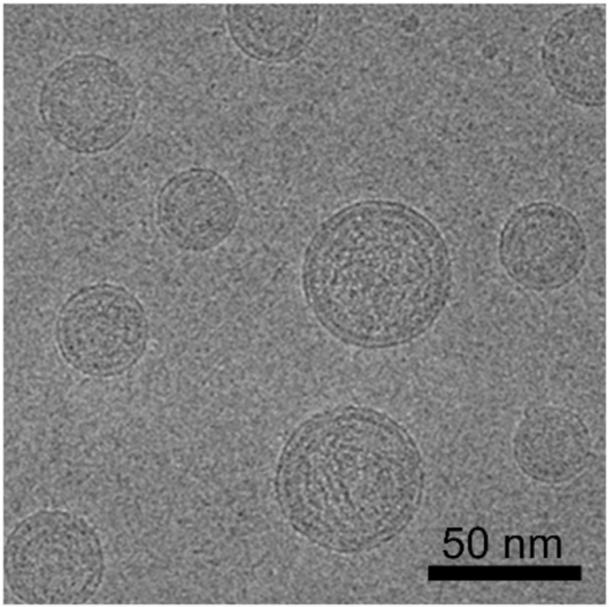
Why Does the Kastrup Lab Care about Blood Clotting?
Lipid nanoparticles (LNPs) delivery mRNA into cells
Ionizable Lipid
Use lipid formulations developed by
Pieter Cullis (UBC) and Marco Ciufolini (UBC)
Similar formulations approved by FDA in 2018 (ONPATTRO) and in two SARS-CoV-2 mRNA in vaccines (Pfizer/BioNTech/Acuitas and Moderna)
Ionizable lipids self-assemble into LNP under acidic condition with RNA.
Notes:
Lipid nanoparticles are important tools at the forefront of gene therapy

Slide 10
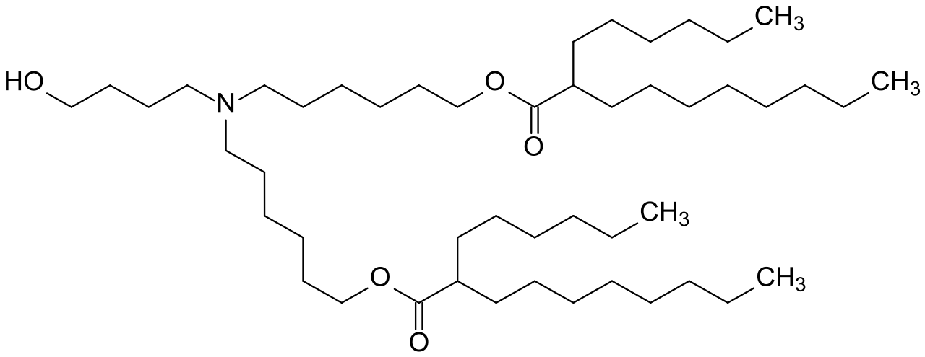
Why Does the Kastrup Lab Care about Blood Clotting?
Lipid nanoparticles (LNPs) delivery mRNA into cells
Ionizable Lipid
Ionizable lipids self-assemble into LNP under acidic condition with RNA.
Notes:
Lipid nanoparticles are important tools at the forefront of gene therapy

Slide 11
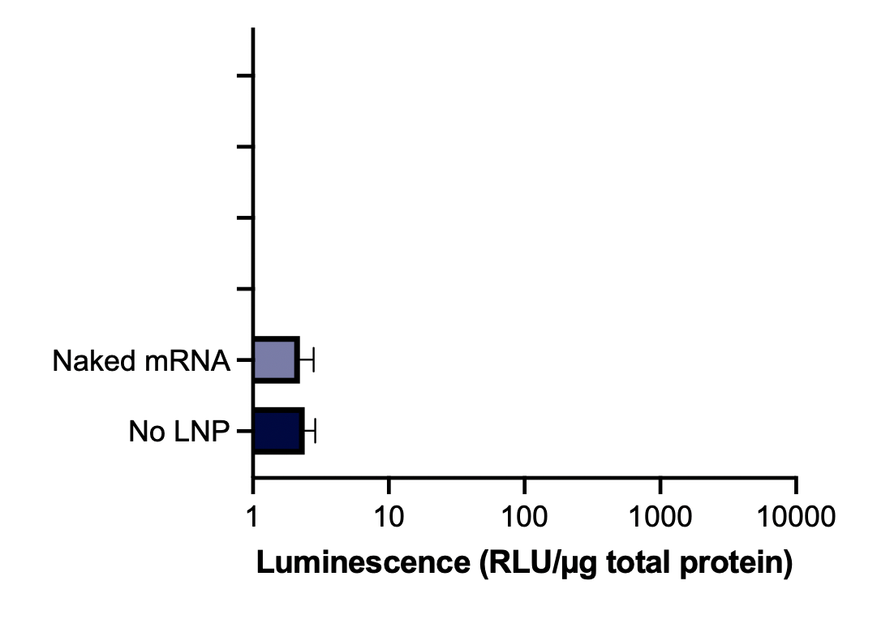
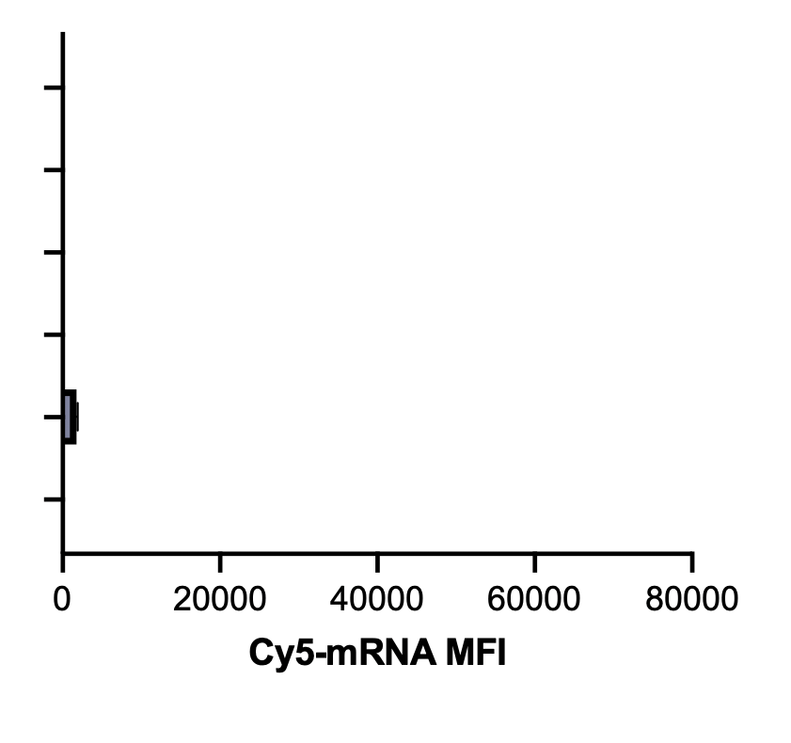
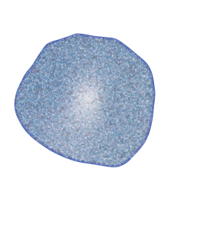
Why Does the Kastrup Lab Care about Blood Clotting?`
Platelets require specialized transfection agents
Protein Expression
mRNA uptake into platelets
+
Washed
Platelets
Free RNA
J. Leung*, C. Strong*, KE Badior*, et al Kastrup Lab. Science Advances, 2023
Expression of Exogenous Protein
(Luciferase)

Slide 12
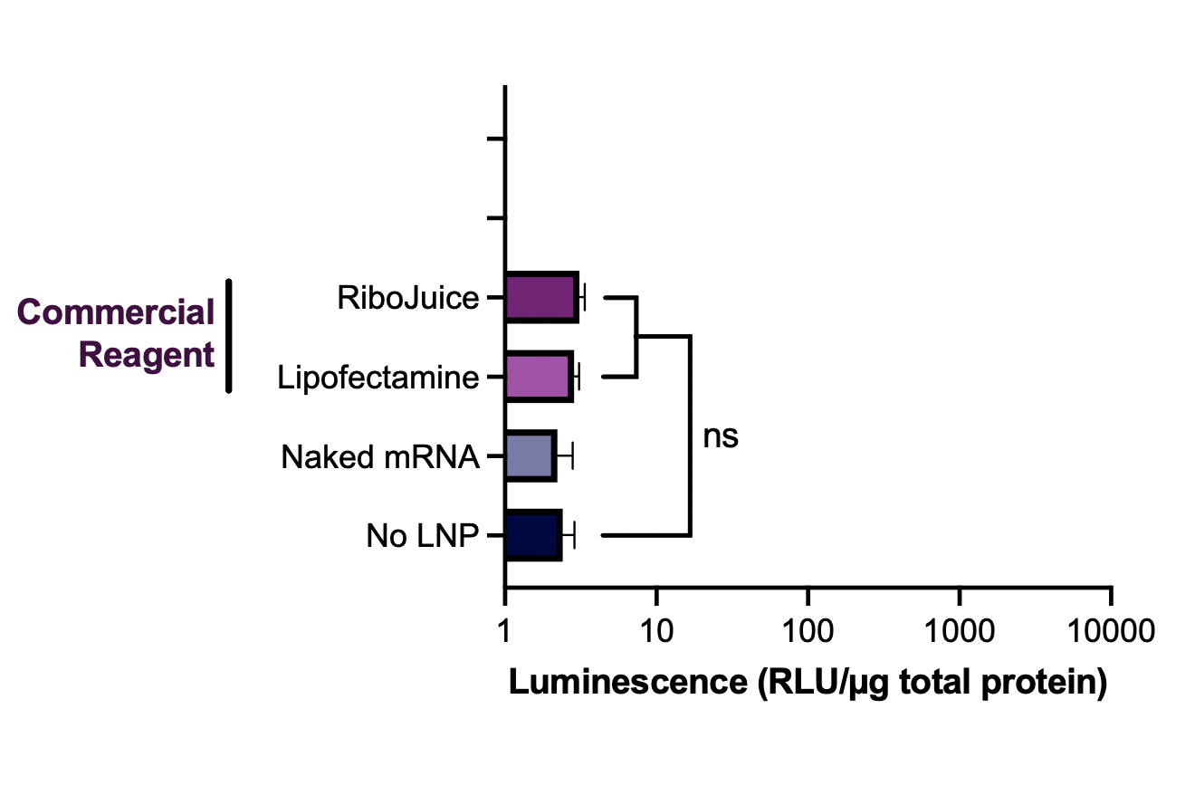
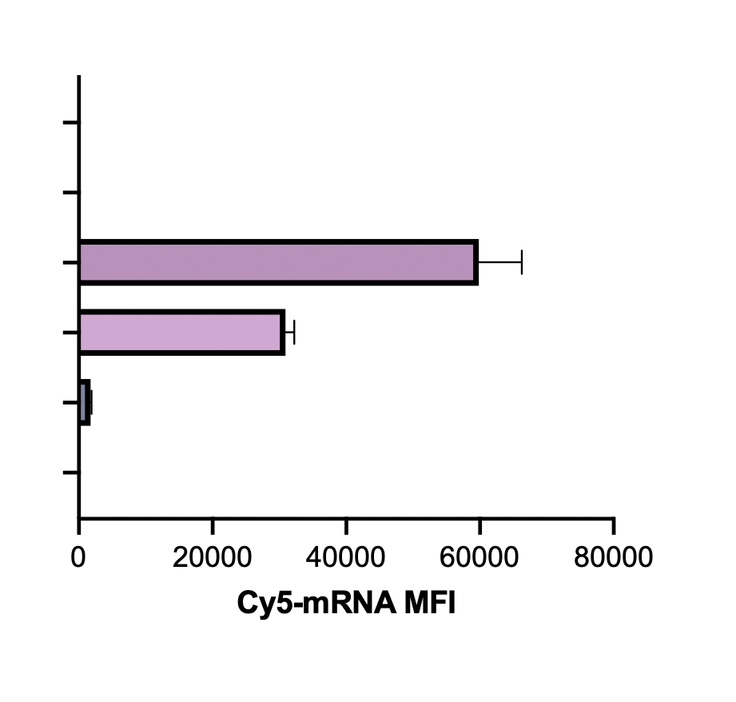

Why Does the Kastrup Lab Care about Blood Clotting?`
Platelets require specialized transfection agents
Protein Expression
mRNA uptake into platelets
+
Washed
Platelets
Commercial Reagents
J. Leung*, C. Strong*, KE Badior*, et al Kastrup Lab. Science Advances, 2023
Expression of Exogenous Protein
(Luciferase)

Slide 13
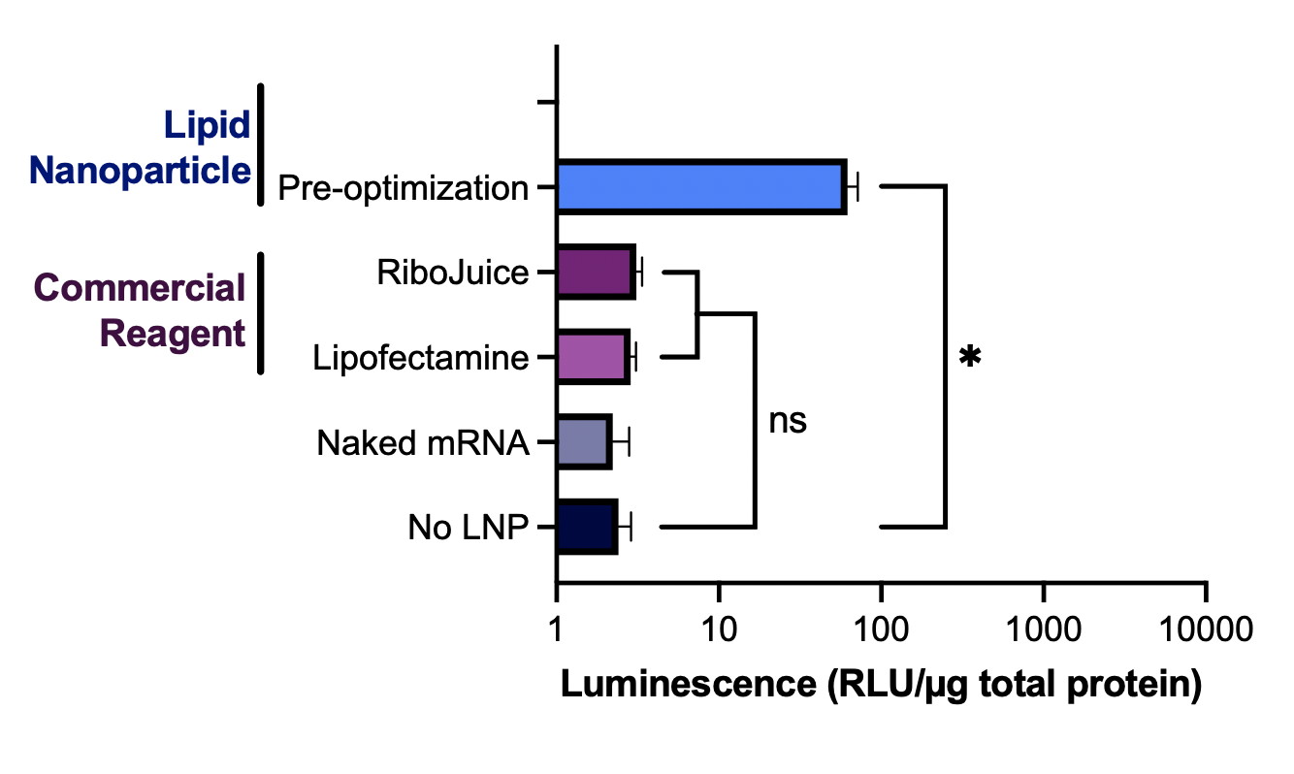
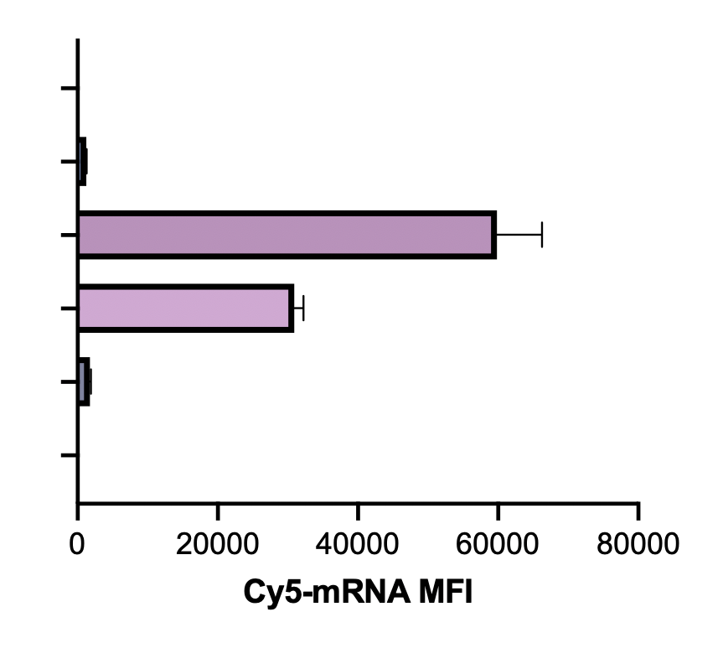
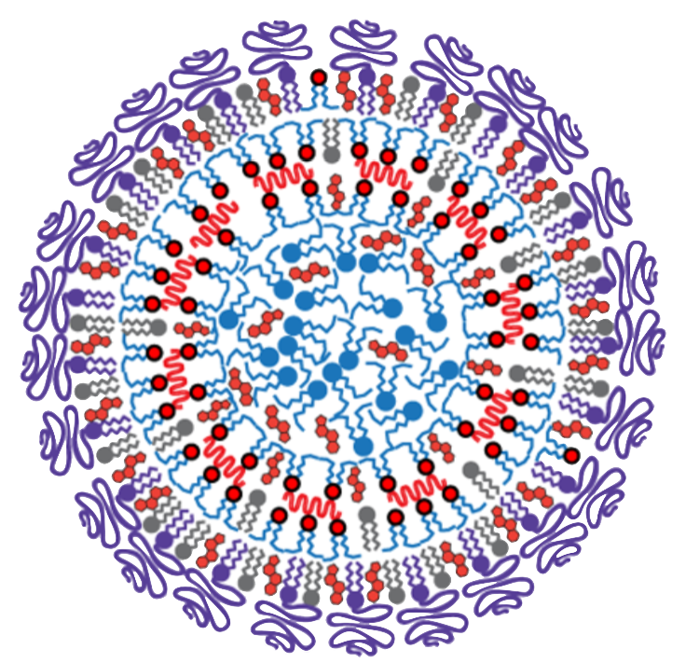
Why Does the Kastrup Lab Care about Blood Clotting?`
Platelets require specialized transfection agents
Protein Expression
mRNA uptake into platelets
+
Washed
Platelets
Lipid Nanoparticles
J. Leung*, C. Strong*, KE Badior*, et al Kastrup Lab. Science Advances, 2023
Expression of Exogenous Protein
(Luciferase)

Slide 14
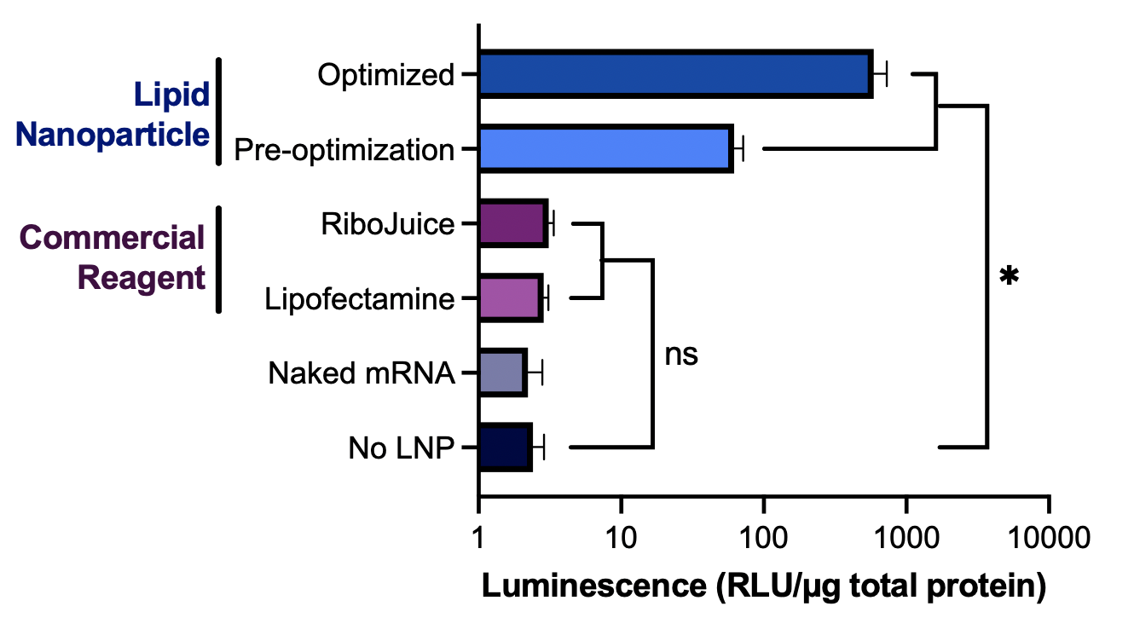
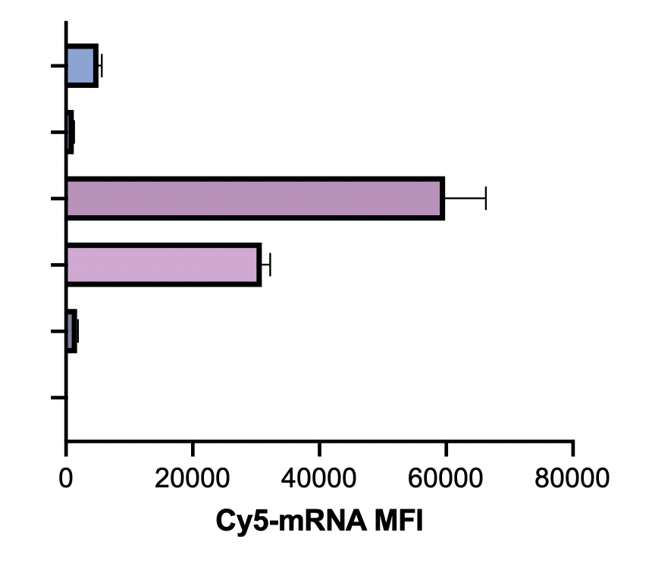
Why Does the Kastrup Lab Care about Blood Clotting?`
Platelets require specialized transfection agents
Protein Expression
mRNA uptake into platelets
10-100 fold increase in luminescence depending on LNP formulation
+
Washed
Platelets
Lipid Nanoparticles
J. Leung*, C. Strong*, KE Badior*, et al Kastrup Lab. Science Advances, 2023
Expression of Exogenous Protein
(Luciferase)

Slide 15
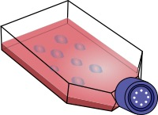
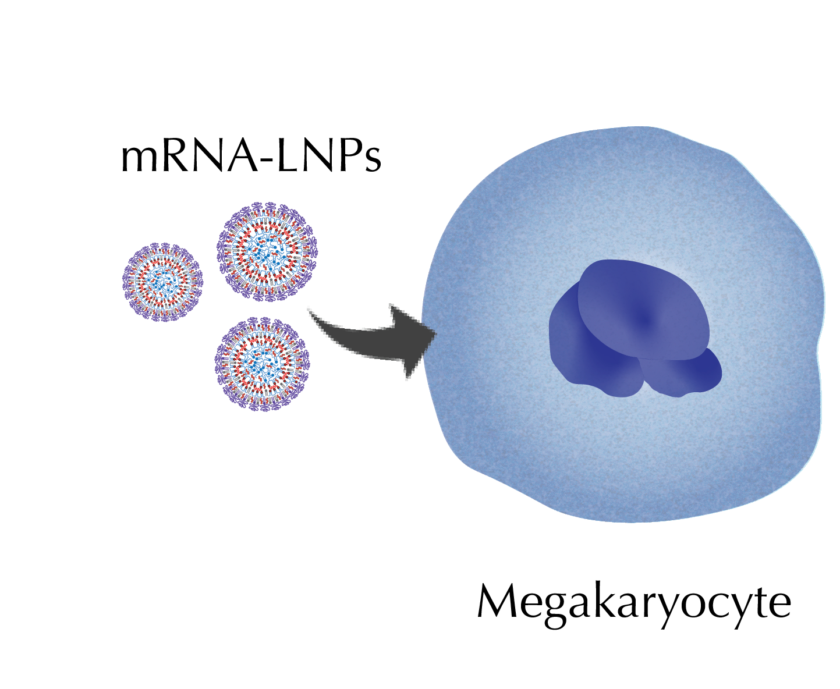
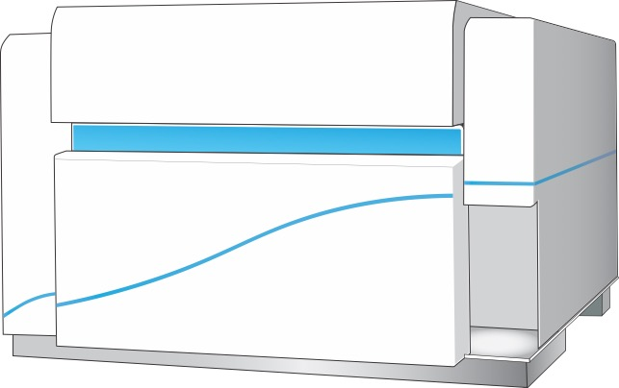
Megakaryocytes robustly express exogenous EGFP and other proteins from mRNA-LNP
Why Does the Kastrup Lab Care about Blood Clotting?`
Method
Day 1
Seed CD34⁺ CB Cells
Day 9
Treat with mRNA-LNP
Day 12
Flow Cytometry
Lipid SM-102 optimal for MK transfection
J. Leung, et al Kastrup Lab. J. Throm. Haem. 2025
Expression of Exogenous Protein
(Luciferase)

Slide 16
Megakaryocytes robustly express exogenous EGFP and other proteins from mRNA-LNP
Why Does the Kastrup Lab Care about Blood Clotting?`
Method
Day 1
Seed CD34⁺ CB Cells
Day 9
Treat with mRNA-LNP
Day 12
Flow Cytometry
Lipid SM-102 optimal for MK transfection
>95% transfection efficiency
J. Leung, et al Kastrup Lab. J. Throm. Haem. 2025
Expression of Exogenous Protein
(Luciferase)

Slide 17
Our approach to creating platelet cell therapies
Optimize mRNA-LNP Composition for Platelet Transfection
Characterize transfected platelets and optimize the platform for clinical compatibility
Evaluate mRNA-LNP products in vivo
Ionizable Lipid
Retained responsiveness Coagulability
Morphology
Hemostasis
Circulation
Cargo Exchange/Transfer
Maximal Protein Expression
Minimal Platelet Activaiton

Slide 18
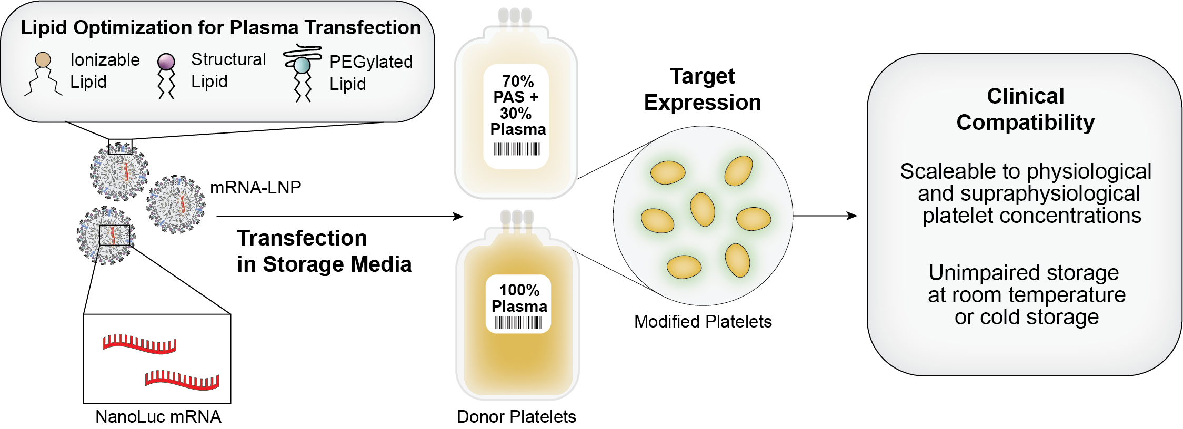
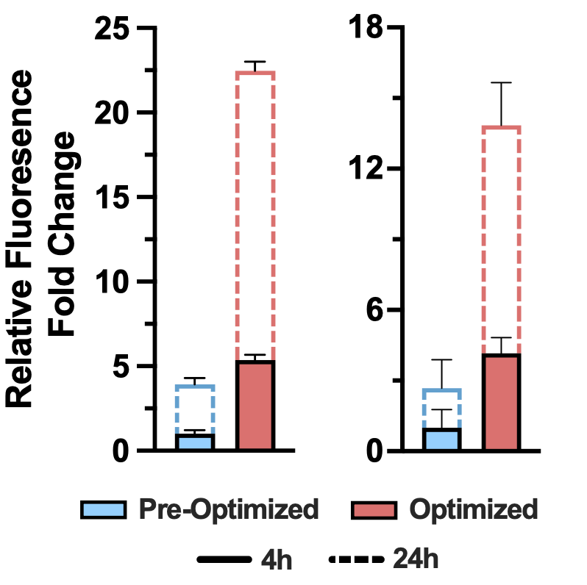






Platelets can be engineered with mRNA-LNP
directly in their storage media
PAS:plasma
Plasma
Luminescence
C. Strong*, J. Leung*, E. Kang*… D Devine, E Jan, PR Cullis, CJ Kastrup, Blood, 2024

Slide 19
mRNA-LNP transfected platelets maintain their
response to agonists and contribute to clot formation and stiffness
Thromboelastography: ROTEM
C. Strong*, J. Leung*, E. Kang*… D Devine, E Jan, PR Cullis, CJ Kastrup, Blood, 2024
Notes:
Calcium ionophore – collagen related peptide - XL

Slide 20
mRNA-LNP transfected platelets have normal morphology
Resting Platelet
Activated Platelet
LNP Transfected Platelet

Slide 21
Our approach to creating platelet cell therapies
Optimize mRNA-LNP Composition for Platelet Transfection
Characterize transfected platelets and optimize the platform for clinical compatibility
Evaluate mRNA-LNP products in vivo
Ionizable Lipid
Retained responsiveness Coagulability
Morphology
Hemostasis
Circulation
Cargo Exchange/Transfer
Maximal Protein Expression
Minimal Platelet Activation

Slide 22
Edited platelets are tolerated in vivo and
contribute to hemostasis
Rat model of polytrauma
Expect no difference in bleeding
(mRNA expresses luciferase)
• With Andre Cap, Adam Meledeo & Xiaowu Wu
(US Army Institute of Surgical Research)
No statistical difference in bleed time or blood loss
J. Leung*, C. Strong*, KE Badior*, et al Kastrup Lab. Science Advances, 2023

Slide 23
Transfected platelets circulate after transfusion
Protein Expression
Platelets express nanoLuc
~20% labeled for LNP
Pre-
transfusion
LNP Marker (DiI)
CD42d

Slide 24
Transfected platelets circulate after transfusion
Protein Expression
Platelets express nanoLuc
~20% labeled for LNP
Pre-
transfusion
LNP Marker (DiI)
LNP-platelets were diluted 20-fold upon transfusion.
CD42d

Slide 25
Transfected platelets circulate after transfusion
Protein Expression
Platelets express nanoLuc
~20% labeled for LNP
Pre-
transfusion
LNP Marker (DiI)
LNP-platelets were diluted 20-fold upon transfusion.
NanoLuc detected in platelets,
~1% labeled for LNP
Post
transfusion
CD42d

Slide 26
Edited platelets are tolerated in vivo and contribute to hemostasis
No statistical difference in bleed time or blood loss
J. Leung*, C. Strong*, KE Badior*, et al Kastrup Lab. Science Advances, 2023

Slide 27
Edited platelets are tolerated in vivo and contribute to hemostasis
No negative impact on coagulation

Slide 28
LNP-treated Platelets Localize to Wound
Transfected platelets accumulate at vascular damage:
Local delivery of mRNA and protein
Normal platelets
Normal Platelets
DAPI
DiI
CD61
20 μm
mRNA-LNP Platelets
mRNA-LNP platelets
DAPI
DiI
CD61
20 μm
Leung*, Strong*, Badior*, Robertson, Wu , Meledeo, Kang, Cap, Devine, Jan, Cullis, Kastrup, Science Advances, 2023

Slide 29
LNP-treated Platelets Localize to Wound
Transfected platelets accumulate at vascular damage:
Local delivery of mRNA and protein
Normal platelets
Normal Platelets
DAPI
DiI
CD61
20 μm
mRNA-LNP Platelets
mRNA-LNP platelets
DAPI
DiI
CD61
20 μm
Leung*, Strong*, Badior*, Robertson, Wu , Meledeo, Kang, Cap, Devine, Jan, Cullis, Kastrup, Science Advances, 2023

Slide 30
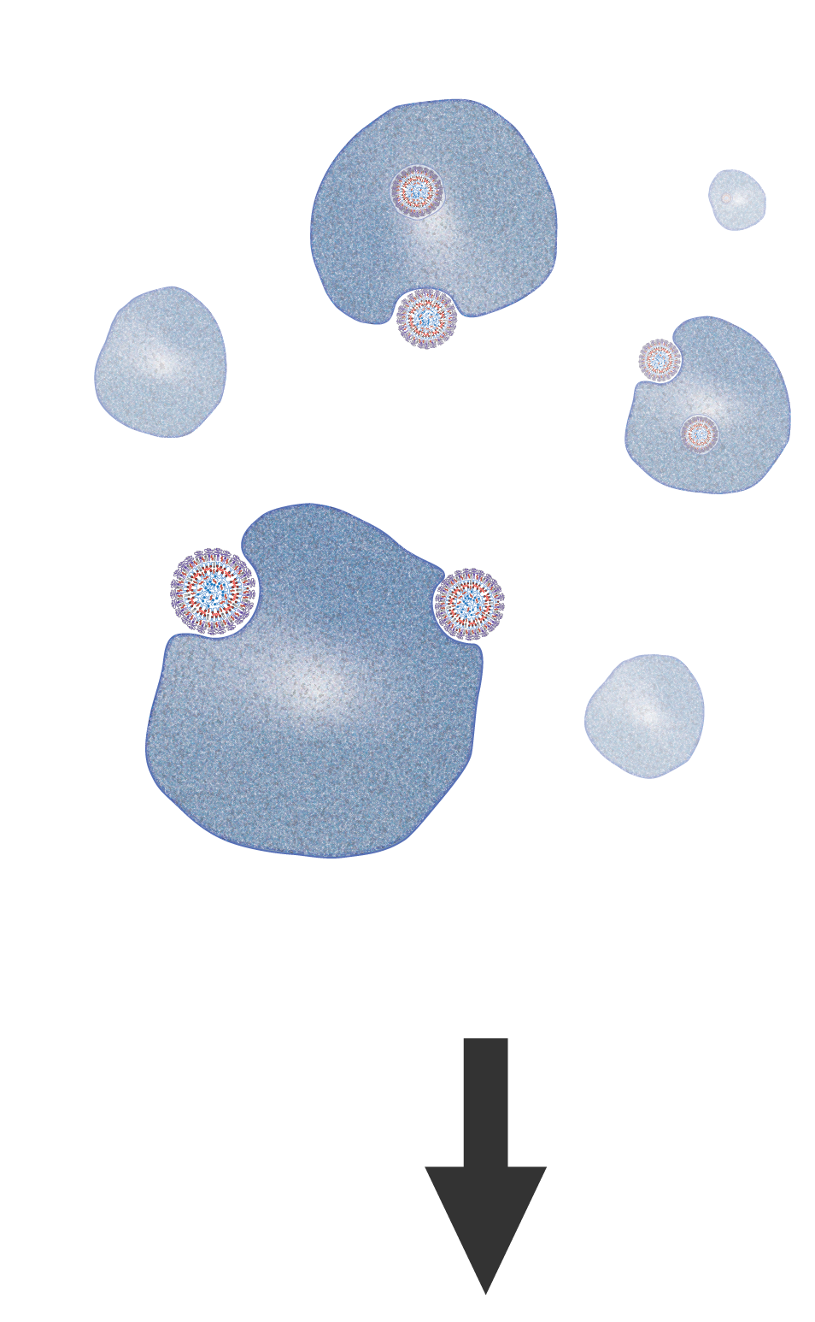
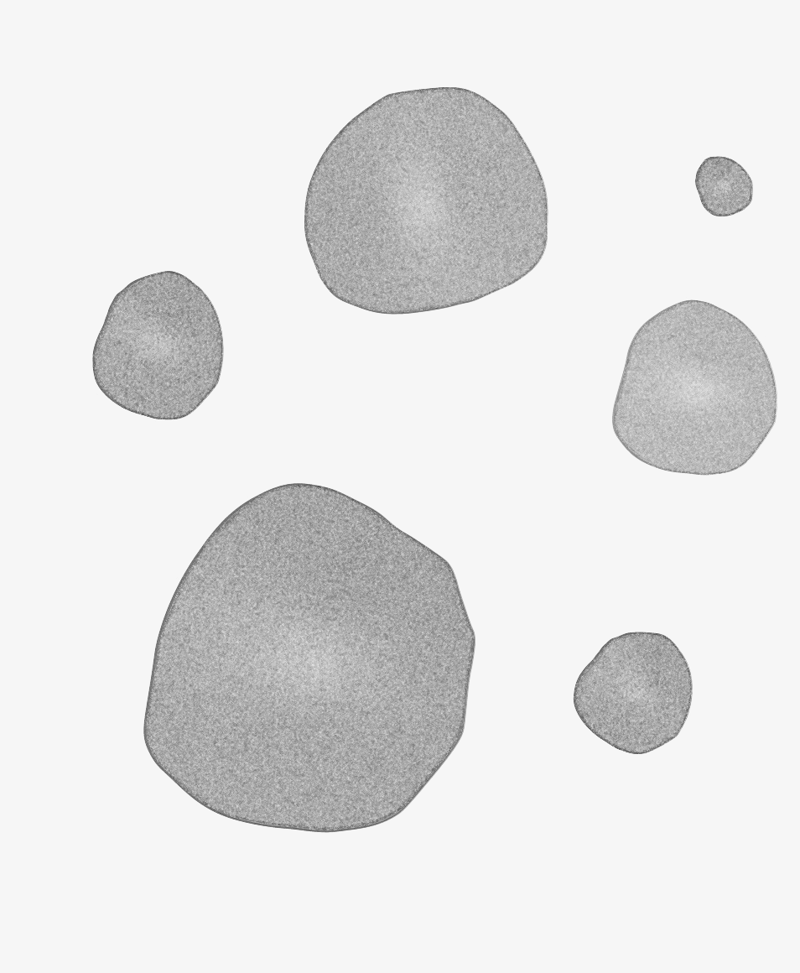
LNP-treated Platelets Localize to Wound
A Current Direction: Using transfusable platelets to locally deliver RNA and protein
Platelets naturally circulate to and accumulate at extra-hepatic disease sites, where they interact with a wide variety of other cell types.
RNA-Modified Platelets
Platelets
+
mRNA-LNP
Platform Technology
Modified Platelets
Improved
Transfusions
Targeted
Therapeutics
Research
Tool

Slide 31
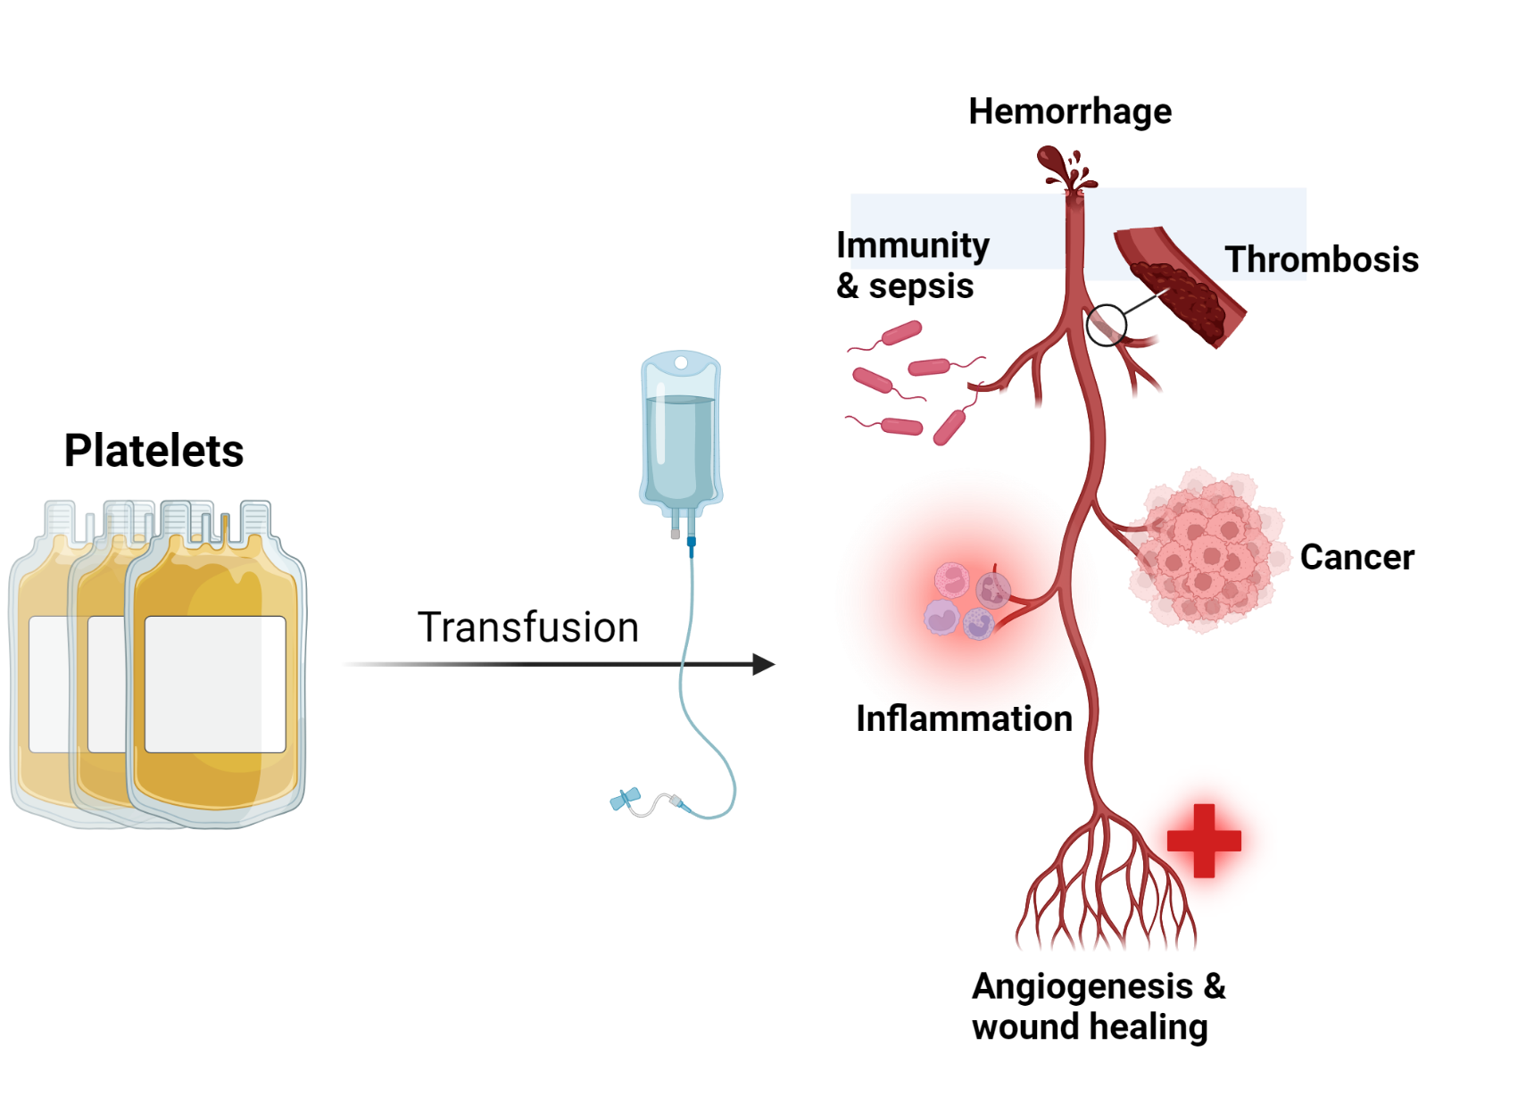
LNP-treated Platelets Localize to Wound
A Current Direction: Using transfusable platelets to locally deliver RNA and protein
Platelets naturally circulate to and accumulate at extra-hepatic disease sites, where they interact with a wide variety of other cell types.
Modified Platelets

Slide 32
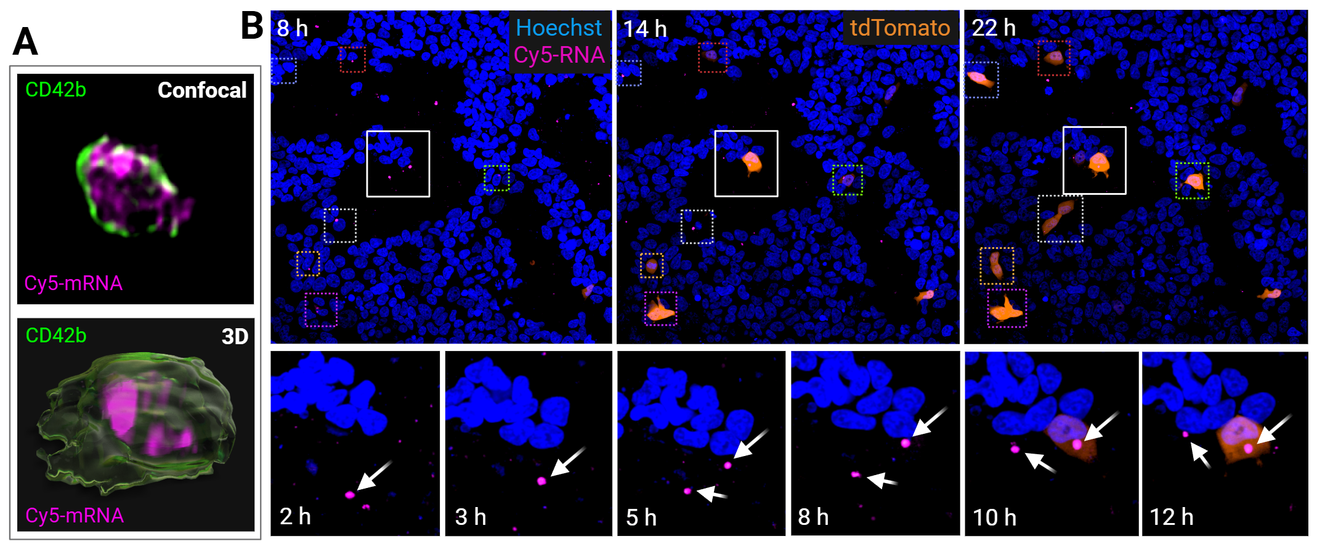
mRNA-platelets transfer mRNA cargo to cultured cells
Transfected Cy5-mRNA is intracellularly stored within individual platelets.
mRNA-platelets (containing both Cy5-mRNA and tdTomato-mRNA) transfer mRNA to recipient HEK-293 cells
followed by expression of tdTomato protein.

Slide 33
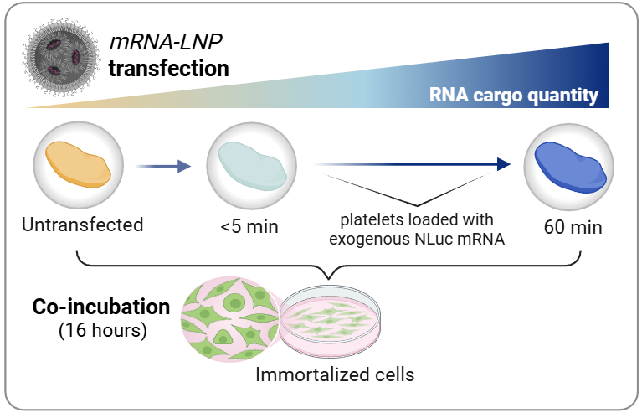
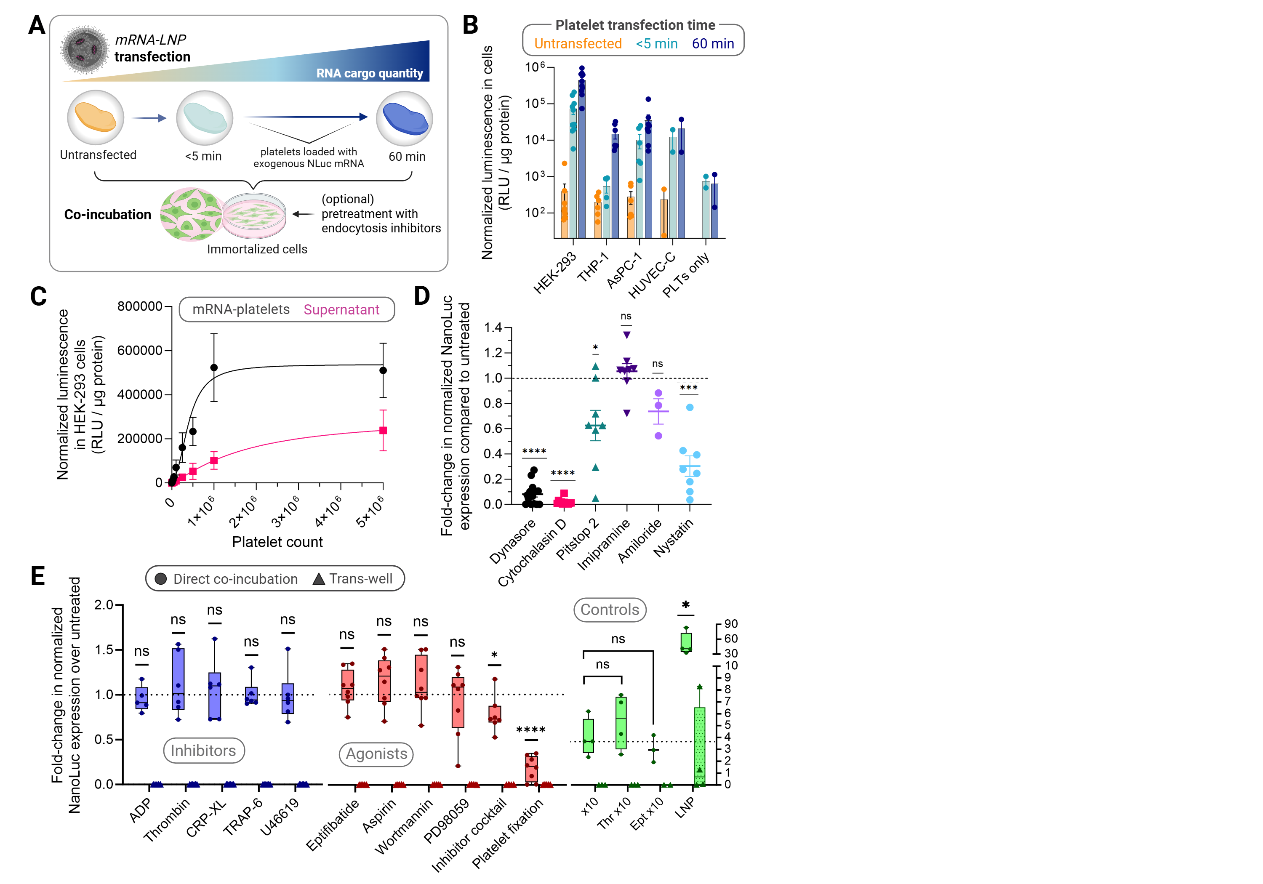
mRNA-platelets transfer RNA to different cell lines
Platelets transfer mRNA to different cell lines: HEK-293 (human embryonic kidney), THP-1 (leukemia monocyte), AsPC-1 (pancreatic cancer), HUVEC-C (endothelial)
mRNA transfer depends on platelet mRNA content; no mRNA, moderate, or high

Slide 34
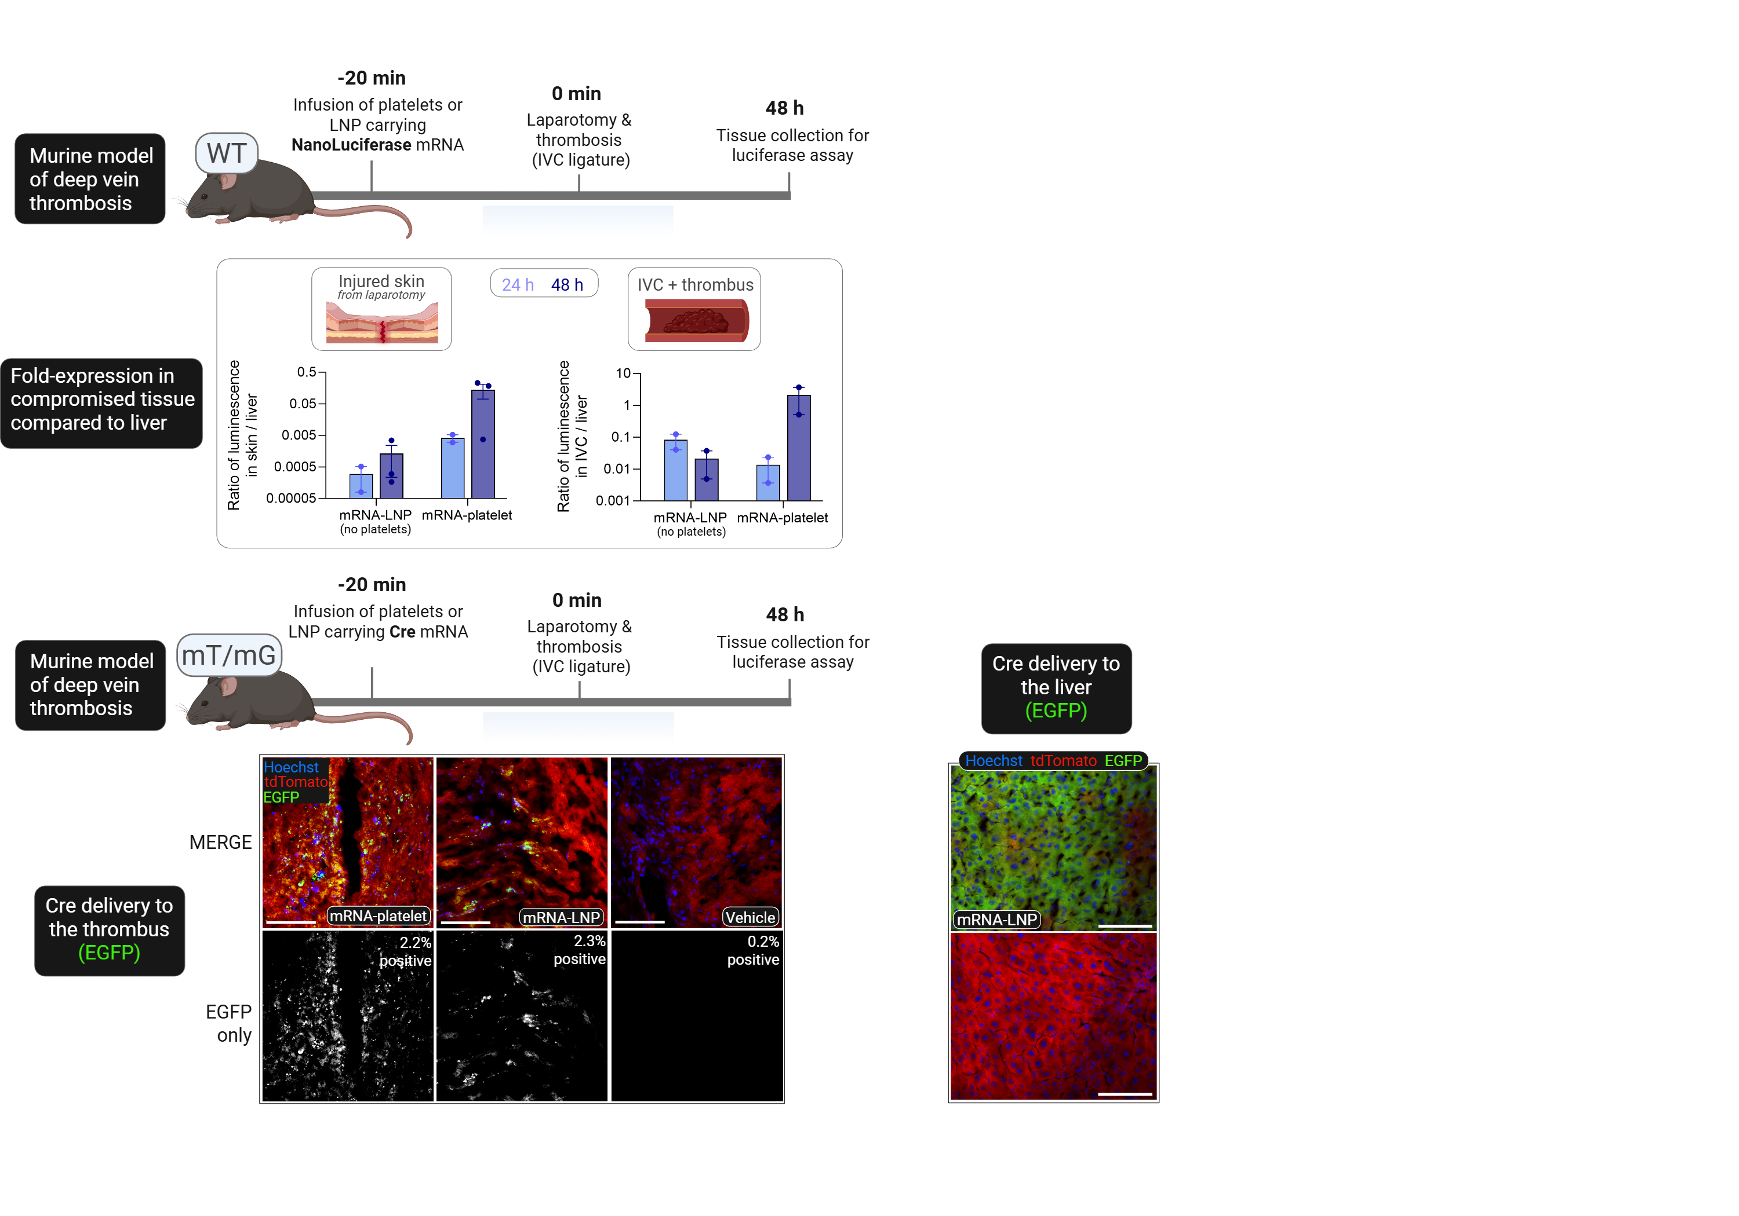
Platelets locally deliver exogenous mRNA to injured and thrombotic tissue

Slide 35
Platelets specifically deliver exogenous mRNA to sites of platelet deposition

Slide 36
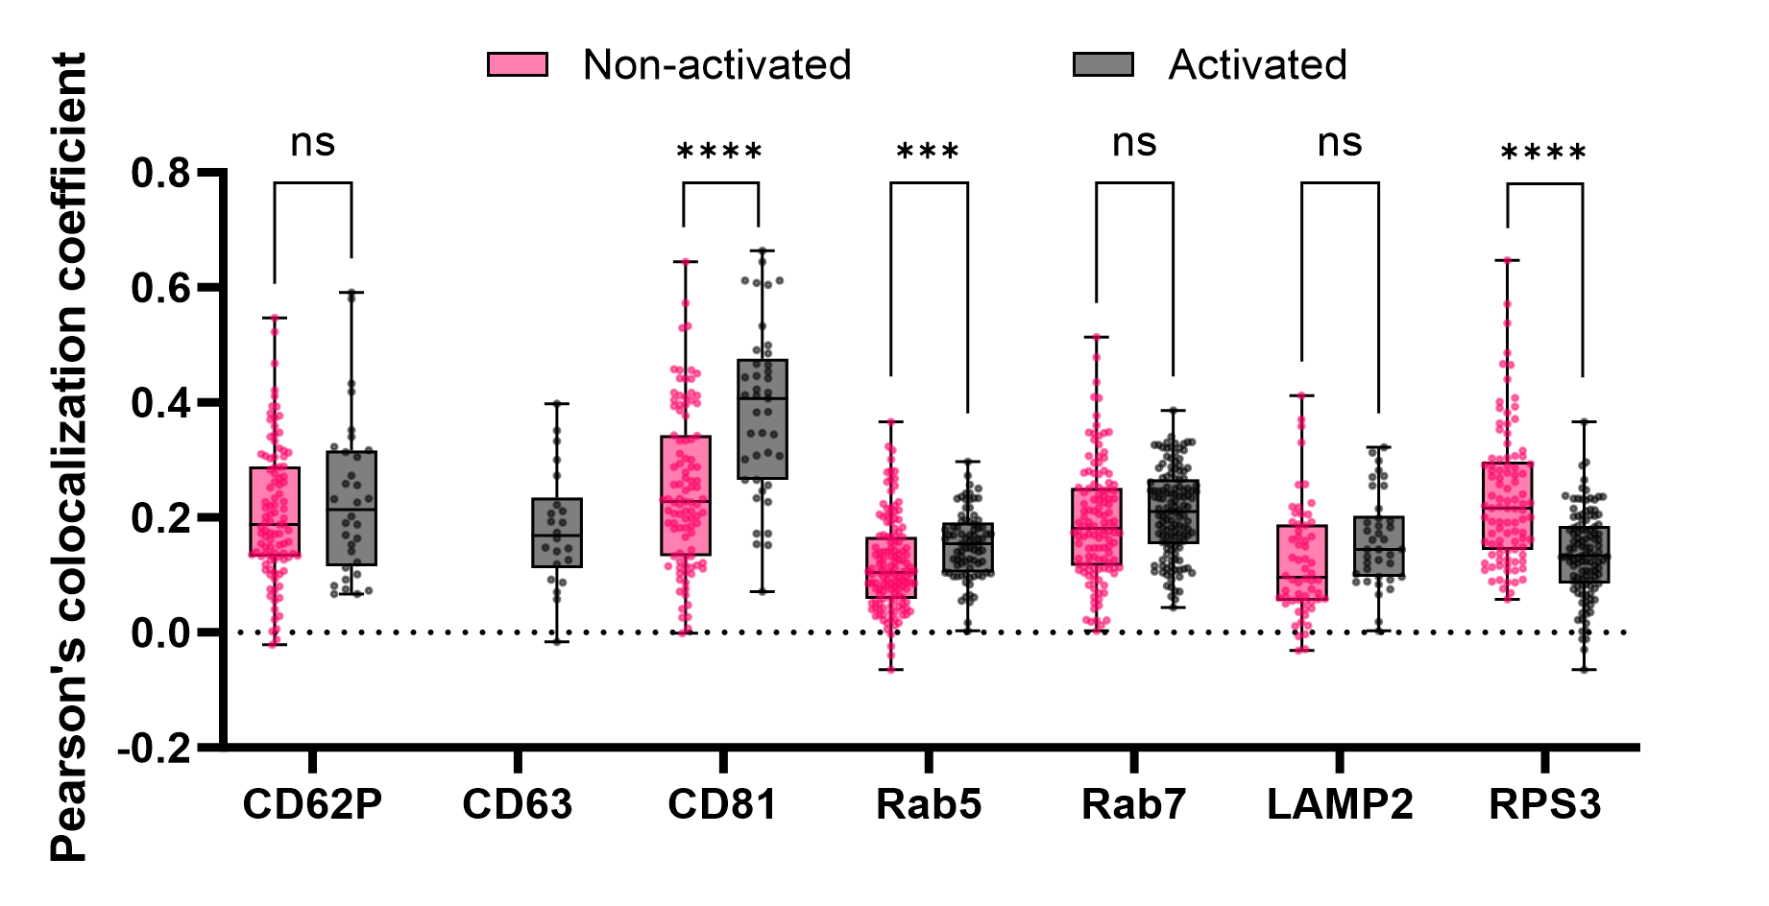
mRNA co-localizes with various platelet proteins, which shifts depending on activation state
mRNA modestly colocalizes with various platelet compartments
Differences in co-localization following platelet activation suggests functional compartmental shifts
  Increased proximity to endosomal compartments and cellular trafficking processes
  Reduced association with ribosomes
To be collected
Early endosomes
Lysosomes
Alpha granules
Exogenous vesicles
Late endosomes
Ribosomes
Dense granules

Slide 37
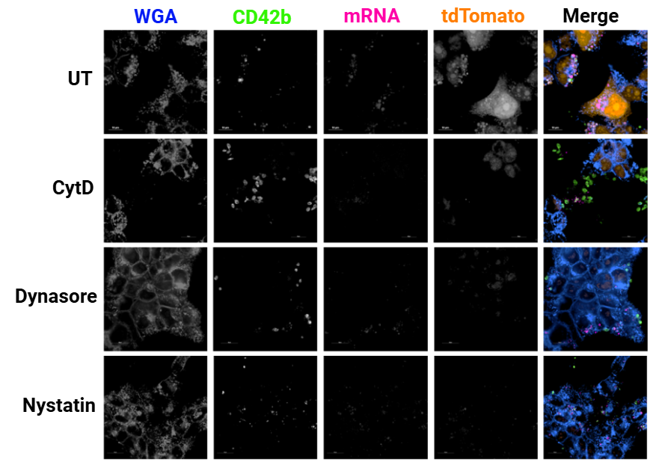
mRNA transfer is mediated by a variety of endocytic mechanisms, except macropinocytosis
A
B
Endocytosis inhibitors: dynamin (dynasore), actin (cytochalasin D), clathrin (pitstop 2), micropinocytosis (imipramine and amiloride), caveolae & lipid rafts (nystatin)

Slide 38
LNP-treated Platelets Localize to Wound
A Current Direction: Using transfusable platelets to locally deliver RNA and protein
Platelets naturally circulate to and accumulate at extra-hepatic disease sites, where they interact with a wide variety of other cell types.
Modified Platelets

Slide 39
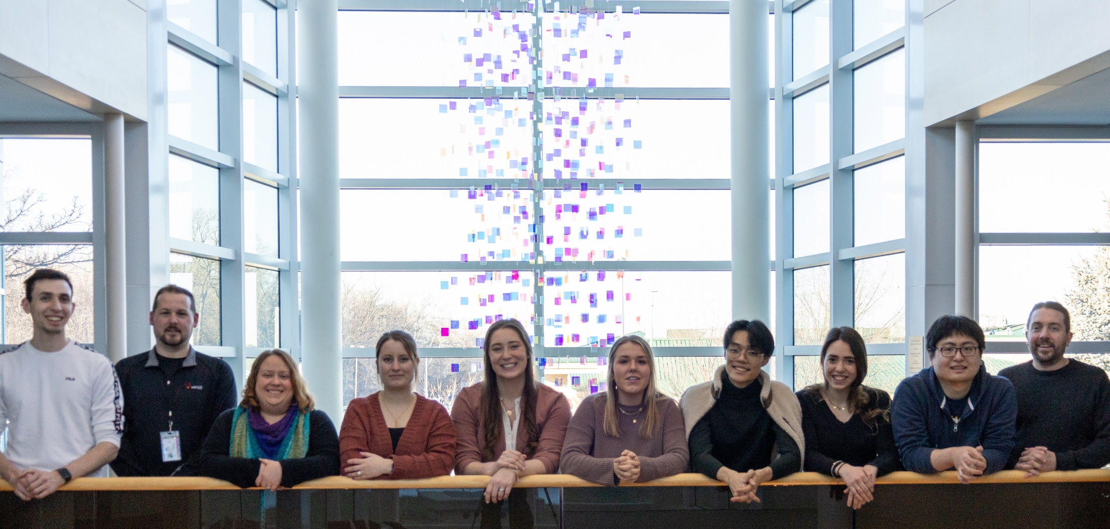



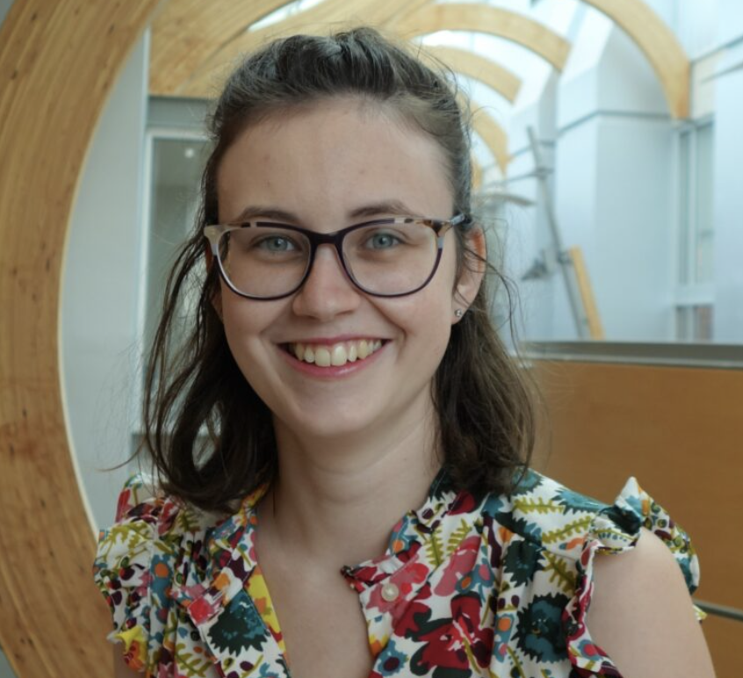

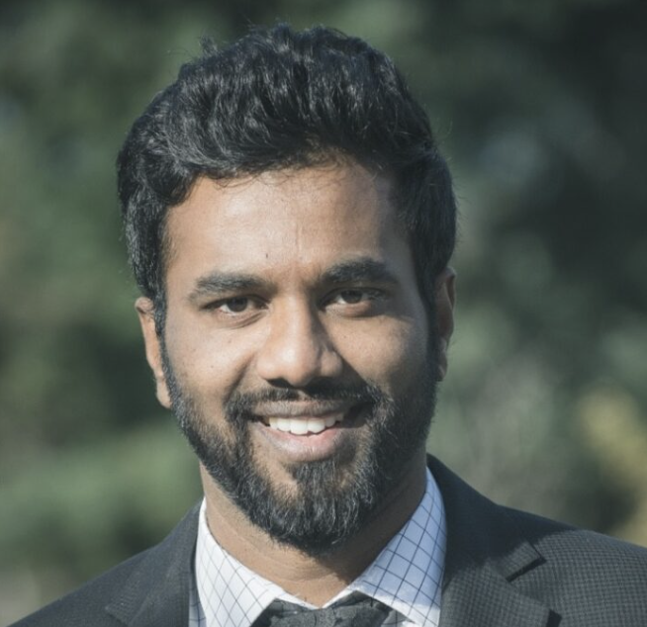
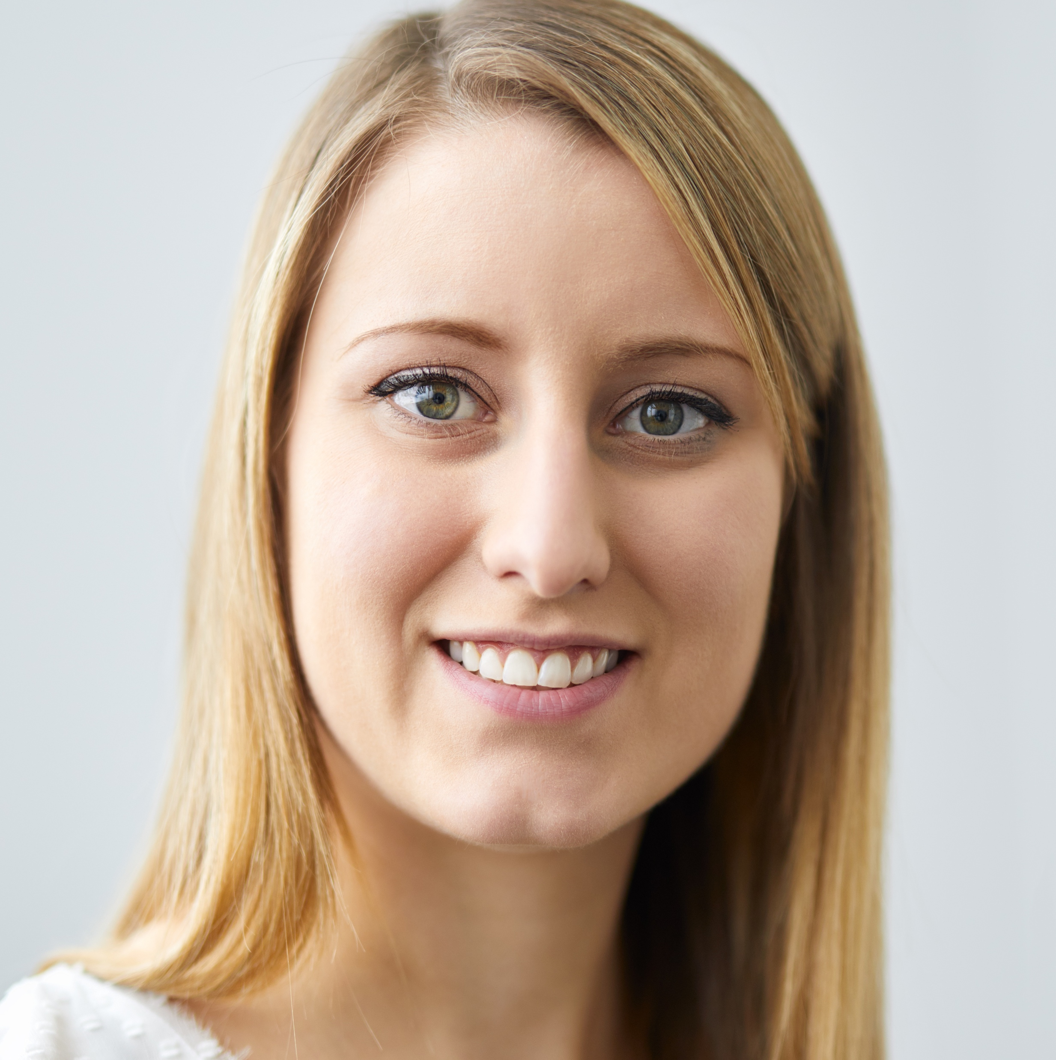
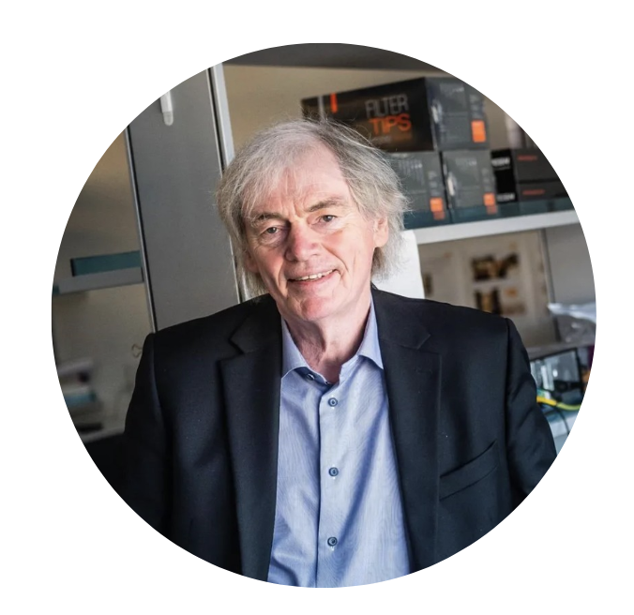
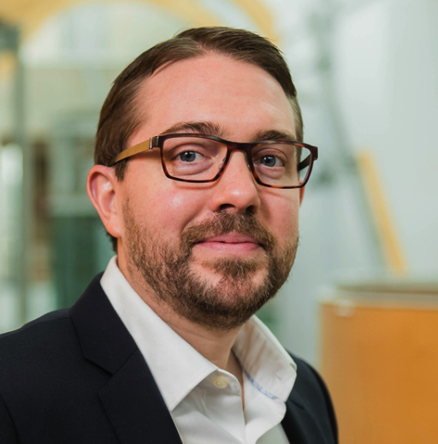
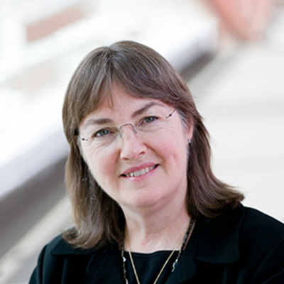







Collaborators (this work):
• Pieter Cullis (UBC)
• Dana Devine (UBC)
• Eric Jan (UBC)
• Andre Cap (US Army ISR)
• Adam Meledeo (US Army ISR)
• Xiaowu Wu (US Army ISR)
Katherine Badior
Massimo Cau
Francesca Ferraresso
Emma Kang
Lih Jiin Juang
Jerry Leung
Manoj Paul
Noah Peng
Madelaine Robertson
Halen Turner
Monica Seadler
Amy Strilchuk
Colton Strong
Canada’s Department of National Defence

Slide 40
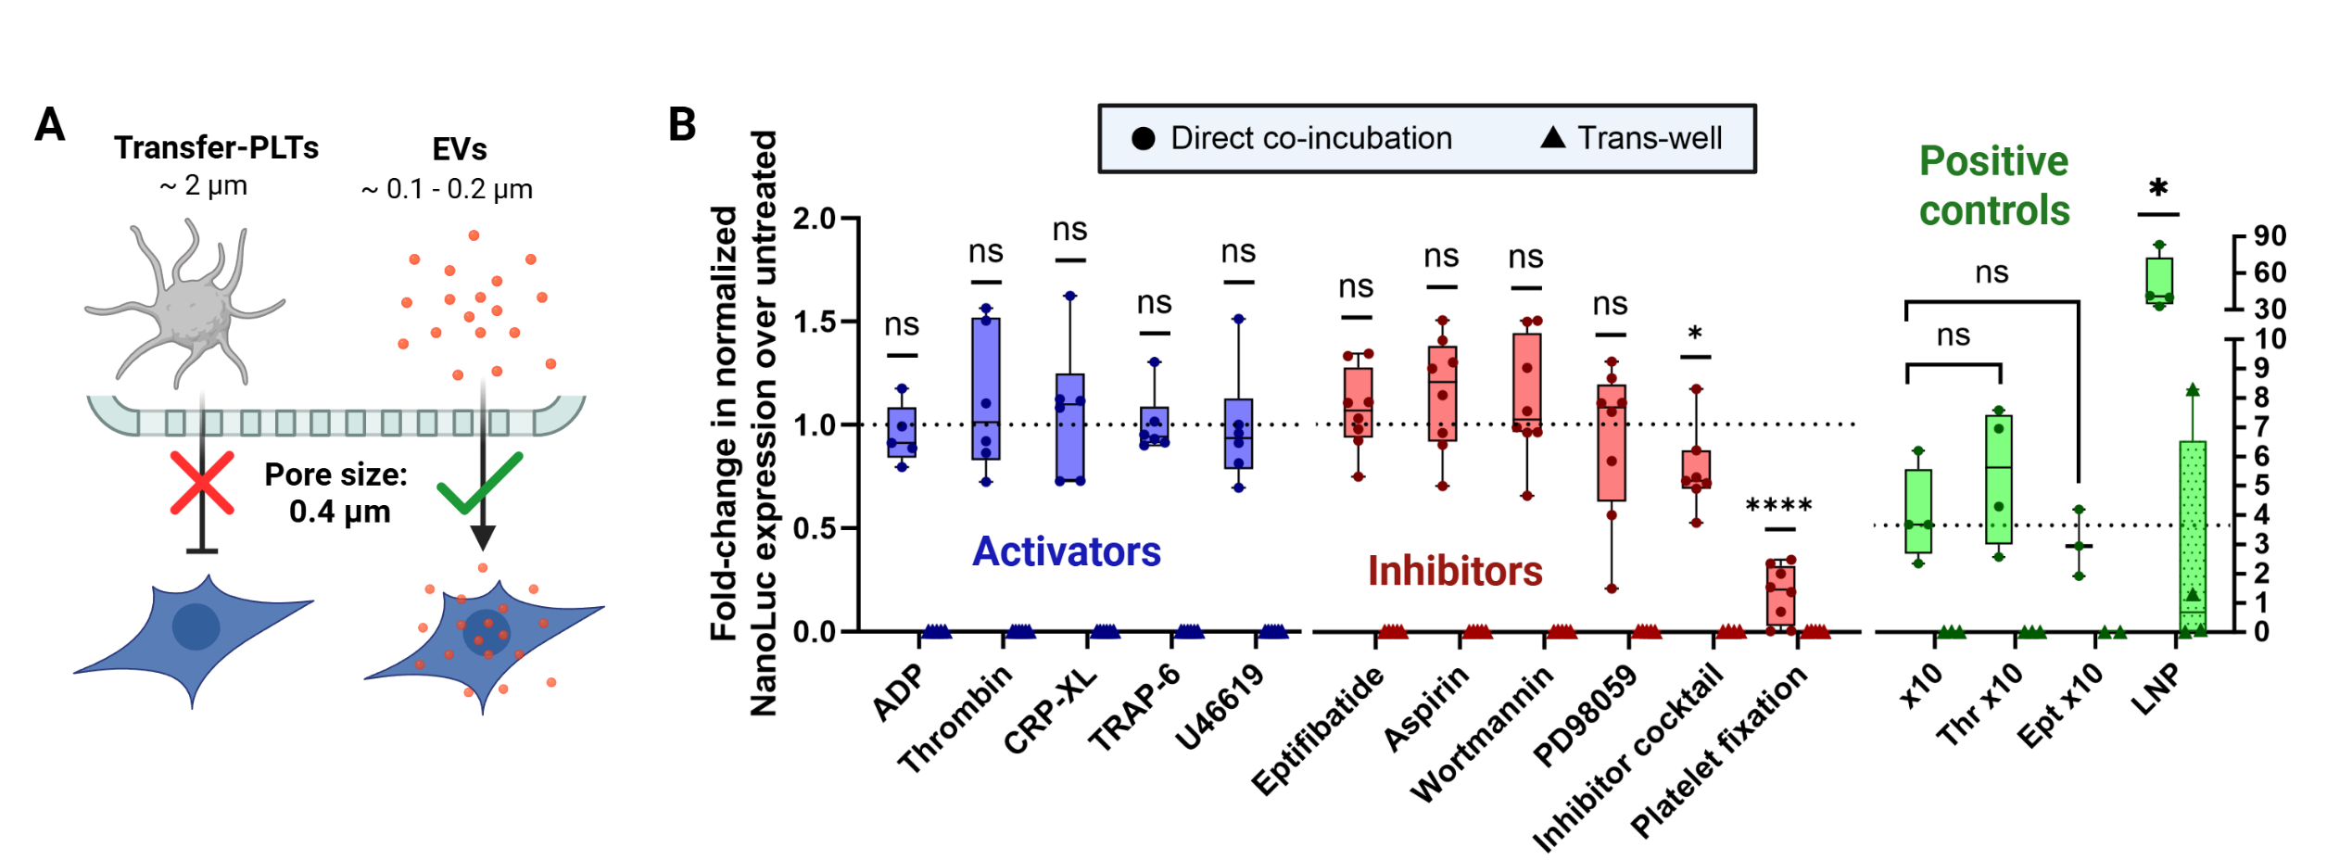
mRNA transfer requires direct contact, and is not affected by platelet activation or inhibition
Platelets were pre-incubated for 30 minutes with varying activators and inhibitors, then placed in co-culture with HEK-293 cells with and without trans-well separation
  Platelets do not transfer mRNA when separated by a trans-well membrane
  Platelet activators and inhibitors do not affect mRNA transfer in this system

Slide 41
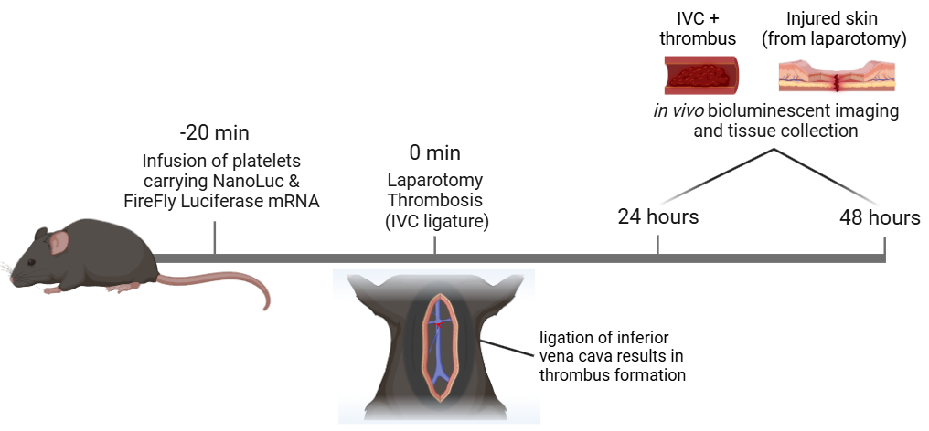
In vivo model of mRNA transfer
Mouse model of thrombosis
via inferior vena cava ligature

Slide 42
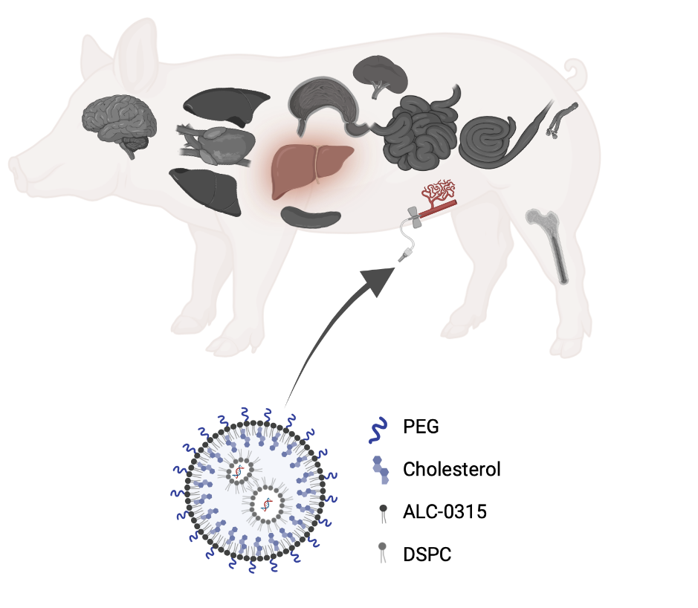
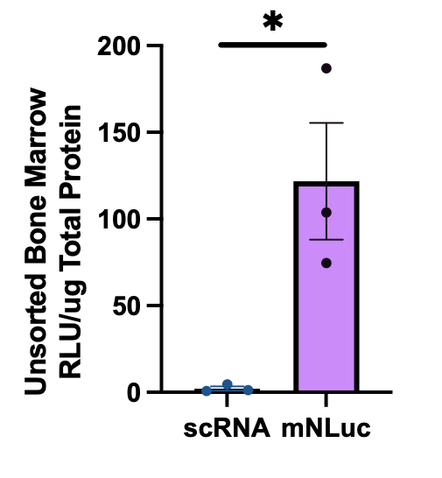
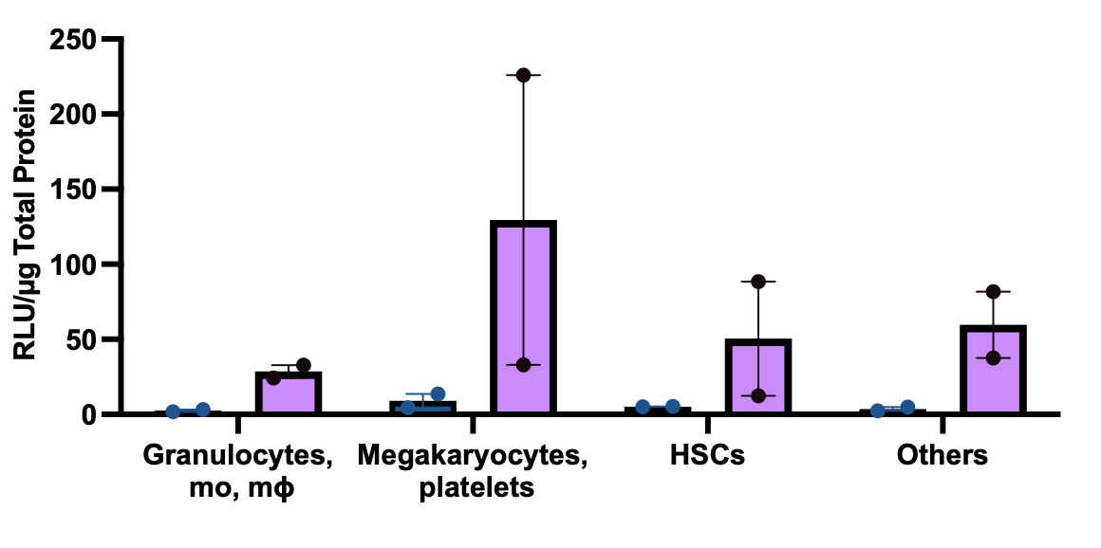
Why Does the Kastrup Lab Care about Blood Clotting?
Future: Controlling protein production in all tissues
Expression of protein from mRNA-LNP in the bone marrow
Luciferace mRNA
Scrambled RNA
scRNA mLuc
mRNA
Ferraresso F, Badior K, Seadler M, Wietrzny A, Zhang Y, Cau MF, Haugen A, Dyer MR, Cullis PR, Jan E, Kastrup CJ
Molecular Therapy – Methods & Clinical Development 2024
Notes:
Many patients with bleeding disorders, whether due to inhibitors etc often take TXA
Unfortunately, TXA’s duration of action is only ~3 hours

Slide 43
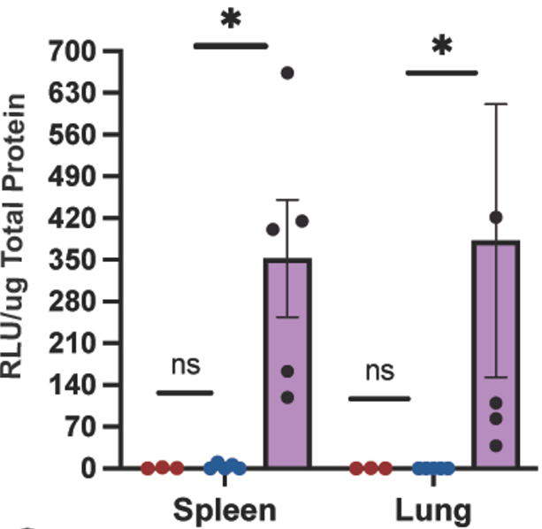




Why Does the Kastrup Lab Care about Blood Clotting?
Future: Controlling protein production in all tissues
Luciferace mRNA
Scrambled RNA
mRNA
Ferraresso F, Badior K, Seadler M, Wietrzny A, Zhang Y, Cau MF, Haugen A, Dyer MR, Cullis PR, Jan E, Kastrup CJ
Molecular Therapy – Methods & Clinical Development 2024
Notes:
Many patients with bleeding disorders, whether due to inhibitors etc often take TXA
Unfortunately, TXA’s duration of action is only ~3 hours

