Slide 1

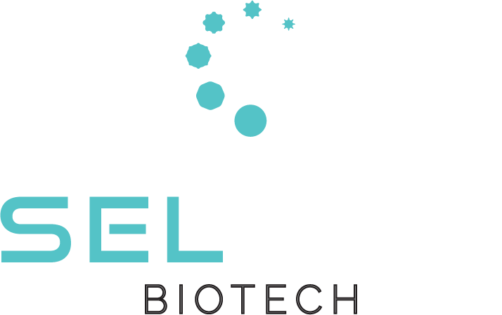
SelSym Biotech
Revolutionizing Hemorrhage Control
Kimberly Nellenbach-Willson, PhD | CSO | kim.nellenbach-willson@selsymbio.com
Seema Nandi, PhD | CEO | seema.nandi@selsymbio.com

Slide 2

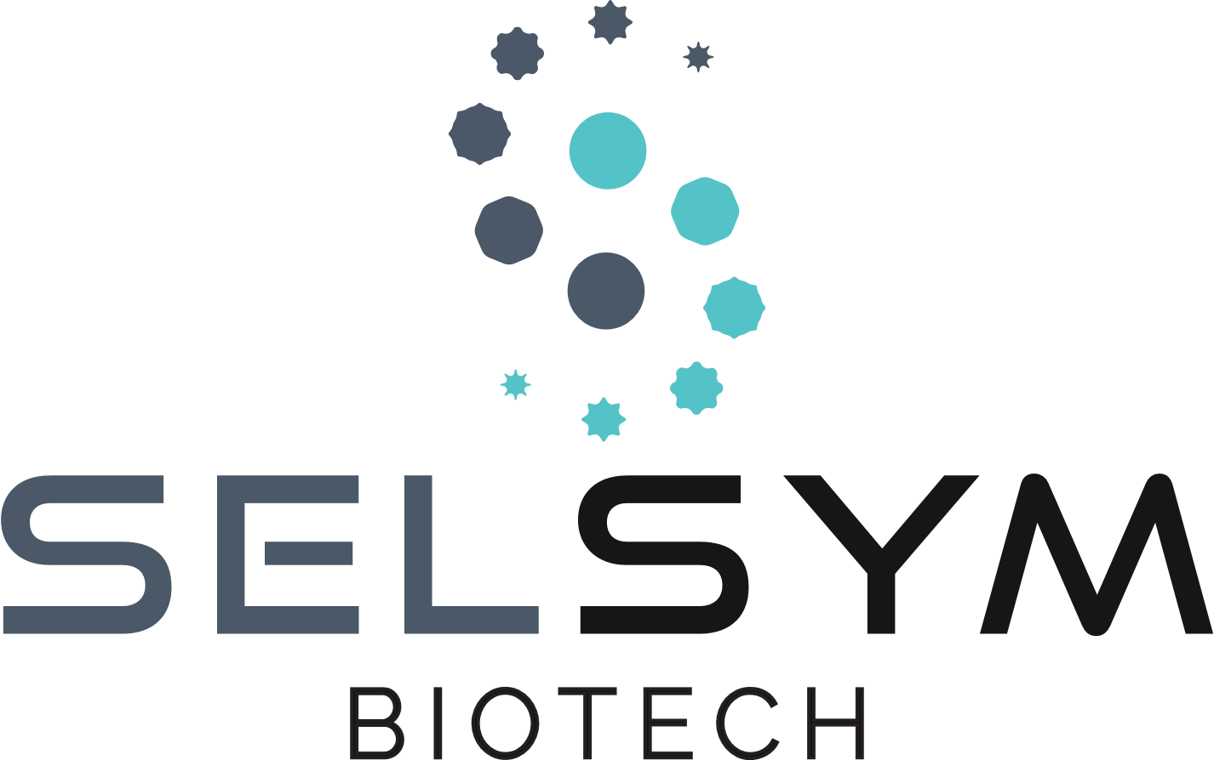
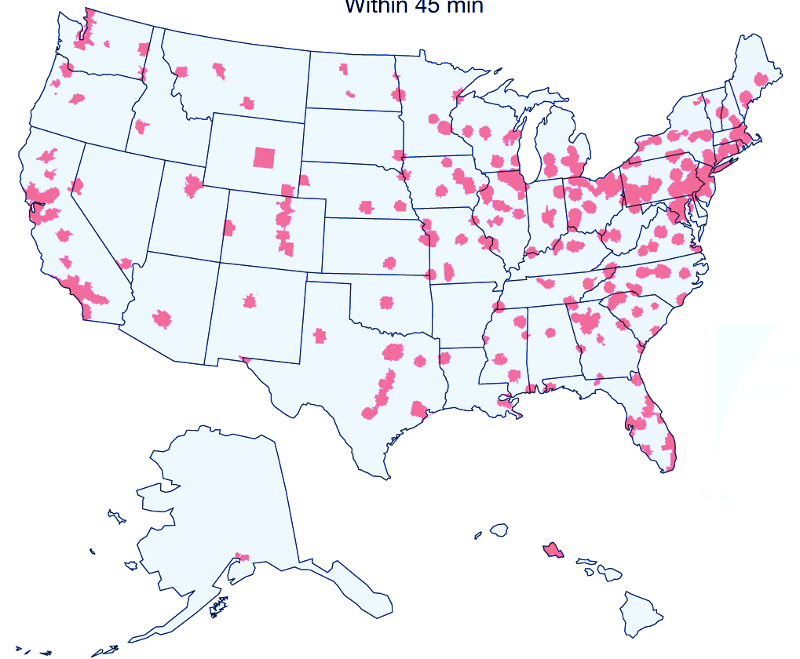
Available hemorrhage care fails to meet modern needs
60M Americans live >1h away from a Level 1 trauma center
“[Trauma] patients should have access to blood [or]…component therapy in 30 minutes or less”
– Joint Trauma System, Defense Committee on Trauma, and Armed Services Blood Program, 2021
State of the Technology Meeting: Platelet and Platelet-like Products

Slide 3
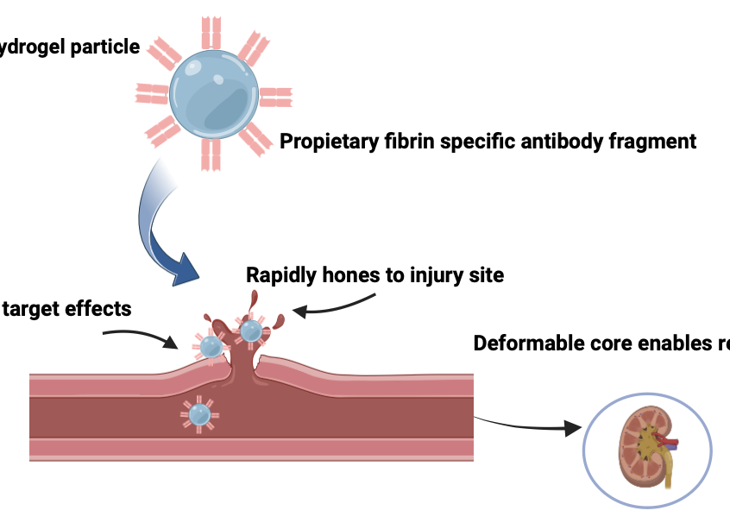



SymClot: a novel platelet-inspired solution to hemorrhage care
Designed to stop bleeding without dangerous off-target effects
Engineered for maximum ambulatory and ER utility
Innovative deformable hydrogel particle
Proprietary fibrin-specific antibody fragment enables wound targeting
Portability: shelf stable without refrigeration
Utility in emerging markets + austere and rural environments
Universal compatibility
No blood typing or antigen screening needed
High wound specificity minimizes risk of off-target effects
Integrates into native clotting processes to stop bleeding
Quick injection rapidly stabilizes patients
No need for slow infusions; practical for mass triage
High deformability enables renal clearance in under 24 hours
State of the Technology Meeting: Platelet and Platelet-like Products

Slide 4
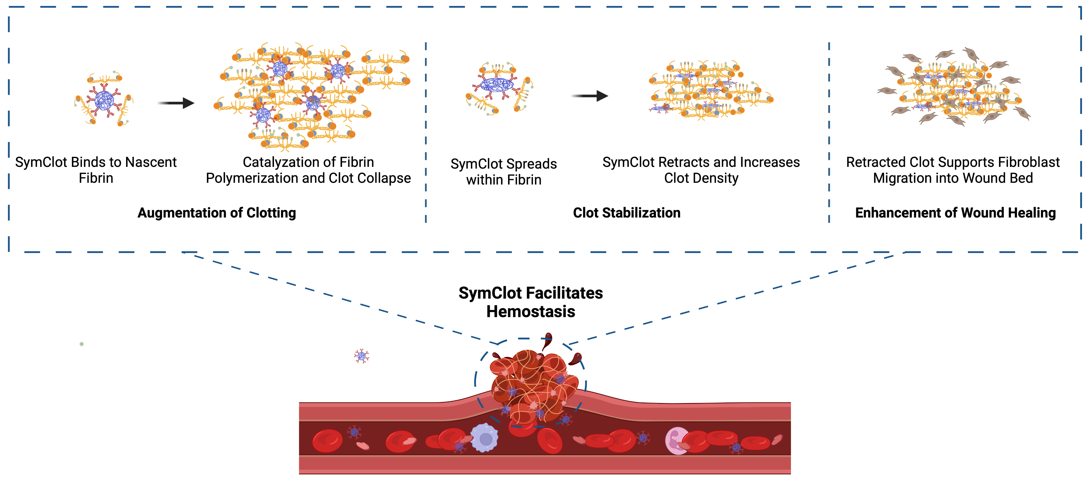
SymClot: platelet inspired for safe, effective clotting
SymClot binds to nascent fibrin
Catalyzation of fibrin polymerization and clot collapse
SymClot spreads within fibrin
SymClot retracts clots, increasing clot density
Retracted clot supports fibroblast migration into wound
Augmentation of Clotting
Clot Stabilization
Enhancement of Wound Healing
SymClot Facilitates Hemostasis
State of the Technology Meeting: Platelet and Platelet-like Products

Slide 5
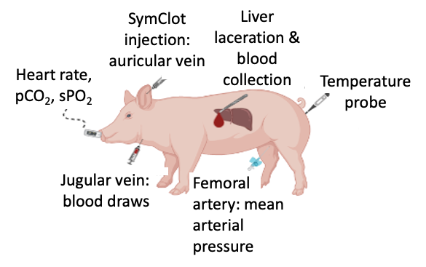
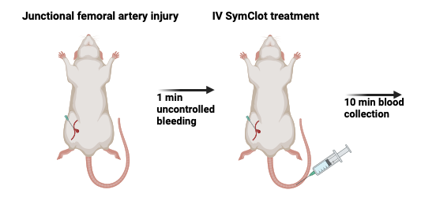
In vivo models: faster and better bleeding management than standards of care
Junctional femoral artery injury
SymClot IV injection
56% reduction in total blood loss vs. standards of care
Strong hemostatic outcomes meet clinical needs
100% of animals achieved complete hemostasis within the golden hour
33.3% faster stoppage of bleeding vs. standards of care
1 min uncontrolled bleeding
SymClot is effective and safe: rapid <24 excretion + no observed off-target thrombosis
State of the Technology Meeting: Platelet and Platelet-like Products

Slide 6



Development Timeline |  | 2021-2024 | 2025 |  | 2026 |  |  |  | 2027 |  |  |  | 2028 |  |  |  | 2029 |  |  |  | 2030
 |  |  | Q3 | Q4 | Q1 | Q2 | Q3 | Q4 | Q1 | Q2 | Q3 | Q4 | Q1 | Q2 | Q3 | Q4 | Q1 | Q2 | Q3 | Q4 | Q1 | Q2
Discovery | Formulation lock
 | In vitro efficacy & safety
 | In vivo efficacy & safety
Pre-Clinical | Non-GLP completion (Phase 2 derisking)
 | GLP pharmacology
 | GLP toxicology
Regulatory | INTERACT request
 | Pre-IND meeting
 | IND submission
Clinical | Phase 1
 | Phase 2
 | Phase 3
Manufacturing | Antibody tech transfer and scaling
 | Cell line development & hydrogel scaling
 | GLP batch stock
 | cGMP process development
 | Phase 2 batch stock
 | Phase 3 batch stock
PAST: $4M Discovery
$2M Preclinical
$12M IND/Phase 1
$25M Phase 2
$40M Phase 3
State of the Technology Meeting: Platelet and Platelet-like Products

Slide 7
Transformative clinical and emergency approach to hemorrhage control
Clear roadmap to clinical translation & market penetration
Current stage: manufacturing scale-up and non-GLP pharma/tox
CONTACT:
Kimberly Nellenbach-Willson, PhD | CSO | kim.nellenbach-willson@selsymbio.com
Seema Nandi, PhD | CEO | seema.nandi@selsymbio.com
State of the Technology Meeting: Platelet and Platelet-like Products

