Slide 1
Platelet Evolution
John Martin
University College London
Yale
NIH February 2025

Slide 2
Platelets are unique, suggesting a unique origin
Definition of a platelet:
No nucleus
Very small
Contain granules
Peripheral bundle of microtubules
Secrete in response to agonists
Surface canalicular connecting system
Cell volume distribution is log Gaussian with wide dispersion.
Found similarly in all mammals (but not in birds or reptiles)
Megakaryocytes:
Uniquely polyploid i.e. increase in nuclear DNA content ( 4N-128N) within an intact nuclear membrane.
One Megakaryocyte produces 3,000 platelets

Slide 3
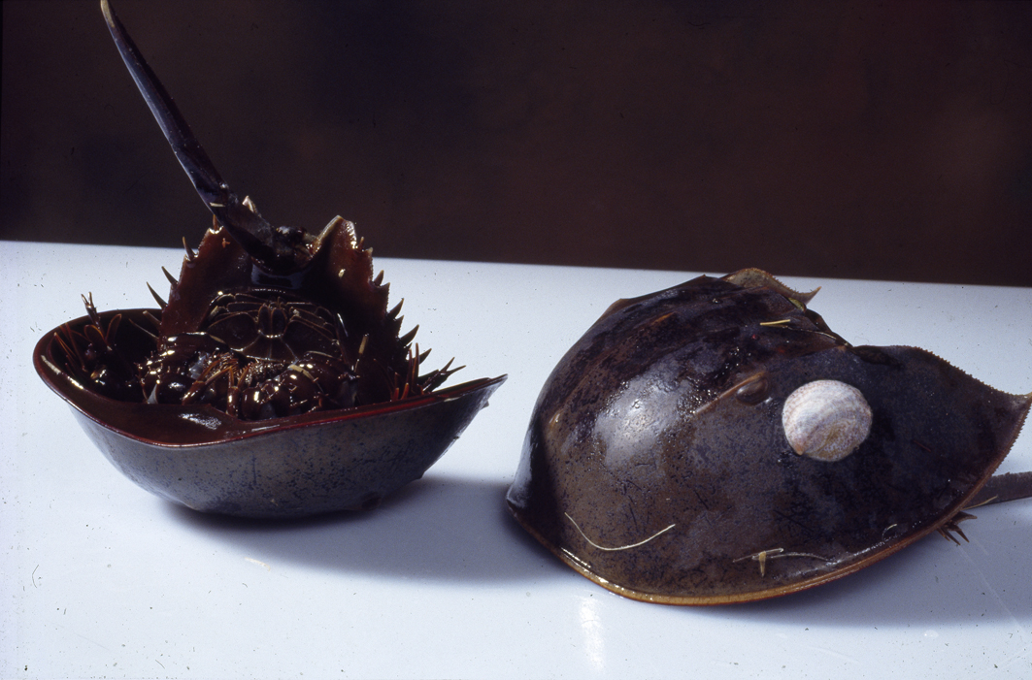

Slide 4
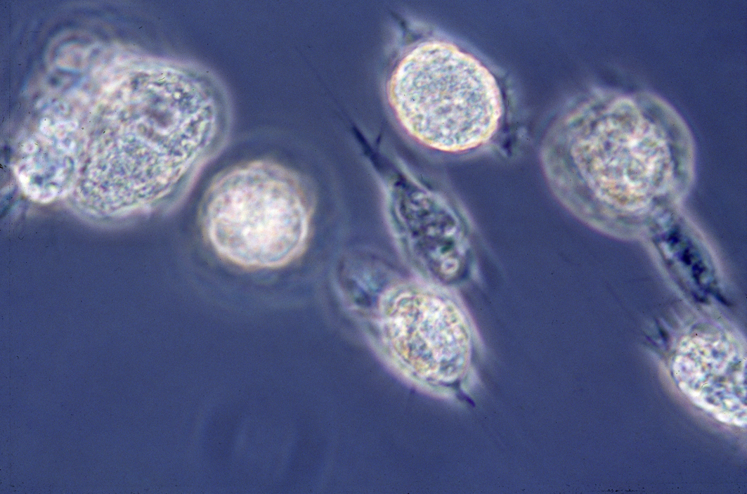

Slide 5
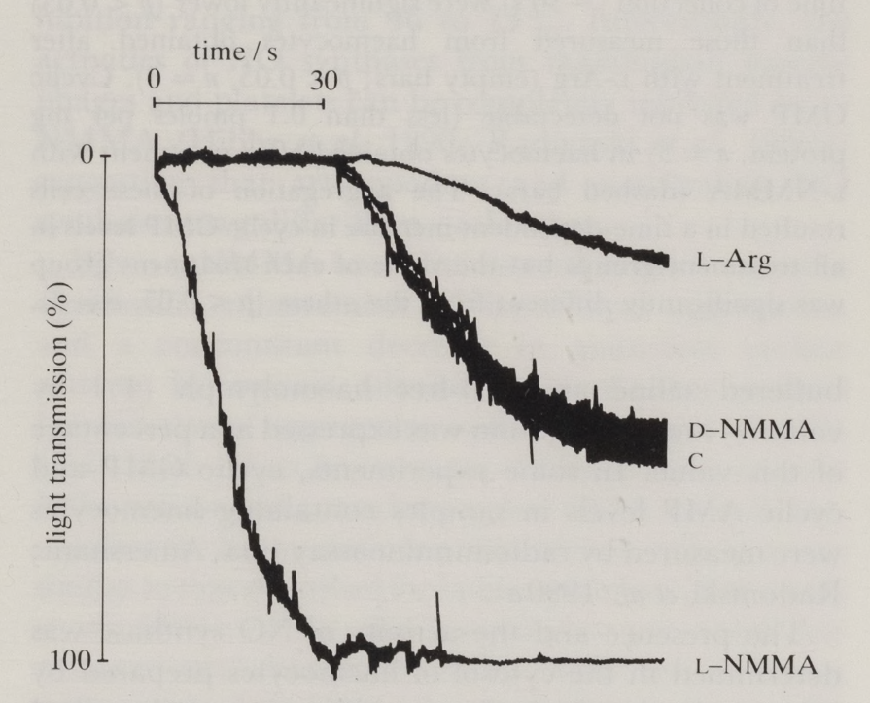
Nitric Oxide production from NO synthase inhibits limulus crab haemocyte aggregation in a Born platelet aggregometer.
Radomski, Martin, Moncada; Synthesis of nitric oxide by the haemocytes of the American horseshoe crab (Limulus polyphemus), (1991); Phil. Trans. R. Soc. Lond. B; 334, 129-133
Feelish & Martin, The early role of nitric oxide in evolution (1995); Trends Ecol. Evol., 10, 496-499

Slide 6
The thrombocyte in birds, reptiles and amphibians
The thrombocyte is a spindle shaped cell, with a 2N nucleus, specialized for haemostasis
It aggregates at the site of bleeding and secretes from granules
The cytoplasm has no demarcation membrane system
Birds, reptiles and amphibians have no megakaryocytes or platelets.

Slide 7
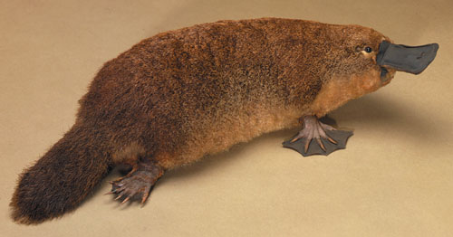
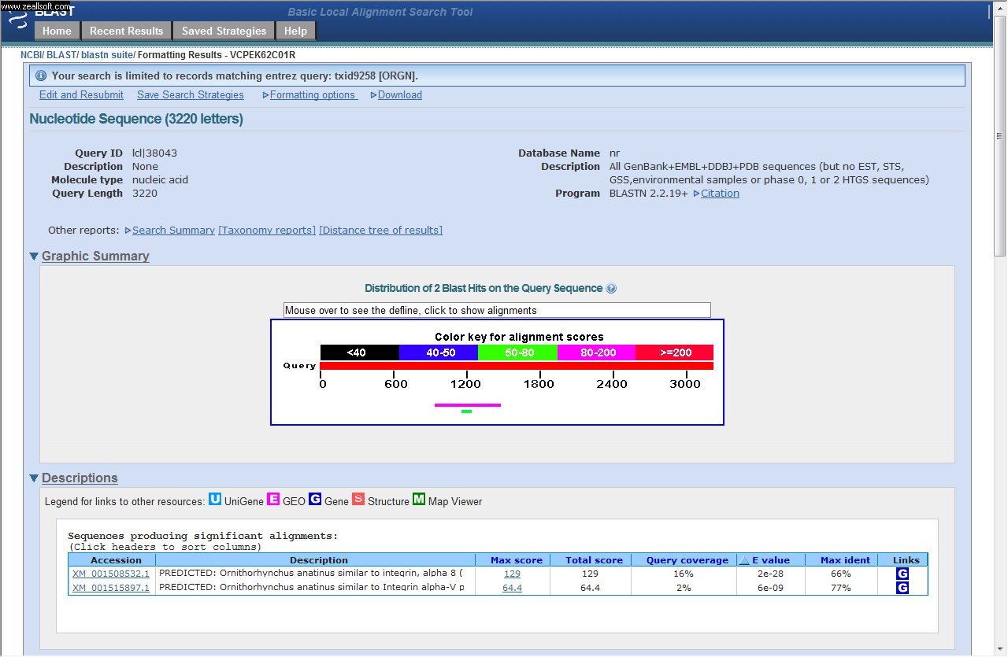
ITGA2B: Homo sapiens Integrin, alpha 2b (platelet glycoprotein IIb of IIb/IIIa complex, antigen CD41)
Blastn: Discontiguous megablast Nucleotide Collection (nr/nt)
{Ornithorhynchus anatinus}

Slide 8
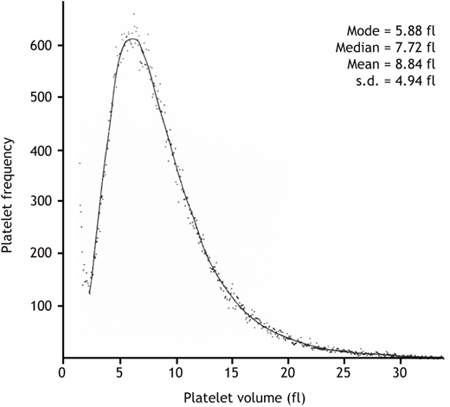
All cells produced by mitosis have a Gaussian (normal) volume distribution
Platelet heterogeneity arises at thrombopoesis; not caused by aging, (as was proposed by Karpatkin (1969)).

Slide 9
Physical fragmentation causes a log Gaussian (logarithmico-normal) curve
Epstein B. (1948). Application of the theory of extreme values in fracture problems. Journal of the American Statistical Association, 43, 403-412
Epstein B. (1948). Logarithmico-normal distribution in breakage of solids. Industrial Engineering Chemistry, 40 (1948), 2289-2291
Sommer, F. Stenger, W. Peukert, N.J. Wagner. (2006). Agglomeration and breakage of nanoparticles in stirred media mills—a comparison of different methods and models. Chemical Engineering Science, 61, 135-148

Slide 10
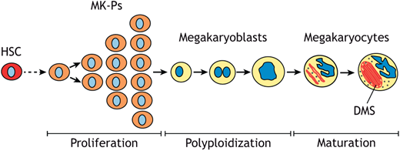
Hypothesis: In one pre-mammal a heritable epigenetic change occurred in the control of mitosis in thrombocyte precursors in the bone marrow giving polyploid thrombocytes (megakaryocytes)

Slide 11
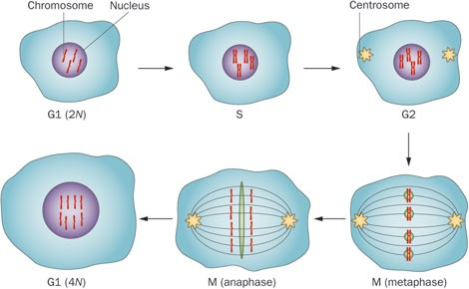
Megakaryocyte endomitosis.
A 2N megakaryocyte undergoes endomitosis to produce a 4N cell, with replication of its DNA without cell division. Continuation of this process to produce megakaryocytes up to 64N is associated with the production of large, dense, hyperactive platelets. The action of Aurora B kinase in metaphase and anaphase is shown in green. Inhibition of Aurora B kinase leads to defective endomitosis. Abbreviations: G1, Gap 1 of interphase; G2, Gap 2 of interphase; M, mitosis; S, synthesis of interphase.
There is a linear relationship between nuclear DNA content and cell size.

Slide 12
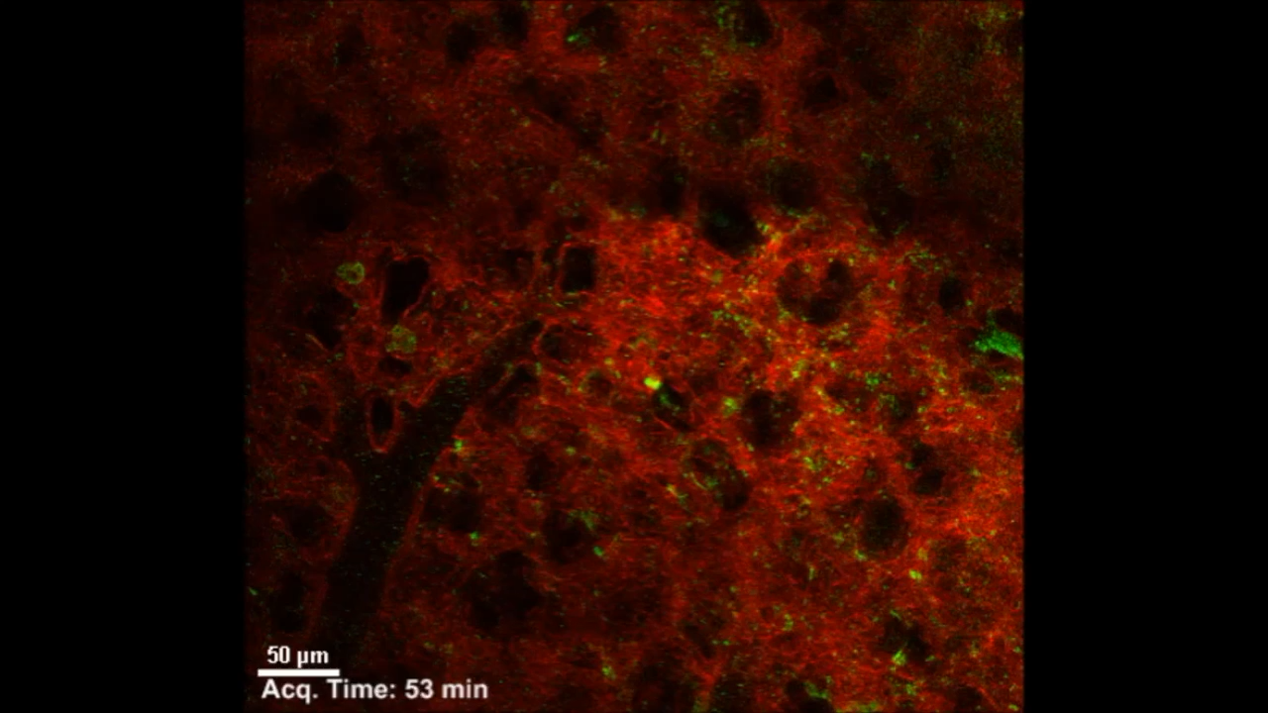
Lefrançais et al,
Nature, volume 544,
Pages 105–109 (2017)

Slide 13

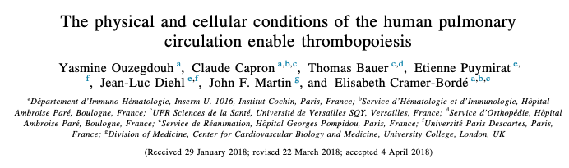

Slide 14
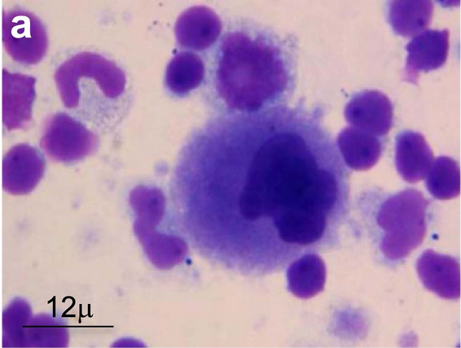
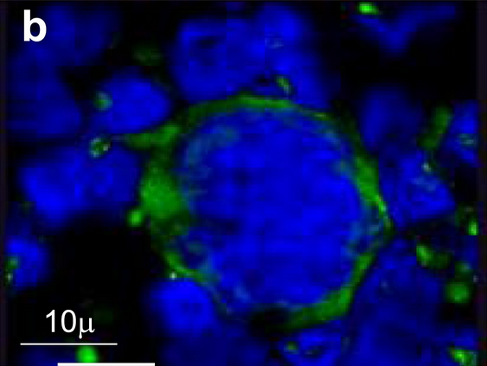
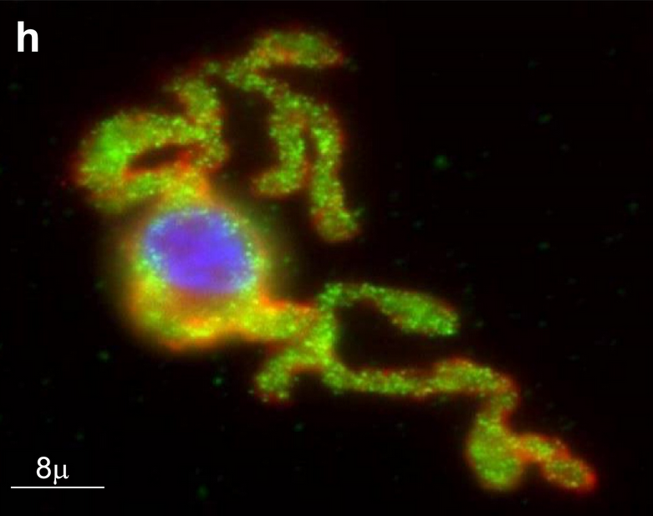
Megakaryocytes in blood taken from the human pulmonary circulation.
Ouzegdouh Y, et al. The physical and cellular conditions of the human pulmonary circulation enable thrombopoiesis. Exp Hematol. 2018 Jul;63:22-27.

Slide 15
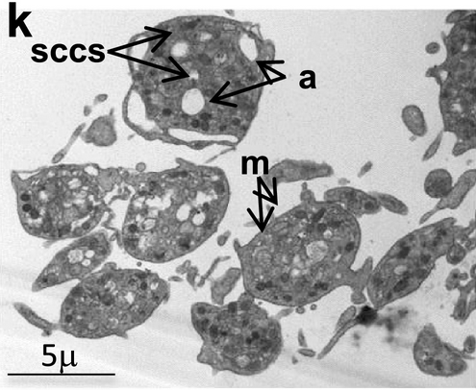
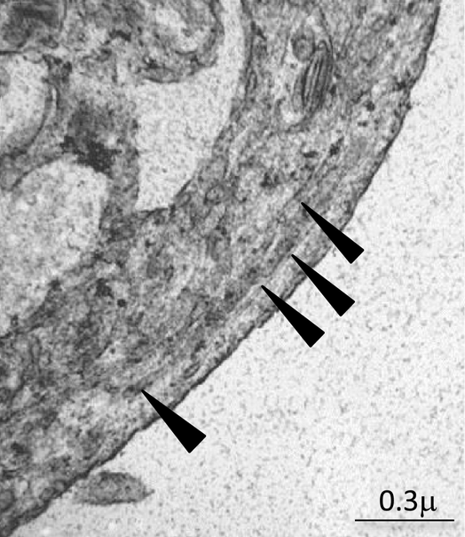
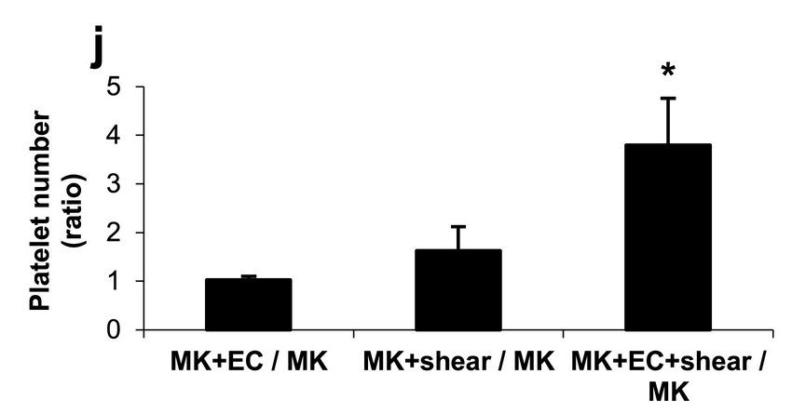
Ouzegdouh Y, et al. The physical and cellular conditions of the human pulmonary circulation enable thrombopoiesis. Exp Hematol. 2018 Jul;63:22-27.

Slide 16
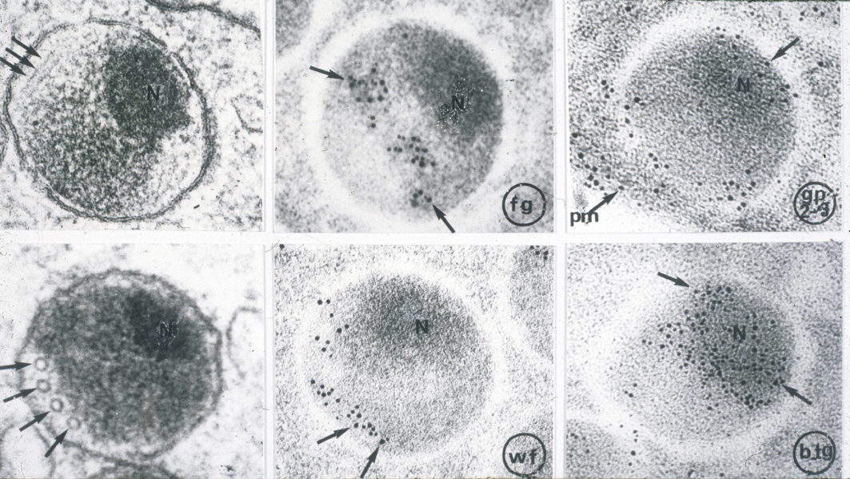

Slide 17
Foetal Platelet Production
At birth the infant has platelets yet there is no pulmonary circulation in utero (i.e. before the closure of the ductus arteriosus)
Perfused placentae showed:
the foetal artery contained megakaryocytes with cytoplasm,
the foetal vein contained megakaryocyte nuclei with no cytoplasm.
Conclusion: in the foetus platelet production occurs in the placenta.
Woods et al. Platelets (1994) 5, 109-112s

Slide 18
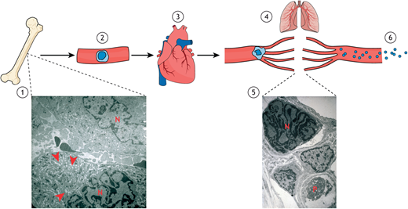

Slide 19
Lefrançais et al,
Nature, volume 544,
Pages 105–109 (2017)

Slide 20
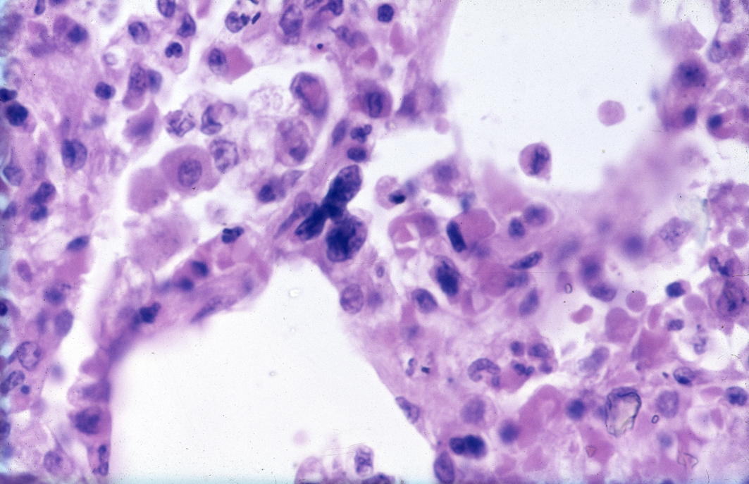

Slide 21
Cytoplasmic fragmentation of a cell into 3,000 particles
increases surface area and speed of secretion
Times increase in surface area of 3,000 fragments compared to mother cell = 11.9
Times increase in speed of secretion of a granule in one of 3,000 fragments compared to mother cell= 15.9
For calculation see Box 1, Martin and D’Avino, (2022) J. Cell Sci. 135 (24) jcs260286.

Slide 22
Schmaier et al. (2011) Occlusive thrombi arise in mammals but not birds in response to arterial injury: evolutionary insight into human cardiovascular disease. Blood, 118; 3661-3669.
Mammalian platelets are more efficient than bird thrombocytes
Chicken vs human ex vivo:
Human platelets more effective than thrombocytes:
Whole blood flow assay
Cell spreading
5HT release to thrombin and collagen
Budgerigar vs mouse in vivo:
Mouse platelets more effective than thrombocytes:
arterial injury model observed over 20 mns.
Mice demonstrate superior haemostasis.

Slide 23
Are there sufficient circulating megakaryocytes to explain daily dynamic platelet production?
The number of megakaryocytes entering the pulmonary circulation in humans [6.73/ml on average (Pedersen, 1978)], if fragmented into 3000 platelets each, given an average cardiac output and knowing the average human blood volume and the platelet life-time in the circulation, can be calculated as sufficient to maintain the average human blood platelet count of 200,000 per microlitre of blood for steady-state platelet production (Trowbridge et al., 1982).
The numbers of megakaryocytes measured in the right heart or pulmonary artery in dogs and humans were sufficient to supply the daily need of platelet production (Howell and Donahue, 1937; Levine et al., 1993; Pedersen, 1971, 1978; Pedersen and Petersen, 1980; Trowbridge et al., 1984)

Slide 24
Platelets and the evolution of the placenta
Evolution attempted live birth and the placenta >100 times, but failed.
Between 220m yrs.– 120m yrs. the placenta evolved from the egg vasculature (possible aided by angiogenic factors from platelets).
In the mammal it is essential that effective haemostasis (from platelets) allows safe separation of the placenta from the uterus (cf Bernard– Soulier syndrome and Glanzmann’s thrombasthenia).
The mammalian mother must survive to suckle the offspring.
The existence of platelets allowed the evolution of the placenta and live birth of a retained foetus, with all its advantages.
Martin, J. F. and Wagner, G. P. (2019). The origin of platelets enabled the evolution of eutherian placentation. Royal Society Biology Letters.15, 20190374

Slide 25
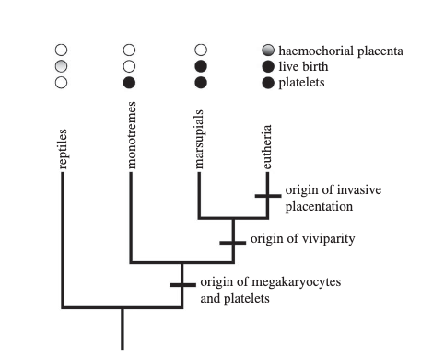
Platelets and megakaryocytes are found in all three clades of mammals but not in reptiles.
Platelets are an exaptation, sensu Gould & Vrba, for the evolution of haemochorial placenta, i.e. a trait that had one important role but that evolved for another purpose; a permissive exaptation

Slide 26
Evolutionary Theory Platelet origin: very rapid change within the animal followed by Darwinian natural selection in the clade
220 million years ago – egg-laying pre-mammal haemostasis via diploid thrombocytes; Gaussian cell volume distribution
Thrombocyte lineage undergoes inheritable change that leads to polyploidy, increasing cell size
Large polyploid cells fragment pulmonary circulation producing platelets
Traits of polyploid megakaryocyte and log Gaussian cell volume distribution of platelets appear
Better haemostasis due to larger cell surface area of platelets and faster secretion of granule contents compared to thromboctye
Clade prospers through natural selection
Other properties of megakaryocytes evolve (e.g. immune function)
Eutherian placentation in mammals is secondary to improved haemostasis; live birth established 120 million years ago
Martin, J. F. and Wagner, G. P. (2019). The origin of platelets enabled the evolution of eutherian placentation. Royal Society Biology Letters.15, 20190374.

Slide 27
Arguments against the hypothesis
Wright JH, (1906), Boston Medical and Surgical Journal; 154: 643–645
Italiano J et al., (1999) Cell Biol;147:1299–1312
Potts et al, (2014) Blood;124: 2725–2729
Paulus, (1975) Blood; 46: 1975 321-336

Slide 28
The site and mechanism of platelet production
It is universally agreed that the bone marrow is abundant in maturing megakaryocytes.
There is evidence that small numbers of magakaryocytes leave the bone marrow, entering the venous circulation
One ml of human inferior vena cava blood contains about 25 megakaryocytes. Fragmentation of these is
sufficient to maintain the balance between platelet production and platelet destruction in human circulation
Any theory of platelet production must explain the platelet log Gaussian cell volume distribution; which is unique.
Any theory of platelet production must explain the origin of megakaryocyte polyploidy.
This is true polyploidy: an increase in nuclear DNA content within a single intact nuclear membrane.
Any theory of platelet production should give quantitative evidence about the number of platelets produced
that would explain the maintained number of circulating platelets in a mammal.
The best fit of the evidence is that all megakaryocytes mature in the bone marrow and then
the necessary number move through the para sinusoidal membrane and are fragmented in the pulmonary circulation.
The necessary cellular and biochemical processes involved in platelet formation, eg proplatelet formation,
would occur in the pulmonary circulation under sheer stress.

Slide 29
Testing the hypothesis
Comparative genomics
Comparative multi-omics analysis of the epigenome, transcriptome and proteome of human megakaryoblasts differentiated in vitro with a different ploidy status and comparison of these results with similar multi-omics analyses of bird thrombocytes.
Cellular synthetic biology
AURKB inhibitor barasertib or Rho kinase inhibitor fasudil administered to chickens. Blood taken from the inferior vena cava to identify polyploid cells. Cytoplasmic particles in peripheral blood identified via electron microscopy, agonist secretion, FACS and volume distribution.

Slide 30
Can we produce more active platelets from megakaryocytes for therapeutic use in treating bleeding?

Slide 31
Megakaryocytes can produce more active platelets
In animal models, platelet destruction produces large high ploidy (up to 128N) megakaryocytes and larger, denser, more reactive platelets.
Men suffering acute cardiac death have large megakaryocytes in their bone marrow compared to age matched controls dying in car crashes.
Men suffering acute myocardial infarction have larger denser platelets than controls with chest pain and no infarction.
Ten-year prospective study of 39,531 people in Denmark: high platelet volume is most powerful predictor of myocardial infarction and death. (Klovaite et al, 2011)
Martin et al. (2012) The causal role of megakaryocyte–platelet hyperactivity in acute coronary syndromes, Nature Reviews Cardiology; 9, 658–670

Slide 32
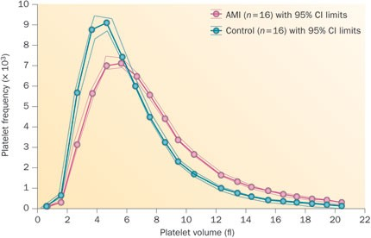

Slide 33
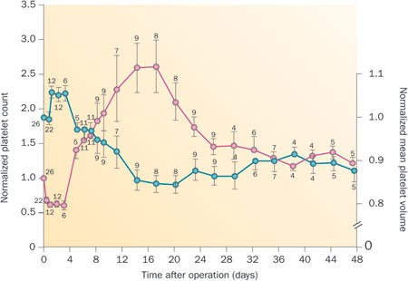

Slide 34
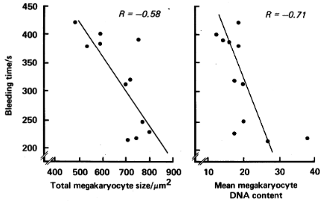
Bleeding time is inversely related to Megakaryocyte Nuclear DNA content and size in humans.
Megakaryocytes from 2cm rib at thoracotomy
Scattergrams illustrating the significant inverse relationship between the bleeding time and total megakaryocyte size (p <0.05) and between the bleeding time and mean megakaryocyte DNA content (p <0.05) in 11 humans with normal thrombopoiesis.
Kristensen, Bath, Martin (1988), The Bleeding Time ls Inverse Related to Megakaryocyte Nuclear DNA Content and Size in Man. Thrombosis and Haemostasis; 59, 357-359 .

Slide 35
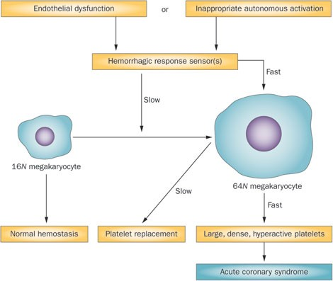
Choudry et al. (2021),
Transcriptional characterization of human megakaryocyte polyploidization and lineage commitment
J Thrombosis Haemostasis 19, 1236-1249.
Martin et al. Nature Reviews Cardiology 9, pages 658–670 (2012)

Slide 36
Why has cell therapy failed?
Expensive
Requires complex technology
Diminished cell function
Donor dependent
Side effects
Small molecule in vivo activated cell therapy has been tested using Tregs. Chorlton et al. (2022), Lancet Clinical Medicine, Vol 51, 2022

Slide 37
Small molecule in vivo activated platelet replacement therapy
There are several candidates to increase platelet number and reactivity:
Vincristine boosts platelet biogenesis in vitro. Harada et al. Blood (2023) 142 (Supplement 1) 1292.
Barasertib, is a potent, orally bioavailable, selective Aurora-B inhibitor with IC₅₀ 0.37 nM. This compound is 100 times more potent over Aurora-A and currently is in phase 3 clinical studies for cancer treatment.
Advantage: the soldier has a tablet in his pocket.
Disadvantage: it would take time to work.
Plan:
Animal studies to find the dose which increases bone marrow megakaryocyte nuclear DNA content without causing apoptosis.
Phase I human studies.
Small molecule in vivo activated cell therapy has been tested using Tregs. Chorlton et al. (2022) Lancet Clinical Medicine

Slide 38
Conclusions
Very rapid evolutionary change, secondary to inheritable epigenetic change, occurred within the pre-mammal, leading to the success of the clade through Darwinian natural selection.
Physical fragmentation of megakaryocytes in the pulmonary circulation is the best fit for platelet origin.
Platelets allowed the evolution of the placenta.
Physical forces are necessary for platelet production, (combined with many other intracellular changes).
Cell therapy is expensive and inefficient.
As a treatment for bleeding which is a cheap, simple tablet that activates megakaryocytes should be investigated.

