Slide 1
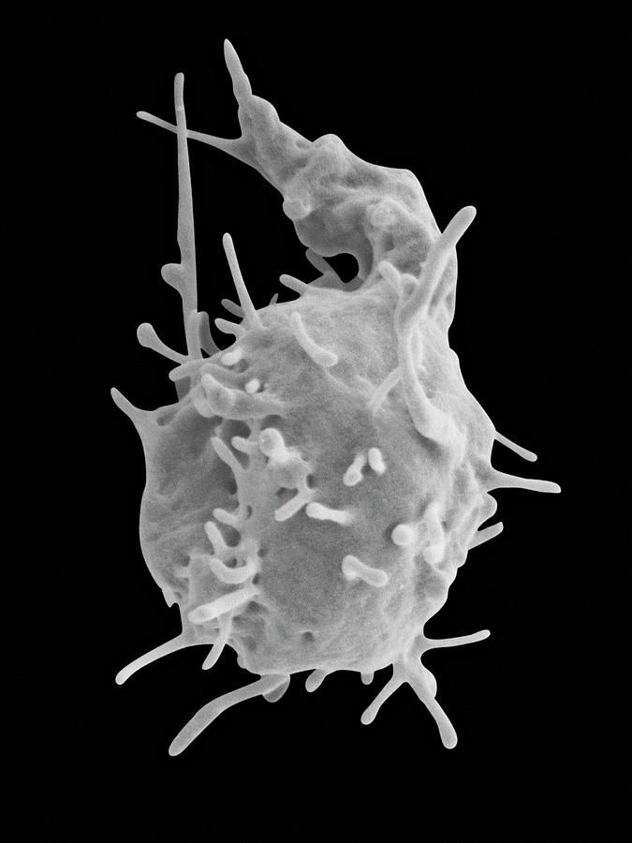
Platelets
Andre Cap, MD, PhD
COL, USA, Retired
Hematology Consultant
Tunnell, Contractor Supporting
Radiation & Nuclear Countermeasures
ASPR/BARDA

Slide 2
Disclosures & Disclaimers
Tunnell Government Services: SME consultant to HHS/ASPR/BARDA
Velico Medical: Chief Medical & Scientific Officer, Board Director
Cross Road Health/Interior Alaska Clinics: Medical Director
Volunteer faculty, Hematology & Oncology, Dept. of Medicine, Brooke Army Medical Center, USU
The following are the private views of the presenter and are not official policy and are not intended to represent the views of the Department of Health and Human Services, the Department of the Army, the Department of Defense, or the Defense Health Agency.

Slide 3
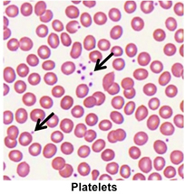
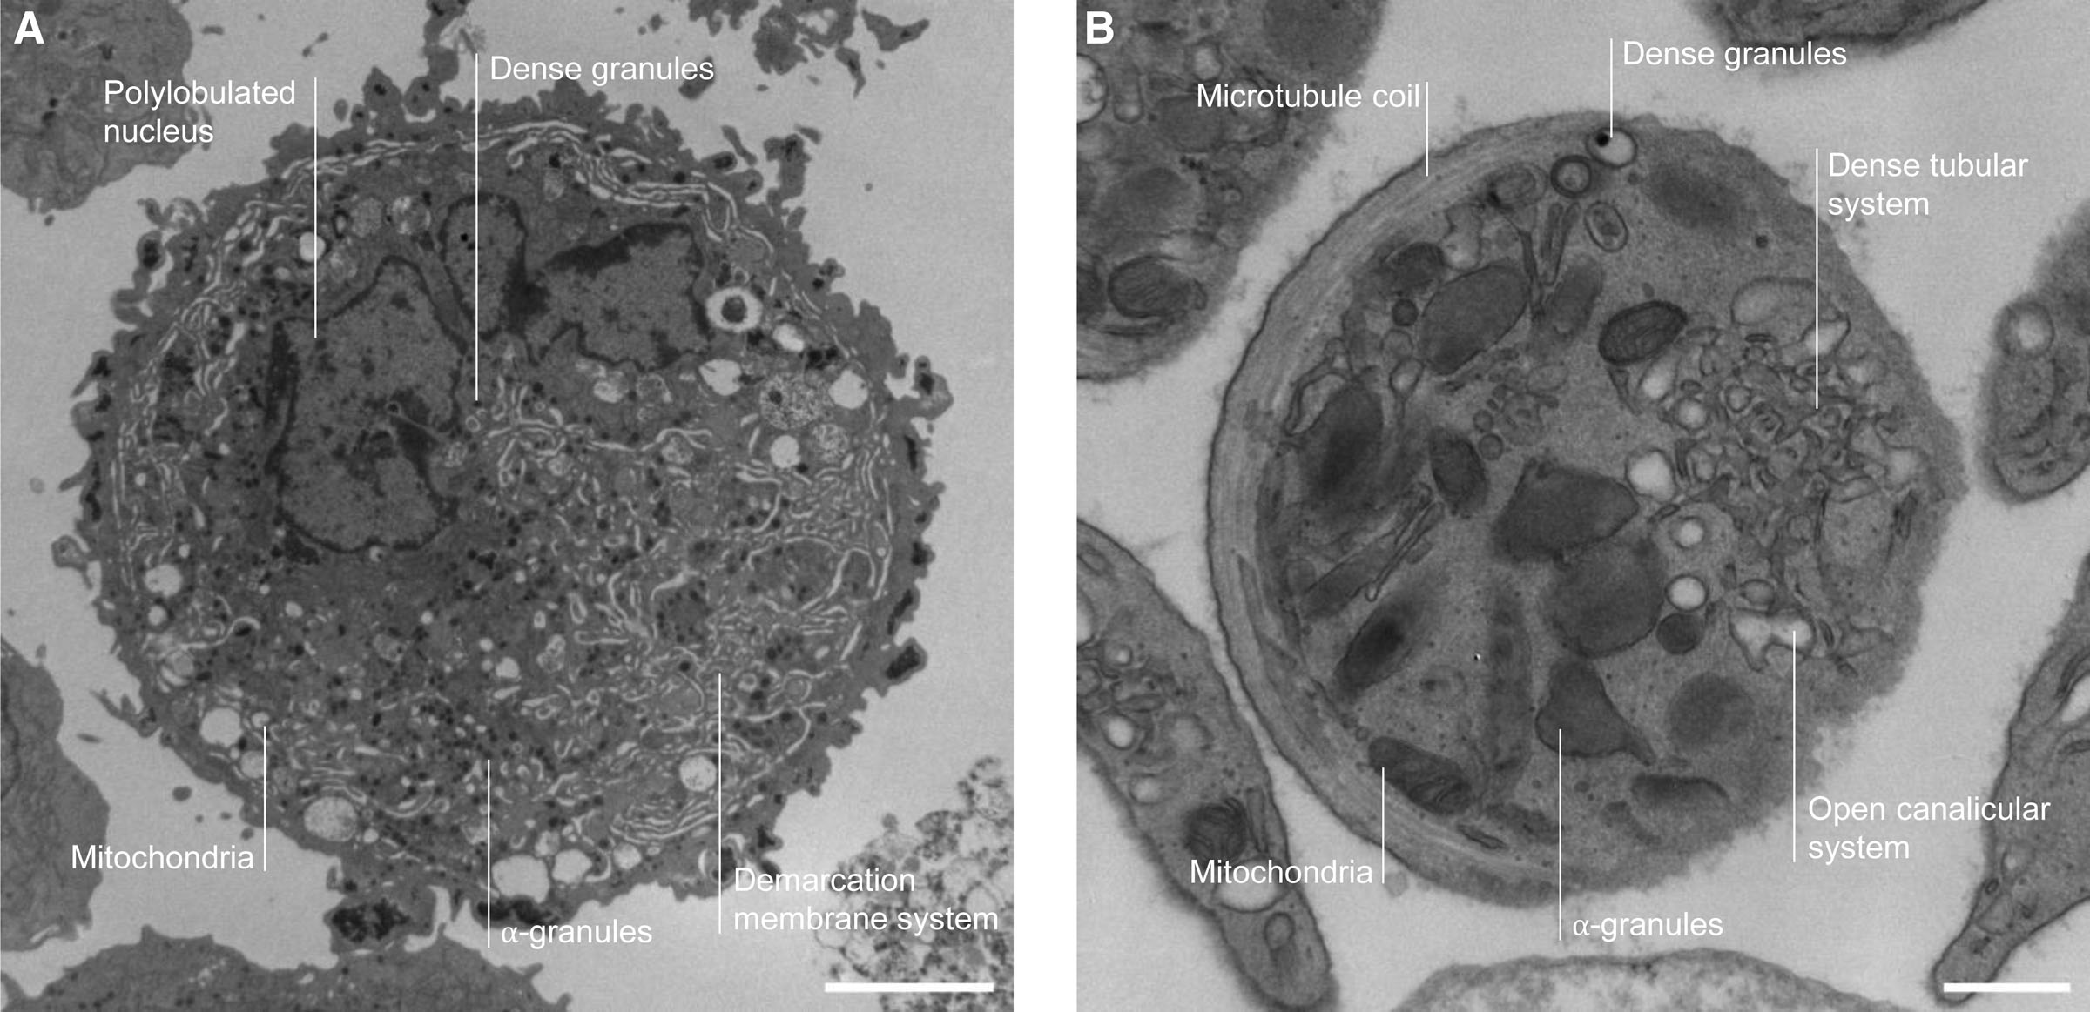
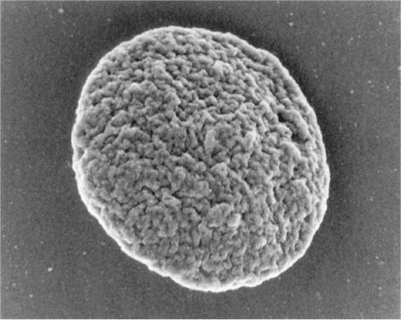
2023 State of the Science/Transfusion Medicine:
Platelets vital for prevention & treatment of bleeding,
Platelet supply inadequate, vulnerable to disruption
New approaches needed for platelet product development
Deconstruct platelets, think beyond blood banking!

Slide 4
1910: Platelets critical to hemostasis
Platelet transfusion (as fresh whole blood) reduces hemorrhage in patients with thrombocytopenia.

Slide 5
No room for nihilism… Platelets needed.
Platelet transfusion reduces hemorrhage mortality in hypoproliferative thrombocytopenia.

Slide 6
Platelets: vital in cardiac surgery
Transfusion, July-August 1963.
First successful cardiopulmonary bypass: 1953
Thrombocytopenia & platelet dysfunction determined to cause abnormal/excessive bleeding
Fresh whole blood or platelet concentrate transfusion in use by 1950s
Annals of Internal Medicine, 1959-10, Vol.51 (4), p.658-667

Slide 7
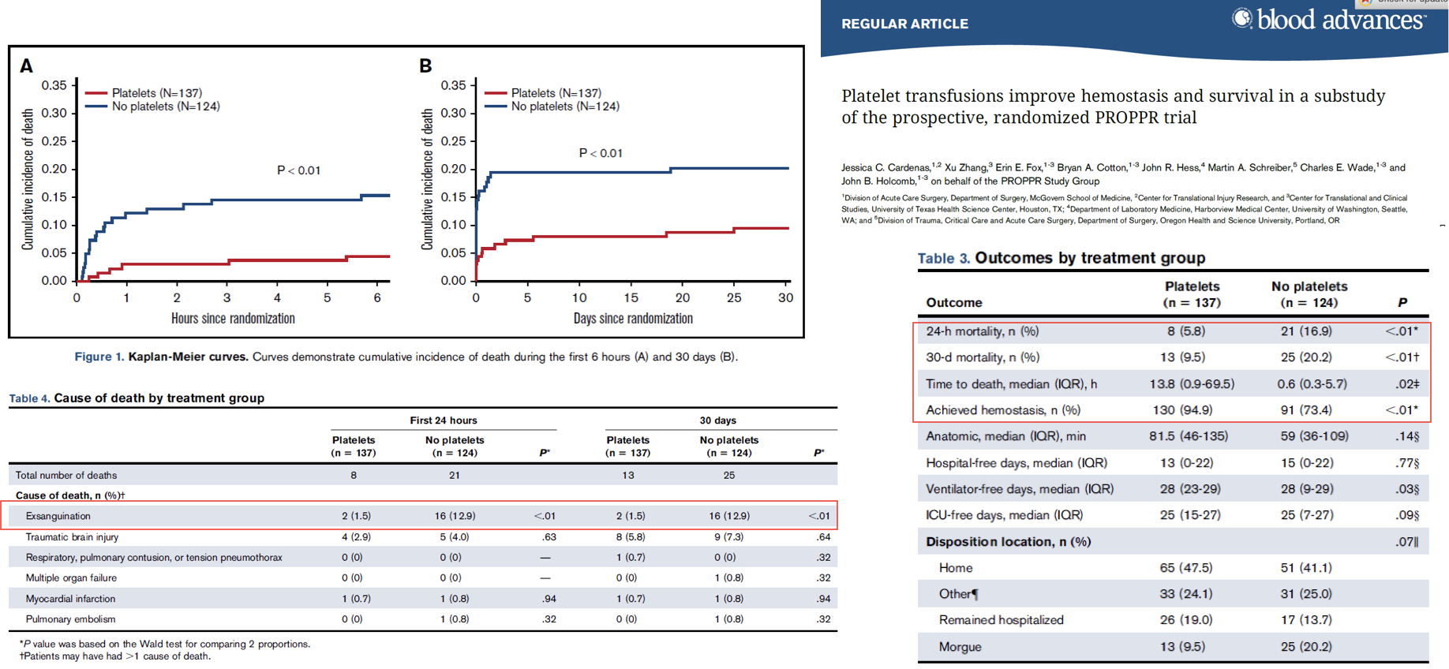
Platelets: yes, needed for trauma as well

Slide 8
With all those coagulation factors, why platelets?
Evolution.
Primary hemostasis is primary.
“The critical balance between hemostasis and thrombosis has likely driven a strong selective pressure on the biological activity of the coagulation proteins. Strikingly, FVIII and VWF specific-activities are inversely correlated throughout evolution (Figure 3). Although this analysis of AnVWF activity is restricted to human GPIb/platelets, our data suggest that primate evolution may have promoted primary hemostatic coverage and reduced the effect of
secondary hemostatic amplification, perhaps as a modulator of thrombosis.”
“Although each monomer of VWF contains a binding site for FVIII, the observed stoichiometry of VWF to FVIII in circulation is 50:1.”

Slide 9
We have a supply chain problem.
Growing demand
Short shelf life
Bacterial risk
Aging donor base
Surge/mass casualty vulnerability
FACTS:

Slide 10
We could try transfusing less…
But we’ve kind of been doing that for a while…

Slide 11
We could implement whole blood platelet collection.
In the US, only 6% of platelet collections are from whole blood.
We are throwing away platelets on a massive scale. Shortages are real and degrade patient care.
This is insane.

Slide 12
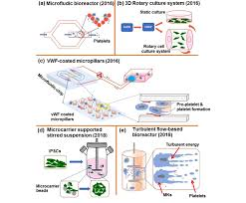
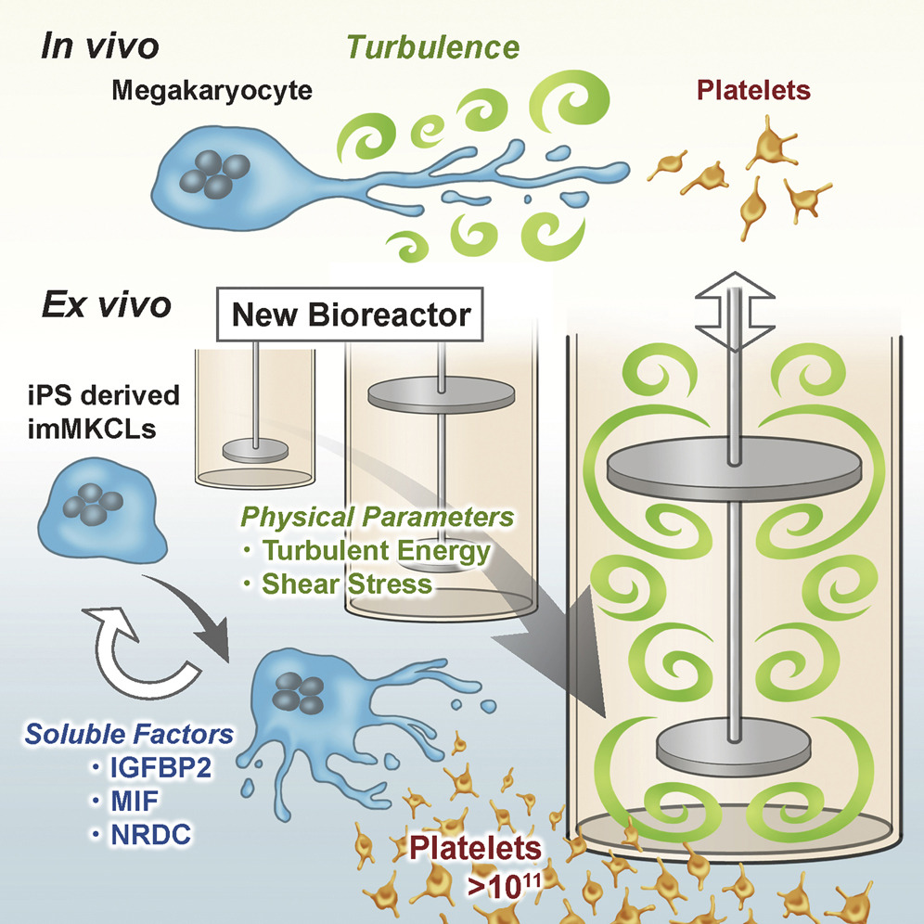
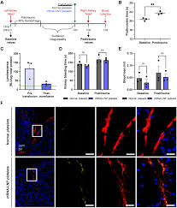
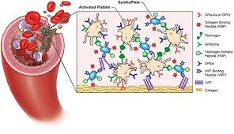
We could develop new products.
We could evolve…
Pharmed PLT
mRNA engineered PLT
Synthetic PLT

Slide 13
At this meeting, let’s drive innovation.
Evolutionary biology
Basic platelet biology
Current clinical uses
Platelet-inspired product development
Translational science
Private investment
Regulatory considerations

Slide 14
Platelets!
Enjoy the meeting.
Collaborate.
Innovate.

