Slide 1

Rion Inc.
Platelet-Derived Exosome
Therapeutics
Chris Paradise, PhD
VP, Research and Development
email: paradise@riontx.com

Slide 2







Company Overview
1
 | Company Overview | Founded in 2017 out of the Mayo Clinic Clinical-stage company leading active human clinical trials 60+ headcount with headquarters in Rochester, MN
 | Platelet-Derived Exosomes | Exosomes are the key drivers of tissue regeneration Platelet-derived exosomes offer ideal regenerative phenotype
 | Innovative Exosome Manufacturing Platform | Scaled cGMP manufacturing process FDA reviewed and approved late-stage CMC package
 | Diversified Exosome Therapeutic Pipeline | Advanced clinical programs in wound care and musculoskeletal Additional programs for MCM’s and Military Medicine
2
3
4
State of the Technology Meeting: Platelet and Platelet-like Products

Slide 3
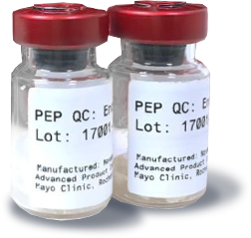
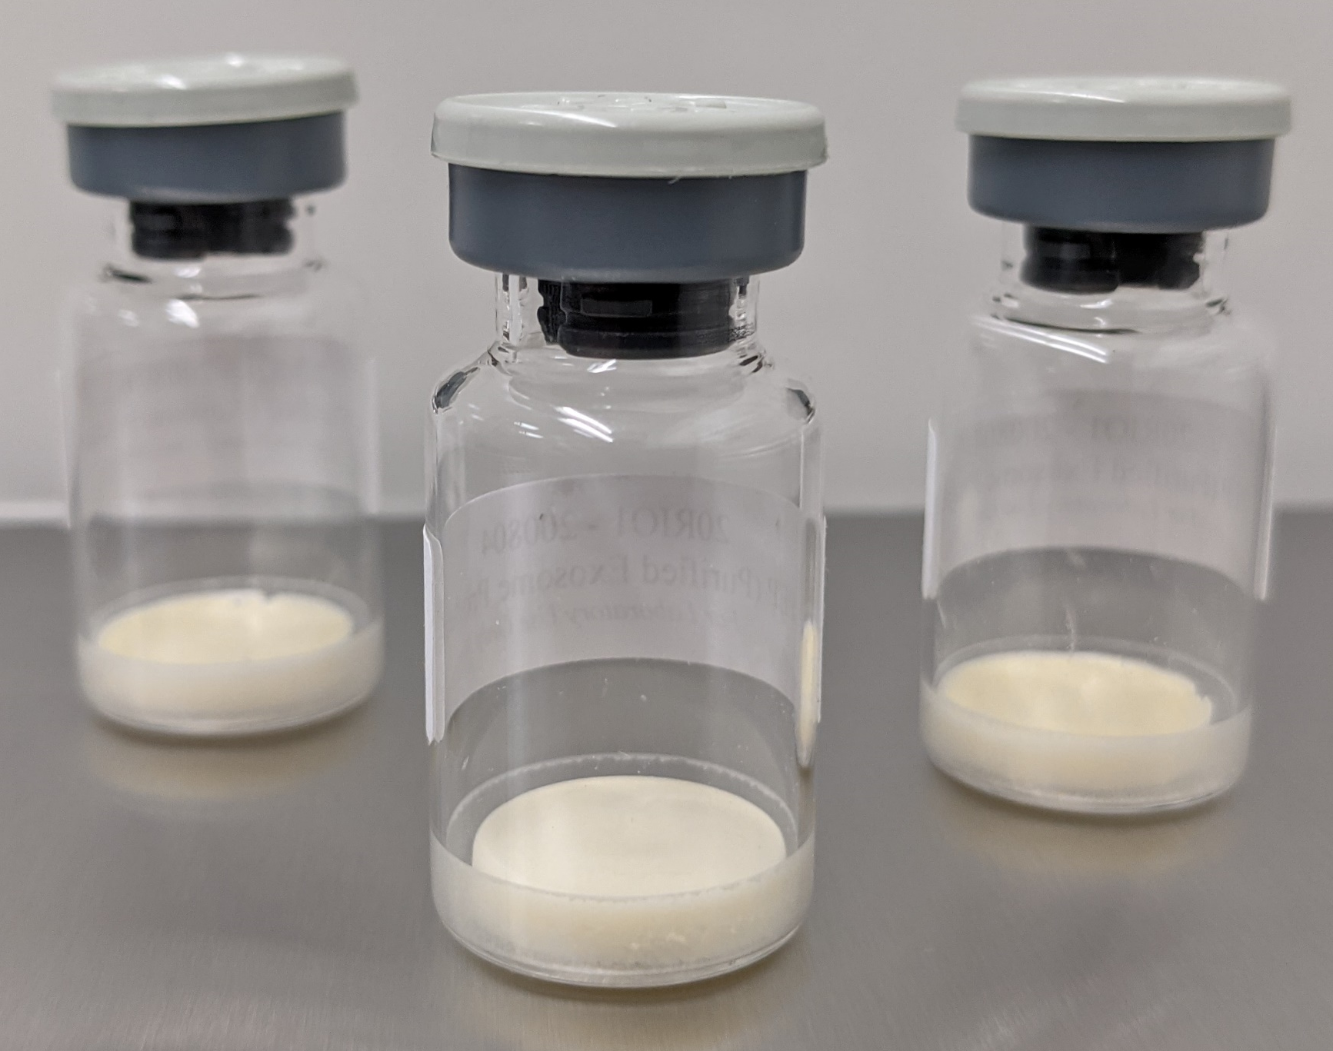
PEP Biologic™
A Next-Generation Regenerative Medicine
Platelet-derived exosomes stabilized as a powder cake
  Amenable to a wide array of regenerative medicine applications
Next-generation Regenerative Medicine
  Acellular
  Allogeneic
  Rapidly reconstituted and administered at point of care
  Stable at ambient temperature for 2 years
Clinical-grade manufacturing
  Established CMC Module compliant with FDA/EMA guidelines
  Successful implementation of viral reduction unit operations
  Scaled, cost-effective, cGMP manufacturing process
  Unit operations amenable to continued scale-up
State of the Technology Meeting: Platelet and Platelet-like Products

Slide 4
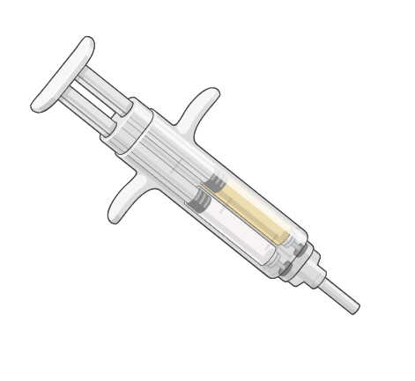
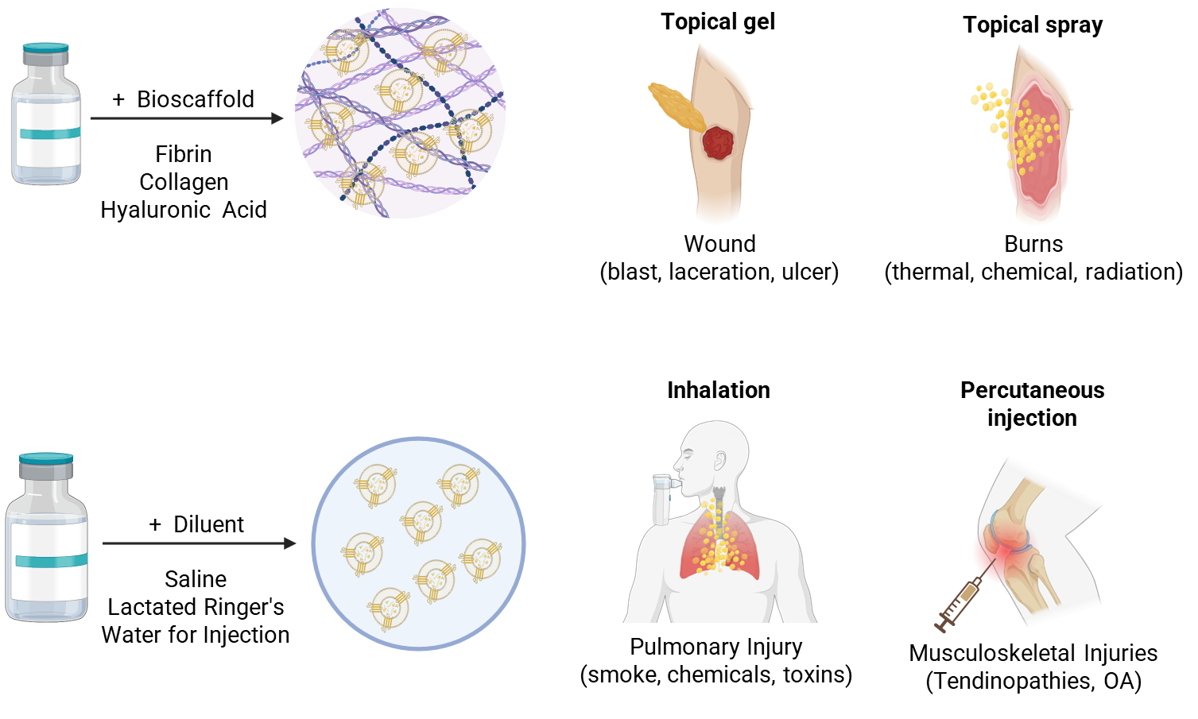
Adaptable Routes of Administration
Rapidly Prepared and Administered in Multiple Configurations
RION PEP
TRL7
TRL5
RION PEP
TRL5
TRL6
State of the Technology Meeting: Platelet and Platelet-like Products

Slide 5
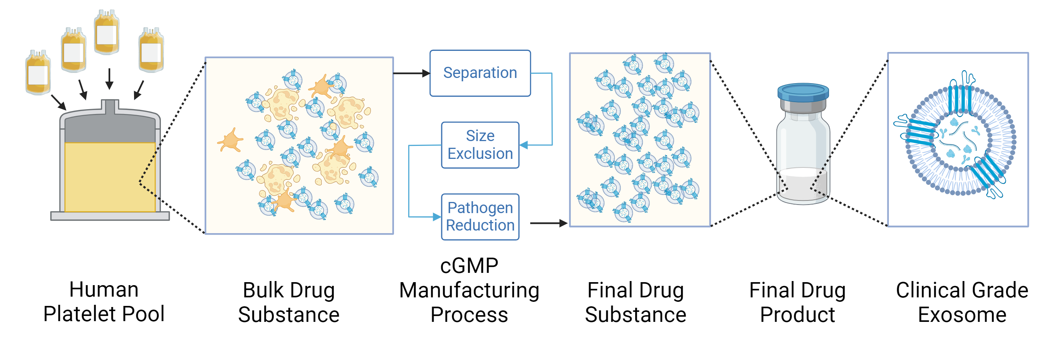
Manufacturing Overview
Established cGMP Manufacturing Process at Scale with FDA Alignment
Separation
Cleanup
Pathogen
Reduction
PEP manufacturing process has been scaled to meet Phase 3 and Commercial needs
State of the Technology Meeting: Platelet and Platelet-like Products

Slide 6
Current Clinical Programs
Dermal, Musculoskeletal, and Toxic Inhalation Injuries
THERAPEUTIC AREA | INDICATION | PRODUCT | PHASE OF DEVELOPMENT
 |  |  | Preclinical | Phase 1 | Phase 2 | Phase 3
Advanced Wound Care | Diabetic Foot Ulcers | Topical PEP™
 | Pressure Ulcers | Topical PEP™
 | Chronic Radiation Ulcers* | Topical PEP™
 | No Options Wounds | Topical/ Spray PEP™
Pulmonary | Smoke Inhalation* | Nebulized PEP™
Musculoskeletal | Knee Osteoarthritis | IA PEP™
 | Achilles Tendinopathy* | IT PEPTM
Complete
Complete
Complete
EOP2
1H 2026
Complete
Complete
Complete
2H 2026
Complete
Q4 2025
Expanded Access Program Active Under 15+ spINDs
Complete
Complete
LPFV Q1 2026
Complete
FPFV Q1 2026
* In collaboration with the Department of War
State of the Technology Meeting: Platelet and Platelet-like Products

Slide 7
RION has partnered with Scientists and Clinicians throughout the DoD to expand the application of PEP Drug Product into the CBRN MCM space
Indication | Development Stage | Institution | Funding Support
Radiation Ulcers | Phase 1 Clinical | Walter Reed National Military Medical Center | Trial supported by WRNMMC Cancer Center
Achilles Tendinopathy | Phase 1 Clinical | Uniformed Services University | Funding provided by CDMRP-MTEC Award ($2.7M)
Radiation Dermatitis | Preclinical | Uniformed Services University | Rion-sponsored CRADA
Toxic Pulmonary Exposures (smoke) | Preclinical | Institute for Chemical Defense | FY23 CDMRP-TERP Award ($2.4M)
Toxic Pulmonary Exposures (mustard) | Preclinical | Institute for Chemical Defense | ICD Intramural NIH Award
State of the Technology Meeting: Platelet and Platelet-like Products

Slide 8
Rion Inc.
Platelet-Derived Exosome
Therapeutics
Chris Paradise, PhD
VP, Research and Development
email: paradise@riontx.com

