Slide 1
“CON”:
Platelet Function Testing
Lucy Zumwinkle Kornblith, MD
Elsbach-Richards Endowed Chair in Surgery I
Associate Professor of Surgery and Laboratory Medicine
Director of Research, SOM Vice Dean’s Office
University of California, San Francisco @ Zuckerberg San Francisco General Hospital
Notes:
Good afternoon, I am Lucy Kornblith, and as I shared yesterday I am a trauma and acute care surgeon at the University of California, San Francisco, and have a lot of experiences using platelet function testing in injured patients as a research tool.

Slide 2
Why?
Over 50% of patients who present to the emergency department after injury have “platelet dysfunction” by these assays
  Degree of injury
  Hemorrhage
  Brain injury outcomes
  Mortality
No response in platelet function measures in response to platelet transfusion
Research studies (flow cytometry, microfluidics, calcium flux assays and so forth) tell us these platelets are functioning
These assays were built to measure pharmacologic inhibition of circulating platelets
Circulating platelets aren’t necessarily the platelets of interest in injury and disease
Notes:
So, why are they garbage? Well, as I mentioned yesterday, first these ex-vivo platelet function assays tell us that over 50% of patients who present to the ED after injury have platelet dysfunction-platelets impaired in their activation and aggregation responses to stimulation ex vivo.
AND to interpret the meaning of that we must consider the clinical associations that are identified. AND in doing so, this “platelet dysfunction” doesn’t predict
→degree of injury
→hemorrhage
→brain injury
→or mortality
AND→although platelet transfusion improves clinical outcomes in patients who are hemorrhaging, IT DOES NOT improve degree of platelet dysfunction measured by these assays
Plus→other assays like flow cytometry to measure surface marker expression, microfluidics, calcium flux assays and so forth support that these platelets maintain important hemostatic aspects of function, in other words they aren’t truly dysfunctional.
And we need to interpret this with the knowledge that →most of these assays were built to measure pharmacologic inhibition of platelets
AND we are sampling→circulating platelets but circulating platelets aren’t necessarily the platelets of interest in injury and disease
So, let me just briefly share some data on→these aspects to convince you

Slide 3
The Data
What about in predicting degree of injury?
Notes:
First, do these assays predict severity of injury?

Slide 4
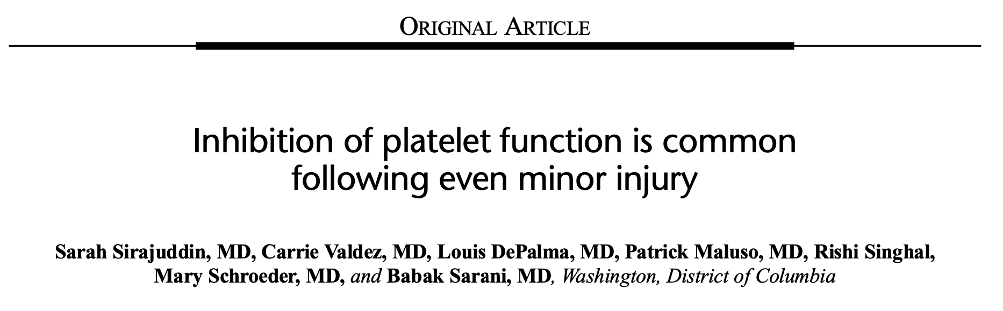
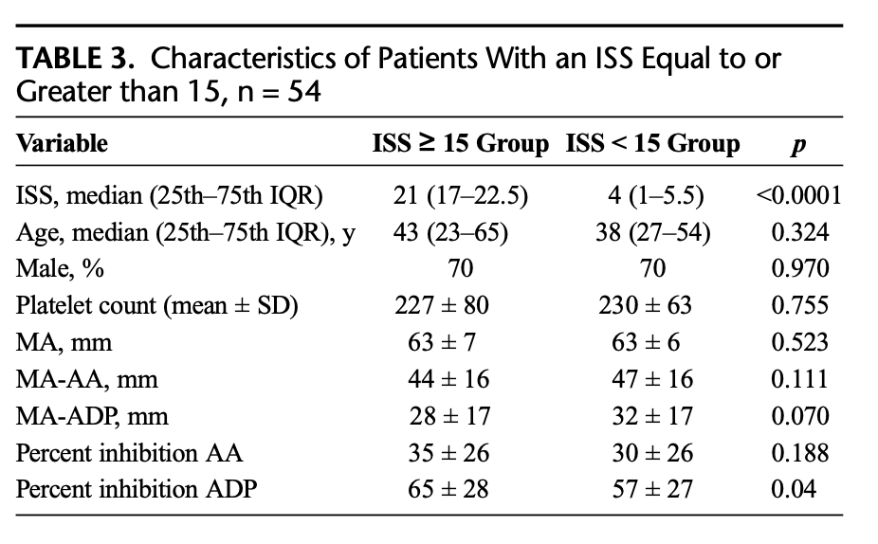
Notes:
They do not. In this cohort of 54 patients, there were no statistically or clinically significant differences in TEG platelet mapping for those with mild injury versus those with severe injury
Ahem→note the senior author

Slide 5
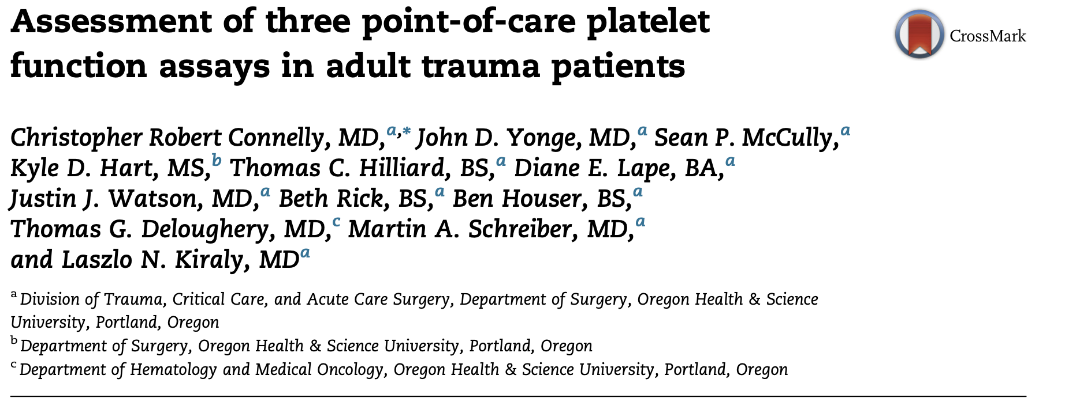
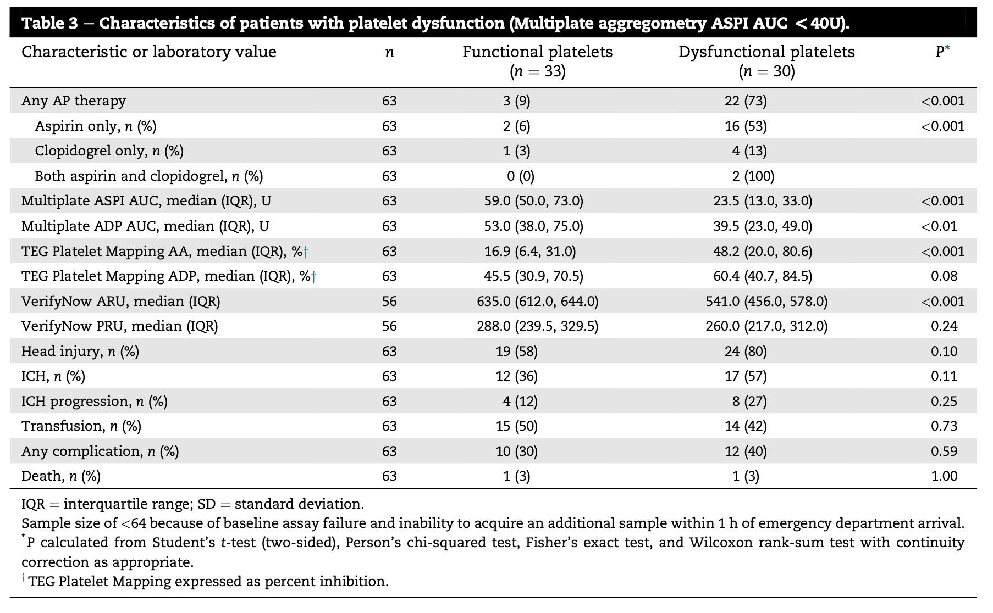
Notes:
And in these 64 injured patients who had platelet function measured via Multiplate, TEG platelet mapping, and VerifyNow you can see that→ although there were nearly half identified to have platelet “dysfunction” by these measures, there was no significant association of platelet dysfunction with →any complication including ICH progression, transfusion, or death.

Slide 6
The Data
What about in predicting degree of injury?
What about in predicting hemorrhage/transfusion?
Notes:
Well okay, but how about massive transfusion?

Slide 7
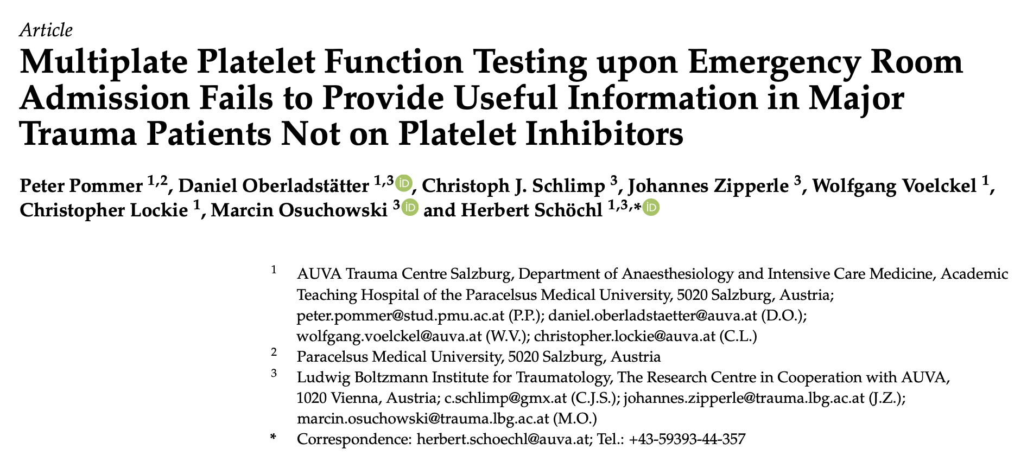
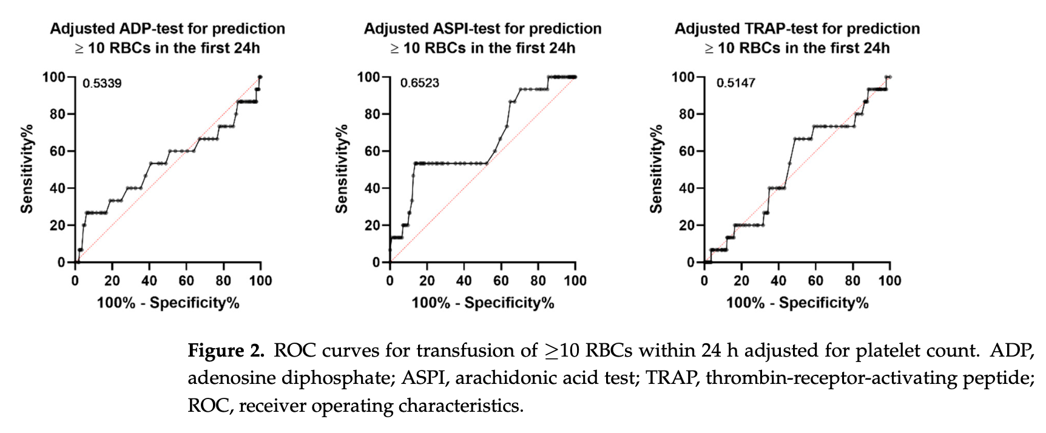
Notes:
Nope.
In this cohort, →you see that Adp, arachidonic acid, and thrombin stimulated aggregation responses in multiplate were a →coin flip for prediction of massive transfusion
NOW, I COULD stop here because this one has the best title of all of them →because it completely summarizes the literature in this area: “platelet function testing upon emergency room admission fails to provide useful information in major trauma patients NOT on platelet inhibitors” but I will drive the point home.

Slide 8
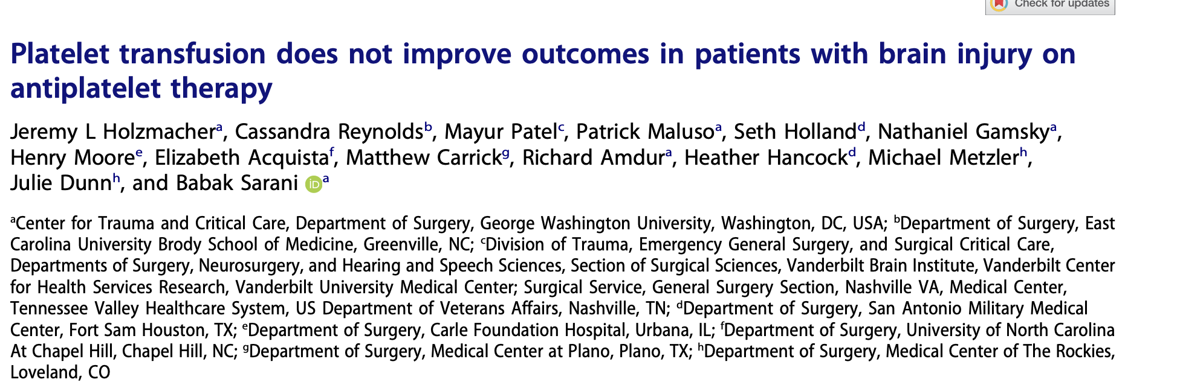
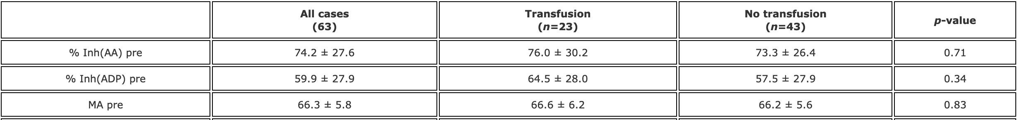
Notes:
And it isn’t just in massive transfusion, in this cohort of patients with brain injury, there was→ no difference in the percent inhibition by TEG platelet mapping between those patients who received or did not receive transfusion.
Also→again, notice our senior author here.

Slide 9
The Data
What about in predicting degree of injury?
What about in predicting hemorrhage/transfusion?
What about in predicting brain injury outcomes?
Notes:
Okay, so what about predicting brain injury outcomes?

Slide 10
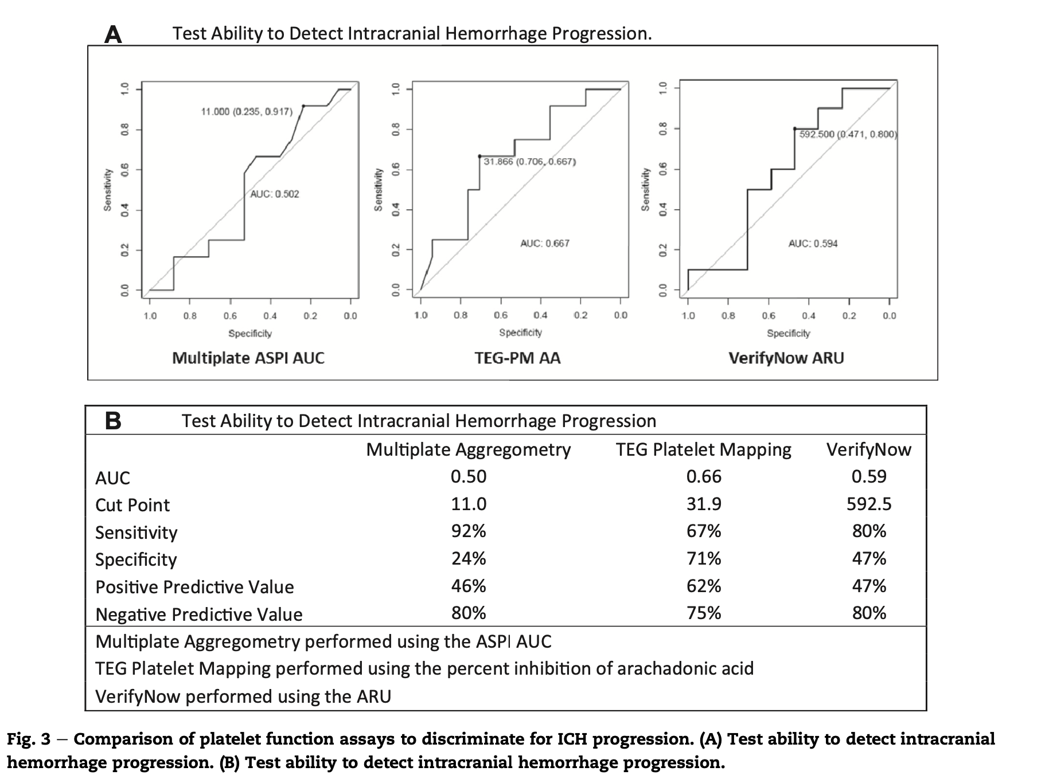
Notes:
Nope. With multiplate, TEG PM, and Verify now the →discrimination for predicting ICH progression is basically a coin flip

Slide 11
The Data
What about in predicting degree of injury?
What about in predicting hemorrhage/transfusion?
What about in predicting brain injury outcomes?
What about in predicting mortality?
Notes:
Okay, what about mortality?

Slide 12
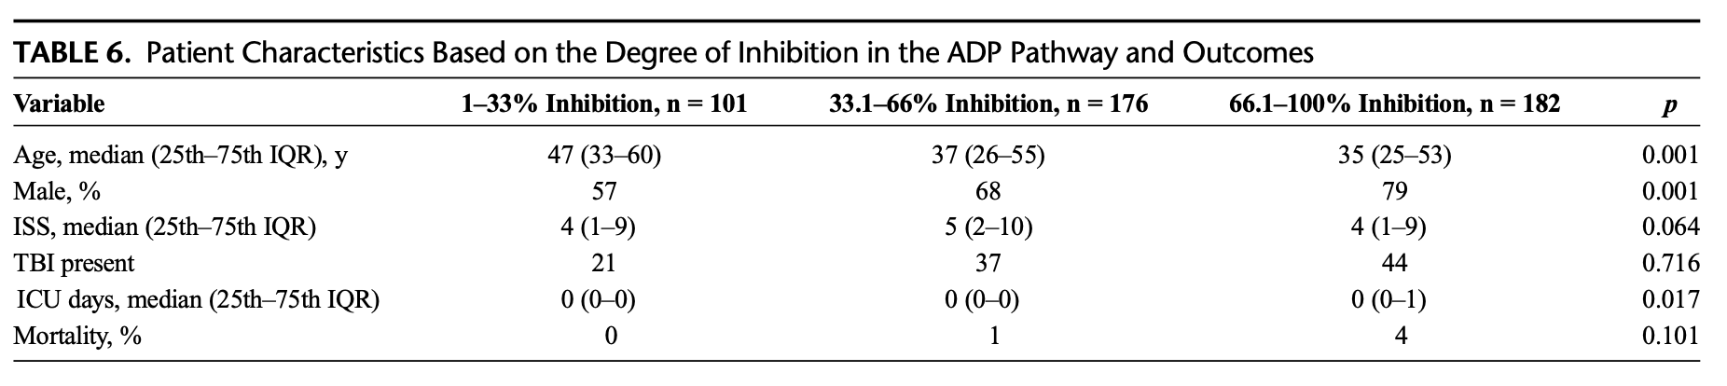
Notes:
No→no difference in mortality across degrees of platelet inhibition for TEG platelet mapping
→note the senior author

Slide 13
The Data
What about in predicting degree of injury?
What about in predicting hemorrhage/transfusion?
What about in predicting brain injury outcomes?
What about in predicting mortality?
What about in predicting anti-platelet use?

Slide 14
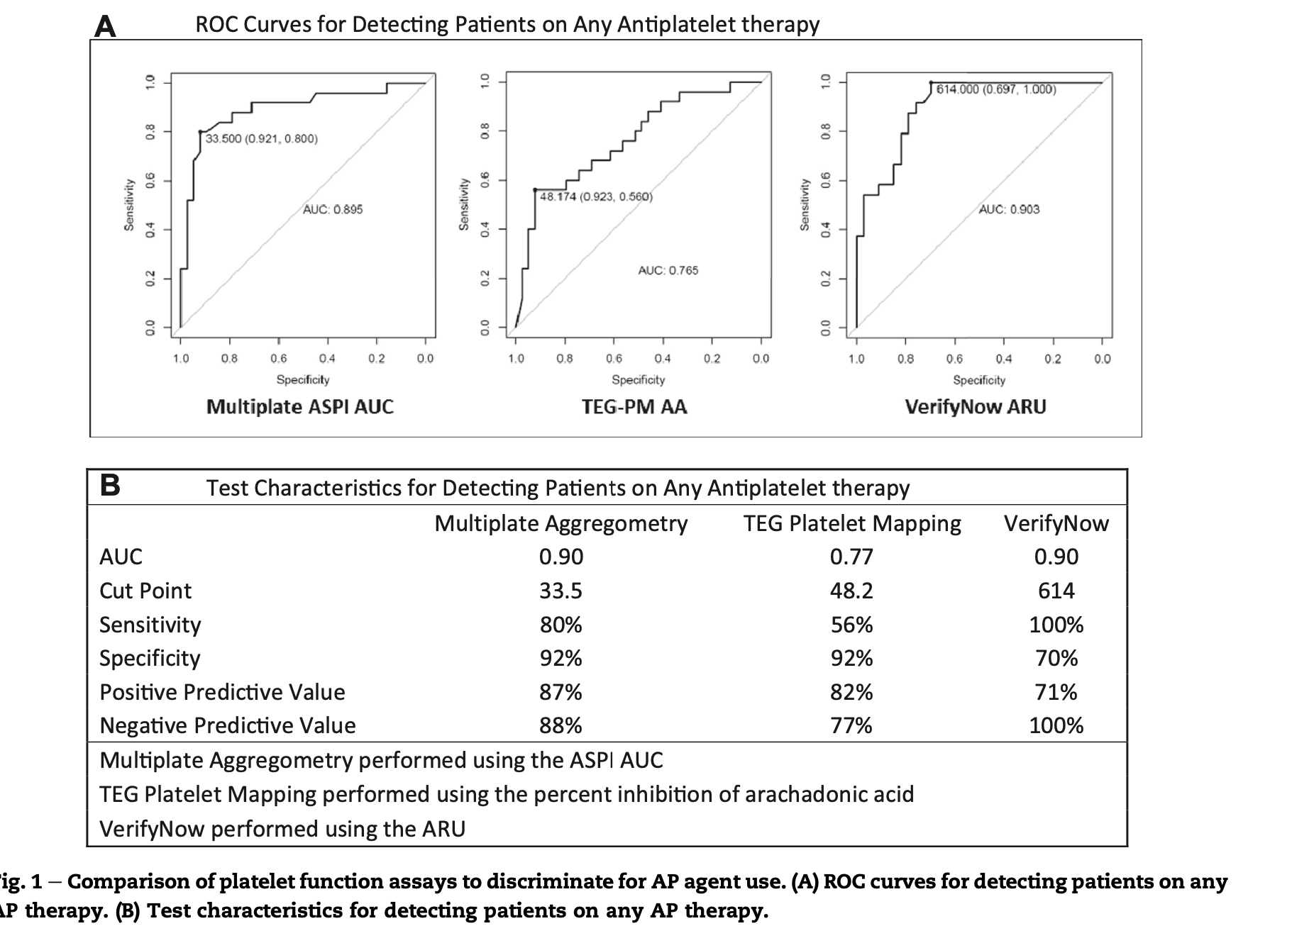
Notes:
Okay, MAYBE.
This is the best performance these platelet function tests have. You can see the → AUC for prediction of antiplatelet therapy for multiplate, TEG platelet mapping and verify now is reasonable.
I would say this is the only potential VALUE that the data supports in these patient populations, predicting anti-platelet medication use

Slide 15
Summary
What about in predicting degree of injury
What about in predicting hemorrhage/transfusion?
What about in predicting brain injury and outcomes?
What about in predicting mortality?
What about in predicting anti-platelet use?
Notes:
So, to summarize I’ve shown you that →these platelet function assays are GARBAGE (his words) for predicting degree of injury, transfusions/hemorrhage, brain injury and outcomes, and mortality.
The only place it is potentially useful is → in predicting anti-platelet use.
And you don’t even have to believe me, or Dr. Sarani’s publications on this…

Slide 16
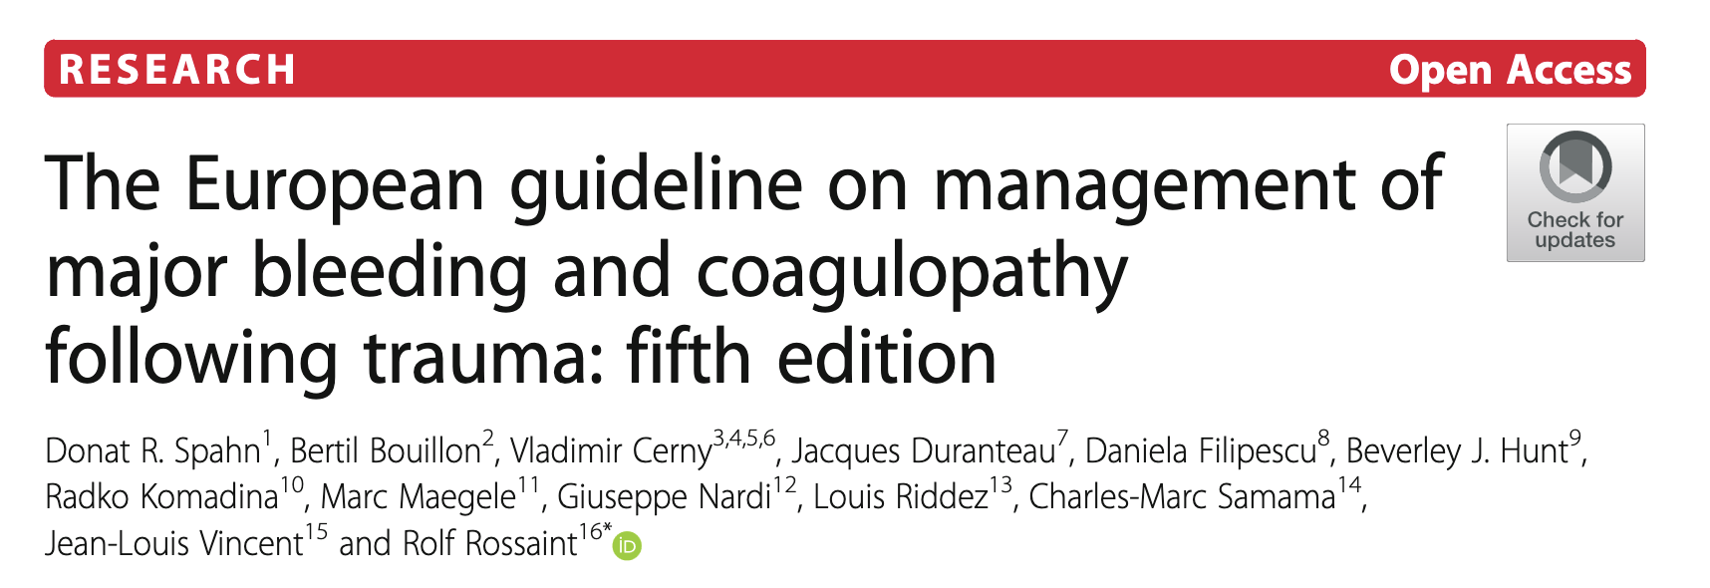
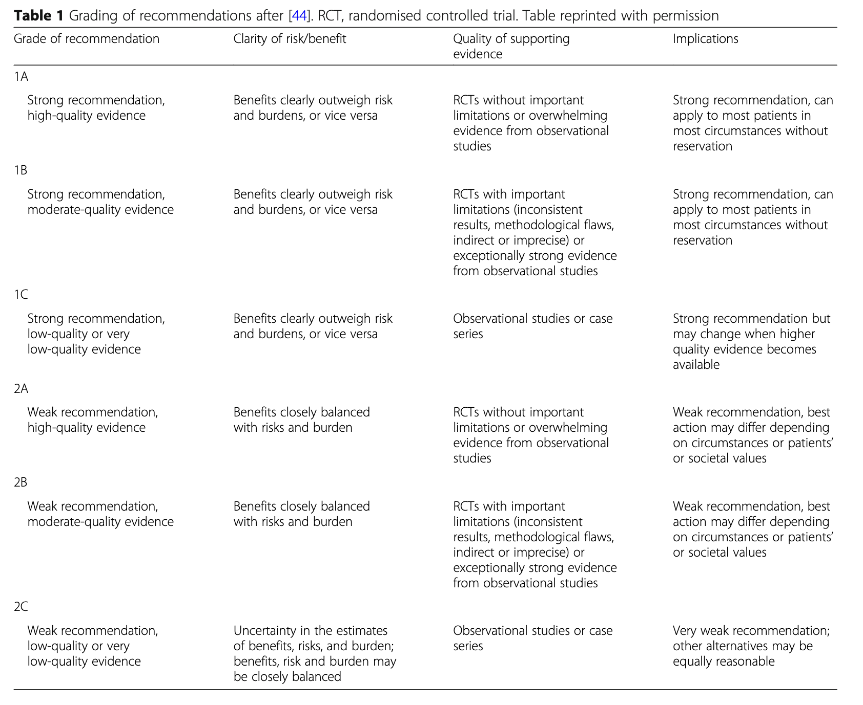
The only role of platelet function point-of care testing in injured patients is to detect antiplatelet effect in traumatic bleeding.
Notes:
The Europeans have modern evidence based guidelines on this, and they have concluded that -->the only role of platelet function point-of care testing in injured patients is to detect antiplatelet effect in traumatic bleeding.
AND On this basis, platelet function testing received a grade 2C recommendation for use in injured patients →which I will remind you is the weakest recommendation due to uncertainly in any estimate of benefit.

Slide 17
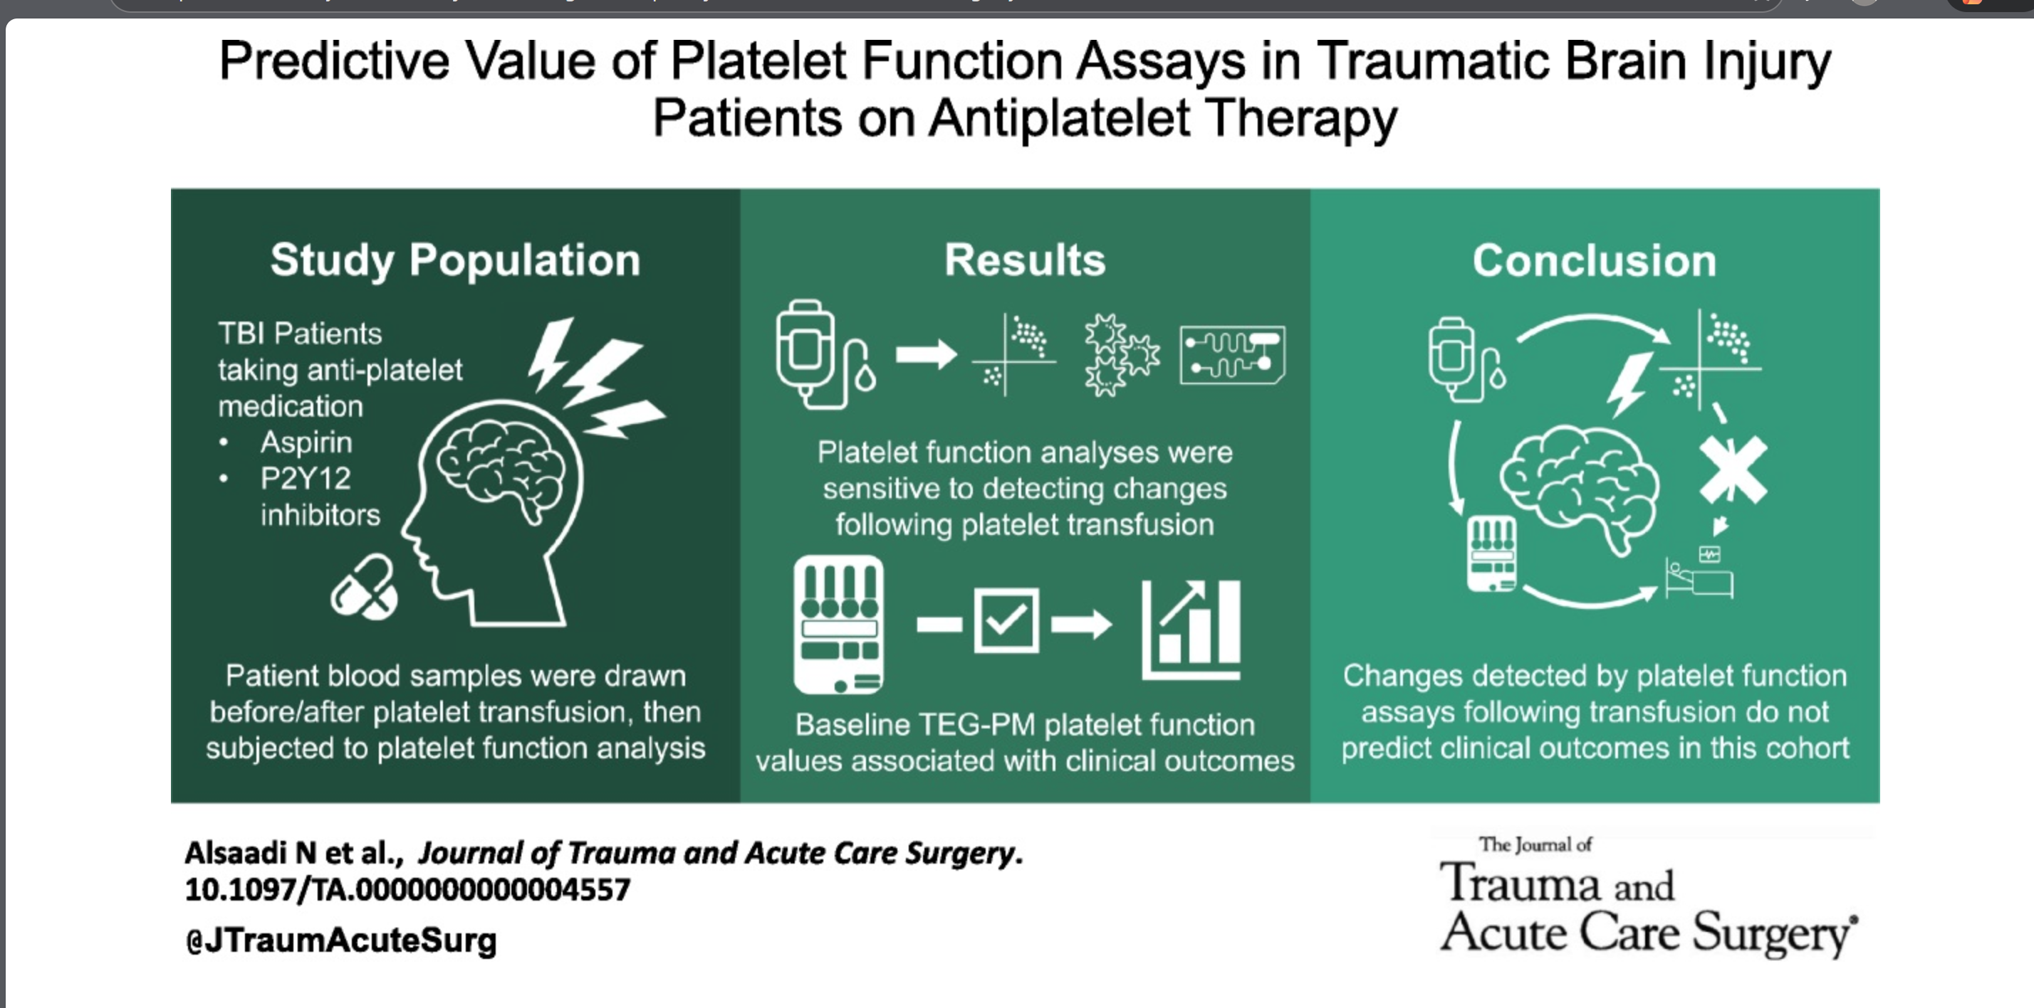

Slide 18
The questions that remain
What do we do about assays intended to measure antiplatelet activity when they identify “platelet dysfunction” in trauma?
How do we improve our assays for platelet function and “dysfunction” for the setting of disease and not pharmacologic inhibition?
How do ex-vivo findings relate to in-vivo biology?
Can we rely on these assays to transfuse injured patients?
Can we even rely on these assays to define anti-platelet use in injured populations?
Notes:
So, I will leave you with some questions that I think exist in this debate:
→What do we do about assays intended to measure antiplatelet activity when they identify “platelet dysfunction” in trauma?
→How do we improve our assays for platelet function and “dysfunction” for the setting of disease and not pharmacologic inhibition?
→How do the ex-vivo findings relate to in-vivo biology?
→Can we rely on these assays to transfuse injured patients?
→Can we even rely on these assays to define anti-platelet use in injured populations?

