Slide 1


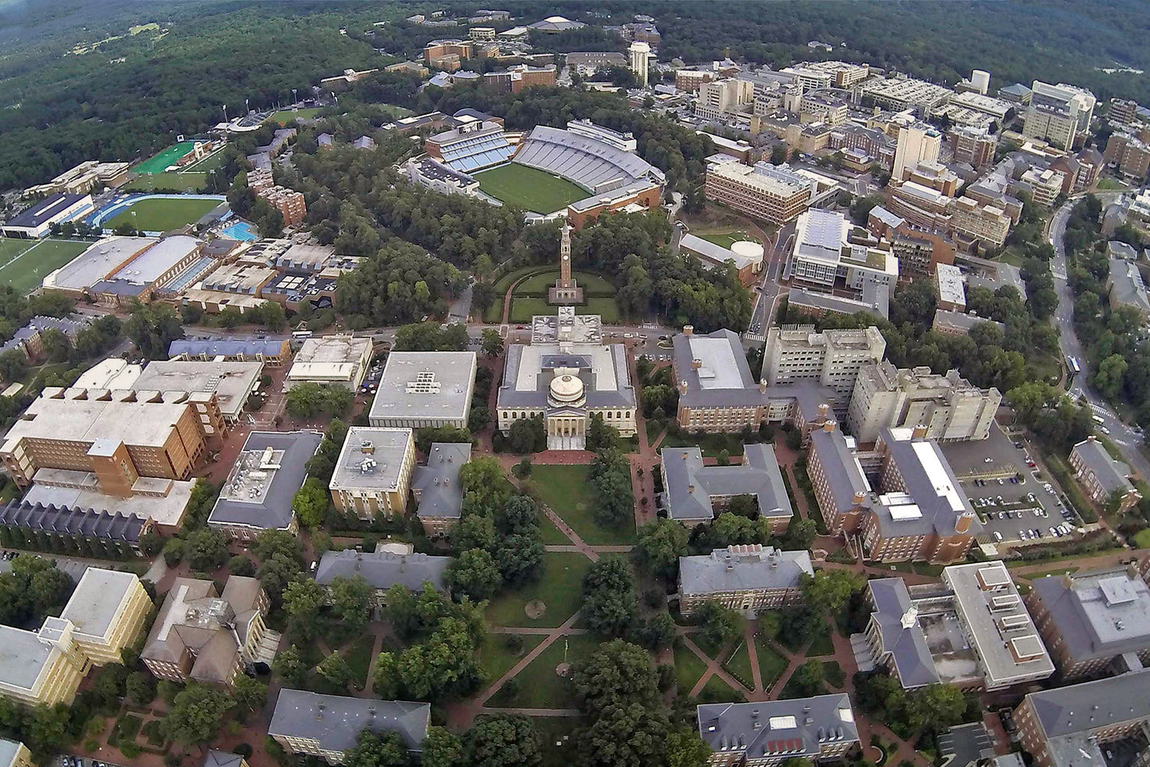
Endothelial Barrier Maintenance/Cross-talk with Platelets
Wolfgang Bergmeier
BLOOD RESEARCH CENTER

Slide 2
Disclosures
Haima Therapeutics, Scientific Advisory Board
HEMAB Therapeutics, Sponsored Research Contract

Slide 3
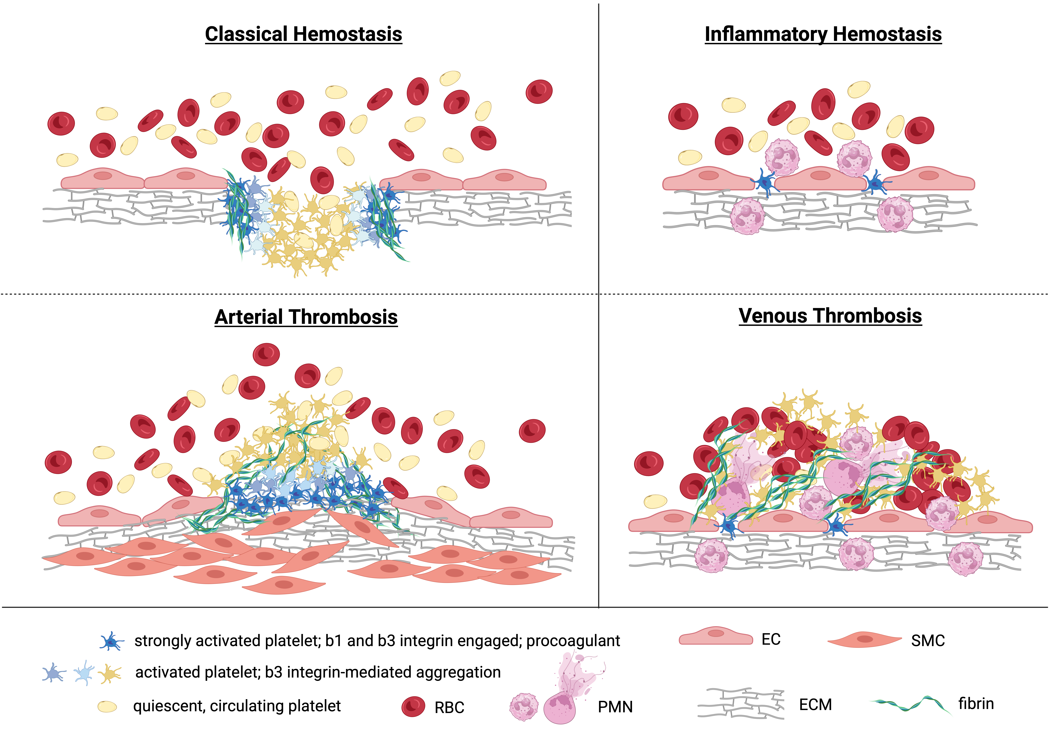

Slide 4
outline
Platelets in Classical Hemostasis
Platelets in Inflammatory Hemostasis

Slide 5
outline
Platelets in Classical Hemostasis
Platelets in Inflammatory Hemostasis

Slide 6
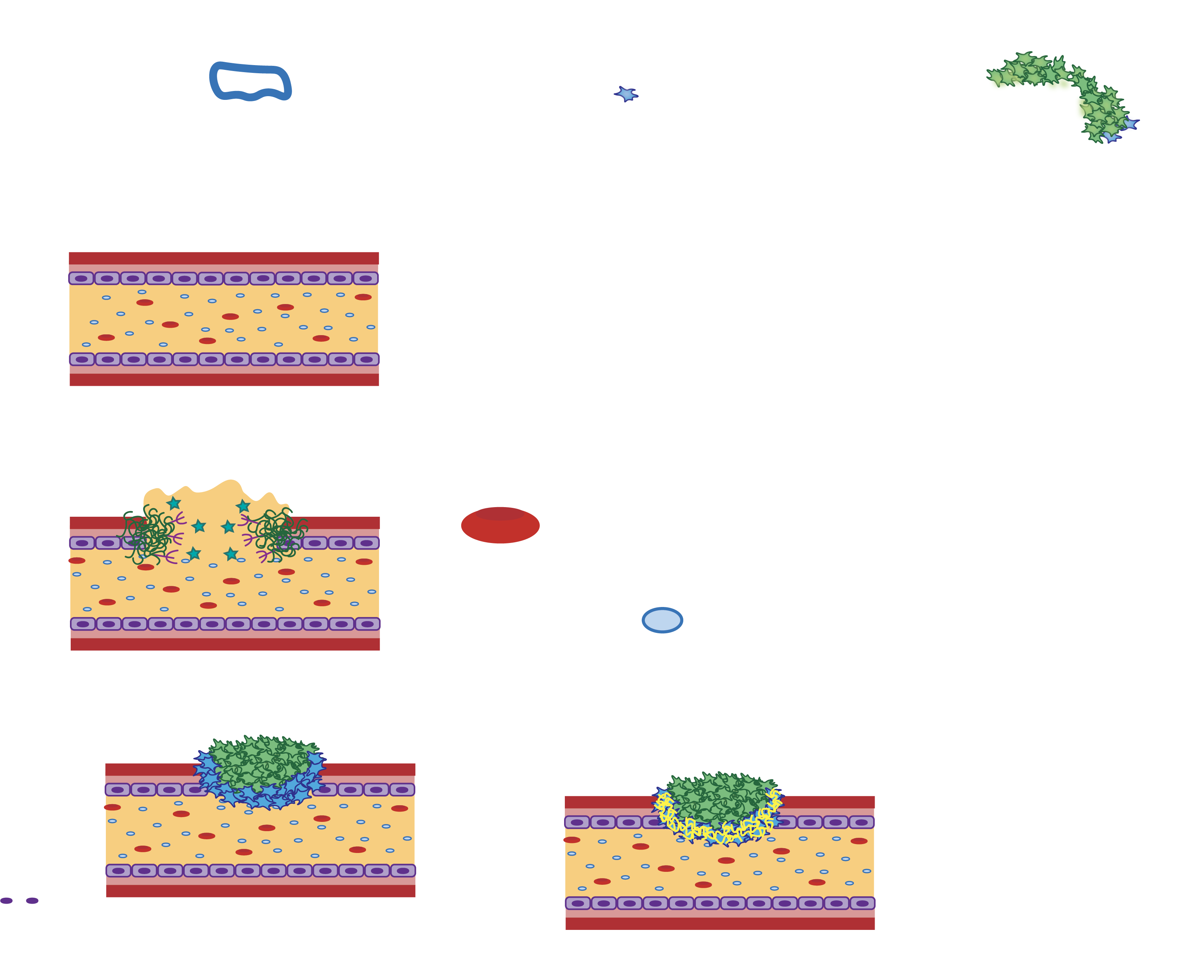
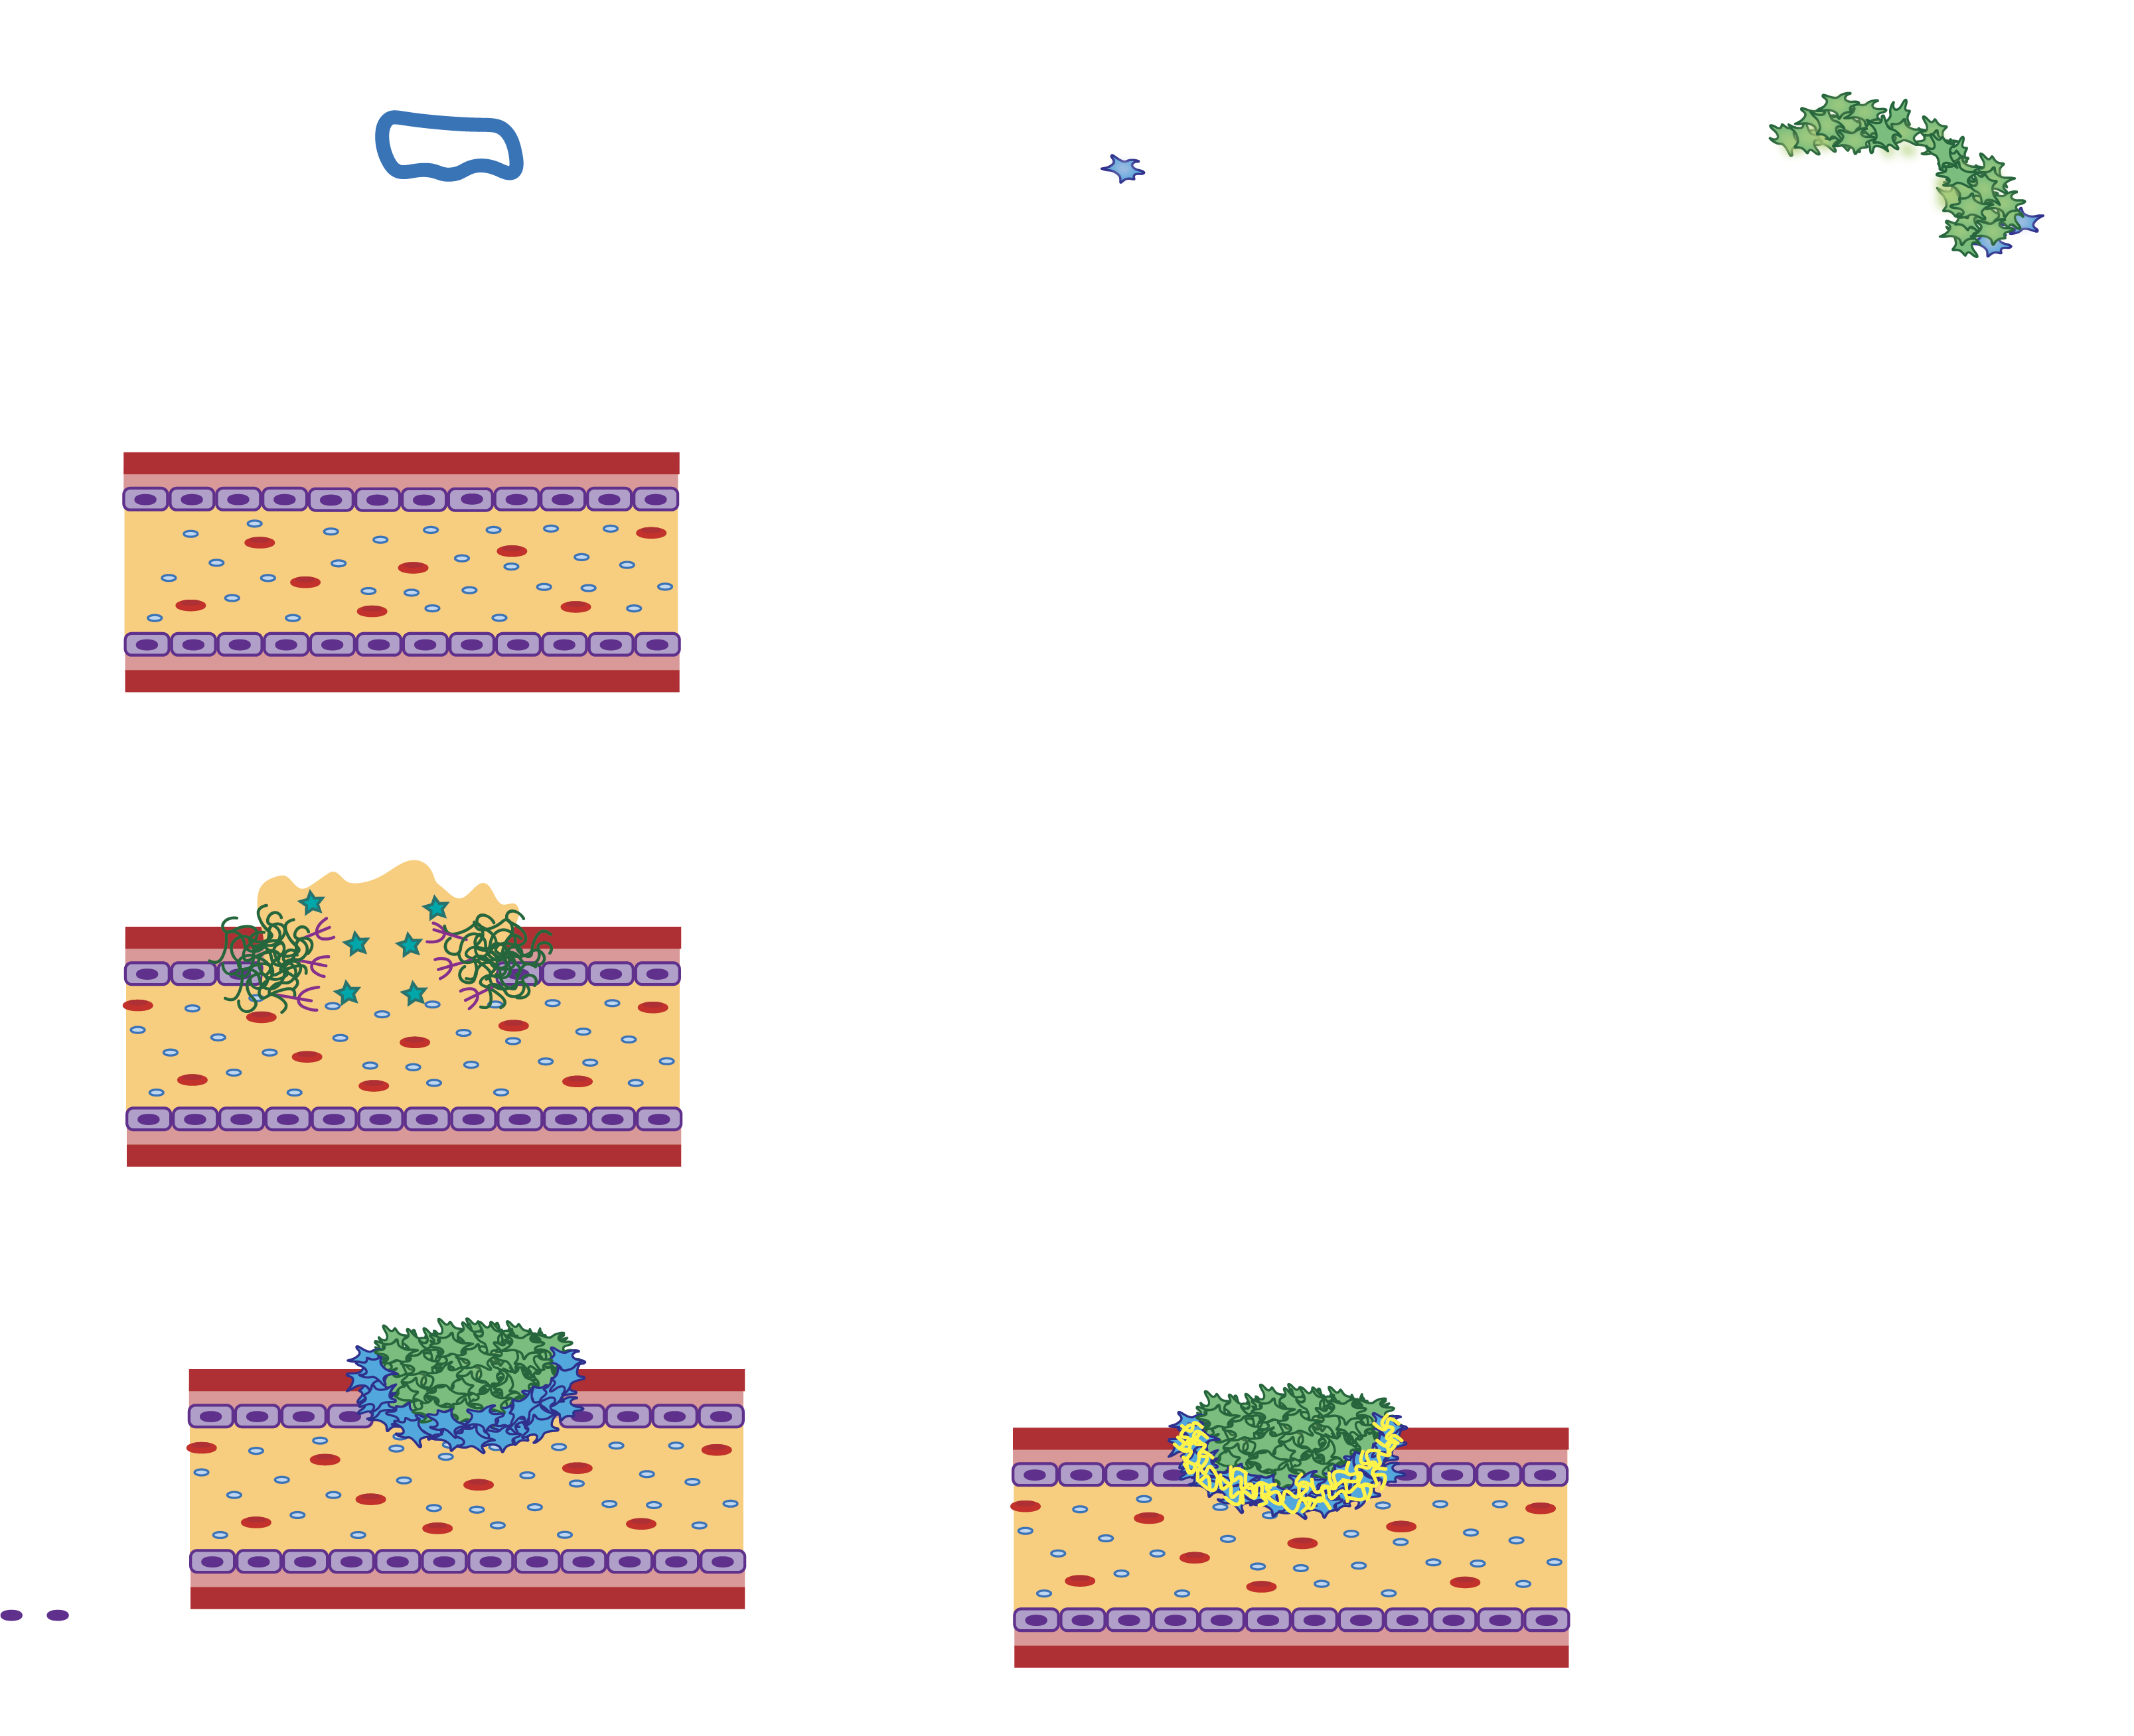
Platelets in Classical Hemostasis
red blood
cell
resting
platelet
Endothelial
cells (ECs)
Plasma
Subendothelium
Healthy blood vessel
Notes:
To define hemostasis in the most basic terms, it is stopping bleeding after vascular injury. Here we have a healthy blood vessel, in purple is the endothelial cells which line the vessel and when the vessel is intact, they are supporting platelets remaining in their quiescent state. Beneath those is the subendothelial layer which contains ligands for platelet activation that are protected from interacting with platelets when the vessel is intact. Within the blood vessel, the blood cells move around in plasma the liquid portion of blood. For simplicity sake, here I only show two blood cell types, red blood cells and platelets.

Slide 7
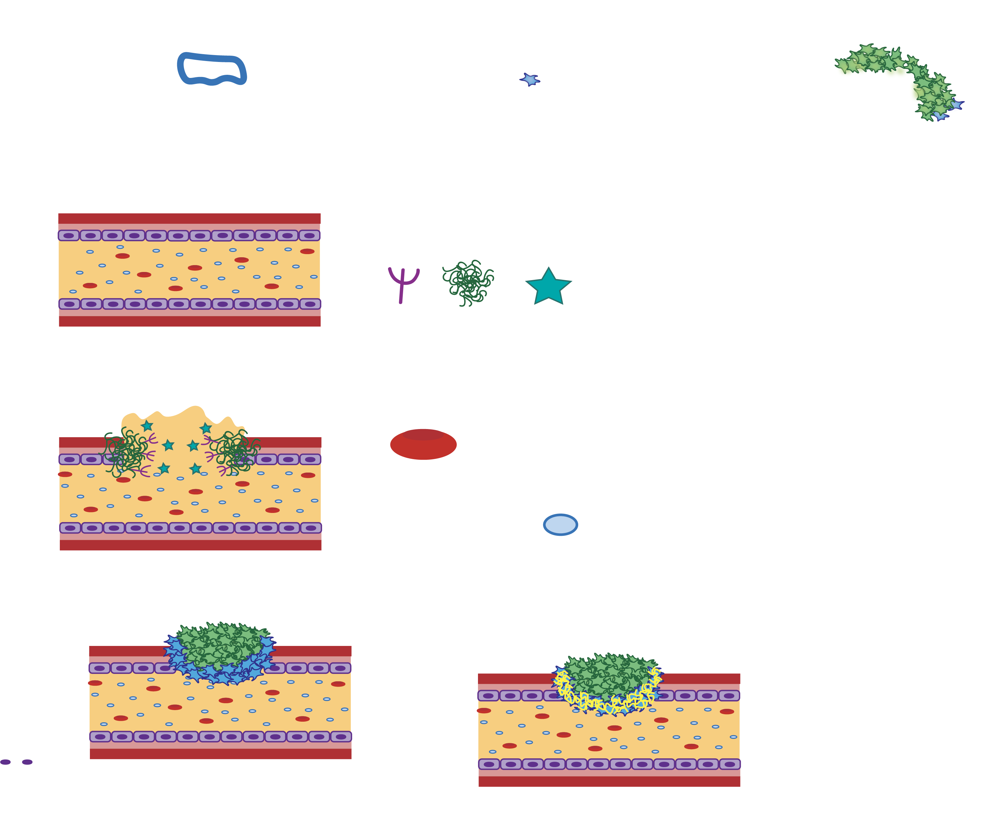
Vascular injury exposes platelet activating ligands
VWF
Collagen
Tissue
Factor (TF)
Red blood
cell
resting
platelet
Vascular injury
Notes:
When there is a vascular injury, the environment goes from promoting platelets remaining in their resting state to promoting their activation. The subendothelial ligands VWF and collagen interact with platelets causing them to tether to the site of injury and activate.

Slide 8
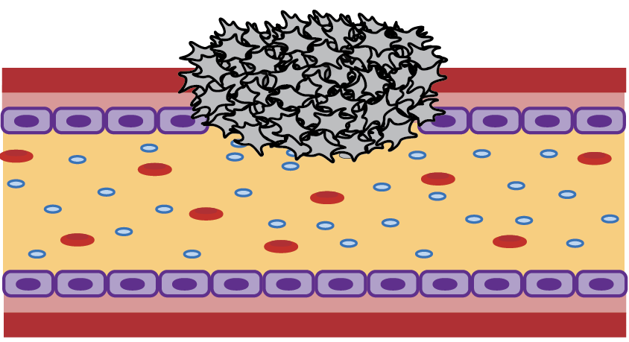
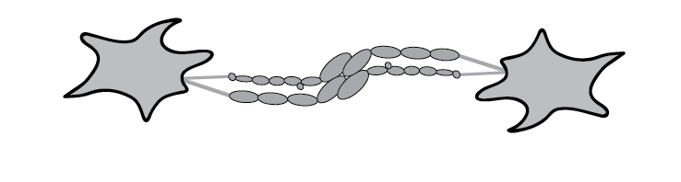
Primary hemostasis: an unstable platelet plug
Platelet aggregate
αIIbβ3 integrin
GPIb-VWF interaction
second wave mediators
Primary hemostasis
Notes:
Activated platelet will create a loose plug to temporarily cease bleeding. This is commonly referred to as primary hemostasis.

Slide 9
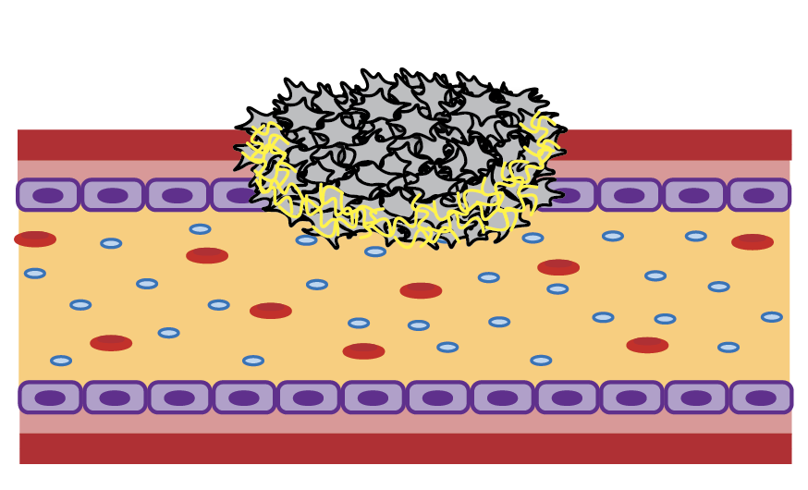

Secondary hemostasis: plug stabilization by coagulation
Phosphatidyl-serine exposure
Release of polyphosphates
coagulation
Stable hemostatic plug
fibrin
secondary hemostasis
Notes:
To become a mature stable hemostatic plug, the protein fibrin must be formed via the process of coagulation an enzymatic part of a process commonly referred to secondary hemostasis.

Slide 10
Secondary hemostasis: clot contraction
αIIbβ3 outside-in signaling
secondary hemostasis
Notes:
To become a mature stable hemostatic plug, the protein fibrin must be formed via the process of coagulation an enzymatic part of a process commonly referred to secondary hemostasis.

Slide 11

Platelets in Classical Hemostasis
Aggregating/contracting platelets
αIIbβ3 integrin
fibrin/ogen
Procoagulant platelets
outer
inner
primary & secondary hemostasis
Phosphatidylserine (PS)
Notes:
However, this plug is not really a homogenous platelet population. There are two primary populations aggregating platelets which promote platelet-platelet interactions through activation of integrins and procoagulant platelets which promote coagulation. We will loop back to aggregating platelets in just a moments but let’s first take a deeper look at the relationship between platelets and coagulation.

Slide 12
Platelet agonist receptors/ signaling
Simple Signaling Concept
Agonist Receptor
ITAM receptors
GPCRs
Ca²⁺, DAG
cAMP
PIP₃
Second Messenger
Signal Integrator
Kinases
Small GTPases
Secretion
Eicosanoids
Integrin activation
Cytoskeletal changes
Cellular Response

Slide 13
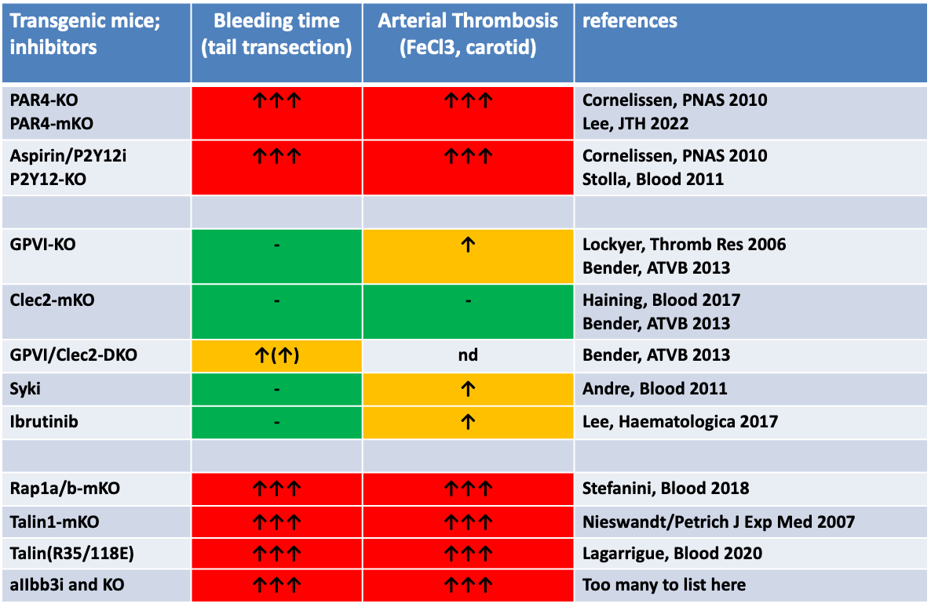
GPCRs are critical for hemostatic plug formation
GPCRs
ITAM receptors & signaling

Slide 14
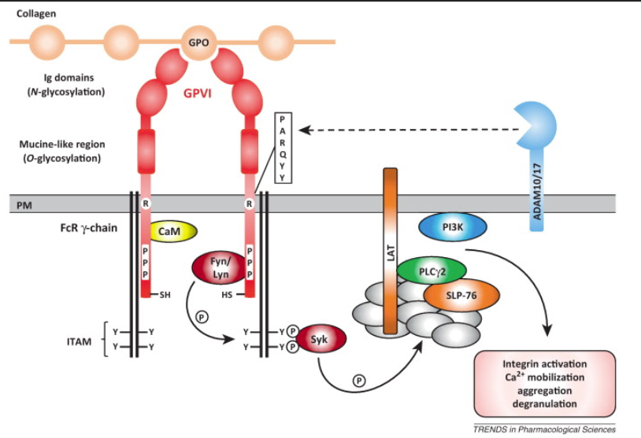
GPCRs are critical for hemostatic plug formation
Why GPCRs are critical for hemostasis?
1) Response to soluble agonists
The GPVI (ITAM) Signalosome
2) High speed signal transduction
Gqβγ
GPCR
Ca²⁺
Gqα-GTP
PLCβ
DAG

Slide 15
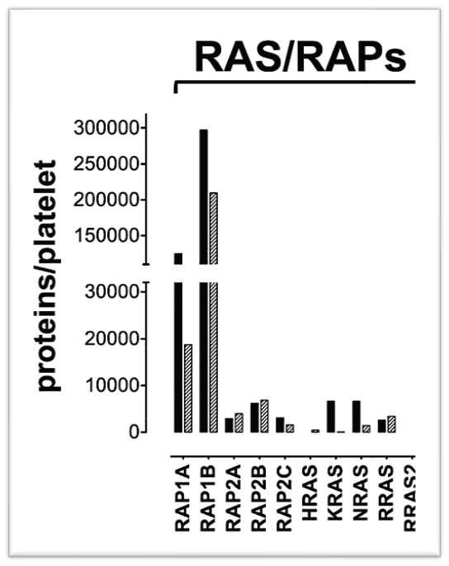
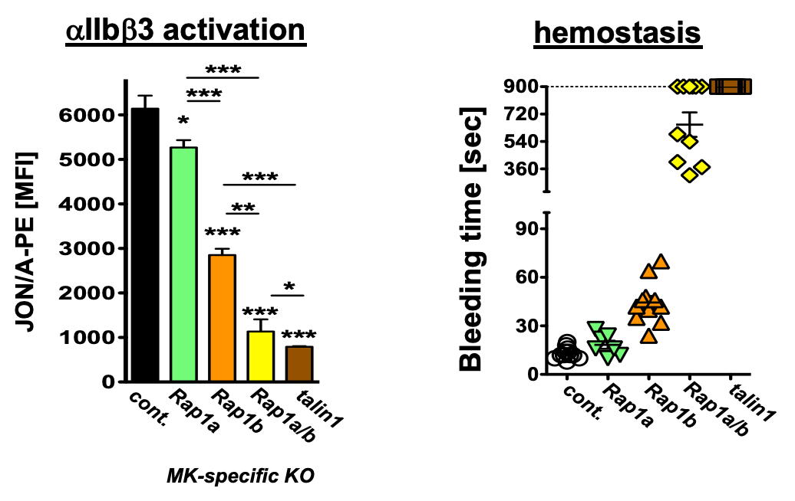
Platelet rely on a unique integrin activation complex
ITAM receptors
GPCRs
Agonist Receptor
ITAM receptors
GPCRs
Ca²⁺, DAG
cAMP
PIP₃
Ca²⁺, DAG
cAMP
PIP₃
Second Messenger
Stefanini et al., Blood 2018
Kinases
Small G proteins
Kinases
RAP1
Signal Integrator
RAP1-TALIN interaction!
Cellular Response
Integrin activation
Integrin activation
X
Lagarrigue et al., Blood 2018

Slide 16
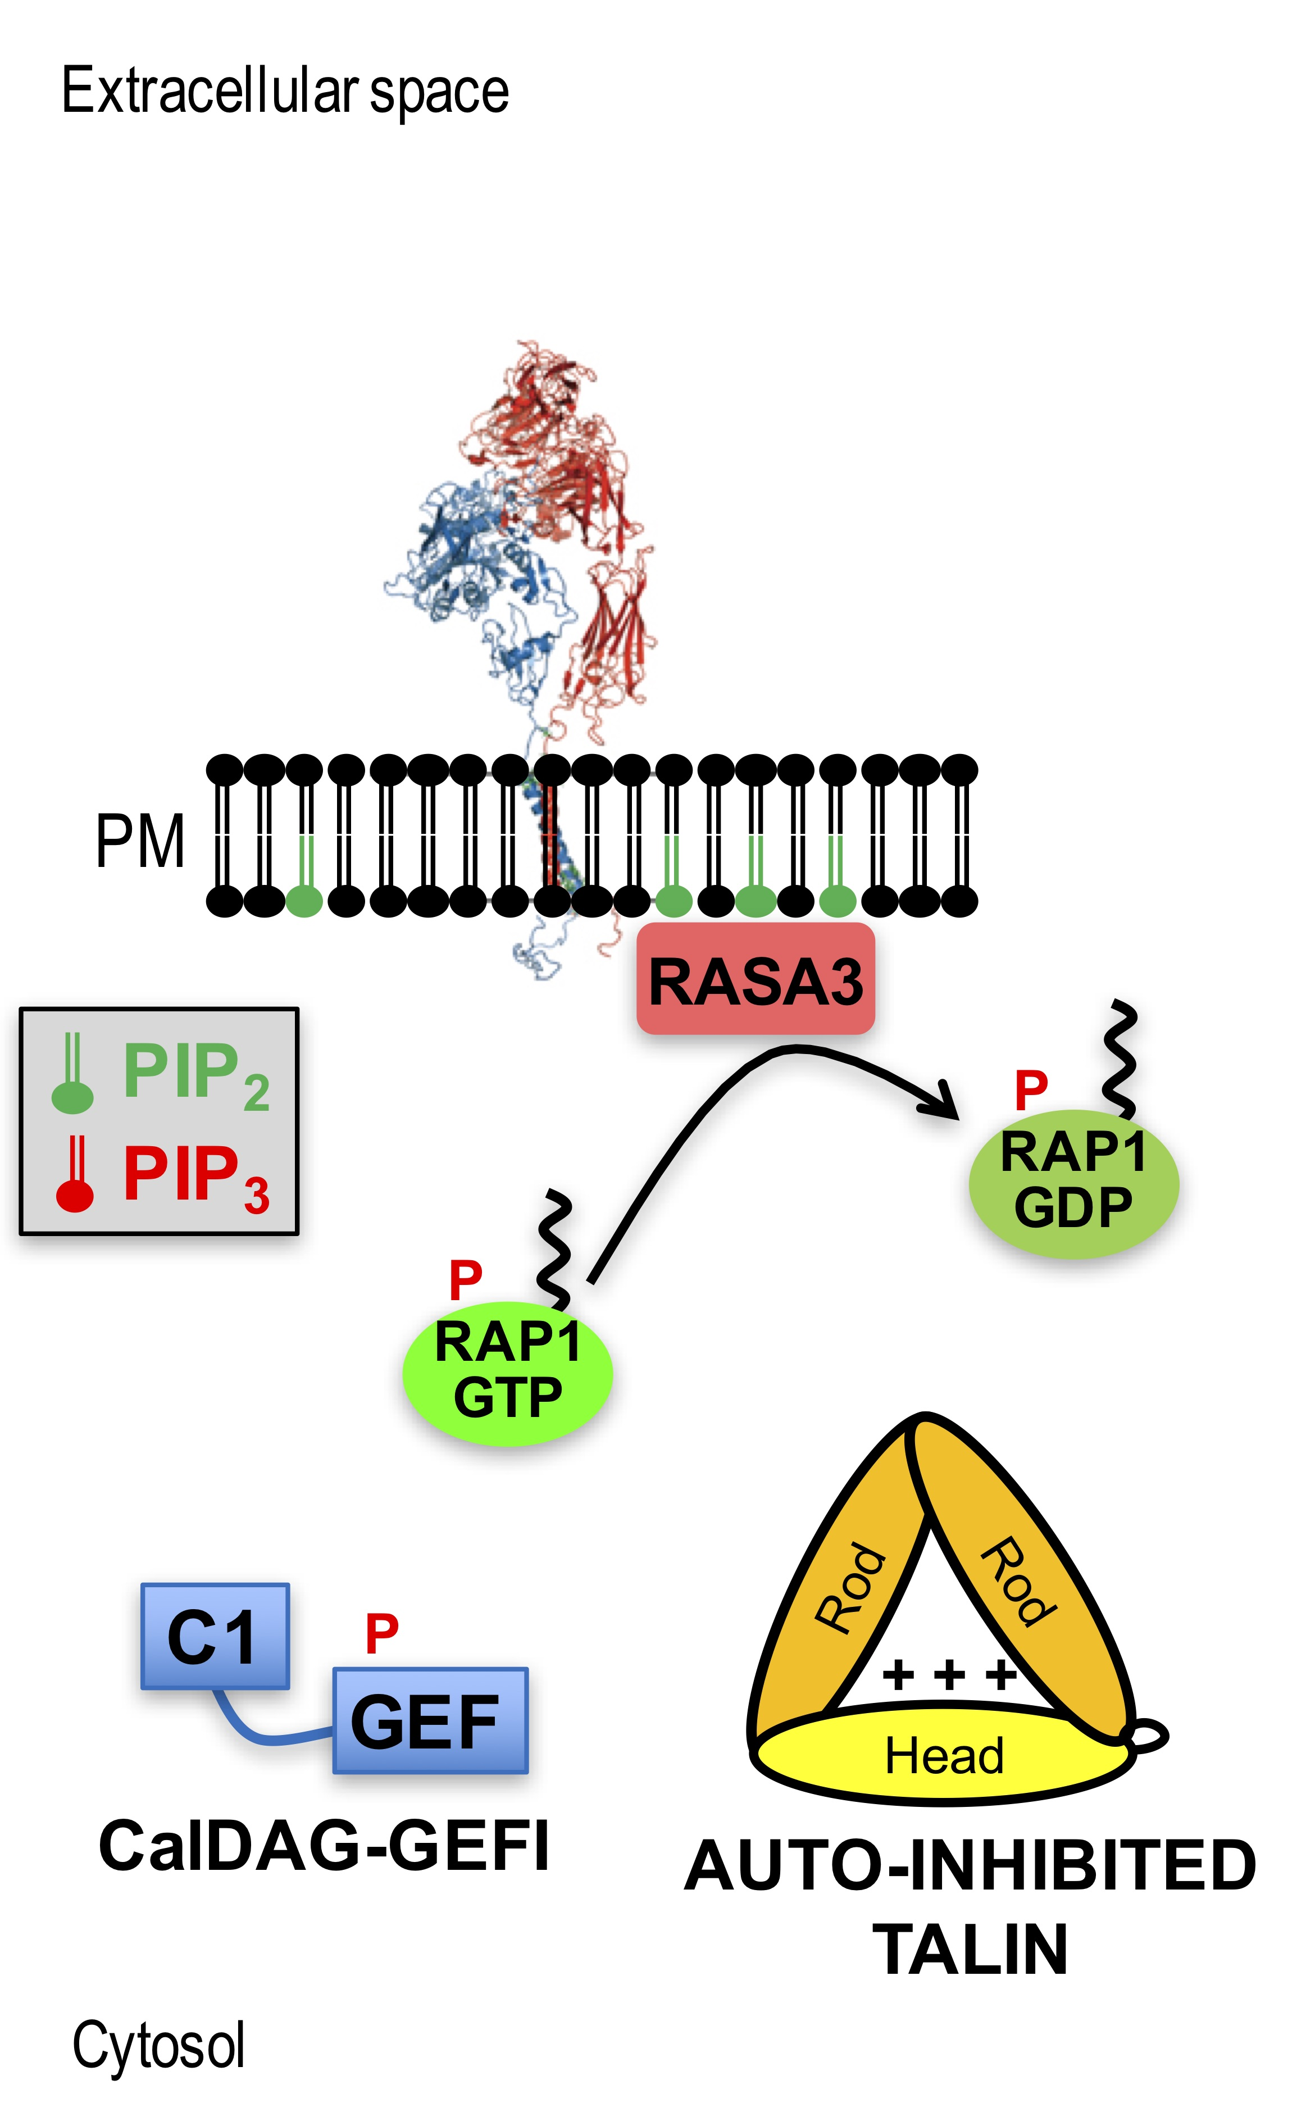
Integrin Activation in Platelets: Built for Speed
PLC
GPCRs
ITAM
receptors
Notes:
Talin binding to integrin: L325R – abolished MPR region binding; W359A -> NPLY sequence (membrane distal). First, binding to NPLY (strong, F3 domain mediated), then MPR (weak; but essential for integrin activation; F3?)
Rasa3:
Cell stimulation and increase of PIP3 and/or IP4 do not affect RASA3 localization.Presumably PIP3 binding could have an inhibitory effect on RapGAP function while not affecting the localization.
Rasa3 part of the GAP1 family: GAP1m and Rasa3 with atypical C2 domains – NOT Ca2+ sensitive (unlike CAPRI and RASAL); R3 has same affinity for PIP2 and PIP3 (uM) – unlike GAP1m which prefers PIP3; Gap1m only RasGAP
Mechanistically RapGAP activity in R3 is more similar to a RasGAP than a RapGAP protein (Arg finger and Gln63 important – C/N-termini important to orient protein)
In CAPRI switch between dimeric (RapGAP) and monomeric form (RasGAP) -> dimers for Rasa3????

Slide 17
G proteins and integrin activation machinery are critical for hemostatic plug formation
Transgenic mice; inhibitors | Bleeding time (tail bleed) | references
PAR4-KO PAR4-mKO | ↑↑↑ | Cornelissen, PNAS 2010 Lee, JTH 2022
Aspirin/P2Y12i P2Y12-KO | ↑↑↑ | Cornelissen, PNAS 2010 Paul, ATVB 2020
GPVI-KO | - | Lockyer, Thromb Res 2006 Bender, ATVB 2013
Clec2-mKO | - | Haining, Blood 2017 Bender, ATVB 2013
GPVI/Clec2-DKO | ↑(↑) | Bender, ATVB 2013
Syki | - | Andre, Blood 2011
Ibrutinib | - | Lee, Haematologica 2017
Rap1a/b-mKO | ↑↑↑ | Stefanini, Blood 2018
Talin1-mKO | ↑↑↑ | Nieswandt/Petrich J Exp Med 2007 Stefanini, Blood 2018
aIIbb3i and KO | ↑↑↑ | Too many to list here
GPCRs
ITAM receptors & signaling
Integrin activation complex

Slide 18
Procoagulant platelets
Aggregating platelets
αIIbβ3 integrin
Aggregating platelet
fibrin
Procoagulant platelets
outer
inner
secondary hemostasis
Phosphatidylserine (PS)
Notes:
However, this plug is not really a homogenous platelet population. There are two primary populations aggregating platelets which promote platelet-platelet interactions through activation of integrins and procoagulant platelets which promote coagulation. We will loop back to aggregating platelets in just a moments but let’s first take a deeper look at the relationship between platelets and coagulation.

Slide 19
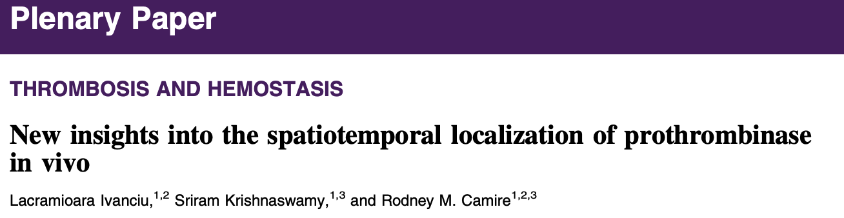
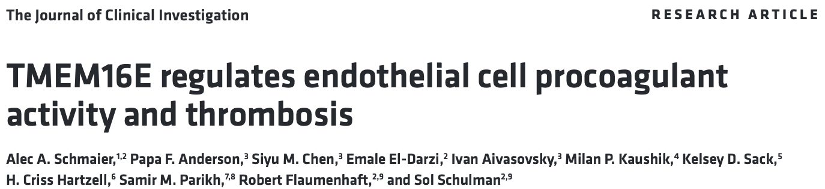
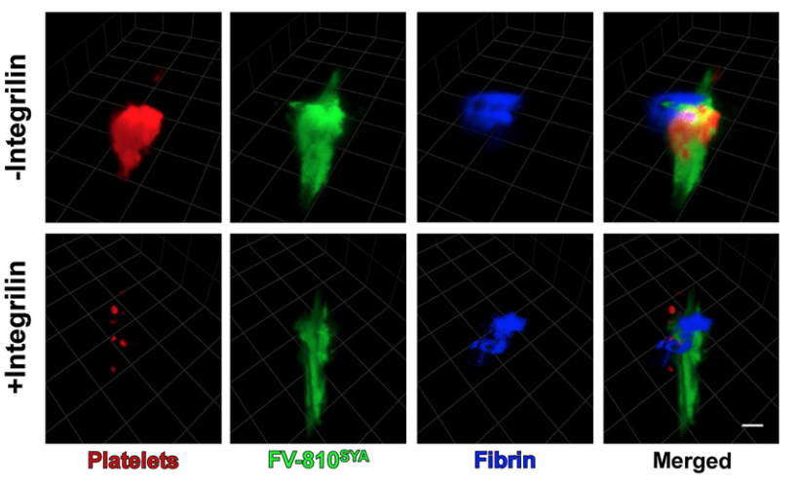
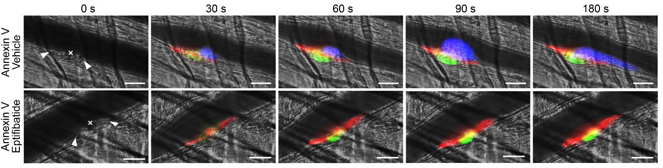
Are procoagulant platelets really important for
hemostasis and thrombosis?

Slide 20

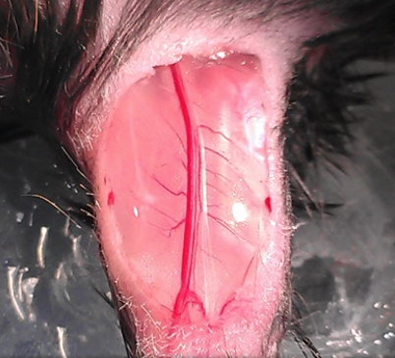
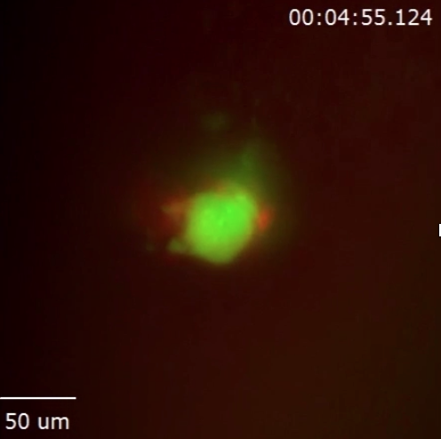
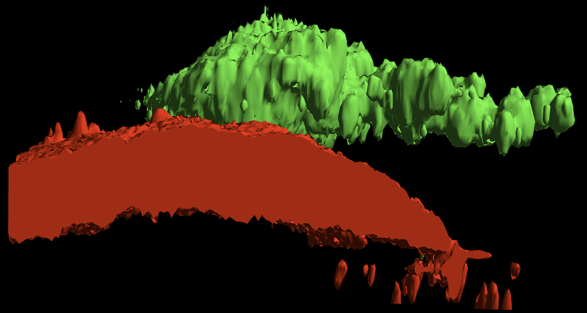
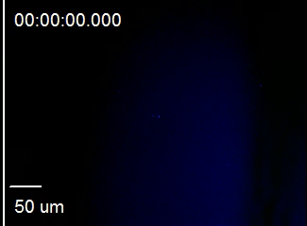

4D model to study platelet-coagulation interplay during hemostatic plug formation
Z dimension
Z Stack 1
Time
Ballard-Kordeliski et al., Blood 2024
Abigail
Ballard-Kordeliski
Getz et al., Blood 2015

Slide 21
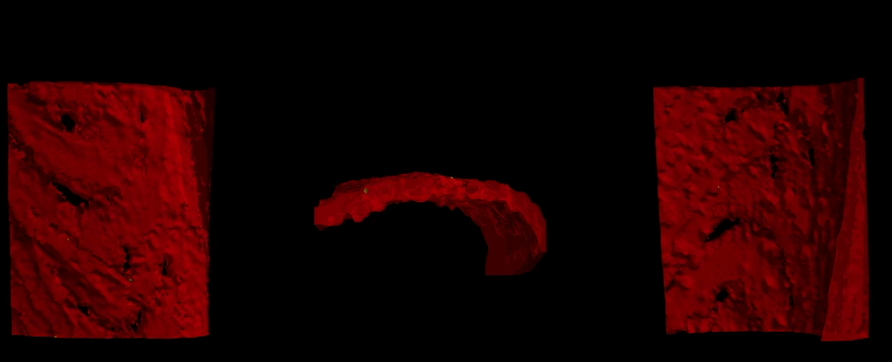

~10 sec/stack
7.5 μm step
Top
Side
Bottom
Platelets
Endothelium
Top
Side
Bottom
Blood Flow
50 μm
Blood Flow
Notes:
mTmG mice: ROSA^{mT/mG} is a cell membrane-targeted, two-color fluorescent Cre-reporter allele. Prior to Cre recombination, cell membrane-localized tdTomato (mT) fluorescence expression is widespread in cells/tissues. Cre recombinase expressing cells (and future cell lineages derived from these cells) have cell membrane-localized EGFP (mG) fluorescence expression replacing the red fluorescence.

Slide 22
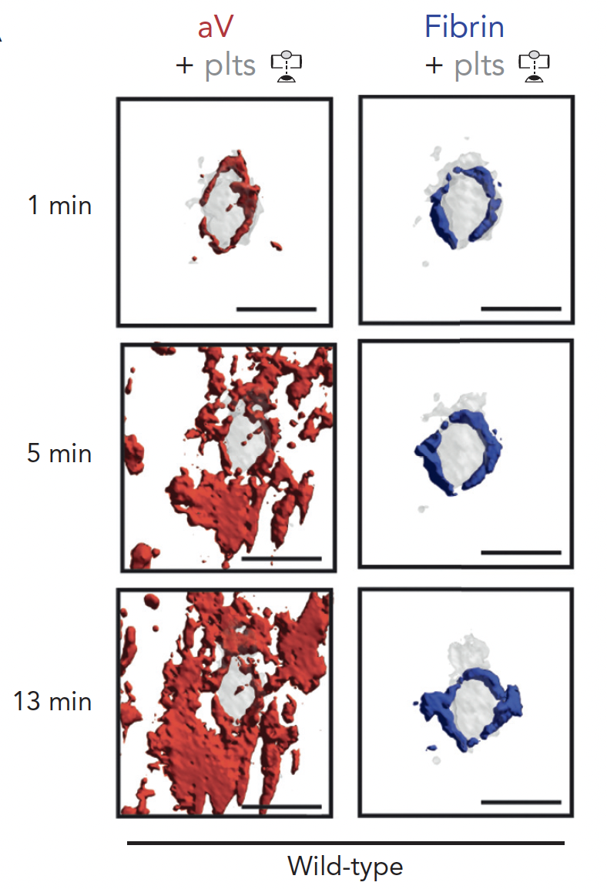
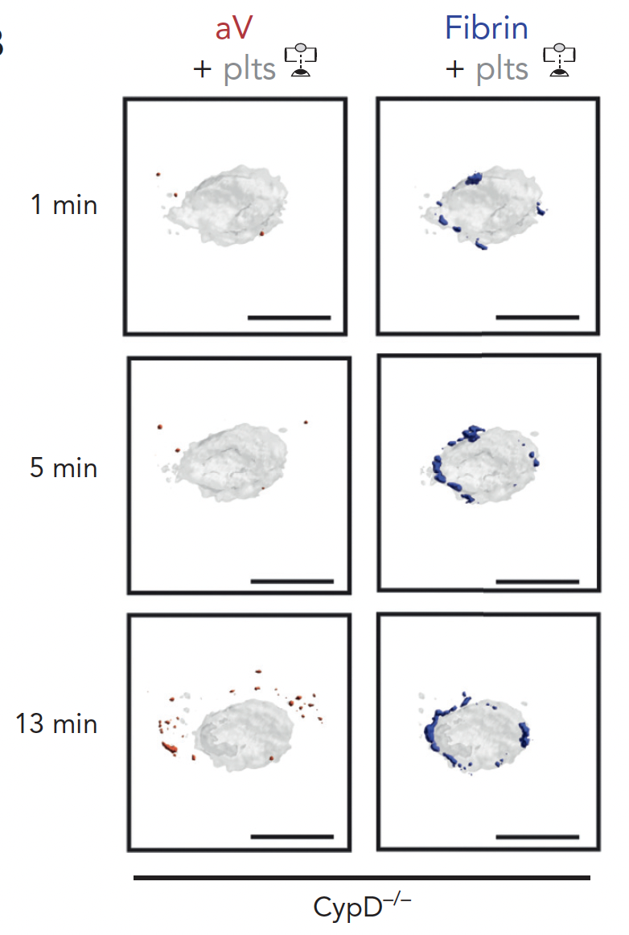
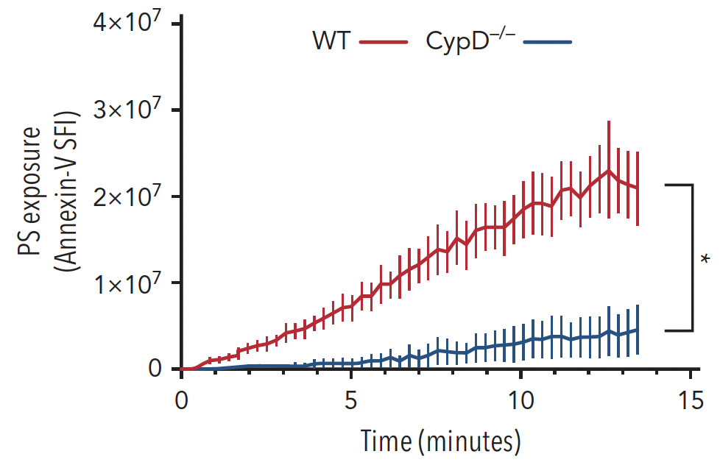
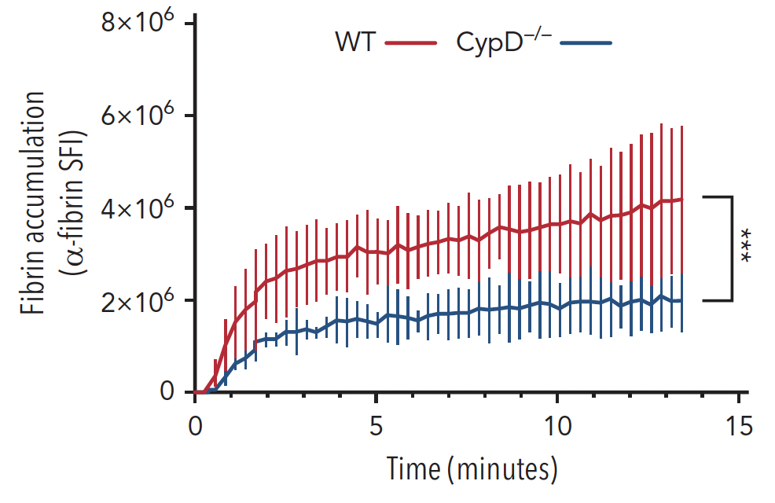
Procoagulant surfaces are critical for fibrin accumulation at sites of laser injury
Ballard-Kordeliski et al., Blood 2024

Slide 23
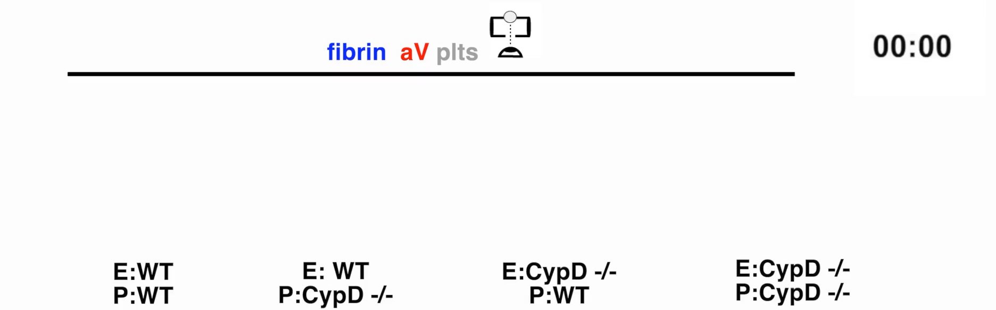
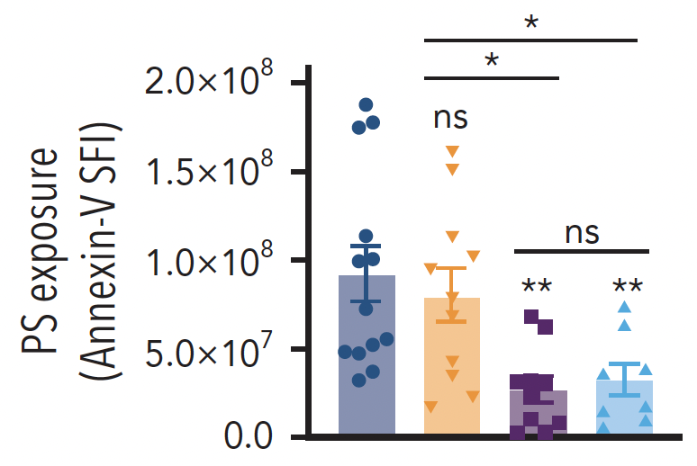
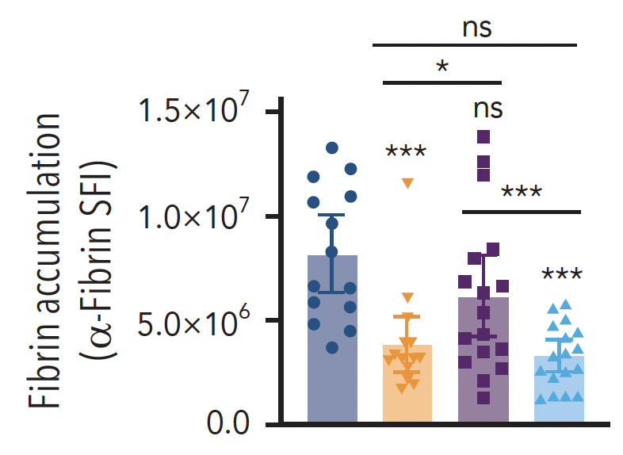
Platelet PS exposure is critical for fibrin accumulation
Ballard-Kordeliski et al., Blood 2024

Slide 24
Platelets in hemostasis
Aggregating/contracting platelets
αIIbβ3 integrin
Aggregating platelet
fibrin
Procoagulant platelets
outer
inner
Phosphatidylserine (PS)
Notes:
However, this plug is not really a homogenous platelet population. There are two primary populations aggregating platelets which promote platelet-platelet interactions through activation of integrins and procoagulant platelets which promote coagulation. We will loop back to aggregating platelets in just a moments but let’s first take a deeper look at the relationship between platelets and coagulation.

Slide 25
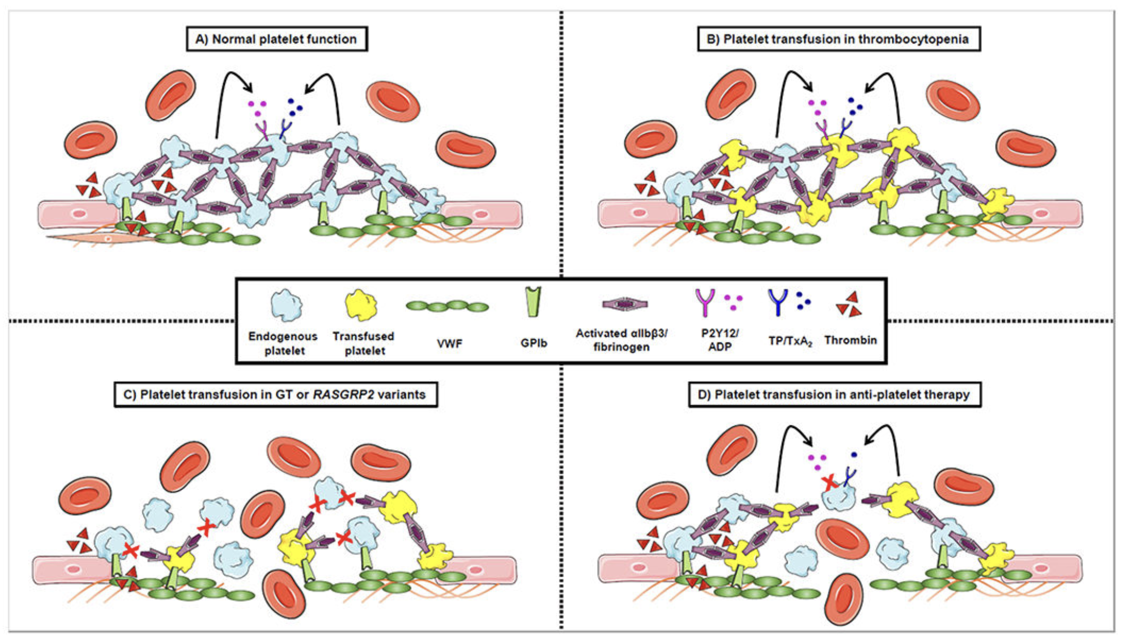
What about endogenous/dysfunctional platelets?
Lee et al., Curr Opin Hematol 2020
Notes:
However, this plug is not really a homogenous platelet population. There are two primary populations aggregating platelets which promote platelet-platelet interactions through activation of integrins and procoagulant platelets which promote coagulation. We will loop back to aggregating platelets in just a moments but let’s first take a deeper look at the relationship between platelets and coagulation.

Slide 26
Current transfusion guidelines for thrombocytopenic patients (based on clinical experience)
platelet counts > 10-20 x 10⁹/L are sufficient to prevent spontaneous bleeding
platelet counts > 50 x 10⁹/L are required to prevent bleeding following major surgery
transfusion of 3 x 10¹¹ platelets (1 apheresis unit) increases the peripheral platelet count in a patient by ~ 30 x 10⁹/L

Slide 27
Transfusion requirements may be different in patients with normal platelet count
GT patient transfused with platelets to control bleeding associated with tonsillectomy and adenoidectomy
apheresis platelets from 1 donor -> post-transfusion GT:normal platelet ratio of ~5:1 -> bleeding
apheresis platelets from 4 donors -> post-transfusion GT:normal platelet ratio of ~1:1 -> NO bleeding
Do endogenous platelets negatively affect transfused platelets???
Jennings, J. Pediatr. Hematol. Oncol. 1991

Slide 28
Impaired hemostasis in individuals with mutations in RASGRP2 (IPD-18)
E260*
A345P
N67Lfs*24
P125*
G248W
N330K
F497fs*22
R220Q
S381F
G305D
REM
Cdc25
EF
EF
C1-like
4
126
150
388
430
487
499
551
609
Q236*
K309*
F181S
L360del
R494Afs*54
R113*
C296Y/R
Y289C
Canault et al., J Exp Med 2014
Lozano et al, Blood 2016
Kato et al, Blood 2016
Desai et al, RPTH 2017
Bermejo et al, Platelets 2017
Sevivas et al, Platelets 2017
Westbury et al, Blood 2017
Yun et al, Haematologica 2019
Moderate to severe bleeding
PFA100 > 300sec
Normal platelet count
Normal clotting activity
Notes:
Add key features of CDGI patients here
nasal packing, tranexamic acid-treatment and transfusion of red blood cells and platelets
spontaneous bruising, petechiae, epistaxis, gingival and gastrointestinal bleeding
normal platelet count and volume and mild anaemia
Blood smears, leukocyte count and differential, markers of liver and kidney function, prothrombin time, activated partial thromboplastin time, fibrinogen and von Willebrand factor levels, were within normal ranges.
consanguineous parents, autosomal recessive

Slide 29
A 2/1 ratio of dysfunctional to functional platelets is required for hemostasis in IPD-18
thrombocytopenic mice
Lee et al., Sci Trans Med 2019

Slide 30
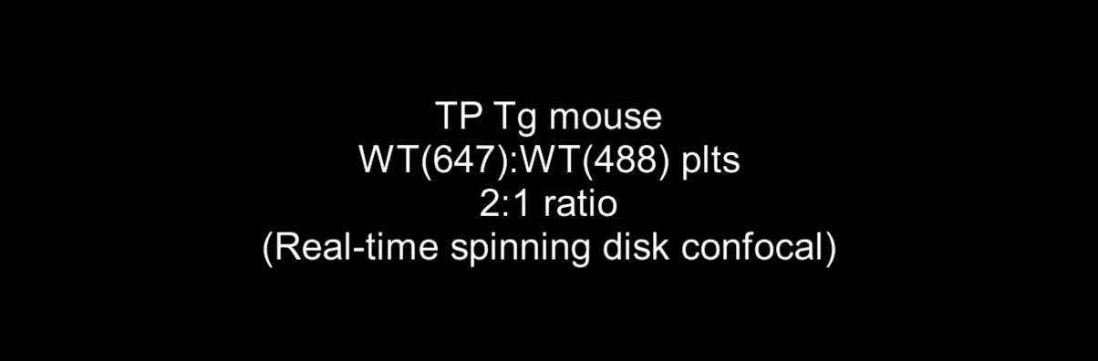
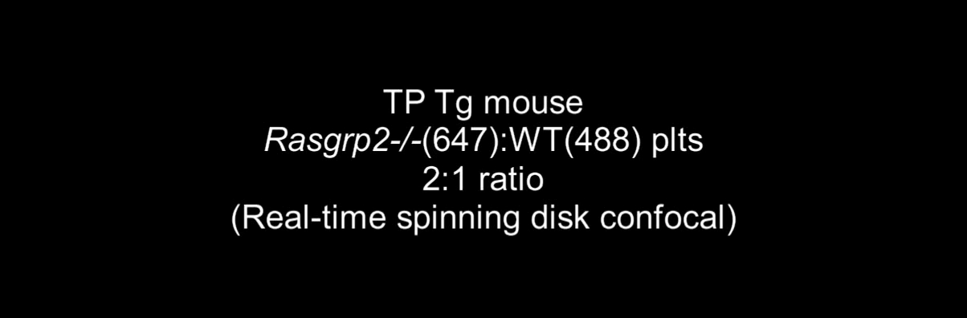
Endogenous, dysfunctional platelets negatively affect hemostatic function of blood product
1. Competition for GPIbα
binding sites
2. Impaired clot contraction/
stabilization

Slide 31
What does this mean for use of platelets and platelet-like products in the treatment of bleeding ?
Platelets:
GPIb-IX required for recruitment to injury site & growing plug
G protein/ integrin signaling needs to be intact
Pro-coagulant and contractile activity critical for stable plug to form
Dysfunctional platelets expressing normal levels of GPIb-IX are “anti-hemostatic”
Platelet-like products:
Need to be functionalized for recruitment to injury site/growing plug
“Carry” pro-coagulant and contractile activity (SenGupta; Brown; …)
Could potentially have “anti-hemostatic” activity when present together
with functional platelets

Slide 32
outline
Platelets in Classical Hemostasis
Platelets in Inflammatory Hemostasis

Slide 33
Single platelets plug holes in the inflamed endothelium

Slide 34
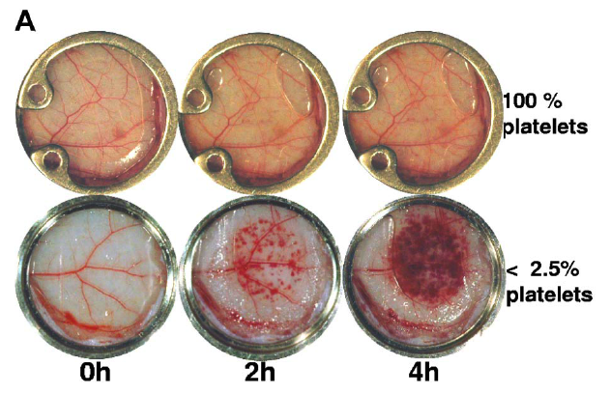
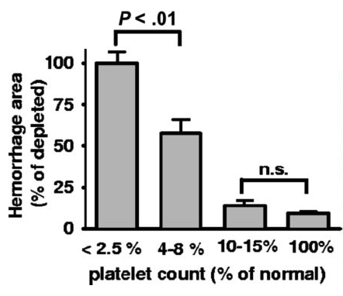
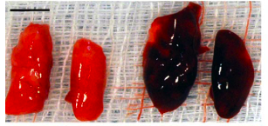
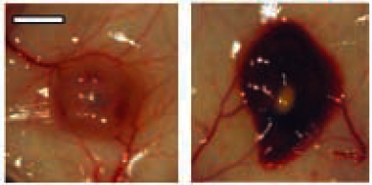
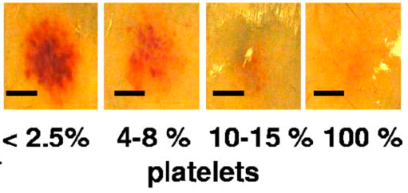
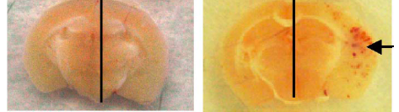
Single platelets plug holes in the inflamed endothelium
platelets
no platelets
rpA (skin)
LPS (lung)
melanoma
stroke
Goerge, Ho-Ti-Noe, Wagner

Slide 35
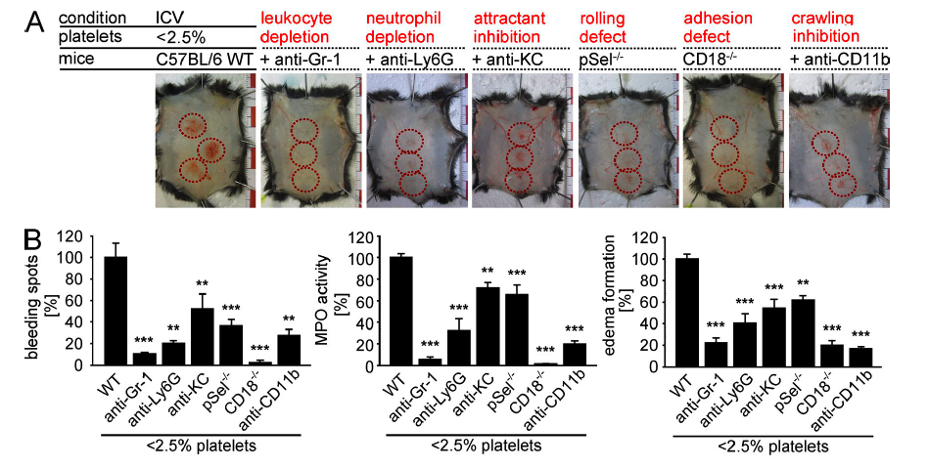
Blocking neutrophil diapedesis prevents hemorrhage during thrombocytopenia
Hillgruber et al., JEM 2015

Slide 36
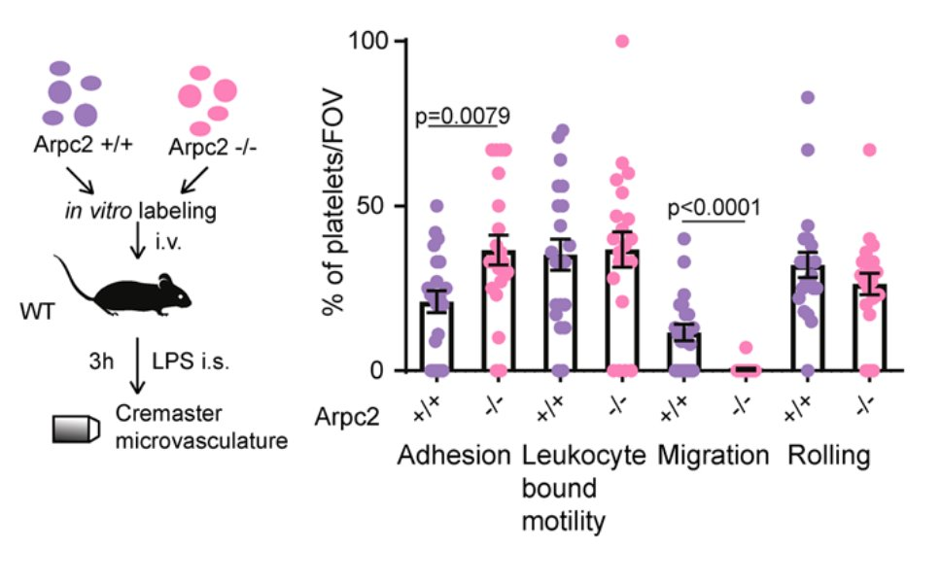
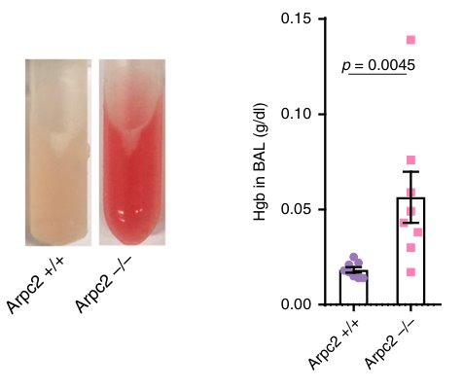
Vascular integrity in inflammation
depends on platelet migration
Nicolai et al., Blood 2022

Slide 37
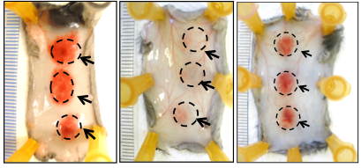
Platelet hem(ITAM) signaling is critical for vascular integrity in inflammation (inflammatory hemostasis)
GPCR
hem(ITAM)
Par4^{-/-}
Plavix ASA
Clec2^{-/-}
JAQ1
depleted
control
depleted
control
Slp76^{-/-}
Immune complexes
Skin
LPS
Lung
Boulaftali et al., JCI 2013
Notes:
Also show blm for itams?!

Slide 38
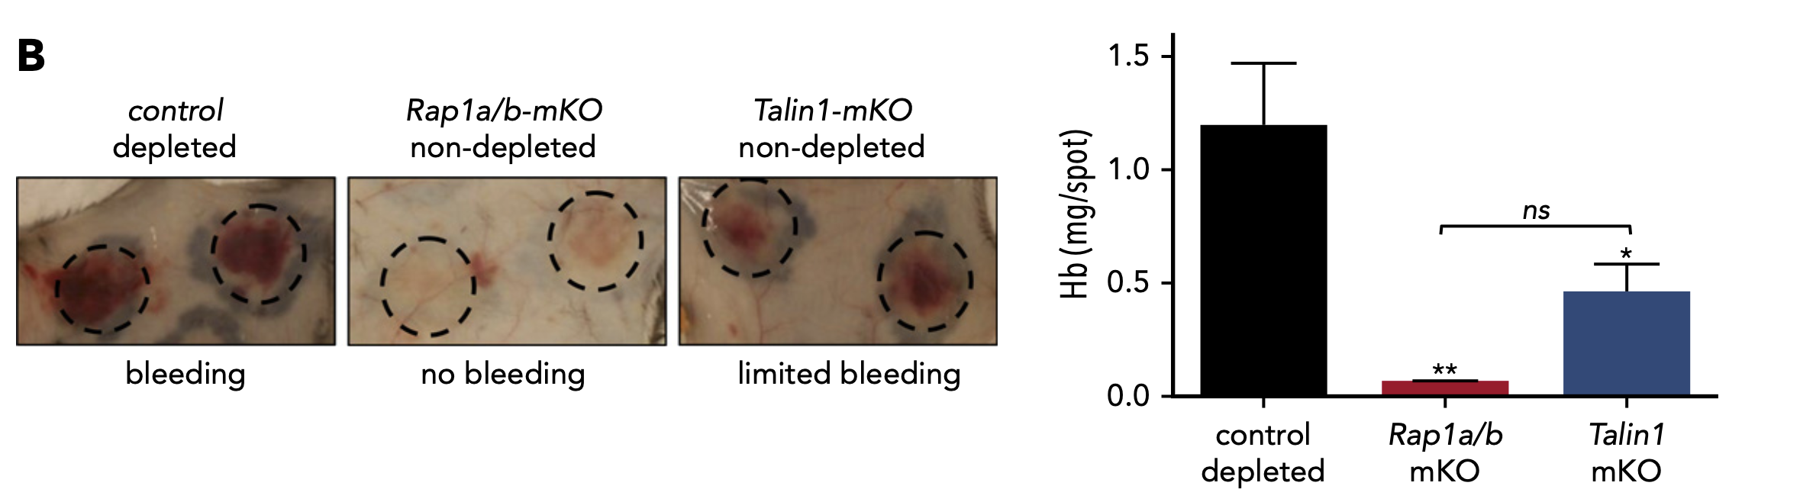
Vascular integrity in inflammation
depends on Talin1 but not Rap1
Stefanini et al., Blood 2018

Slide 39
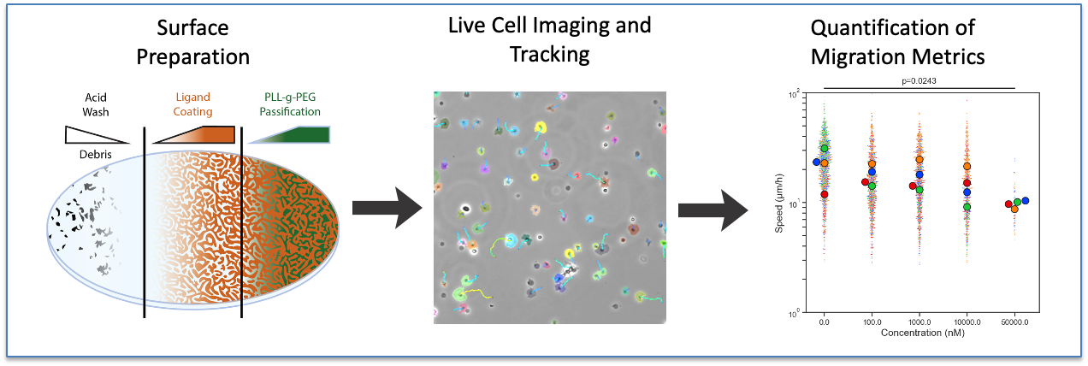
A novel high throughput platform to study platelet migration
high-throughput platelet migration assay (24/96 well format), facilitated by novel deep learning-based image analysis pipeline
Vander Ploeg et al., unpublished

Slide 40
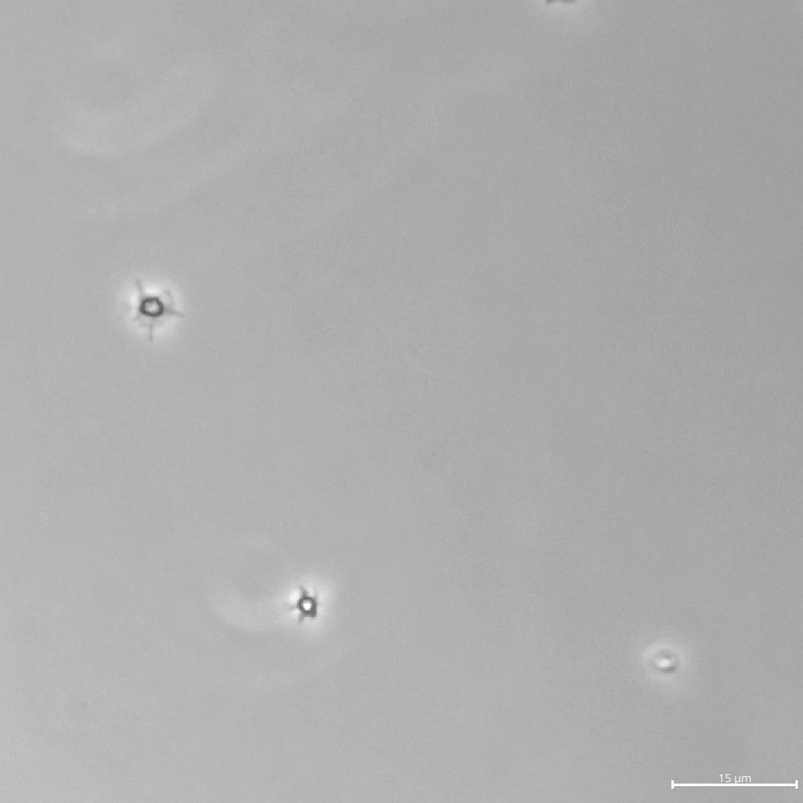
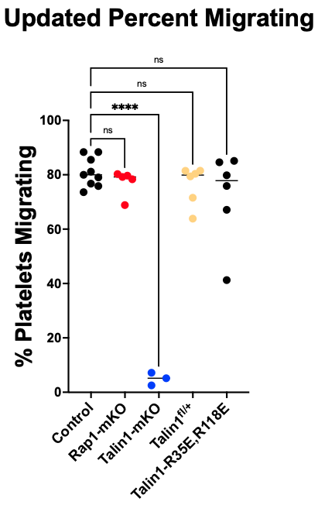
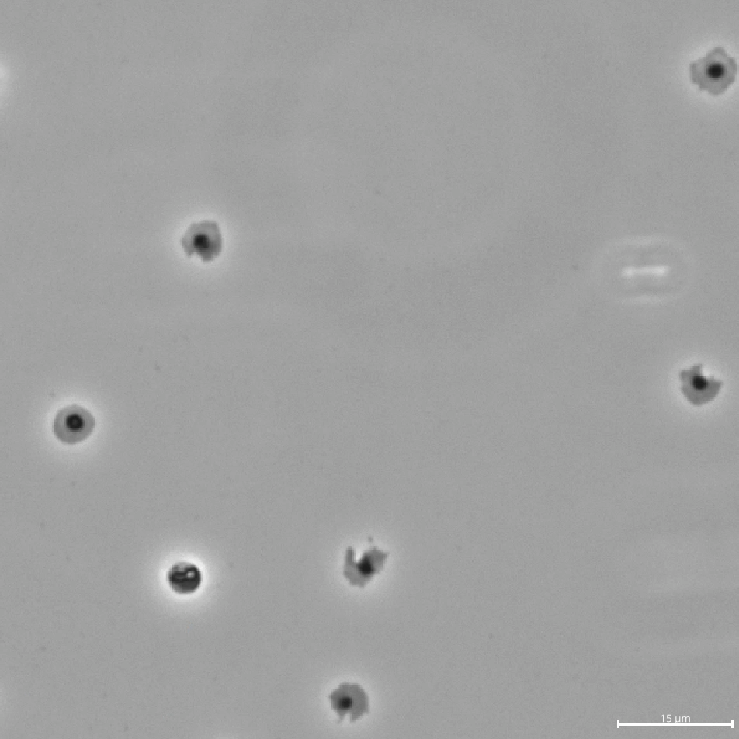
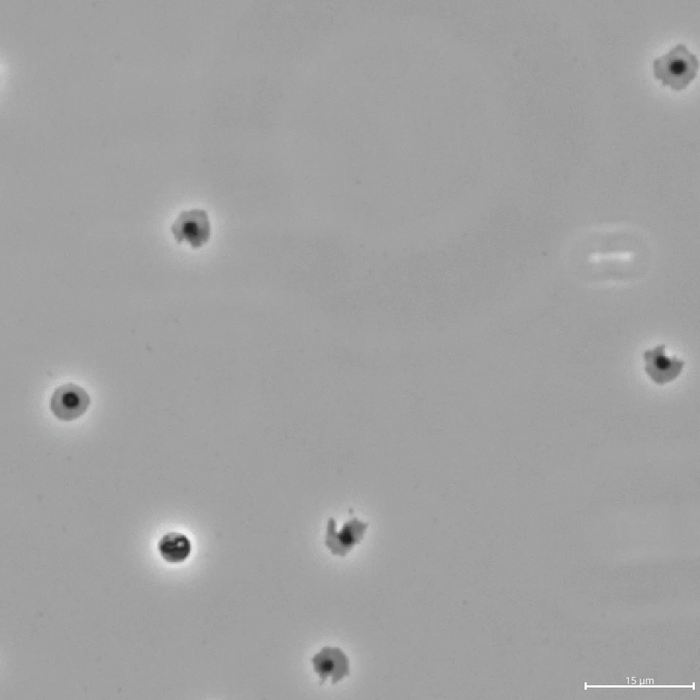
Talin, but not Rap1, is critical for platelet migration
Tln^{mKO}
control
Rap1^{mKO}
Vander Ploeg et al., unpublished

Slide 41
Hemostasis = Hemostasis
Transgenic mice; inhibitors | Bleeding time (tail bleed) | Inflammatory Hemostasis
PAR4-KO PAR4-mKO | ↑↑↑ | -
Aspirin/P2Y12i P2Y12-KO | ↑↑↑ | -
GPVI/Clec2-DKO | ↑(↑) | ↑↑↑
Syki | - | nd
Ibrutinib | - | -
Rap1a/b-mKO | ↑↑↑ | -
Talin1-mKO | ↑↑↑ | ↑+
aIIbb3i and KO | ↑↑↑ | -

Slide 42

Acknowledgement:
UNC Chapel Hill
Nigel Mackman
D. Adalsteinsson
E. O’Shaughnessy
Matt Flick
Alisa Wolberg
Brian Cooley
Rafal Pawlinski
Bergmeier lab
Abigail Ballard-
Kordeliski
David Paul
Robert Lee
Lucia Stefanini
Alexei Martyanov
David Rocco
Matt Vander-Ploeg
Summer Jones
Nikki Ziegmann
Annabel Crosswell
Ansh Gulati
Carmen Sagues
Anirban Sen Gupta (Case Western)
Paul Kim (McMaster University)
Mark Ginsberg (UCSD)

