Slide 1


The Second Revolution in Transfusion Medicine
Contact: aasami@megakaryon.com

Slide 2


What We Do
Development of Human iPSC-derived platelets as next-generation transfusion products
World’s first allogeneic transfusion using HLA-homozygous iPSC-derived platelets (2022)
Population & Maturity
Target: Platelet transfusion–refractory patients, from prophylactic support to emergency hemostasis
Current stage: Preclinical development of HLA-deficient iPSC-derived platelets toward the next clinical trial
Company Snapshot
Founded in 2011, Japan; became a subsidiary of Sysmex (2023)
No U.S. government funding to date
State of the Technology Meeting: Platelet and Platelet-like Products

Slide 3


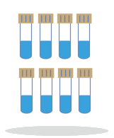

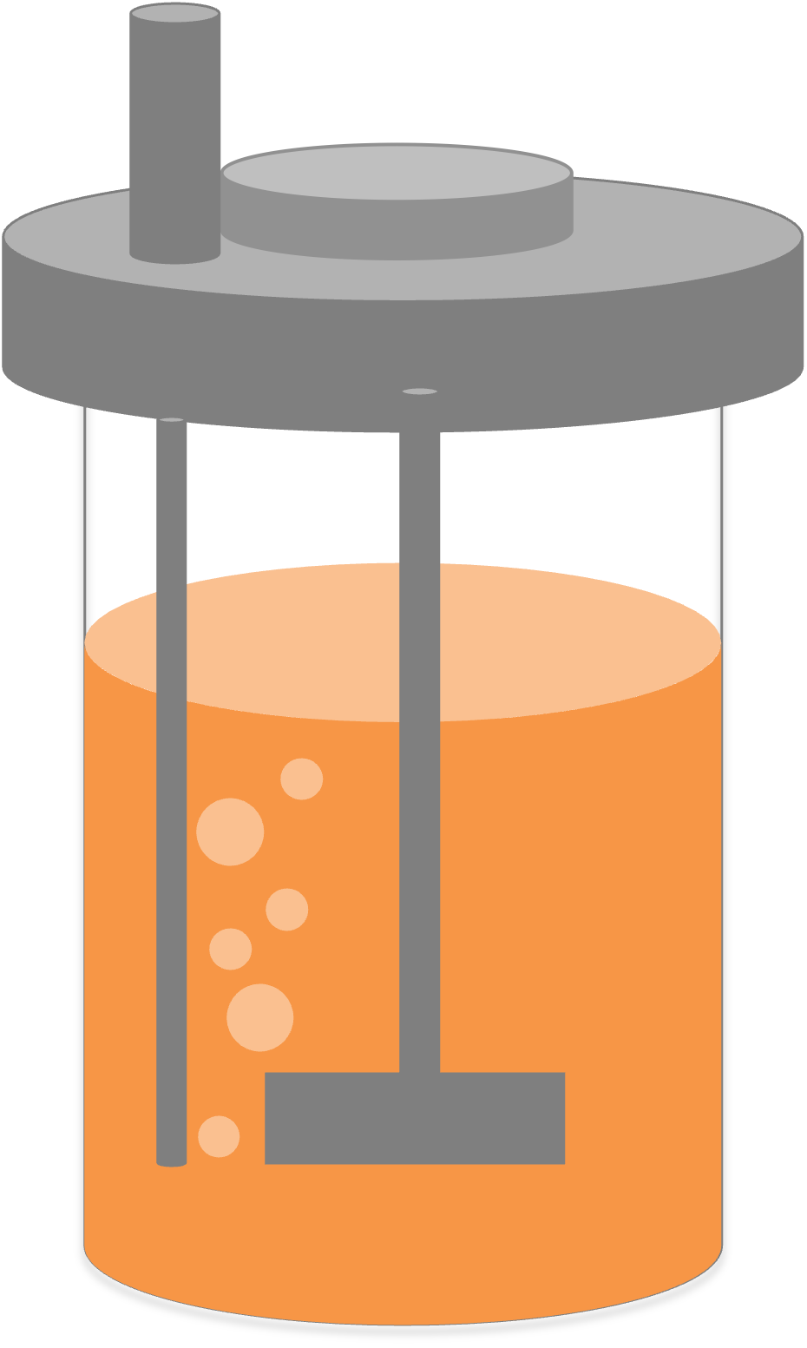
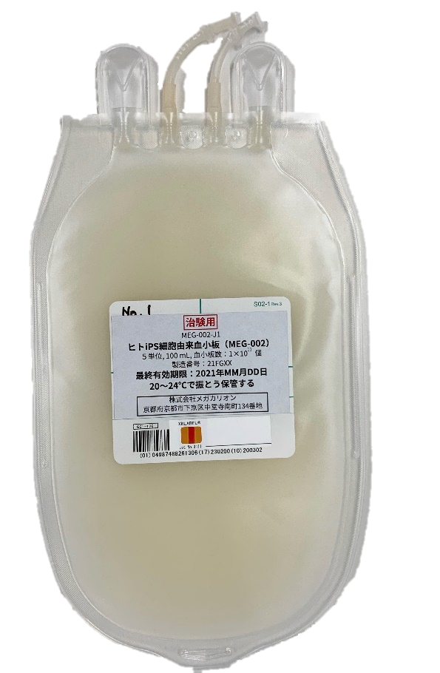

Manufacturing of iPSC-derived Platelets
3 Genes
HPC
MKCL
Candidate
Screening
MCB & WCB Manufacturing
QC
Clinical-
grade iPSC
Establishment
Cell Banking
Clinical-grade MCB / WCB
Xray
PLT Release
Expansion
Maturation
Purification
Formulation
QC
WCB
PLT Products
Up-Stream
Down-Stream
State of the Technology Meeting: Platelet and Platelet-like Products

Slide 4
MEG-002: First-in-Human Clinical Trial
Time-Course Changes in Platelet Counts
FIH Clinical Trial
Allogenic iPSC-derived platelets (MEG-002)
A patient with thrombocytopenia
Dose: 6 x 10¹⁰ platelets / 60 mL
Results
No adverse event
Increase in total platelet counts
Circulation of MEG-002 was separately observed by using CD36 as a marker.
First evidence of iPSC-plts circulate in humans
State of the Technology Meeting: Platelet and Platelet-like Products

Slide 5
Innovation in Progress:
Redefining Platelet Transfusion
Current Limitations
Donor dependency
Short shelf life
Risk of infectious disease transmission
Plasma-related adverse reactions
HLA alloimmunization
Unpredictable availability
HLA-deficient iPSC-derived Platelets
Donor-independent
Long-term storable
No risk of infection
Plasma-free
Prevention of anti-HLA Ab development
On-demand, reliable supply
Not an alternative to donor platelets —
a new platform for transfusion medicine.
State of the Technology Meeting: Platelet and Platelet-like Products

