Slide 1
Platelet Transfusion in Cardiac Surgery: The CHIPS Trial and Future Directions
Platelet State of the Science Meeting
Feb 17-19
Philip C. Spinella, MD, FCCM
Professor of Surgery
Professor of Critical Care Medicine
Co-Director, Trauma and Transfusion Medicine Research Center
Associate Medical Director, Center for Military Medicine Research
University of Pittsburgh

Slide 2
Disclosures
Consultant
  Cerus, Grifols
Advisory Board
  CSL Behring, Haima, Octapharma,
Co-Founder, Chief Medical Officer
  Kalocyte

Slide 3
Objectives
Platelet Transfusion in Cardiac Surgery
Platelet Storage Temperature and Function
CHIPS Trial
Future Directions

Slide 4
Platelets Use in Cardiac Surgery
Cardiac Surgery
  10-20% of platelet use
2 million platelets transfused per year in US
  98% from apheresis collections
  200-400,000 per year for Cardiac Surgery
Need will increase due to aging population
  20 million more people above 65 years of age in next 10 years
Where will supply come from to meet this demand?

Slide 5
Why Platelets used in CT Surgery?
Platelet Dysfunction in Cardio Pulmonary Bypass (CPB)
  Activation and consumption on artificial surfaces
  Mechanical injury and receptor shedding
  Dilution and hypothermia
  Inflammatory and biochemical inhibition
  Fibrinolysis and impaired platelet–fibrin interaction

Slide 6
Platelet Dysfunction in CPB
The result is:
  Reduced adhesion
  Reduced aggregation
  Reduced clot strength
Despite platelet counts that may appear adequate
Platelet indication is difficult to determine
When will we develop accurate assays of platelet function?

Slide 7
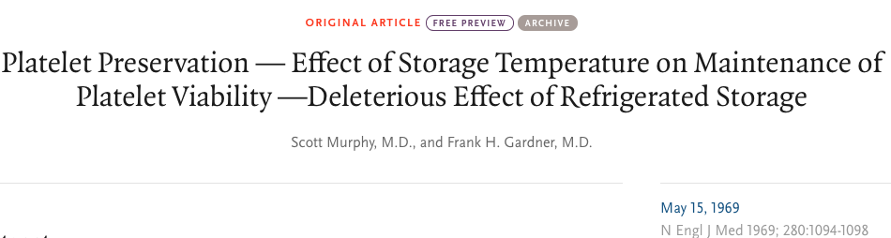
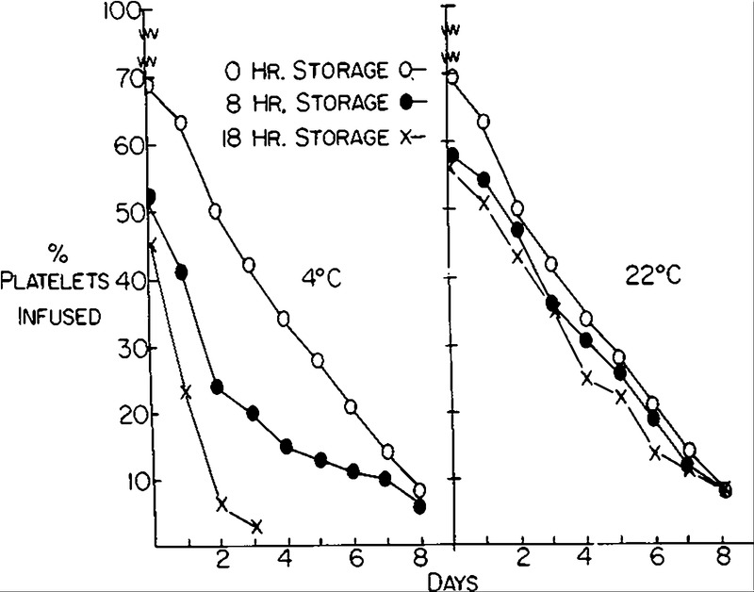
Platelet Storage Temperature
“The use of cold platelets should be abandoned…for transfusion purposes”

Slide 8
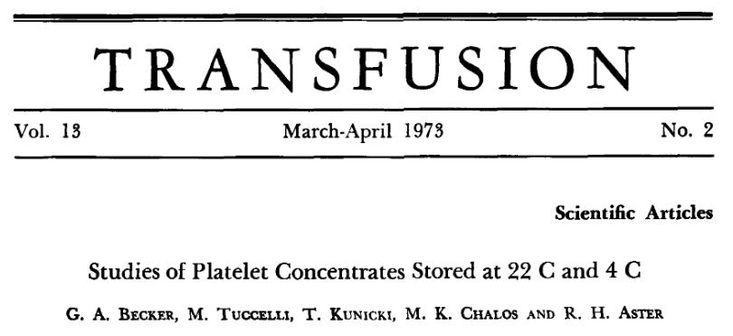
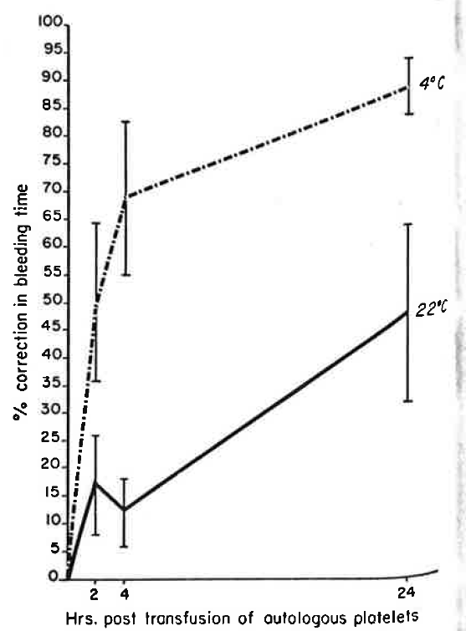
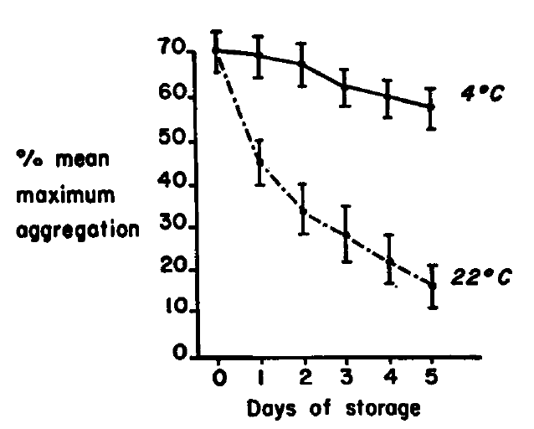
Cold Storage Increases Hemostasis
Light Transmission Aggregometry
Notes:
We have known for 50 years that a cold stored platelet does improve hemostatic function. Aggregometry results indicate cold platelets have increased aggregation compared to RT platelets and in an RCT examining adults on aspirin or who were thrombocytopenic cold platelets significantly reduced bleeding time compared to RT platelets.

Slide 9
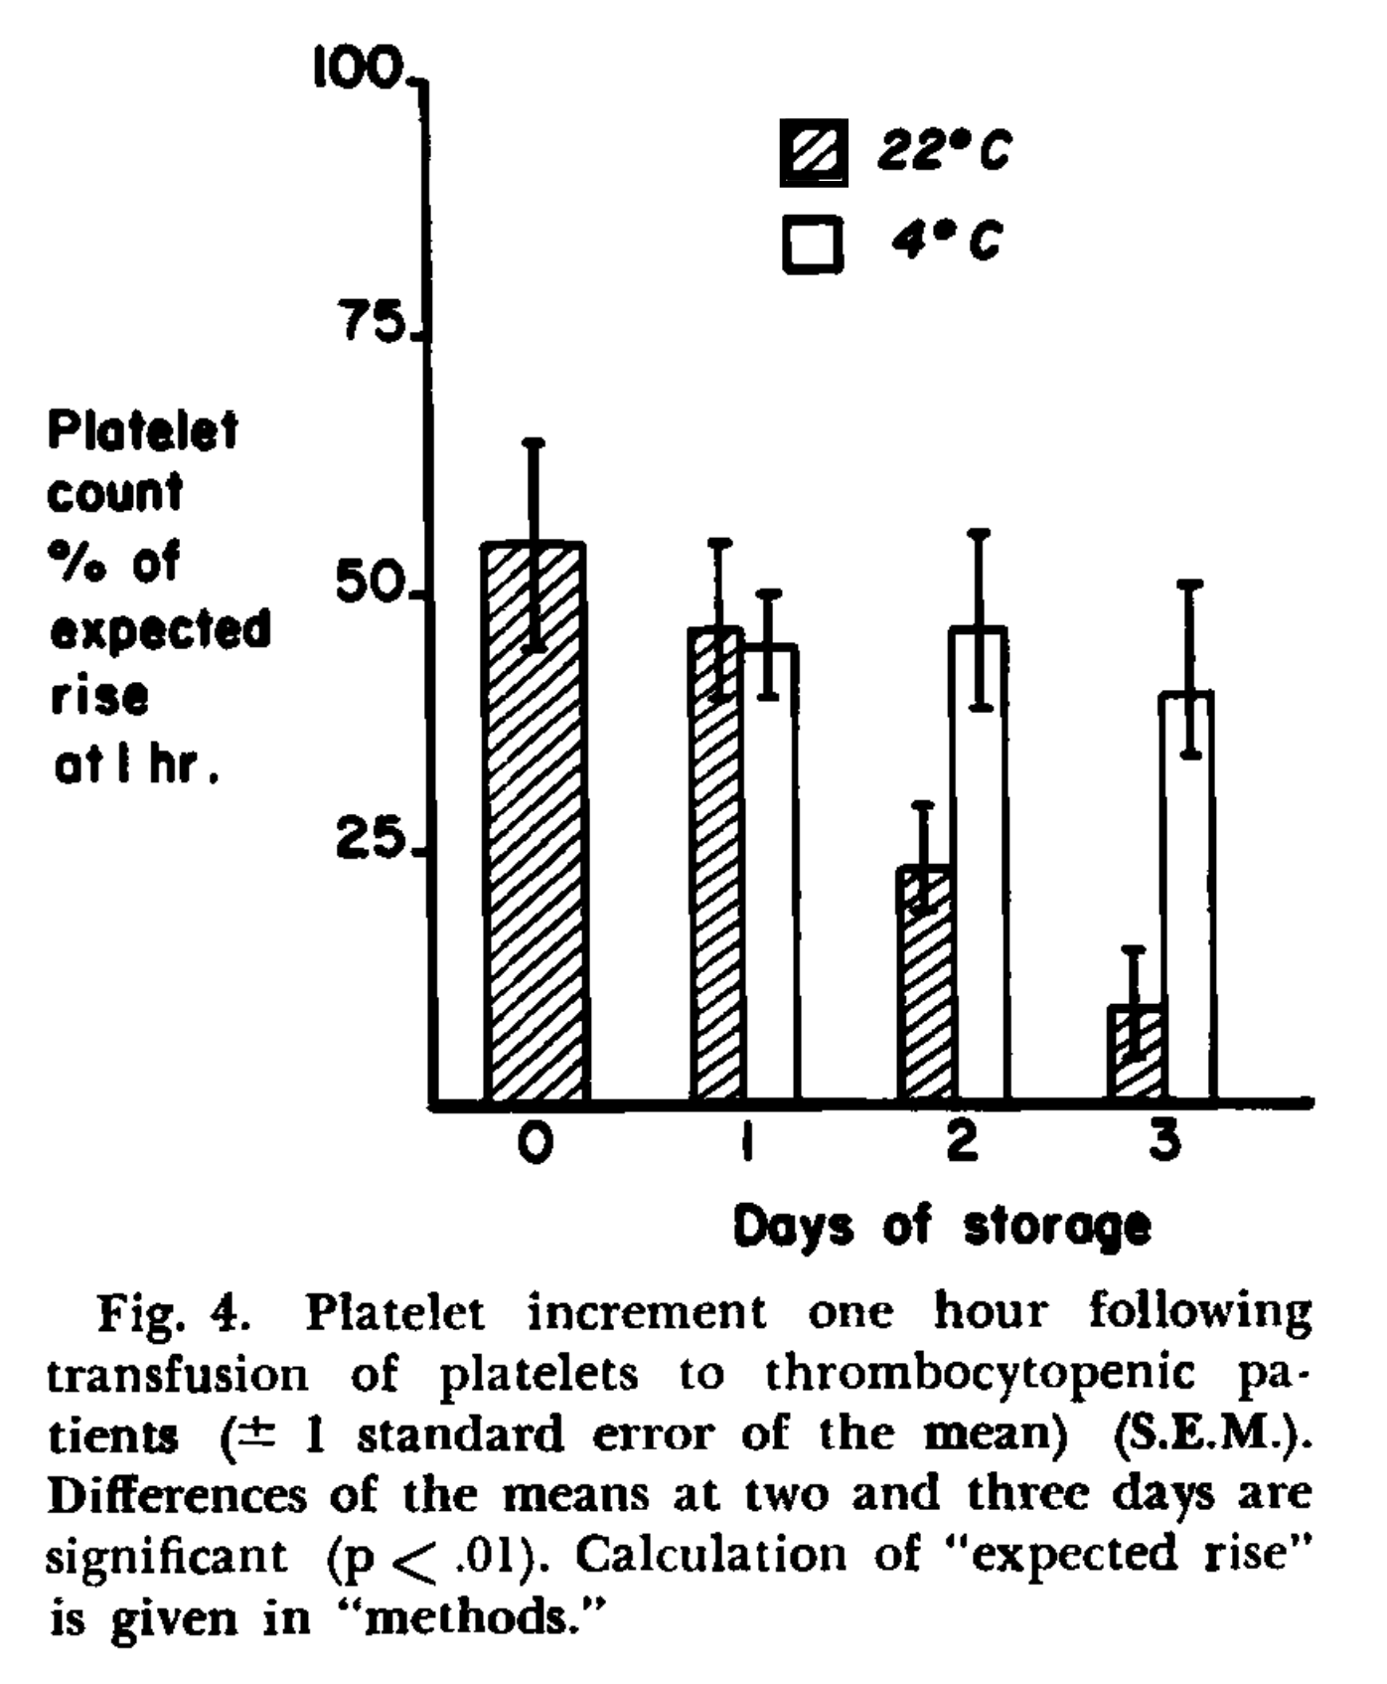
CSP Improved Expected Increase in PLT Count
Becker. Transfusion. 1973

Slide 10
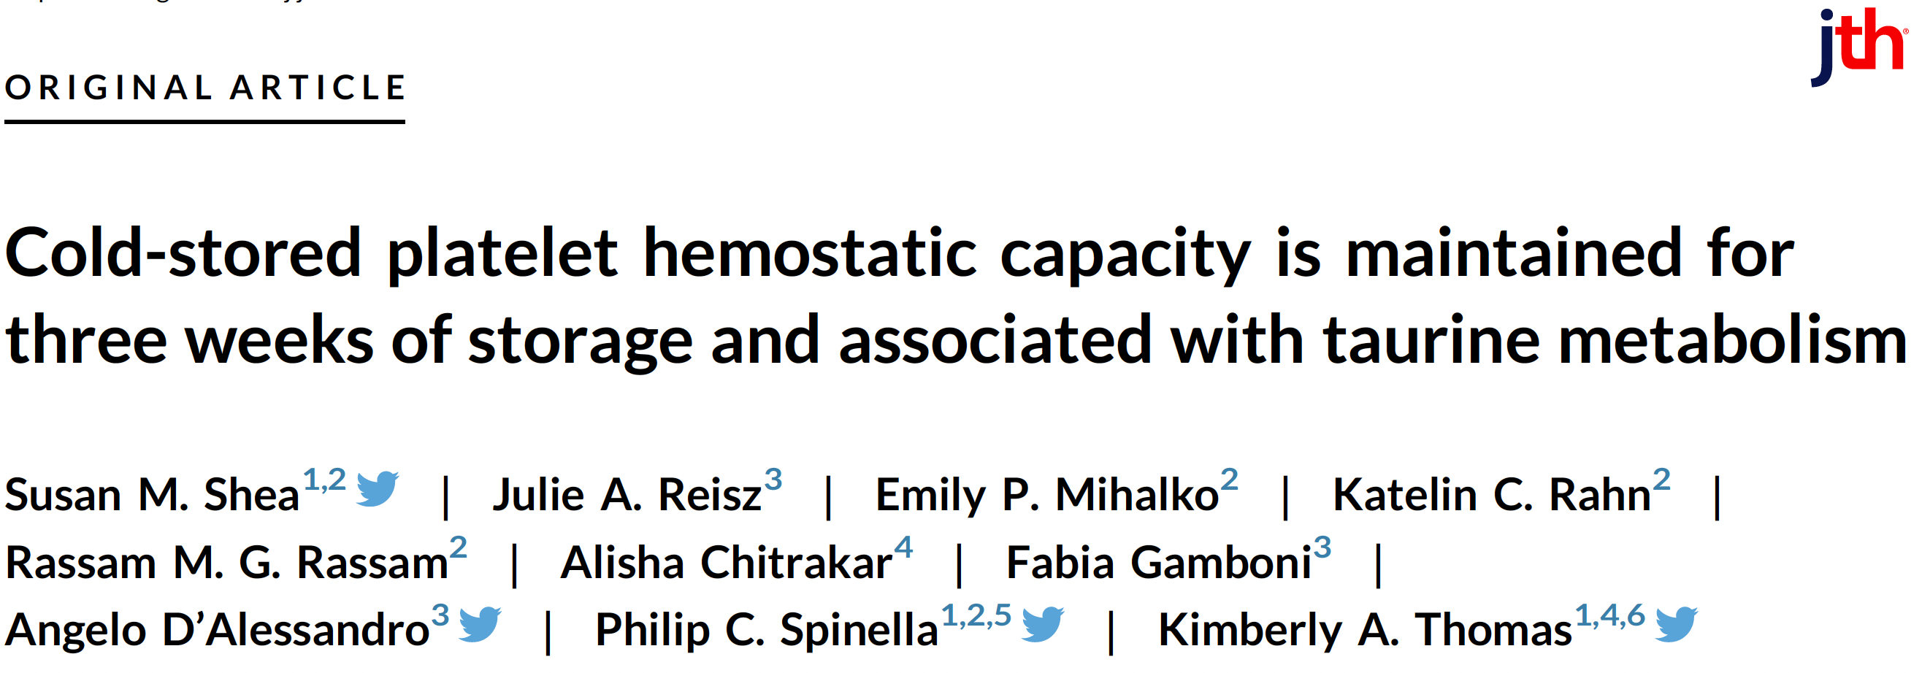
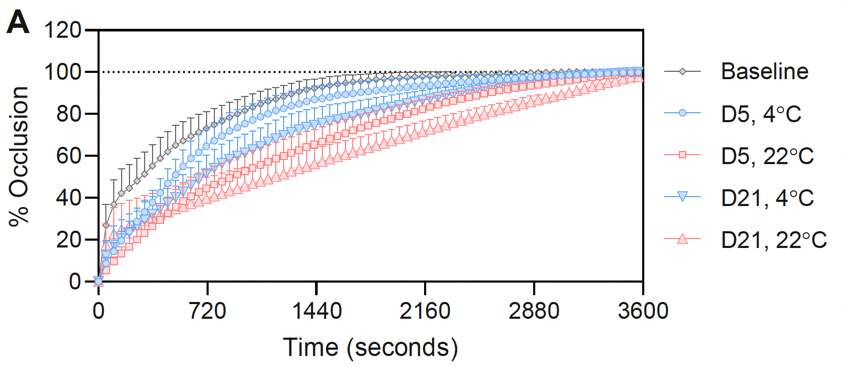
Hemostatic Function of CSP up to 21 days Storage

Slide 11
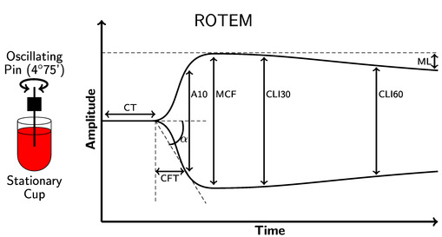
Viscoelastic Clot Firmness: Platform Distinction, Plasma-Dominated
Clot Viscoelastometry
# significantly different from Trima Plasma ; $ Trima PAS; % Amicus Plasma; & Amicus PAS
Courtesy of Susan Shea, PhD
Trauma and Transfusion Medicine Research Center, Department of Surgery

Slide 12
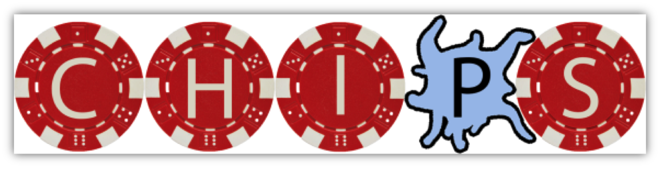
Chilled Platelet Study
  Phase 3, international, multi-center, randomized, partially blinded, adaptive, non-inferiority/superiority study

Slide 13
CHIPS Design
Primary endpoint: 5-level bleeding score
Non-inferiority margin of 1 unit on bleeding score, with gated test for superiority
Interim analyses every 200 participants
Maximum sample size of 1000

Slide 14
Interventions
Room temperature platelets (usual care)
  Apheresis platform used at the clinical site
Cold stored platelets
  Apheresis platforms used at sites
  Stored 1-6 C
  Not agitated
  Placed in cold within 8 hrs
  No bacterial cultures
Intervention period: 24 hrs from enrollment
Randomization: fixed at 2:1 (CSP:RTP)

Slide 15
CHIPS Design
Storage duration adaptive design to determine the maximum storage for CSP
  Storage age changed according to prespecified rules
  Started at 7 days with max of 21 days

Slide 16
Inclusion Criteria
Greater than 3 kg Less than 85 years of age Complex cardiac surgery with cardiopulmonary bypass

Slide 17
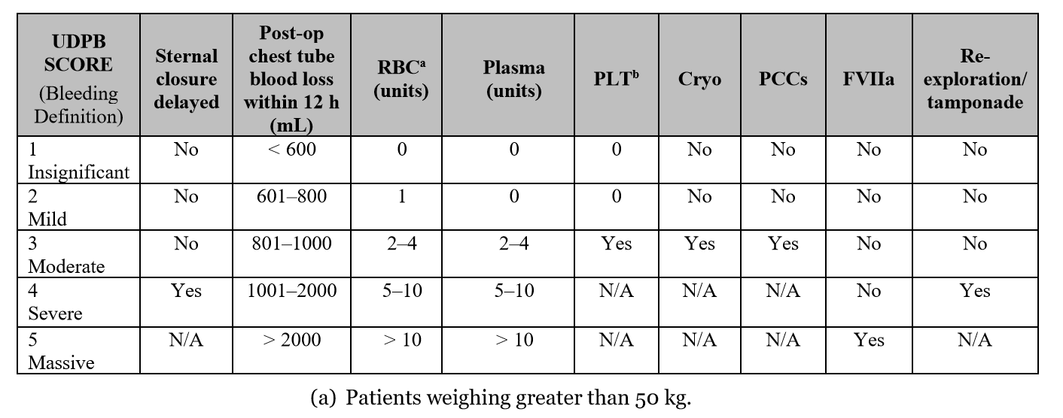
Primary Outcome:
Peri-Operative Bleeding Score
Score calculated after the first platelet transfusion
Dyke C, et al. Universal definition of peri-operative bleeding in adult cardiac surgery. JTCVS 2013.

Slide 18
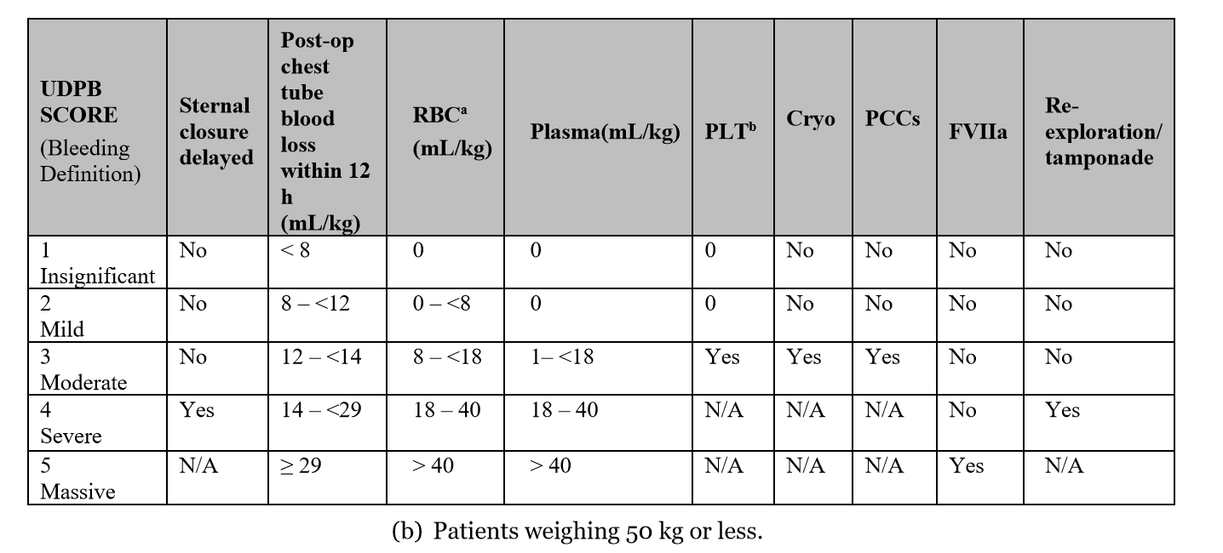
Primary Outcome (<50kg)
Score calculated after the first platelet transfusion

Slide 19
Clinical Sites
25 US sites
  Enrolling children (7)
  Enrolling adults (19)
2 Australian sites
  Adults only

Slide 20
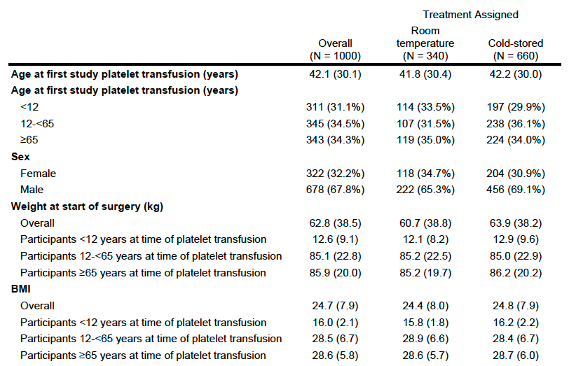

Slide 21

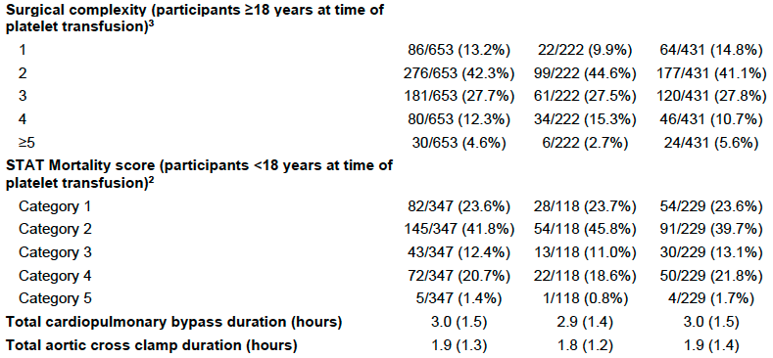

Slide 22
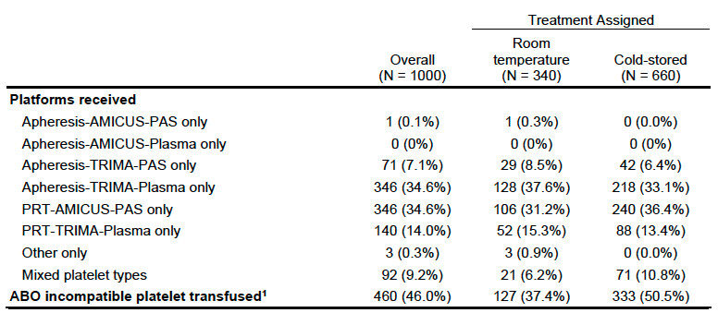
Apheresis Platelet Platforms

Slide 23
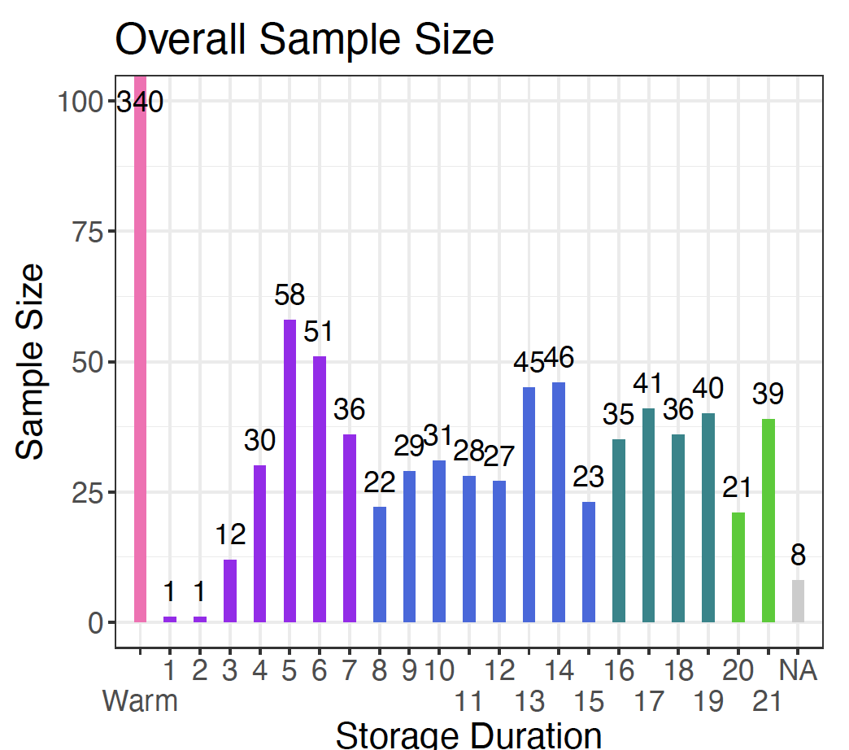
CSP Age Increased With Adaptive Design Up To 21 days

Slide 24
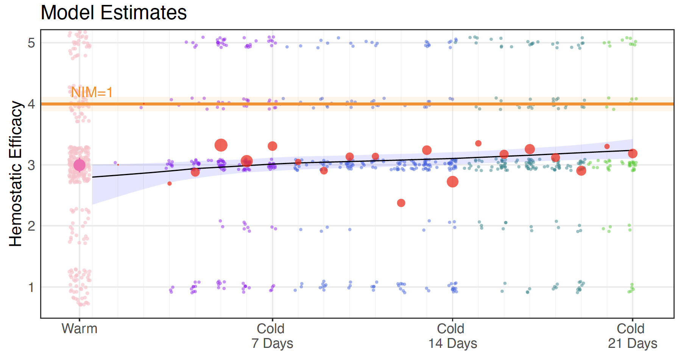
CSP up to 21 days were non-inferior to RTP
Bleeding Score

Slide 25
24 Hour Chest Tube Output
 | Room Temp Platelets | Cold Stored Platelets | P value
24 hr chest tube output (ml/kg) | 8.4 (5.5-15.9) | 8.9 (5.2-15.4) | 0.83

Slide 26
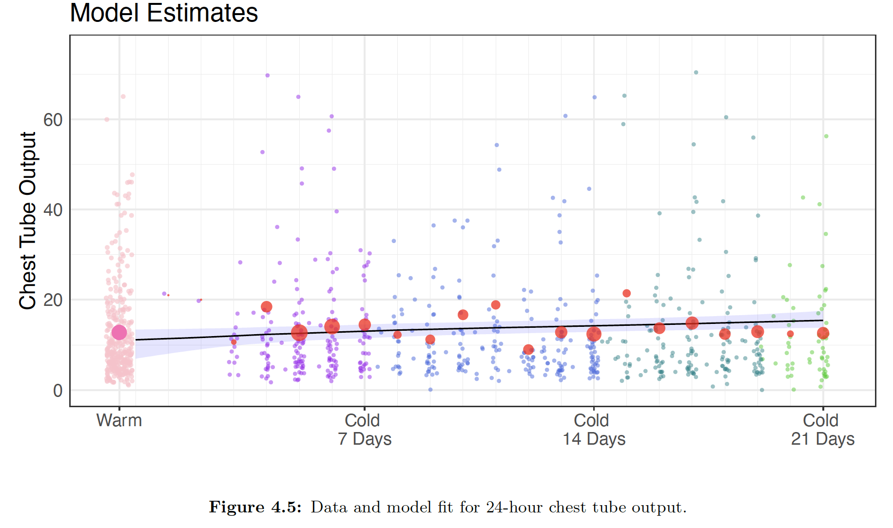
24 Hour Chest Tube Output

Slide 27
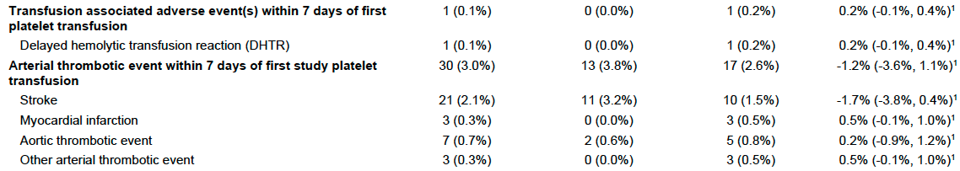
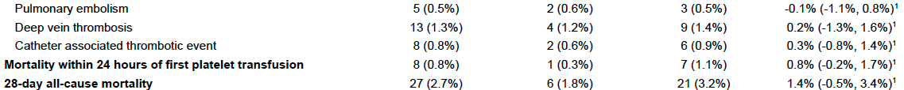
No Difference in Thrombotic
& Safety Outcomes
No SAEs reported that were related and unexpected

Slide 28
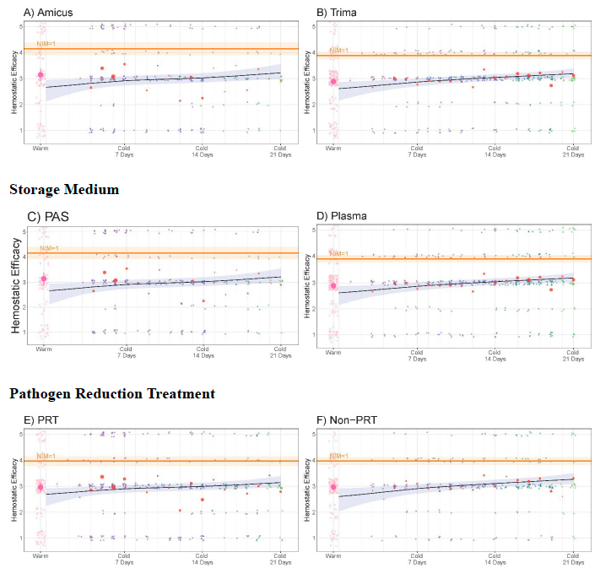
Outcomes by Manufacturing Method

Slide 29
Conclusions
Cold stored platelets:
  Extend shelf life to 21 days
  Maintain hemostatic efficacy and safety
  Improve blood supply resilience
“This changes how we think about platelet storage.”

Slide 30
THANK YOU!
Investigators at 27 sites
Clinical Coordinating Center
  Taegen Sullivan
  Tina Bockelman
  Christina Daniel
  Meghan Huff
Data Coordinating Center-Utah University
  John Van Buren
Medical Monitor
  Frank Booth
Berry Consultants and DSMB Chair
  Roger Lewis
US Department of Defense/USAMMDA
  Funding

Slide 31
CSP Licensing Timeline
12-18 months before BLA amended
FDA variance will not be changed prior to BLA amendments

Slide 32
Future Directions/Questions
Can CSP be used for prophylaxis and acute bleeding in hypoproliferative thrombocytopenia?
Can we license buffy coat platelets with cold storage?
  Prevent waste of WBD platelets
  Increases availability with possible 21 day storage duration

Slide 33
Future Directions/Questions
Can we lower platelet count to 2.5 from 3 to increase availability without sacrificing efficacy?
Can we develop better storage solutions and better bags/containers to improve function?

Slide 34


