Slide 1
DARPA Biological Technologies Office (BTO)
Dr. Michael Koeris
Biological Technologies Office Director​
Defense Advanced Research Projects Agency​
Advancing Autonomous Medicine
06/17/2026

Slide 2

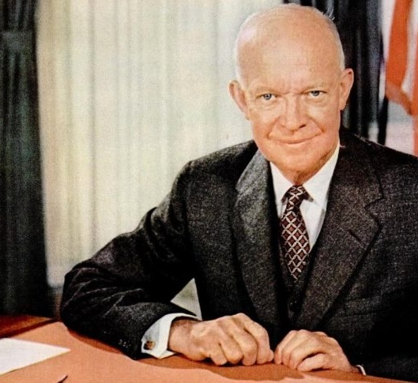
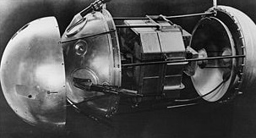
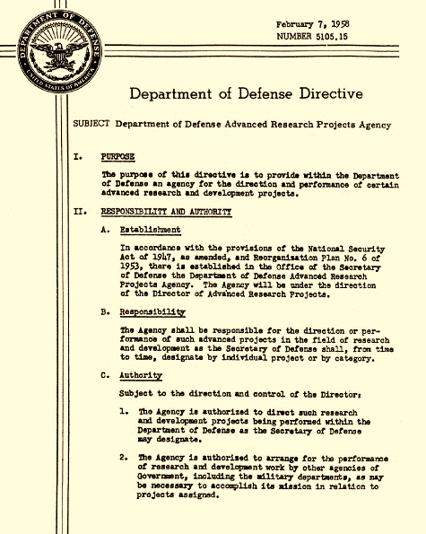
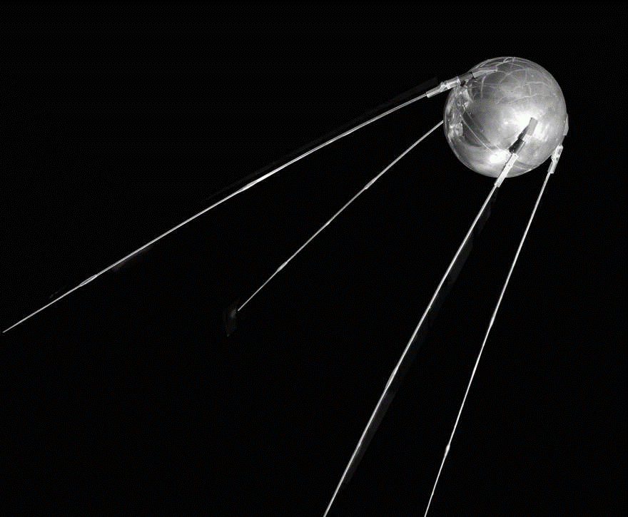
Origin of Defense Advanced Research Projects Agency (DARPA)
October 4, 1957
February 7, 1958
“The purpose of this directive is to provide within the Department of Defense an agency for the direction and performance of certain advanced research and development projects.”
U.S.S.R. beats U.S. to space with Sputnik satellite; U.S. should never again be surprised by technology.

Slide 3


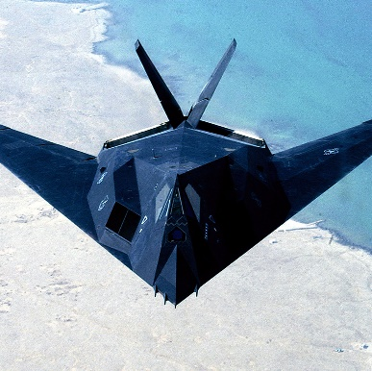
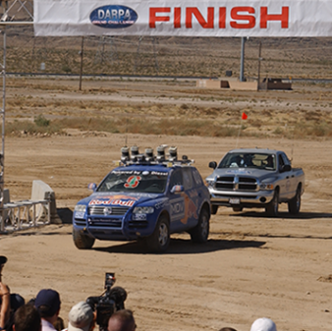
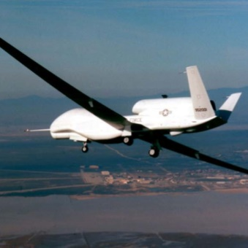
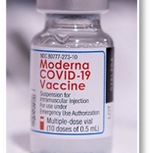
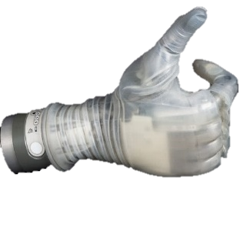
DARPA’s Role in the S&T Ecosystem
Create breakthrough, paradigm-shifting solutions.
Accept and manage significant technology risk.
Disrupt or massively accelerate technology roadmaps.

Slide 4






DARPA Technical Offices
Defense Sciences
Office
Biological Technologies
Office
Multi X
Office
Information Processing Techniques Office
Strategic Technology
Office
Tactical Technology
Office
Materials, manufacturing, and structures
Sensing, measuring, and affecting
Math, computation, and processing
Complex, dynamic, and intelligent systems
Warfighter
  Tactical combat casualty care
  Performance optimization
Warfighting
  Edge manufacturing
  Create operational advantages
Frontier technologies
  Data factories
  Simulation
Quantum, photonic, and organic circuits
New microsystems manufacturing ecosystem
Dual-use by design
Transformative artificial intelligence
Offensive and defensive cyber
Fighting in the information domain
Resilient, adaptable, and secure systems
Advanced sensors and processing
Battlefield effects
Command, control, and communications
Systems Warfare
National Resilience
Economic Warfare
Protracted War
National Mobilization
Reimagination of hardware design, development, and test
Rapid, affordable, and scalable manufacturing
Decisive long-range effects
Novel approaches that radically change the military advantage calculus

Slide 5

BTO Office Mission
BTO focus is innovation to win in both
competition and conflict with pacing threats.
Mission: For National Security, BTO prevents surprise by denying adversaries the benefit of Chemical and Biological effects and technologies at all scales and creates surprise through asymmetrical advantage to win at any scale.
Key Domain 1: Defense at all Scales
Key Domain 2: Surprise at any Scale

Slide 6

Biological Capabilities To Strengthen National Security
Data
Simulation
F3:
Frontier
Technology
Live Chain
Advantages
F1:
Warfighter
F2:
Warfighting
Performance
Sustainment & Logistics

Slide 7
Biological Capabilities To Strengthen National Security
Live Chain
F1:
Warfighter
Performance

Slide 8
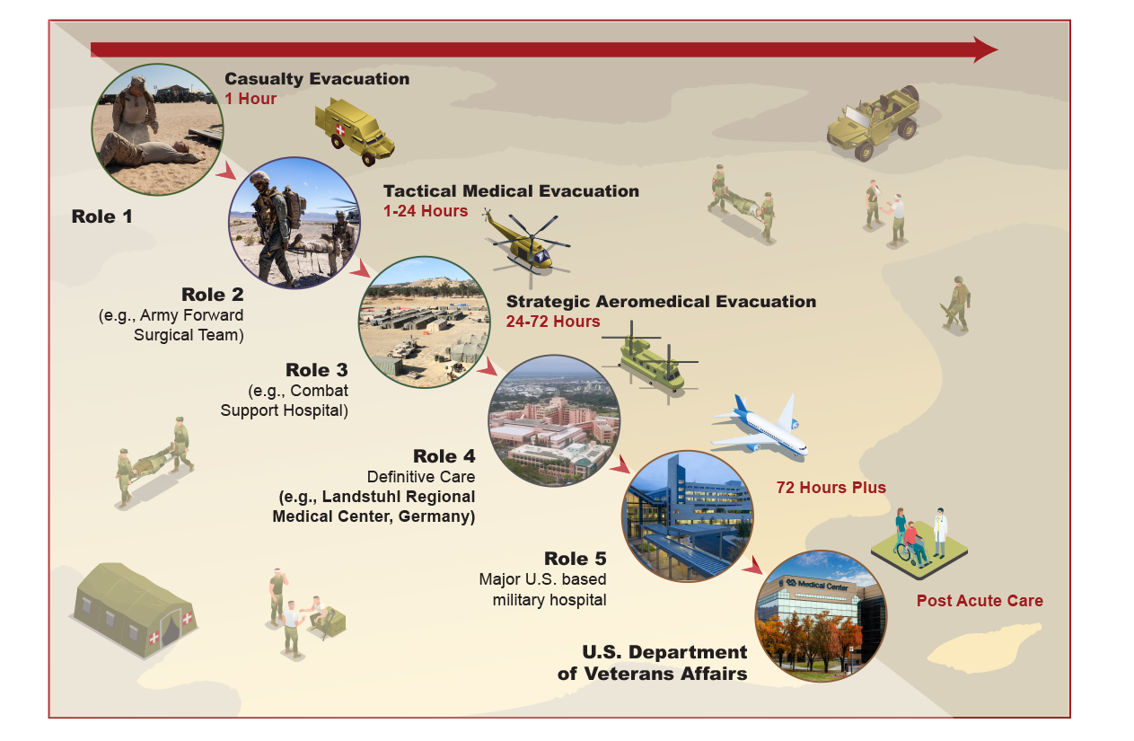
Current Military Care Paradigm
F1
Global War on Terror View of Echelons
  Timeframes not realistic
Contingent on uncontested movement
  Unmitigated ground transport
  Rapid rotary wing access
  Unencumbered strategic airlift
All of these are likely not going to be available in the next war
None of this changes the
fundamental principles of
healthcare delivery.
IS BROKEN

Slide 9
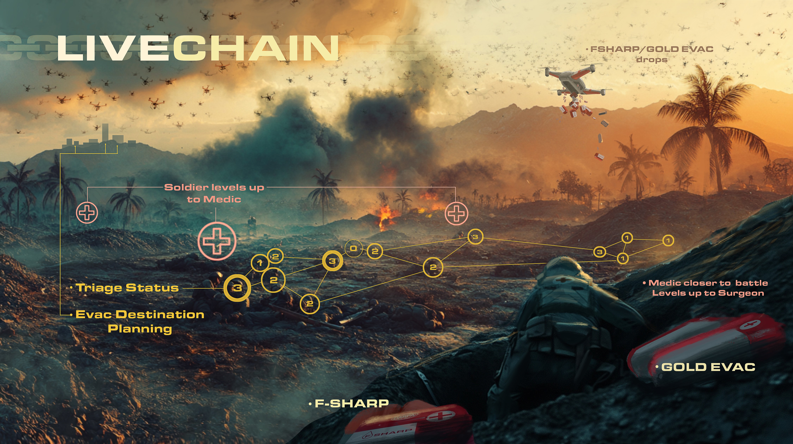
Credit: DARPA | Colie Wertz

Slide 10




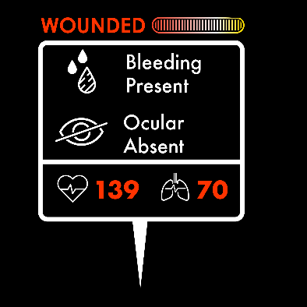







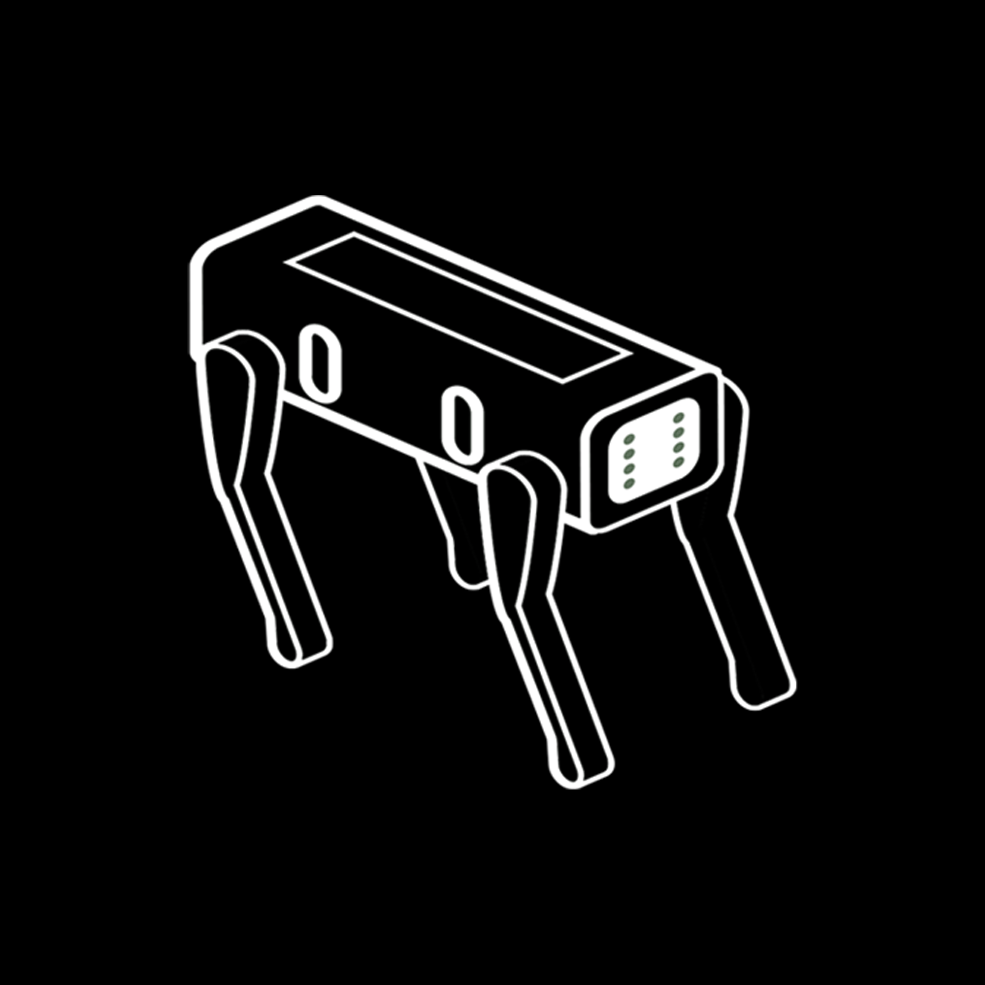






DARPA Triage Challenge
F1
Problem: Current triage approaches are inadequate for mass casualty incidents and have limited value for predicting need for life-saving medical interventions.
Systems Competition
Data Competition
Locate, assess, prioritize
Predict need for care
Care provider interface
Predictions for Life-Saving Interventions
Pre and In-hospital data
Blood Product
In 20 min Confidence 80%
Ventilation
In 40 min Confidence 75%
Medic interface
x
x
x
Damage Control Surgery
In 120 min Confidence 60%
x
x
Priority
x
x
Primary Triage – Point of injury, medical providers sort casualties by injury severity.
Secondary Triage – Resuscitation and administration of life-saving interventions en route and at the trauma center.
Vision: Scalable, timely, accurate capture of novel injury signatures to enhance triage decision-making in austere, complex, and mass-casualty settings.
DoW: Department of War

Slide 11

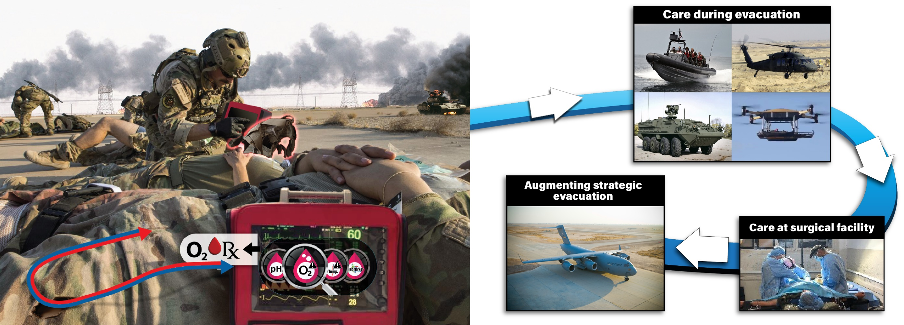
GOLDEVAC
UNCLASSIFIED
F1
Problem: Current “golden hour” operations for medical evacuation of injured service members will not function for future conflicts in all theaters
Program vision: Provide expert level care – from point of injury through entire evacuation process

Slide 12
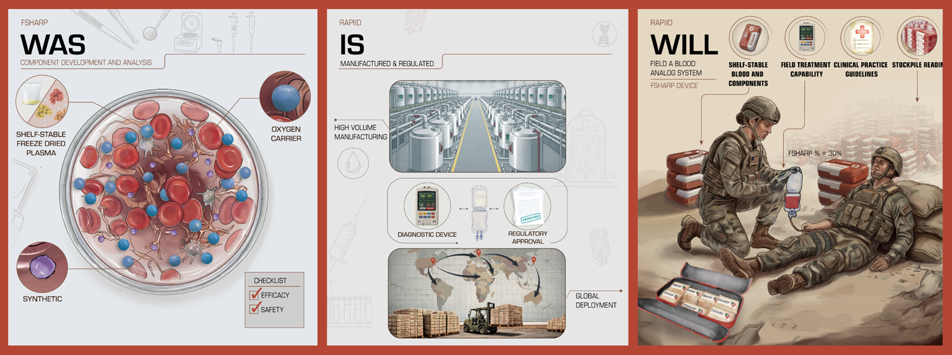
Resuscitation And Prevention of Ischemia ​Induced Dysfunction (RAPIID)​
F1
Vision: RAPIID will deliver a shelf-stable whole blood solution that is authorized for use in warfighters, along with supporting modalities, in the next three years at a rate of 1,000 units/week.

Slide 13
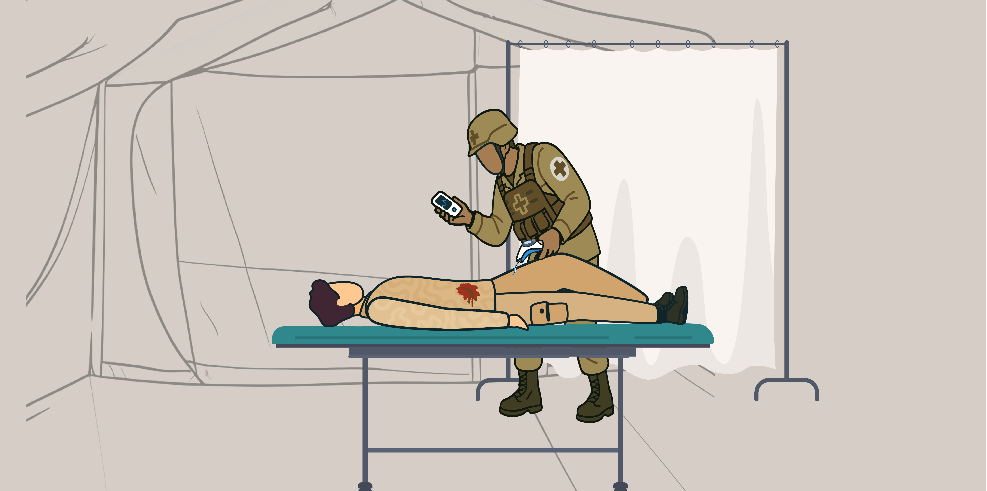
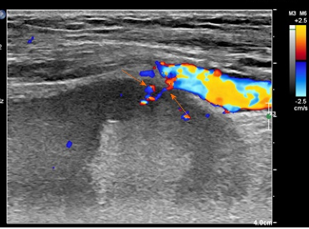

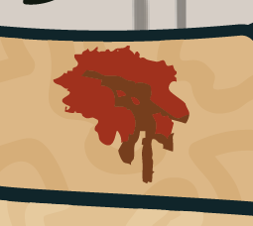
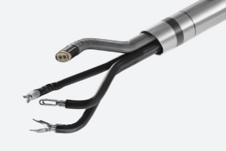
Medics Autonomously Stopping Hemorrhage (MASH)
F1
Problem: Without pre-hospital solutions for internal hemorrhage the DoW will have massive warfighter losses to survivable injuries.
Impacts
External sensors
Stop lethal forms of torso hemorrhage without a surgeon via demonstrator system
Provide MIS path to enter trauma market and utilize full autonomy
Push standard of pre-hospital hemorrhage control from 3 hrs → 48 hrs
Intravascular / extravascular robots
Multi-modal automated bleed detection and localization¹
Why DARPA?
Automated, minimally-invasive end effectors and sensors
Forward-based automated trauma surgery can only be de-risked by combining novel signal exploitation coupled with the latest in robotic learning.
Vision: Forward medical sites with autonomous robotic systems to stabilize torso hemorrhage without need of a surgeon, providing 48+ hours to reach definitive care.
  MIS: minimally-invasive surgery
Notes:
Citation:
Ma JJ, Zhang B. Diagnosis of an actively bleeding brachial artery hematoma by contrast-enhanced ultrasound: A case report. World J Clin Cases 2020; 8(17): 3835-3840 (link: https://www.wjgnet.com/2307-8960/full/v8/i17/3835.htm

Slide 14

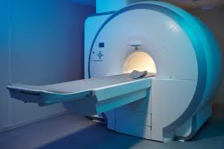





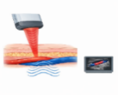

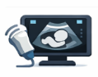

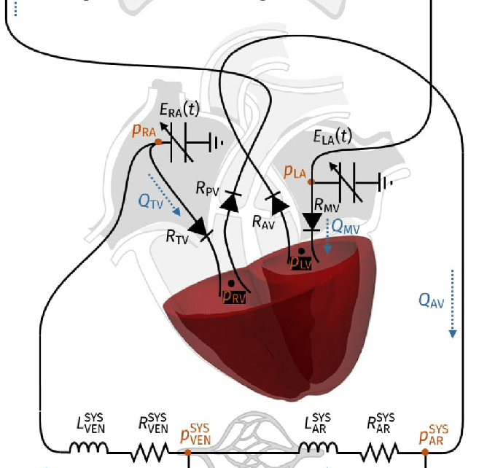


Virtual-Integrated Twin for Autonomous Lifesaving
F1
Problem: Care at Point of Injury suffers from lack of insight, not lack of data
Problem
Objective
Predictive physiology for austere medicine
VITAL Concept
Limited time, limited foresight, high-consequence decisions
High Fidelity Cardiovascular
Model
Sensor Fusion
Physiology & Operational Context
Real-Time Reduced Order
Model
Computational Model
Intervention
Guidance
Intrinsic Uncertainty Quantification
Vision: A continuously updating human twin for forecasting deterioration and guiding intervention

Slide 15
Biological Capabilities To Strengthen National Security
Data
Simulation
F3:
Frontier
Technology

Slide 16

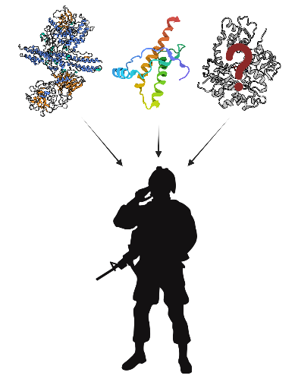
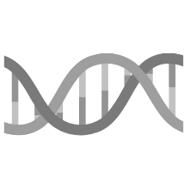
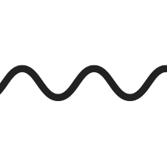



Network of Optimized Dynamic Energy Signatures (NODES)
F3
Implications of Not Knowing Protein Function
Biological threats will be undeterred
Epidemics will spread
Food production is affected
94%
86%
15-58%
artificial
% Known
Natural
accidental
1-10%
Adversaries will spring surprises willy nilly…
DNA
RNA
Protein
Function
Complexity
DNA: Deoxyribonucleic Acid RNA: Ribonucleic Acid CUI: Controlled Unclassified Information
Vision: Deep technology to predict multiple unknown protein functions in 1 hour and with >90% confidence, available in both class and CUI forms with a public-facing User Interface

Slide 17
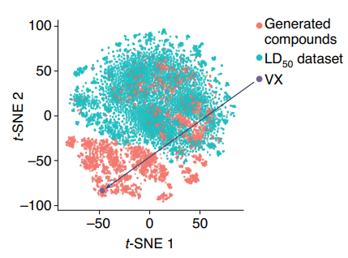

F3
PROTEAN: DARPA can change the chemical warfare equation
Problem: Dual-Use of AI Drug Design - A Wake-Up Call: Nerve agents number in the tens of millions
Protean hypothesizes that the key to overcoming this hurdle lies in elucidating the structure, dynamics, and binding pockets that regulate protein function
40,000 new chemical agents predicted in 6 hours
*Many more lethal than VX*
Endogenous
Reactant or
Ligand Binding
Endogenous
Product or
Ligand Release
Protean MCM
Stabilizes Toxin-Resistant but Functional State
Novel Allosteric/Cryptic Site Identification
Dimension 2 in Toxic Space
Exposure to Toxin
Normal Function
Normal Function + Resistance
Dimension 1 in Toxic Space
Urbina et al. 2022 Nature Machine Intelligence
Vision: Protecting a single protein enables elimination of nerve agents as an entire class of threat

Slide 18


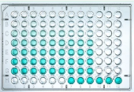
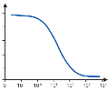
Simulating Microbial Systems (SMS)
F3
Overall Goal: Create physics-based simulations to predict the behavior of cells
Simulate
& Predict
Simulations could be a valuable tool for…
Accelerate Medical Countermeasure R&D
Biomanufacturing
(Robust Supply Chain)
Physics-Based Simulations of Cells
Measure
& Inform
Vision: Need general capability to simulate cell function.

Slide 19

The Path from Idea to Impact
Programs originate with a program manager
  PMs identify opportunity to make a difference
DARPA PMs typically serve 3 – 5 year terms
  This means approximately 25% turnover annually
New PMs: new ideas and potentially investments in new research areas
  Program inspiration can come from anywhere!
Impact!
Program is completed and technology is transferred to partners
Final demonstrations and testing
Ongoing Program Management & Reviews
Program is active! Performers conduct R&D and report progress to PM
Solicitation and Procurement to establish program performers
PM discusses idea with Office Director and Deputy Director
PM presents formal briefing to DARPA leadership for approval
PM preps formal briefing

Slide 20
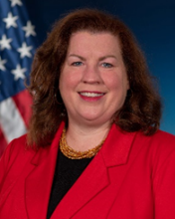
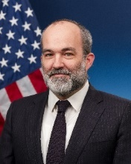
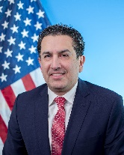
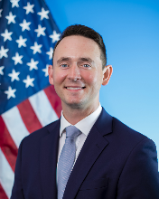
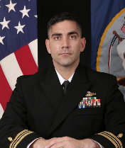
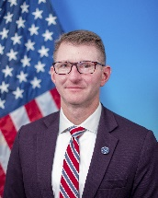
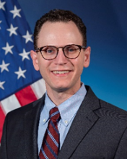
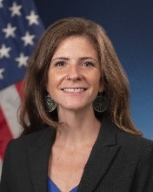
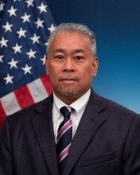
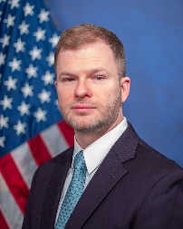
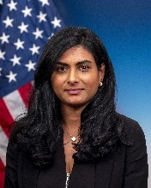
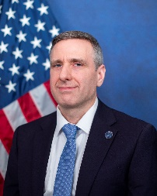
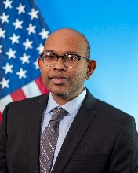
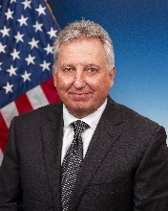
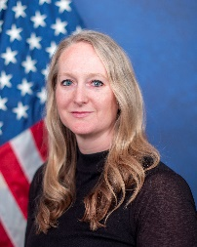
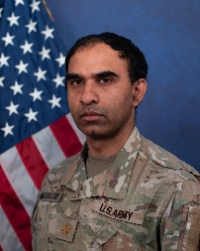
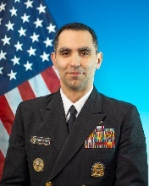
BTO Program Managers
Catherine Campbell, Ph.D.
Marine Biology & Bioinformatics
Pedro Irazoqui, Ph.D.
Electrical Engineering
Roozbeh Jafari, Ph.D.
Digital Health
William Mounfield, Ph.D.
Chemical Engineering
LCDR Robert Murray, Ph.D.
Animal Science
Jeremy Pamplin, M.D.
Automated Medicine
Matthew Pava, Ph.D.
Neuroscience
Tiffany Prest, Ph.D.
Microbiology
Mark Salvador, Ph.D.
Remote Sensing
Kyle Schwing, Ph.D.
Systems Engineering & Social Science
Sushma Savarala, Ph.D.
Chemistry
Russell Schwartz, Ph.D.
Computational and Systems Biology
Abhishek Singharoy, Ph.D.
Biophysics
Jeffrey Zaleski, Ph.D.
Bioinorganic Chemistry
D.PM
D.PM
D.PM
Bethany Brown, Ph.D.
Clinical Research
MAJ Senthil Mudaliar, MD,
MBA, MPH, M.Eng
Medicine and Engineering
CDR Cody Thornton, Ph.D.,
M.P.H, M.B.A
Public Health

Slide 21


Become a BTO Program Manager
Shape the Future of Biotechnology at DARPA
  Design and launch ambitious research with significant funding.
  Collaborate with top minds across academia, industry, and government.
  Drive Breakthroughs: From concept to demonstration in just 2-4 years.
  Shape fields and deliver national security advantages.
Scan to Learn More
There are few opportunities where one can strive to create and prevent technological surprise, working alongside leaders in multiple fields, even Nobel Laureates, to solve tomorrow’s hardest challenges; PMs at DARPA are afforded that opportunity every day.”
—William Mounfield, Ph.D, BTO PM
https://www.darpa.mil/careers/program-manager#what
BTO_Recruiting@darpa.mil
Distribution Statement ‘A’ (Approved for Public Release, Distribution Unlimited)
21

Slide 22
Become a DARPA Innovation Fellow
Shaping tomorrow’s leaders and driving transformative innovation
  Unparalleled Mentorship: Fellows receive direct mentorship from top DARPA Program Managers, gaining hands-on experience in program development and strategy.
  Operational Leadership: Fellows lead self-directed research, manage project portfolios, and initiate projects within their first year to qualify for continued participation.
  Career-Defining Opportunities: Fellows are supported in transitioning to leadership roles in academia, industry, or government, with security clearance sponsorship for national security opportunities.
BTO_Recruiting@darpa.mil
Distribution Statement ‘A’ (Approved for Public Release, Distribution Unlimited)
22

Slide 23

BTO
SPECIAL
OPPORTUNITIES
Learn how you can get involved with BTO!
BTO_Outreach@darpa.mil
Distribution Statement ‘A’ (Approved for Public Release, Distribution Unlimited)
23

Slide 24


ERIS Marketplace
Office-Wide Solicitation
Scan to Learn More
This announcement seeks revolutionary research ideas for topics not being addressed by ongoing BTO programs or other published solicitations.
Scan to Learn More
BTO is accepting submissions under the following topic areas:
Topic Area 4
Supports technologies for defense of humans and elements of the bioeconomy.
Topic Area 5
Supports technologies for human health and performance optimization.
https://www.darpaconnect.us/eris
https://www.darpa.mil/about/offices/bto#opportunities
ERIS is DARPA’s digital environment for post-competitive, readily awardable technology solutions delivered via 7-minute pitch videos.
Submissions accepted on a rolling basis.
ERIS is open to all U.S.-based innovators—startups, researchers, universities, nonprofits, large businesses, and individuals.
Submissions accepted on a rolling basis.
ERIS@darpa.mil
BTOBAA2026@darpa.mil
Distribution Statement ‘A’ (Approved for Public Release, Distribution Unlimited)
24

Slide 25

STAY CONNECTED
Visit us online for more opportunities
Email BTO_Outreach@darpa.mil to join our distribution list for the monthly newsletter and real-time announcements.
BTO_Outreach@darpa.mil
Distribution Statement ‘A’ (Approved for Public Release, Distribution Unlimited)
25

Slide 26
Distribution Statement ‘A’ (Approved for Public Release, Distribution Unlimited)

