Slide 1
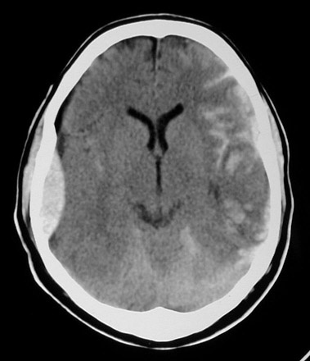
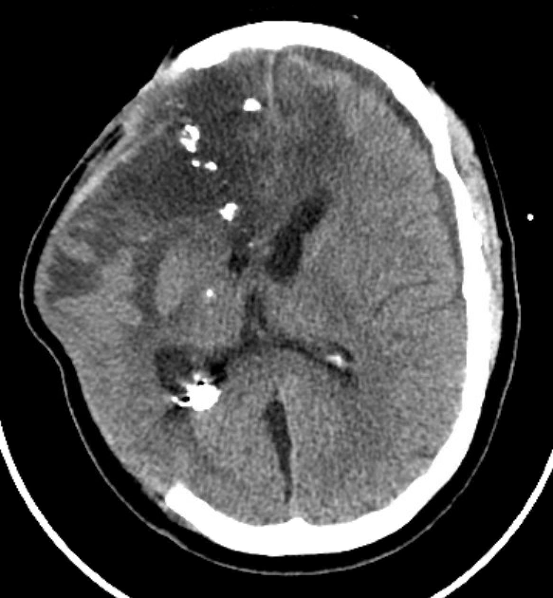
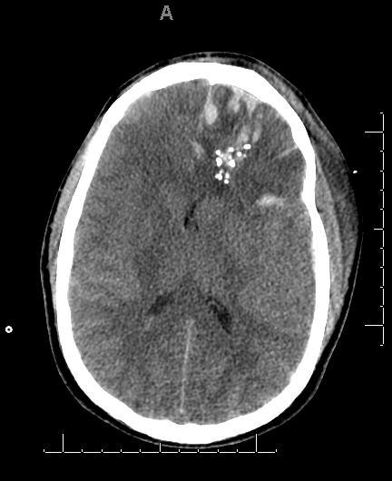

Platelet Therapy in Traumatic Brain Injury
David O. Okonkwo, MD, PhD
Professor of Neurological Surgery
University of Pittsburgh
Past Chair, AANS/CNS Section on Neurotrauma and Critical Care

Slide 2
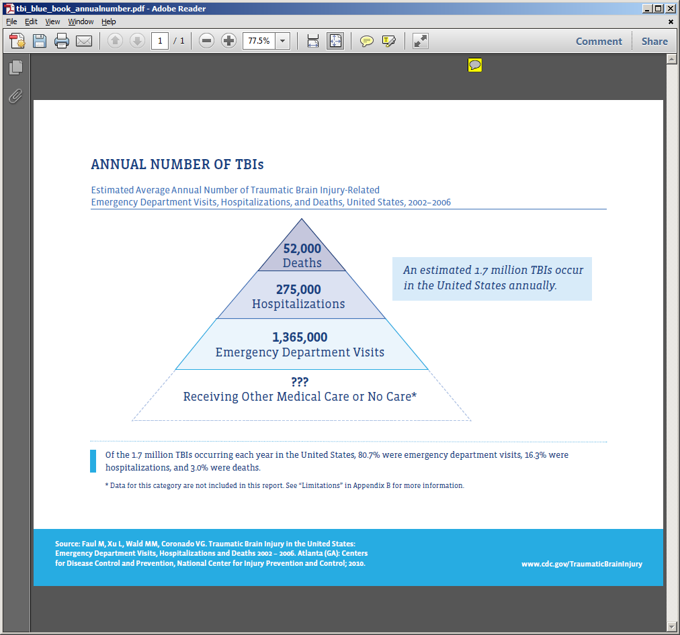
Public Health Burden of TBI
TBI US 2.8-4 Million/Year World 51 Million/Year
Every Hour in the United States:
6 Deaths
31 Hospitalizations
194 Emergency Room Visits
457 Concussions
(estimated 4 Million)

Slide 3
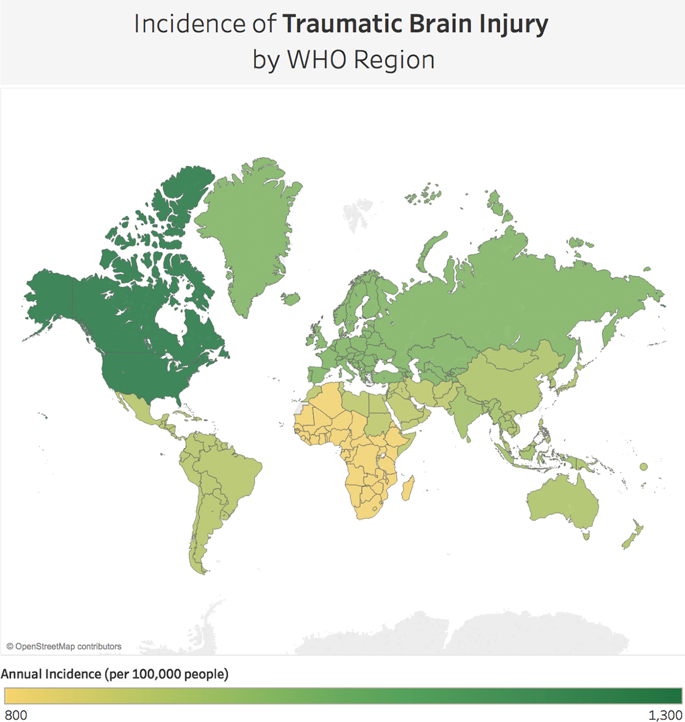
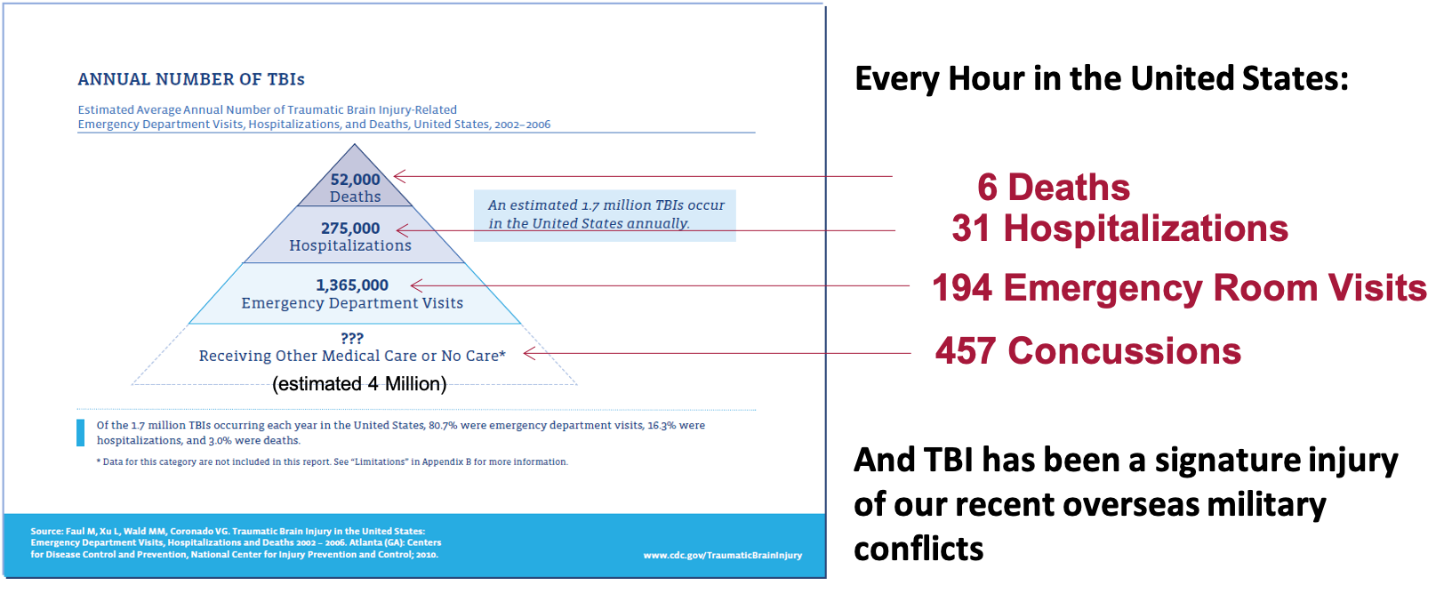

Trauma is now the leading cause of death under age 45 across the world and TBI accounts for half of all trauma deaths
TBI US 2.8- 4 Million/Year World 51 Million/Year

Slide 4
State of Affairs in Modern TBI Care
TBI is a leading cause of death and disability
TBI disproportionately affects older populations with pre-existing comorbidities
A significant percentage of this at-risk demographic takes oral antiplatelet agents
Antiplatelet therapies lack a direct reversal agent or antidote
The benefits of platelet transfusion have not been consistently demonstrated
Precision transfusion medicine is a critical need in TBI care

Slide 5
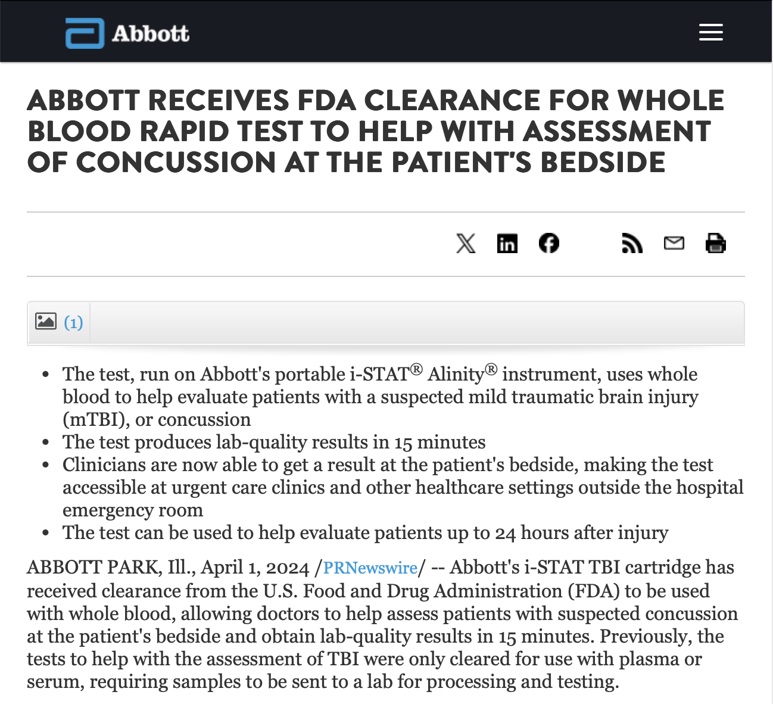
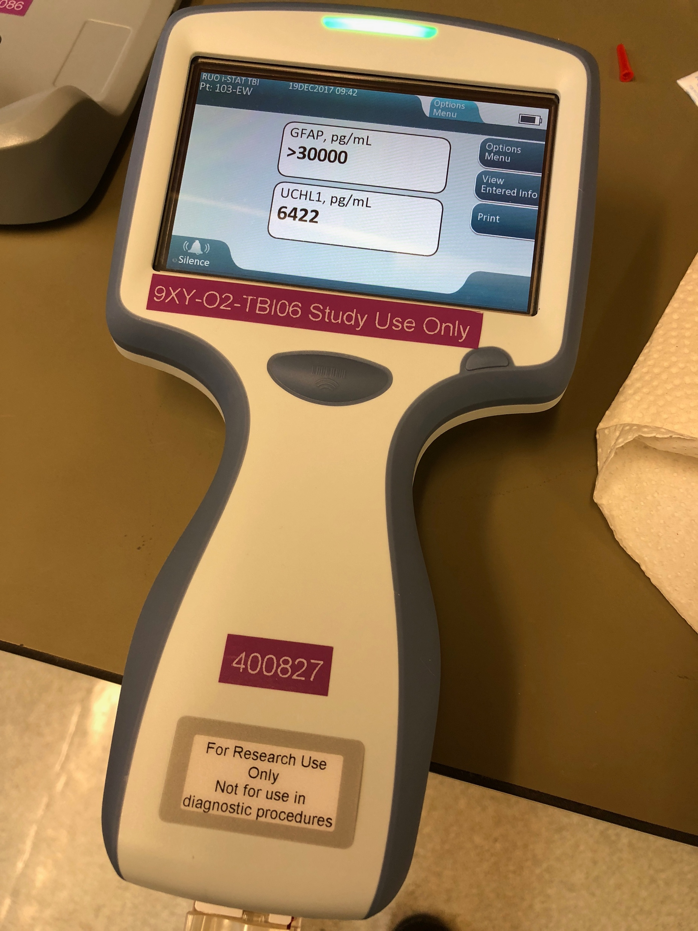
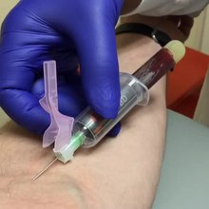
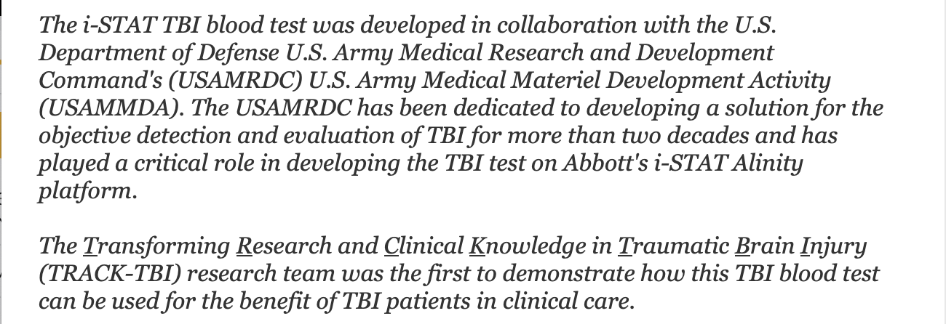
Plasma test
Results <15min

Slide 6
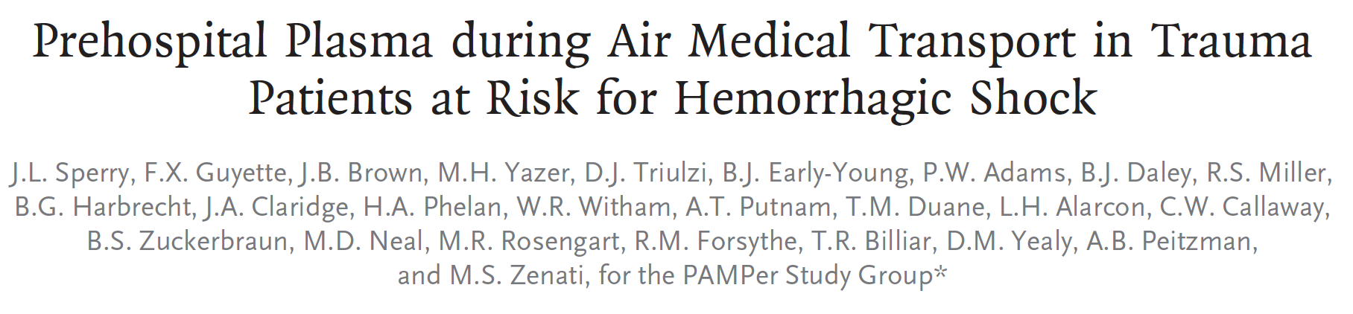
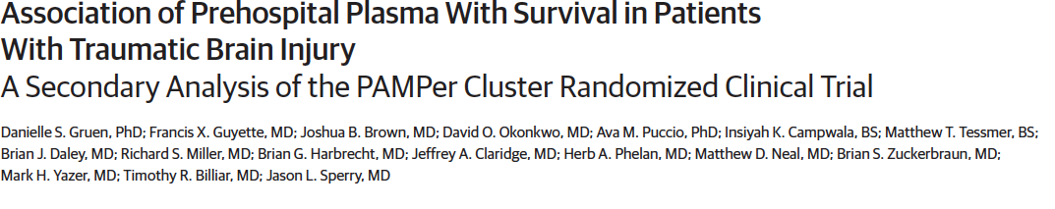
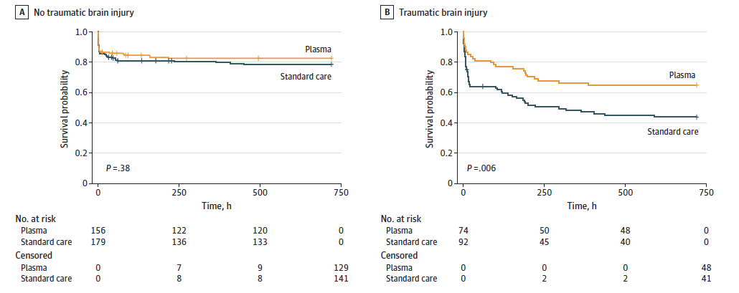


PAMPER Trial

Slide 7
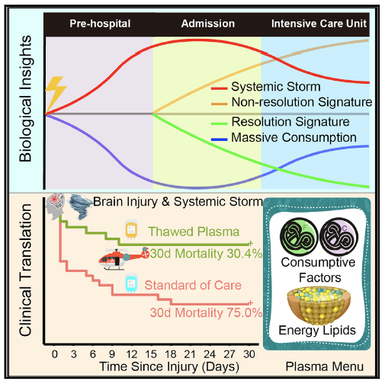

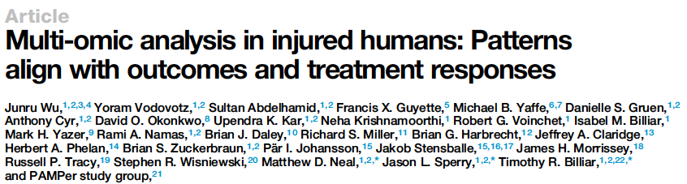

Paradigm shifts in Trauma Care
Multi-omics analysis of patients in the DOD-funded PAMPER trial identified an endotype of TBI patients with a 45% absolute reduction in mortality with plasma resuscitation.

Slide 8
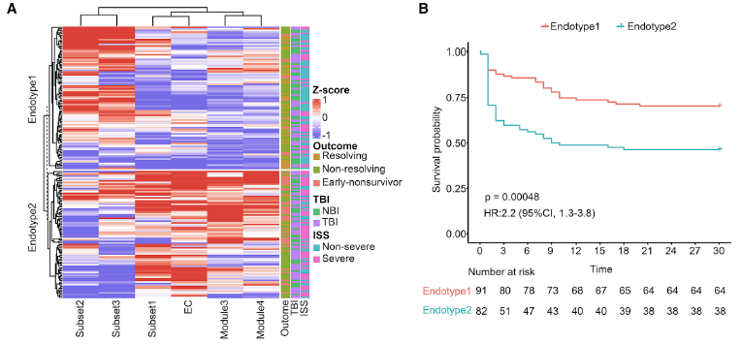
30-d mortality-related signatures (endotypes)
A ‘‘systemic storm’’ pattern with release of 1,061 markers, together with a pattern suggestive of the ‘‘massive consumption’’ of 892 constitutive circulating markers, is identified in the acute phase post-trauma.

Slide 9
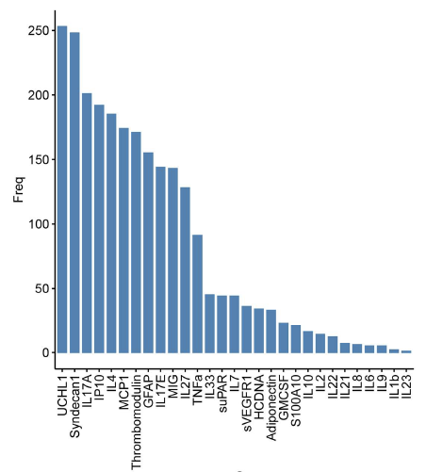
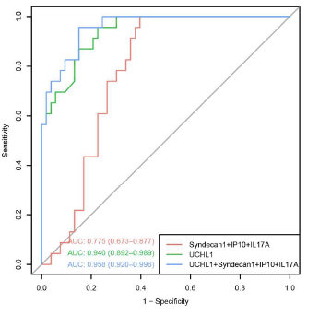
Correlation b/w Multi-omics and Blood Biomakers
Frequency of features selected by machine learning
ROC for predictive models of Endotype-2
Only endotype 2-TBI patients with high UCHL1 levels benefit from early plasma

Slide 10
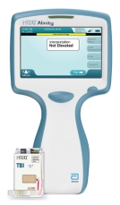
Paradigm shifts in Trauma Care
Multi-omics analysis of patients in the DOD-funded LITES Network PAMPER trial identified an endotype of TBI patients with a 45% absolute reduction in mortality with plasma resuscitation.
=consider FFP resuscitation in polytrauma+TBI patients with elevated UCH-L1

Slide 11
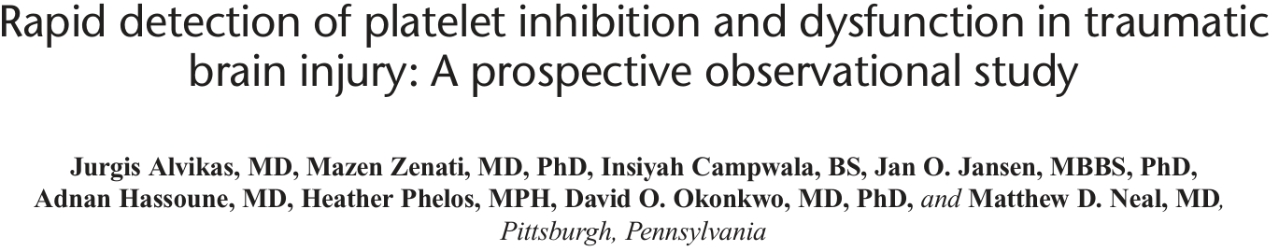
Unanswered questions in TBI re: platelets
Do platelets decrease ICH in TBI? (Do antiplatelet meds increase ICH?)
Do they improve outcomes? (Do antiplatelet meds worsen outcomes?)
Can we improve on present treatment strategies?
resuscitation and reversal
Does monitoring platelet function in TBI matter?

Slide 12
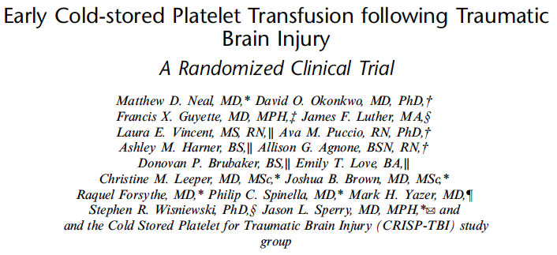
Inclusion:
Adult (>17y), non penetrating TBI (CT confirmed)
determined to require platelet transfusion
Exclusion:
systolic blood pressure < 90 mmHg
OR for non-neurosurgical intervention in the first 60 minutes
therapeutic anticoagulation
platelet transfusion contraindication
Cold Stored Platelet for TBI (CriSP-TBI) Trial

Slide 13
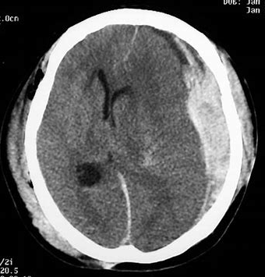
Cold Stored Platelet for Traumatic Brain Injury (CriSP-TBI) Trial
Primary Outcomes: Extended Glascow Outcomes Scale (GOSE)
Secondary Outcomes: Mortality, need for neurosurgical intervention, Rotterdam score (progression of ICH by CT)

Slide 14
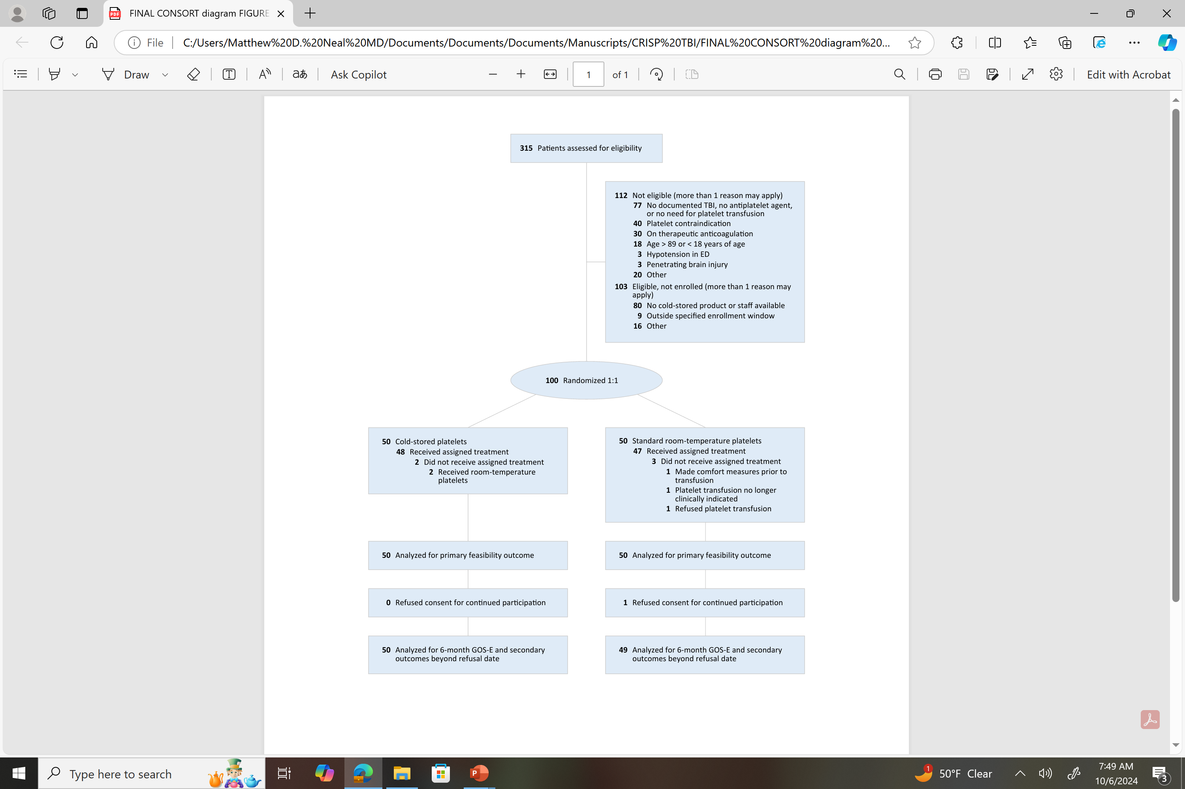

Slide 15
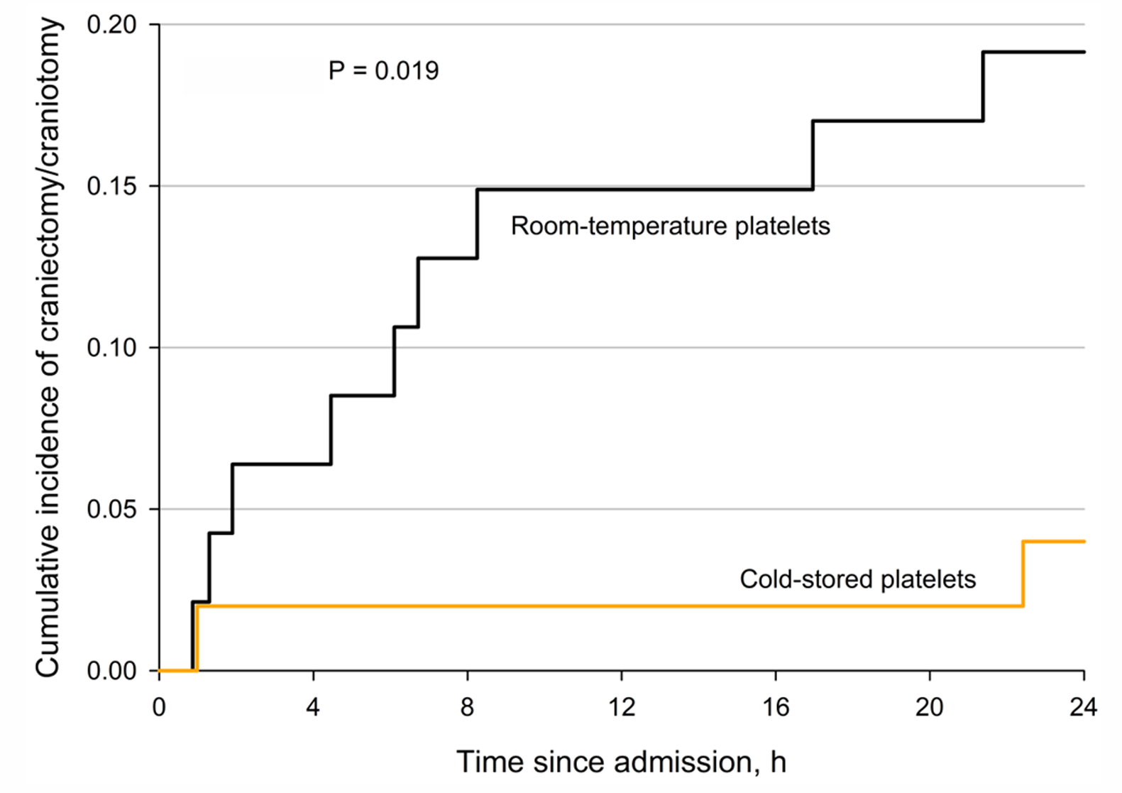
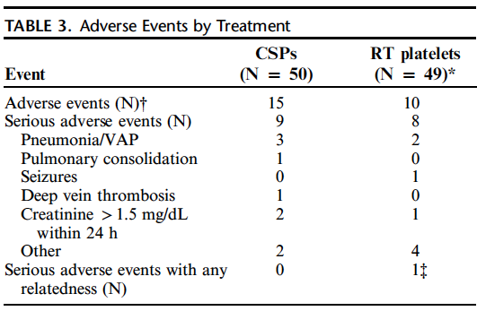
Decreased rate of NSGY intervention in cold stored platelet arm

Slide 16
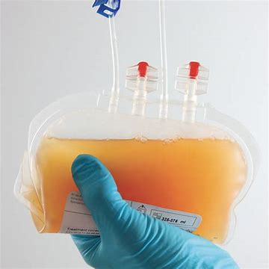

CRISP-TBI Conclusions
Cold stored platelet transfusion for TBI was feasible and safe
No difference in GOSE, low mortality
No statistical difference in TBI progression – but hypothesis generating absolute reduction in CSP group
Decreased need for neurosurgical intervention with CSP
No association of VerifyNow with clinical outcomes
TEG-PM initial value predicts important clinical outcomes (but not response to transfusion)
WE NEED A DEFINITIVE TRIAL OF COLD STORED PLATELETS IN TBI

Slide 17
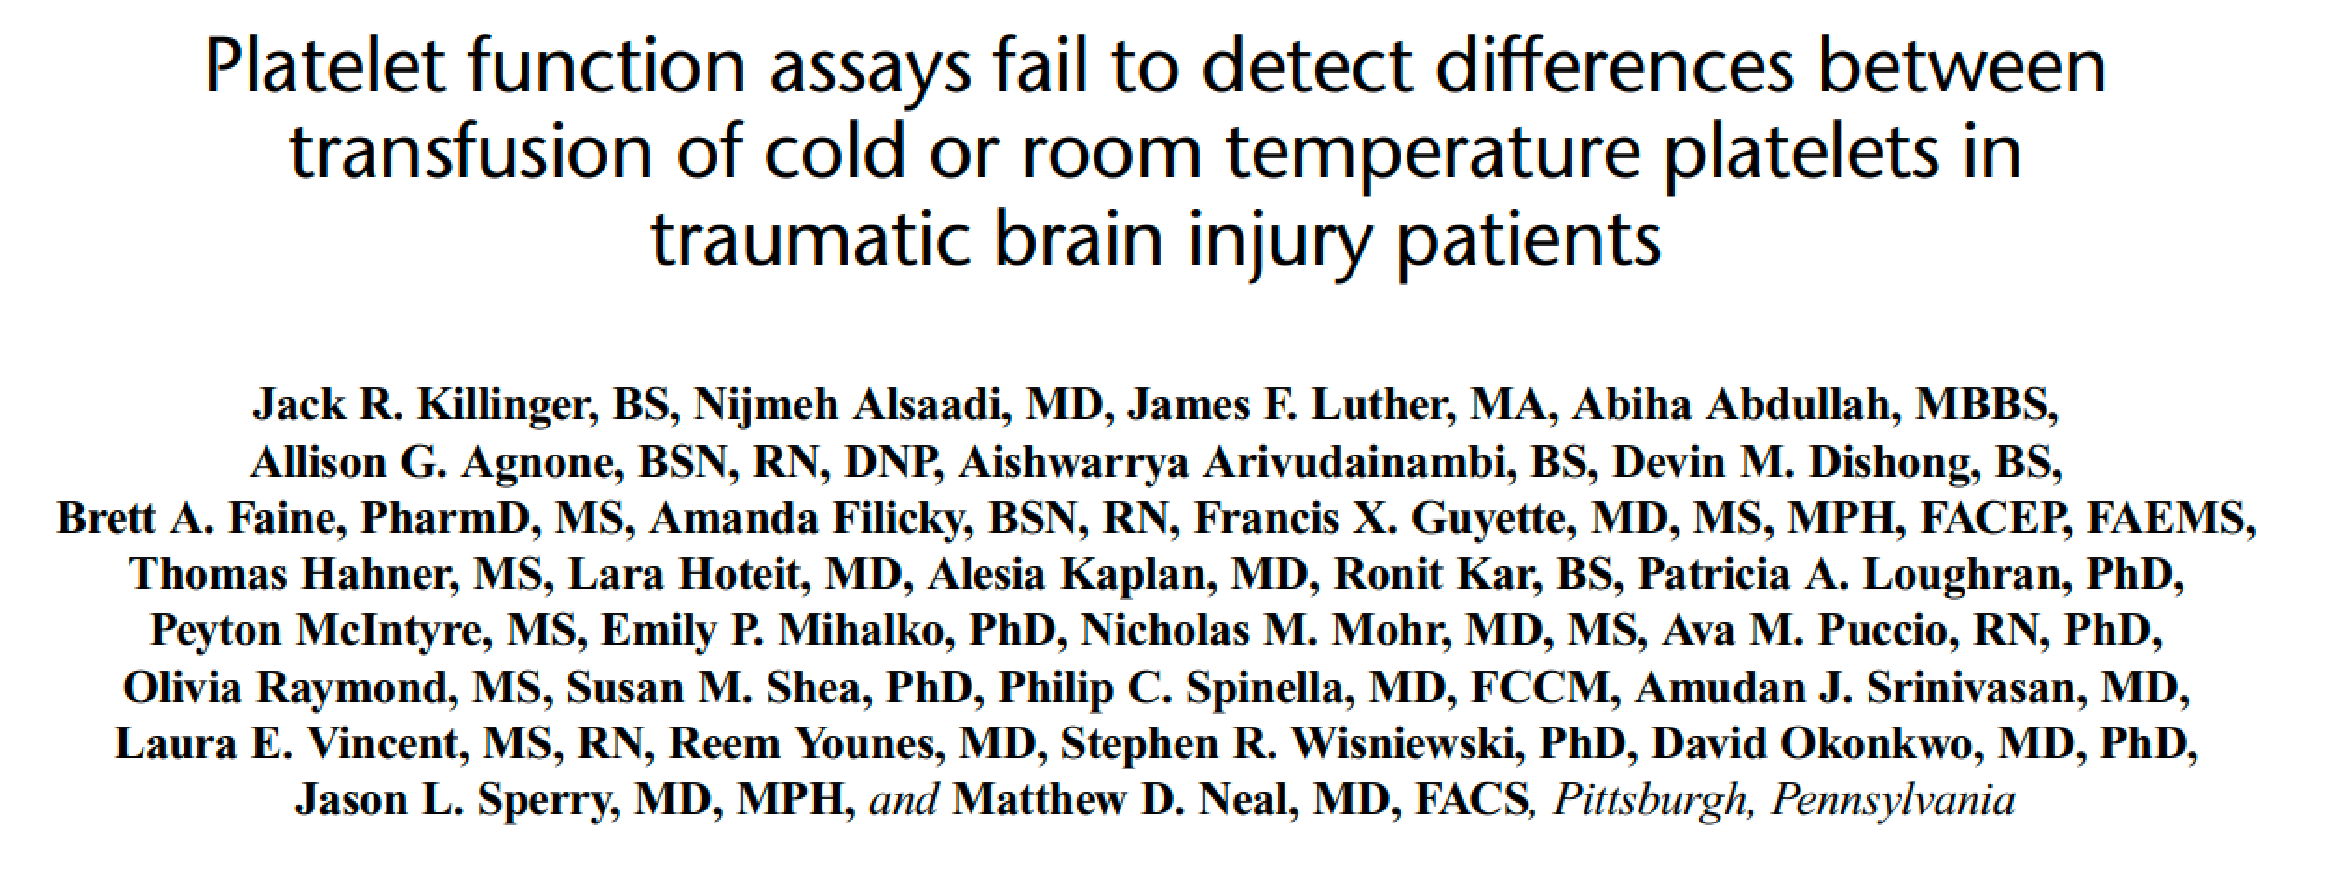
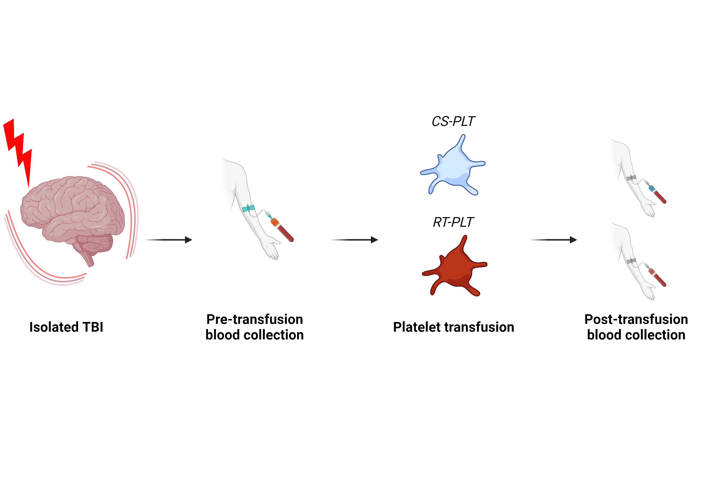

A priori sub-study
Independent of treatment arm

Slide 18
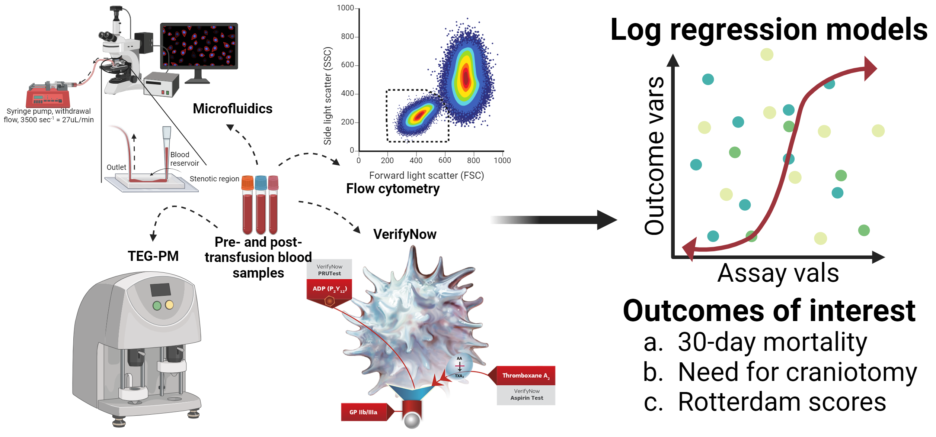
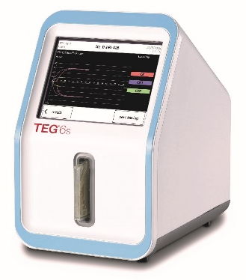
Hypothesis: absolute change in value from pre- to post-transfusion of clinically utilized platelet function assays (PFAs), would predict mortality, need for neurosurgical intervention, and progression of ICH
Notes:
all of our assays and the subsequent sub analysis

Slide 19
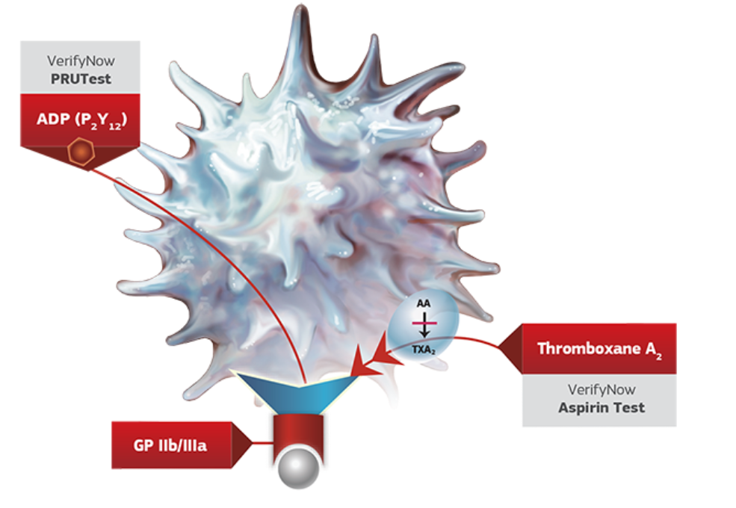
VerifyNow values do not predict clinical outcomes
 | 30-day mortality |  |  | Need for Craniec-/Cranio-tomy |  |  | Initial Rotterdam Score |  |  | Follow-up Rotterdam Score
Assay | OR (95% CI) | P | c | OR (95% CI) | P | c | OR (95% CI) | P | c | OR (95% CI) | P | c
VerifyNow
Pre-transfusion
ASA* | 1.00 (0.99 to 1.01) | 0.95 | 0.457 | 1.00 (1.00 to 1.01) | 0.32 | 0.640 | 1.01 (1.00 to 1.01) | 0.10 | 0.608 | 1.01 (1.00 to 1.01) | 0.040 | 0.632
P2Y12† | 1.01 (1.00 to 1.02) | 0.20 | 0.613 | 0.99 (0.98 to 1.01) | 0.37 | 0.763 | 1.00 (0.99 to 1.01) | 0.65 | 0.550 | 1.00 (0.99 to 1.01) | 0.84 | 0.513
Post-transfusion
ASA* | 0.99 (0.98 to 1.00) | 0.18 | 0.647 | 1.04 (1.00 to 1.08) | 0.08 | 0.838 | 1.00 (1.00 to 1.01) | 0.38 | 0.558 | 1.00 (1.00 to 1.01) | 0.13 | 0.620
P2Y12† | 1.01 (0.99 to 1.02) | 0.45 | 0.635 | 1.01 (0.99 to 1.03) | 0.44 | 0.706 | 1.00 (0.99 to 1.01) | 0.53 | 0.582 | 1.01 (1.00 to 1.02) | 0.27 | 0.654
Delta
ASA* | 0.99 (0.98 to 1.00) | 0.18 | 0.691 | 1.00 (0.99 to 1.01) | 0.53 | 0.606 | 1.00 (0.99 to 1.00) | 0.64 | 0.531 | 1.00 (0.99 to 1.00) | 0.67 | 0.526
P2Y12† | 1.02 (0.99 to 1.05) | 0.17 | 0.679 | 1.04 (0.98 to 1.10) | 0.17 | 0.900 | 1.02 (1.00 to 1.03) | 0.11 | 0.669 | 1.02 (1.00 to 1.04) | 0.042 | 0.711
No association with any value with mortality, need for neurosurgical intervention, or initial Rotterdam score
Moderate association with an increase in the follow up Rotterdam score
Notes:
Verifynow analysis results

Slide 20

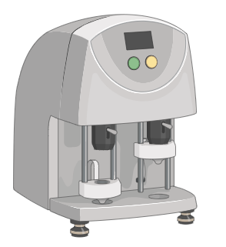
Thromboelastography (TEG6s) with platelet mapping (TEG-PM)
Pre-transfusion
Delta: Post - Pre
Notes:
Teg table is so large it needs broken down, this is explaining that

Slide 21
Pre-transfusion
TEG-PM initial values predict outcomes
 | 30-day mortality |  |  | Need for Craniec-/Cranio-tomy |  |  | Initial Rotterdam Score |  |  | Follow-up Rotterdam Score
Assay | OR (95% CI) | P | c | OR (95% CI) | P | c | OR (95% CI) | P | c | OR (95% CI) | P | c
Thromboelastography
Pre-transfusion
Kaolin MA | 0.92 (0.86 to 0.99) | 0.018 | 0.757 | 0.95 (0.88 to 1.02) | 0.19 | 0.684 | 0.97 (0.92 to 1.03) | 0.32 | 0.572 | 0.96 (0.91 to 1.01) | 0.12 | 0.614
ActF MA | 0.88 (0.79 to 0.98) | 0.018 | 0.707 | 0.89 (0.79 to 0.99) | 0.037 | 0.710 | 0.93 (0.88 to 0.99) | 0.024 | 0.598 | 0.89 (0.83 to 0.95) | <.001 | 0.661
ADP MA | 0.97 (0.94 to 1.01) | 0.11 | 0.652 | 0.97 (0.94 to 1.01) | 0.14 | 0.630 | 0.97 (0.95 to 1.00) | 0.026 | 0.624 | 0.97 (0.95 to 0.99) | 0.013 | 0.640
ADP %Inhibition | 1.01 (0.98 to 1.03) | 0.60 | 0.544 | 1.01 (0.99 to 1.03) | 0.43 | 0.561 | 1.01 (0.99 to 1.02) | 0.25 | 0.566 | 1.01 (0.99 to 1.02) | 0.31 | 0.551
ADP %Aggregation | 0.99 (0.97 to 1.02) | 0.60 | 0.544 | 0.99 (0.97 to 1.01) | 0.43 | 0.561 | 0.99 (0.98 to 1.01) | 0.25 | 0.566 | 0.99 (0.98 to 1.01) | 0.31 | 0.551
AA MA | 0.99 (0.95 to 1.03) | 0.54 | 0.602 | 0.97 (0.93 to 1.02) | 0.28 | 0.691 | 1.00 (0.97 to 1.02) | 0.79 | 0.540 | 0.99 (0.97 to 1.01) | 0.41 | 0.593
AA %Inhibition | 0.99 (0.97 to 1.01) | 0.29 | 0.536 | 0.99 (0.97 to 1.01) | 0.44 | 0.574 | 0.99 (0.97 to 1.00) | 0.12 | 0.629 | 0.99 (0.97 to 1.00) | 0.10 | 0.662
AA %Aggregation | 1.01 (0.99 to 1.03) | 0.29 | 0.536 | 1.01 (0.99 to 1.03) | 0.44 | 0.574 | 1.01 (1.00 to 1.03) | 0.12 | 0.629 | 1.01 (1.00 to 1.03) | 0.10 | 0.663
Abbreviations: N number of observations; OR odds ratio; CI confidence interval; P probability; c concordance statistic. NOTE: no probability values reach statistical significance after a Bonferroni correction of 0.05 /120 = 0.0004.
Increased pre-transfusion Kaolin MA predicted decreased 30-day mortality
Increased pre-transfusion ActF MA predicted decreased mortality, need for neurosurgical intervention, and lower (better) Rotterdam score
Increased ADP MA predicted decreased initial and follow-up Rotterdam scores
Notes:
Pre transfusion teg data

Slide 22
Delta
Change in TEG-PM after transfusion does not predict outcomes
 | 30-day mortality |  |  | Need for Craniec-/Cranio-tomy |  |  | Initial Rotterdam Score |  |  | Follow-up Rotterdam Score
Assay | OR (95% CI) | P | c | OR (95% CI) | P | c | OR (95% CI) | P | c | OR (95% CI) | P | c
Thromboelastography
Delta
Kaolin MA | 0.99 (0.88 to 1.12) | 0.91 | 0.391 | 1.06 (0.96 to 1.18) | 0.24 | 0.735 | 1.05 (0.97 to 1.14) | 0.20 | 0.594 | 1.04 (0.96 to 1.12) | 0.36 | 0.593
ActF MA | 0.92 (0.74 to 1.16) | 0.50 | 0.589 | 1.00 (0.81 to 1.25) | 0.96 | 0.482 | 1.11 (0.97 to 1.27) | 0.14 | 0.571 | 1.10 (0.96 to 1.26) | 0.17 | 0.561
ADP MA | 0.97 (0.90 to 1.03) | 0.32 | 0.552 | 1.01 (0.95 to 1.07) | 0.84 | 0.499 | 1.04 (1.00 to 1.08) | 0.06 | 0.607 | 1.03 (0.99 to 1.07) | 0.13 | 0.593
ADP %Inhibition | 1.00 (0.96 to 1.04) | 0.88 | 0.559 | 0.99 (0.96 to 1.03) | 0.69 | 0.570 | 0.98 (0.96 to 1.00) | 0.06 | 0.603 | 0.98 (0.96 to 1.00) | 0.10 | 0.592
ADP %Aggregation | 1.00 (0.97 to 1.04) | 0.88 | 0.559 | 1.01 (0.97 to 1.04) | 0.69 | 0.570 | 1.02 (1.00 to 1.05) | 0.06 | 0.603 | 1.02 (1.00 to 1.04) | 0.10 | 0.592
AA MA | 0.97 (0.93 to 1.02) | 0.25 | 0.585 | 1.00 (0.95 to 1.04) | 0.85 | 0.521 | 1.00 (0.97 to 1.03) | 0.97 | 0.489 | 1.00 (0.97 to 1.03) | 0.95 | 0.504
AA %Inhibition | 1.00 (0.97 to 1.03) | 0.86 | 0.536 | 1.01 (0.98 to 1.05) | 0.42 | 0.595 | 1.00 (0.99 to 1.02) | 0.98 | 0.507 | 1.00 (0.99 to 1.02) | 0.92 | 0.483
AA %Aggregation | 1.00 (0.97 to 1.03) | 0.86 | 0.536 | 0.99 (0.96 to 1.02) | 0.42 | 0.595 | 1.00 (0.98 to 1.01) | 0.98 | 0.524 | 1.00 (0.98 to 1.01) | 0.92 | 0.483
Abbreviations: N number of observations; OR odds ratio; CI confidence interval; P probability; c concordance statistic. NOTE: no probability values reach statistical significance after a Bonferroni correction of 0.05 /120 = 0.0004.
The “delta” in any TEG-PM measurements following a transfusion were not predictive over any clinical outcomes
Notes:
Delta teg data

Slide 23
Unanswered questions in TBI re: platelets
Do platelets decrease ICH in TBI? (Do antiplatelet meds increase ICH?)
Do they improve outcomes? (Do antiplatelet meds worsen outcomes?)
Can we improve on present treatment strategies?
resuscitation and reversal
Does monitoring platelet function in TBI matter?

Slide 24
State of Affairs in Modern TBI Care
TBI is a leading cause of death and disability
TBI disproportionately affects older populations with pre-existing comorbidities
A significant percentage of this at-risk demographic takes oral antiplatelet agents
Antiplatelet therapies lack a direct reversal agent or antidote
The benefits of platelet transfusion have not been consistently demonstrated
Precision transfusion medicine is a critical need in TBI care

Slide 25

Thank You!

