Slide 1
Double Materiality Assessment
1

Slide 2
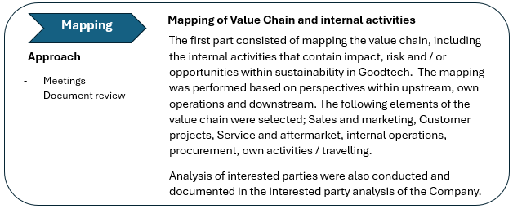
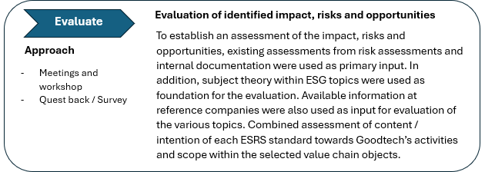
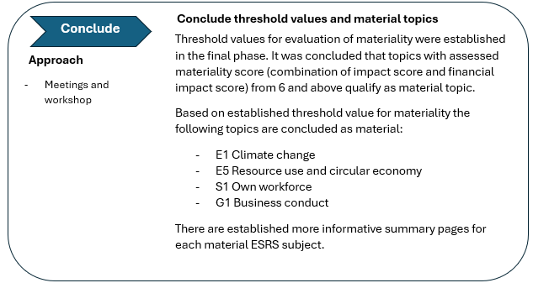
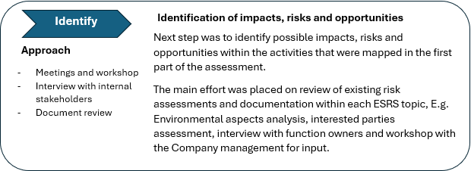
Process approach
Double Materiality Assessment ESG 2024/2025

Slide 3
Double Materiality Assessment ESG 2024/2025
Materiality of ESG topics | illustrated by IRO* matrix
 | Climate / Environment |  |  |  |  | Social |  |  |  | Business Conduct
 | Climate Change | Pollution | Water and marine resources | Biodiversity and ecosystems | Resource use and circular economy | Own workforce | Workers in the value chain | Affected communities | Consumers and end users | Business conduct
Sales and marketing
Customer projects
Service and aftermarket
Internal operations
Procurement
Own activities / travelling
Impact
Risk
Opportunity
The IRO matrix is established based on summarized conclusions of each ESRS topic versus identified value chain.
Scoring of IRO are further defined and visualized in separate ESRS summary pages.
ESRS topic evaluated to be material
*IRO - Impact, Risk and Opportunity
IRO is a framework within CSRD that emphasizes a holistic approach to sustainability reporting. This means that companies must disclose not only their environmental and social impacts, but also the risks and opportunities associated with sustainability topics.

Slide 4
Material topics
Double Materiality Assessment ESG 2024/2025
S1
Topics evaluated as high
E1 Climate change
E5 Resource use and circular economy
S1 Own workforce
G1 Business conduct
Topics evaluated as medium
E2 Pollution
E3 Water and marine resources
S2 Workers in the value chain
Topics evaluated as low
E4 Biodiversity and ecosystems
S3 Affected communities
S4 Consumers and end users
High
G1
E5
S2
E1
Medium
E2
Material impact
S3
E3
E4
Low
Material topics
S4
Climate / Environment
Social
Financial impact
Governance

Slide 5
Material topics - Granulated version with ESRS sub-topics
Double Materiality Assessment ESG 2024/2025
S1-A
Sub-topics evaluated as high
E1 Climate change
E1-A Climate change mitigation
E1-B Energy
E5 Resource use and circular economy
E5-A Waste
S1 Own workforce
S1-a Working conditions
S1-b Equal treatment and opportunities for all
G1 Business conduct
G1-a Corporate culture
G1-c Corruption and bribery
S1-B
High
G1-A
G1-C
E5-A
E1-B
Material impact
Medium
E1-A
Low
Material topics
Climate / Environment
Social
Financial impact
Governance

Slide 6
Double Materiality Assessment ESG 2024/2025
Material ESRS topic
Sources
GRI Material Assessment 2022, Environmental Aspects Analysis, Interested parties' analysis, Governing documentation, Interview Sales
ESRS E1 Climate change
Objective of the ESRS standard
How the undertaking affects climate change, in terms of material positive and negative actual and potential impacts; The undertaking’s past, current, and future mitigation efforts in line with the Paris Agreement (or an updated international agreement on climate change) and compatible with limiting global warming to 1.5°C; The plans and capacity of the undertaking to adapt its strategy and business model, in line with the transition to a sustainable economy and to contribute to limiting global warming to 1.5°C; Any other actions taken by the undertaking, and the result of such actions to prevent, mitigate or remediate actual or potential negative impacts, and to address risks and opportunities; The nature, type and extent of the undertaking’s material risks and opportunities arising from the undertaking’s impacts and dependencies on climate change, and how the undertaking manages them; The financial effects on the undertaking over the short-, medium- and long-term of risks and opportunities arising from the undertaking’s impacts and dependencies on climate change
Qualitative assessment of materiality - IRO
The main part of Goodtech's greenhouse gas emissions are linked to the upstream value chain where emissions occur from the production of goods (process emissions) to direct emissions from fuel for transport. Emissions from own operations are largely linked to direct emissions from the car fleet (scope 1*), as well as business travel in the form of air transport. The company encourages employees to travel to work by public transport as there is a limit on the number of parking spaces. Emissions from energy consumption (electricity and district heating) at the various Goodtech locations, scope 2**, are considered low as this is based on green energy (renewable electricity). Reasonable use of energy is followed up in connection with the use of data storage and processing of data (server use). Impact materiality Negative impact: Actual negative impact through climate impact in the production of products Goodtech purchases, in purchased transport, own transport and travel activities. Technological changes, as a result of global developments related to the topic, can lead to changes in competence requirements, supply and demand. There may be regulatory changes, for example related to the oil and gas industry, which will reduce/restrict our markets either in the form of direct impact or in the form of ripple effects. Both taxes and bans may be applicable, for example an increase in C02 taxes, a ban on the use of various input factors, etc. Positive impact: Increased need for Goodtech's solutions to further develop/revolutionize the industry towards a more climate-friendly approach (for example, efficiency projects, renewal of facilities, production and automation solutions in both existing traditional and new green industries, etc.). The company demands solutions that are in the best interest of the climate and the environment through established guidelines (Code-of-Conduct) for suppliers. Strategic focus on replacing the car fleet from fossil to electric by 2030. The company is well-equipped for digital communication and interaction internally and externally, which reduces the need for travel. Financial materiality: Risk Over time, chronic climate change may affect our customer segment. Weather and climate changes may lead to changes in the need for our services. Goodtech's current operations and approach are not considered to have to adapt to any significant extent due to climate change. Opportunities Increased opportunities within new renewable energy, as well as industries that will experience positive ripple effects from the transition process. Future energy solutions will create opportunities and needs for Goodtech's products and services. The company's solutions contribute to lower energy consumption, with the demands that customers now face, this will provide Goodtech with market opportunities in the future.
Impact | Risk | Opportunities
Medium | Low | High
Where in the value chain is this topic relevant for Goodtech?
Sub-topic | Value chain | I | R | O
Climate change - adaptation |  | Medium | Low | High
Energy |  | Medium | Medium | High
Climate change - mitigation |  | Medium | Low | Medium
Sales
Customer
Internal operations
Travel
Service
Procurement
Sales
Customer
Internal operations
Travel
Service
Procurement
Sales
Customer
Internal operations
Travel
Service
Procurement
Strategic initiatives relevant for the topic
Effect on our Customers Sustainable investments Sustainable operations
* Scope 1: Direct emissions - This means emissions that are related to something the business owns. If the business owns production factories, or cars and machines that run on fossil fuels, these CO2 emissions must therefore be included in the business's Scope 1 emissions.
** Scope 2: Energy consumption - This concerns the business's electricity use and district heating/cooling. Many are surprised that they must calculate CO2 emissions from the use of Norwegian electricity, when we only produce renewable electricity. Although emissions are low for Norwegian hydropower, there are emissions related to construction, maintenance and operation that are distributed to each kWh of electricity used.
*** Scope 3: Indirect emissions - Scope 3 is emissions related to all goods and services that the business purchases and sells. This is a large and complex category that covers all indirect emissions, except for energy use, which is Scope 2.

Slide 7
Double Materiality Assessment ESG 2024/2025
Material ESRS topic
Sources
GRI Material Assessment 2022, Environmental Aspects Analysis, interested parties' analysis, Governing documentation
ESRS E5 Resource use and circular economy
Objective of the ESRS standard
How the undertaking affects resource use, including resource efficiency, avoiding the depletion of resources and the sustainable sourcing and use of renewable resources (referred to in this Standard as “resource use and circular economy”) in terms of material positive and negative actual or potential impacts Any actions taken, and the result of such actions, to prevent or mitigate actual or potential negative impacts arising from resource use, including its measures to help decoupling its economic growth from the use of materials, and to address risks and opportunities the plans and capacity of the undertaking to adapt its strategy and business model in line with circular economy principles including but not limited to minimizing waste, maintaining the value of products, materials and other resources at their highest value and enhancing their efficient use in production and consumption The nature, type and extent of the undertaking’s material risks and opportunities related to the undertaking’s impacts and dependencies, arising from resource use and circular economy, and how the undertaking manages them The financial effects on the undertaking over the short-, medium- and long-term of material risks and opportunities arising from the undertaking’s impacts and dependencies on resource use and circular economy
Qualitative assessment of materiality - IRO
Overconsumption of resources is a major driver of natural risk, and the extraction of metals and minerals has an increasing risk as the “low-hanging fruit” is extracted. Resource use is a challenge both in terms of raw materials used in the production of goods Goodtech supply through customer projects but also related to the use of materials in the packaging associated with these products. In any case, the upside within other sub-themes is considered higher than the downside as Goodtech delivers solutions that serve the industry and society at large by maximizing resource utilization and minimizing resource needs. Impact materiality Negative impact: Waste is the subcategory under ESRS E5 that has the broadest impact on Goodtech’s value chain. The volume of waste generated from own operations is mainly related to consumption (renewal) of IT equipment, waste from the procurement of goods and workshop activities. The largest volume of waste is generated through customer projects in the form of packaging (wood, soft plastic and hard plastic) associated with equipment deliveries. In both our own operations and in customer projects, EE waste and hazardous waste are also generated. Negative ripple effects related to suppliers' waste volume in connection with the production of equipment. Good resource utilization in our supply chain, as well as due diligence and follow-up are important focus areas. Positive impact: RENAS membership that ensures responsible handling of EE waste. Target for sorting rate at locations with workshop / assembly activities. Customer projects that contribute to more efficient resource utilization or reduced resource use / waste generation. Financial materiality Risk: Risk of increased costs related to lack of handling / sorting of waste. Incorrect handling of waste can lead to increased footprint, loss of reputation and customer relationships, in addition to costs related to lack of sorting of waste. The supply chain is mainly geographically located in Scandinavia and Europe where there are good schemes for waste management. Opportunity: In connection with customer projects, Goodtech has opportunities by offering solutions that reduce waste for the customer through efficient raw material processing and society. Increasing the degree of circular economy among waste management companies will provide potential cost savings through increased sorting rates (more fractions to sort waste into).
Impact | Risk | Opportunities
Medium | Medium | Medium
Where in the value chain is this topic relevant for Goodtech?
Sub-topic | Value chain | I | R | O
Waste |  | Medium | High | Medium
Resource inflows, including resource use |  | Medium | Low | Medium
Resource outflows related to products and services |  | Low | Low | Medium
Sales
Customer
Internal operations
Travel
Service
Procurement
Sales
Customer
Internal operations
Travel
Service
Procurement
Sales
Customer
Internal operations
Travel
Service
Procurement
Strategic initiatives relevant for the topic
Sustainable operations Effect on our Customers Effect in the value chain
Even though the overall assessment of the main topic falls below materiality value 6, the isolated assessment of the sub-topic Waste qualifies the topic as material.

Slide 8
Double Materiality Assessment ESG 2024/2025
Material ESRS topic
Sources
GRI Material Assessment 2022, Interview HR, Interested parties' analysis, Corporate risk assessment 2024
ESRS S1 Own workforce
Objective of the ESRS standard
How the undertaking affects its own workforce, in terms of material positive and negative actual or potential impacts Any actions taken, and the result of such actions, to prevent, mitigate or remediate actual or potential negative impacts, and to address risks and opportunities The nature, type and extent of the undertaking’s material risks and opportunities related to its impacts and dependencies on its own workforce, and how the undertaking manages them The financial effects on the undertaking over the short-, medium- and long-term of material risks and opportunities arising from the undertaking’s impacts and dependencies on its own workforce
Qualitative assessment of materiality - IRO
Our employees are our most important resource and everyone at Goodtech should experience that we have a safe working environment, free from harassment, discrimination and other unwanted conditions. Goodtech is highly dependent on its own workforce in the performance of its business activities. The degree of impact is also significant within all subcategories under the topic and is followed up through several different tools, such as Great Place To Work certification, performance appraisals, training programs, etc., to name a few. Employees' working conditions are crucial for Goodtech to be able to succeed with strategic initiatives and further growth. Our highest priority is to protect our employees and others affected by our activities against occupational accidents and personal injuries. A working environment that is both safe and health-promoting will contribute to lower sick leave, lower turnover, fewer injuries and high-quality deliveries. During 2024, the company has invested in HR capacity to ensure a further close follow up and preventive approach. Impact materiality Negative impact: No negative impact identified in Goodtech's value chain, but there is a risk of negative impact on its own employees through lack of follow-up of measures to avoid discrimination and harassment. Positive impact: Potential positive impact on employees through performance reviews, career opportunities, training programs, GPTW surveys and through programs that promote diversity and equality. Financial materiality Risk: Risk of reputational damage if a lack of handling of diversity and equal opportunities is revealed in Goodtech's own operations. This also includes the risk of employees leaving and the associated challenges with new hires and continuity of competence. Serious personal injuries and negative HSE statistics over time will have a negative impact on both the company's reputation for new employees, as well as lost opportunities for new projects and assignments. Opportunity: Goodtech is a competence-driven company that will achieve growth and solidity by preserving and further developing employee competence, as well as by ensuring a responsible and positive working environment based on respect, equal treatment and diversity.
Impact | Risk | Opportunities
High | Medium | Medium
Where in the value chain is this topic relevant for Goodtech?
Sub-topic | Value chain | I | R | O
Working conditions |  | High | Medium | Medium
Equal treatment and opportunities for all |  | High | Medium | Medium
Other work-related rights |  | High | Low | Medium
Sales
Customer
Internal operations
Travel
Service
Procurement
Sales
Customer
Internal operations
Travel
Service
Procurement
Sales
Customer
Internal operations
Travel
Service
Procurement
Strategic initiatives relevant for the topic
Sustainable operations Effect on our Customers

Slide 9
Double Materiality Assessment ESG 2024/2025
Material ESRS topic
Sources
GRI Material Assessment 2022, Corporate risk assessment 2024, Interested parties' analysis, Annual report 2023, Statement Transparency Act 2023 & 2024
ESRS G1 Business conduct
Objective of the ESRS standard
Business ethics and corporate culture, including anti-corruption and anti-bribery, the protection of whistleblowers, and animal welfare The management of relationships with suppliers, including payment practices, especially with regard to late payment to small and medium-sized undertakings Activities and commitments of the undertaking related to exerting its political influence, including its lobbying activities
Qualitative assessment of materiality - IRO
Good business conduct encompasses how Goodtech conducts its business, through good values. Governing documents such as the Code of Conduct provide the foundation for good business conduct and sets requirements for how employees should act in interaction with other internal or external parties. The sub-topic Corruption and Bribery covers the perspective of Goodtech's own employees or among employees in the value chain. Goodtech carries out preventive measures against corruption and bribery in the form of training, courses and through established routines and guidelines within the topic. Goodtech may be exposed to corruption both among its own employees, but also among employees in the value chain, suppliers and other partners. Goodtech operates mainly in the European / Scandinavian market, which has a good score according to the Corruption Perception Index 2024. Impact materiality Negative impact: No negative impact identified in Goodtech's value chain, but there is a risk of negative impact if the current topic is not followed up through training and reporting in the organization. Positive impact: Positive impact through established procedures and guidelines, including the Code of Conduct. An annual review of ethical guidelines for all employees is carried out and must be confirmed. Clear requirements for suppliers through the Supplier Code of Conduct. As the company is also subject to the Norwegian Transparency Act, systematic follow-up and due diligence of suppliers within the topic is ensured through supplier qualification and follow-up. Financial materiality Risk: Risk of significant reputational damage with long-term effects if corruption and bribery are discovered among Goodtech's own employees. There is also a risk of reputational damage if corruption is discovered at companies Goodtech purchases goods from. No specific risk has been identified in 2023 and 2024 as a result of due diligence assessments in accordance with the Norwegian Transparency Act. Opportunities: No opportunities identified
Impact | Risk | Opportunities
High | Medium | Low
Where in the value chain is this topic relevant for Goodtech?
Sub-topic | Value chain | I | R | O
Corporate culture |  | High | Medium | Low
Protection of whistle-blowers |  | High | Low | Low
Management of relationships with suppliers |  | High | Low | Low
Corruption and bribery |  | High | Medium | Low
Sales
Customer
Internal operations
Travel
Service
Procurement
Sales
Customer
Internal operations
Travel
Service
Procurement
Sales
Customer
Internal operations
Travel
Service
Procurement
Sales
Customer
Internal operations
Travel
Service
Procurement
Strategic initiatives relevant for the topic
Sustainable operations Effect in the value chain

Slide 10



Summarized assessment of non-material topics
Double Materiality Assessment ESG 2024/2025
ESRS topic | Sub-topic | Value chain | IRO assessment | Conclusion
E2 Pollution | Pollution of air Pollution of water Pollution of living organisms and food resources Microplastics |  |  | Not material, but being monitored
E3 Water and marine resources | Water Marine resources |  |  | Not material
E4 Biodiversity and ecosystems | Direct impact drivers of biodiversity loss Impacts on the state of species Impacts on the extent and condition of ecosystems Impacts and dependencies on ecosystem services |  |  | Not material
S2 Workers in the value chain | Working conditions Equal treatment and opportunities for all Other work-related rights |  |  | Not material, but being monitored
S3 Affected communities | Communities’ economic, social and cultural rights Communities’ civil and political rights Rights of indigenous peoples |  |  | Not material
S4 Consumers and end- users | Information-related impacts for consumers and/or end-users Personal safety of consumers and/or end-users Social inclusion of consumers and/or end-users |  |  | Not material
Sales
Internal operations
Travel
Service
Procurement
Customer
Sales
Customer
Internal operations
Service
Procurement
Travel
Sales
Customer
Internal operations
Travel
Service
Procurement
Sales
Customer
Internal operations
Travel
Service
Procurement
Sales
Customer
Internal operations
Travel
Service
Procurement
Sales
Customer
Internal operations
Travel
Service
Procurement
Reassessment of both material and non-material topics will be conducted on an annual basis.

