Slide 1
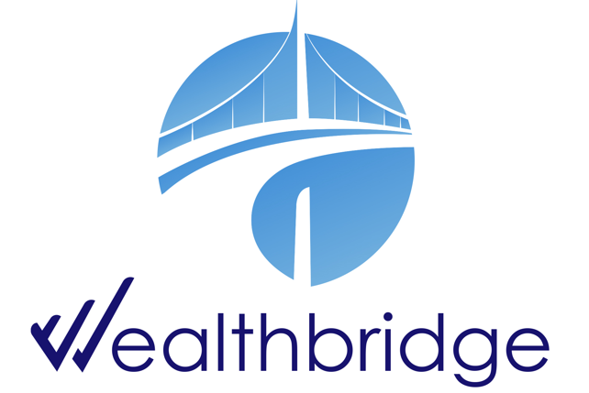
WEEKLY
BRIEF
1st December – 5th December 2025
Wealthbridge Economic Advisory

Slide 2
NEWS HIGHLIGHTS
Key Highlights During the Week
International News
Local News
United States: US manufacturing weakens, services see fastest growth since February; Private payrolls drop by the most since 2023; Inflation steady, consumer sentiment slightly improves
UK & Eurozone: UK housing market resilient despite budget worries; Eurozone inflation picks up, GDP revised higher, labor market still tight; German manufacturing orders rise more than expected.
China: China Manufacturing PMI Hits 4-Month Low; China Stocks Slip Ahead of Key Policy Meetings.
Japan: Japan Composite PMI Confirmed at 3-Month High; Shares Fall on BOJ Rate Hike Fears
South Africa: South Africa Current Account Gap Narrows in Q3; Rand at Near 3-Year High
Ghana: Disinflation in Ghana Remains on Track
Egypt: GDP Growth Hits Over 3-Year High of 5.3%
Nigeria’s GDP rises by 3.98% in Q3 2025, driven by strong agricultural and industrial growth
Nigeria’s public debt rises to N152.39 trillion in Q2 2025
Nigerian equities market reclaim N2.4 trillion after November’s N6.5 trillion crash
CBN revises cash withdrawal rules effective January 2026, ends special authorization
NGX expands market offerings with the introduction of commercial paper listings
FBNQuest vs Nestoil: Appeal Court adjourns receivership case over ‘legal representation controversy’.
BMI: Nigeria’s oil output to rise to 1.73 million bpd in 2026
Key Macroeconomic Indices
NAFEM (₦/$) | Monetary Policy Rate | Brent Crude oil price ($/Barrel) | Inflation Rate | GDP Growth Rate
N1,450.43/$1 (05/12/25) | 27.00% (Nov 2025) | $63.76 (05/12/25) | 16.05% (Nov 2025) | 3.98% (Q3 2025)

Slide 3
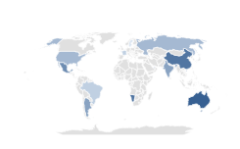

Global Economy
& Markets
The United States
US manufacturing weakens while services see fastest growth; Private payrolls drop by the most since 2023; US inflation steady
The ISM reported that U.S. manufacturing activity contracted for a ninth month in November, with the PMI edging down to 48.2% from 48.7% as weaker deliveries, new orders, and employment weighed on the index. However, service activity firmed, with the PMI rising to 52.6%, the highest in nine months, while the prices index eased to its lowest level since April.
ADP reported that private payrolls fell by 32,000 in November, reversing October’s revised 47,000 gain and marking the biggest drop since March 2023. Cuts were broad-based and led by small firms. Challenger data showed more than 71,000 announced layoffs in November, pushing year-to-date cuts to roughly 1.17 million, the highest since 2020.
The BEA reported that the PCE index rose 0.3% in September, matching August, while core PCE increased 0.2%. Both were up 2.8% year-over-year. Expected inflation in the year ahead decreased to 4.1% from 4.5% in the prior month, the lowest reading since January 2025 and the fourth consecutive month of declines.
What to Expect
Source: Trading Economics, WealthBridge Research
Slowing factory activity and softer job gains signal a mild cooling in the economy, while steady services and easing inflation reduce the risk of a sharper slowdown. A better sentiment may offer support, although overall growth is likely to moderate.
Drivers
Indices’ Performance
Gains were supported by steady PCE data that reinforced expectations of a Fed rate cut next week, along with improving consumer sentiment that boosted confidence in the outlook. Strength in major tech names also helped lift the broader market.
S&P 500 | 6,870.40 | 0.31% ①
Nasdaq Composite | 23,578.13 | 0.91% ①
Dow Jones Industrial average | 47,954.99 | 0.50% ①
US Stocks Extend Gains After PCE
U.S. stocks ended the week higher, supported by steady inflation data and improving sentiment that strengthened expectations for a Fed rate cut next week. Major indexes posted modest gains, led by tech names, as the S&P 500 approached a record and the Nasdaq and Dow also advanced.
Netflix cut most of the early losses incurred after the company announced a deal to acquire Warner Bros.

Slide 4

Global Economy
& Markets
UK & Eurozone
UK housing market resilient despite budget worries; Eurozone inflation picks up, GDP revised higher, labor market still tight; German manufacturing orders rise more than expected
UK housing data showed steady conditions in November, with prices rising 0.3% and outperforming expectations, while Bank of England figures pointed to firm underlying mortgage demand. Approvals slipped slightly to 65,018, suggesting activity remains resilient despite policy uncertainty.
Eurozone inflation in November edged up to 2.2% from 2.1%, slightly above forecasts but still close to the ECB’s target, while core inflation held at 2.4% as lower energy costs offset stronger services prices.
Revised data showed GDP rising 0.3% in Q3, supported by investment and growth in France and Spain, while unemployment stayed at 6.4%. Retail sales were flat on the month but rose 1.5% year over year, beating expectations.
Germany reported a 1.5% rise in factory orders for October, the second monthly increase, with gains driven by strong demand for transport equipment and a sharp rebound in metal production.
What to Expect
Source: Trading Economics, WealthBridge Research
Resilient UK housing and firm mortgage demand suggest stable near-term activity despite policy uncertainty.
Mixed eurozone data point to modest growth, while steady inflation and rising factory orders may keep the ECB on hold for now.
Drivers
Indices’ Performance
European Markets Mixed as Investors Weigh Policy Signals
FTSE 100 | 9,667.05 | -0.55% ②
DAX index | 24,027.48 | 0.80% ①
CAC 40 | 8,130.83 | 0.10% ①
FTSE MIB | 43,430.71 | 0.17% ①
Market moves were driven by fresh eurozone inflation readings, shifting expectations for central bank policy, and mixed economic indicators across major European economies, alongside broader global sentiment.
European markets were mixed for the week as investors weighed inflation data and policy signals. Germany’s DAX rose 0.80%, Italy’s FTSE MIB gained 0.17%, and France’s CAC 40 edged up 0.10%. The UK’s FTSE 100 slipped 0.55%.

Slide 5

Global Economy
& Markets
Asia
China Manufacturing PMI Hits 4-Month Low, China Stocks Slip Ahead of Key Policy Meetings
China’s manufacturing PMI slipped to 49.9 in November, a four-month low and below expectations, signaling a mild pullback in factory activity. Output and new orders were broadly flat, though foreign demand improved. Input costs rose on higher metal prices, while output prices weakened.
Chinese equities slipped as the Shanghai Composite fell 0.2% and the Shenzhen Component dropped 0.6%, with markets pausing after recent gains amid caution ahead of key policy meetings. Investors rotated into lower-valuation sectors, but sentiment stayed muted on tightening liquidity and limited earnings updates. Analysts expect volatility to persist until clearer policy signals emerge.
What to expect
Softer manufacturing data and cautious market tone suggest activity may remain subdued.
Investors may wait for clearer guidance, keeping volatility elevated in the near term.
Shanghai Composite | 3,902.99 | 0.37% ①
Hang Seng Index | 26,083.86 | 0.87% ①
Nikkei 225 index | 50,490.10 | 0.47% ①
Japan Composite PMI Confirmed at 3-Month High; Japanese Shares Fall on BOJ Rate Hike Fears
Japan’s composite PMI held at 52.0 in November, its strongest level since August, signaling continued private-sector expansion. Faster services growth and easing manufacturing weakness supported activity, while employment rose at the quickest pace in five months.
Japanese equities weakened, with the Nikkei down 1.14% and the Topix off 1.05%, as rising expectations of a December BoJ rate hike weighed on sentiment. Reports that key government members would not oppose a move boosted speculation of policy tightening, with markets also pricing in further hikes next year.
Outlook
Japan’s outlook remains supported by steady private-sector momentum, but rising expectations of BoJ tightening and softer global demand may temper growth in the coming months.

Slide 6
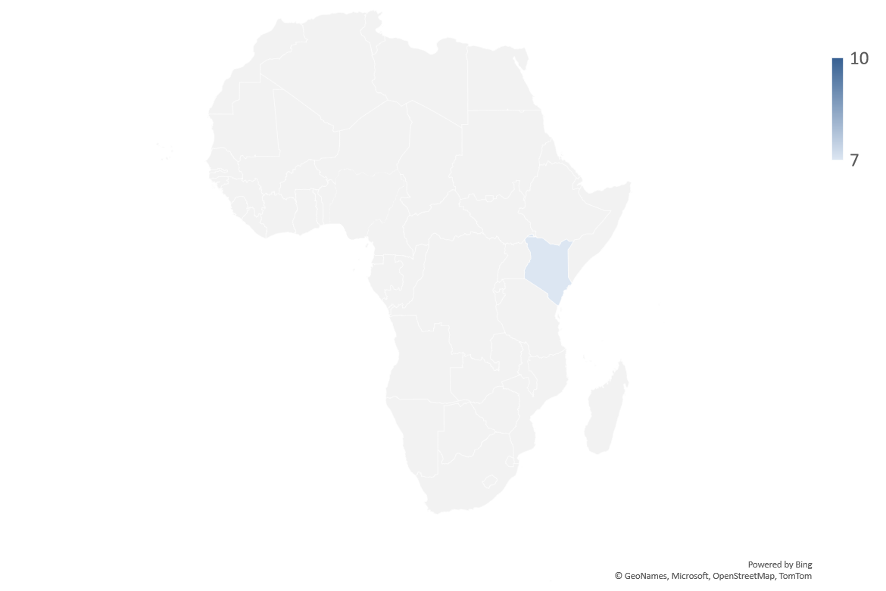



AFRICAN Economy
Current Account Gap Narrows in Q3; Rand at Near 3-Year High
South Africa’s current account deficit narrowed to ZAR 57 billion in Q3, improving from ZAR 72.2 billion in the prior quarter as the primary income shortfall eased and the deficit fell to 0.7% of GDP, below expectations.
A smaller trade surplus and weaker services balance partly offset the improvement, as rising imports, especially crude oil and refined fuels, outpaced export growth.
The South African rand strengthened to around 16.9 per dollar, its firmest level since early 2023, supported by strong demand for the country’s $3.5 billion eurobond issuance, which drew nearly four times the offer and signaled improved investor confidence.
Disinflation in Ghana Remains on Track
Ghana's annual inflation rate decelerated for the 11th month running to 6.3% in November 2025, from 8% in October, largely due to a more favorable exchange rate. Higher cocoa and gold prices have contributed to a stronger cedi this year. Food inflation eased to 6.6% from 9.5% in October, while non-food price growth slowed to 6.1% from 6.9%. On a monthly basis, the CPI increased by 0.9% in November, after a 0.4% fall in the prior month.
GDP Growth Hits Over 3-Year High of 5.3%
Egypt’s economy expanded 5.3% in Q1 FY 2025/26, its fastest pace in over three years and well above last year’s 3.5%, driven by stronger non-oil manufacturing, tourism, and telecommunications.
Non-oil sectors such as ICT and financial services also posted solid growth, though extraction output fell 5.3% amid weaker petroleum and gas production.

Slide 7

Domestic Economy and Markets Highlights
Snapshot of Key Macroeconomic Indicators
Indicators | Current | Previous
Inflation rate | 16.05% (Nov 2025) | 18.02% (Sep 2025) | ② 197 bps
MPR | 27.00% (Nov 2025) | 27.00% (Nov 2025) | 0 bps
Quarterly GDP Growth Rate | 3.98% (Q3 2025 y/y) | 4.23% (Q2 2025 y/y) | ② 591bps
Yearly GDP Growth Rate | 3.38% (FY 2024; y/y) | 3.04% (FY 2023; y/y) | ❐ 34 bps
GDP (Nominal) | N113.59 Trn (Q3 2025) | N100.73 Trn (Q2 2025) | ❐ 12.77%
Brent Crude oil price | $63.76 (05/12/25) | $62.87 (28/11/25) | ❐ 1.42%
Exchange rate (NAFEM W-O-W% , N/$) | N1,450.43/$1 (05/12/25) | N1,446.74/$1 (28/11/25) | ② 0.26%
Parallel Market FX Rate (IMTO) (N/$) | N1,471.00/$1 (04/12/25) | N1,470.00/$1 (28/11/25) | ② 0.07%
P2P (N/$) | N1,485.00/$1 (05/12/25) | N1,475.00/$1 (28/11/25) | ② 0.68%
External Reserve | $45.043 billion (04/12/25) | $44.606 billion (27/11/25) | ❐ 0.98%

Slide 8


Domestic Economy and Markets Highlights
Key Monetary/Fiscal News
CBN revises cash withdrawal rules, effective January 2026, and ends special authorization
The Central Bank of Nigeria issued new cash withdrawal rules effective January 2026, discontinuing the special approval that previously allowed individuals and corporates to withdraw N5 million and N10 million monthly.
Under the revised limits, individuals may withdraw up to N500,000 weekly and firms up to N5 million, with higher amounts attracting excess-withdrawal fees. ATM withdrawals are capped at N100,000 daily and N500,000 weekly, while all denominations can now be loaded in ATMs.
The CBN said the changes aim to cut cash-handling costs, strengthen security, and reduce money-laundering risks, with banks required to file monthly reports on withdrawals and deposits above the limits.
Nigeria’s public debt rises to N152.39 trillion in Q2 2025
Nigeria’s total public debt rose to N152.39 trillion in Q2 2025, up from N149.38 trillion in the previous quarter, reflecting a 2.01% increase driven by higher domestic and external obligations.
External debt stood at N71.84 trillion, while domestic debt reached N80.55 trillion, highlighting continued reliance on both markets to finance government needs.

Slide 9

Domestic Economy and Markets Highlights
Key Economic News
Nigeria’s GDP rises by 3.98% in Q3 2025, driven by strong agricultural and industrial growth
Nigeria’s economy expanded by 3.98% in Q3 2025, slightly above the 3.86% recorded a year earlier, with agriculture, industry, and services all posting improvements. Services remained the largest contributor at 53.02% of GDP, while nominal output rose to N113.59 trillion from N96.16 trillion in Q3 2024.
The oil sector recorded modest gains, with average production rising to 1.64 mbpd and real growth at 5.84%, though output slipped quarter-on-quarter. Oil contributed 3.44% to real GDP, marginally above last year but below Q2 levels.
Non-oil activity grew by 3.91%, supported by agriculture, telecoms, real estate, financial institutions, trade, construction, and manufacturing. The non-oil sector accounted for 96.56% of total real GDP, underscoring its continued role in driving economic growth.
Nigeria’s oil output to rise to 1.73 million bpd in 2026
Nigeria’s oil output is projected to edge up to 1.73 million bpd in 2026, slightly above 2025 levels and higher than its OPEC quota, supported by midstream upgrades, debottlenecking, and additional volumes from smaller fields.
BMI warned that delays at the Dangote Refinery could lift fuel import needs and worsen FX pressures, while rising insecurity poses risks to both agricultural and oil production, with potential spillovers to investment and fiscal stability.
External risks also remain elevated, as geopolitical tensions with the U.S. could threaten oil exports and financing access, even as recent NNPC data show mixed trends in crude and gas production heading into year-end.

Slide 10

Domestic Economy and Markets Highlights
Key Economic News
Nigerian equities market reclaim N2.4 trillion after November’s N6.5 trillion crash
Nigerian equities rebounded strongly in the first week of December, recovering N2.44 trillion after November’s steep losses, as renewed investor appetite pushed the All-Share Index up 2.45% to 147,040.08 points.
Trading activity was led by ICT and Financial Services stocks, with turnover rising to 6.62 billion shares worth N113.22 billion. E-Tranzact, Cornerstone Insurance, and Access Holdings dominated volumes, together accounting for over 73% of total market turnover.
Market breadth improved as more equities advanced across key indices, though Oil & Gas and Commodity indices posted slight declines. The overall rebound helped stabilize sentiment heading into December after one of the heaviest monthly sell-offs in NGX history.
FBNQuest vs Nestoil: Appeal Court adjourns receivership case over ‘legal representation controversy.’
The Court of Appeal in Lagos adjourned the high-profile receivership dispute involving FBNQuest Merchant Bank, First Trustees, Nestoil, and Neconde Energy to January 15, 2026, after a conflict arose over the authorised legal representation for the respondents.
The adjournment follows an earlier ex parte order that temporarily barred Nestoil and Neconde from interfering with a court-appointed receiver over an alleged $1.01 billion debt, with multiple senior counsels now contesting representation and filing applications on change of counsel.
The case, one of Nigeria’s largest commercial disputes involving liabilities exceeding N1 trillion, carries major implications for future debt-recovery and enforcement actions between financial institutions and large corporates.

Slide 11







Domestic Markets
Equities Market
The Nigerian Equities Market Ended The Week Bullish
Sectoral Performances
Market Capitalisation: N93.722 trn (① 2.67% W-o-W)
All Share Index: 147,040.08 (① 2.45% W-o-W)
Year-to-Date 42.86% (① 867 bps W-o-W)
Total Turnover (Trades): 6.617 bn (① 59.83% W-o-W)
Value of Trades: N113.224bn (② 2.30% W-o-W)
Fixed Income Market
Bond Market
The FGN bonds market began the session on a bearish note, pressured by sentiment from Thursday’s NTB auction. Selling pushed the 2032 bond yield toward 16.75%, while the average benchmark yield rose by 3 basis points day-on-day to 15.52%.
Top Gainers & Decliners
NTB and Money Markets
The Treasury Bills market was active following Thursday’s auction, with trades on the newly issued 364-day bill and the November 19 paper executed at around 16.85%. The DMO also released the Q1 T-bill calendar, which reflected an increased auction size.
System liquidity strengthened significantly, rising to a net surplus of N3.17 trillion, driven by OMO repayments and primary market repayment. The Open Buy Back rate held steady at 22.50%, while the Overnight rate also remained unchanged at 22.75%.

Slide 12



For more info call:
+234 809 999 4372
E-mail address
info@wealthbridge.com.ng
Visit us at:
21, Bourdillon Road, Ikoyi, Lagos
100, Ademola Adetokunbo street, Wuse II, Abuja
Visit our website
www.wealthbridge.com,ng
6

