Slide 1
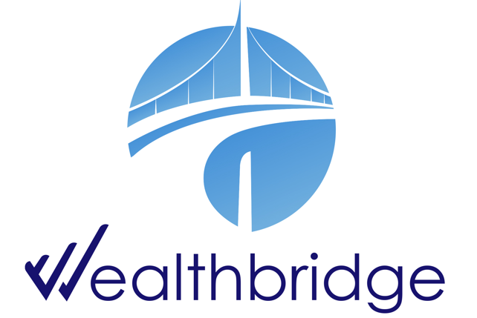
WEEKLY
BRIEF
Week of 11th November – 14th November 2025
Wealthbridge Economic Advisory

Slide 2
NEWS HIGHLIGHTS
Key Highlights During the Week
International News
Local News
United States: December rate cut odds decline amid cautious Fed commentary
UK & Eurozone: UK labor market weakens, economic growth falters; Eurozone Industrial Production Slows
China: China Economy Loses Steam as Housing Market Remains Distressed
Japan: Investors Lean Toward January Rate Cut as Japan Inflation Accelerates
South Africa: S&P upgrades South Africa for first time in nearly 20 years as reforms gain traction
Ghana: Ghana scraps tax on minerals exploration to boost investment
Senate okays Tinubu’s ₦1.15trn domestic loan to cover 2025 budget shortfall
Nigeria’s economic activities expand for 11 consecutive months
FG suspends 15% import tax on imported petrol
Nigeria likely to review Capital Gains Tax, Edun says
Ellah Lakes Plc launches N235 billion equity raise to accelerate growth and drive expansion
SEC, FMBN unveil sharia-compliant home financing scheme targeting 28 million housing deficit
Key Macroeconomic Indices
NAFEM (₦/$) | Monetary Policy Rate | Brent Crude oil price ($/Barrel) | Inflation Rate | GDP Growth Rate
N1,441.23/$1 (14/11/25) | 27.00% (Sep 2025) | $64.26 (14/11/25) | 18.02% (Sep 2025) | 4.23% (Q2 2025)

Slide 3
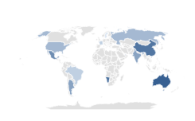

Global Economy
& Markets
The United States
December rate cut odds decline amid cautious Fed commentary
Hawkish commentary from several Federal Reserve policymakers also appeared to weigh on equity markets. Speaking Wednesday, Atlanta Fed President Raphael Bostic stated that he considers “signals from the labor market as ambiguous and difficult to interpret.”
Meanwhile, St. Louis Fed President Alberto Musalem said he believes policymakers “need to proceed and tread with caution,” while Cleveland Fed President Beth Hammack said she believes that monetary policy needs to “remain somewhat restrictive” due to concerns about persistently high inflation.
The probability of a rate cut following the Fed’s December meeting declined to around 46% as of Friday afternoon, down from about 67% the prior Friday and close to 95% a month ago, according to the CME FedWatch tool.
What to Expect
U.S. economy is likely to slow further as companies cut costs and hiring remains weak
Overall, the outlook points to a soft slowdown rather than a full recession, but risks remain if job losses deepen
Source: Trading Economics, WealthBridge Research
Drivers
Indices’ Performance
U.S. Stock Market Closes Mixed as Hyper Growth Stocks Trim Gains
U.S. stocks finished the week mixed, as the Dow Jones Industrial Average and S&P 500 Index posted modest gains while the Nasdaq Composite and small-cap Russell 2000 indexes lost ground.
Stocks were mostly lower as concerns regarding elevated valuations and increased scrutiny around AI spending seemed to help drive a rotation away from many of the growth-oriented stocks that have helped propel indexes to recent all-time highs.
Positive earnings reports fueled the initial rise at the start of the week, but investors feel the stocks were overvalued, such as Palantir.
S&P 500 | 6,734.11 | 0.05% ②
Nasdaq Composite | 22,900.59 | 0.45 % ②
Dow Jones Industrial average | 47,147.48 | 0.34 % ①

Slide 4

Global Economy
& Markets
UK & Eurozone
UK labor market weakens, economic growth falters; Eurozone Industrial Production Slows
In the UK, unemployment in the three months through September increased to 5% for the first time since January 2021. Wage growth also slowed in the third quarter, with the annual growth rate in weekly earnings, excluding bonuses, easing to 4.6% from 4.8% in the prior period.
GDP growth slowed more than forecast to 0.1% in the third quarter—below a consensus estimate of 0.2% forecast. GDP contracted in September by 0.1% sequentially. The slowdown was partly due to a 28.6% decline in car production in September.
Meanwhile, after dropping 1.1% in August, eurozone industrial production in September ticked up 0.2% versus the prior month—well below the 0.9% forecast in a FactSet market survey. Irish output decreased sharply in contrast to above-average increases in Germany, Italy, and France.
What to Expect
U.K. unemployment rates
Source: Trading Economics, WealthBridge Research
The Bank of England may cut rates later this year if economic data continues to slow.
Analysts expect a fall in confidence in the capacity of Germany’s economic policy to tackle the pressing issues.
European markets end lower Friday as investors react to earnings
Indices’ Performance
In local currency terms, the pan-European STOXX Europe 600 Index ended 1.77% higher on relief that the U.S. federal government reopened.
However, cooling sentiment on artificial intelligence curbed the market’s gains. Most major stock indexes rose.
Germany’s DAX tacked on 1.30%, France’s CAC 40 Index advanced 2.77%, and Italy’s FTSE MIB climbed 2.51%. The UK’s FTSE 100 Index was little changed.
Drivers
FTSE 100 | 9,356.81 | 0.02%% ①
DAX index | 23,921.99 | 1.30% ①
CAC 40 | 8,174.20 | 2.77%①
FTSE MIB | 41,758.11 | 2.51% ①
Negative investor sentiment as regards AI-related stocks.
Reopening of the U.S. government boosted sentiment in the European markets.

Slide 5

Global Economy
& Markets
Asia
China Economy Loses Steam as Housing Market Remains Distressed
The latest batch of official indicators showed that China’s economy lost steam as it entered the fourth quarter.
China’s housing market, now in its fourth year of a slump, remained under pressure. New home prices in 70 cities, excluding state-subsidized housing, fell 0.45% in October from September, the steepest decline in a year, while existing home values fell 0.66%, the biggest drop in 13 months.
The ongoing malaise in China’s property market has been a major growth headwind, making consumers reluctant to spend and worsening the deflation that has stalked China’s economy since early 2023.
Fixed asset investment shrank 1.7% in the first 10 months of the year, a record drop for the period, according to China’s statistics bureau.
Source: Trading Economics, WealthBridge Research
What to expect
Shanghai Composite | 3,954.79 | 0.18% ②
Hang Seng Index | 25,906.65 | 1.26.% ①
Nikkei 225 index | 52,411.34 | 0.20% ①
Most economists believe that Beijing’s official growth target of about 5% this year is still manageable, particularly after the U.S. and China struck a one-year trade truce at talks in South Korea last month.
Investors Lean Toward January Rate Cut as Japan Inflation Accelerates
Drivers
The yield on the 10-year Japanese government bond rose to 1.70% from the previous week’s 1.68%. Investors pared back their expectations of the BoJ raising interest rates in December, with many converging around the view that a January rate hike now looks more likely.
BoJ Governor Kazuo Ueda suggested that Japan is progressing in meeting the conditions for raising interest rates. The central bank looks at underlying inflation, which strips away temporary factors, and that is gradually accelerating toward its 2% target.
Inflation in Japan rose to 2.9% in September, the first such rise since May, and about 900 basis points above the BoJ’s target levels.

Slide 6
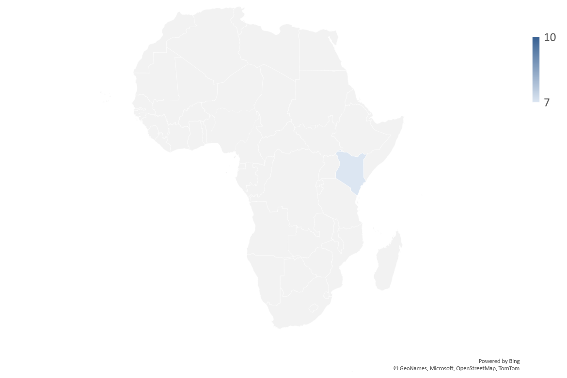


AFRICAN Economy
S&P upgrades South Africa for first time in nearly 20 years as reforms gain traction
South Africa on Friday secured its first credit rating upgrade in nearly 20 years after S&P Global raised the country’s foreign-currency long-term sovereign rating to "BB" from "BB-", citing stronger growth prospects, an improving fiscal outlook and reduced contingent liabilities following better performance at state power utility Eskom.
The National Treasury has worked to arrest rising debt and restore fiscal credibility to put the country back on a growth path.
A recent mid-term budget review showed debt to GDP stabilising at 77.9% this financial year and the budget deficit narrowing to 4.7% of GDP in 2025/26 from 4.8% in the May budget.
S&P said in a statement it expects South Africa's GDP growth to pick up to 1.1% in 2025 after a subdued 0.5% in 2024 and to average 1.5% through 2026-2028 as electricity and other sectors support growth.
Ghana scraps tax on minerals exploration to boost investment
Ghana will abolish value-added tax on mineral exploration and reconnaissance to boost investment in its mining sector, its finance minister said, as Africa’s top bullion producer seeks to reverse over two decades of sluggish new development.
Ghana, which has been overhauling its mining sector, introduced the levy 25 years ago amid broader fiscal reforms.
Industry groups, including the Ghana Chamber of Mines, have long argued that the tax discouraged greenfield investment and eroded Ghana's competitiveness versus the likes of Ivory Coast, Burkina Faso and Kenya, which exempt exploration from VAT.
“Abolishing VAT will revive investor confidence, stimulate greenfield activity, and ensure the long-term sustainability of the country’s mining sector,” Cassiel Ato Forson told parliament during the 2026 budget presentation.

Slide 7

Domestic Economy and Markets Highlights
Snapshot of Key Macroeconomic Indicators
Indicators | Current | Previous
Inflation rate | 18.02% (Sep 2025) | 20.12% (Aug 2025) | ② 210 bps
MPR | 27.00% (Sep 2025) | 27.50% (July 2025) | ② 50 bps
Quarterly GDP Growth Rate | 4.23% (Q2 2025 y/y) | 3.13% (Q1 2025 y/y) | ❐ 110bps
Yearly GDP Growth Rate | 3.38% (FY 2024; y/y) | 3.04% (FY 2023; y/y) | ❐ 34 bps
GDP (Nominal) | N100.73 Trn (Q2 2025) | N94.051Trn (Q1 2025) | ❐ 7.10%
Brent Crude oil price | $64.26 (14/11/25) | $63.72 (7/11/25) | ❐ 0.96%
Exchange rate (NAFEM W-O-W% , N/$) | N1,441.23/$1 (14/11/25) | N1,437.43/$1 (7/11/25) | ❐ 0.26%
Parallel Market FX Rate (IMTO) (N/$) | N1,458.00/$1 (14/11/25) | N1,458.00/$1 (7/11/25) | 0%
P2P (N/$) | N1,467/$1 (14/11/25) | N1,472/$1 (7/11/25) | ② 0.33%
External Reserve | $43.532 billion (14/11/25) | $43.172 billion (7/11/25) | ❐ 0.83%

Slide 8

Domestic Economy and Markets Highlights
Key Fiscal News
Senate okays Tinubu’s ₦1.15trn domestic loan to cover 2025 budget shortfall
The Senate on Wednesday approved President Bola Tinubu’s request to raise ₦1.15 trillion from the domestic debt market to bridge the funding gap in the 2025 budget.
In its report, the committee recommended the Senate’s approval of the additional borrowing to cover the ₦14.10 trillion deficit in the 2025 Appropriation Act, which increased following a review of the budget size.
According to the report, the 2025 budget provides for total spending of ₦59.99 trillion — an increase of ₦5.25 trillion from the ₦54.74 trillion earlier proposed by the executive arm. Out of the total ₦14.10 trillion deficit, ₦12.95 trillion had already been approved for borrowing, leaving an unfunded balance of about ₦1.15 trillion.
Nigeria’s economic activities expand for 11 consecutive months
Nigeria’s economic activities have maintained steady growth for 11 consecutive months, as the composite Purchasing Managers Index for October 2025 stood at 55.4 points, according to the CBN.
The October 2025 PMI figure of 55.4 points represents an increase from 54.0 points recorded in September 2025, signifying a stronger and broad-based expansion in aggregate economic activity. The CBN report highlighted that out of the 36 subsectors surveyed, 25 recorded expansion during the review period, marking the eleventh consecutive month of economic growth.
In the industrial sector, the PMI rose to 54.2 index points in October from 51.4 points in September, reflecting a notable improvement in industrial performance and sustained growth momentum. Further analysis revealed that 9 of the 17 subsectors surveyed within the industry group reported an increase in activity, confirming the sector’s continued recovery and contribution to overall economic expansion.

Slide 9
Domestic Economy and Markets Highlights
Key Economic News
FG suspends 15% import tax on imported petrol
The federal government through the Nigerian Midstream and Downstream Petroleum Regulatory Authority (NMDPRA) has suspended the implementation of the 15 percent ad-valorem import duty on imported Premium Motor Spirit (PMS) and diesel.
President Bola Ahmed Tinubu had approved a 15 percent import policy on PMS and diesel in October 2025. This development stirred widespread concern across the oil and gas sector, with operators warning it could raise petrol prices, worsen inflation, and increase import costs, even as the government insists the policy aims to boost local refining and generate revenue.
The proposal sought the application of a 15 per cent duty on the cost, insurance, and freight value of imported petrol and diesel to align import costs with domestic market realities.
Nigeria likely to review Capital Gains Tax, Edun says
There are talks to review the controversial Capital Gains Tax (CGT) ahead of its implementation next January, according to Wale Edun, Minister of Finance and the coordinating minister of the economy.
Edun said the CGT, a part of a series of tax reform measures by the government, which have generated concerns from investors and brokers alike, would be looked into to allow “optimum results”.
“We have heard what you have said about capital gains tax. We are looking at it. We will listen. We will analyse. We will discuss and we will, at the end of it, decide, and hopefully we will decide what is best for Nigeria,” Edun said at the listing of the MOFI Real Estate Investment Fund on the Nigerian Exchange on Tuesday.

Slide 10


Domestic Economy and Markets Highlights
Key Market News
Ellah Lakes Plc launches N235 billion equity raise to accelerate growth and drive expansion
Ellah Lakes Plc is launching a N235 billion Offer for Subscription by issuing 18.8 billion ordinary shares at N12.50 each to fund strategic acquisitions and upgrade processing facilities. The application list for the Offer opened on Monday, 10 November 2025, and will close on Friday, 5 December 2025.
The capital will be used to integrate newly acquired assets and enhance operational efficiency in palm oil and cassava processing, aiming for immediate financial and operational scale.
“We are inviting investors to capitalise on a clear trajectory of growth, one that is built on over 30,000 hectares of resilient, diversified assets and robust processing capacity. The N235 billion equity expansion represents a capital phase that will transition Ellah Lakes from foundation building to full-scale market expansion”, the Ellah Lakes CEO said.
SEC, FMBN unveil sharia-compliant home financing scheme targeting 28 million housing deficit
The Securities and Exchange Commission (SEC) and the Federal Mortgage Bank of Nigeria (FMBN) have announced a strategic collaboration to develop a comprehensive Non-Interest Mortgage (NIM) scheme with a target to plug 28 million housing deficit.
The initiative, unveiled on Friday at a high-level meeting in Abuja, is designed to provide millions of Nigerians, particularly those excluded from conventional interest-based mortgages, access to homeownership through ethical, Sharia-compliant financing structures.
The models under consideration include: Musharakah (Diminishing Partnership), Ijara (Lease-to-Own), and Murabaha (Cost-Plus Sale) Sukuk instruments.

Slide 11







Domestic Markets
Equities Market
The Nigerian Equities Market Ended The Week Bearish
Sectoral Performances
Market Capitalisation: N156.425 trn ( 64.67% W-o-W)
All Share Index: 147,013.59 (② 1.68% W-o-W)
Year-to-Date 42.83% ( 56 bps W-o-W)
Total Turnover (Trades): 7.325 bn ( 102.41% W-o-W)
Value of Trades: N156.425bn ( 44.96% W-o-W)
Fixed Income Market
Bond Market
The Nigerian secondary bond market concluded the week on a bullish note, driven by sustained investor demand across tenors. The strong demand exerted downward pressure on yields, with the average benchmark yield falling 20 basis points to 15.57%.
Similarly, the Nigerian sovereign Eurobond market extended its positive momentum, with the average yield declining 21 basis points week-on-week to 7.77%. This
reflects renewed investor confidence in Nigeria’s external debt.
Top Gainers & Decliners
32.30%
NTB and Money Markets
Momentum in the secondary Treasury Bills market was solid throughout the week as strong demand filtered across maturities. The newly issued 5-Nov bill led the rally, tightening from 15.70% to around 15.30%. This firm buying interest dragged the
average NTB yield lower by 44bps to 16.98%.
The week’s highlight was the CBN OMO auction, where the CBN sold N2,547.55 bn across the 152-day and 173-day bills. The 152-day tenor cleared at N645.15 bn with a stop rate of 20.59%, while the 173-day tenor saw N2,445.40 bn sold at 20.69%.

Slide 12



For more info call:
+234 809 999 4372
E-mail address
info@wealthbridge.com.ng
Visit us at:
21, Bourdillon Road, Ikoyi, Lagos
100, Ademola Adetokunbo street, Wuse II, Abuja
Visit our website
www.wealthbridge.com,ng
6

