Slide 1
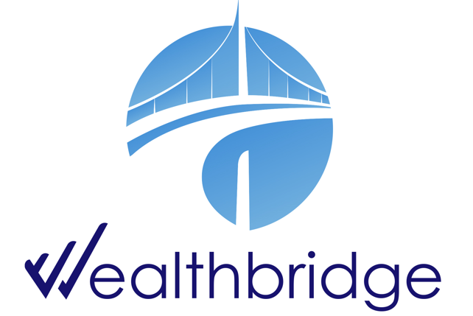
WEEKLY
BRIEF
Week of 6th October – 10th October 2025
Wealthbridge Economic Advisory

Slide 2
NEWS HIGHLIGHTS
Key Highlights During the Week
International News
Local News
United States: Fed minutes signal cautious support for further rate cuts; US Stocks Slide as Trump Threatens New Tariffs on China.
UK & Eurozone: German industry output falls sharply; government unveils economic package; UK housing markets stumble; UK Stocks End in the Red
Asia – China: China intensifies chip import controls; China strengthens rare earth export rules for Tech, Military uses. World Bank raised China’s growth outlook
Japan: Japan 10-Year Yield Near 17-Year High Amid Political Uncertainty.
Africa – South Africa: South Africa factory output shrinks for 2nd Month; South African Rand eases slightly from 1-year high
Kenya: Kenya to resume talks with IMF on new loan program; Kenya Delivers 8th Consecutive Rate Cut
CBN releases new guidelines for instant refund for failed ATM transactions
Naira to close at N1,458.8/$1 by December 2025
Nigeria’s Public Debt Breakdown: Who we are owing as of June 2025
Crude oil production falls 3.09% to 1.58m bpd in September – NUPRC
Finance Ministry denies stopping cost-of-collection deductions for FIRS, others
Nigerian banks dominate NGX’s N3.67 trillion equity listings with over N2.1 trillion in 2025
Key Macroeconomic Indices
NAFEM (₦/$) | Monetary Policy Rate | Brent Crude oil price ($/Barrel) | Inflation Rate | GDP Growth Rate
N1,455.35/$1 (10/10/25) | 27.00% (Sep 2025) | $62.73 (10/10/25) | 20.12% (Sep 2025) | 4.23% (Q2 2025)

Slide 3
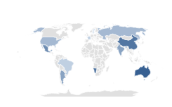

Global Economy
& Markets
The United States
Fed Minutes Signal Cautious Support for Further Rate Cuts; US Consumer Sentiment Little Changed in October
With no major data releases due to the U.S. government shutdown, investors focused on the Fed’s September meeting minutes. Policymakers highlighted persistent inflation and a weakening labour market, noting rising risks on both fronts. Most officials signalled support for further easing this year, while some favoured a cautious approach, arguing policy may not be overly restrictive.
The University of Michigan consumer sentiment for the US came in at 55 in October 2025, compared to 55.1 in September and forecasts of 54.2, preliminary estimates showed. Consumer sentiment was virtually unchanged from September, as improvements in current personal finances and year-ahead business conditions were offset by declines in expectations for future personal finances as well as current buying conditions for durables..
What to Expect
Rising inflation risks, a weak labor market, and safe-haven demand may strengthen expectations for a Fed rate cut later this year to support the economy.
United States Michigan Consumer Sentiment
Source: University of Michigan
US Stocks Slide as Trump Threatens New Tariffs on China
Drivers
Indices’ Performance
US stocks slid on Friday, erasing early gains after President Trump threatened a “massive increase in tariffs” on Chinese imports, sparking renewed trade war fears. The S&P 500 fell 1.7%, the Dow Jones dropped over 500 points, and the Nasdaq slid 2.5% as tech led broad market losses.
U.S. Treasuries generated positive returns as yields decreased sharply in response to reescalating U.S.-China trade tensions late in the week. (Bond prices and yields move in opposite directions.) Government shutdown risks also appeared to contribute to safe-haven demand for Treasuries during the week.
The main drivers behind the stock market were renewed U.S.-China trade tensions, sharp declines in tech stocks, and investor rotation into defensive sectors.
S&P 500 | 6,552.51 | (2.43)% ②
Nasdaq Composite | 22,204.43 | (2.53)% ②
Dow Jones Industrial average | 46,758.28 | (2.73)% ②

Slide 4

Global Economy
& Markets
UK & Eurozone
German industry output falls sharply; government unveils economic package; UK housing markets stumble
In Germany, industrial output fell 4.3% in August, much worse than expected, as front-loading effects ahead of U.S. tariffs faded. A steep drop in auto production led the decline, with other manufacturing sectors also weakening.
Exports slipped 0.5% month over month, including a 2.5% drop to the U.S., and plunged 20.1% year over year. The government announced cost-cutting measures and incentives to support the auto industry.
In the UK, housing market activity slowed in September as the Halifax house price index unexpectedly fell 0.3% after a 0.2% rise in August, defying expectations of another increase.
RICS data showed buyer demand and agreed sales remained negative for a third month, while the house price balance improved slightly to -15 from -18 in August.
What to expect:
With weak German output and a soft UK housing market, the ECB and BOE are expected to stay cautious and keep rates steady to support growth.
Inflation Rate (October 2024 – September 2025)
Source: Trading Economics , WealthBridge Research
UK Stocks End in the Red; European Stocks Stumble into the Weekend
Indices’ Performance
The Eurozone’s STOXX 50 and STOXX 600 fell around 1% on Friday, weighed down by defense and mining stocks.
The FTSE 100 fell 0.9% on Friday to 9,427, dragged down by miners and industrials as renewed U.S.-China trade tensions weighed on sentiment.
Drivers
European stocks ended lower, driven mainly by renewed U.S.-China trade tensions, a sharp drop in oil prices, and weakness in defense and mining stocks.
Sentiment was further dampened by easing geopolitical risks in the Middle East, which weighed on defense shares.
FTSE 100 | 9,427.66 | (0.67)% ②
DAX index | 23,464.84 | (0.56)% ②
CAC 40 | 7,519.75 | (2.02)% ②
FTSE MIB | 40,442.79 | (2.80)% ②

Slide 5

Global Economy
& Markets
Asia
World Bank Lifts China 2025 Growth, Warns of Slower 2026 Pace; China Strengthens Rare Earth Export
The World Bank raised its 2025 growth forecast for China to 4.8% from 4.0%, citing stronger-than-expected near-term performance. The Bank, however, warned that growth momentum will likely slow in 2026 amid weak consumer and business confidence, soft export orders, and reduced fiscal support.
September data showed factory output and retail sales grew at the slowest pace in nearly a year, underscoring lingering economic weakness..
China tightened rare earth export controls, expanding restrictions on processing technology, overseas cooperation, and exports to defense and semiconductor users.
The move broadens measures first announced in April, underscoring China’s dominance in rare earth supply. The new rules, which cover a wider range of magnet products and recycling equipment, take effect immediately.
China Annual GDP Growth Rate and World Bank Forecast
Source: National Bureau of Statistics of China, World Bank
What to expect
Shanghai Composite | 3,897.00 | 1.80% ①
Hang Seng Index | 26,290.22 | (3.13)% ②
Nikkei 225 index | 45,199.80 | 5.07% ①
China’s tighter controls on rare earths and chips may disrupt supply chains and heighten trade tensions, prompting the U.S. and allies to seek alternative sources.
Japan Wholesale Prices Rise, As 10-Year Yield Near 17-Year High Amid Political Uncertainty
Wholesale prices rose 2.7% year-on-year in September, exceeding forecasts and adding to expectations of further tightening.
Japan’s 10-year bond yield hovered just below 1.7%, near a 17-year high, as political uncertainty grew following Komeito’s split from the LDP, complicating policy plans.
Markets increased bets on a BOJ rate hike on October 30 amid a weaker yen and rising inflation pressures.
The yen depreciated to around JPY 152.8 against the U.S. dollar, from about JPY 147.5 at the end of the previous week.
Drivers
The main drivers were rising inflation pressures, a weaker yen, and heightened political uncertainty, which fueled market expectations of a near-term BOJ rate hike.

Slide 6
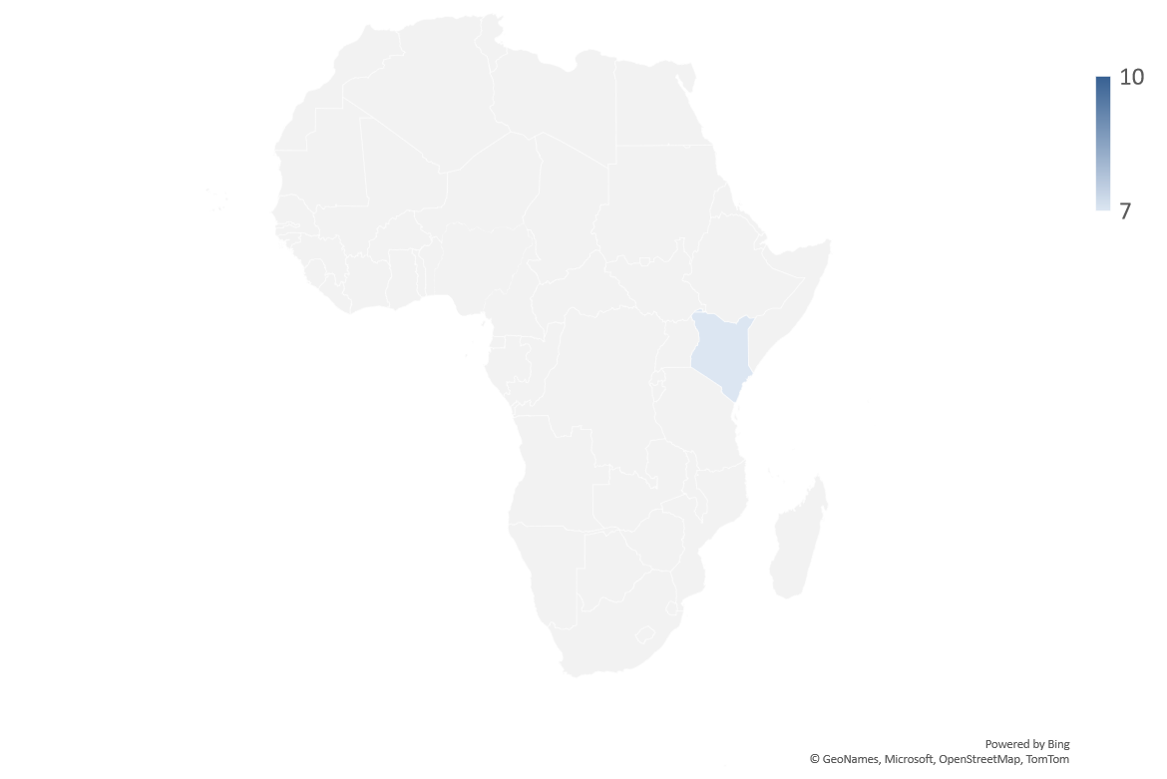


AFRICAN Economy
South Africa Factory Output Shrinks for 2nd Month; South African Rand Eases Slightly from 1-Year High
South Africa’s manufacturing output fell 1.5% year-on-year in August, driven mainly by declines in iron and steel (-5.9%) and food and beverages (-3.0%).
The fall was largely driven by a sharp 5.9% drop in the basic iron and steel, non-ferrous metal products, and machinery division, which shaved 1.3 percentage points off total output, and a 3.0% decline in the food and beverages division, which reduced the index by another 0.7 points.
On a seasonally adjusted monthly basis, output rose 0.4% after a 0.8% drop in July..
The rand weakened slightly to around ZAR 17.3/USD from a one-year peak of ZAR 17.1/USD, as investors took profits following gold’s rally.
Weak industrial output in August added pressure, though fiscal sentiment improved after the Treasury reaffirmed plans to meet 2025 budget targets.
The Finance Minister confirmed plans to lower the inflation target to the bottom of the 3%–6% band, though no timeline was set.
Kenya to Resume Talks with IMF on New Loan Program; Kenya Delivers 8th Consecutive Rate Cut
Kenya will resume talks with the IMF next week in Washington on a new loan programme, following the expiry of its USD 3.6bn facility earlier this year.
A new IMF deal is expected to support Kenya’s external debt repayments and bolster financial stability amid fiscal pressures.
The Central Bank of Kenya cut its policy rate by 25bps to 9.25%, marking the eighth straight cut since April 2024 to boost credit and growth.
The Bank’s Governor noted stable inflation expectations and projected GDP growth of 5.2% in 2025 and 5.5% in 2026.
We expect continued monetary easing to support growth while keeping inflation contained.

Slide 7

Domestic Economy and Markets Highlights
Snapshot of Key Macroeconomic Indicators
Indicators | Current | Previous
Inflation rate | 20.12% (Sep 2025) | 21.88% (July 2025) | ❐ (176 bps)
MPR | 27.00% (Sep 2025) | 27.50% (July 2025) | (50 bps)
Quarterly GDP Growth Rate | 4.23% (Q2 2025; y/y) | 3.13% (Q1 2025; y/y) | ❐ (110bps)
Yearly GDP Growth Rate | 3.38% (FY 2024; y/y) | 3.04% (FY 2023; y/y) | ❐ (34 bps)
GDP (Nominal) | N100.73 Trn (Q2 2025) | N94.051Trn (Q1 2025) | ❐ (7.1%)
Brent Crude oil price | $62.73 (10/10/25) | $64.35 (03/10/25) | ② (2.52%)
Exchange rate (NAFEM W-O-W% , N/$) | N1,455.35/$1 (10/10/25) | N1,465.68/$1 (03/10/25) | ❐ 0.70%
Parallel Market FX Rate (IMTO) P2P (N/$) | N1,485/$1 N1,492/$1 (10/10/25) | N1,555/$1 N1,480/$1 (03/10/25) | ②4.50% 0.81%
External Reserve | $42,576 billion (10/10/25) | $42,407 billion (03/10/25) | ❐ 0.40%
②

Slide 8

Domestic Economy and Markets Highlights
Monetary & Fiscal Policy News
CBN releases new guidelines for instant refund for failed ATM transactions
The Central Bank of Nigeria (CBN) released new draft guidelines requiring banks to give instant refunds for failed ATM transactions.
If instant reversal fails, refunds must be completed within 24 hours for on-us transactions and 48 hours for not-on-us transactions.
ATM operators must automatically initiate refunds without waiting for customer complaints.
Banks must deploy one ATM for every 5,000 cards issued, with full compliance expected by 2028.
ATMs must meet higher security and operational standards, including anti-skimming devices, CCTV, and tactile features for the visually impaired.
Machines must ensure user convenience, such as dispensing cash before card release and providing receipts on request.
CBN will enforce compliance through audits, inspections, and penalties for defaulters..
What to expect
In the early stages, banks and ATM operators may face operational pressure to meet refund timelines and upgrade infrastructure.
Over time, faster refunds could boost customer confidence and trust in the banking system.
Improved service reliability may drive higher usage of electronic payment channels.
Stricter deployment targets and security standards could enhance financial inclusion and reduce fraud.
Increased regulatory oversight may lead to better dispute resolution and accountability.

Slide 9


Domestic Economy and Markets Highlights
Key Economic News
Naira to close at N1,458.8/$1 by December 2025
Standard Bank revised its year-end naira forecast to ₦1,458.8/$1 for 2025, supported by improved FX reserves and rising investor confidence.
Robust banking liquidity, averaging ₦2.8 trillion daily, has helped stabilize the FX market.
CBN’s recent CRR refund and OMO maturities boosted system liquidity without triggering naira depreciation.
Strengthened FX reserves were driven by increased NNPCL dollar remittances and rollover of $3–$3.5bn bilateral transactions.
Corporate and private investors holding excess liquidity are less likely to demand FX, supporting currency stability.
Standard Bank expects further resilience in the naira, though political and fiscal pressures ahead of 2027 elections may pose risks.
Nigeria’s Public Debt Breakdown: Who we are owing as of June 2025
Nigeria’s total public debt reached ₦152.39 trillion ($99.68 billion) as of June 2025, the highest on record in naira terms.
Domestic debt via FGN securities remains the largest component at ₦80.55 trillion (52.8% of total debt).
Eurobonds account for 17.4% of total debt, while World Bank loans make up 19.4%.
China is Nigeria’s biggest bilateral creditor at ₦8.46 trillion ($5.53 billion), funding key infrastructure projects.
President Tinubu has requested approval to raise $2.3 billion in new and refinancing external borrowing to support the 2025 budget.
The World Bank projects Nigeria’s debt-to-GDP ratio will fall below 40% for the first time in a decade, supported by steady growth and fiscal reforms.
Stronger FX reserves (above $42 billion) and a 6.1% current-account surplus signal improving macroeconomic stability.

Slide 10


Domestic Economy and Markets Highlights
Key Economic News
Crude oil production falls 3.09% to 1.58m bpd in September – NUPRC
Nigeria’s crude oil and condensate output fell to 1.58 mbpd in September 2025 from 1.63 mbpd in August, driven by a three-day PENGASSAN strike and scheduled maintenance at key facilities.
The September figure comprised 1.39 mbpd of crude and 0.19 mbpd of condensates.
Output represented 93% of Nigeria’s OPEC quota of 1.5 mbpd, indicating moderate stability despite disruptions.
Peak daily output during the month was 1.81 mbpd, while the lowest was 1.35 mbpd, reflecting production volatility
The dip coincides with OPEC+ signaling a modest production increase for November, which has begun weighing on crude prices. Despite the setback, output was still 1.6% higher year-on-year compared to September 2024.
Finance Ministry denies stopping cost-of-collection deductions for FIRS, others
The Federal Ministry of Finance has debunked claims that the government has stopped revenue agencies from deducting their cost of collection at source.
The Ministry clarified that there has been no policy change affecting agencies like FIRS, NUPRC, and Customs.
It stated that ongoing discussions are focused on reviewing the cost-of-collection structure to boost transparency and efficiency.
Any potential adjustments will follow due process, stakeholder consultations, and formal communication.
The cost-of-collection framework currently allows revenue agencies to retain a portion of collections to fund their operations before remitting to the Federation Account.

Slide 11
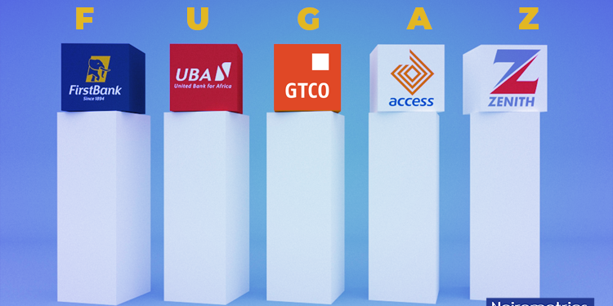
Domestic Economy and Markets Highlights
Market News
Nigerian banks dominate NGX’s N3.67 trillion equity listings with over N2.1 trillion in 2025
Guaranty Trust Holding Company (GTCO) Plc, Access Holdings Plc, Zenith Bank Plc, and UBA Plc led record-breaking supplementary listings on the NGX in the first nine months of 2025, with a combined market value exceeding N2.1 trillion.
Total corporate equity listings on the NGX reached N3.67 trillion, with banking sector listings accounting for over 90% of the total.
GTCO Plc raised N369.58 billion through two major public offers, while Access Holdings Plc and Zenith Bank Plc raised N351.01 billion and N350.46 billion, respectively, through rights issues and public offers.
Other Tier-1 and mid-tier banks also raised significant capital, including First HoldCo (N149.56bn), Wema Bank (N147.80bn), Stanbic IBTC (N148.71bn), UBA (N239.40bn), FCMB (N167.67bn), Fidelity Bank (N175.85bn), and Sterling Financial Holdings (N101.64bn).
The surge in equity issuance reflects the banking sector’s aggressive recapitalisation drive ahead of the CBN’s new regulatory requirements.
Analysts expect stronger capital buffers, improved investor sentiment, and increased market liquidity as large banks consolidate market share.
Lower interest rates could further expand valuation multiples and boost investor inflows into the equity market.

Slide 12







Domestic Markets
Equities Market
The Nigerian Equities Market Ended The Week Bullish
Sectoral Performances
Market Capitalisation: N93.296 Trillion ( 2.37% W-o-W)
All Share Index: 146,988.04 ( 2.37% W-o-W)
Year-to-Date 42.81% ( 838 bps W-o-W)
Total Turnover (Trades): 8.403 bn(0.00% W-o-W)
Value of Trades: N115.501bn (② 99.90% W-o-W)
Fixed Income Market
Bond Market
The Nigerian secondary bond market closed on a bullish note, driven by strong investor demand which led to the average yield falling by 29 basis points to 15.98% for the week. Trading activity was robust across all tenors, reflecting improved market sentiment. Similarly, the Eurobond market closed on a bearish note, with average yields rising by 17 basis points to 8.06% on the back of sustained selloffs.
Top Gainers & Decliners*
NTB and Money Markets
System liquidity opened strong at N5.12 trillion, supported by N480.66 billion in OMO and T-bills maturities, before easing to N3.39 trillion as liquidity management measures kicked in. Banks channelled surplus funds into the CBN’s SDF window. Interbank rates held broadly stable at 24.50% and 24.9% for OBB and Overnight rate, respectively.
In the T-bills market, sentiment was bullish, as renewed demand pushed average yields down 55bps to 17.40%, reflecting strong liquidity-driven appetite.
At the OMO auction, demand surged to ₦4.4 trillion against a ₦600 billion offer, with ₦3.0 trillion allotted at stop rates of 19.45% and 19.49%, signalling cautious tightening. Similarly, the NTB auction drew ₦1.06 trillion in bids, with most interest at the 364-day tenor, which cleared at 15.77%, underscoring investors’ preference for short-term, high-yield assets.
Week-on-week, the average benchmark yield declined by 64bps to close at 17.32%.

Slide 13



For more info call:
+234 809 999 4372
E-mail address
info@wealthbridge.com.ng
Visit us at:
21, Bourdillon Road, Ikoyi, Lagos
100, Ademola Adetokunbo street, Wuse II, Abuja
Visit our website
www.wealthbridge.com,ng
6

