Slide 1
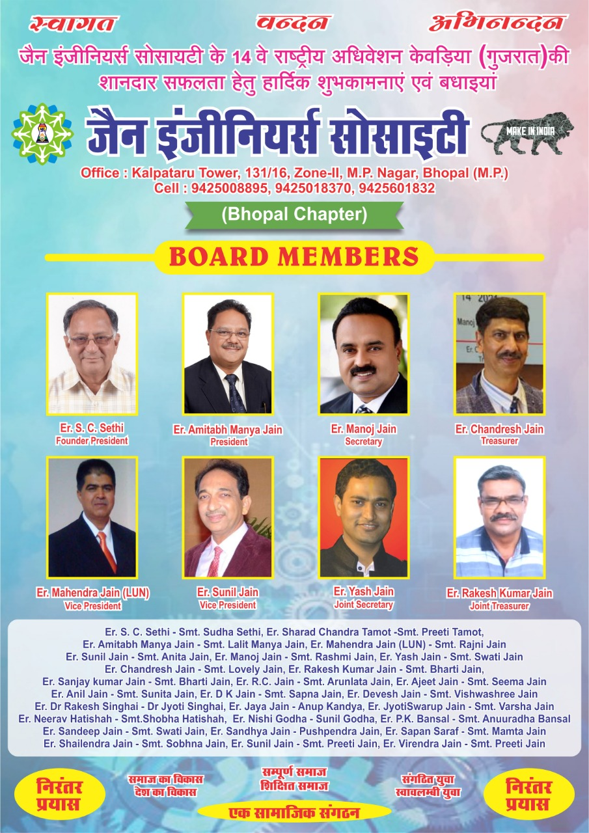

Slide 2



Slide 3

Permanent Project

Slide 4
BHOPAL JES CHAPTER
EXECUTIVE BOARD MEMBER

Slide 5

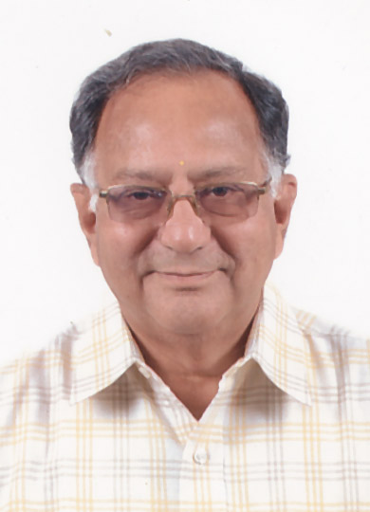
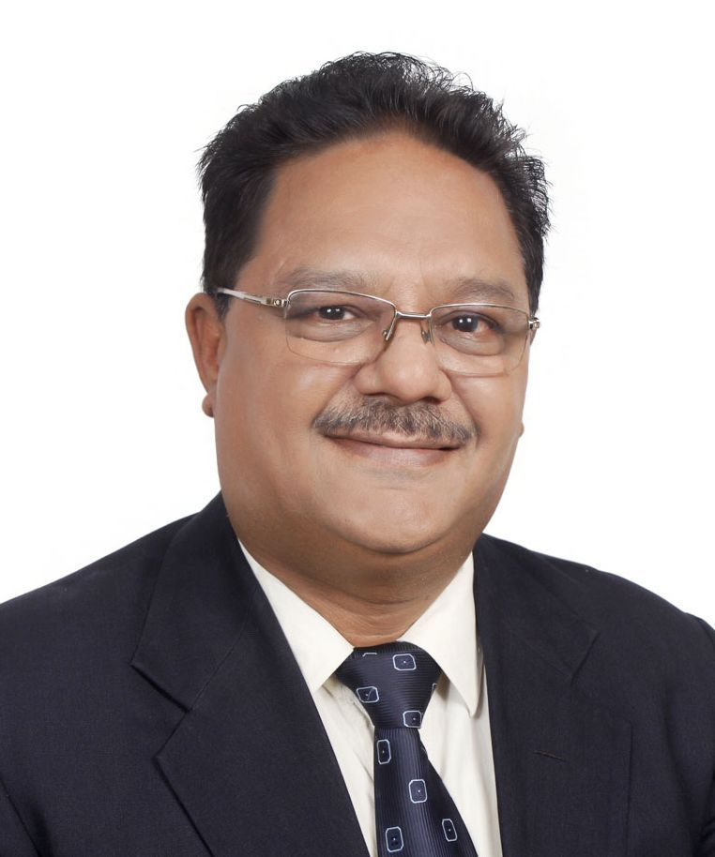
BHOPAL JES CHAPTER
EXECUTIVE BOARD MEMBER
Founder President
Er. S. C. Sethi
PRESIDENT
Er. Amitabh Manya_Jain

Slide 6
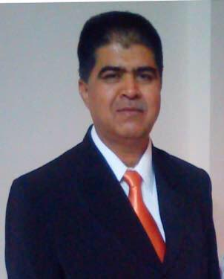
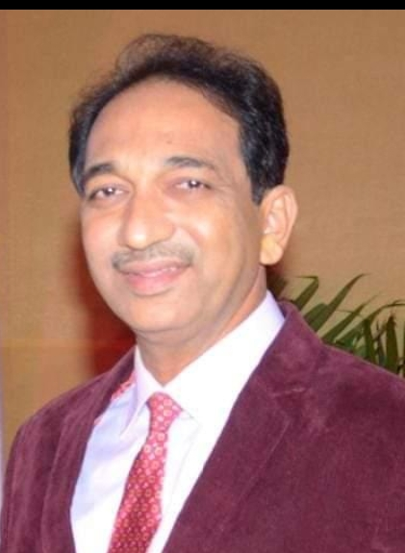
BHOPAL JES CHAPTER
EXECUTIVE BOARD MEMBER
VICE PRESIDENT
Er. Mahendra Jain (LUN)
VICE PRESIDENT
Er. Sunil Jain

Slide 7

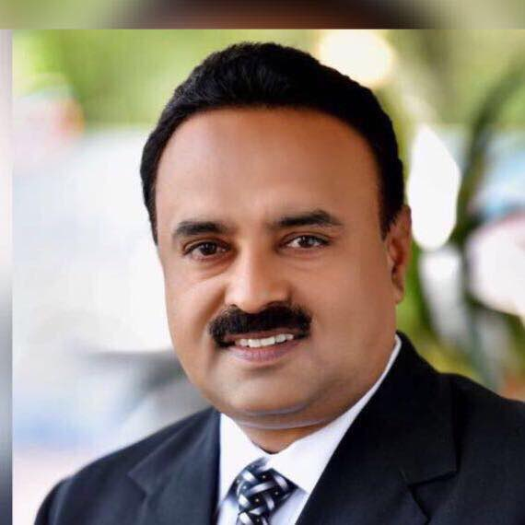
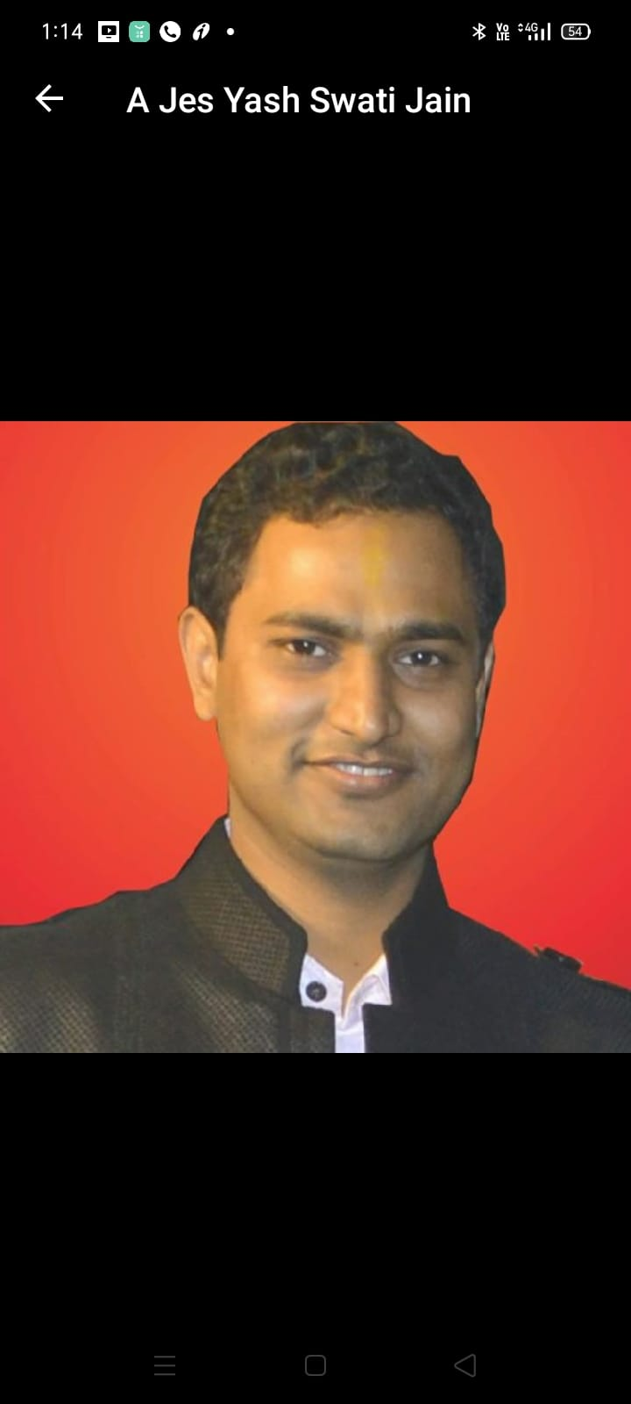
BHOPAL JES CHAPTER
EXECUTIVE BOARD MEMBER
SECRETARY
Er. Manoj Jain
(EMKAY BHARAT)
JOINT SECRETARY
Er. Yash Jain

Slide 8
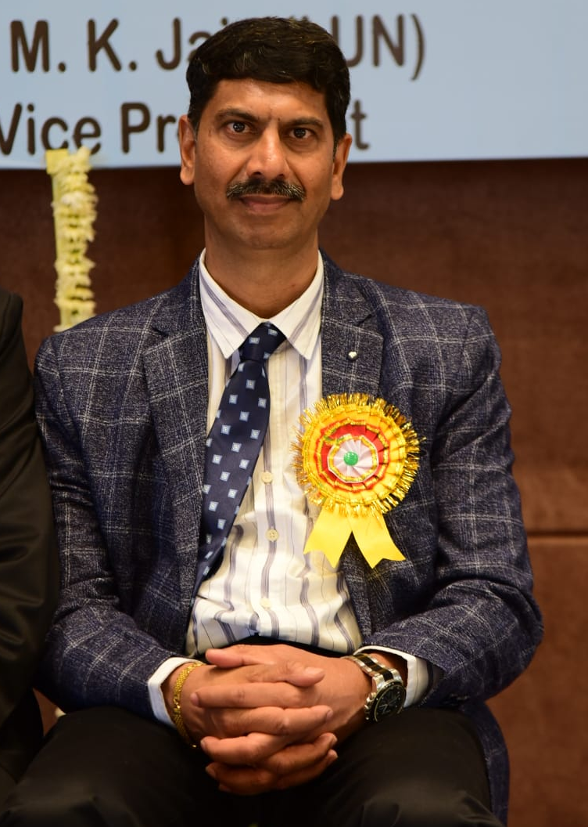
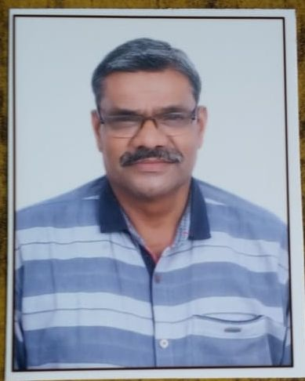
BHOPAL JES CHAPTER
EXECUTIVE BOARD MEMBER
SECRETARY
Er. Chandresh Jain
SECRETARY
Er. Rakesh Bharti Jain

Slide 9
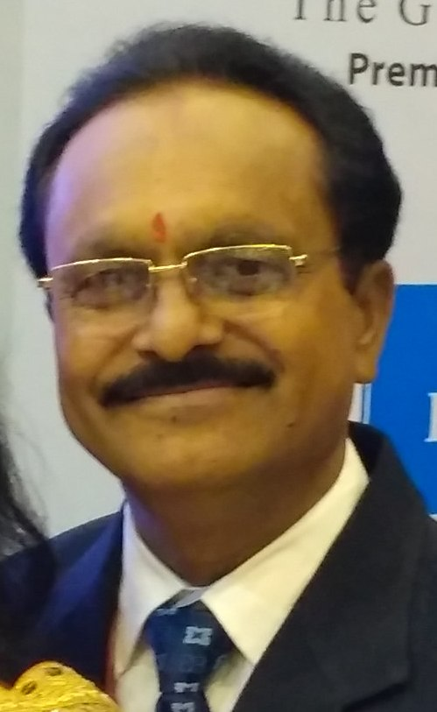
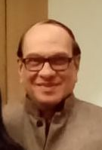
BHOPAL JES CHAPTER
EXECUTIVE BOARD MEMBER
CULTURAL SECRETARY
Er. Sanjay Bharti
Immediate Past President
Er. R. C. Jain

Slide 10
Engineer of the Year Award 2021-22
Date : 15-09-2021

Slide 11


Slide 12


इंजीनियर्स डे सितंबर
जैन इंजीनियर सोसायटी, भोपाल
द्वारा आयोजित धार्मिक प्रतियोगिता मे
स्वागत, वंदन, अभिनंदन

Slide 13
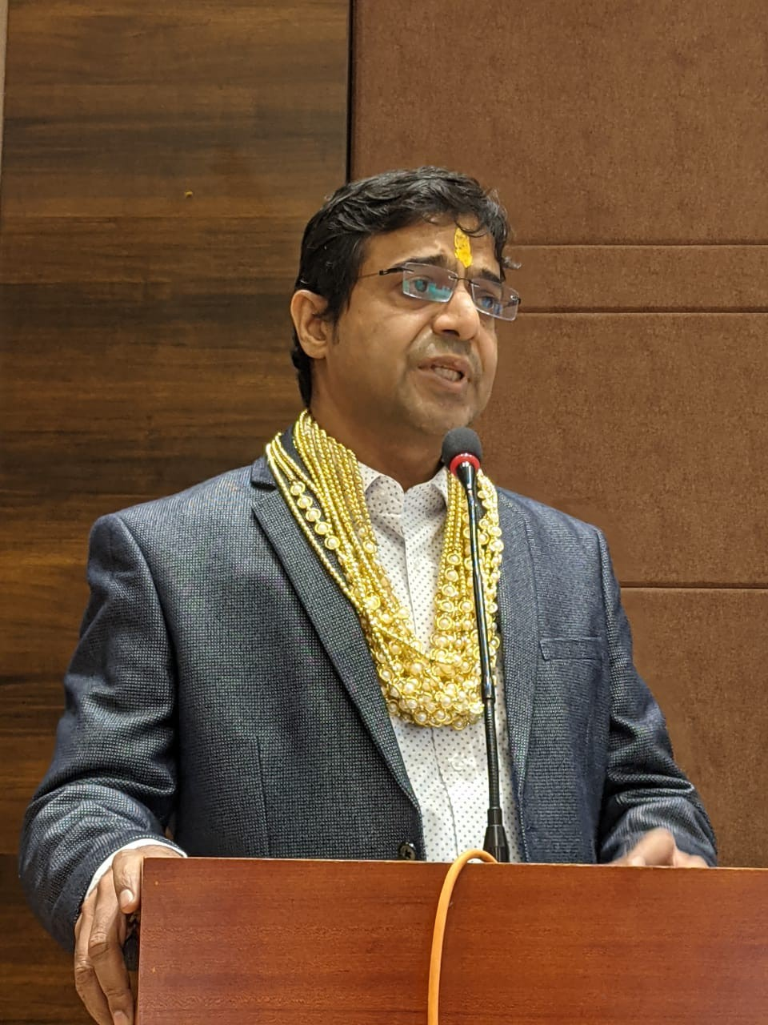
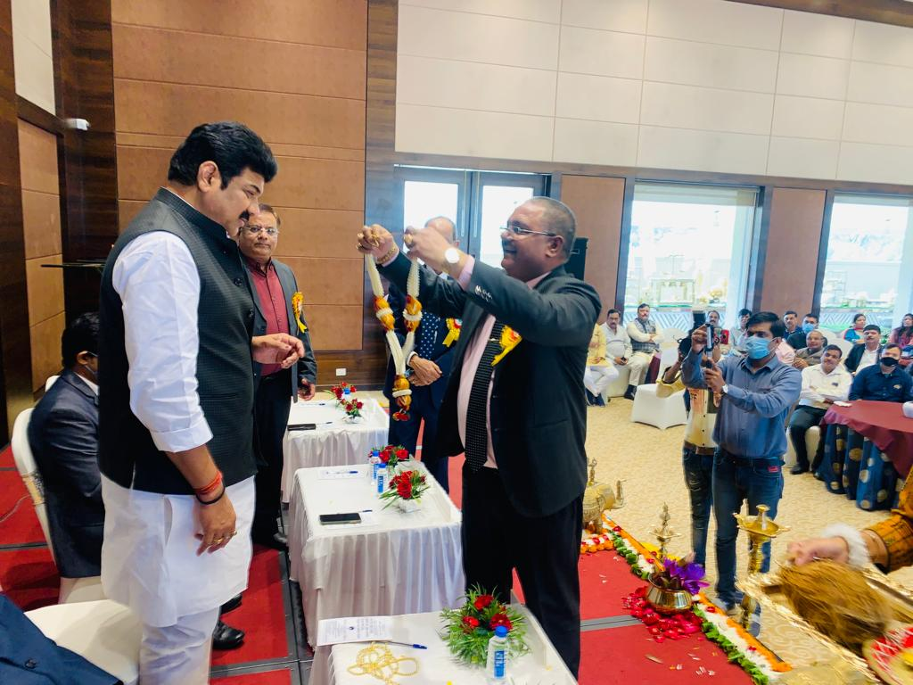
Engineer of the Year Award 2021-22

Slide 14
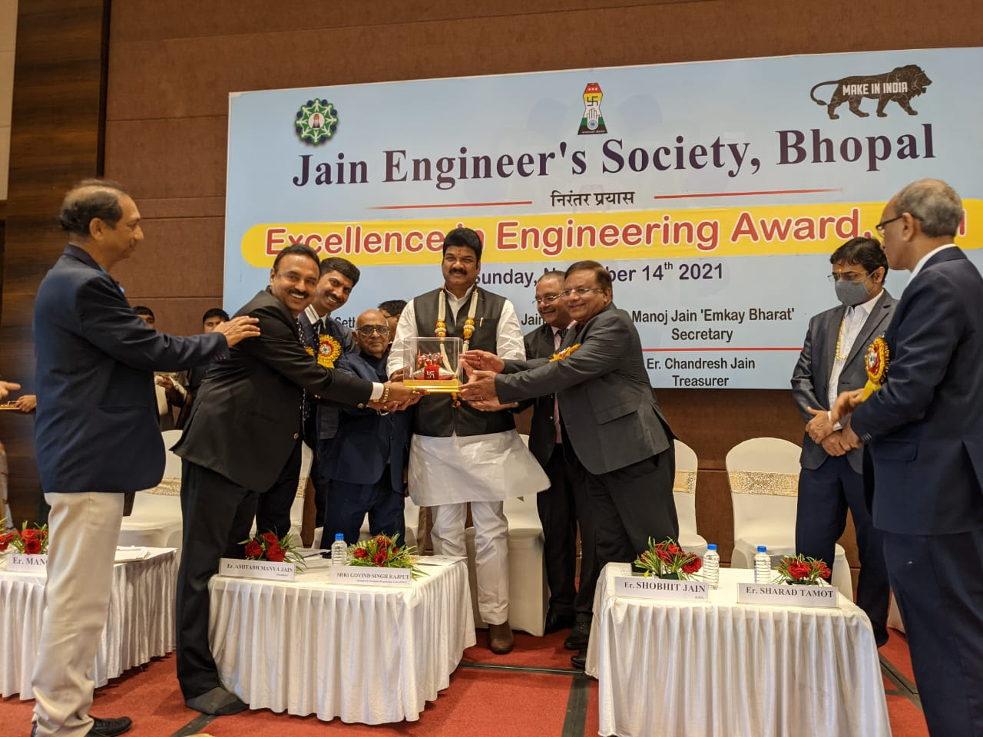
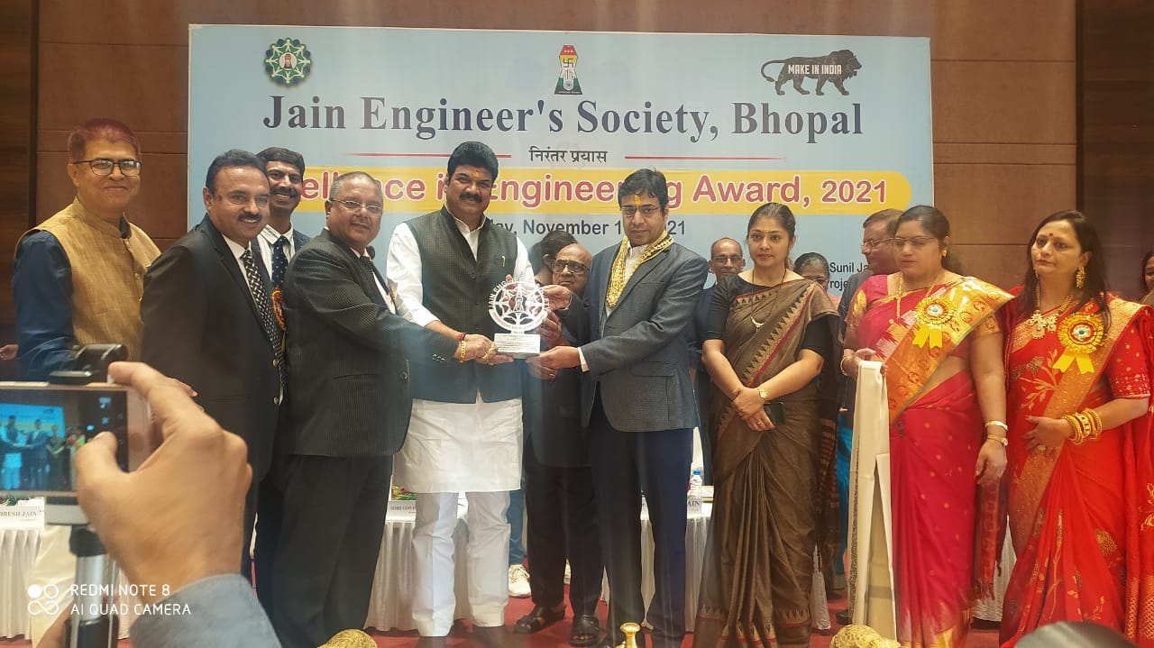
Engineer of the Year Award 2021-22

Slide 15
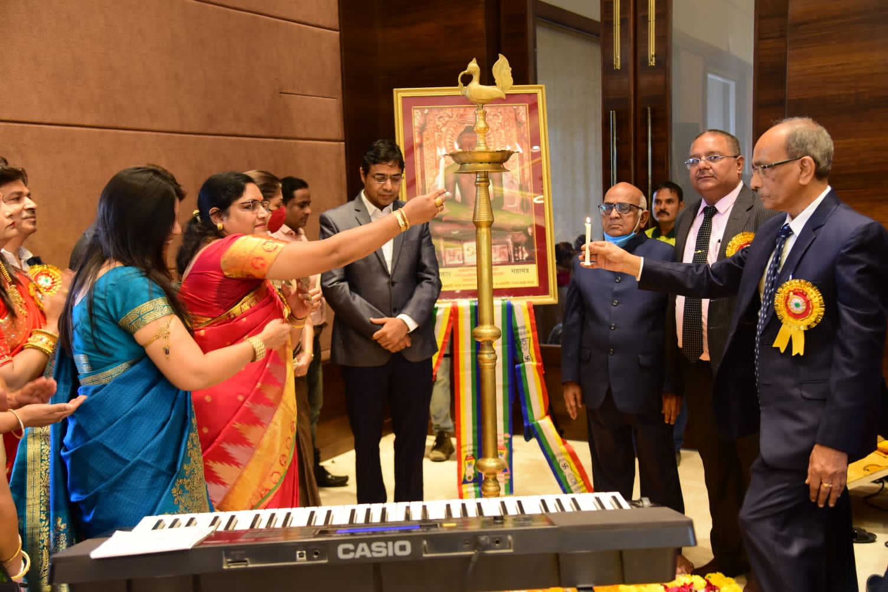
Engineer of the Year Award 2021-22

Slide 16
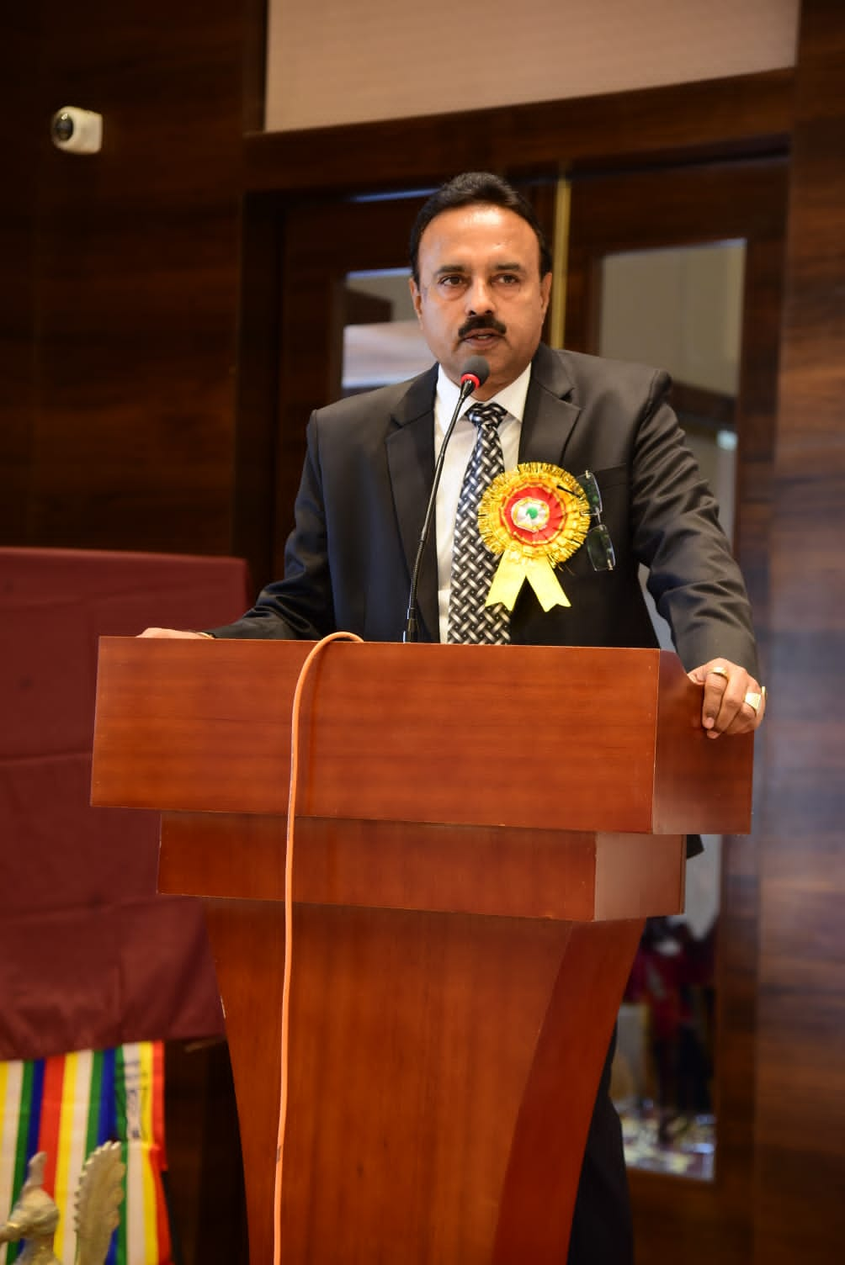
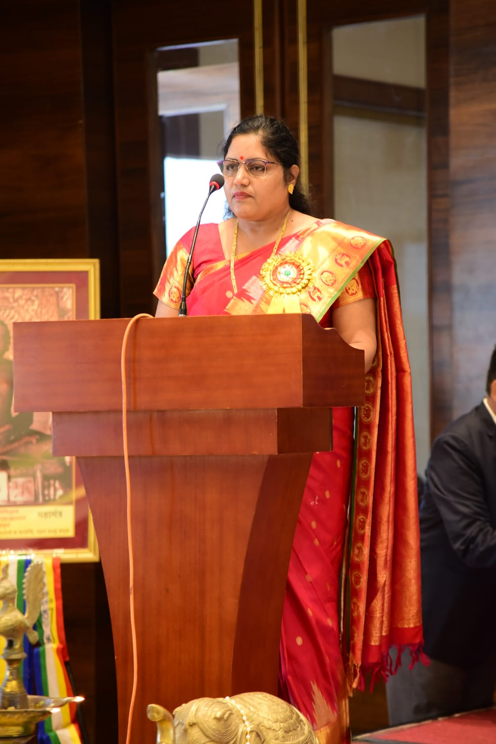
Engineer of the Year Award 2021-22

Slide 17
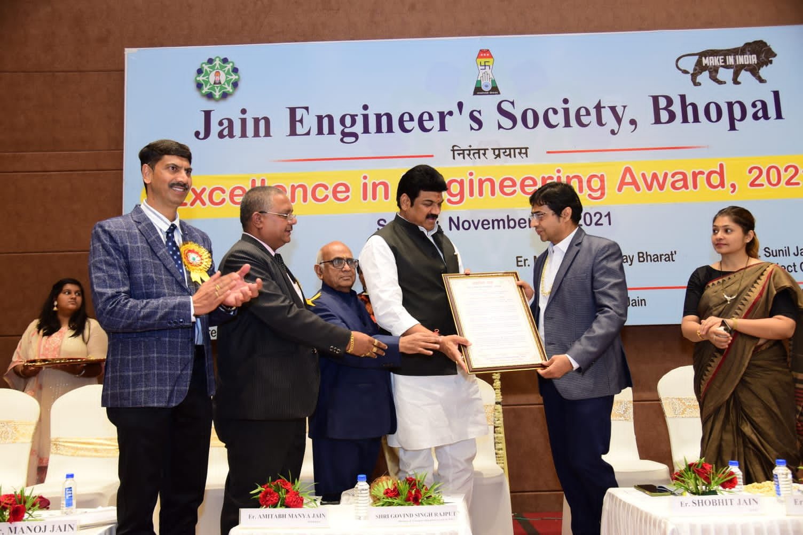
Engineer of the Year Award 2021-22

Slide 18
Engineer of the Year Award 2021-22

Slide 19
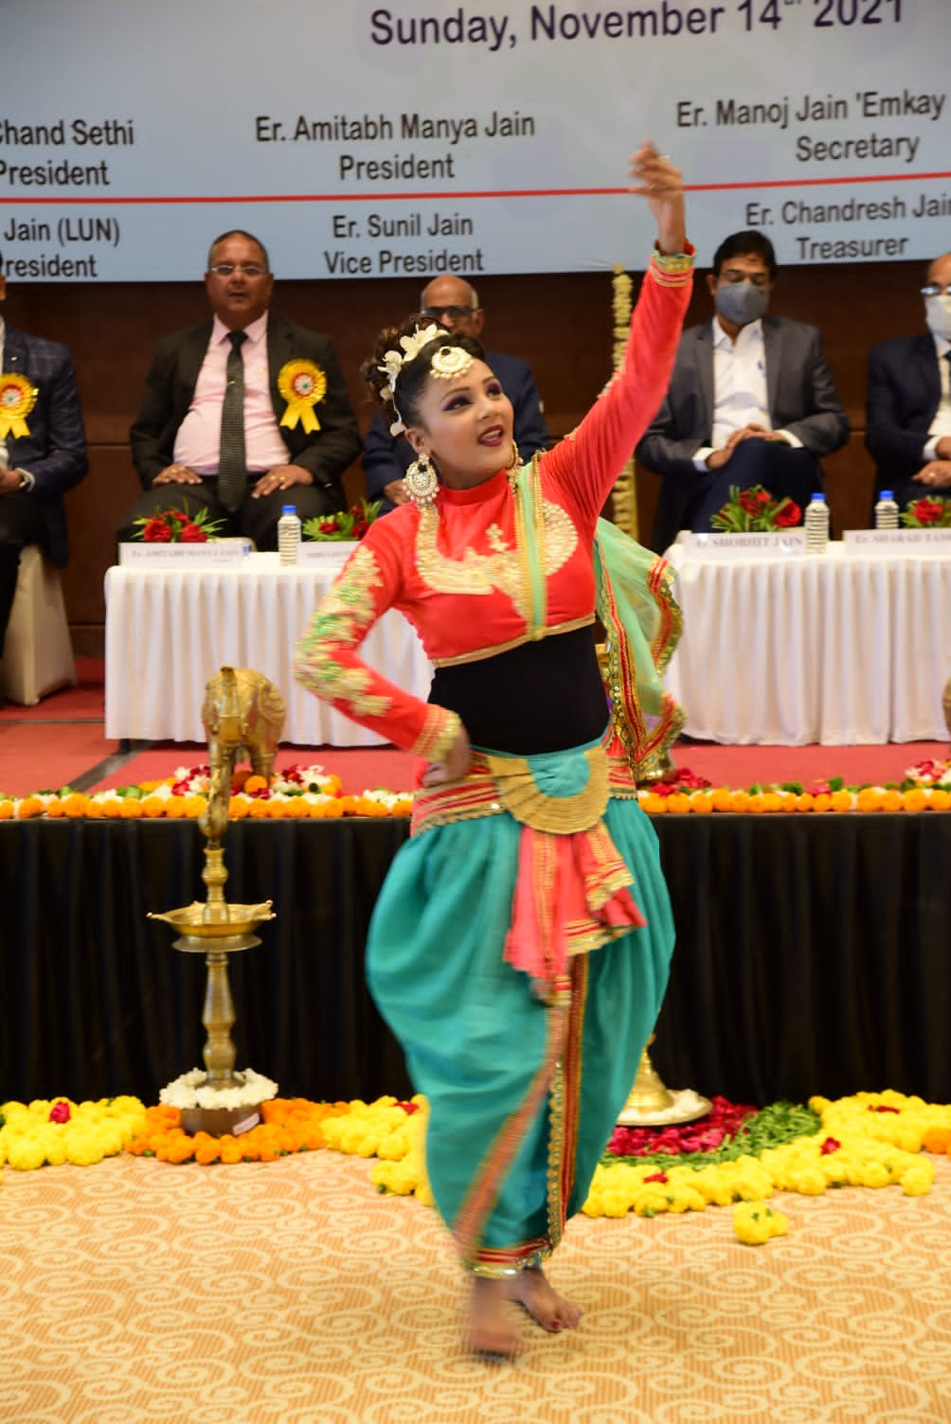
Engineer of the Year Award 2021-22

Slide 20
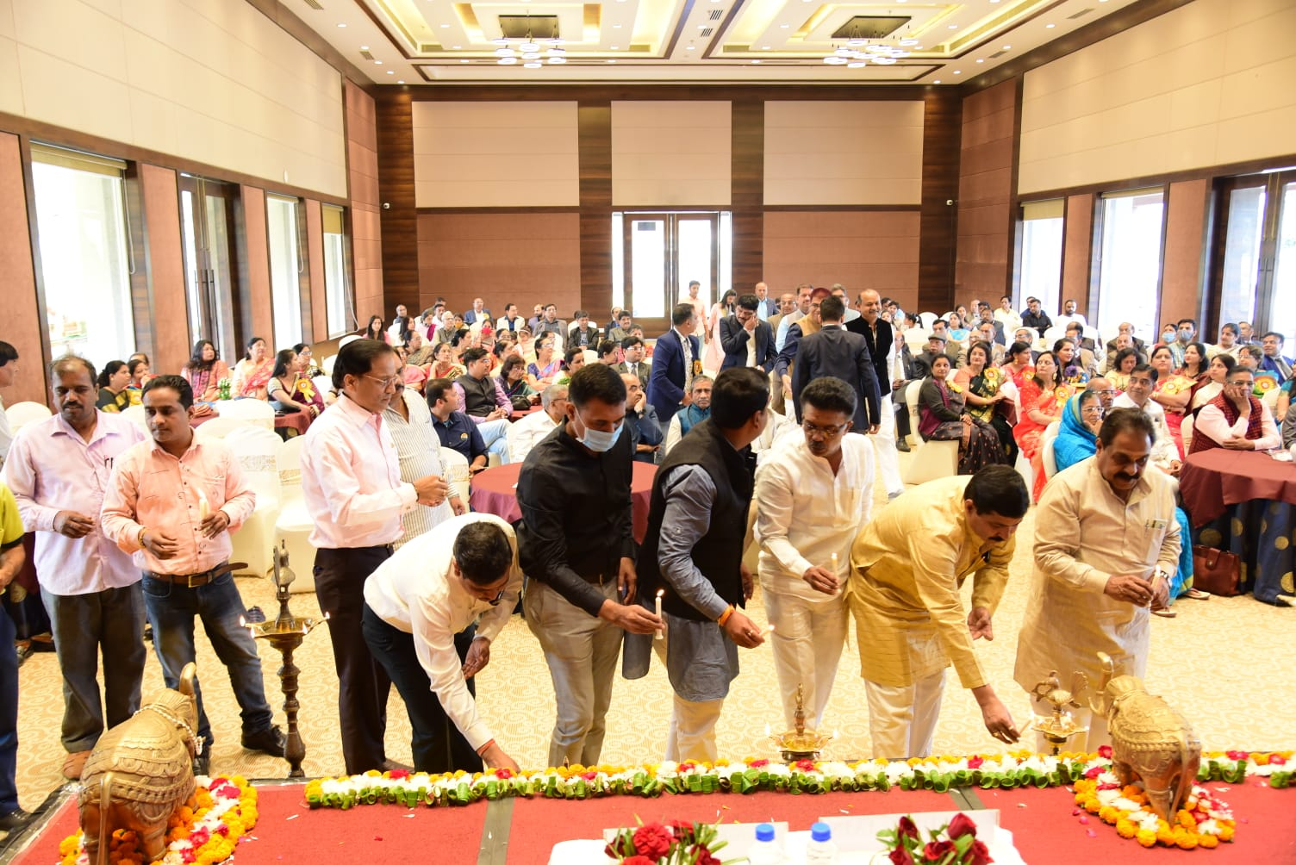
Engineer of the Year Award 2021-22

Slide 21
GO SHALA DONATION - 2021-22

Slide 22
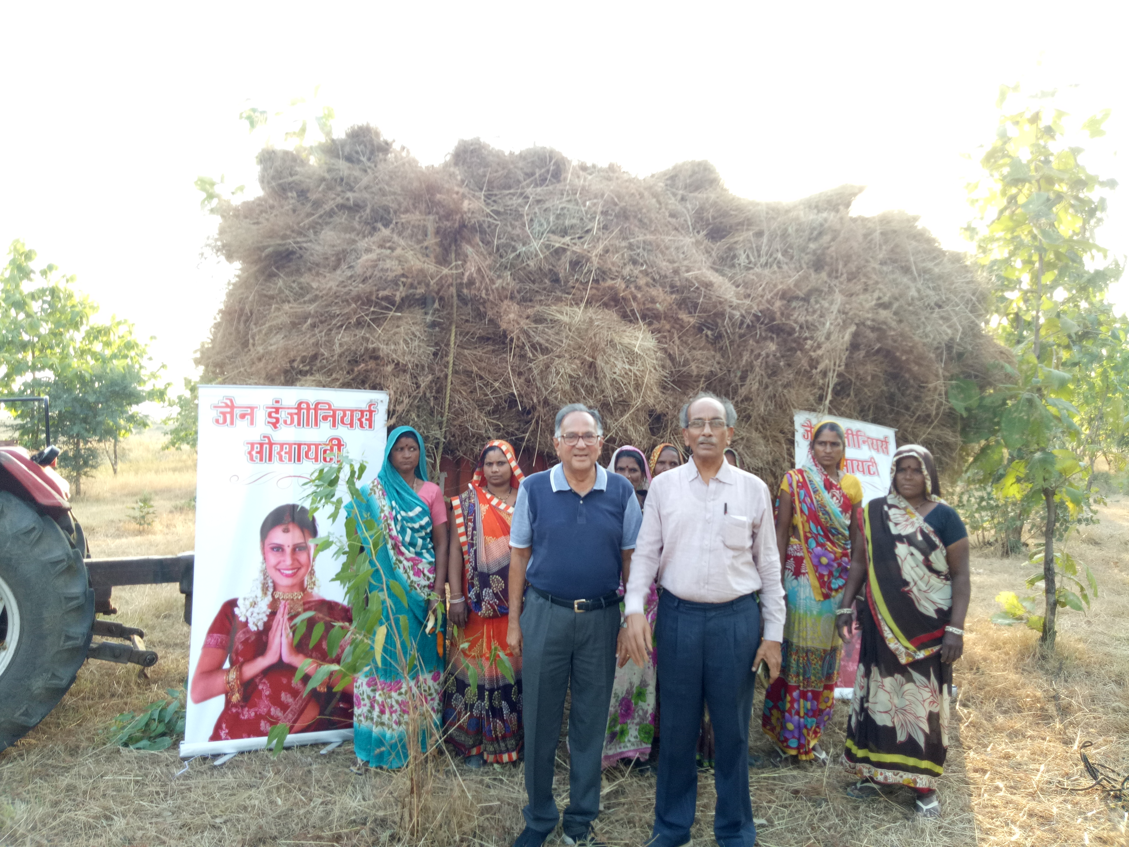
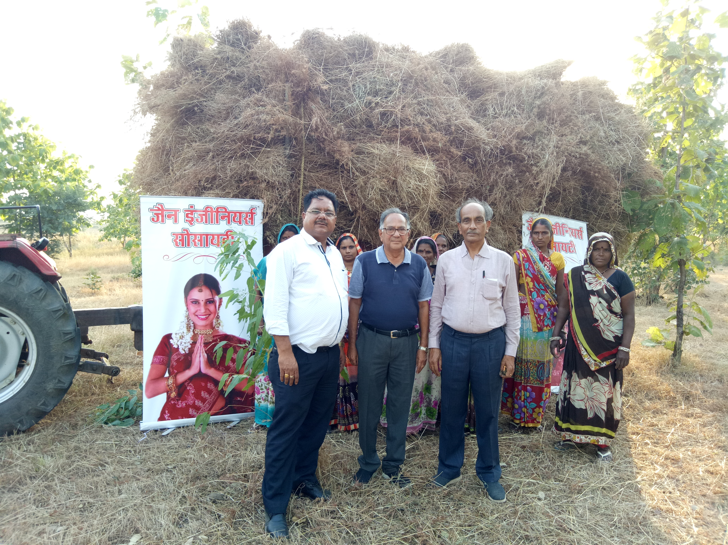

Slide 23
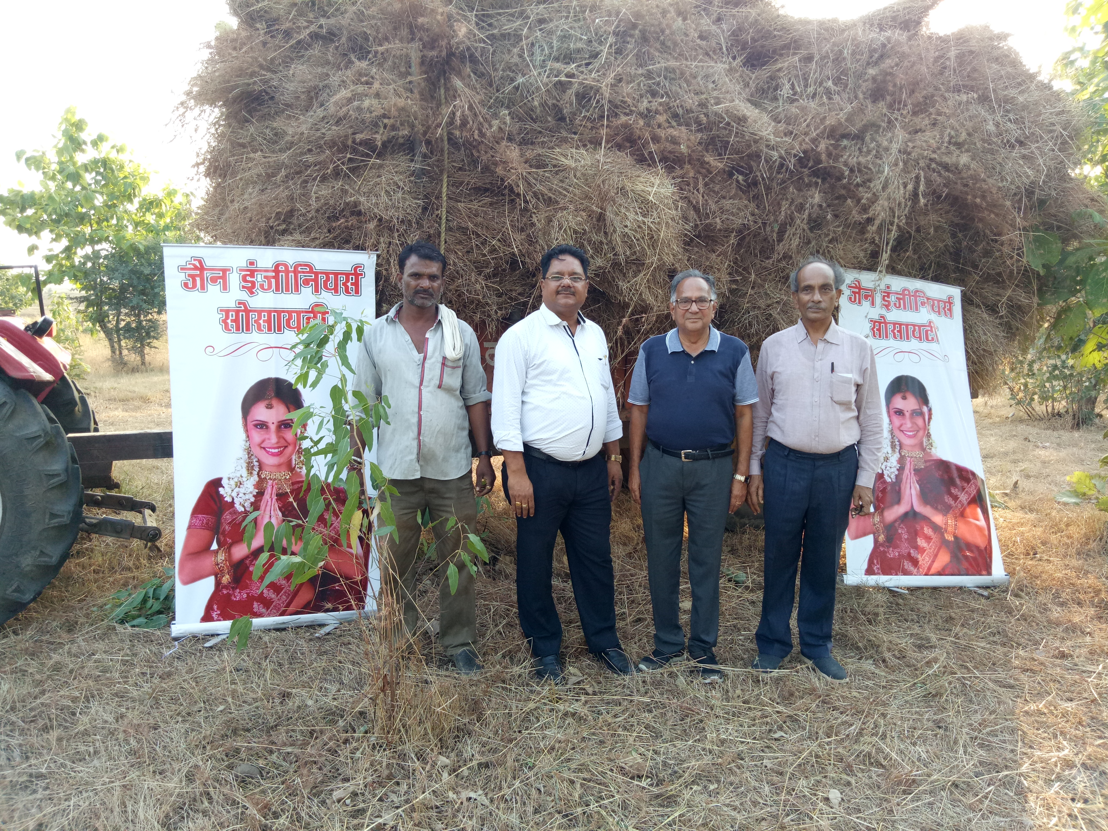

Slide 24
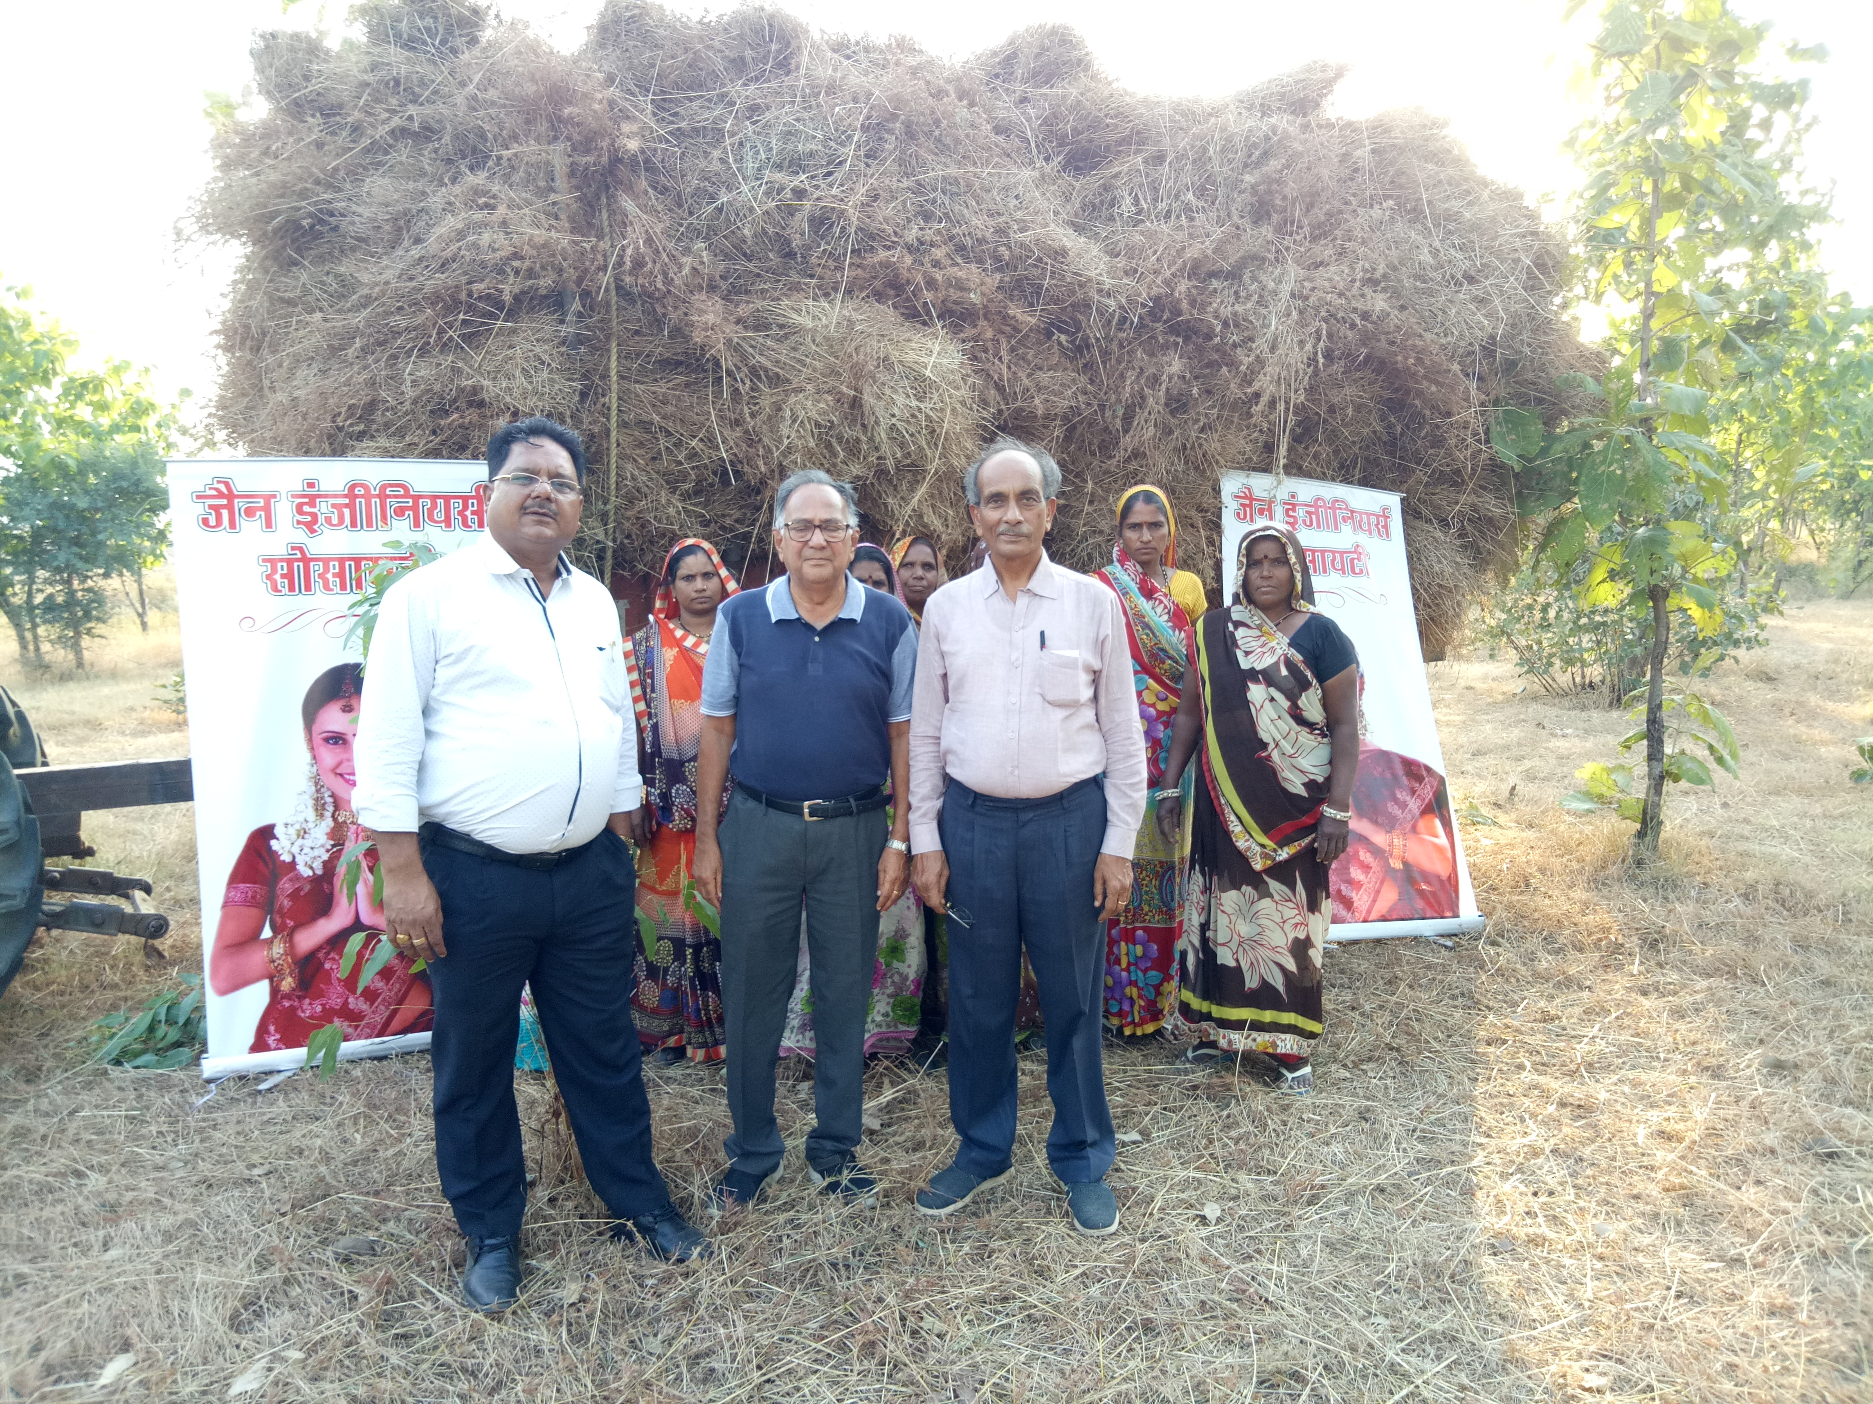

Slide 25
SNEH MILAN - 2021-22
29-08-2021

Slide 26
SNEH MILAN - 2021-22

Slide 27
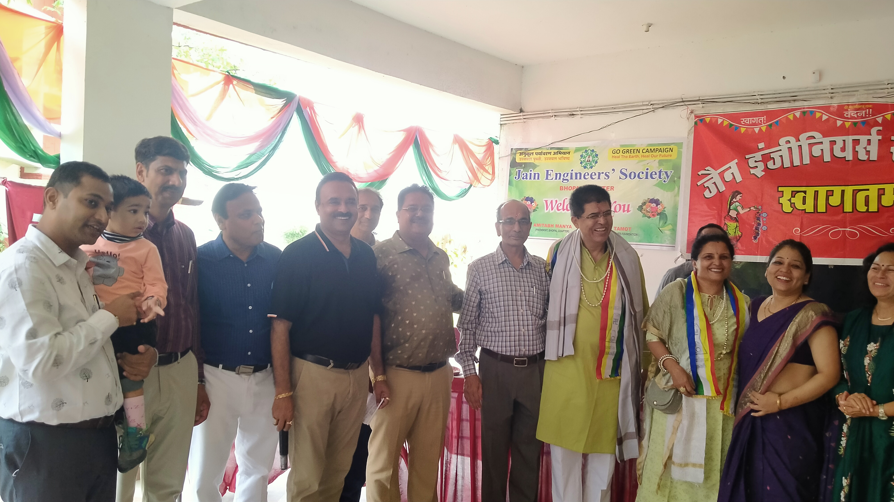
SNEH MILAN - 2021-22

Slide 28
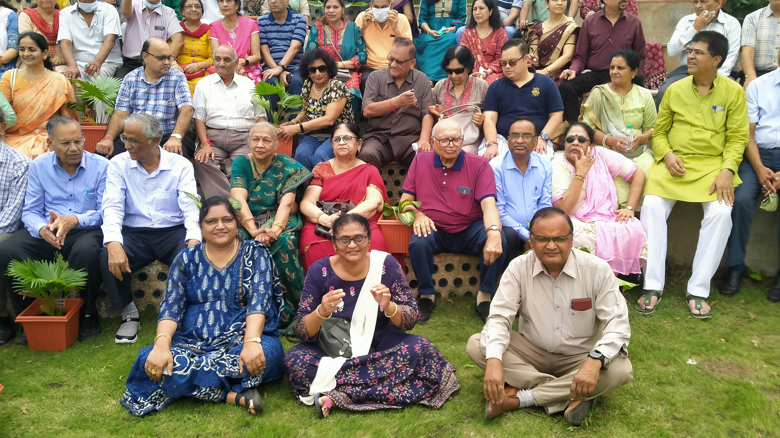
SNEH MILAN - 2021-22

Slide 29
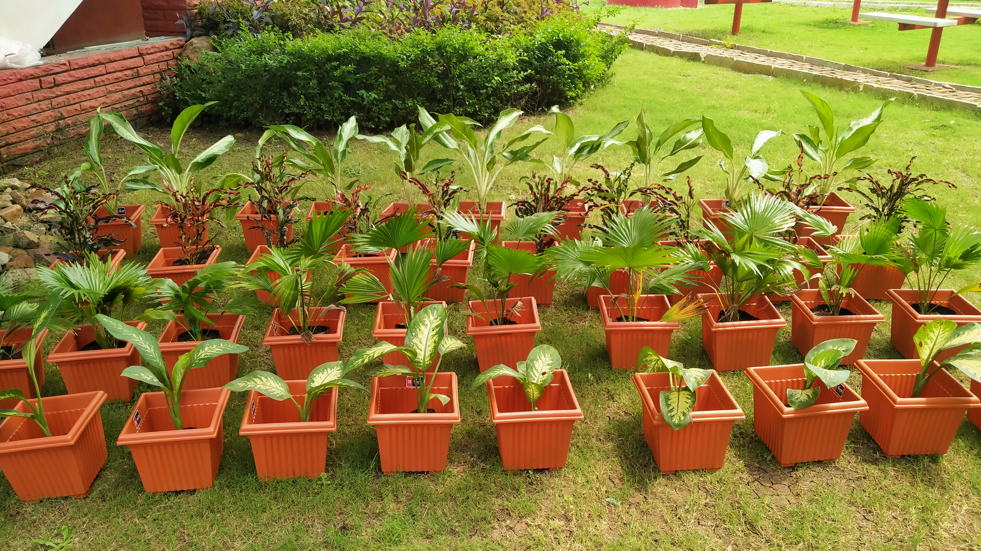

Slide 30

INDEPENDENCE DAY – 2021-22
15 August Programme

Slide 31
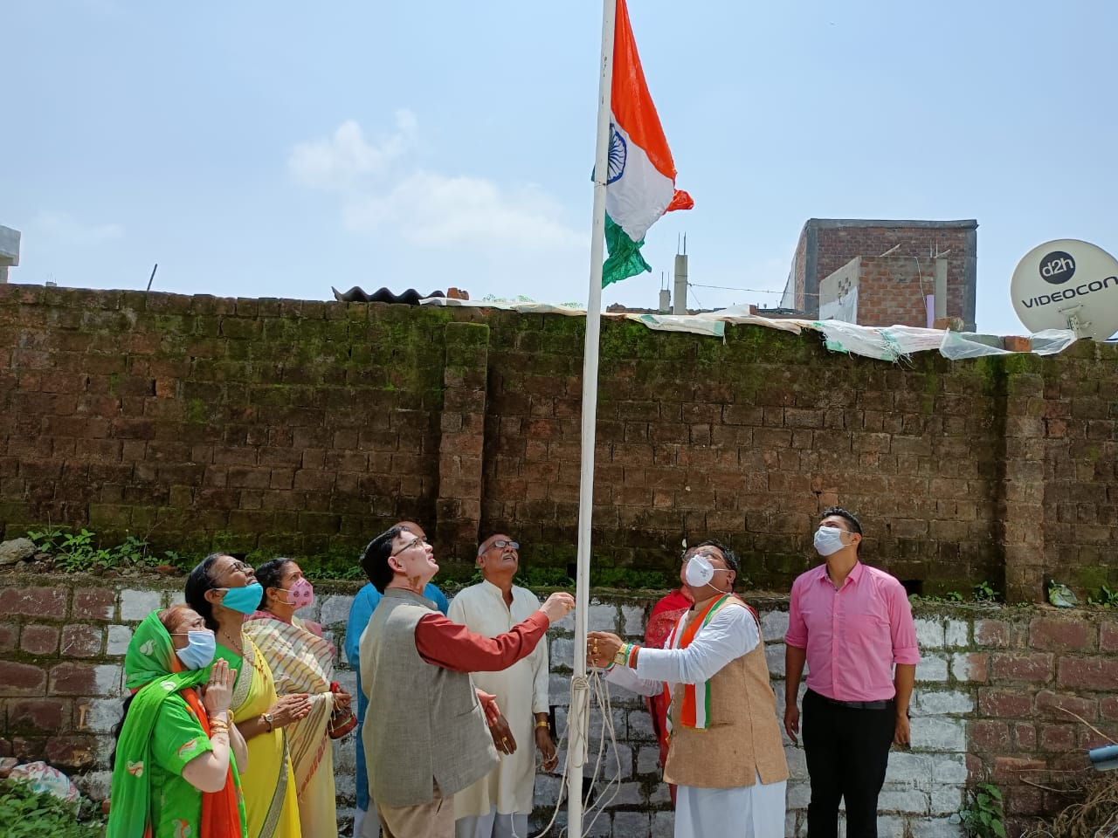

Slide 32
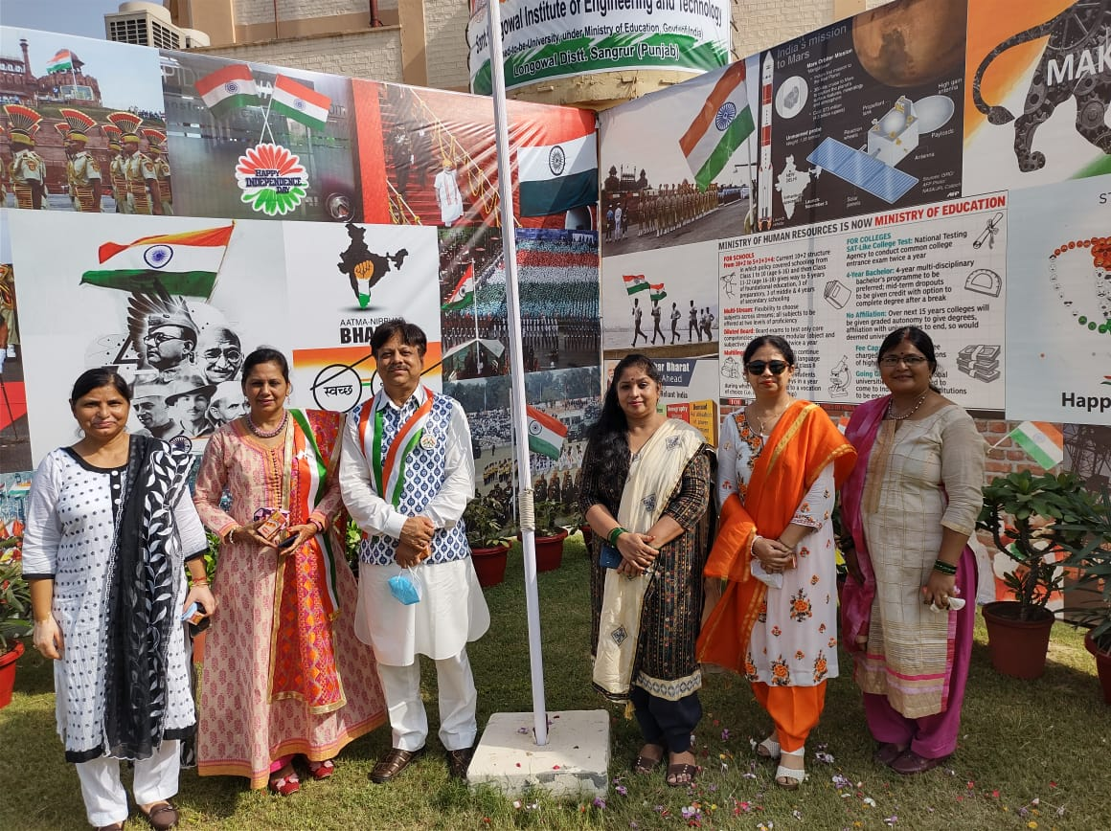

Slide 33
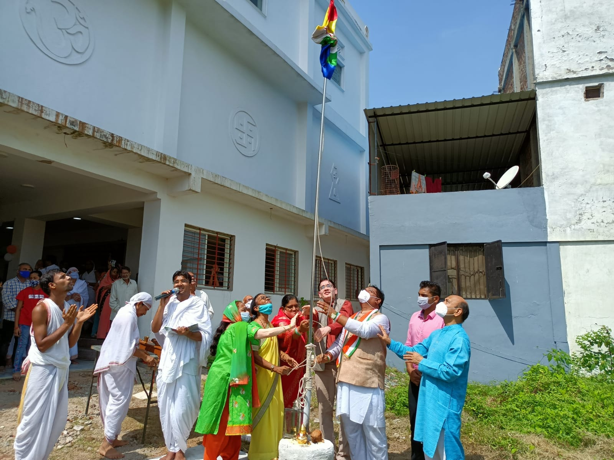

Slide 34
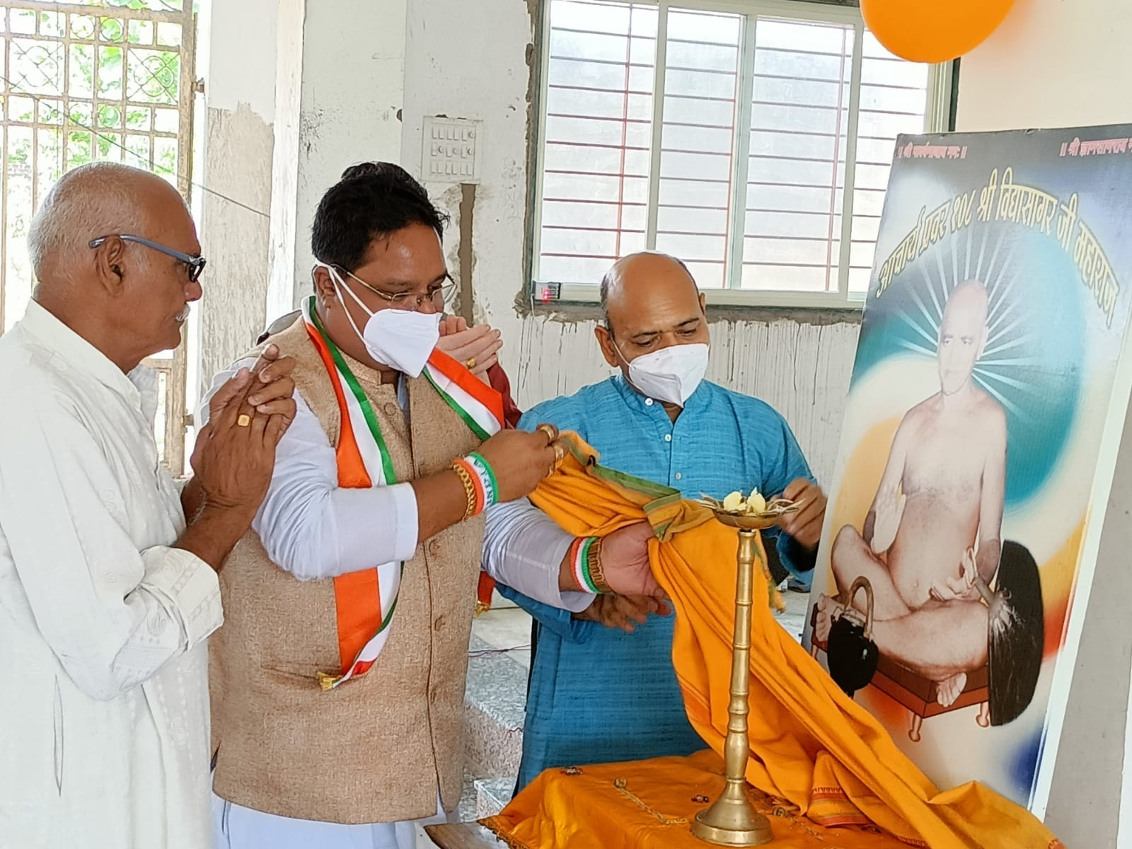

Slide 35
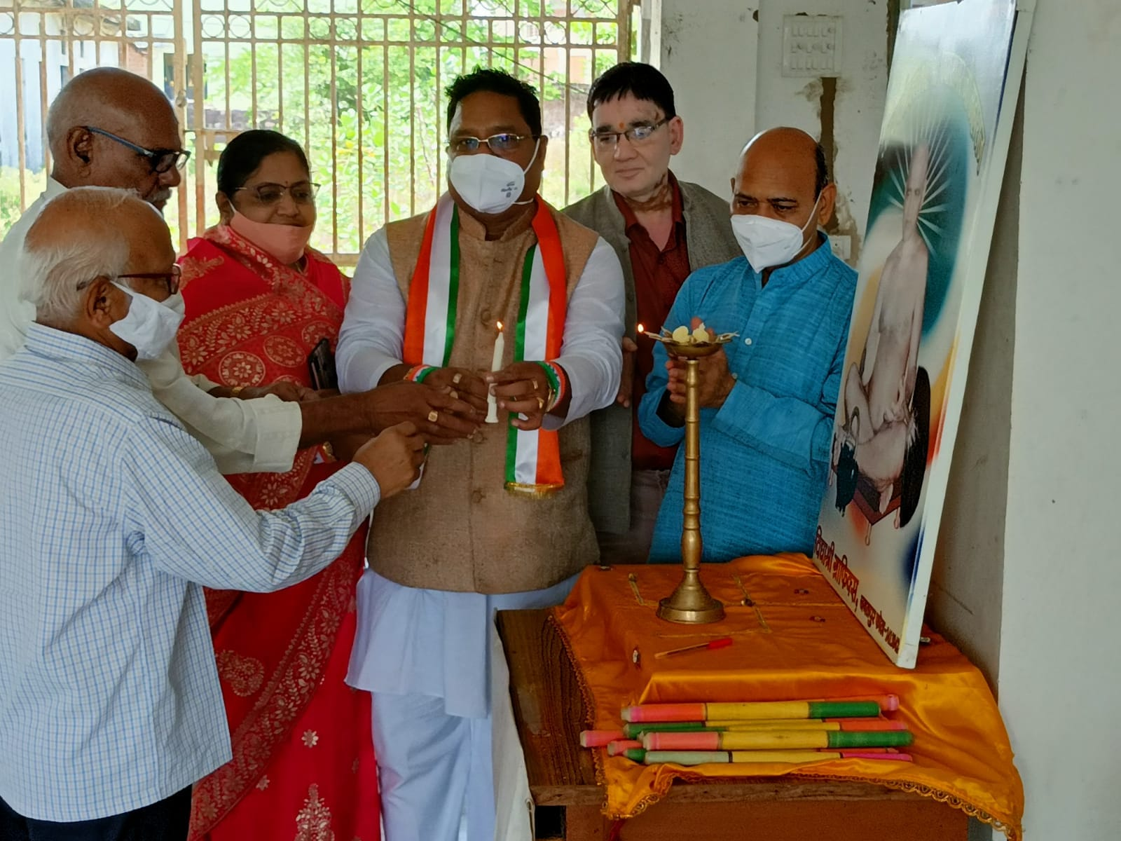

Slide 36
SIDHAWARKOOT YATRA- 2021-22
31-07-2021

Slide 37
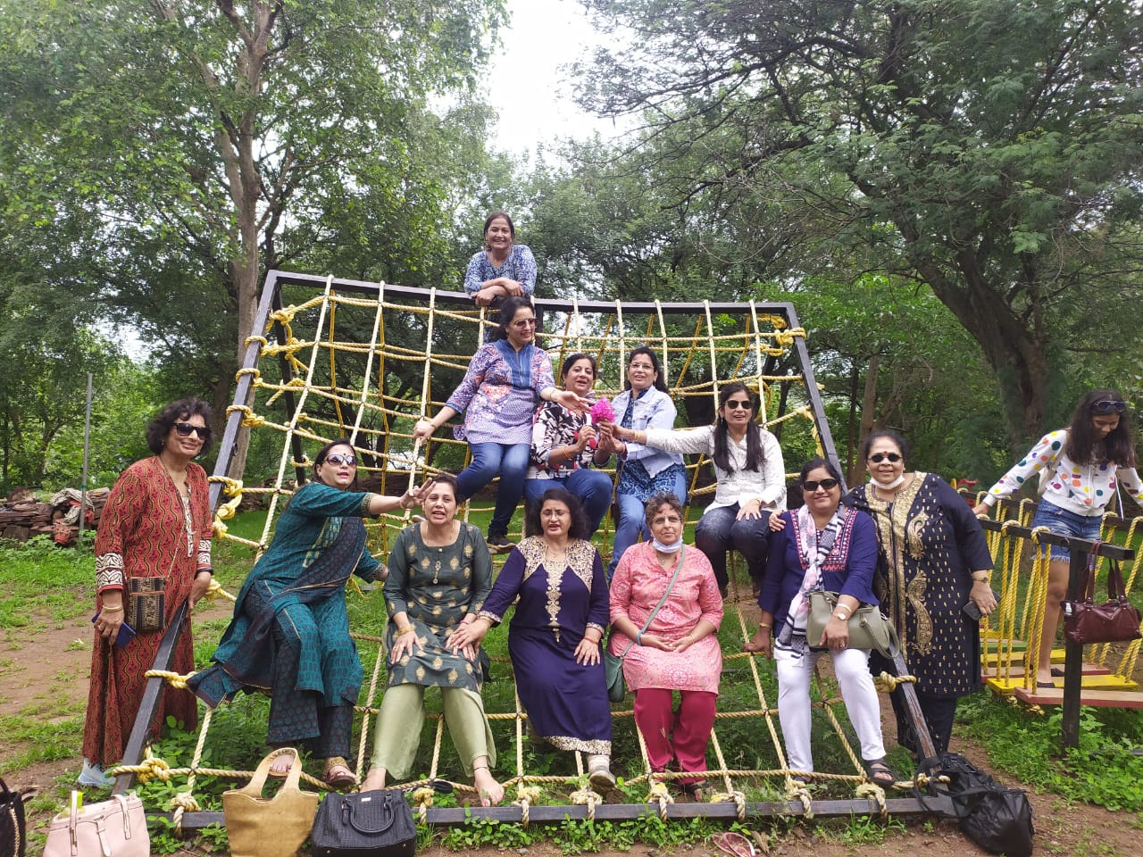
SIDHAWARKOOT YATRA- 2021-22

Slide 38
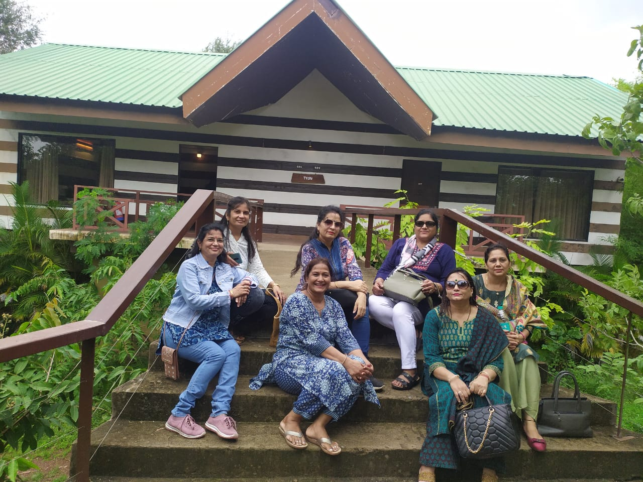
SIDHAWARKOOT YATRA- 2021-22

Slide 39

SIDHAWARKOOT YATRA- 2021-22

Slide 40
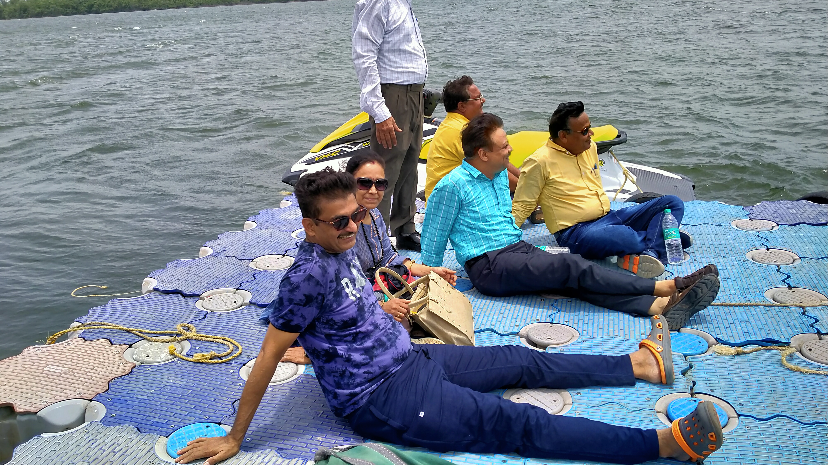
SIDHAWARKOOT YATRA- 2021-22

Slide 41
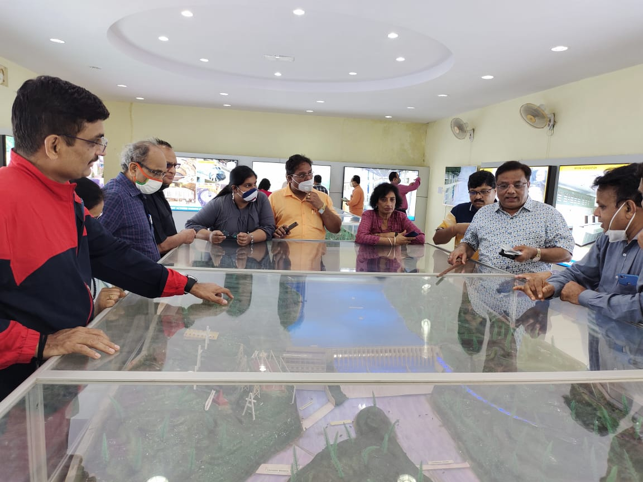
SIDHAWARKOOT YATRA- 2021-22

Slide 42
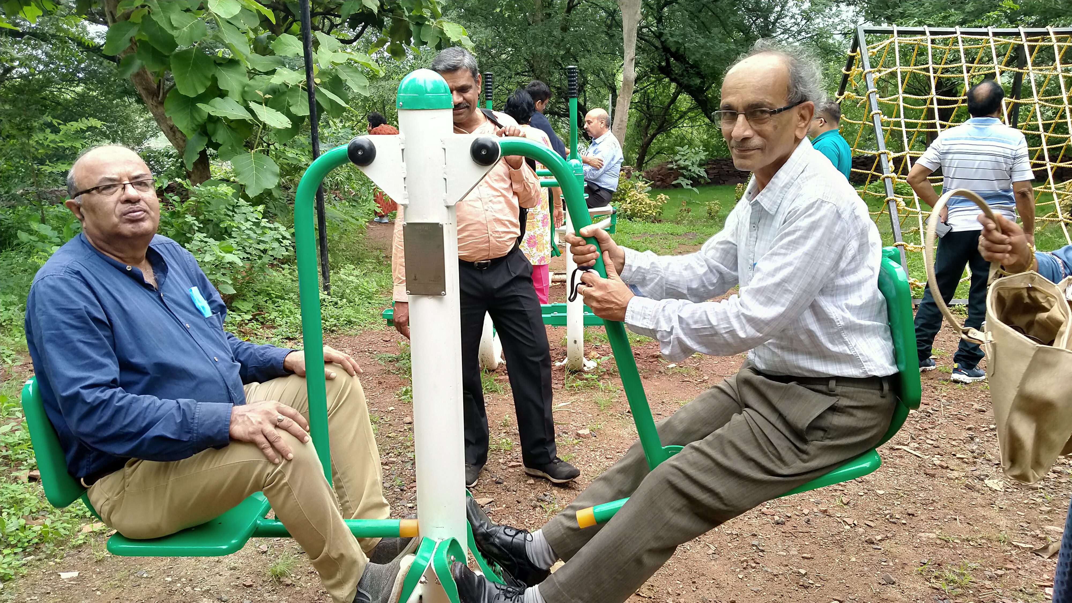
SIDHAWARKOOT YATRA- 2021-22

Slide 43
TAMOT SCHOOL PROGRAMME
2021-22

Slide 44
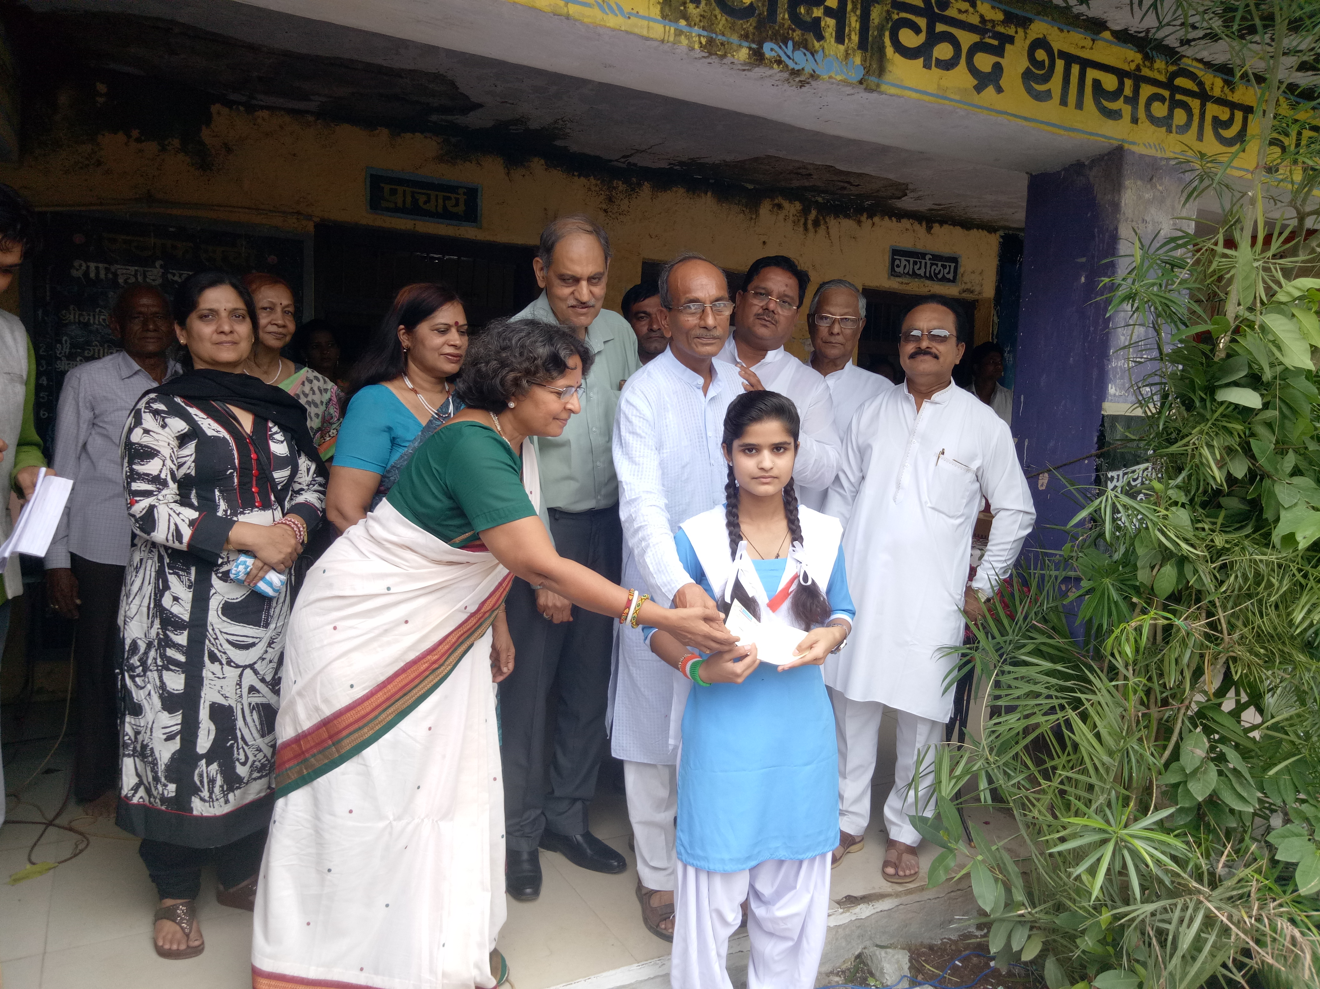
GIRLS SCHOLARSHIP
SCHOLARSHIP PROGRAMME
IN TAMOT SCHOOL

Slide 45
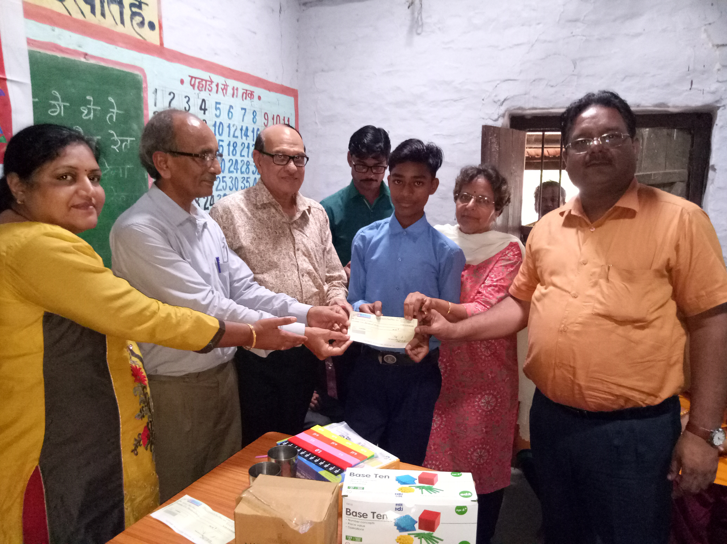
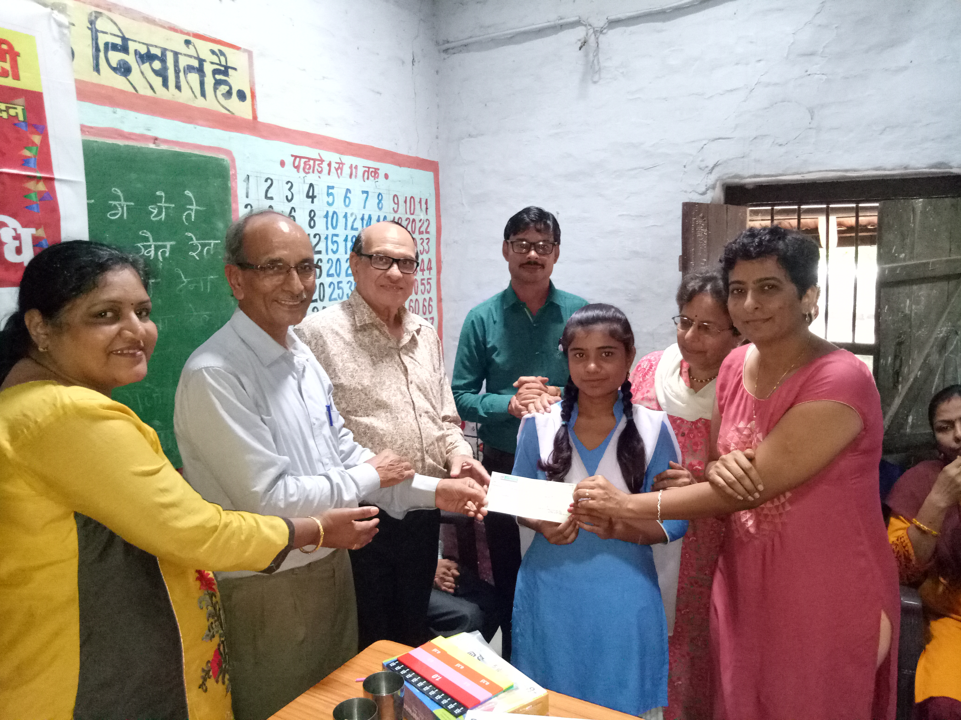

Slide 46
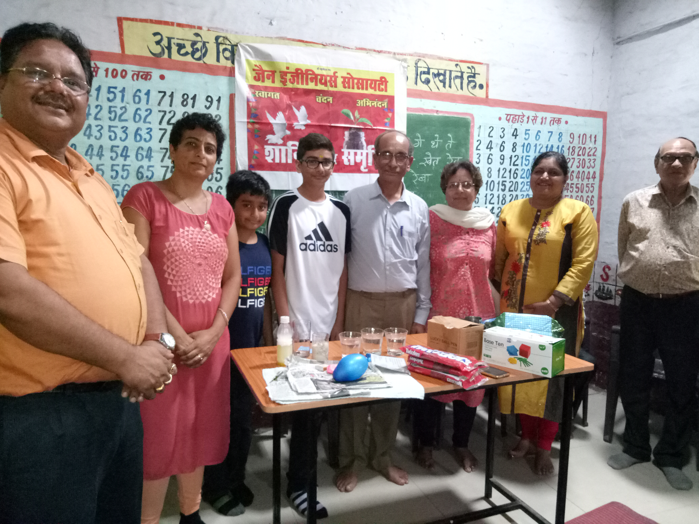

Slide 47
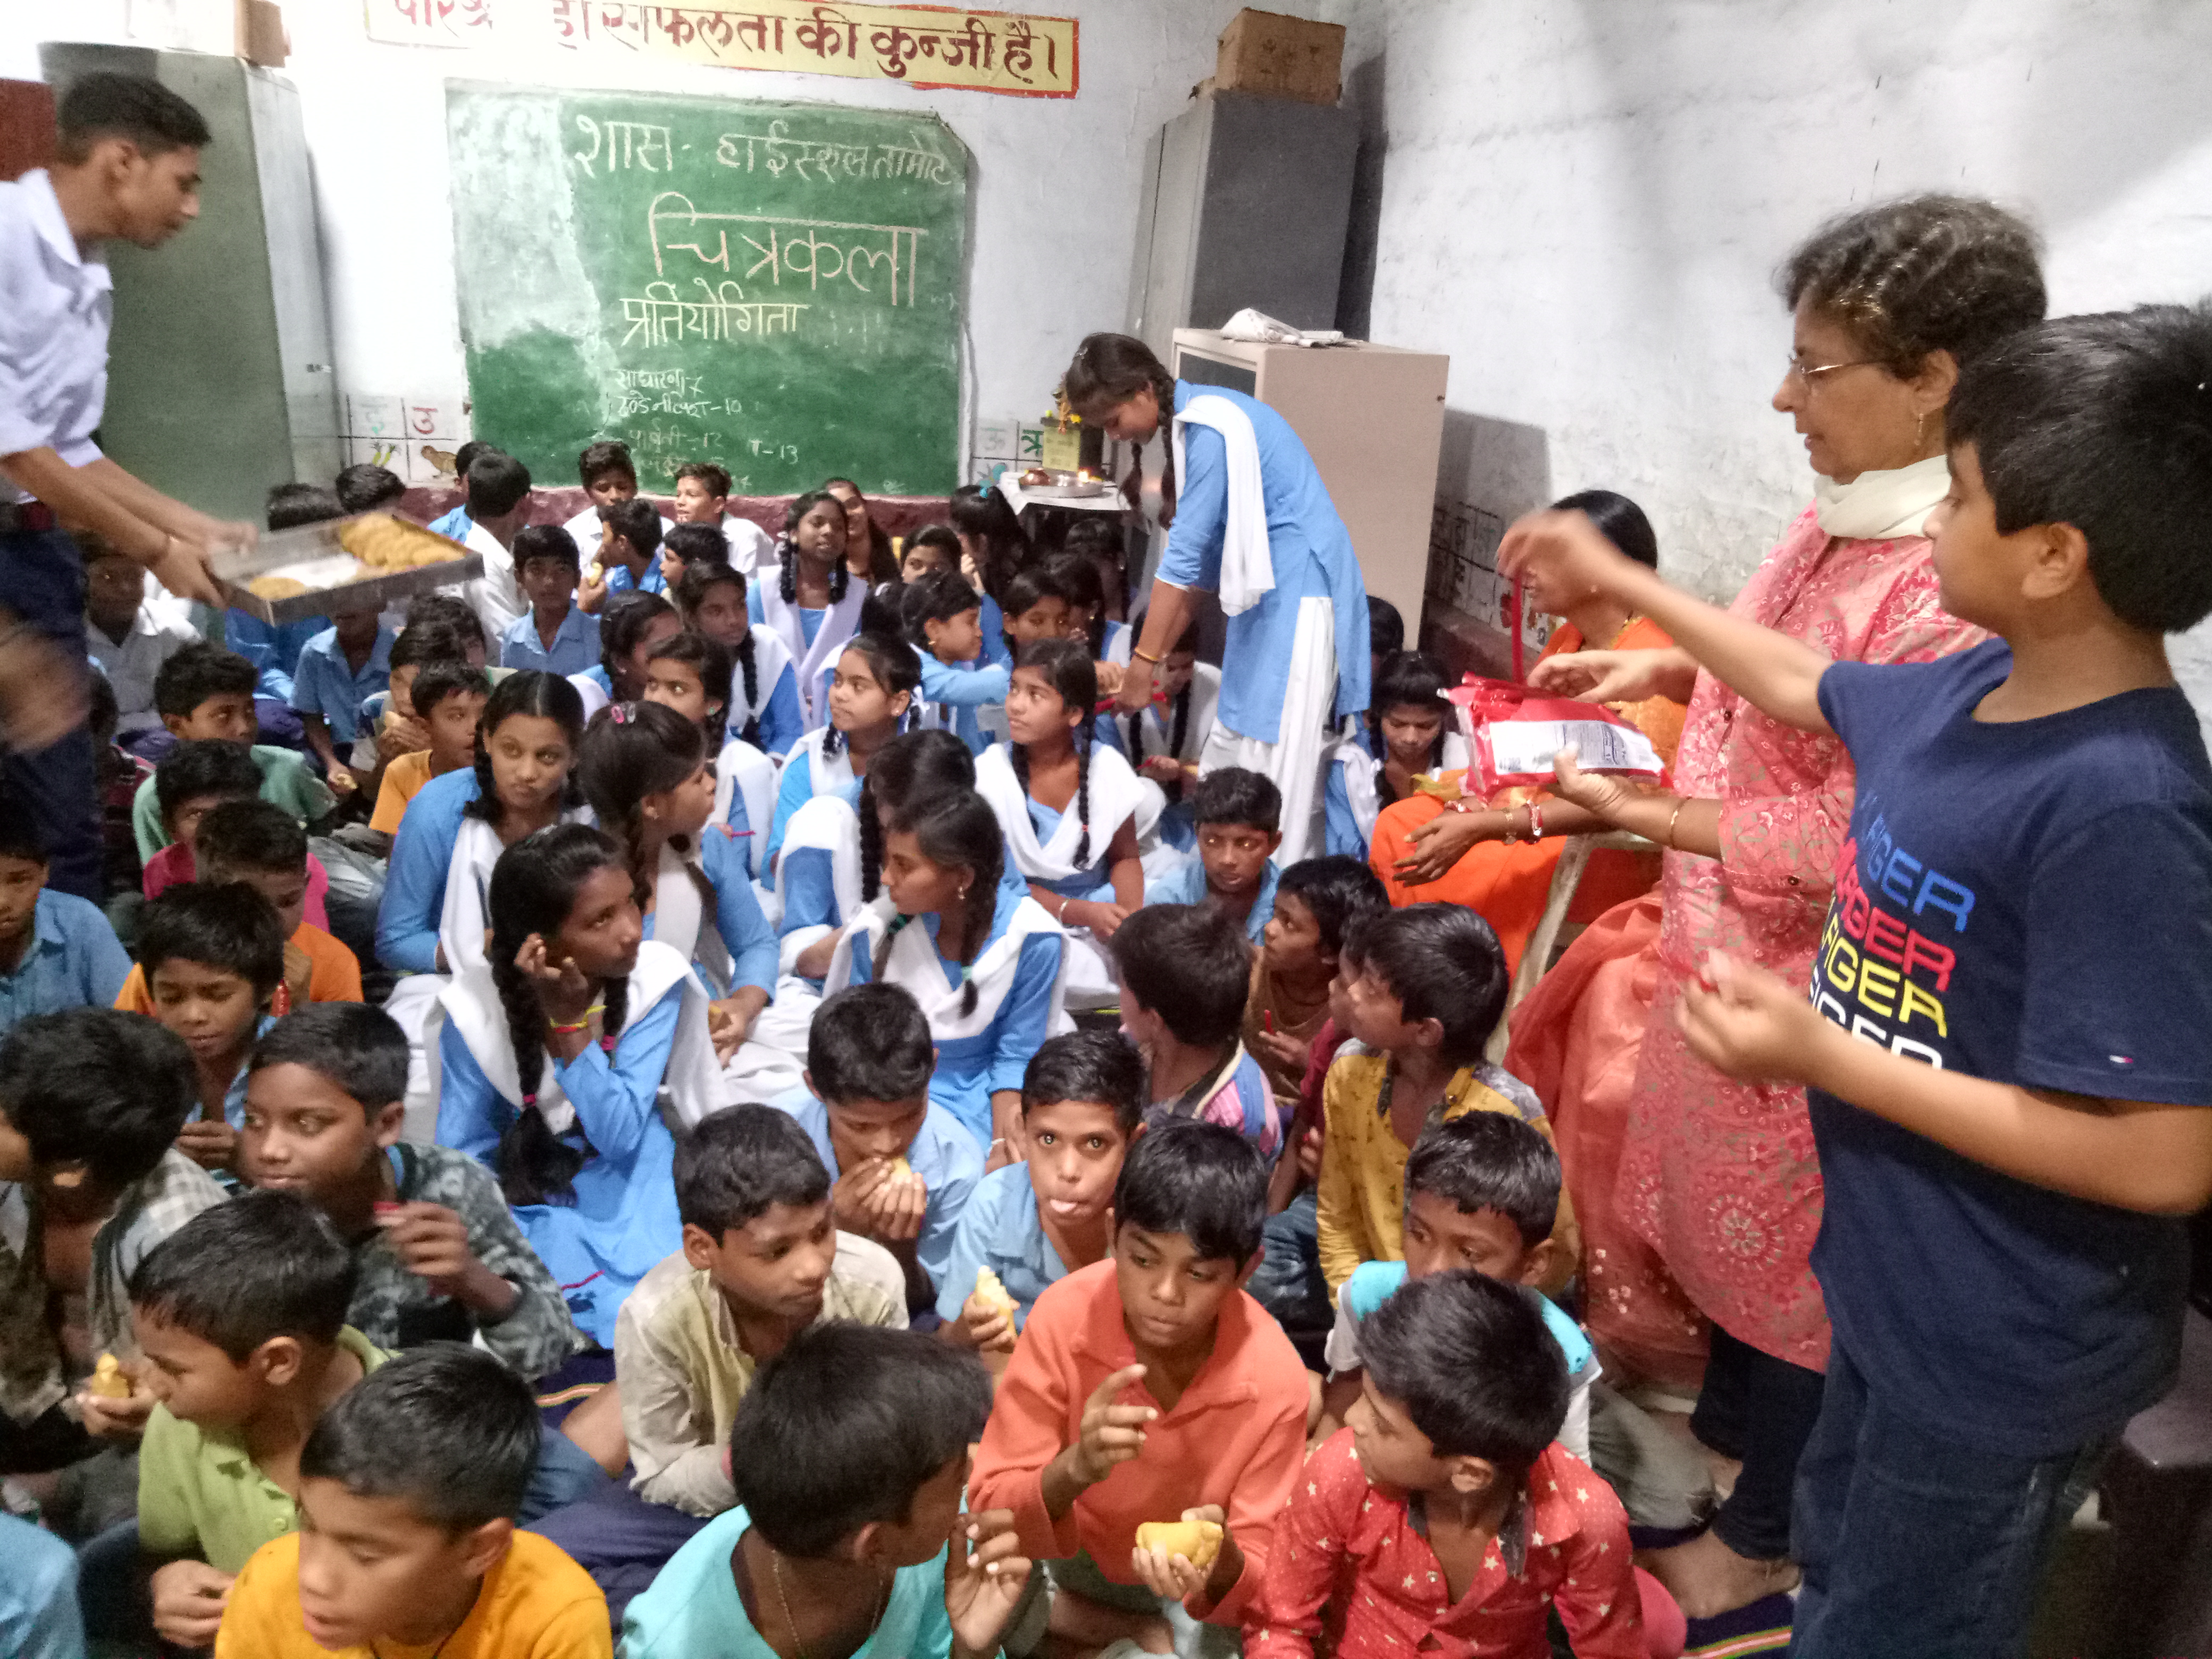
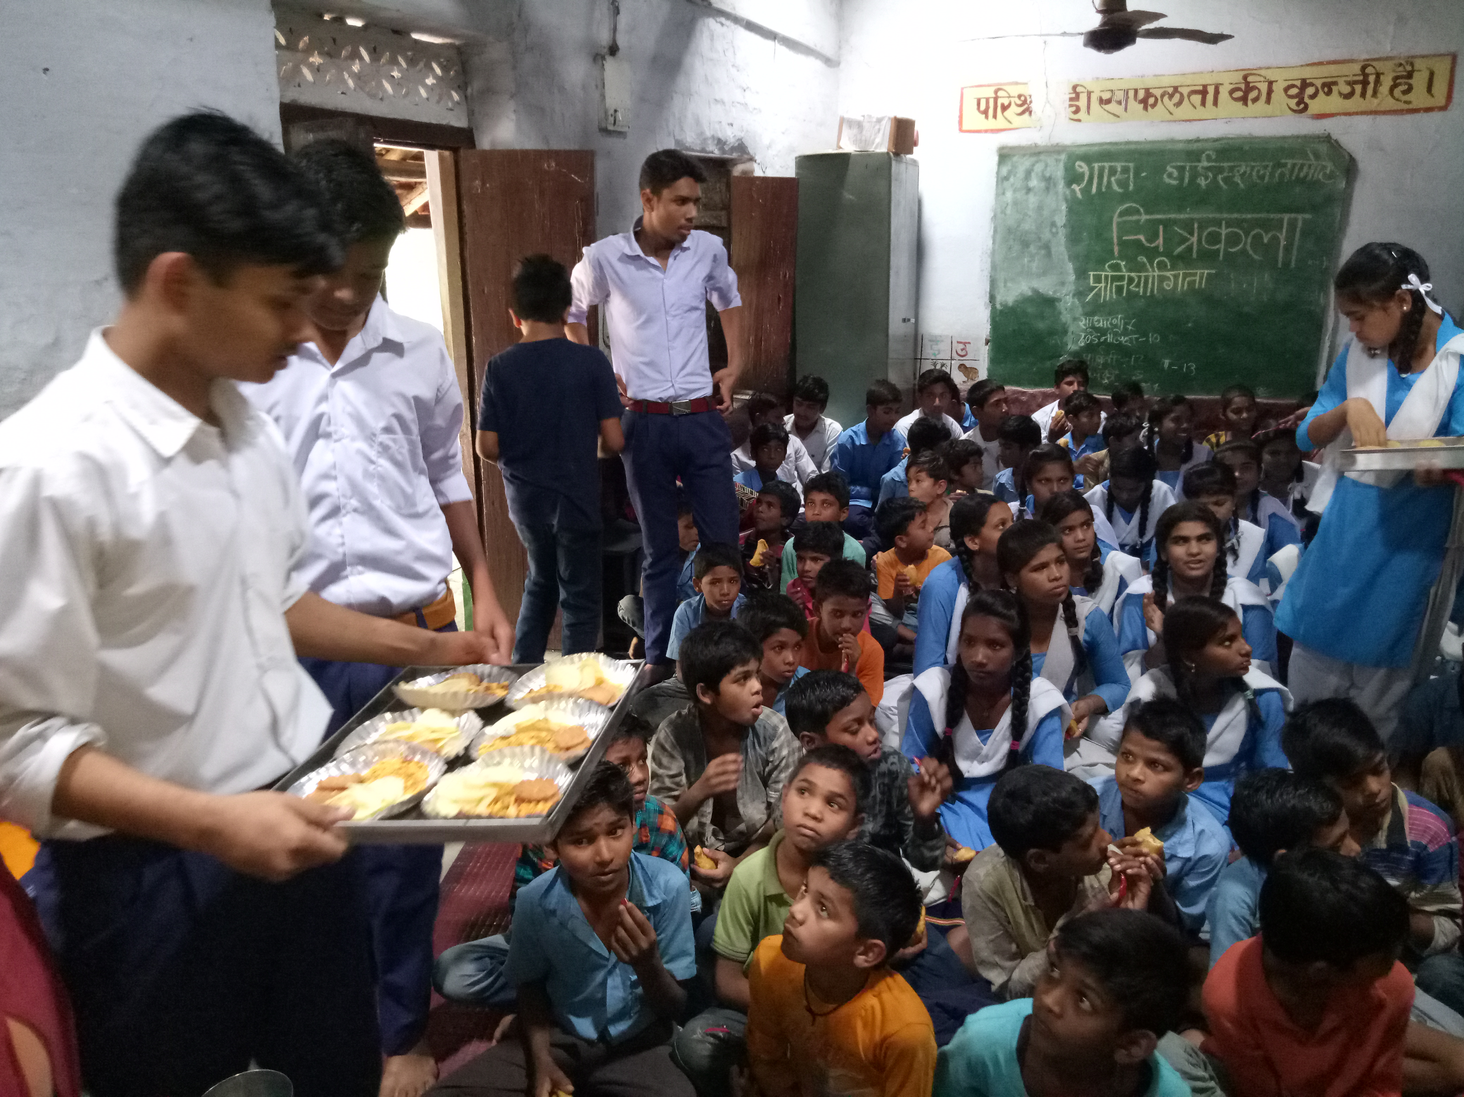

Slide 48


