Slide 1
OneStream Certification Exam Registration Process
A Step-by-Step Guide
October 6, 2026
For questions, please submit a case form to the Certification team via the ServiceNow Support Portal

Slide 2
Exam Registration Overview
1
Login to CM Connect
5
Schedule Your Exam
2
Confirm your CM Connect profile
6
On Exam Day
3
Register for an Exam
7
Using Your Mobile Device for Proctoring
4
Confirm your TESTWise Profile
8
Operating System Requirements

Slide 3

Login to CM Connect
  Click on CM Connect (formerly CertMetrics) in your OneStream Portal
  If you do not have this option in your OneStream Portal, submit a case form or have a member of your team submit a case form to Account Maintenance via the ServiceNow Support Portal
  Additionally, candidates can navigate to https://osportal.onestream.com/ to access the OneStream Portal and CM Connect

Slide 4
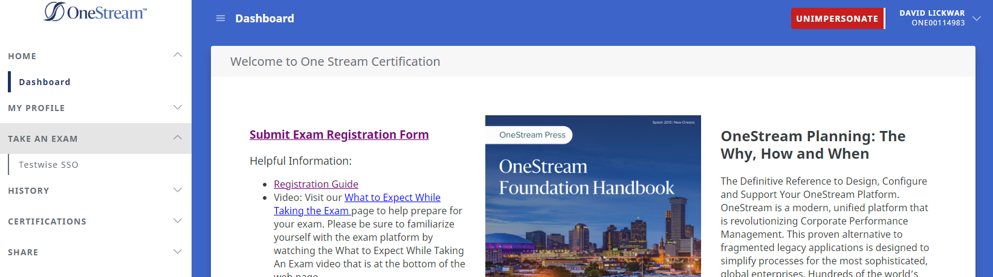
Confirm Your CM Connect Profile
  From the CM Connect home page click on the My Profile link

Slide 5
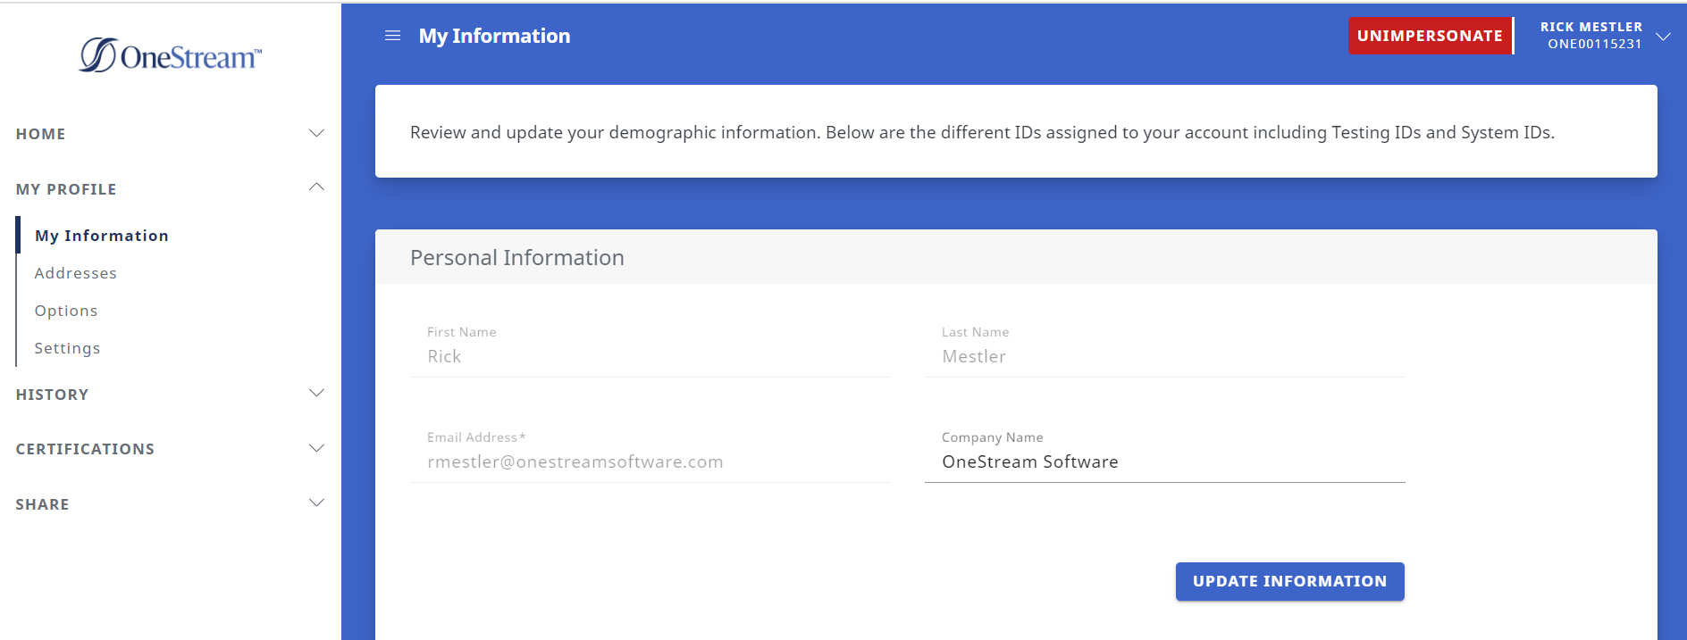
Confirm Your CM Connect Profile
  Confirm that your profile information is correct
  If your name in CM Connect does not match your government-issued ID, submit a case form to the Certification team via the ServiceNow Support Portal
    If your name in CM Connect doesn’t match your government-issued ID, you might NOT be able to sit for your exam and you will forfeit your exam fee

Slide 6
Register for an Exam
  On the CM Connect homepage, expand “Take an Exam” on the left
  Click “TestWise SSO” to register for an exam

Slide 7
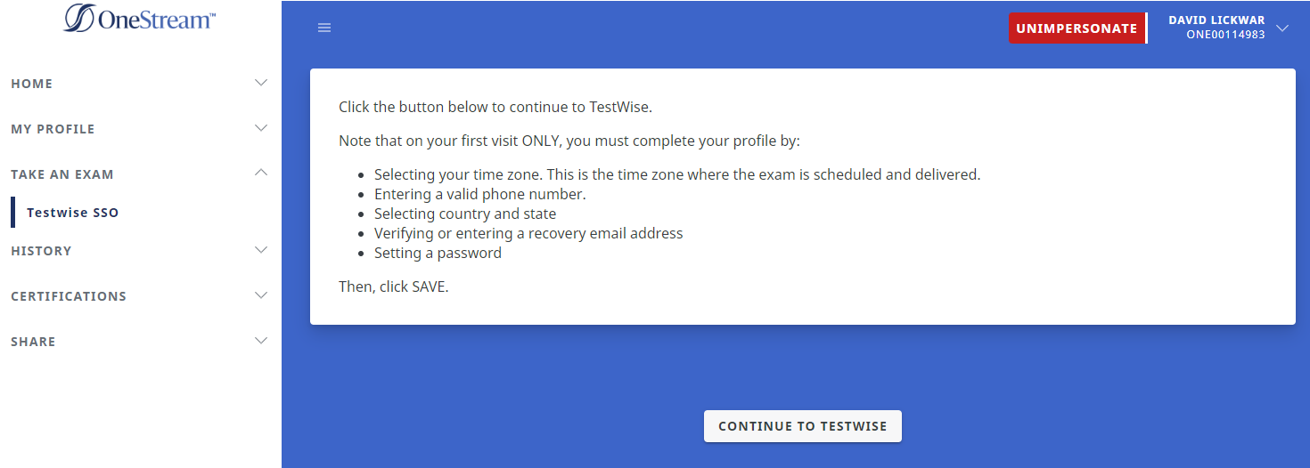
Register for an Exam
  When the page reloads, read the important message(s) and then click “Continue to TestWise”

Slide 8
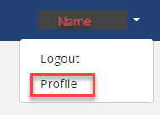
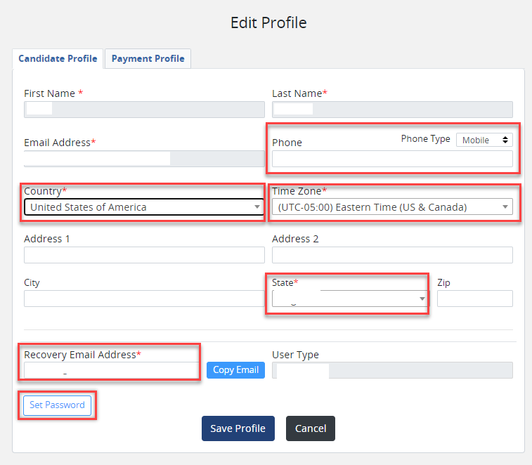
Complete your TESTWise Profile
Verify the information in your profile is correct
NOTE: This is only done the first time you visit TestWise
You will be unable to change your name or email address on file. Submit a case form to the Certification team via the ServiceNow Support Portal to update that information
Confirm your first and last name match what is on your legal ID that will be used on exam day. If a change is needed, contact OneStream immediately.
Ensure the following is present:
  Your time zone is correct
  NOTE: This is the time zone your exam is scheduled in
  A valid phone number
  Country
  State
  Set your recovery Email Address
Click “Set Password” to set a TestWise password
Click Save Profile

Slide 9
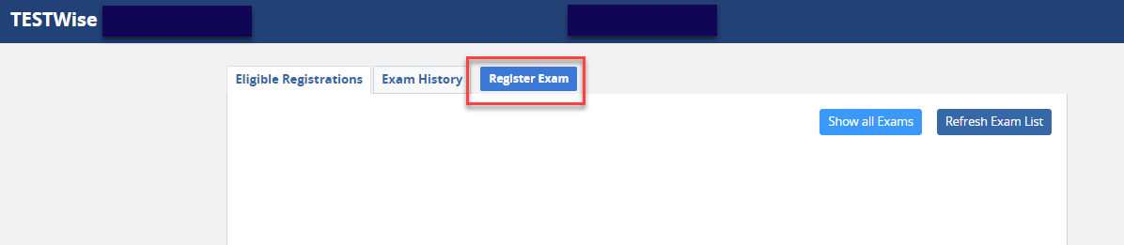
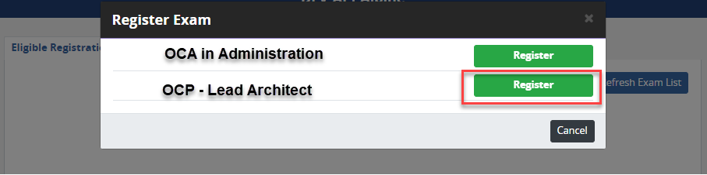
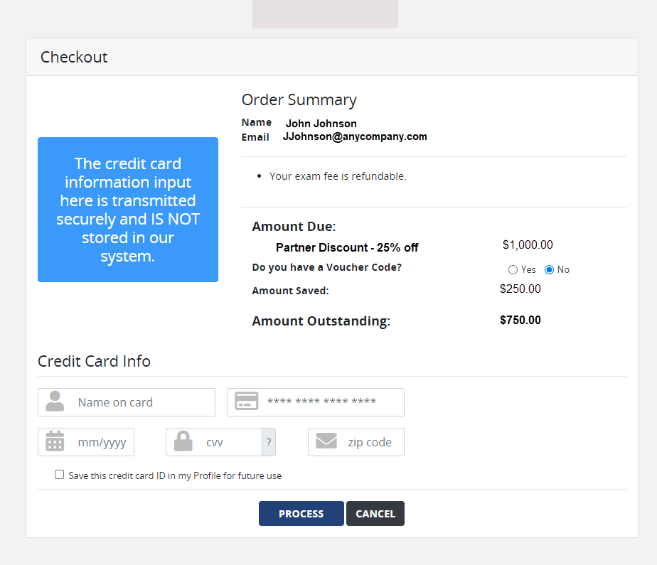
Schedule an Exam
1
Click Register Exam to schedule your exam
2
Click the “Register” button that corresponds to the desired exam
3
After entering payment information, candidates will be redirected to MonitorEDU to schedule exam
NOTE: All exams are delivered virtually; OneStream Certification exams are NOT offered in test centers

Slide 10
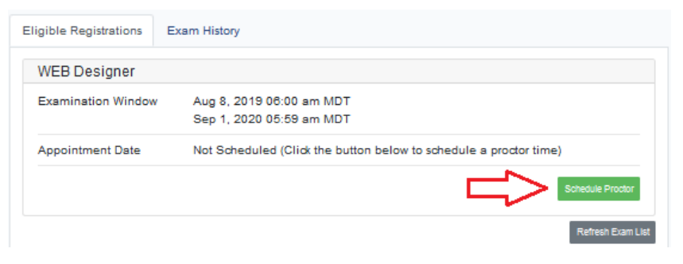
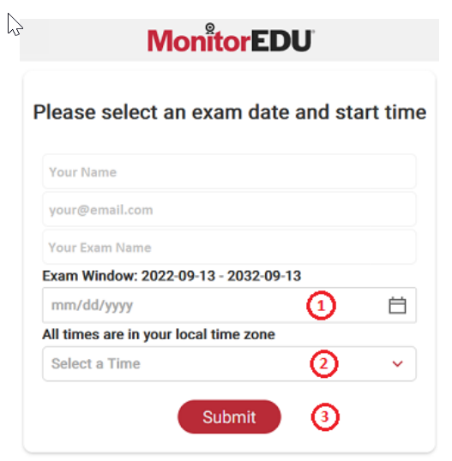
Schedule an Exam
Click “Schedule Proctor”
Select the date you’d like to take your exam
Select the time you’d like to take your exam
  Your scheduled time will be the time zone in your profile information
Click the “Submit” button
After scheduling your proctor, close the MonitorEDU web browser tab.
NOTE: The TESTWise screen will automatically update to show your scheduled appointment date. If not, click “Refresh Exam List”.

Slide 11
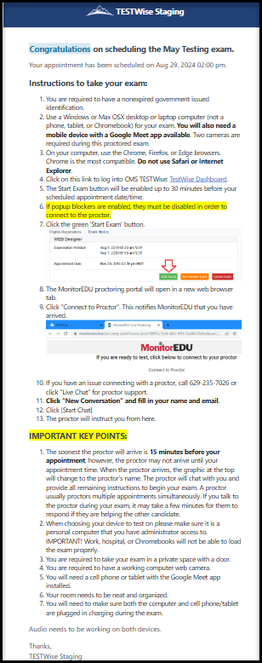
Confirming of your Appointment
After scheduling and paying, an email with your appointment details will be sent to you from TestWise.
Retain this email until after your appointment date; it is the ONLY communication you will receive regarding your scheduled appointment and appointment URL
Use a non-work computer and a personal Wi-Fi connection to take your exam.
If you are unprepared and therefore unable to take your test, your appointment will be used, and you will be required to contact your test sponsor to pay for and reregister for another attempt.
On exam day, log into CM Connect and SSO to TestWise 15 minutes before your exam appointment.

Slide 12
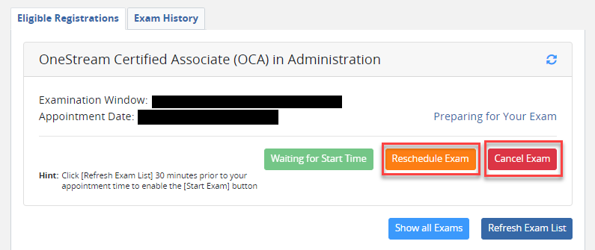
Reschedule/Cancel your Exam Appointment
Login to CMS TESTWise through CM Connect.
On the dashboard, click “Reschedule Exam” or “Cancel Exam”
The MonitorEDU proctoring portal will open in a new web browser tab. Follow prompts.
When you are finished in the MonitorEDU portal, close the browser tab. Click “Refresh Exam List” in the TESTWise screen to see any changes that were made in the MonitorEDU portal.
If you cancelled, the three buttons will change to a “Schedule Proctor” button, and you will be able to reschedule.
NOTE:
Candidates can reschedule or cancel an exam up to 24 hours before a scheduled exam without a fee/penalty
Rescheduling or canceling an exam within 24 hours of an existing appointment will result in a $5 late fee (payable the next time you schedule a proctor)
Candidates who do NOT appear for a scheduled exam, or who attempt to cancel or reschedule after their appointment begins, will forfeit the entire exam fee and must pay for another attempt.

Slide 13
On Exam Day
  Log into CM Connect.
  On the homepage, expand “Take an Exam” on the left.
  Click “TestWise SSO” to navigate to TestWise.

Slide 14

On Exam Day
  When the page reloads, click “Continue to TestWise”

Slide 15
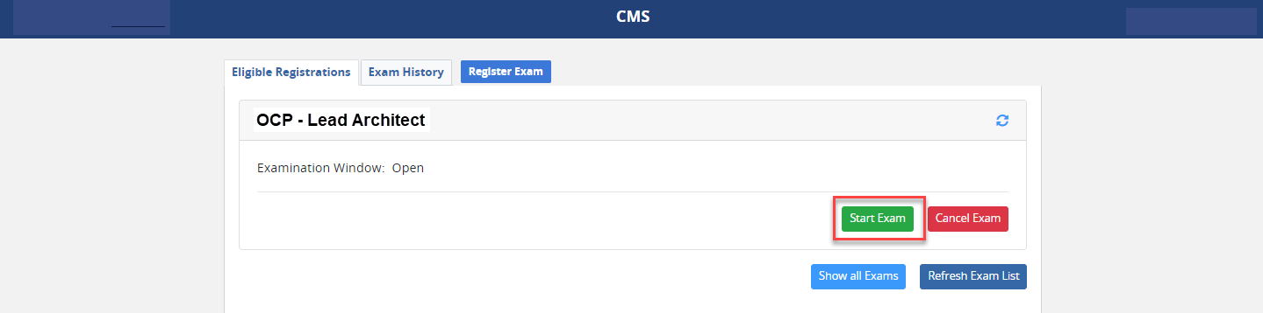
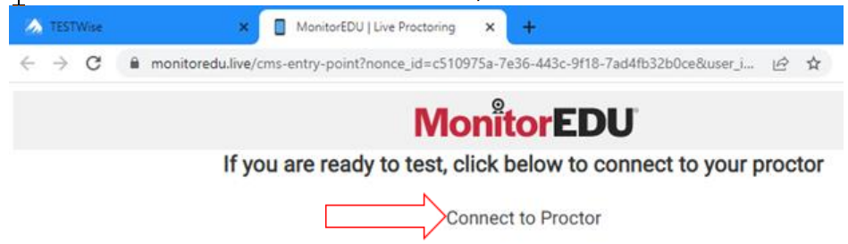
On Exam Day
Click the GREEN button labeled “Start Exam” 15 minutes prior to your exam time to begin your exam appointment.
The MonitorEDU proctoring portal will open in a new web browser tab.
Click “Connect to Proctor”. This notifies MonitorEDU that you have arrived.
Issues connecting? Call 1-629-235-7026 or click “Live Chat” for proctor support.

Slide 16
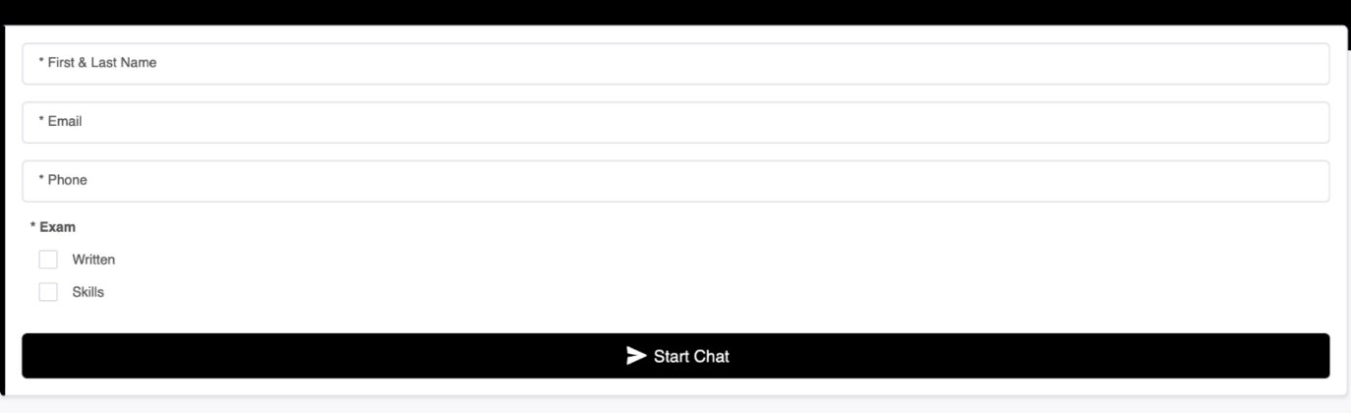
Populate Candidate Information and Connect to Proctor
The soonest the proctor will arrive is 15 minutes before your appointment, however,
the proctor may NOT arrive until your appointment time.
When the proctor arrives, the graphic at the top will change to the proctor’s name. The proctor will chat with you and provide all remaining instructions to begin your exam.
  A proctor usually proctors multiple appointments simultaneously. If you talk to the proctor during your exam, it may take a few minutes for them to respond if they are helping the other candidate
Complete these fields prior to the proctor joining:
  Click “Start Chat”
  A proctor will then
  greet you and get you
  connected with your
  mobile device using
  Google Meet.

Slide 17

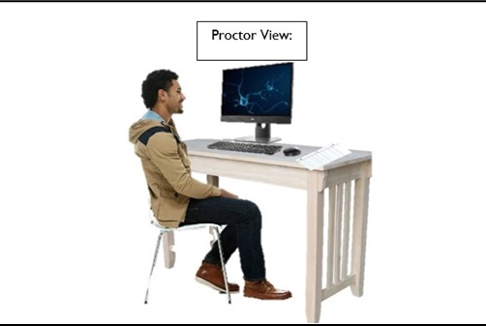
Using Your Mobile Device for Proctoring
In addition to your computer, you must have a cell phone or tablet.
  You will need to make sure both the computer and cell phone/tablet are plugged in and charging during the exam. Audio must work on both devices.
Although a proctor will walk you through each of the details below, the following will provide you with an idea of what will happen and what will be needed. These things will not always necessarily happen in this order.
Once the proctor arrives, they will send you a google meet code that you will connect on your mobile device, after that you will be speaking to the proctor, rather than typing chats.
  The proctor will then send you a URL to connect to MonitorEDU on the computer.
  The proctor will send you the rules for MonitorEDU and any specific rules about the exam.
  You will need to show your government-issue ID.
  You will complete a 360-degree scan of your room. See www.monitoredu.com/faq for specific details of how to set up your room.
  Desk surface needs to be clear of any non-exam related materials as in the following images:

Slide 18
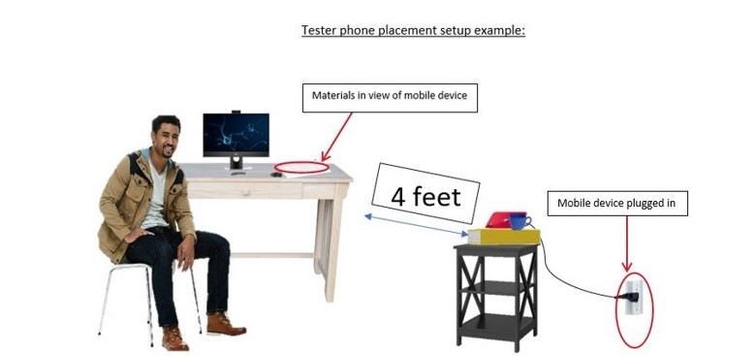
Using Your Mobile Device for Proctoring
Anything behind you needs to be covered and/or taken down.
While you may NOT use dual monitors during your exam, you MAY use a larger external monitor provided the laptop is CLOSED. As a result, you must provide an external webcam because the laptop will be closed.
  The proctor will ask you to place your mobile device carefully so that you and your screen can be seen easily. This may take some time, so be prepared.
The proctor will ask you to open Task Manager (on a Windows machine, ctrl-alt-delete; on Mac, Finder) and check to make sure you are not running any extra programs.
The proctor will ask you to make sure that remote access to your machine is turned off and provide instructions for how to accomplish this.
For security reasons, you will be asked to remove your watch, remove any listening devices (other than hearing aids), and check your pockets on high-stakes exams.
Once all the security checks and mobile placements have been completed, the proctor generates the exam links and provides them to you in the chat.
Click on the exam to initiate the connectivity check.
Begin your exam by clicking the “I am ready to begin” button.

Slide 19
Operating System Requirements
Several systems work together to deliver OneStream’s certification exams. It is essential that you test requirements of each system PRIOR to your scheduled reservation to avoid issues on test day
  You will need TWO cameras for your exam. One on your laptop and one on your mobile device.
    Download Google Meet for FREE on your mobile device.
  Verify your sound, camera, and microphone all function in both sample meetings
    Use a supported browser: Chrome, Firefox, or Edge (NOTE: Safari and Internet Explorer are unsupported)
    Turn off your popup blocker
  Verify you can complete this 5-question quiz PRIOR to exam day
    You must verify your computer and testing location both meet the minimum requirements. Perform these verification steps EARLY and from the same PRIVATE location and room where you will take your exam, using the SAME computer you will use when you take your exam.
  All background applications and processes must be disabled, as they could interfere with exam performance
  Be sure that all VPN software is disabled or disconnected. For best results, do NOT test on a work computer or Chromebook; there may be security configurations on your work computer that could affect exam performance
    It is common for companies to setup VPN and network filters that will interfere with your exam. Your IT department can add settings to allow your exam to function properly, but it may take a few days. If a candidate is unable to test due to interference with background applications and processes, the exam appointment and fee will be forfeited, and the candidate will need to reschedule their exam and pay a retake fee
      If you experience issues using a company computer or sitting at work, ask your IT department to following the instructions in this guide, which may resolve the issues
  Ensure that third-party cookies are enabled in the browser.
  Clear the browser’s cookies and cache.

Slide 20
OneStream Certification Team
For questions, submit a case form to the Certification team via the ServiceNow Support Portal

