Slide 1
May 2023
AIR-to-WATER & WATER-to-WATER HEAT PUMPS

Slide 2
③ endeavor to source all our parts from the Americas
Design strategy:
leapfrog the competition by solving problems they can’t or won’t
① prioritize reliable operation
② make our heat pumps fully serviceable
④ ability to customization our heat pumps
⑤ the introduction of renewable connectivity

Slide 3
A single platform designed around two semi-hermetic compressor types:
What we have created
①nominal 25 ton (clg) reciprocating compressor circuit, ranges from 25T up to 200T
②nominal 60 ton &120ton (clg) screw compressor circuits, ranges from 60T up to 360T
4 pipe Simultaneous ASHP is 25 to 200 ton in reciprocating compressor platform

Slide 4
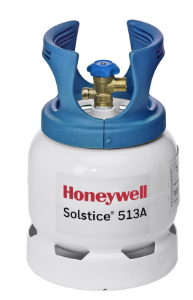
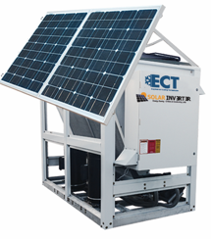
Green Refrigerant R513A
What we have created
①A1- which is low-toxicity and non-flammable
② Low Global Warming Potential at 630GWP
③ Azeotropic blend of HFC R134a (44%) & HFO R1234yf (56%) with zero glide
Designed to achieve ASHRAE 90.1 std 2019 minimum efficiency
special features such as:
adiabatic precooling
renewable energy
custom hydronic packages

Slide 5
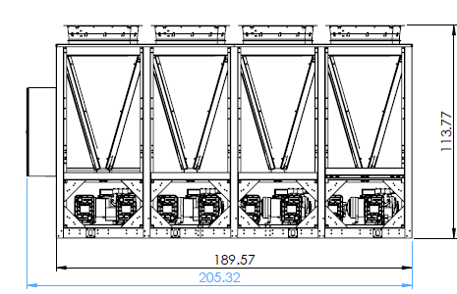
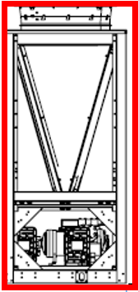
Each circuit is its own unit controls for best-in-class redundancy
Our Reciprocating model

Slide 6
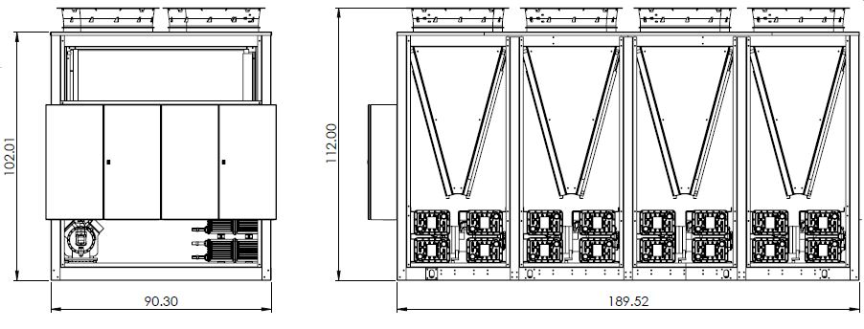
Ranges in sizes from 25 tons up to 200 tons in the same platform as the 2-pipe reciprocating. Since all modules are vfd driven and have their own controller, this results in best-in-class reliability & precision control
4 pipe Simultaneous ASHP

Slide 7
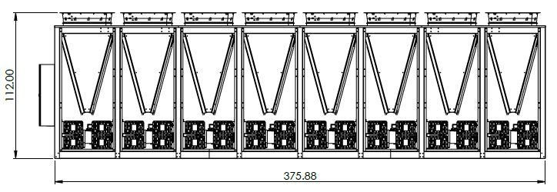
Here is a look at our size 200 and typical operating conditions to illustrate performance
in simultaneous mode we are pulling the heat from the cooling water loop and pushing it into the heating water loop
At the conditions above (45/110) this represents a TER of 6.93
TER is total energy recovery, and it is in the same units as COP
said another way, you put 1.0kw of electricity into this unit at these conditions and you get 7x the input in productive output

Slide 8
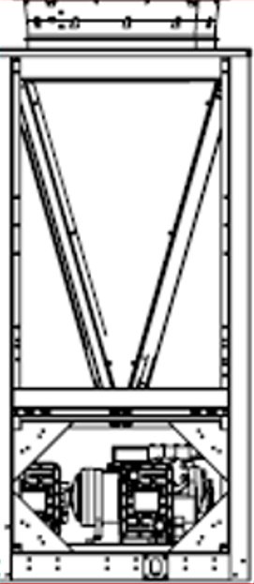
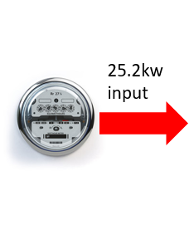
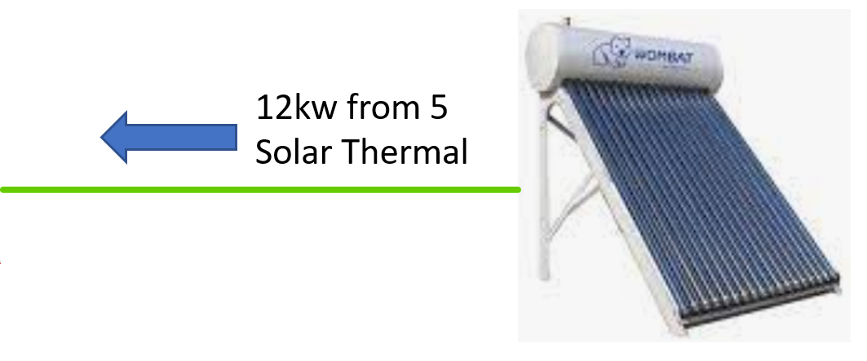
Renewable Connectivity- a great option!
On a 23F ambient day we can make 190mbh of 110F water at a COP of 2.2 with our size 025, draws 25.2kw power….
and with some renewable energy sources (shown below) we will only need to consume 1.2kw of utility power

Slide 9
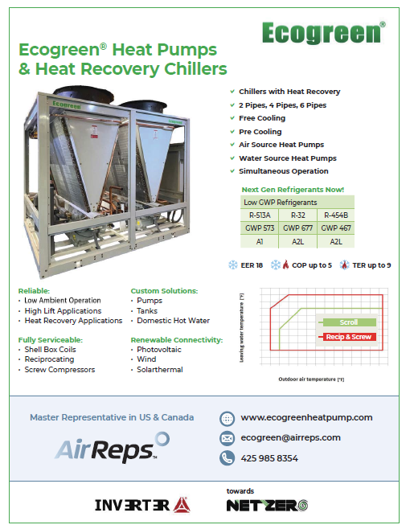
The state of Ecogreen:
2-pipe ASHP product-
available today!
available today!
4 pipe ASHP product-
Dedicated heat recovery-
available today!
water-to-water 4-pipe heat pump, &
water-to-water 6-pipe simultaneous heat pump…
available today!

Slide 10
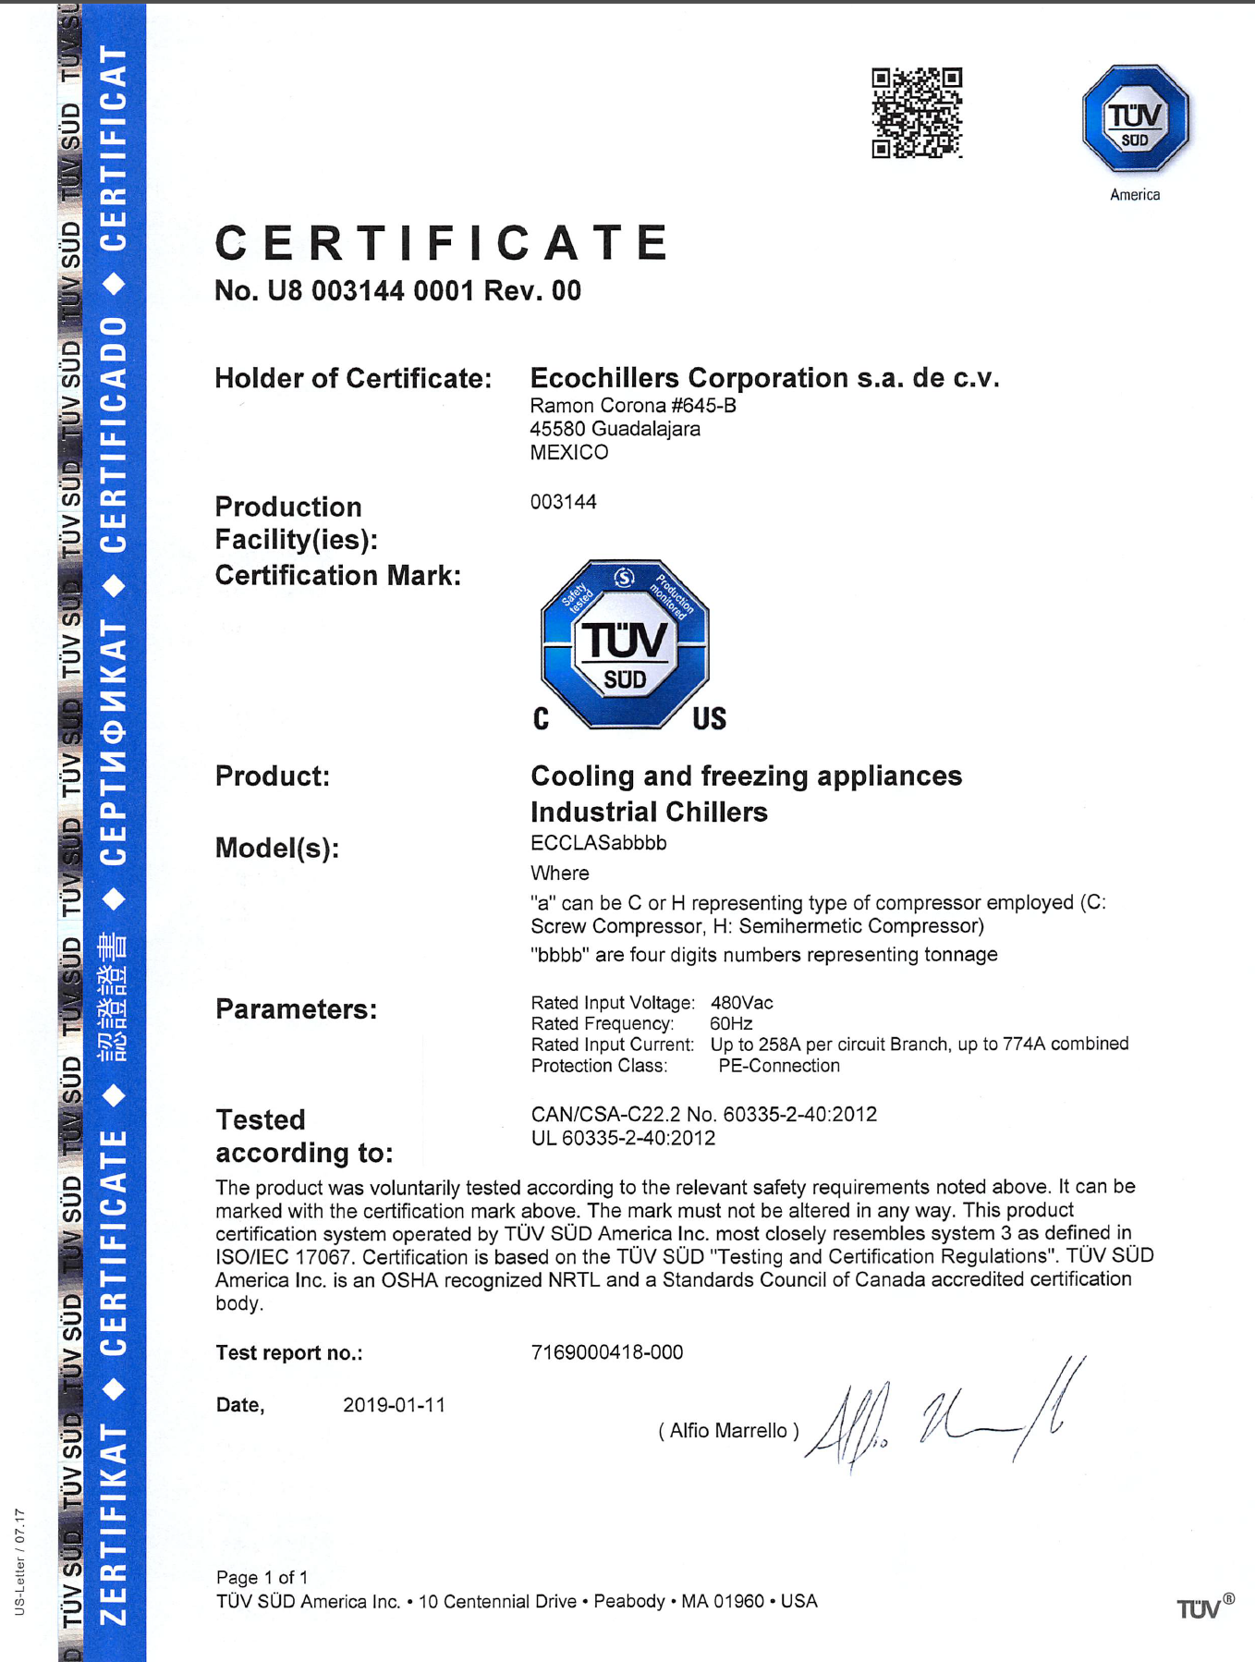
Internationally Recognized Testing Lab
Deeper dive
TUV is a globally recognized testing lab from Europe and it is recognized in the US & Canada (NRTL)

Slide 11
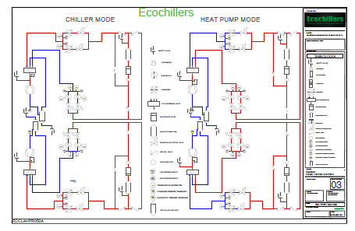
Deeper dive

Slide 12
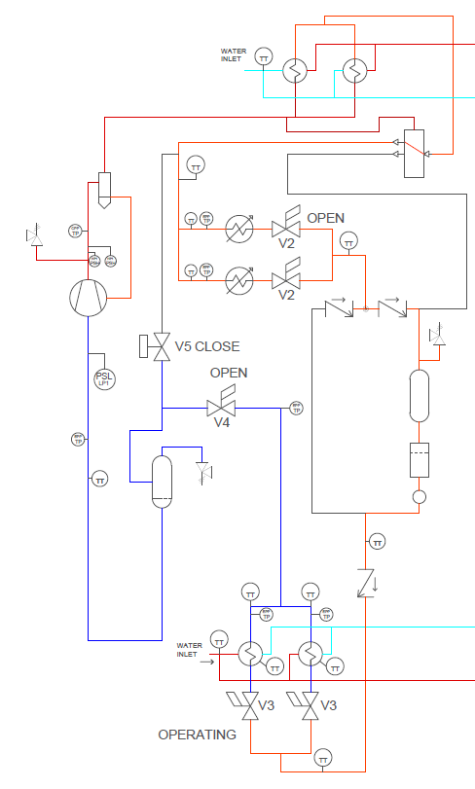
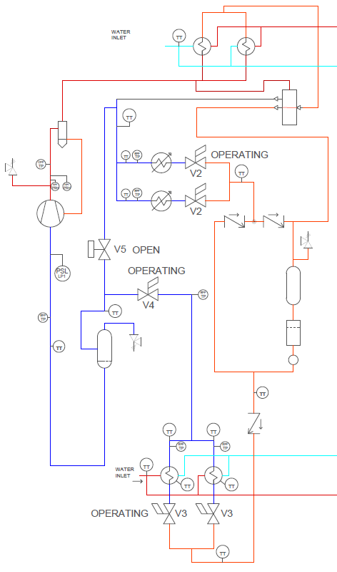
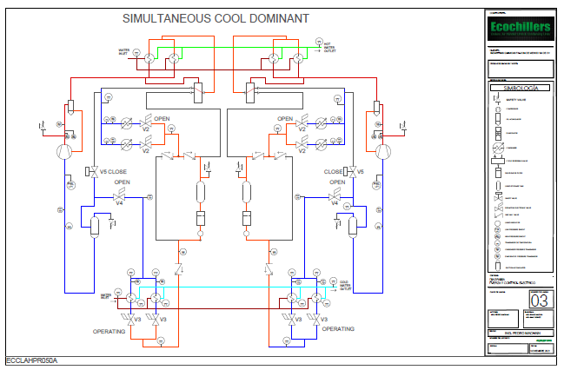
While the competition tries to catch the load, we track the load with each circuit!
Each circuit balances (modulates) to meet all loads. We Heat and Cool to the correct capacity AT THE SAME TIME!
The others cycle on/off & bounce from one mode to the other using time & loop temperature drift in an effort to catch the load…
but it is reactive rather than proactive.
4 pipe Simultaneous ASHP- the advantage

Slide 13
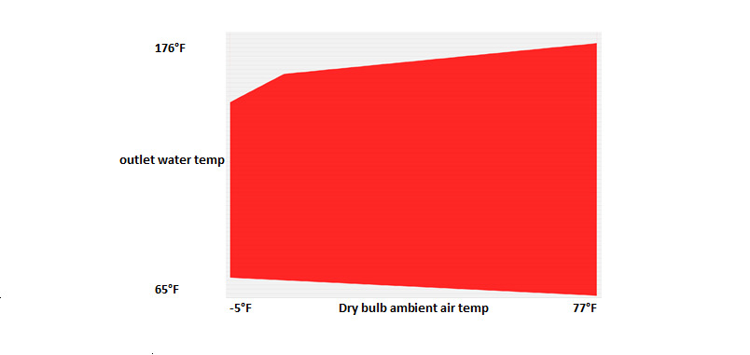
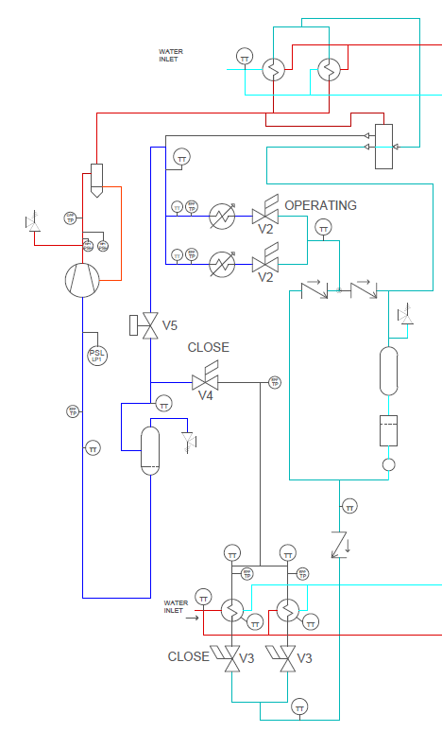
Industry leading reliability-
Proper application of compressor operating map
Deeper dive
Refrigerant receivers for mismatched loads from cooling & heating
VFDs on compressors & EC motors on air coil fans

Slide 14
High Lift (hot water) & Low Suction (cold ambient) conditions in heating mode is a lot like commercial refrigeration….
Just Opposite
This Photo by Unknown Author is licensed under CC BY-NC-ND

Slide 15
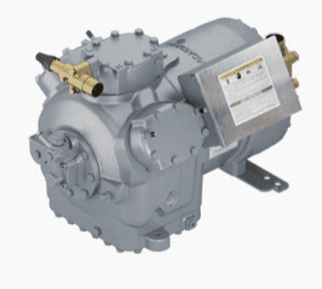
Deeper dive
Proper application of compressor operating map
This is the operating envelop in heating mode for our Reciprocating compressor
Semi-hermetic compressors designed for high lift & low ambient temperatures

Slide 16
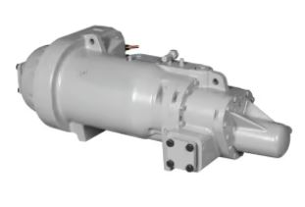
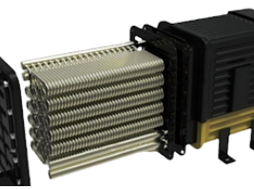
Fully serviceable-
Deeper dive
Semi-hermetic compressors are designed to be worked on in place
Shell box heat exchanger can be opened and cleaned

Slide 17
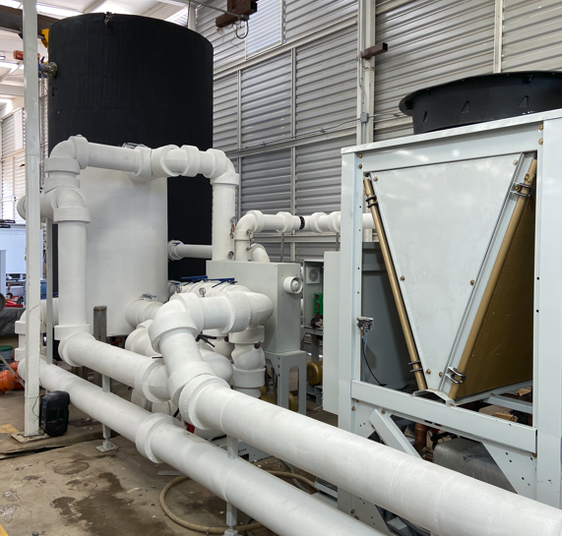
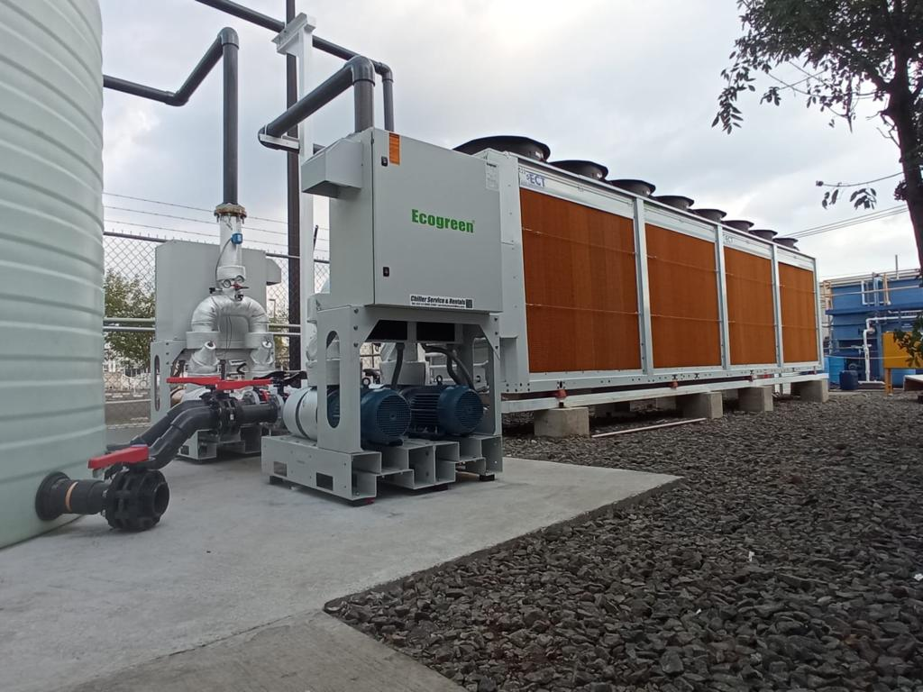
Customizable
Deeper dive

Slide 18
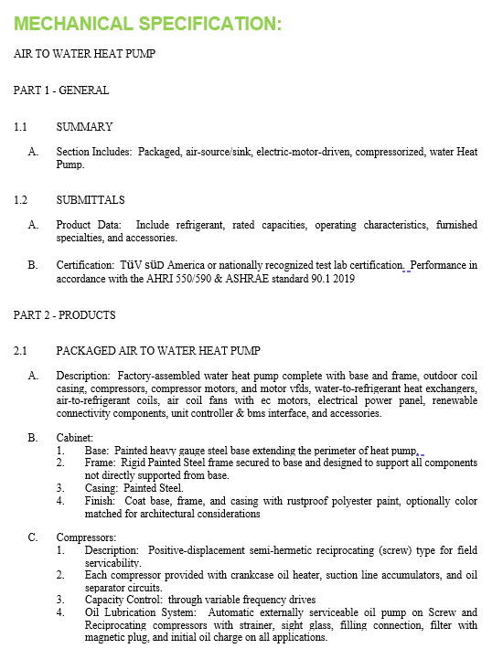
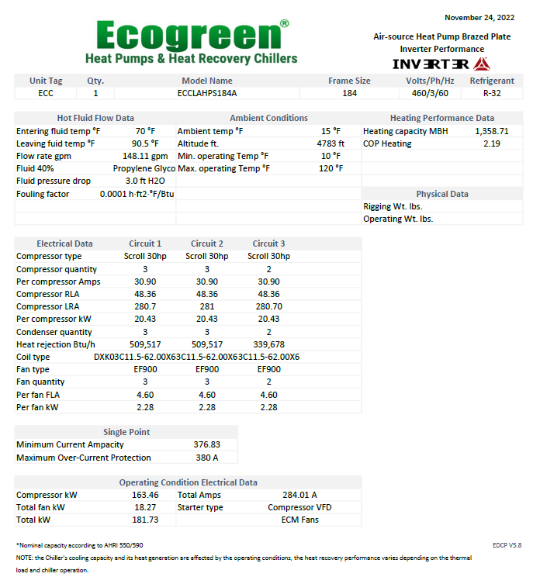
support

Slide 19
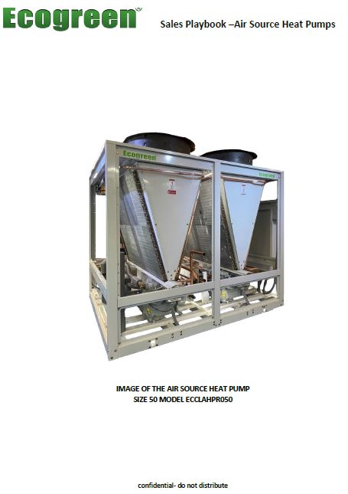
support

Slide 21
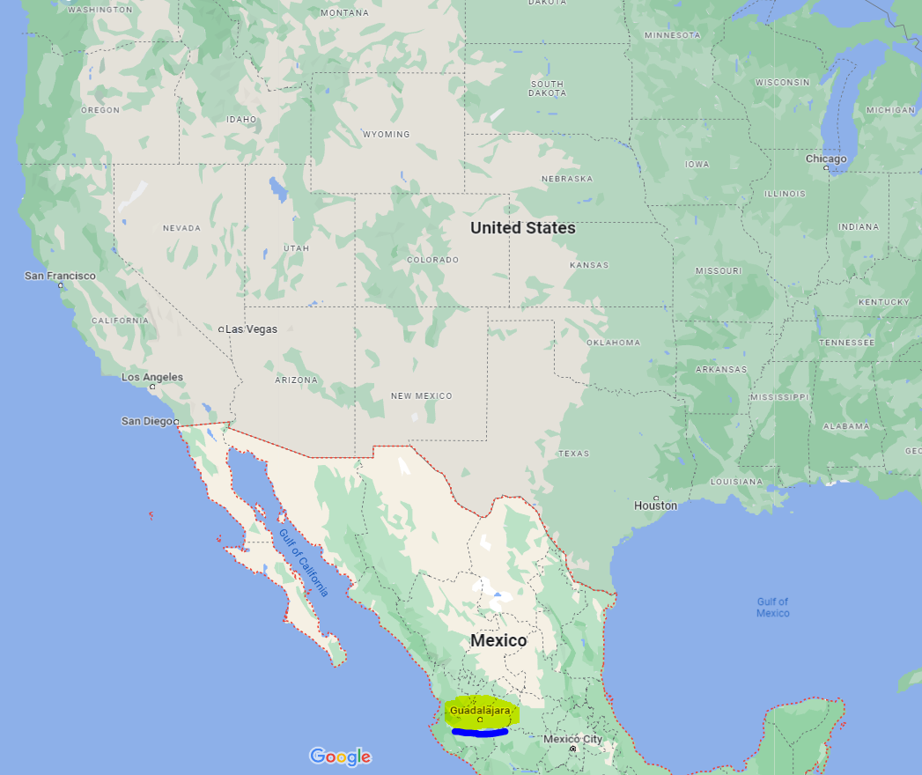
About Ecochillers
Ecochillers is a Mexican manufacturer of chillers, and they specialize in heat recovery.
In business for 25yrs they are located in Guadalajara, Mexico just northwest of Mexico City.
Ecogreen heat pumps are another chapter to a long history of production by EcoChiller.

