Slide 1
Design Practices
for
Air-to-Water &
Water-to-Water Heat Pumps
Dave Greenheck, PE CEM
Director of Product Development
July 2023

Slide 2
Agenda for today’s training
How does a Heat Pump work?
Recommended Layout
Electric & Gas Water Heaters & Domestic Hot Water
Operating conditions & the operating envelope
Constant water flow vs Variable water flow
Defrost- its derate on capacity & efficiency
System volume- how to properly size the system
Water quality & scale from heating mode
Applications- hybrid design, DHRC, & proper redundancy

Slide 3
How does a Heat Pump work?
In winter we pull heat from the atmosphere and push it into the house
What’s it purpose, It’s in the name…
It “pumps heat”
In summer we pull heat from the house and push it to the atmosphere

Slide 4
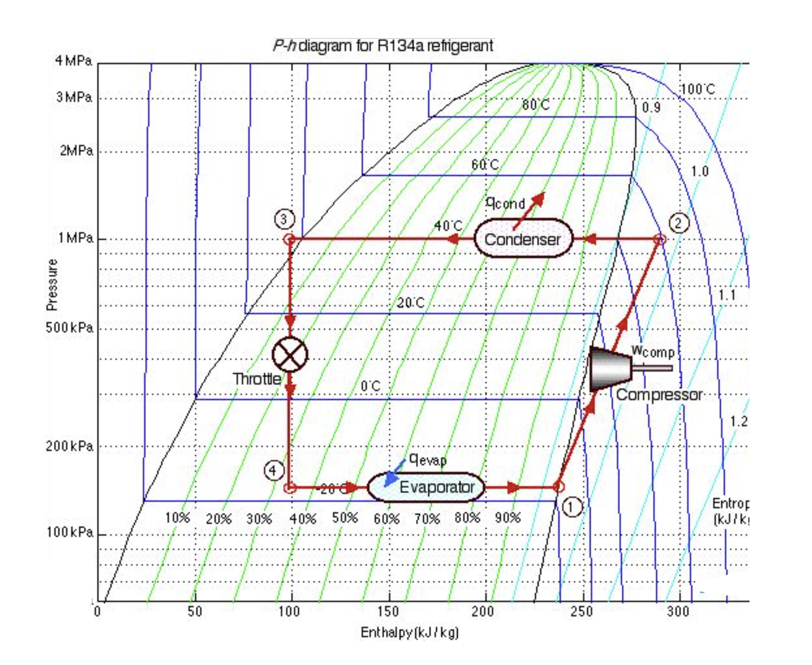
How does a Heat Pump work?
Below is a PH diagram with refrigeration components/cycle superimposed
Hot water in heating mode or warm summer air in cooling
Cold water in cooling mode or cold winter air in heating mode

Slide 5
Recommended Layout
Air source heat pumps want constant flow
If the building side needs variable flow, then decouple it from the heat pump(s)
This can be accomplished with 4 ported buffer tanks, gasketed plate heat exchangers, or a decoupler pipe

Slide 6
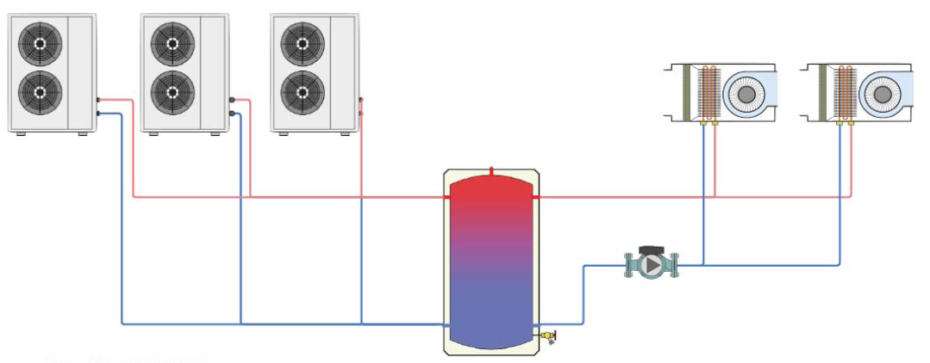
Recommended Layout
when multiple units are used for either redundancy or to meet the load,
then these should be piped in parallel

Slide 7
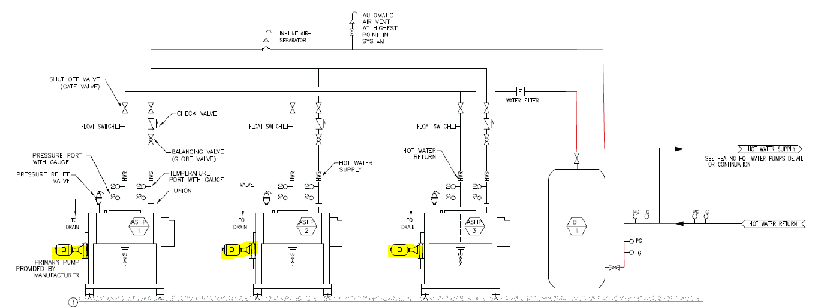
Recommended Layout
One pump per unit is ideal, alternatively a set of primary pumps serving all heat pumps
Either works but dedicated pumps per ashp is easier & reduces chances of operating problems

Slide 8
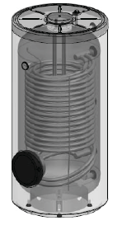
Difference between compression heat & electric/gas heat for DHW
When sizing indirect tanks for domestic hot water (DHW) you’ll need more surface area when using heat pumps vs gas or electric water heaters. This is because the transfer of heat depends on the surface area and the delta T of the fluid, and the delta T of a heat pump is typically about ½ that of a gas or electric water heater
Gas & Electric water heaters can do very large delta Ts (>30F) while compression systems (heat pumps) are more limited ≤16F.
Therefore, you may need a larger heat exchanger (up to double the surface area) when doing DHW retrofits.
A rule of thumb with indirect tanks & heat pumps is about 90 sq in/mbh

Slide 9
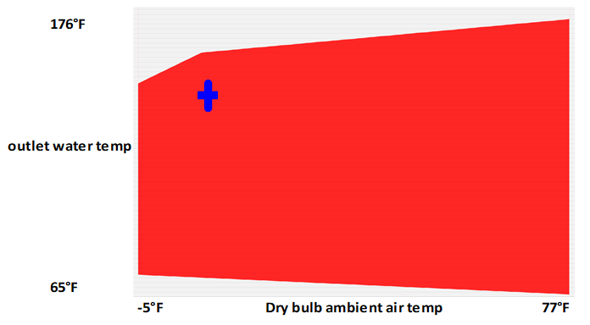
Operating Temperature vs Operating Envelope
While operating at the limits of the compressor envelop is possible, it is not advisable for extended periods.
Similar to your car-
just because your speedometer goes to 160mph, it doesn’t mean you should run it at that speed continuously

Slide 10
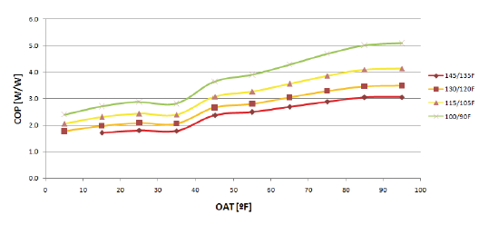
COP as it relates to Air & Water conditions
Coefficient of Performance is affected by both the outside air temperature and the leaving water temperature
The bigger the difference (lift) the less efficient the operation of the ASHP
below is a chart showing COP of a typical scroll heat pump in heating mode w/ curves of varying LWTs
Some compressors (recips & screws) do much better with higher lifts, so be mindful of what LWT’s you specify and which type of compressors you allow in your design.

Slide 11
COP of the Central Plant vs efficiencies of the Terminal Devices
While ensuring your central plant has high efficiency (COP) and leaving water temperature has an effect on that…. you must also balance the energy your system consumes at the terminal devices (fan coils, radiators, etc) and leaving water temperature affects that too.
For example, if the leaving water is only 110F it may take a 3 or 4 row fancoil vs a 1 or 2 row fancoil which represents higher first cost & fan energy.
And while oversizing a fan coil may work in some cases it often conflicts with minimum turndown requirement.
So, in the final analysis, it’s not a simple one LWT answer but a comparison of whole system efficiency & requirements that drives the LWT decision.

Slide 12
Constant Flow
ASHP prefer constant flow over variable flow
The waterflow rate through each unit should be constant and within the min & max allowed:
Too high of flow may cause mechanical damage to the heat exchanger & compressors to short cycle
Too low of flow can cause poor water distribution inside the heat exchanger with danger of water freezing & high pressure alarming conditions when in heating mode
Good delta T is typically between 8 and 16F, but avoid designing systems close to these limits when possible.
Recommended delta T is between 10 to 14F

Slide 13
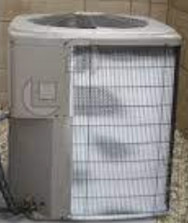
Defrost
ASHP need to perform defrost cycles, more or less depending on operating conditions
Typically frosting on the outdoor coil occurs between 40F and 25F

Slide 14
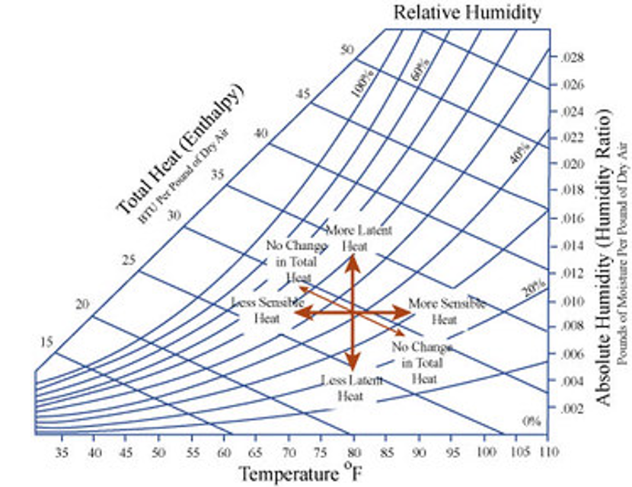
Defrost- why does it occur between 40F & 25F db?
Above 40F db ambient the air coil temperature is above 32F (freezing)
Below 25F db Ambient the air coil is well below 32F but there is not enough absolute moisture in the air to form frost

Slide 15
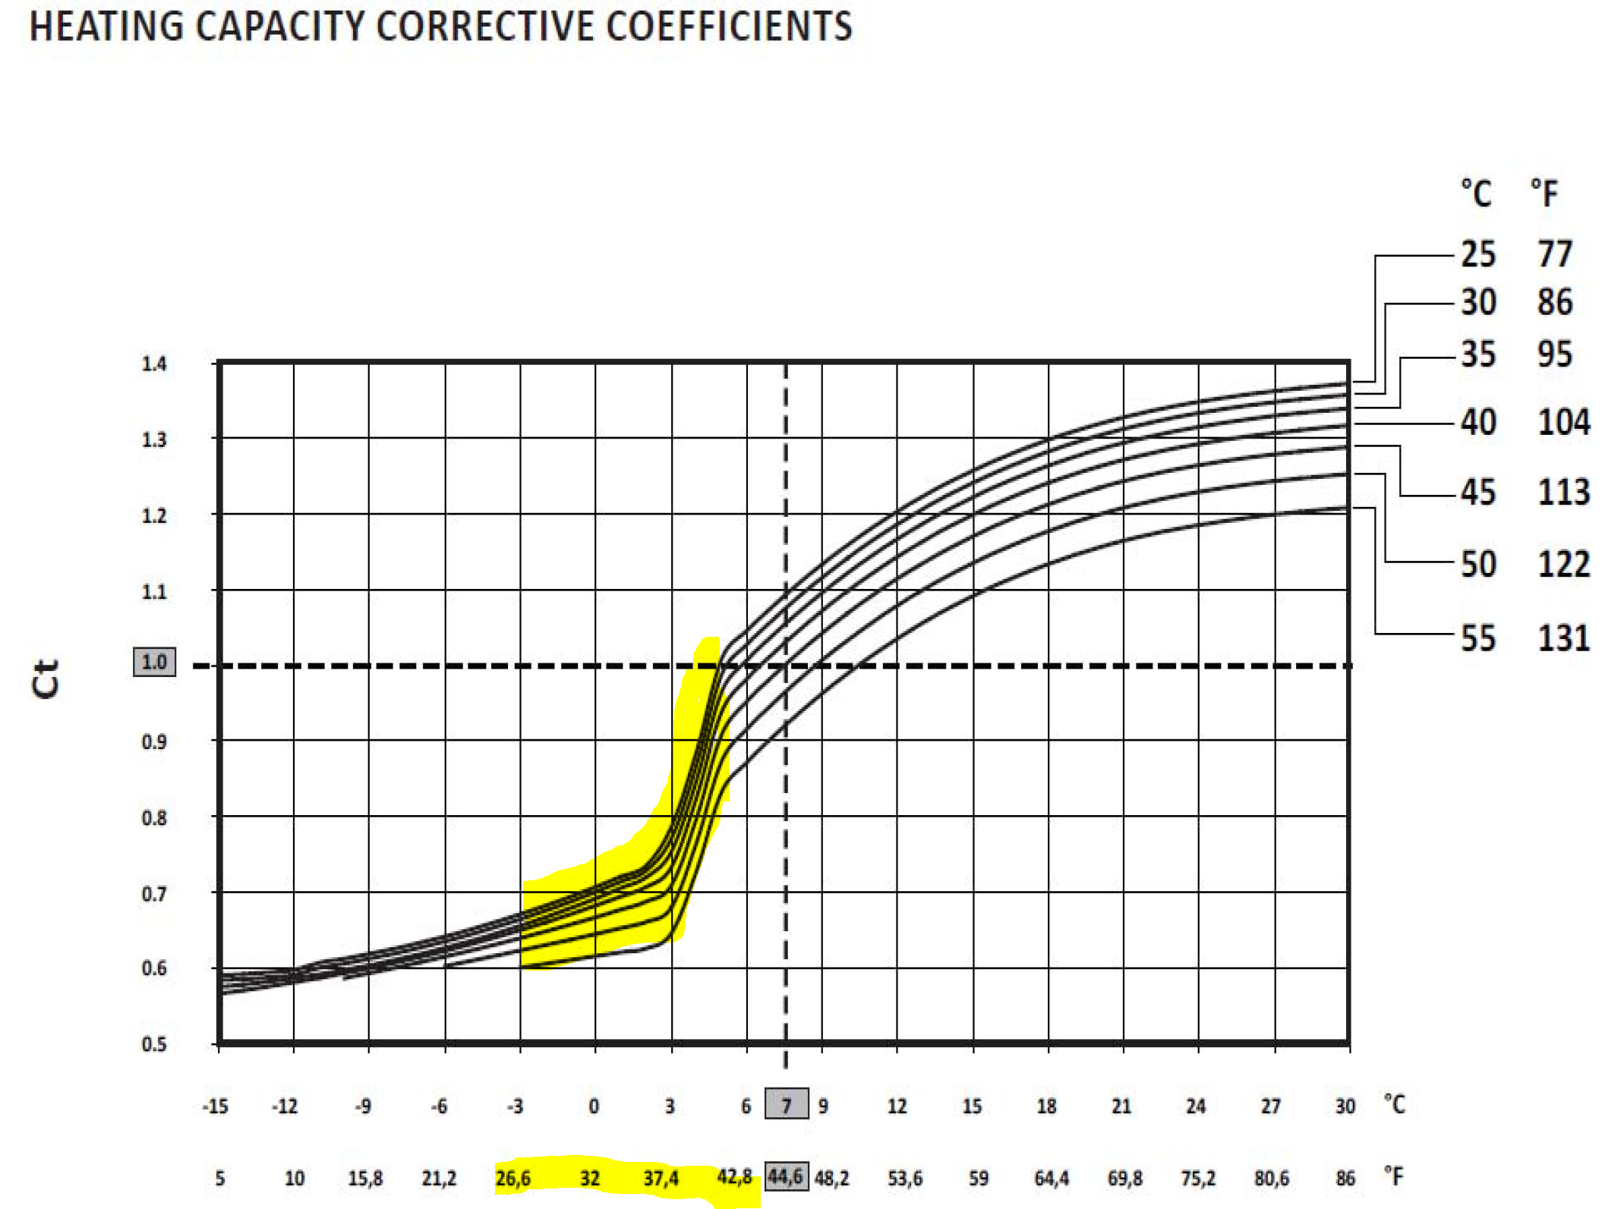
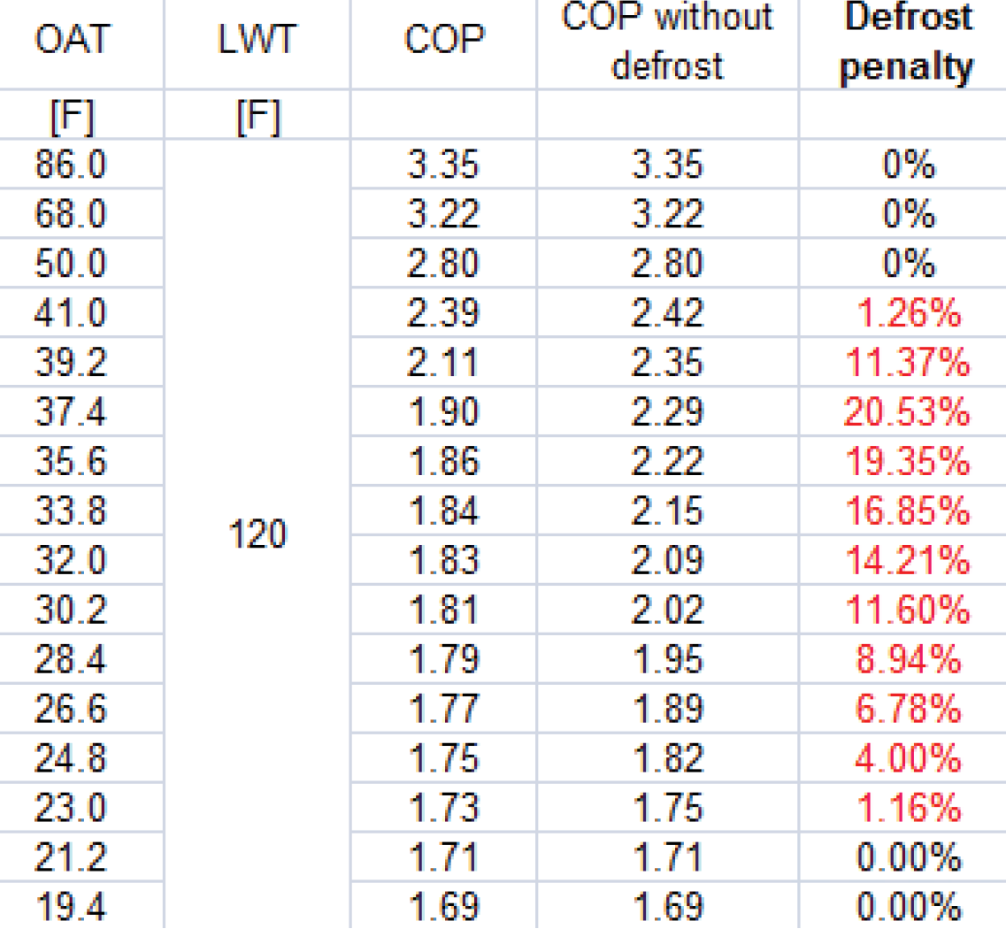
Defrost
Defrost cycles must occur on the outdoor coil typically between 40F and 25F, and below is a visual of that loss of effective capacity over time when outdoor temperatures pass through this temperature range

Slide 16
Defrost
In Europe the Eurovent standard for ASHP’s EN14511:2018 requires defrost derate appear in all certified ashp manufacturer’s selection data.
This is not a requirement in the North America yet because AHRI hasn’t adopted a standard for air source heat pumps, but it is coming & it will most likely mirror the Eurovent standard.
In the meantime, several manufacturers are claiming anywhere between 10% & 15% derate. This is something you’ll want to confirm with each ashp manufacturer you are working with in design.
In cold climate designs compare the building heating load at design condition (ie; 5F db ambient) to the building heating load at 25F, and if the design condition is > 1.15 x heating load @ 25F then you have enough capacity to account for defrost derate.

Slide 17
Defrost
Defrost has an impact on the performance of an air source heat pump. Remember when defrost is active you aren’t heating the system but taking heat out of the system in our 2 pipe configuration, therefore:
It must be considered when sizing the unit, unless the design heating ambient temperature is well below 25F
It should be considered when calculating the required system volume and buffer tank (if needed)
It should only initiate when needed
It should run for the minimum time possible

Slide 18
Defrost
Ecogreen specific note:
Our 4 pipe simultaneous ASHP requires chilled water flow & a chilled water load (albeit small). The bigger the loop volume the less load you’ll need, but you may still need a load.
Our piping design uses the energy in the cold water loop to effect defrost of the air coil
This was a conscientious decision as we know simultaneous heat & cool ashp’s are best applied when there is a continuous heating & cooling demand, so it is not a burden to operation and assists with system efficiency. In fact, it become a benefit as it removes heat from the chilled water loop when in defrost
in the rare case where this cannot be supported, and you want 4 pipe simultaneous heating/cooling, you can add a diverting valve & piping to allow flow from the heating loop to the cooling loop in order to draw load to the cold side.

Slide 19
System Volume sizing
Minimum system volume sizing depends on the size & type of unit.
This minimum system volume is dependent on these criteria…
Minimum compressor run time to ensure oil returns to the compressor
Maximum compressor starts per hour
The decrease in system water temperature as a result of the defrost cycle
Some manufacturers require minimum operating mode run time for simultaneous cooling & heating units (4 pipe ashp). Ecogreen does not but others do, so keep that in mind.

Slide 20
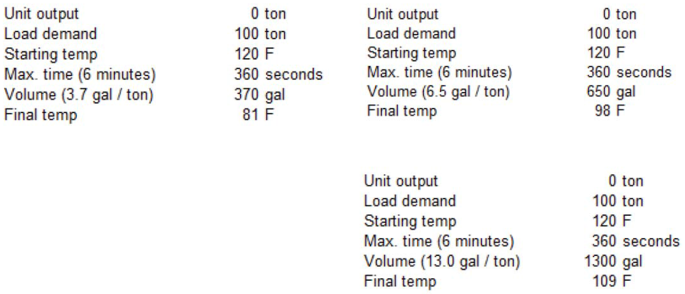
System Volume- sizing for defrost
How low will the loop temperature be after a defrost cycle in our 2pipe ASHP and in others ASHPs in general?
Example
100 ton ashp
100% heating demand on a cold winter day
in defrost, the cycle reverses so the unit is in cooling mode
which drops the loop temperature

Slide 21
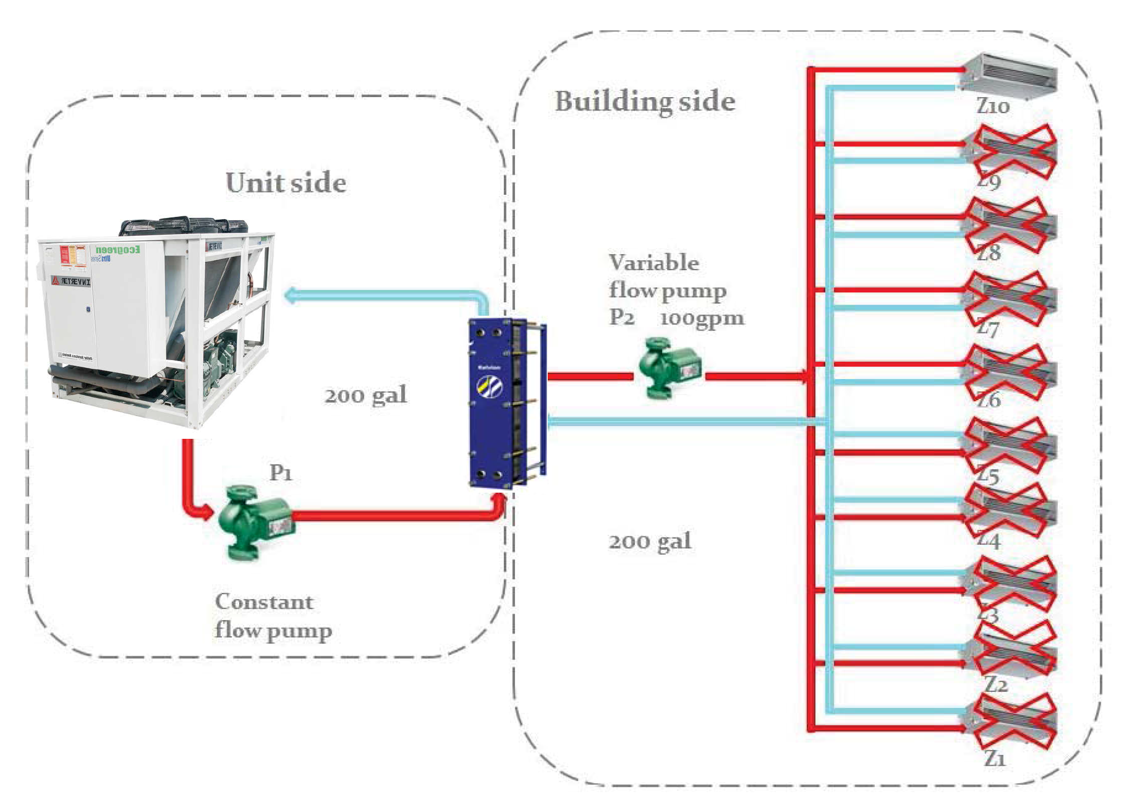
System Volume- effective volume
Only count what is active in the worst case scenario, so closed zones don’t count. Add the primary & secondary loops for total volume.
If this is less than the required system volume, then a buffer tank equaling the difference must be added.
Be sure to start the secondary pump prior to enabling the heat pump, and only stop the secondary pump after disabling the heat pump

Slide 22
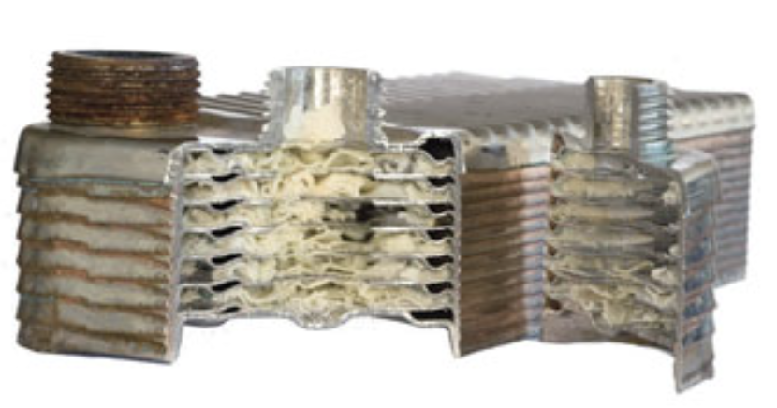
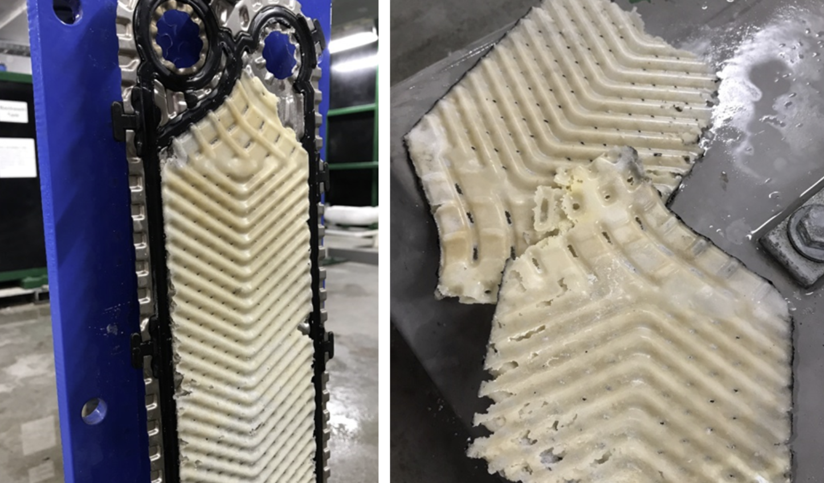
Water Quality & Scale
Water is inversely soluble, which means minerals like calcium come out of solution when water is heated
This means scale will form on surfaces, like the ones shown below. This is not a problem in cooling mode so mostly overlooked by heat pump manufacturers.
So, it is important to understand & control the quality of the water in our system should your heat exchangers be susceptive to scale.

Slide 23
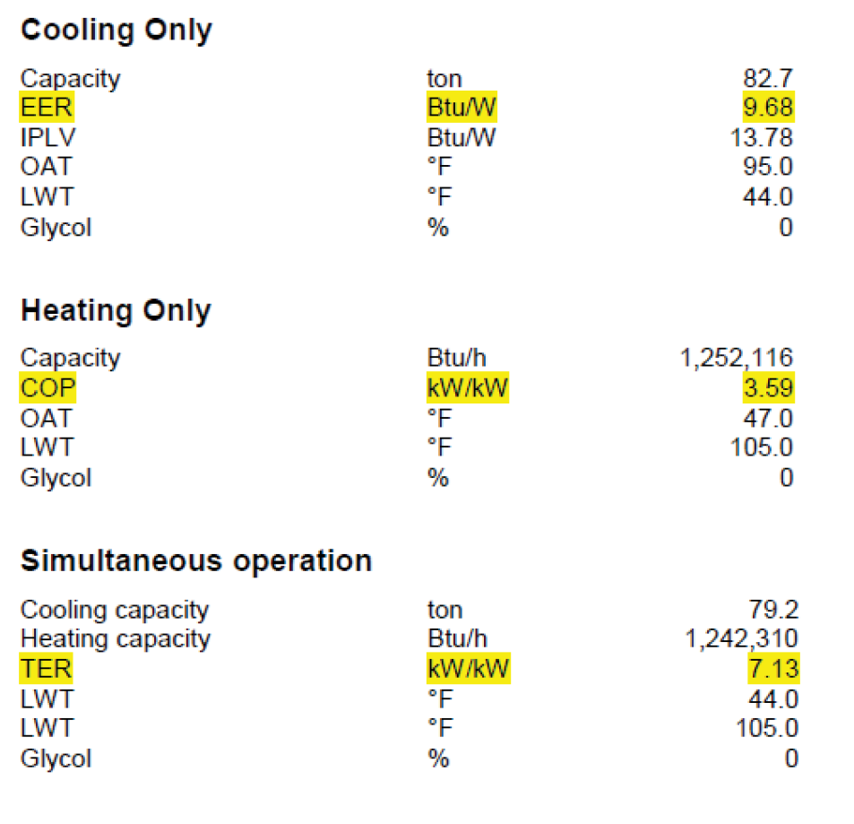
Applications- hybrid design
Heat recovery chillers are very efficient when operating in heat recovery mode, and heat pumps are a very efficient method of heating water. Both can generate energy savings resulting in reduced operating costs.
However, there are more efficient solutions to produce just cooling.
For most buildings, a hybrid solution with both heat recovery, heat pumps, & chillers is the most efficient & cost effective solution.

Slide 24
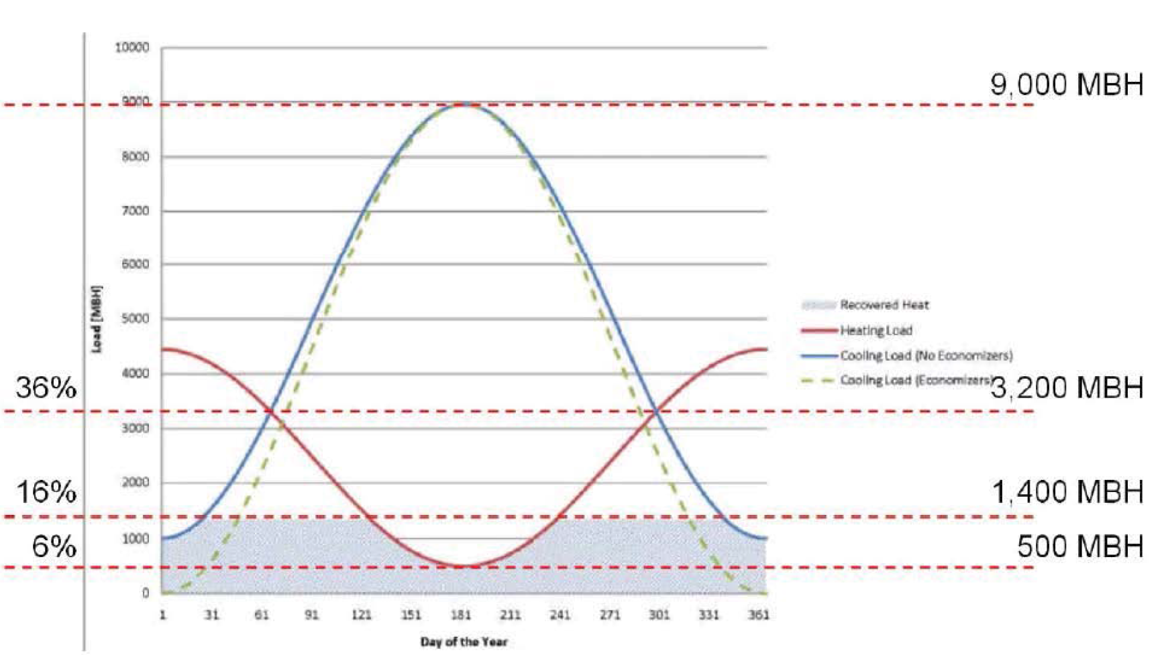
Applications- hybrid design & energy recovery
Just because you can provide a 4 pipe simultaneous unit that doesn’t mean that you should make the entire plant 4 pipe simultaneous ashp’s
Try to size the simultaneous unit so it operates as much as possible.
By doing this you also get the best payback on the 4 pipe unit investment

Slide 25
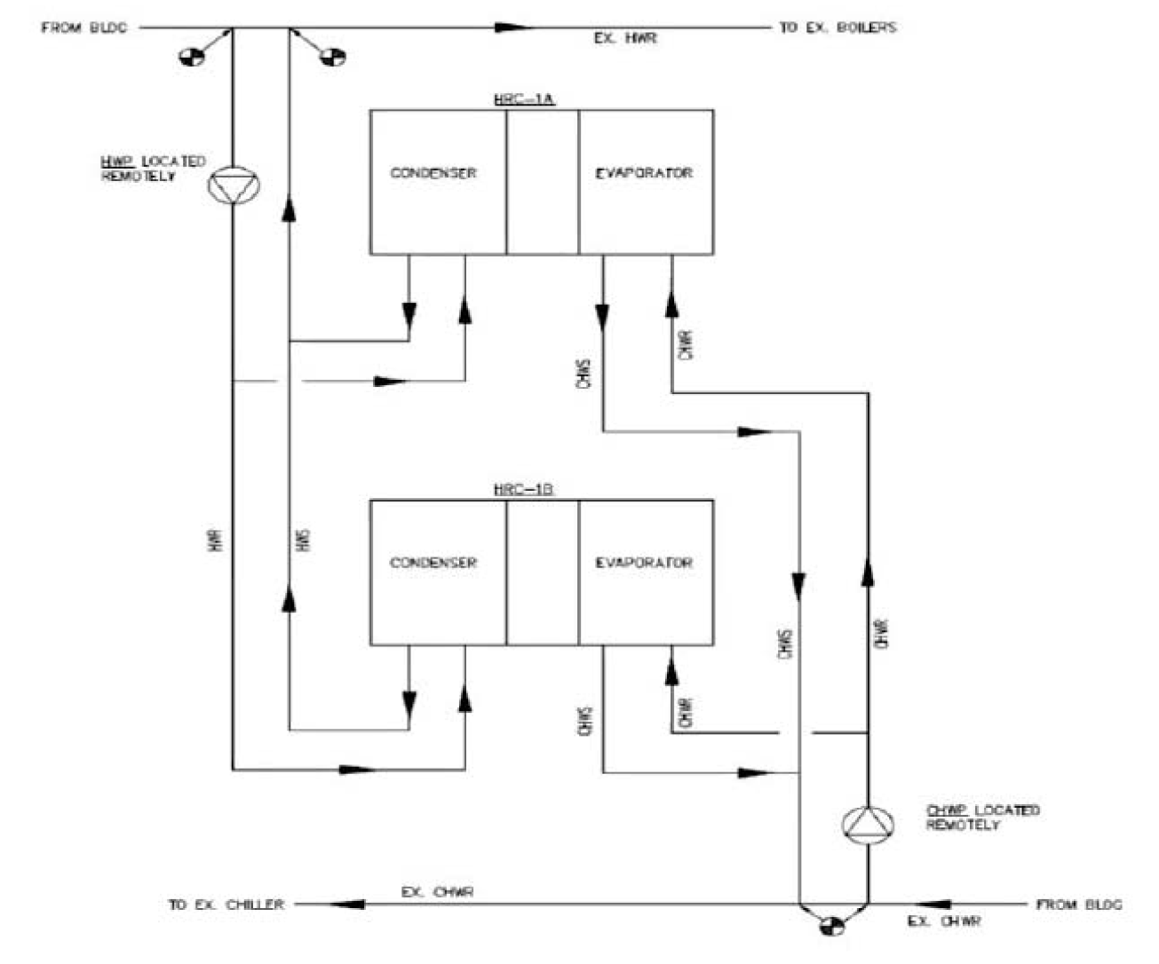
Applications- dedicated heat recovery
First, a note on dedicated heat recovery chillers…
Since the unit is not connected to a source loop its output is limited to the smallest load of the two sides (heating or cooling)
These chillers are water-to-water type, so you cannot heat when you are not cooling, and vice versa
If there is no bms interface, then you must size it for the min cooling or heating loads that are always present
Also, you can only control to one side of the chiller at a time. So, it’s either controlling to the cold side or to the hot side.

Slide 26
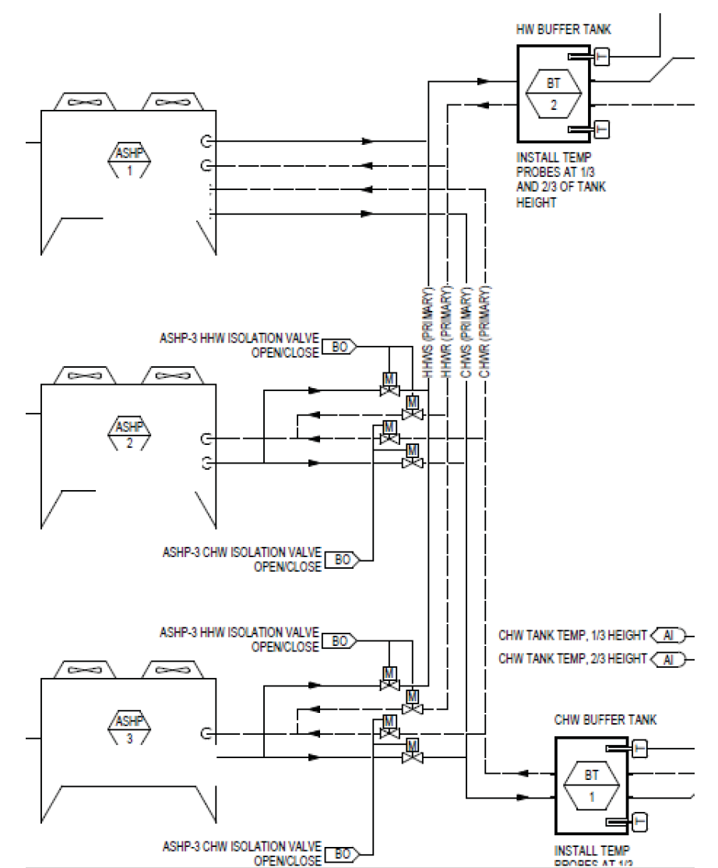
Designing for redundancy
The magic number of Heat Pumps is 3!
If any one of the three is down, then at least you have one for cooling loop and the other for the heating loop
They don’t have to be the same size or all 2 pipe or all 4 pipe, you just need qty3 minimum for some redundancy. And your customer can determine sizes based on the amount of redundancy they want

Slide 27
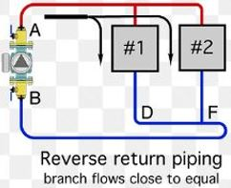
Piping Note
We install the piping headers (supply & return) in the field outside of the unit casing in order to maximize component access for service & repair. Please note the following regarding this configuration
Ships loose for field install or the field can do a custom piping arrangement if desired
Isolation valves to each ckt (module) are not required but they can be beneficial to mimimize water drain when servicing
Because of this uniqueness the piping connection location is more flexible, but we recommend reverse return piping when coming from one of the two ends of the unit.
Standard practice is to run water through all shell boxes regardless whether they are active or not

Slide 28
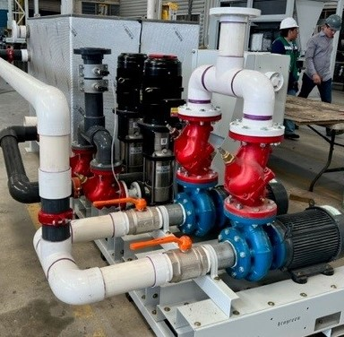
Pumping Note
Pump packages are also external to the casing and typically end mounted opposite the control panel side of the unit.
It can be single point or separate point powered. In either case they are unit controlled.
We can provide a single pump or everything up to and including an entire hydronic plant (buffer tanks, expansion tanks, primary & secondary pumps, gasketed plate heat exchangers, etc in a pump room enclosure).

Slide 29
Conclusions
All ashp’s must defrost when in heating mode and operating through cooler ambient temperatures. The performance derate for capacity must be accounted for when sizing systems and calculating system volumes.
Follow guidelines for properly sizing system volume and buffer tanks
Recommended layout:
Primary/secondary for constant flow through the heat pumps
Buffer tanks on the primary loop
One pump per unit
Simultaneous heating & cooling units can greatly increase the efficiency of a building, but care must be taken to best match the unit size to the dominate simultaneous loads. Oversizing these units will decrease the plan efficiency.
Avoid designing at the edge of the operating envelop and design around reasonable delta Ts

Slide 30
Q & A

