Slide 1





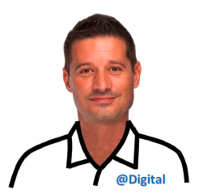

“RDS 4 all” use case
RDS4X.org
Common Meaning
81346 RDS
“A common language for aerospace, … and beyond!”
Presented by Thomas BARRÉ (thomas.barre@airbus.com / common.language@airbus.com)
Notes:
Good morning, nice to meet you all.
I am Thomas BARRE.
During 15 years I have lead design teams at Airbus;
At that time I’ve suffered of the lack of digital continuity across data;
So 8 years ago I joined the Airbus CTO team to solve this issue.
Today I’ll tell you more about the solutions fo found.

Slide 2
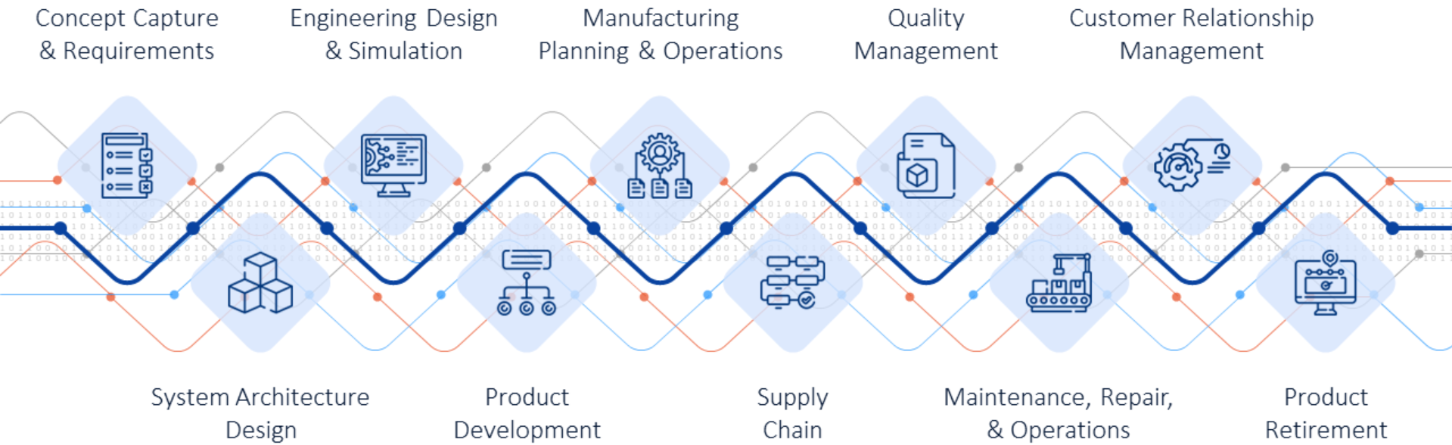

The vision
Data is the new gold.
Digital continuity & digital thread are key to co-operations & data-based studies
Notes:
Our target is digital continuity across data that are siloted

Slide 3
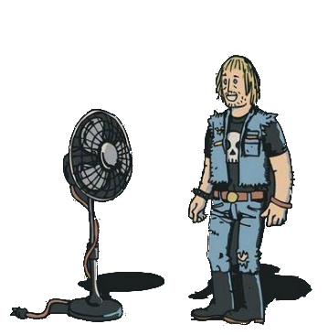
From the pain to the solution
I’M A HUGE METAL FAN.
ME TOO !
Current
Cost / time to manage data
READI.org
The ambition of this language
based on proven international standards
is to value data by providing practical solutions
to clarify, federate & query data,
at marginal cost and time, even at scale
With common language
Nb of data, domains, enterprises, IT systems
Notes:
But even best in class companies using ontologies & latest IT solutions fail to federate data at the scale & complexity of huge projects;
They face exponential costs & time to connect billions of data coming from authors having different backgrounds,
in extended enterprise & across IT solutions.
Why?
Because (PRESS KEY) they do not share the same meaning reference as shown in this funny picture!
This was before using a Common Language.
The ambition (PRESS KEY) of this language based on proven international standards is to value data
by providing practical solutions to clarify, federate & query data,
at marginal cost and time, even at scale.

Slide 4

Value proposal - common reference concept
link to common reference concept
(e.g. using codes)
Tag
The innovation is to use a common business language on tags as bridge between data: new & legacy data are understood & operated across silos (domains, enterprises, IT solutions, …) at marginal cost and time
Common Reference
Definition
Definition
Definition
Foundation ontology
Concept ∝
Concept β
Concept γ
Code
Code
Code
Domain 1
Domain 2
Domain 3
Class B
Class E
Local ontologies
Class A
Class D
Class C
Data
Data 1
Data 2
Data 3
Data 4
Data 5
Data 6
Notes:
The vision is to use (PRESS KEY) a common reference that is shared and recognized;
This common reference contains (PRESS KEY) concepts,
Their (PRESS KEY) explicit definition,
and (PRESS KEY) codes.
To be understood at scale by human and machines these concepts are exposed in an ontology format:
This is (PRESS KEY) the foundation ontology.
All the exposed data (PRESS KEY) are related to this foundation ontology:
either directly, (PRESS KEY)
or through data model, (PRESS KEY)
or through the domain ontology concepts. (PRESS KEY)
Practically these relations between data and foundation ontology codes are written on tags (PRESS KEY);
These tags are attached to the data (PRESS KEY)
That allows to use the common reference in a distributed mode.
Now the meanings of the data are coming from the foundation ontology.
Let’s see an example …

Slide 5
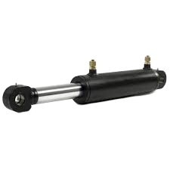
Value proposal - Example
This language is used to provide meaning to data thanks to tags applied on top of Unique Identifiers
Unique Identifier
Common Language tag (shortened)
-MMA
MMA “hydraulic cylinder”:
System for providing mechanical movement or force,
powered by fluid displacement or pressure,
providing movement corresponding to a liquid volume.
Notes:
…with this hydraulic actuator;
The shortened tag (PRESS KEY) “-MMA” is the link to (PRESS KEY) this definition contained into the foundation ontology.
Use the term you want to name this object as its meaning comes from this definition;
Use the human language you want to write this definition as its meaning remains the same.
Now how Airbus has created this common reference?

Slide 6
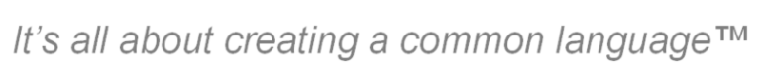
The origin
ISO/IEC 81346 Reference Designation System (RDS)
www.81346.com
Notes:
To ensure that definitions are recognized by a wide audience we have used recognized standards;
The (PRESS KEY) ISO/IEC 81346 “Reference Designation System” is providing a pool of concepts
and their explicit definitions designated by codes.
This standard is not only providing a pool of definitions, it organizes them;

Slide 7













A common framework
The common reference is a set of structured concepts definitions & associated designation language
It is made of 15 000 definitions & relations between them
Systems
Construction
Powerplant
…
Oil & Gas
…
Aerospace
Manufacturing
…
…
…
…
Variant aspect
Procedural aspect
Spatial aspect
Functional aspect
Physical aspect
Processes
Relations
Properties
Documents
Notes:
This standard is dealing with several domains such as Constructions.
As Airbus is designing and producing aircrafts we have extended this standard
to (PRESS KEY) these domains with the support of the authors of this standard.
For each domain I can use various aspects:
Physical aspect (PRESS KEY), functional aspect (PRESS KEY) ,spatial aspect (PRESS KEY), and variant aspect (PRESS KEY) ;
There are libraries of definitions per aspect and domain.
The (PRESS KEY) processes libraries were developed by Airbus and can be used for all the domains;
They are used to designate aircrafts’ and plants’ operations, as well as projects activities.
The (PRESS KEY) relations libraries are also applicable to all the domains;
Up to here I can designate any element of an aircraft or a plant;
To designate their characteristics such as their dimensions, weight, or cost, …
we use the (PRESS KEY) properties libraries developed by Airbus.
Ultimately I want to represent all these information into (PRESS KEY) data or document;
They are designated using another standard - the ISO/IEC 81355 - which is strongly connected to the RDS one.
In a word (PRESS KEY), the common reference is more than just a pool of definitions,
this is a framework that structures the representation of data.
It contains about 15000 definitions and relations between them.
Practically, …

Slide 8
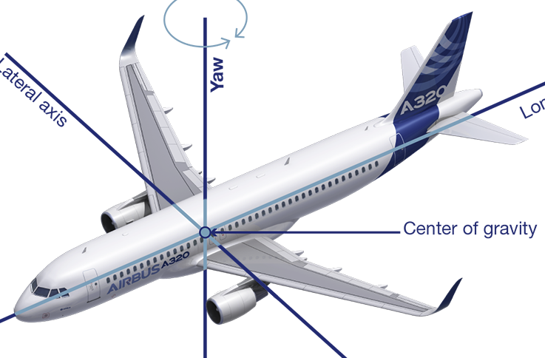
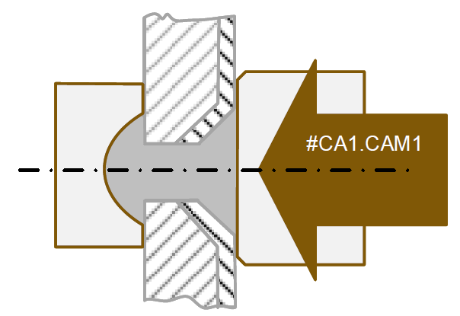
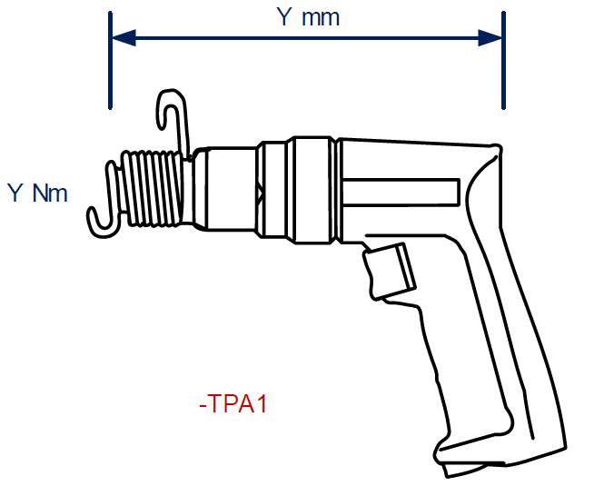
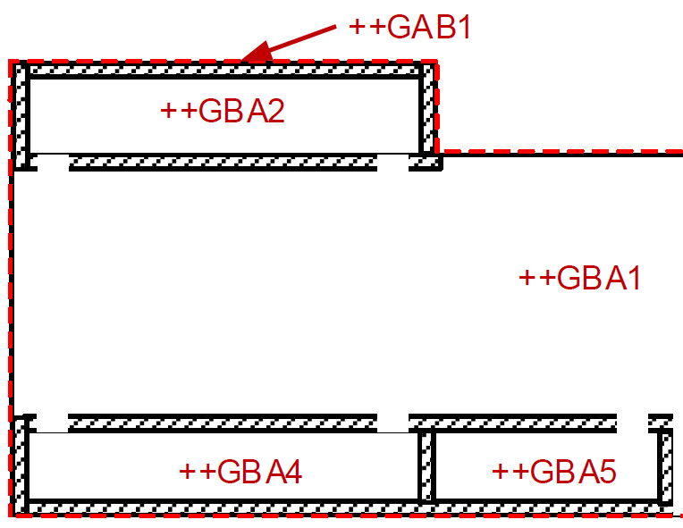



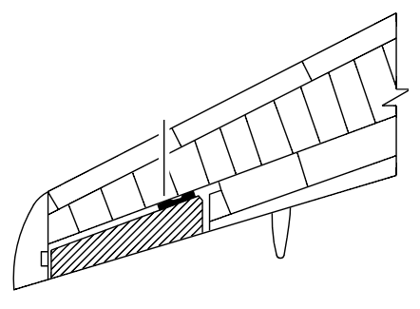
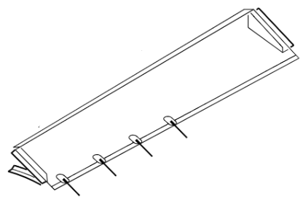
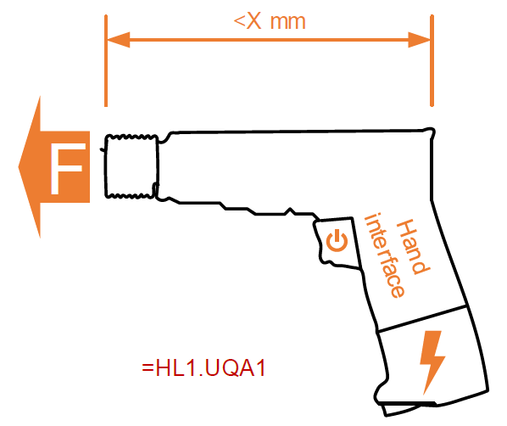
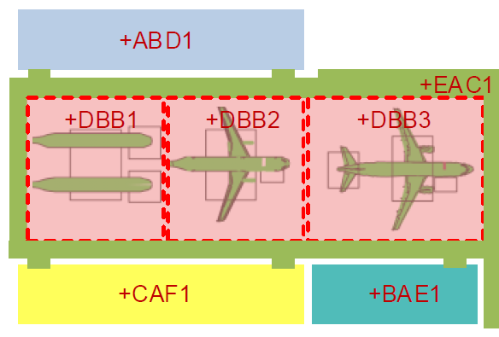
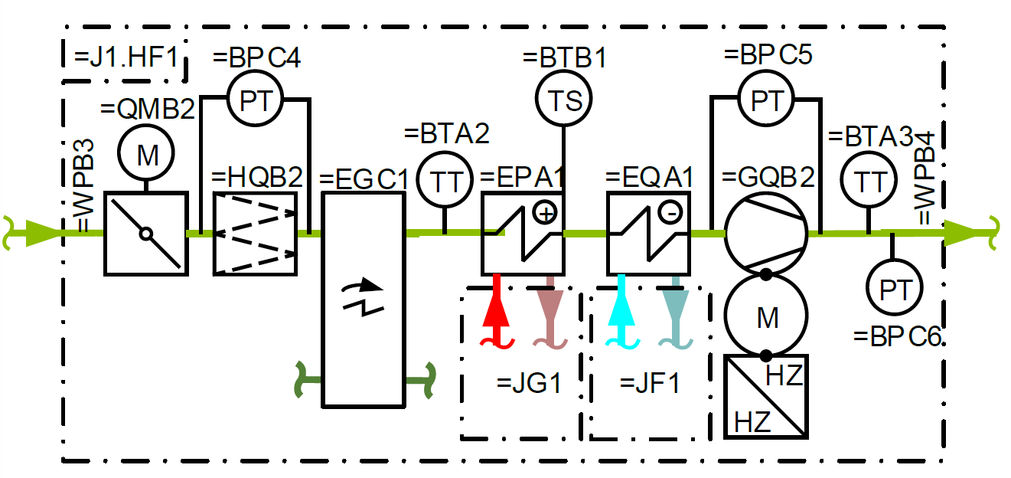
The reference model in action
Aircraft
Process
Manufacturing
Building
+
Spatial
=
Functional
-
Physical
$ Procedural
=
Functional
-
Physical
+
Spatial
+
Spatial
=
Functional
-
Physical
This language is used to designate and federate data (digital thread) across silos using the same framework
+DCA
=BE
-QPC
$CAL
=UQA
-TPA
+DBB
+GBA
=HG
-XDB
“Trailing edge”
“Roll”
“Aileron”
“Workorder”
“Riveting”
“Torquing tool”
“Station”
“Hangar”
“Pwr distribution”
“Socket”
-UQA
“Rivets”
@AAAAAD
“Dia.”
=BE Direction system creating roll movement
=UQA Object for localising other objects, by static jointing, with rigid and permanent mechanical means
+DCA Equipment operation space providing equipment movement space
-TPA Object for transforming other objects of matter by shape forging
-QPC Open flow controlling object for directing a flow by variable means
+DBB Space designed for active technical systems which support human activities of fabricating and preparing products
-UQA Object for localising other objects, by static jointing, with rigid and permanent mechanical means
+GBA Space defined by physical boundary, designed to host one or more activity spaces
@AAAAAD Width of circle, cylinder or sphere
=HG Technical system supplying other systems with electrical energy
$CAL Process of joining objects or materials, shaping by irreversible assembling, by deformation
-XDB Interfacing object for low voltage electric power, with for pluggable connections
Notes:
… I can use this framework (PRESS KEY) to create a reference model:
This (PRESS KEY) aircraft has several functions;
One of them (PRESS KEY) is called “Roll”,
Which code (PRESS KEY) is “=BE”;
This code drives you to (PRESS KEY) this definition of the 81346;
This definition ensures that (PRESS KEY) everybody understand this concept the same way.
This roll function is located (PRESS KEY) in a given zone of the wing called “trailing edge”,
and is allocated to (PRESS KEY) this physical part called “aileron”
which elementary parts are joined (PRESS KEY) by “rivets”
of a (PRESS KEY) specific diameter.
On the process side, (PRESS KEY) this rivet is assembled following a “workorder”
On the manufacturing side, (PRESS KEY) this riveting process is enabled by this “riveting” function;
This is somehow the specification of (PRESS KEY) this physical “torquing tool”,
which is located (PRESS KEY) into this manufacturing space called “station”,
(PRESS KEY) which is located into this building area called “hangar”,
(PRESS KEY) which has a “power distribution” function,
(PRESS KEY) enabled by this “socket”.
This is the digital thread (PRESS KEY) across aspects and domains.
Now you understand how this language allows to link silos.

Slide 9

Start
The Common Language project
Today
Ready for application at scale
2017
2018
2019
2020
2021
2022
2023
2024
2025
2026
2027
CTO - research
DDMS - development
PM&T - incremental deployment
(Chief Technical Officer)
(Digital Design Manufacturing & Services ⇔ Airbus transformation program)
(Processes, Methods & Tools)
Discover ISO/IEC 81346
Conf. & change
Operable by machines
As foundation ontology
At scale knowledge interoperability method
Aircrafts & relations
ISO/IEC 81346 part 20 - Vehicles
2000 definitions
Manufacturing
ISO/IEC 81346 part 14 - Manufacturing
2700 definitions
Properties
ISO/IEC 81346 part 8 - Properties
900 definitions
Processes
ISO/IEC 81346 part 50 - Processes
250 definitions
Ready for integration!
Models
Economy
Libraries browser
Ontologies with 81346 tags
Tag automation
Table 2 graph
Text 2 graph converter & Common Language standard as a service
Practical Use Cases (for design, manufacturing, customer services, …)
Incremental local implementations
External use cases
Legend:
Method
Domain exploration
Libraries
Standardisation
Tools
Use Cases
Notes:
The aim of this project is to enable knowledge interoperability at scale
Over the last 8 years (PRESS KEY) we have first discovered the 81346 standard,
then enhanced it to become a data management method;
Meanwhile (PRESS KEY) extensions have been created with the standard authors and hundreds of domain experts;
Then the point is to ensure that this language is used by the whole value chain.
There is no way to impose a language of a given company;
It has to be created by the community of practice of this domain.
Standards are consensus between experts;
That’s why Airbus has decided to offer its common language through its integration into the 81346 standard;
So these extensions (PRESS KEY) are under the ISO/IEC standardisation process to become parts of this standard;
During this process it has been decided to extend the aircraft domain to all types of vehicles meaning that cars, trucks, helicopters, launchers and ships are now covered.
Manufacturing and processes should be published as international standard within the next 6 months,
vehicles and properties less than 1 year later.
We have (PRESS KEY) developed tools to ease the application of this standard;
Meanwhile (PRESS KEY) we have tested this language, method and tools on practical cases with success.
So this language (PRESS KEY) is a great candidate for incremental integration into companies operating system;
The target is (PRESS KEY) to be ready for the next Aircraft program;
To reach that target it is time to bullet proof this language with others, so the participation to this implementor forum
Let see what we have started in this forum

Slide 10



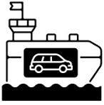


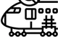
RDS4X use case
Properties
Properties
started btw Airbus & DNV & SysEng
intermediate delivery in Dec’ 2025
formal prez’ end of Q1 2026
call for software editors
Project devlpt & mngt
Registers & audits ships
From capabilities & behaviours to parts specs’
From process to operations using Agents etc…
Located on buildings of several sites
Supply chain operated with trucks, ships, aircrafts, …
Properties
Properties
Properties
Properties
Notes:
We are creating a use case that will create the reference model as shown previously
of a aerospace program
that design an aircraft from its intended capabilities & behaviours to parts specifications
then develop and operate a manufacturing system to produce aircrafts
This manufacturing system is located into buildings spread over the world
that are supply by trucks, aircrafts and ships
that are registered and audited by DNV
I can continue this story

Slide 11

Want to try? Any question? => common.language@airbus.com
Thank you!
© Copyright Airbus SAS 2025 / A Common Language as at scale digital continuity enabler - “A common language for aerospace, … and beyond!” - PLM Road Map & PDT Europe 2025 | Paris, France | 5-6 Nov’ 2025
This document and all information contained herein is the sole property of Airbus.
No intellectual property rights are granted by the delivery of this document or the disclosure of its content.
This document shall not be reproduced or disclosed to a third party without the expressed written consent of Airbus.
This document and its content shall not be used for any purpose other than that for which it is supplied.
Airbus, its logo and product names are registered trademarks.
Notes:
Many thanks for your attention and pertinent questions,
it was a pleasure to share this experience with you
See you!

