Slide 1
SEC-hub software

Slide 2
Where is the reference model stored
CAD/ECAD/CAE tools
Create or propose designations, but does not govern and approve them.
ERP (e.g., SAP)
Uses designations for BOMs, materials, and production, but does not own them.
MES
Executes production using designations but does not define them.
EAM/CMMS
Uses designations for assets in the field; may extend them, but engineering source remains elsewhere.
PLM
Handles BOM IDs and life cycle information, but does not govern them with imbedded syntax rules

Slide 3

Where is reference the reference model stored
CAD/ECAD/CAE tools
ERP (e.g., SAP)
MES
EAM/CMMS
PLM
RDS Reference model

Slide 4
RDS mobile App

Slide 5
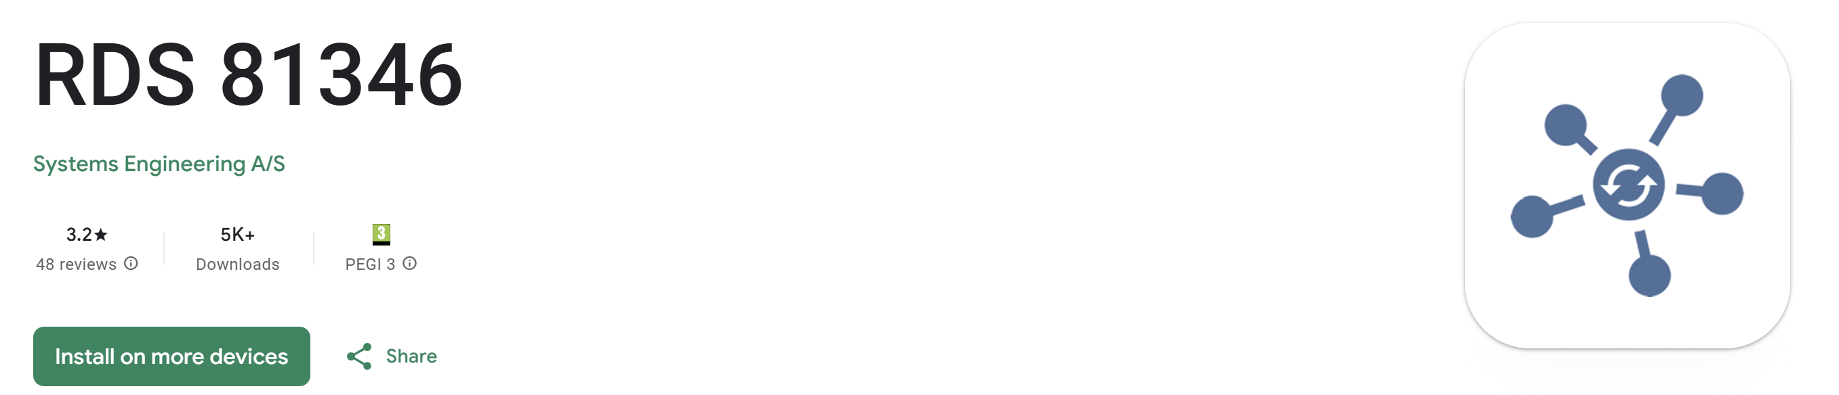


Slide 6
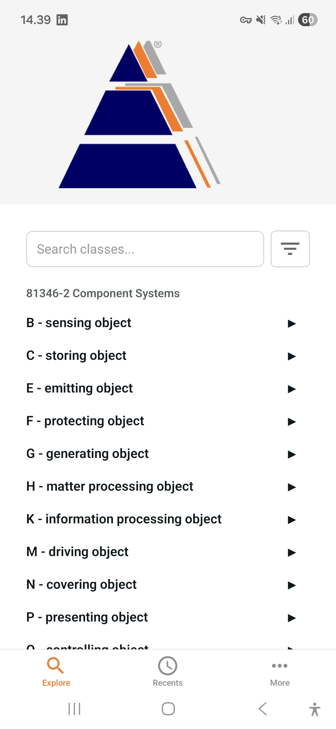

Slide 7
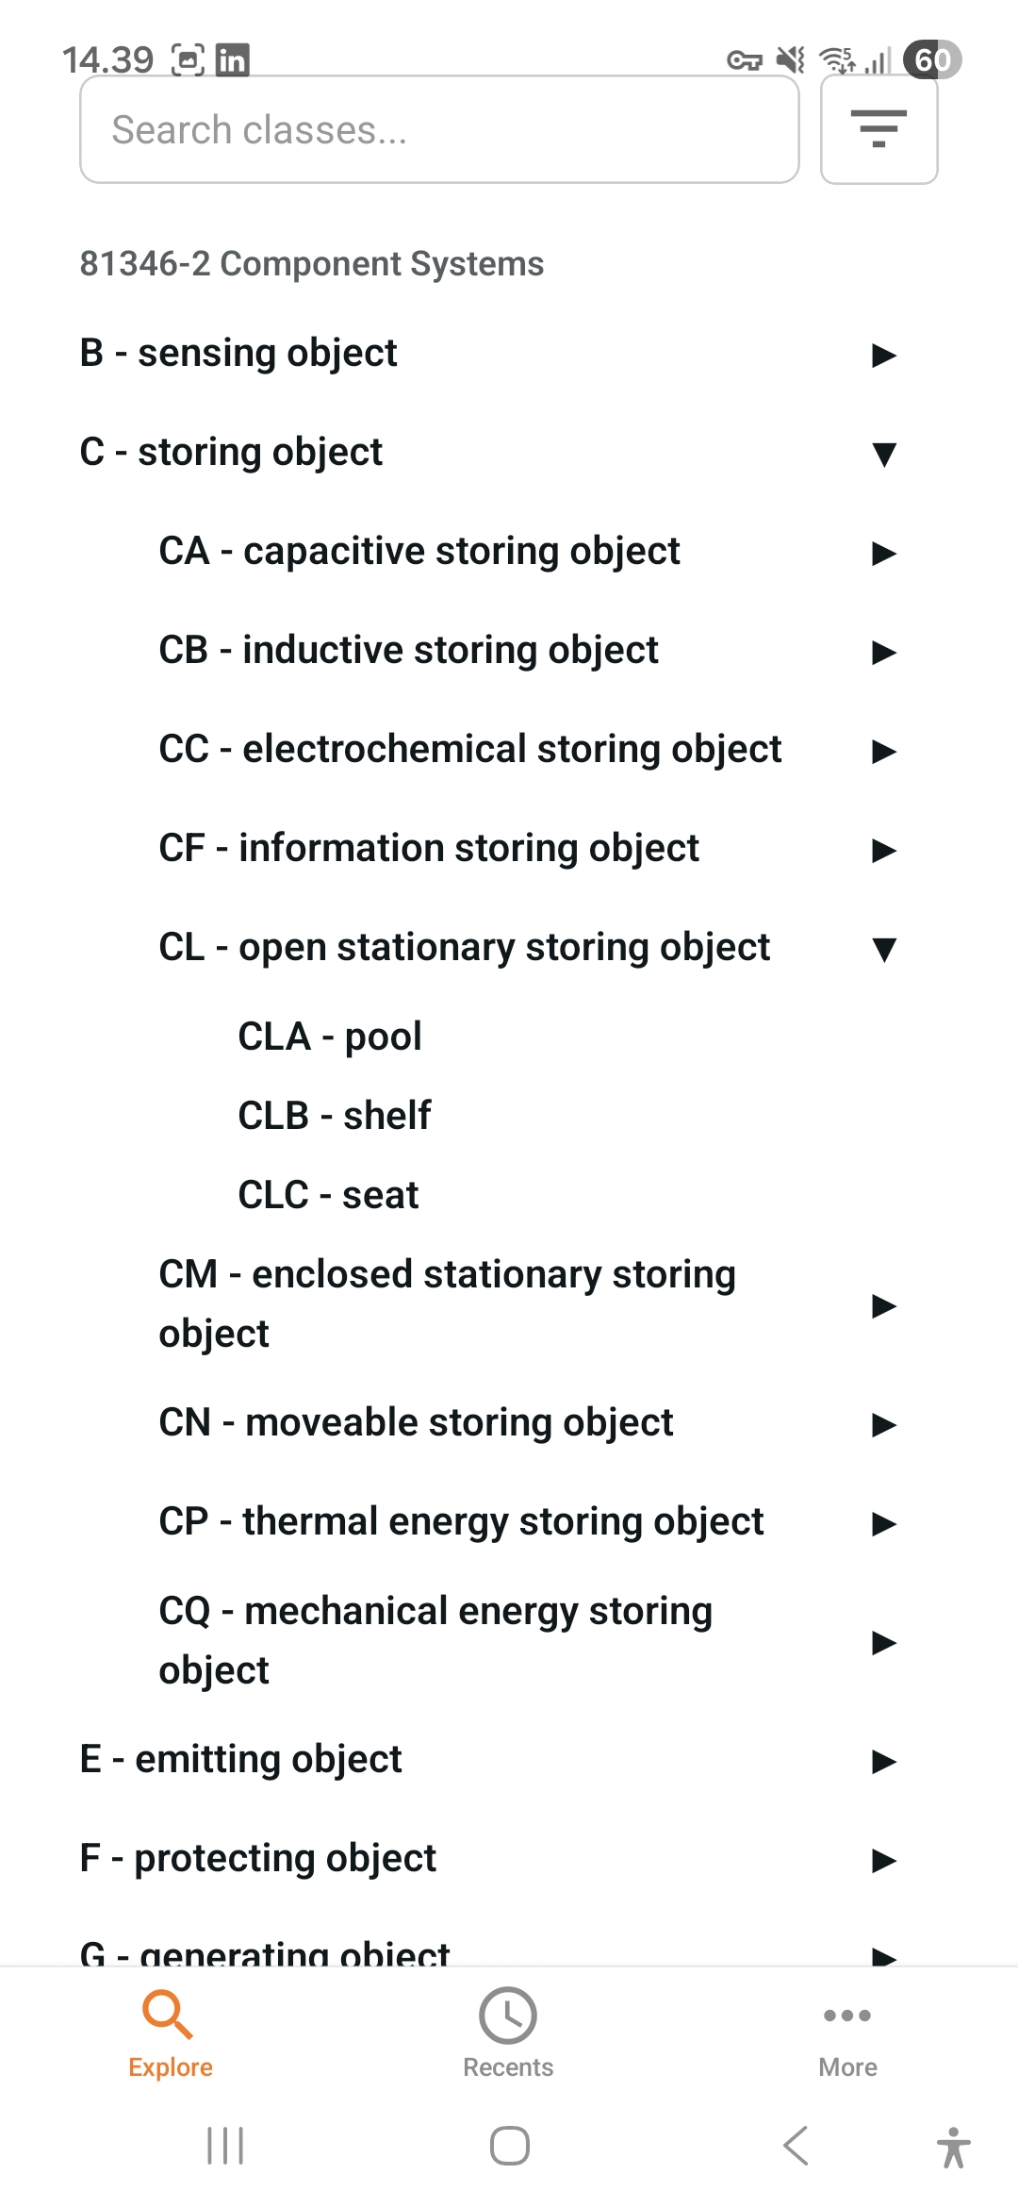

Slide 8
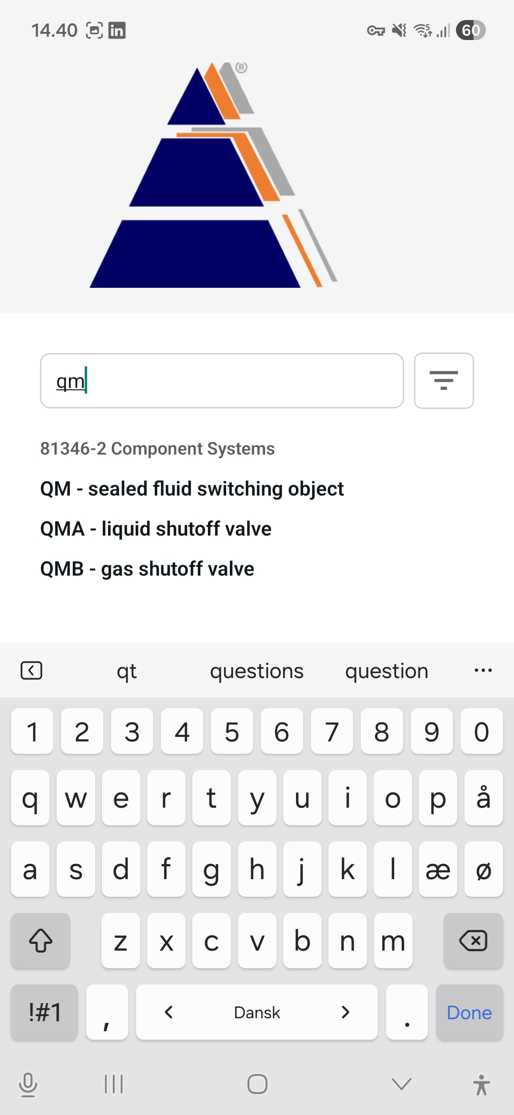

Slide 9
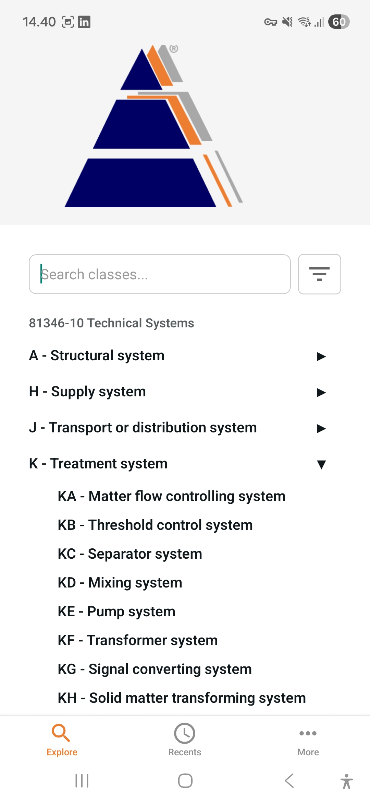

Slide 10
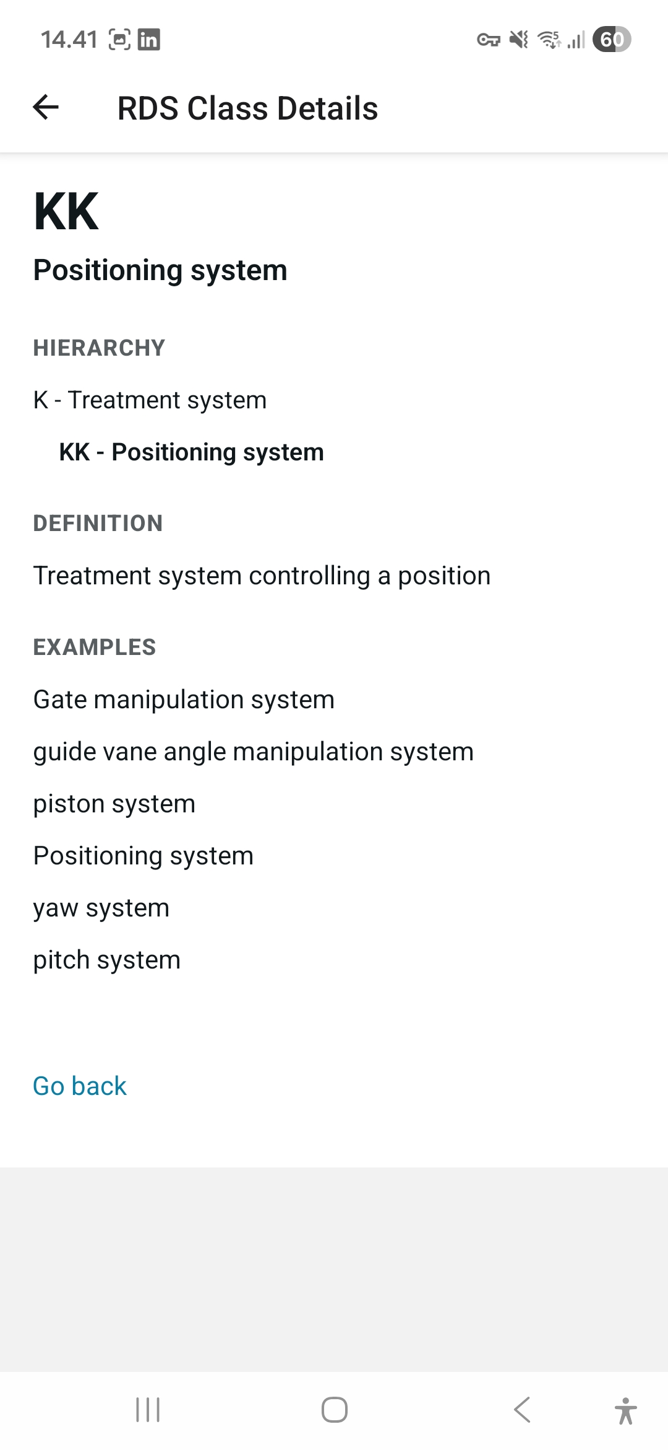

Slide 11
Supported 81346 parts:
81346-2
81346-10
81346-12
81346-14 (FDIS)

