Slide 1

RDS4X
Let’s demonstrate the added value of ISO/IEC 81346 (RDS)
Yann CHAPELLE (yann.y.chapelle.external@airbus.com)
Thomas BARRE (thomas.barre@airbus.com)
RDS4X.org
24-02-2026

Slide 2




Content of this Presentation
Draft of our WHY HOW WHAT communication kit
First usecase overview
Next steps?

Slide 3

Agenda
Communication Kit
Why?
How?
Usecase Overview
What?
Next Steps

Slide 4
Agenda
Communication Kit
Why?
How?
Usecase Overview
What?
Next Steps

Slide 5




Why?
AS IS
Increasing amount of data is unmanageable
Lack of meaning and context
Disparate softwares and storage solutions create data silos

Slide 6



Why?
TO BE
Scalability of data management
Explicit and contextualized data
Reliability and accessibility ensured by data continuity

Slide 7



Why?
We believe in a Common Language for…
Universal Understanding
Seamless Interoperability
Future-Proof Consistency
Universal Understanding
Seamless Interoperability
Future-Proof Consistency
To help us design, build, operate, and maintain even the most complex projects

Slide 8
Agenda
Communication Kit
Why?
How?
Usecase Overview
What?
Next Steps

Slide 9




How? | The Reference Model
Provides the essential structure for data, ensuring information is born "intelligent" and contextualized
Introduction of a Reference Model that…
Acts as the semantic bridge that aligns different softwares

Slide 10
Agenda
Communication Kit
Why?
How?
Usecase Overview
What?
Next Steps

Slide 11

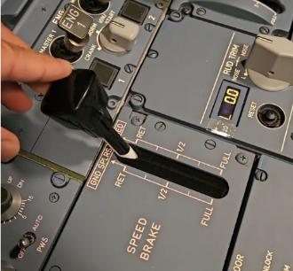
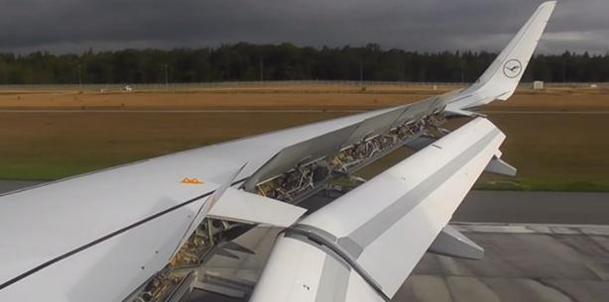
What is a spoiler?
A spoiler is a device which increases the drag and decreases the lift of an airfoil in a controlled way
But not only…
Speed brake?
Spoiler?

Slide 12




What is a spoiler?
It is a very complex system that links the pilot to the airflow
How can we clarify and explicit this complexity unambiguously?
How can we take into account its various aspects?
We need a reference model
Let’s use RDS 81346 to address this challenge!

Slide 13
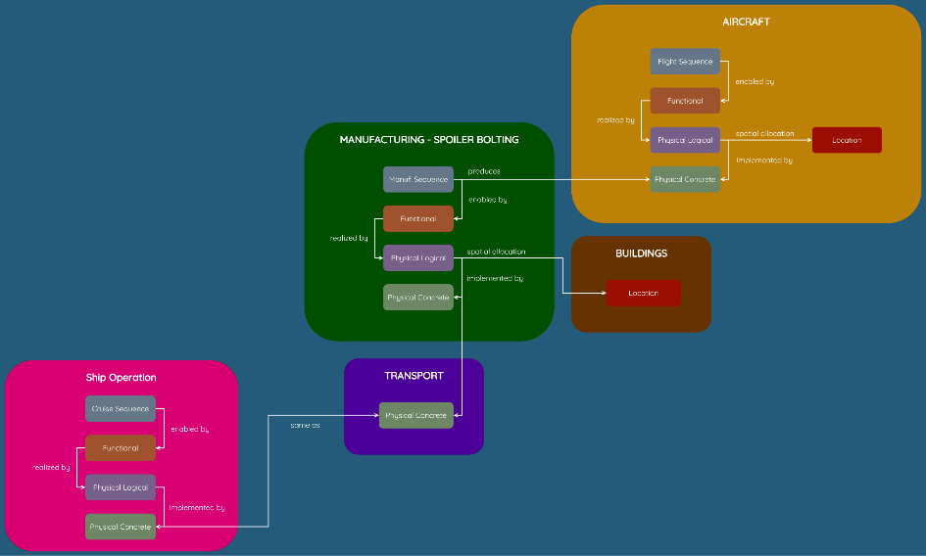
Full Reference Model

Slide 14

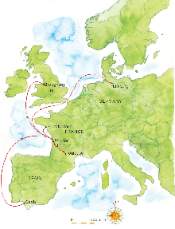
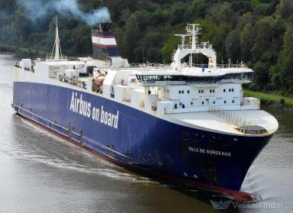
Collaboration across vehicle industrials
DNV will demonstrate the applicability of Part 20 for ships
Integration in the Reference Model as transporter between facilities

Slide 15



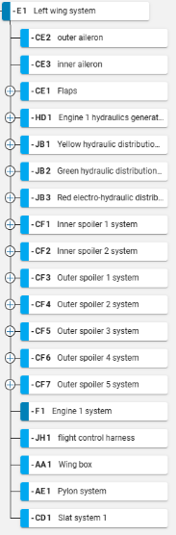

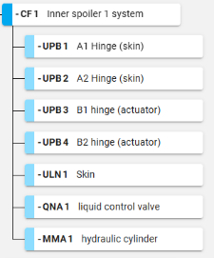

Physical Aspect – Logical View
Using part 20 - Vehicles and part 2 - Components with Product Aspect
Systems are directly linked to RDS and its definitions
CF – technical system designed to control fluid dynamics by modifying it by active means
UPB – object holding other objects by non-static mechanical jointing
ULN – object for structurally holding other objects in the form of a plane or curved surface withstanding tensile forces
QNA – object for controlling the variation of flow of liquid in sealed enclosures
MMA – object for providing mechanical movement or force powered by fluid displacement or pressure providing movement corresponding to a liquid volume

Slide 16

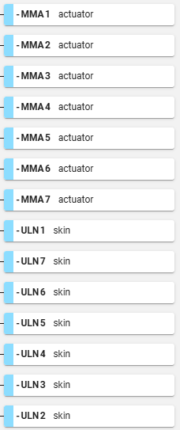
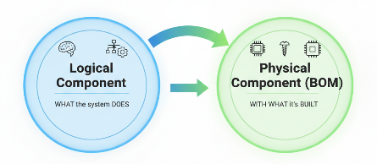

Physical Aspect – BOM
The logical physical view is linked to the Bill of Materials that realizes it
What we assemble
What we buy
ULN – object for structurally holding other objects in the form of a plane or curved surface withstanding tensile forces
MMA – object for providing mechanical movement or force powered by fluid displacement or pressure providing movement corresponding to a liquid volume

Slide 17

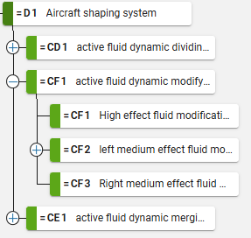


Functional Aspect
Using part 20 - Vehicles and part 2 - Components with Functional Aspect
RDS provides a common language for both technical teams and business owners
It ensures everyone agrees on the system's capabilities
D – vehicle system designed to control angular orientation
CD – technical system designed to control fluid dynamics by dividing it by active means
CF – technical system designed to control fluid dynamics by modifying it by active means
CE – technical system designed to control fluid dynamics by merging it by active means

Slide 18

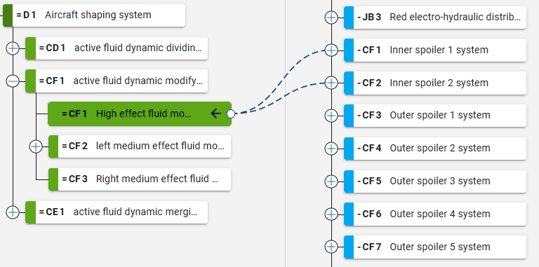
Functional ↔ Product Link
The reference model allows anyone to understand which function is allocated to which product
FUNCTIONAL
PRODUCT

Slide 19

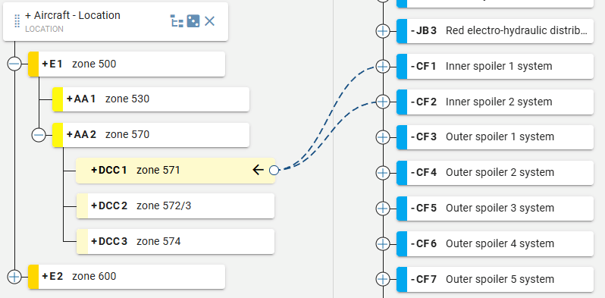
Location Aspect
Using spaces classification, it is also possible to link a product to its location
LOCATION
PRODUCT

Slide 20

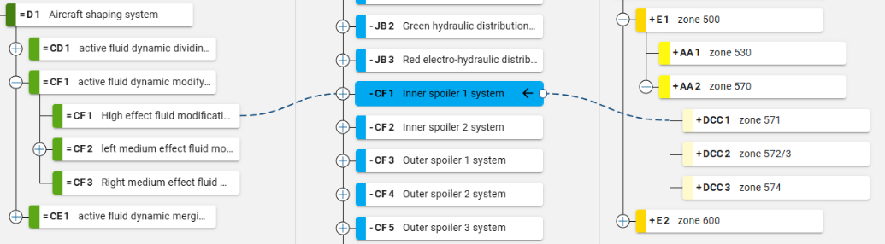
The Model Tells Stories
This is because Inner spoiler 1 system is located in zone 571 (inner area) that it has High effect fluid modification capability
(while outer spoilers have medium effect…)

Slide 21

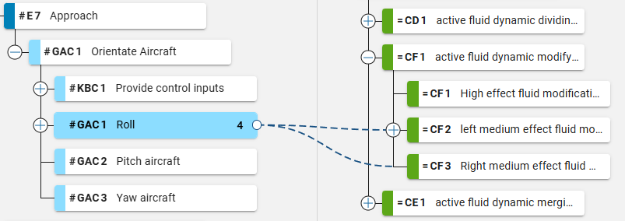
Link to the Processes
Using part 50 - Processes
This view conveys the fact that the Roll process is realized by the functions of medium effect fluid modification
PROCEDURAL
FUNCTIONAL
E – the act of moving an entity
GAC – task for changing position of an object in space by autonomous rotation around an axis
KBC – task for supervising equipment or procedures for modification by adjusting the input

Slide 22

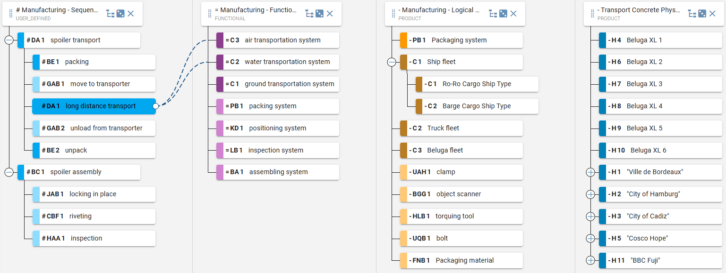
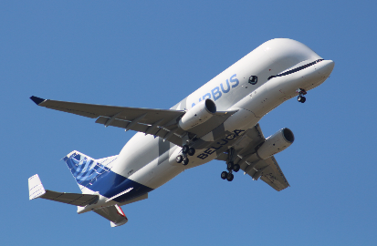
Manufacturing Story Example
Long distance transport can be realized by air or water transportation system functions
Air transportation system function is allocated to Beluga fleet made of 6 Beluga XL
PROCEDURAL
FUNCTIONAL
LOGICAL
PHYSICAL

Slide 23

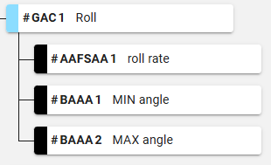

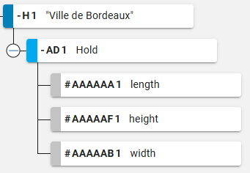

Assigning Properties
Using part 8 - Properties
Properties defines the specific characteristics or attributes of an object
Properties are directly anchored to a specific system
Properties provide a link between data and knowledge

Slide 24
Agenda
Communication Kit
Why?
How?
Usecase Overview
What?
Next Steps

Slide 25
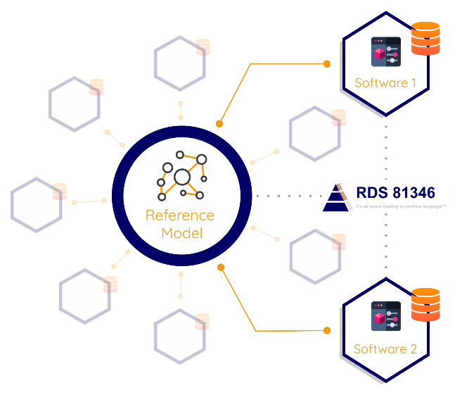
How? | Connect Different Softwares

Slide 26
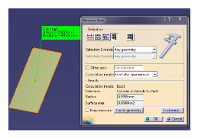
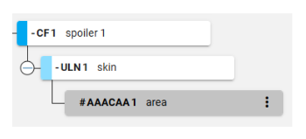
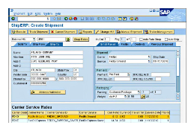
How? | Connect Different Softwares

Slide 27

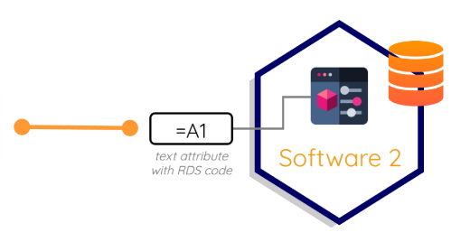
How? | Speaking RDS is a Capability
How are softwares linked to the RDS?
Some softwares natively speak RDS…
… Others only need a text attribute that stores RDS code to speak it

Slide 28
Agenda
Communication Kit
Why?
How?
Usecase Overview
What?
Next Steps

Slide 29


What? | Call to Software Editors
We invite software editors to join us in building an interoperable ecosystem powered by the RDS framework.
Participate in the construction of RDS Enablers

Slide 30
What? | Call to Software Editors

Slide 31
What? | Call to Software Editors
Manual text entries
Assisted selection through AI

Slide 32
Agenda
Communication Kit
Why?
How?
Usecase Overview
What?
Next Steps

Slide 33





What we will present end of Q1
RDS as an enabler of interoperability of knowledge
Status on Part 20 testing
Intermediate status on specification of missing RDS artefacts
Software – Expression of the need & Call for editor collaboration

Slide 34
Thank you
This document and all information contained herein is the sole property of Airbus. No intellectual property rights are granted by the delivery of this document or the disclosure of its content. This document shall not be reproduced or disclosed to a third party without the expressed written consent of Airbus. This document and its content shall not be used for any purpose other than that for which it is supplied.
Airbus, its logo and product names are registered trademarks.

