Slide 1
Satel finds a better way to manage testing
In conversation with Petri Reiman, Test Specialist and Test Team Manager, Satel
WATS UP Keynote
Notes:
Opening frame (you speak):
Welcome Petri Reiman, Test Specialist and Test Team Manager at Satel. 5-10 minutes, conversational.
Set-up line: Satel is a Finnish radio technology company whose products keep mission-critical networks running - and behind that sits a test data story a lot of you will recognise.

Slide 2


Mission-critical connectivity
Meet Satel
x
Cold open
Video: youtube.com/watch?v=qvo-qxRxrSk
Notes:
Cold open - play the video, then come in cold.
Q1: Petri, for anyone who has never heard of Satel - what do your radios actually keep running out there?
Q2: How big is the test operation behind that?

Slide 3
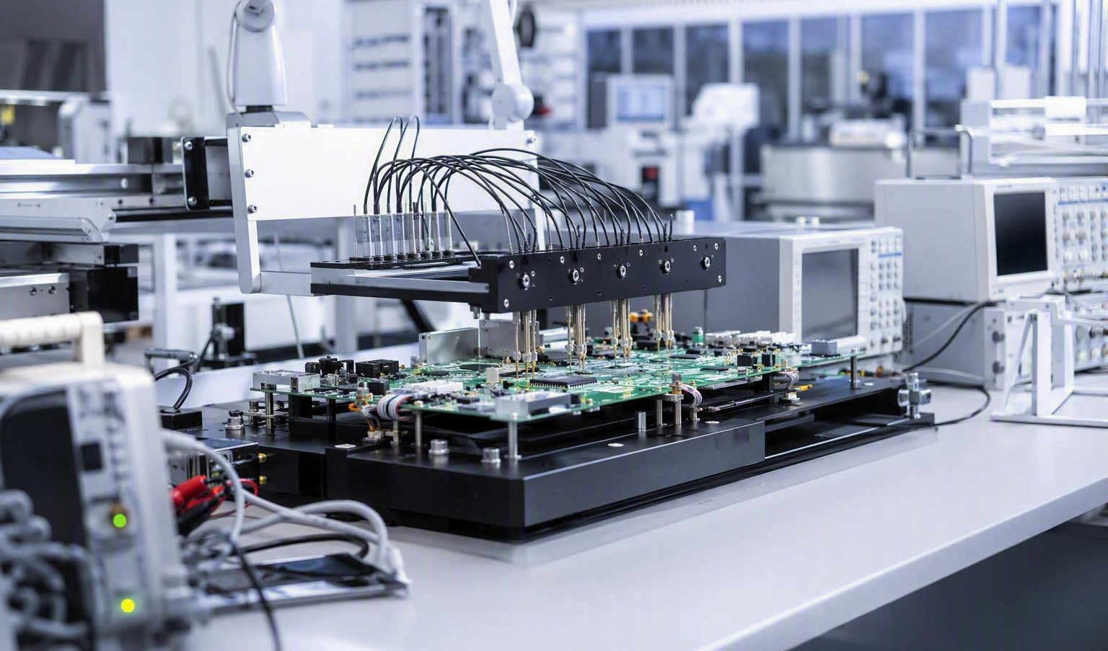
Satel in brief
Finnish radio technology since 1986
x
Founded 1986, Salo, Finland
Radio technology for mission-critical networks
SCADA, GNSS, machine connectivity, transport
Part of Topcon since 2023
Notes:
Q3: You've been designing and building in Finland since 1986. What does that mean for how you test?
Q4: You support both R&D and production - how different are those two worlds for your team?
Backup facts: Salo, Finland; ~51-200 employees; SCADA and utilities, GNSS, machine connectivity, transport, environmental monitoring; acquired by Topcon in 2023.

Slide 4
The DIY years
x
In-house SQL tools
Constant updates, constant maintenance
Couldn't keep up as Satel grew
Notes:
Q5: Before WATS, what did test data management actually look like day to day?
Q6: What broke first - the maintenance, the scaling, or the speed?
Q7: What finally made you say: we need something else?
Listen for: every test or product change meant updating the in-house SQL tools.

Slide 5
Before and after WATS
x
Homegrown SQL tools
WATS
Built in-house
Updated for every change
Hard to scale
All test data, one place
Trends spotted early
Daily workflow
Notes:
Q8: If you compare the two ways of working - what is the single biggest difference?
Q9: What could you not do before that you do routinely now?
Let Petri fill the right-hand column himself; don't read it out.

Slide 6
From one test station to nearly all of them
x
Etteplan
One test station, 2016
Nearly all test systems today
Confidence in limits and performance
Faster answers
Nothing to maintain
Notes:
Q10: You heard about WATS through Etteplan and started with one single test station in 2016. Why start that small?
Q11: What convinced you to expand across nearly all your test systems?
Q12: How long did it take before the team trusted the data?

Slide 7
In Petri's words
"Having easy access and oversight of all test data gives insights that support both production and R&D."
Petri Reiman, Satel
Part of the daily workflow
Notes:
Q13: You've said easy access to all test data gives insights that support both production and R&D - can you give us one concrete example?
Q14: What would you tell someone still maintaining their own homegrown test data system?
Close: thank Petri, hand back to the keynote.

Slide 8
Notes:
Wrap-up. Thank Petri and the Satel team. Point people to the full customer story on wats.com.

