Slide 1

Video

Slide 2

WATS-UP - Drammen
2026
Content by
Mia Shi – Test Engineer
Tue Lunde Shultz - Manufacturing Data Analyst
Eric Jensen - Senior Test Development Engineer
Morten Wille - Manager, Manufacturing Test Ballerup
Aaron Greenyer - Manufacturing Process Engineer
Thanh Osmancevic - Operations Technology Manager
Ole Happle Sørensen - Director of Global Industrialization

Slide 3

Topics:
Short GN Intro
Part numbers from PLM
Serial Number, Subunit linking & Key Component BOM)
R.E.D.
Data requirements
Data Quality
Open Box Audit / Outgoing Inspection
GR&R with WATS
WATS SW Distribution
Repair data
WATS Management Reporting
WATS Aleva Heat Map + Unit Flow
WATS Conformance Reporting

Slide 4

GN at a glance
Born global
In 1869, Danish industrialist
C.F. Tietgen envisioned a more
connected world and founded GN to facilitate communication for people worldwide.
Hearing
Enterprise
Gaming
We help people with hearing loss overcome real-life challenges, improve communication and collaboration for businesses, and provide great experiences for gaming enthusiasts.
Revenue by division
16%
Gaming
100 countries
Serving customers across the globe
7,500+
employees worldwide
43%
Hearing
Revenue by regions
~30 million
products produced annually
39%
North America
40%
Europe
41%
Enterprise
21%
Rest of World
Notes:
Today, GN offers world-leading hearing, audio, video collaboration, and gaming solutions that bring people closer.
With our three divisions, we help people with hearing loss overcome real-life challenges, improve communication and collaboration for businesses, and provide great experiences for gaming enthusiasts.
At GN, we rely on our partnerships to help provide the best possible solutions to our users. We partner with customers, start-ups, and other industry leaders – such as Google, Apple, Microsoft, and Cochlear – to offer the most innovative, intelligent, and cutting-edge audio solutions to people around the world.
GN serves customers in 100 countries. Our products are marketed by the brands ReSound, Jabra, SteelSeries, KontrolFreak, Beltone, Interton, Danavox, BlueParrott, FalCom, and Audigy.
The GN Group has its headquarters in Denmark and has more than 7,500 employees worldwide across the Group.

Slide 5
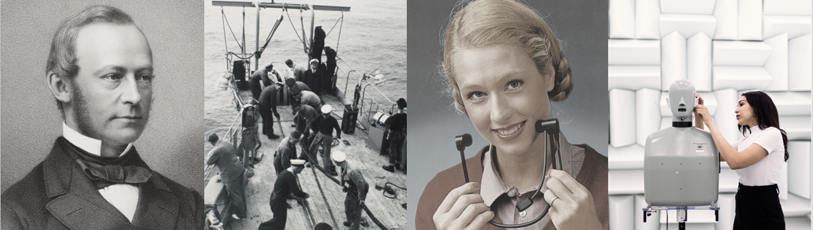

We have a proud history
1869
2026
”The development of the world
is dependent on communication”
GN founder C.F. Tietgen, 1869
GN created the first telegraphic connection
between China and the rest
of the world
Today, GN continues to facilitate communication
for people worldwide, touching more lives than ever
Notes:
GN was founded in 1869 by industry mogul C. F. Tietgen and already the same year GN established the first telegraphic connection between China and Europe.
C. F. Tietgen had a vision of connecting the world, and today GN continues to facilitate communication for people worldwide.
Inspired by our strong heritage, GN touches more lives than ever with our unique expertise and the broadest portfolio of products and services in our history – bringing people closer to what is important to them.

Slide 6
More than 155 years of innovation and world-firsts
1869
First telegraphic connection between China and the rest of the world
2006
First mechanical gaming keyboard
2022
Hearing aids with 150% improvement in speech understanding in noise
1960
Europe’s first mobile phone using transistors
2010
First 2.4 GHz hearing aid technology
2023
First hearing aid supporting Bluetooth® Low Energy Audio
1991
First ultra-noise-cancelling headphone
2014
First Made for iPhone hearing aid
2024
First hearing aid to connect with Auracast™ broadcast devices
1992
First hearing aid with digital sound processing
2016
First wireless earbuds with
built-in heart rate monitor
2025
First 180° Android-powered video bar designed for small rooms
2000
First mobile Bluetooth® headset
2018
First true wireless earbuds for business use
2025
Smallest AI powered hearing aid
2003
First open-ear hearing aid
2020
First hearing aid with microphone and receiver-in-ear
2025
First Hi-Res Wireless Certified headphones for gaming
2004
First gaming headset
2021
First intelligent video bar for video conferencing
2026
First true cross-over headset, delivering professional grade performance, attractive design and comfort
Notes:
The GN Group builds on 150+ years of insight and innovation. Our ambitious 150-year journey has taken us from telegraph cables to radio waves and intelligent audio engineering.
Innovation has been in our DNA since 1869, and since then we have brought multiple world-firsts, with some of them listed here.

Slide 7












Current GN Group
Medical grade
hearing technology
Professional
collaboration
Gaming
Enterprise
headsets
and video
solutions
Hearing
instruments
Gaming gear
Notes:
At GN, we are proud to have hearing, audio, video, and gaming expertise for medical, professional, and consumer segments – all under one roof.
With our combined expertise, we develop innovation that address real life challenges for people with hearing loss, deliver a seamless collaboration experience for businesses, and superior sound and gaming solutions to consumers.
As one GN, our unique combination of competences has already led to several breakthrough products in the various markets we are operating in.
A few examples of this combined expertise:
Thanks to radio technology developed for ReSound ONE hearing aids, we created our newest range of Jabra Elite true wireless earbuds.
Jabra Enhance Pro over-the-counter hearing aids combine advanced medical grade hearing technology with Jabra’s consumer audio expertise.
Jabra MySound enables users to tailor their experiences based on their unique hearing profile. Algorithmic drawing on GN Hearing’s database of +85,000 hearing tests makes this possible. (Jabra MySound is an app that allows the consumers to personalize their soundscape).

Slide 8
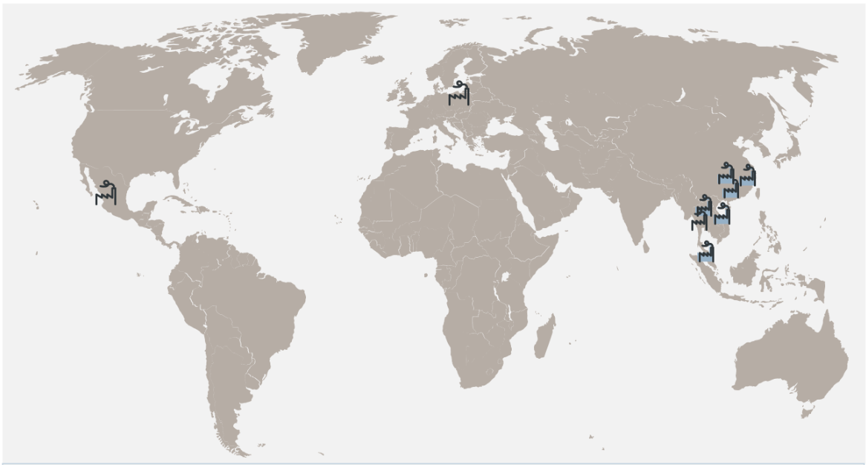

Factory data collection thru Cloud services
GN uses a hybrid of Cloud and On-site data collection solutions
We collect data from our own sites as well as external partners (OEM & JDM ) using same data requirements to external and internal solutions
Most stations are online with instant upload – others upload thru a server hourly or daily

Slide 9

Generic data quality standards
How to ensure WATS and other TDM systems work as intended

Slide 10
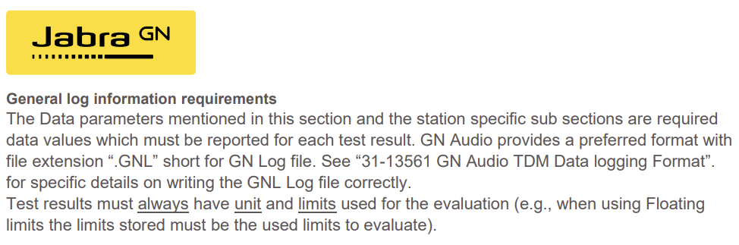
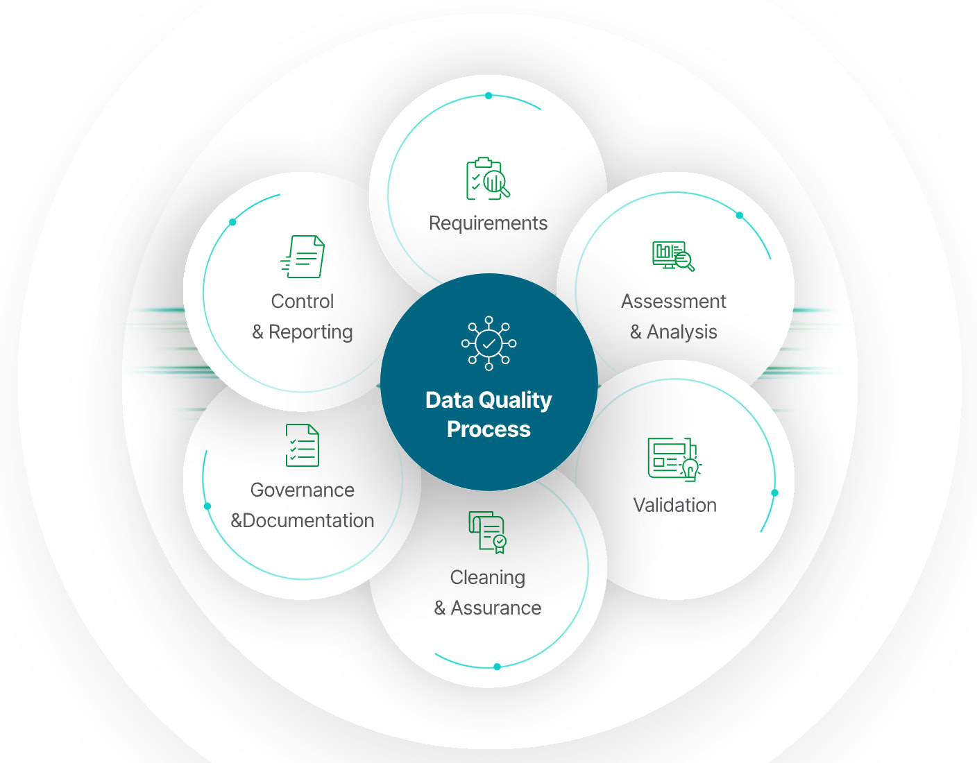
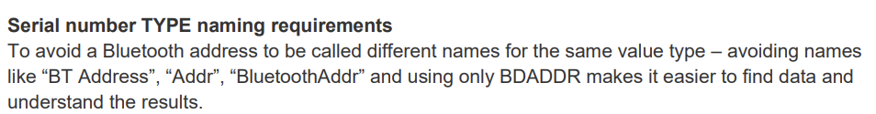
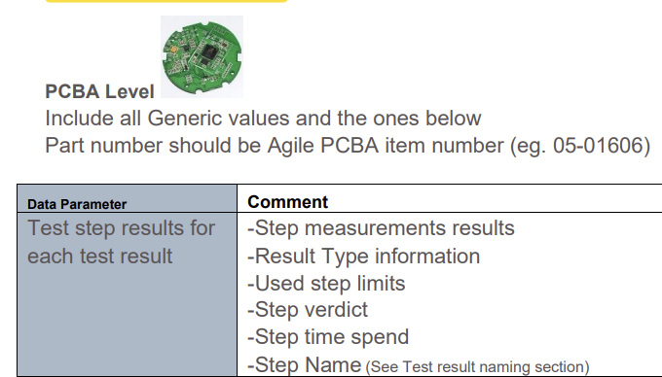
Data input quality
  GN Global data reporting requirements standard
  Training sessions
  Data review
  Examples

Slide 11
Data Requirements
Thru data logging and reporting requirements GN can collect manufacturing results globally and link the data thru standardized Subunit information
Even with offline logging and daily / weekly upload to WATS the linking works well
Thru Global requirements we have aligned internal and external data collection – combined reporting into 1 system for better insights with little effort to GN
Standard status reports includes outsourced production with standard details and information level

Slide 12
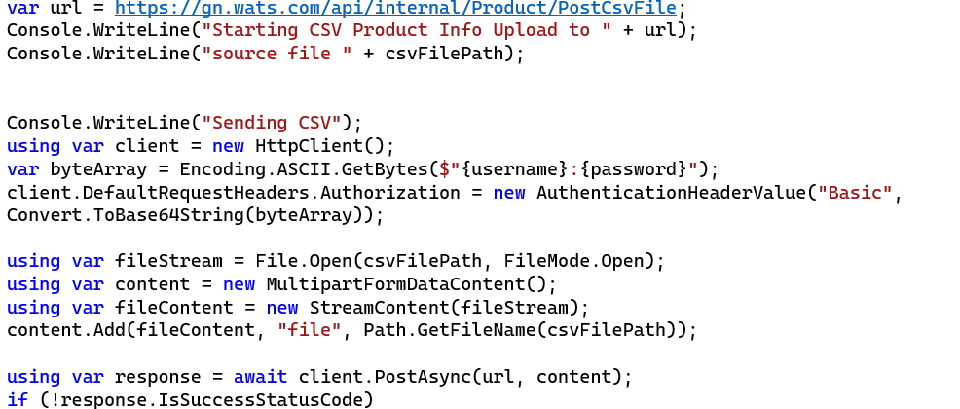
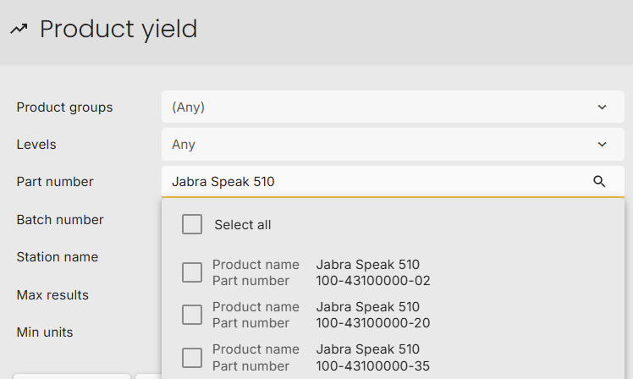
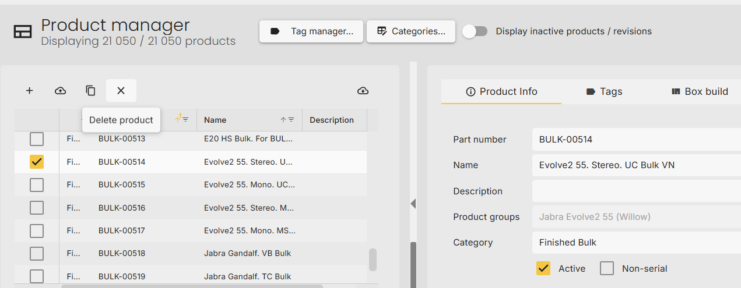
Part number syncronization with PLM system
Automated exporting Part numbers from PLM system nightly and pushing changes into WATS using simple CSV file format and HTTP PUSH
As Data is for the whole company – identifying a device can be by :
Project name (Leo)
Part number / SKU Number (BULK-00232) or
Product Model Name (Jabra SPEAK 510)
depending on the users department name (R&D, Operations, Sales etc.) @ GN you can find them with all using search and product groups – the source is the PLM system

Slide 13
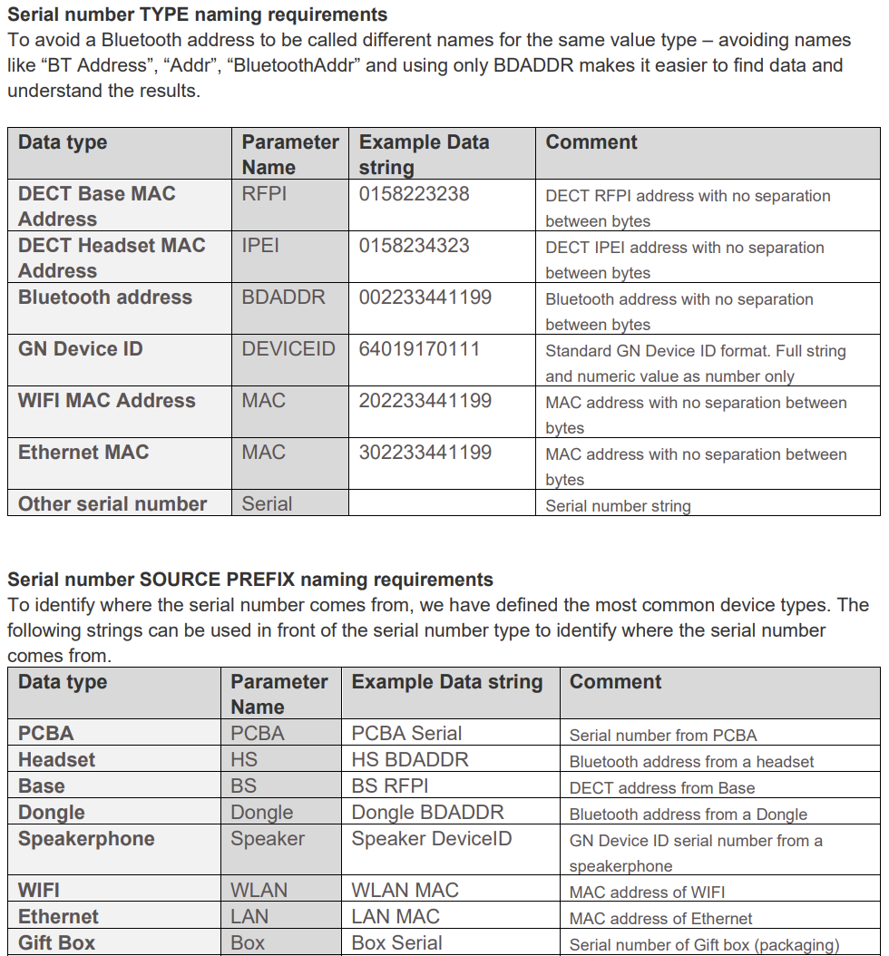
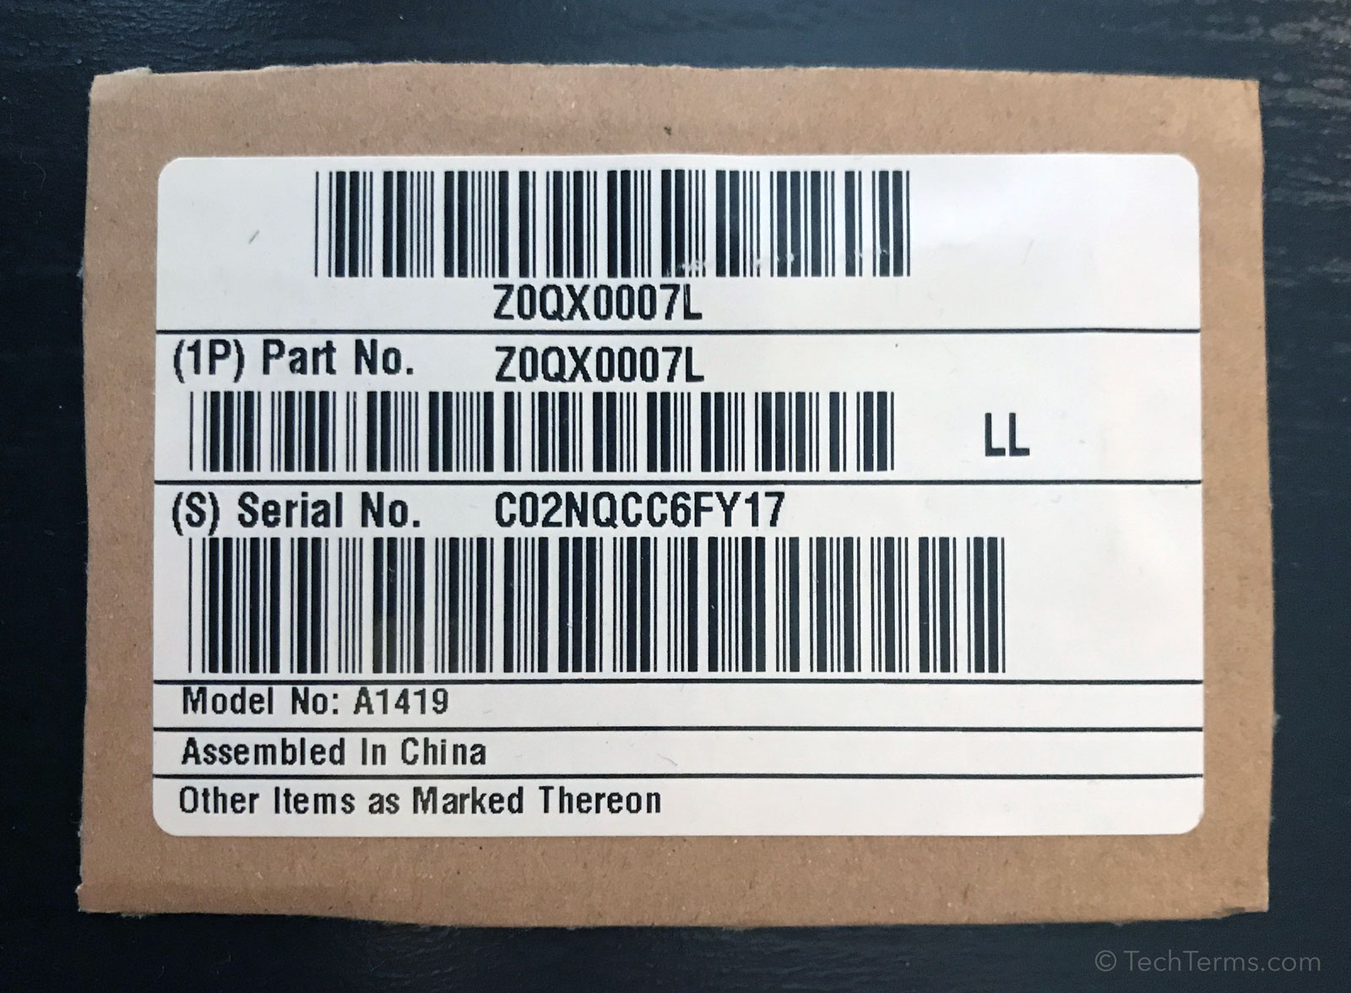
Serial Numbers
What is a serial number
In a product consisting of multiple serial numbers one must be the Main serial number with consistency in datasets

Slide 14
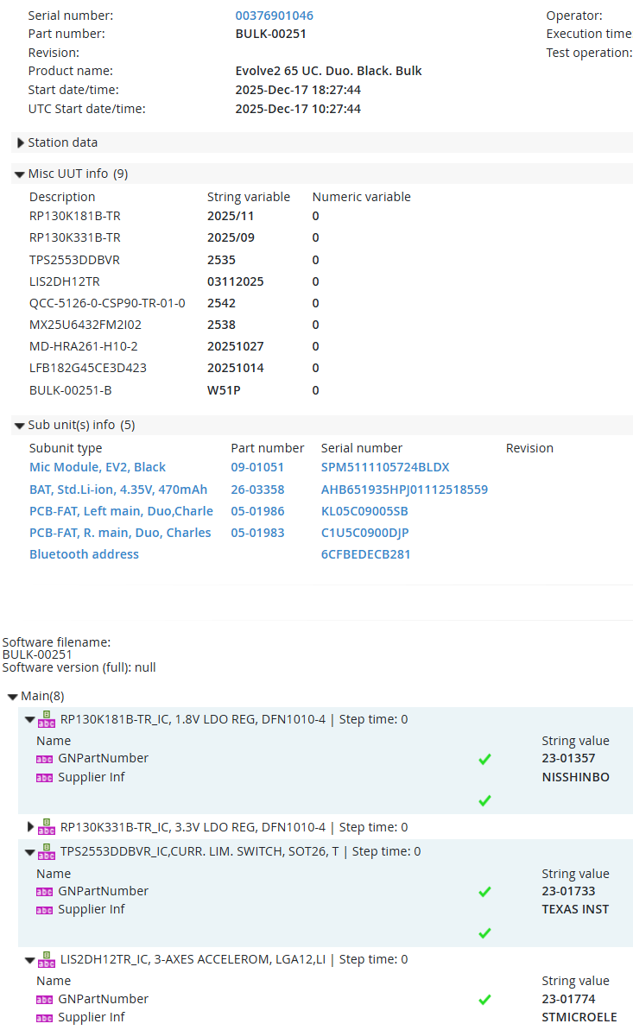
Key Component BOM
Collecting Batch number serials from all key components like active ICs, Batteries, Speakers etc.
Data upload daily from MES for easier root-causing assistance to R&D
Searchable data
Identify where
used

Slide 15
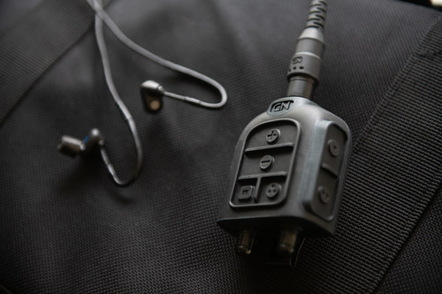
Open Box Audit
From Paper to Digital

Slide 16
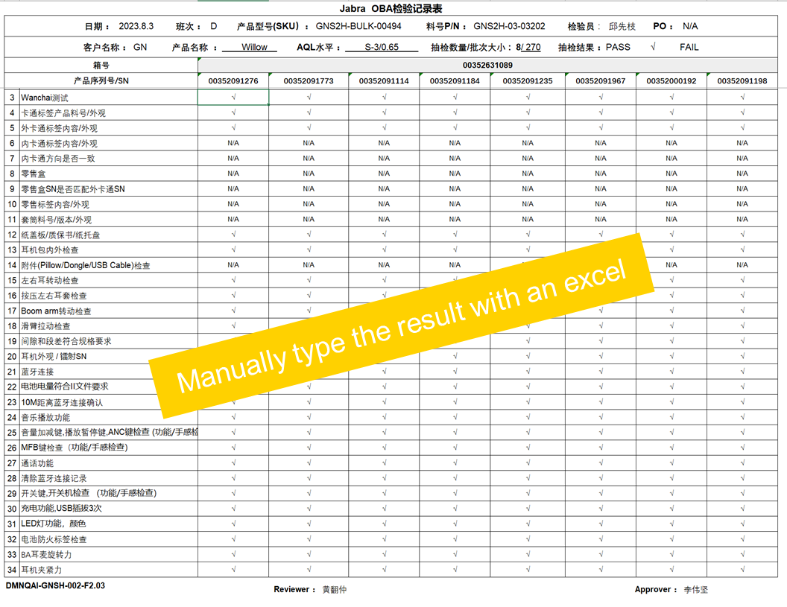
Background
Open Box Audit test records was paper and manual entry into excel
WATS have “operator interface” feature which can make a simple sequence.

Slide 17
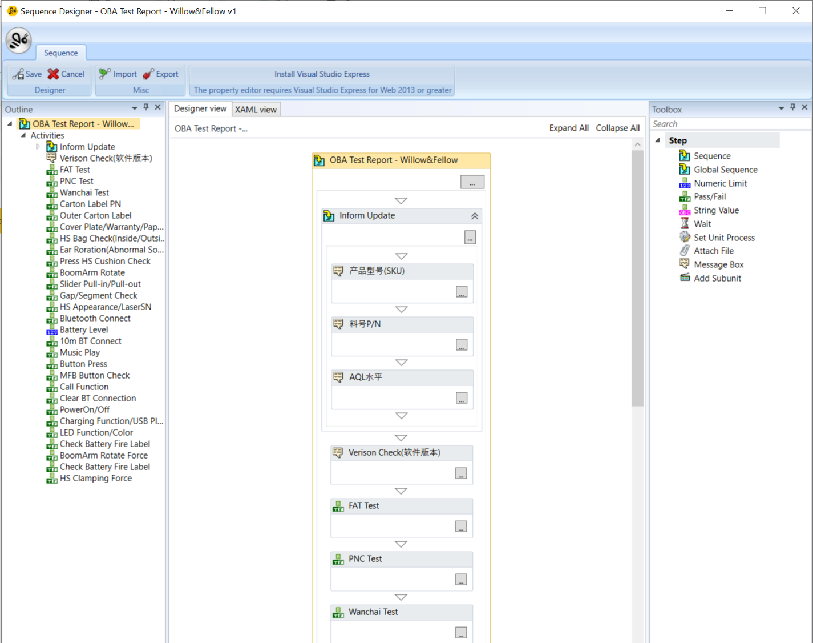
Setup Check Sequence
Using WATS Sequence Designer
Create Sequence
Define setting
Sequence Design
Add check items
Add Relations
Bundle PNs

Slide 18
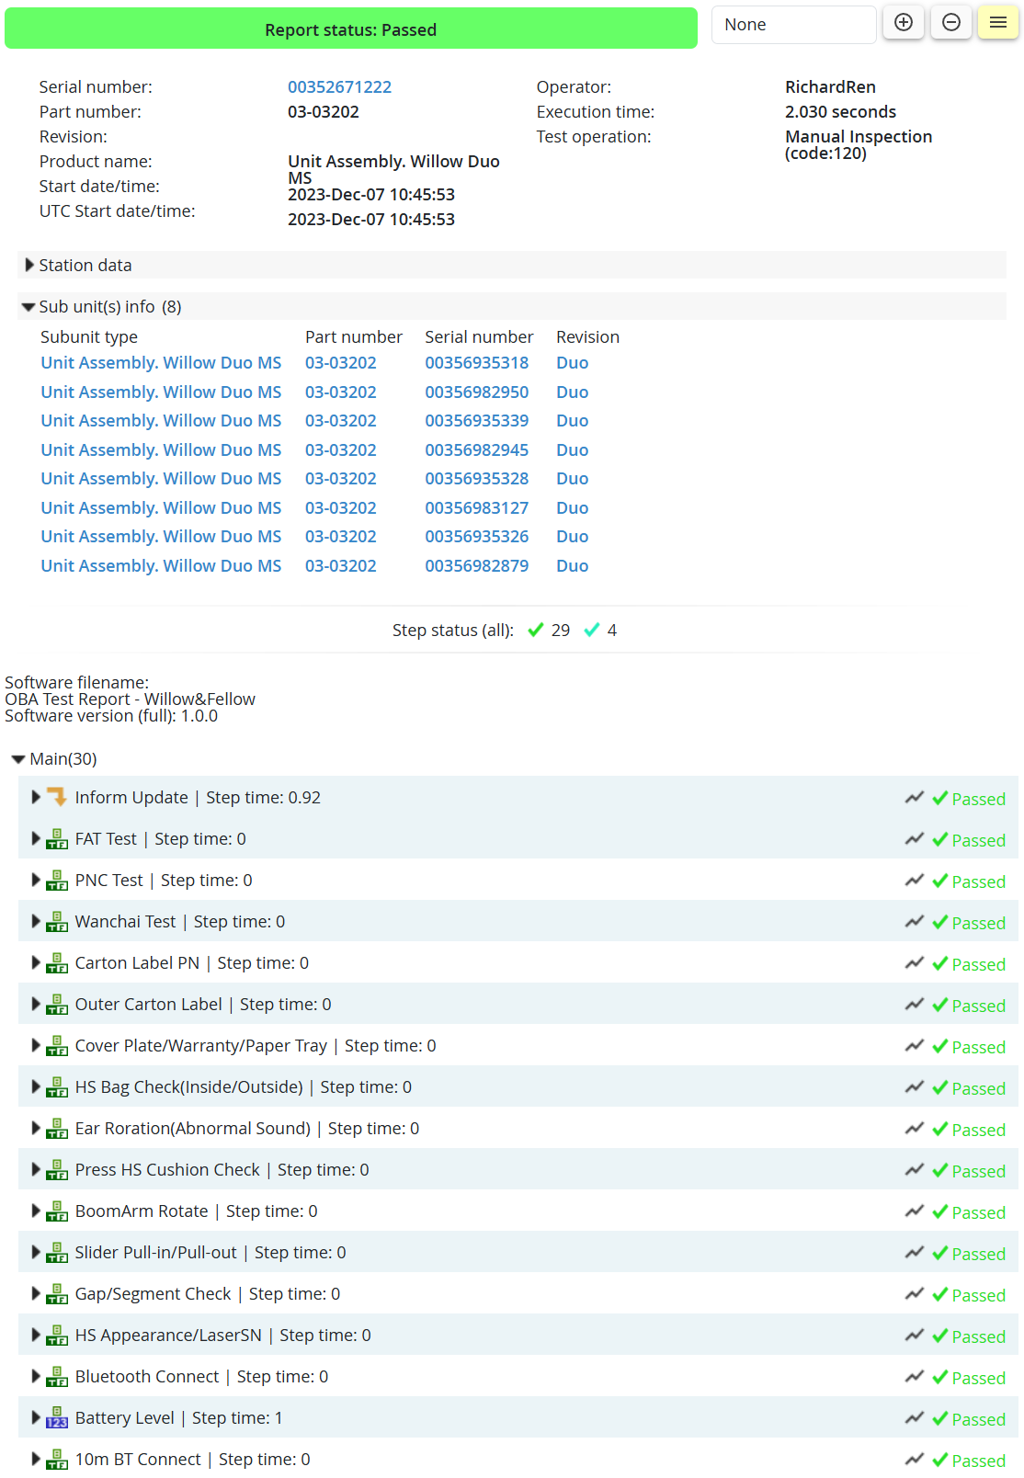
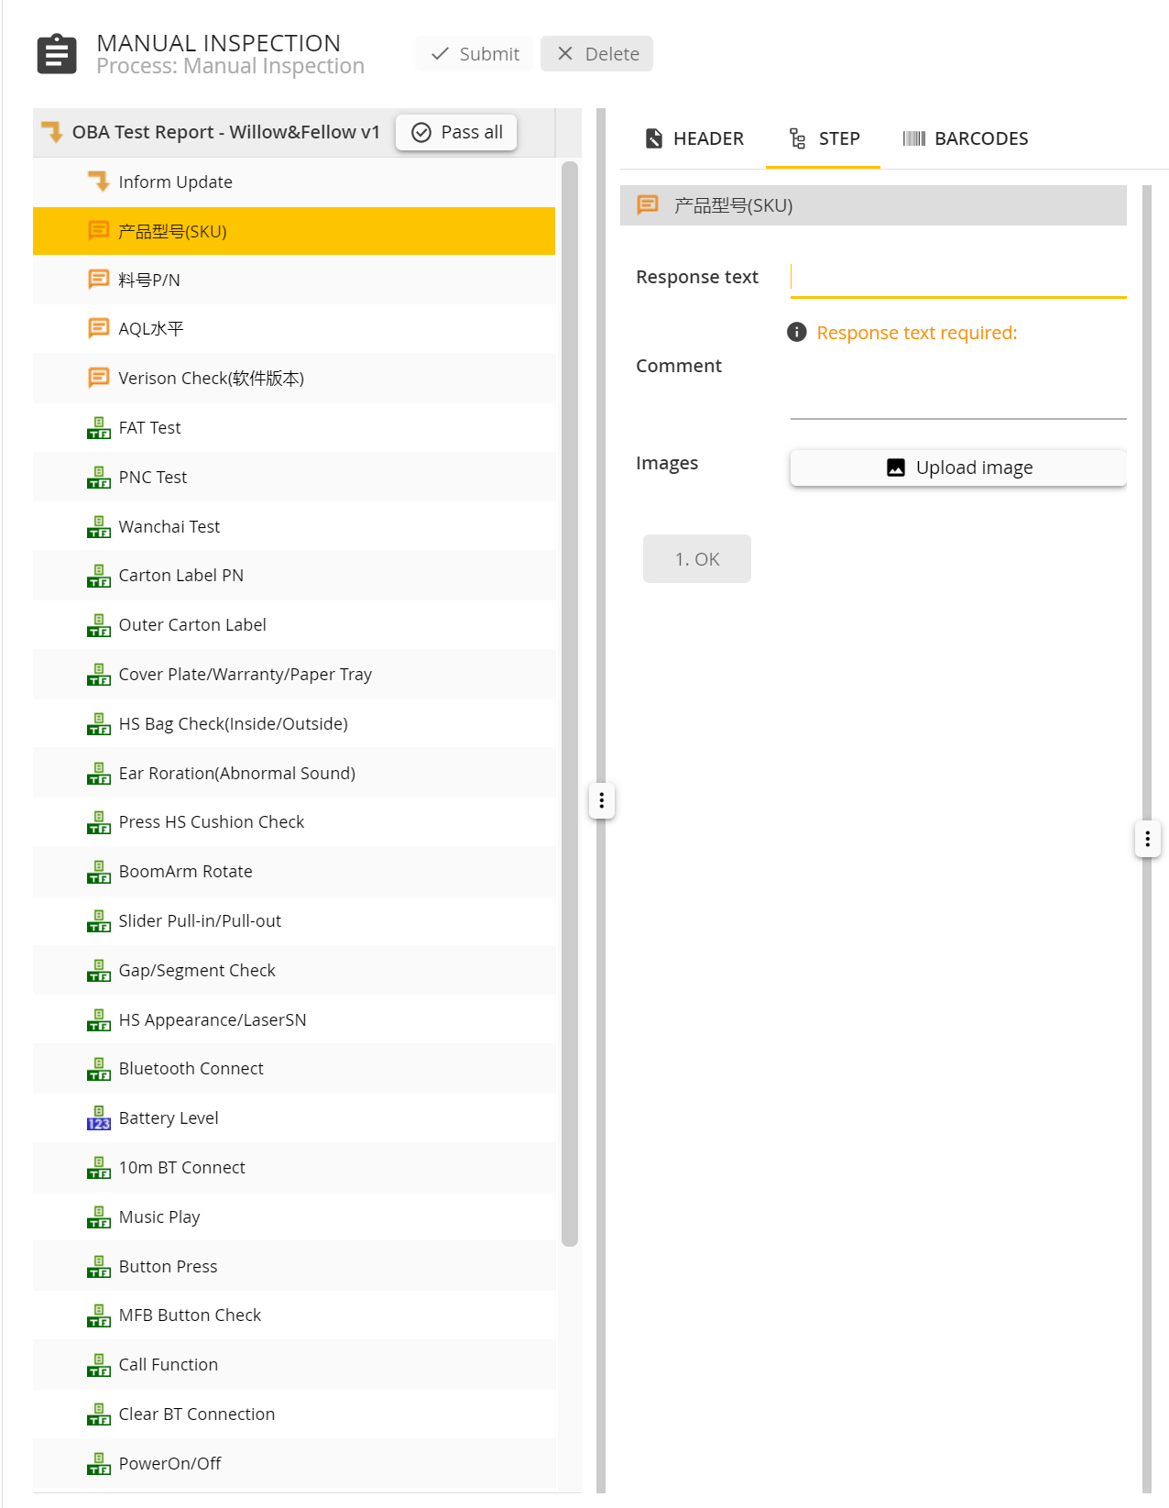
Manual Inspection Test
Operator Interface
Scan SN and type PN
Start Test
Scan sub-units SN
Submit/Upload Test Data
Test data will be bundled by SN
Test report: https://gn.wats.com/Modules/ViewUUT_Report.html?id=c8c7f90a-a3ca-4c39-8d94-b418221507d3

Slide 19
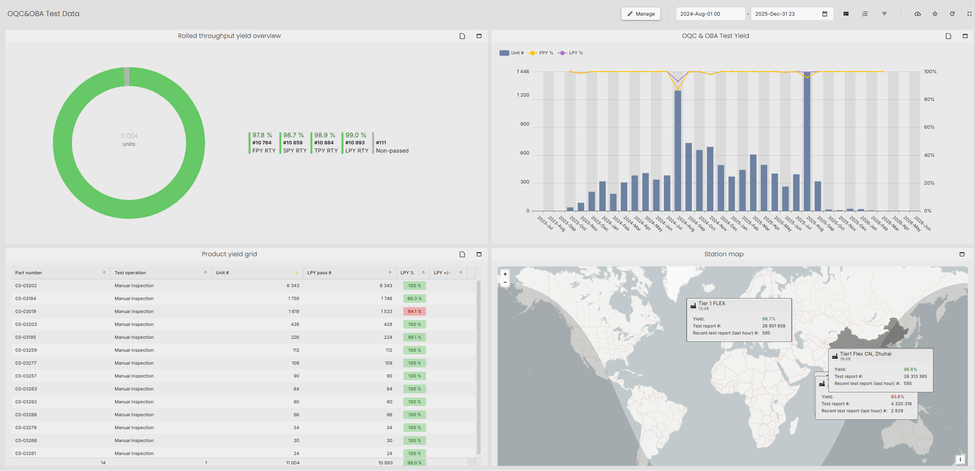
OBA Test Dashboard

Slide 20
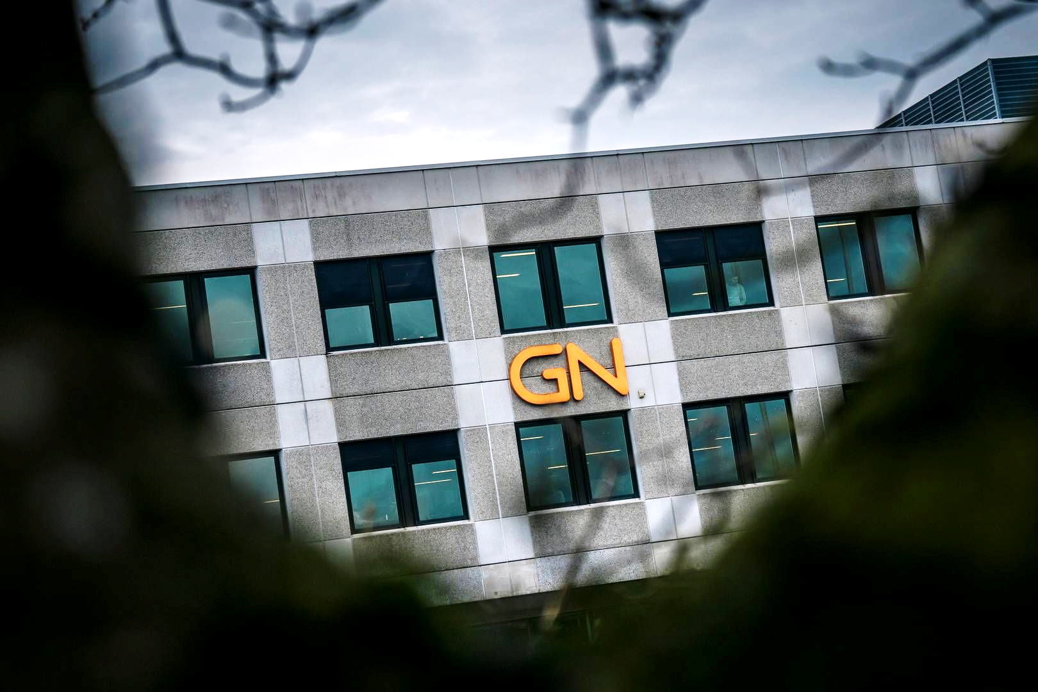
Radio Equipment Directive (RED) (2014/53/EU)

Slide 21
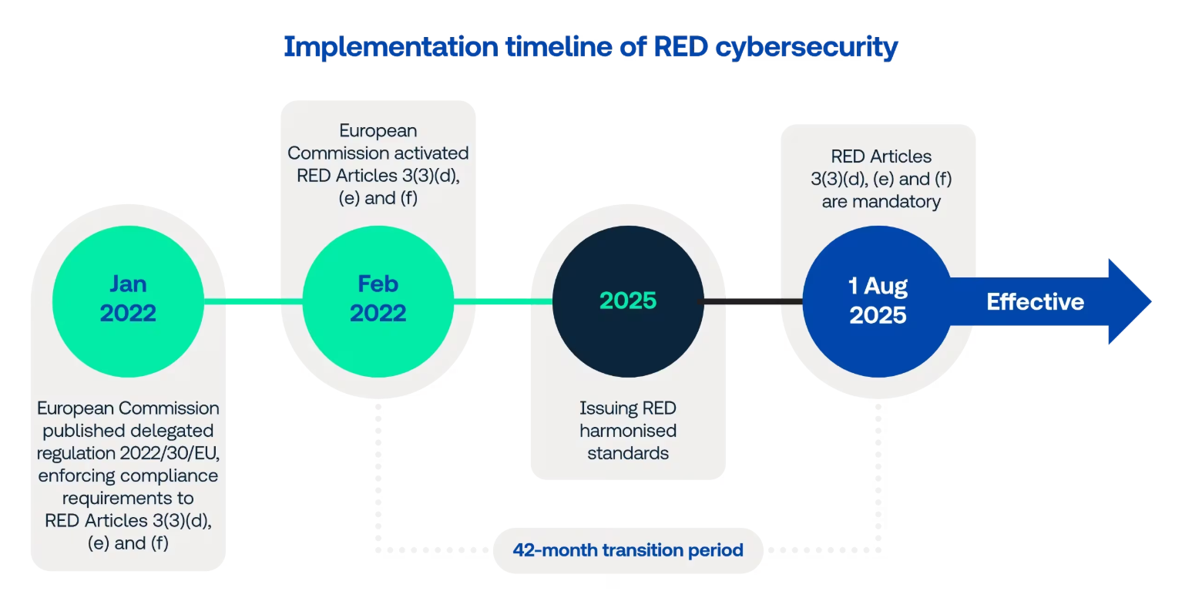
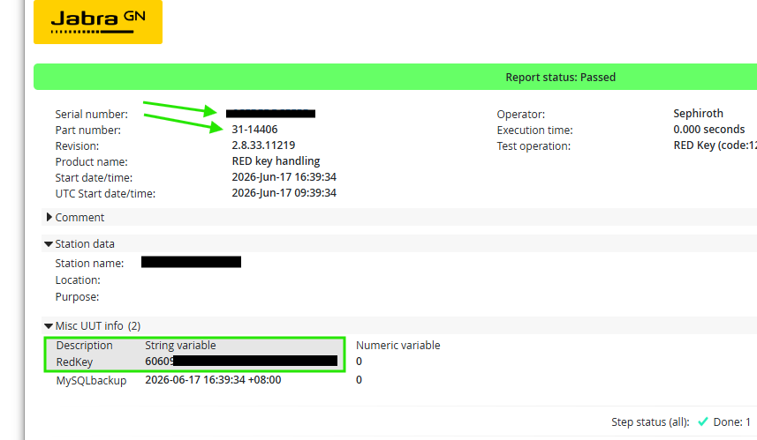
Handling mandatory RED security in real-time
Articles 3.3 d/e/f were made effective August 1 2025, effectivley requiring us to:
- prevent misuse of service and network resources
- protect end users in relation to GPDR
- enhancing features to protect against fraduolous attacks
Utilizing UUT reports in WATS, GN was able to quickly outline, develop and test a global solution, allowing us to keep track of RED keys to unlock devices in use cases across manufacturing sites and regions, without the keys following the end user device.
Locking in bulk production, and unlocking/locking again in End of Line production.
It was made possible by deploying a support module for our test applications, with a global WATS token, only having access to the part number we've defined for the RED key UUT reports.
Note: The same concept will be applied for other globally accessible key exchanges; some through Asset Manager, and some through UUT reports

Slide 22

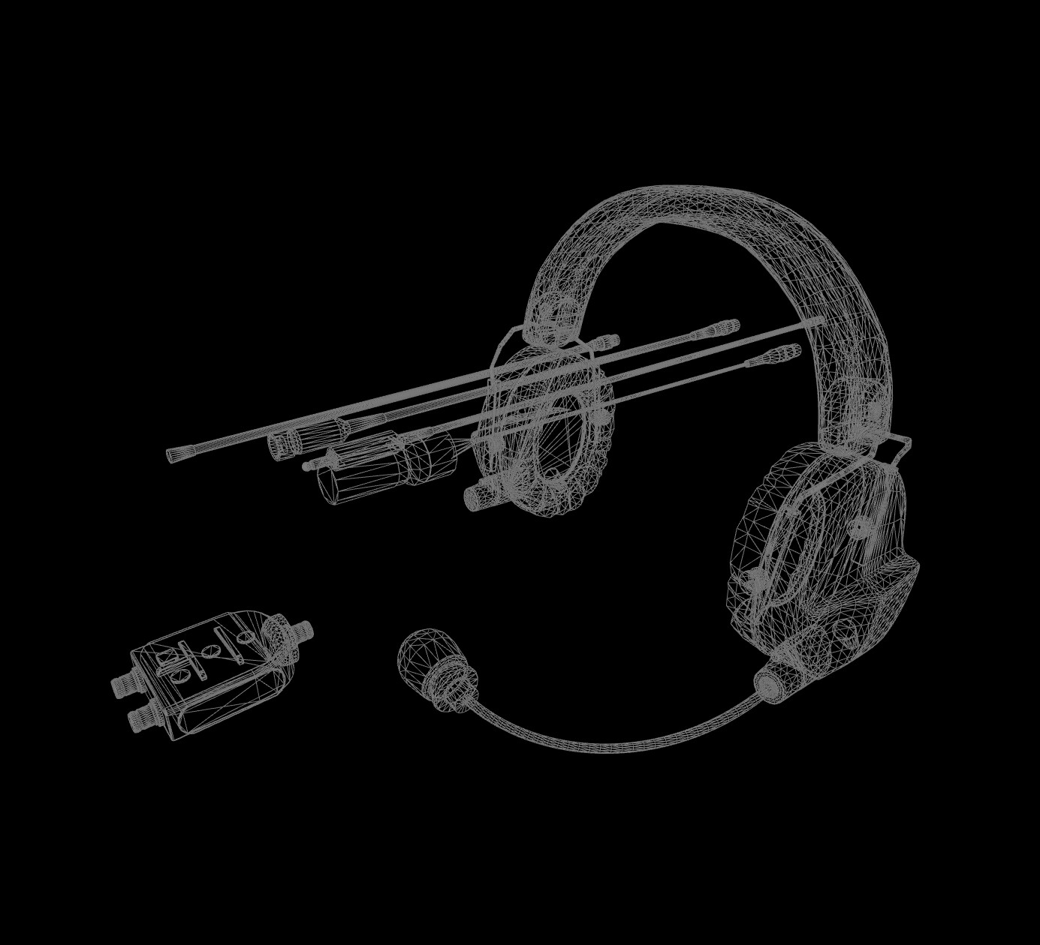
WATS SW Distribution

Slide 23
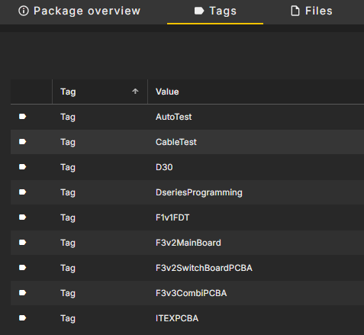
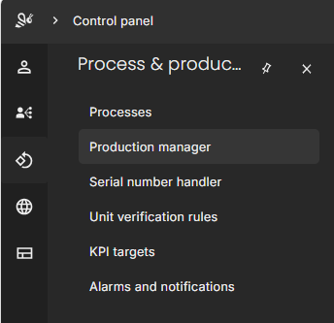

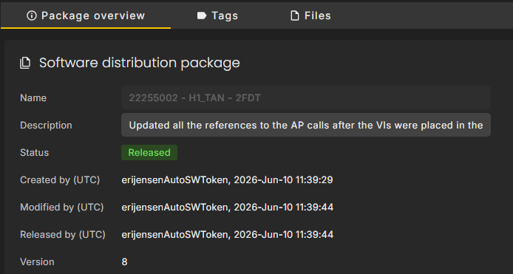
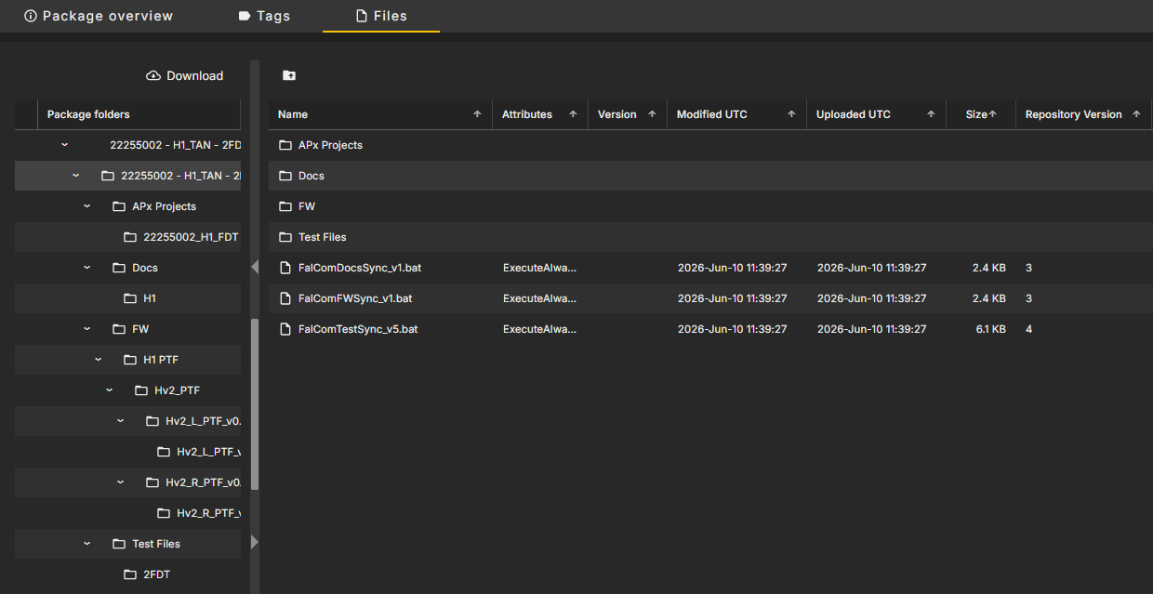
Dependencies
Software distribution is file distribution
Status
Content

Slide 24
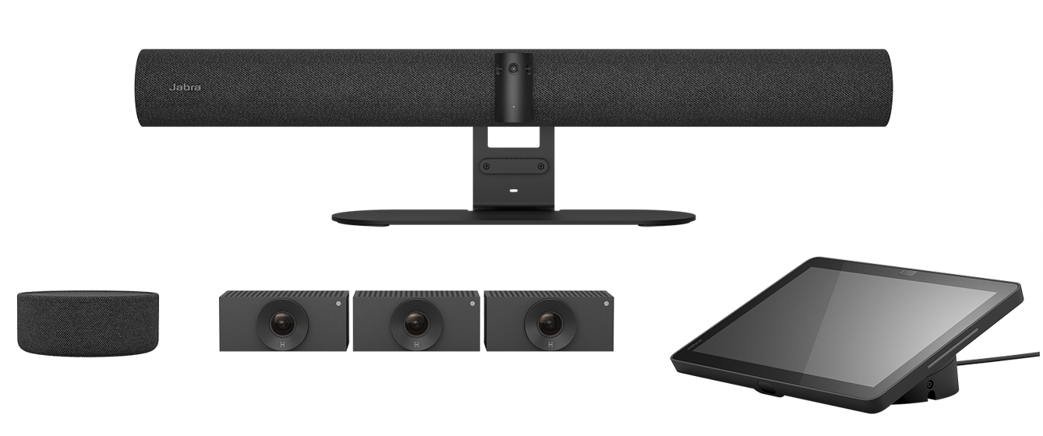
Gage R&R with WATS

Slide 25
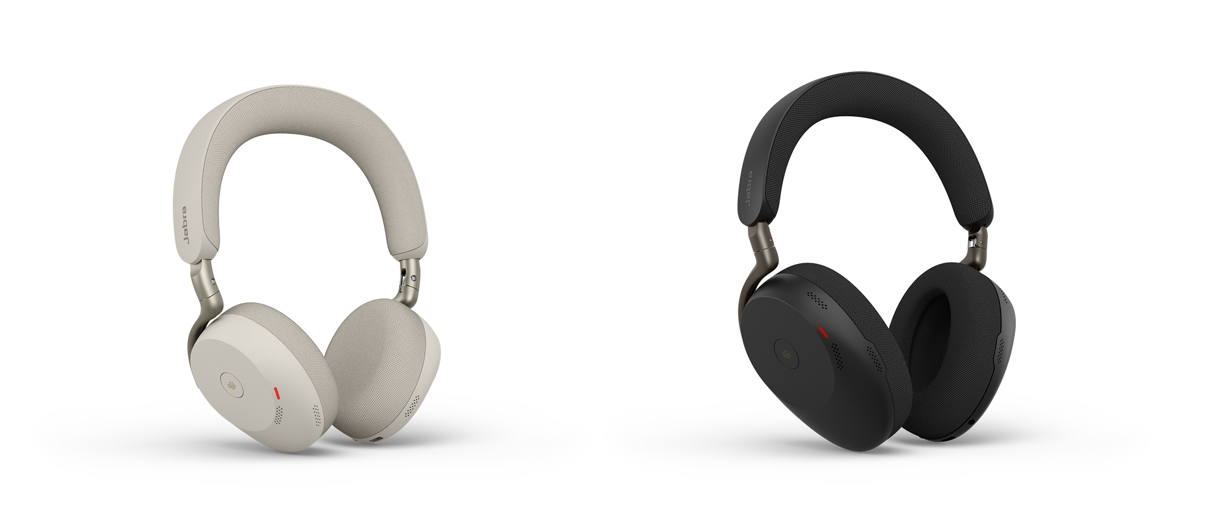
Agenda
GN process overview
GRR types
Data criteria for GRR
Acceptance criteria for GRR
GRR example

Slide 26
GN NPI Process overview
Simplified GRR
Full GRR
Alpha
Beta
Pilot
MP
First factory build with all test stations
Factory build
Sellable goods
Production line approved and released for Mass Production
Open limits
Gather data
Limits based on Alpha data
Final limits

Slide 27
GRR Types
Full GRR (Mass Production)
10 UUTs
3 operators
3 runs per UUT/operator
90 UUT reports in total
Simplified GRR (Alpha, Beta)
1A:
    1 UUT
    1 operator acting as 3
    5 runs per operator
    15 UUT reports in total
1B:
    5 UUTs
    1 operator acting as 3
    3 runs per UUT and “operator”
    45 UUT reports in total

Slide 28
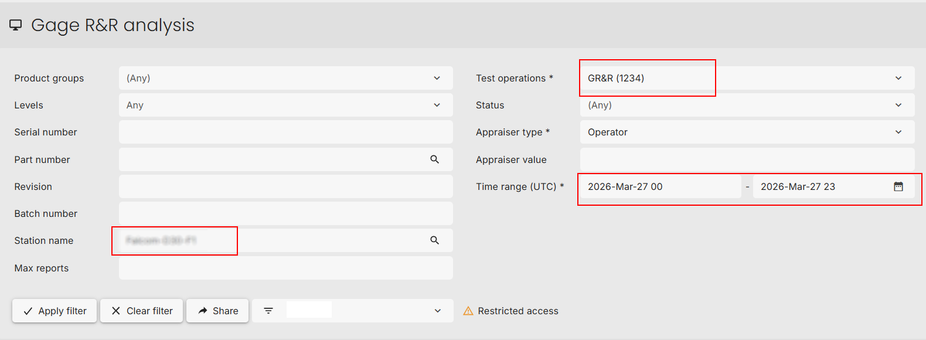
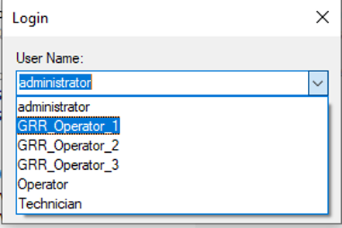
Data criteria for GRR
Test operation always set to “GR&R (1234)” during GRR
  Test operation is only used for GRR, regardless of underlying test (PCBA, Acoustic, Functional)
  Fixed operator names “GRR Operator 1,2,3”
  Use date and station name to locate data in WATS

Slide 29
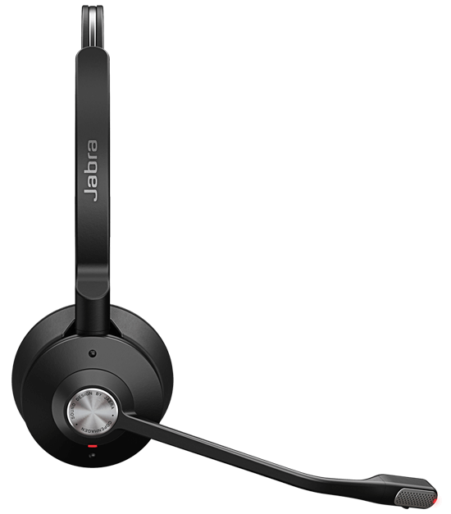
Acceptance criteria for GRR
Total GRR Tolerance below 20%
Cpk between 1.6 and 4
If the criteria is met: GRR is accepted and approved
Else:
Improve test stability
Change limits
Apply domain knowledge to approve GRR

Slide 30
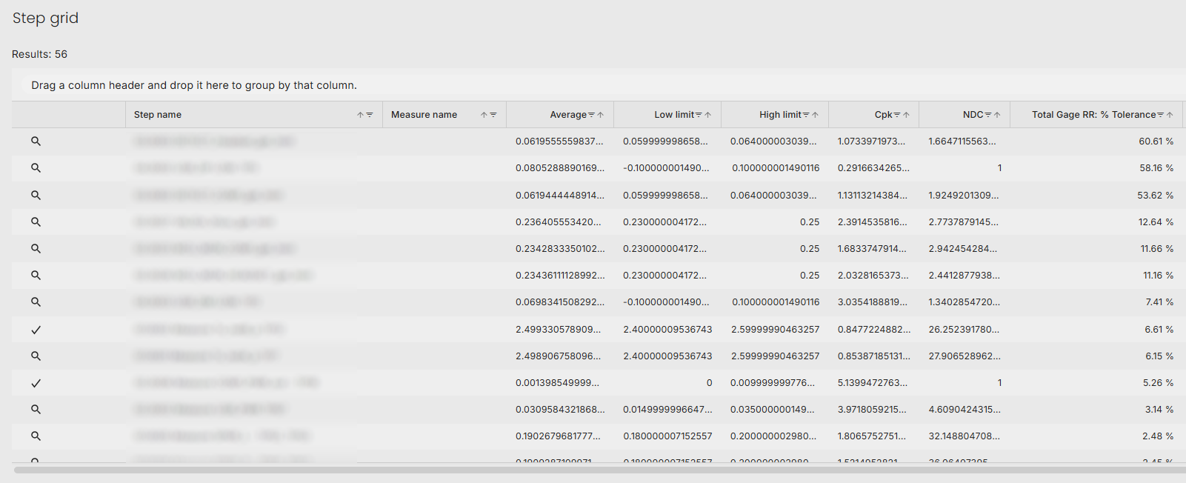
GRR Example – PCBA test for product main board
Problem?

Slide 31
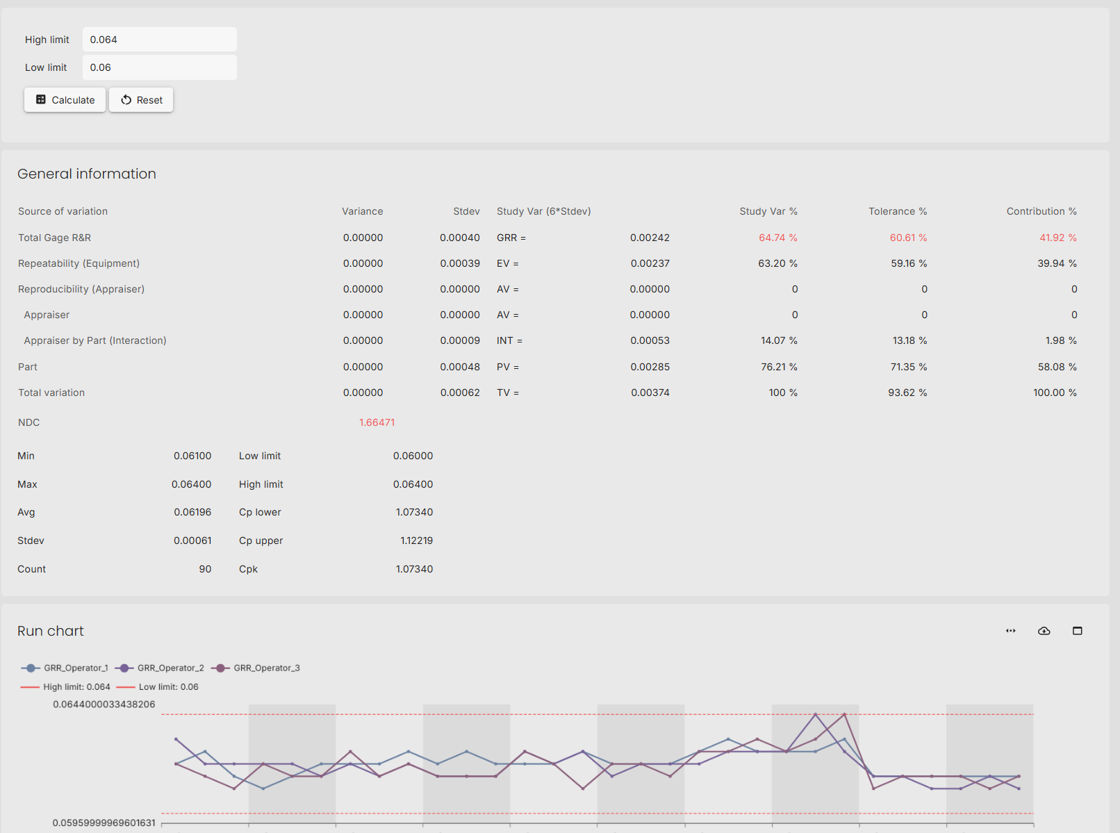
Although all are passed, the Cpk and GRR Tolerance are out of spec.
Root cause:
ADC quality not good enough for limits
Solution:
Widen limits

Slide 32
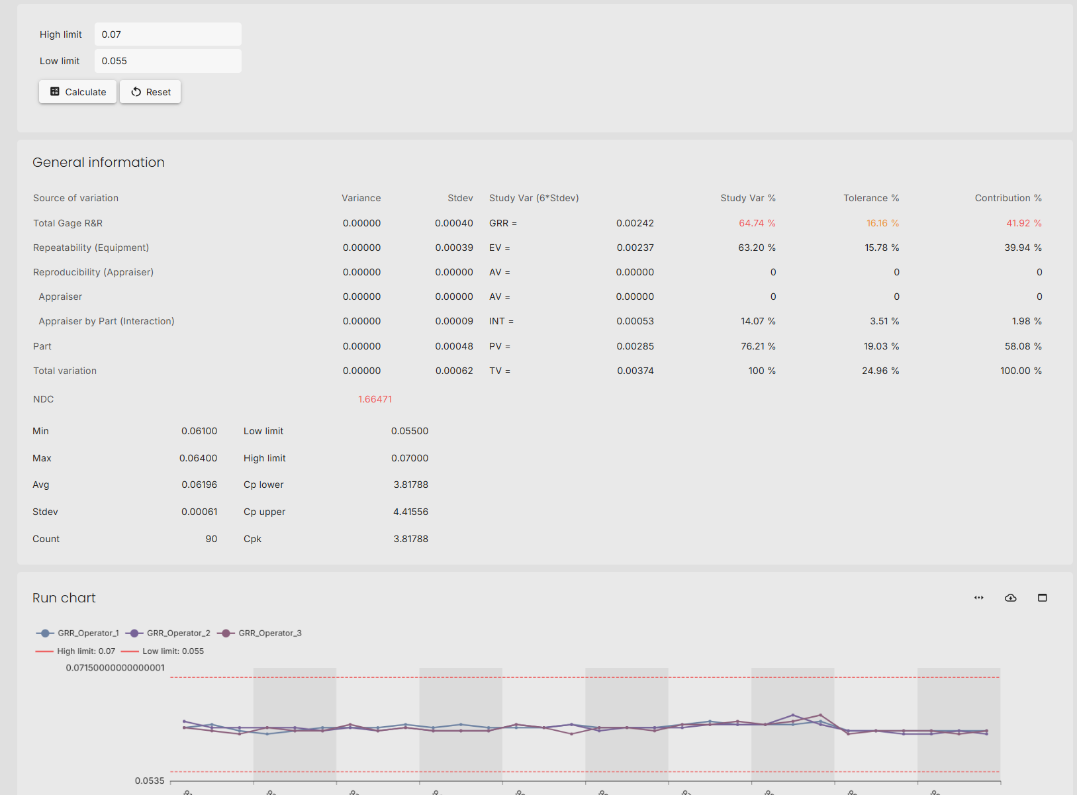
Use the limit adjuster in WATS to find limits with good GRR tolerance and Cpk.
Verify with R&D that test will catch true failures.
With new limit, GRR tolerance reduced to 16% and Cpk = 3.8

Slide 33
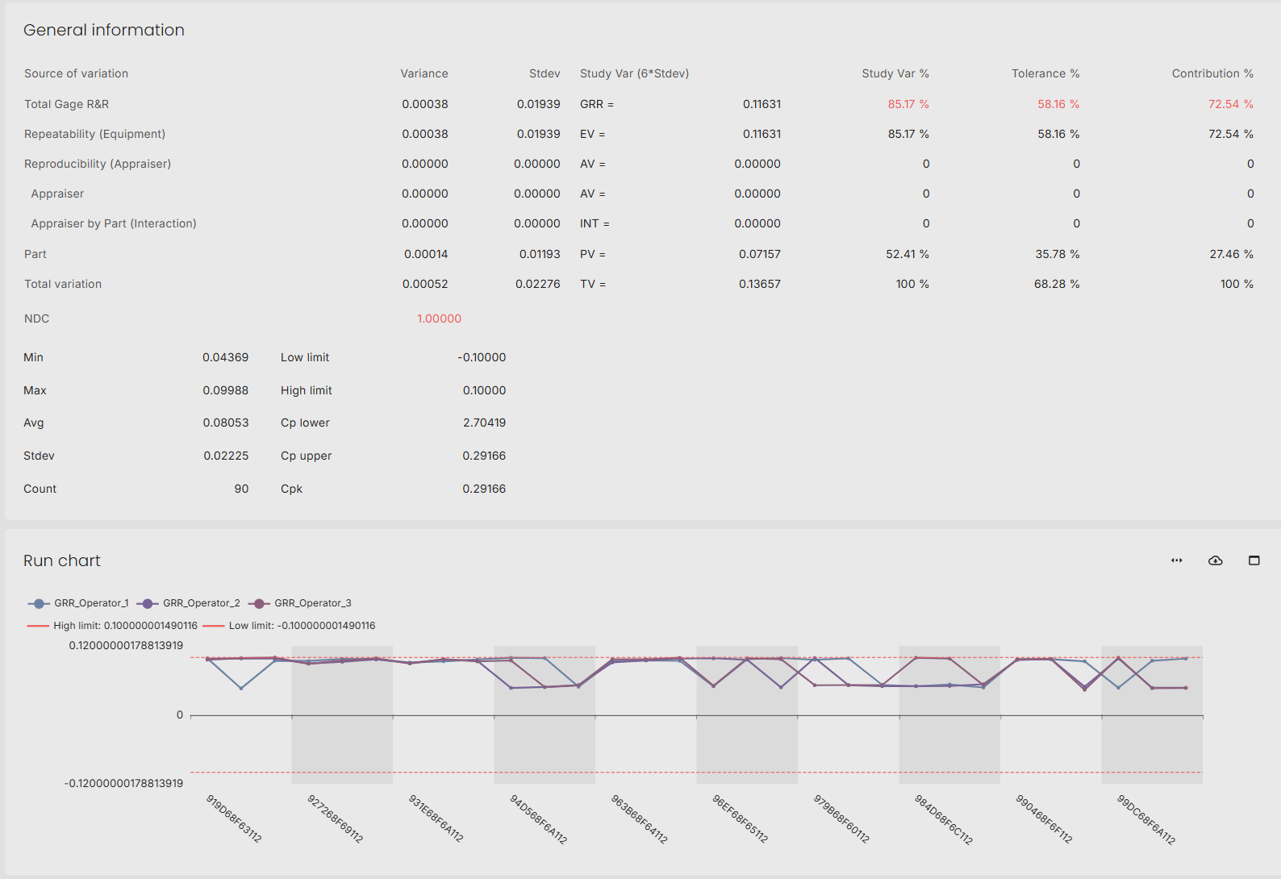
All passed results at upper limit
Root Cause:
UUT switching from high to low voltage, but no sink in system so voltage stays high.
DMM acting as sink. Multiple measurements brings voltage down and test pass just below limit.
Solution:
Known root cause. Keep test and limits.
Test will catch true failures

Slide 34
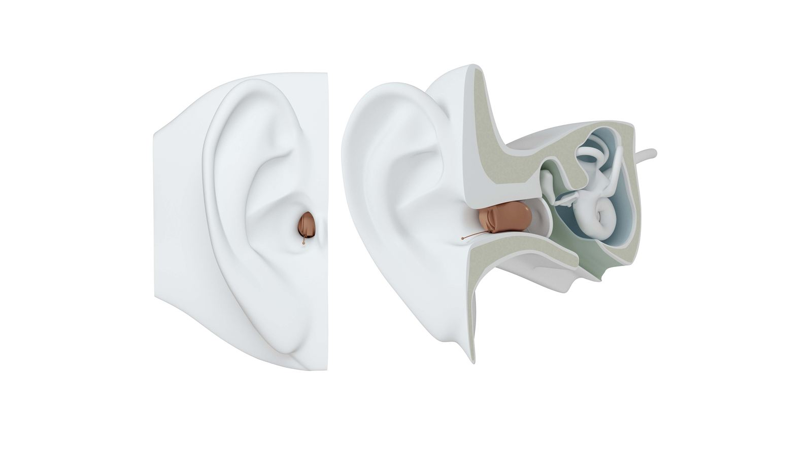
WATS Aleva Heat Map + Unit Flow

Slide 35
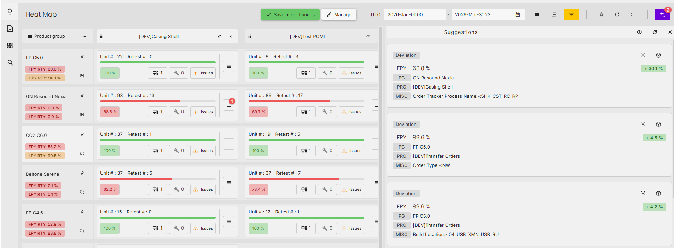
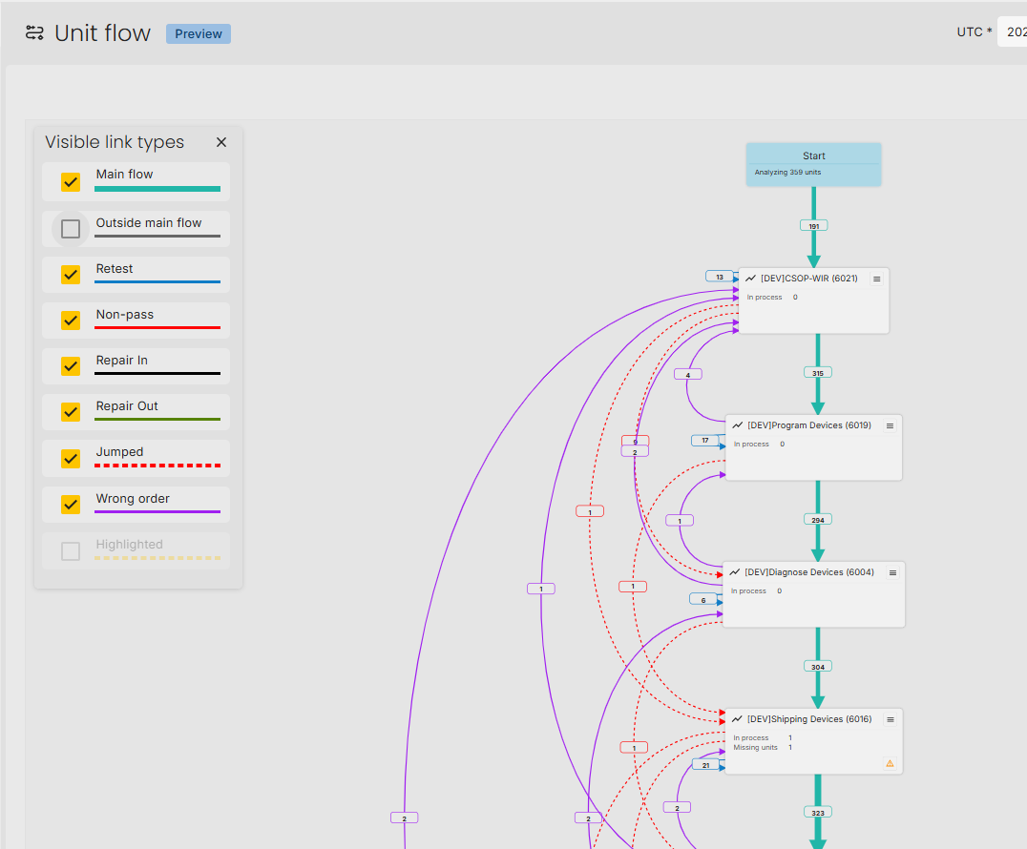
WATS Aleva Heat Map + Unit Flow
@The WATS Company – we need to talk about this

Slide 36
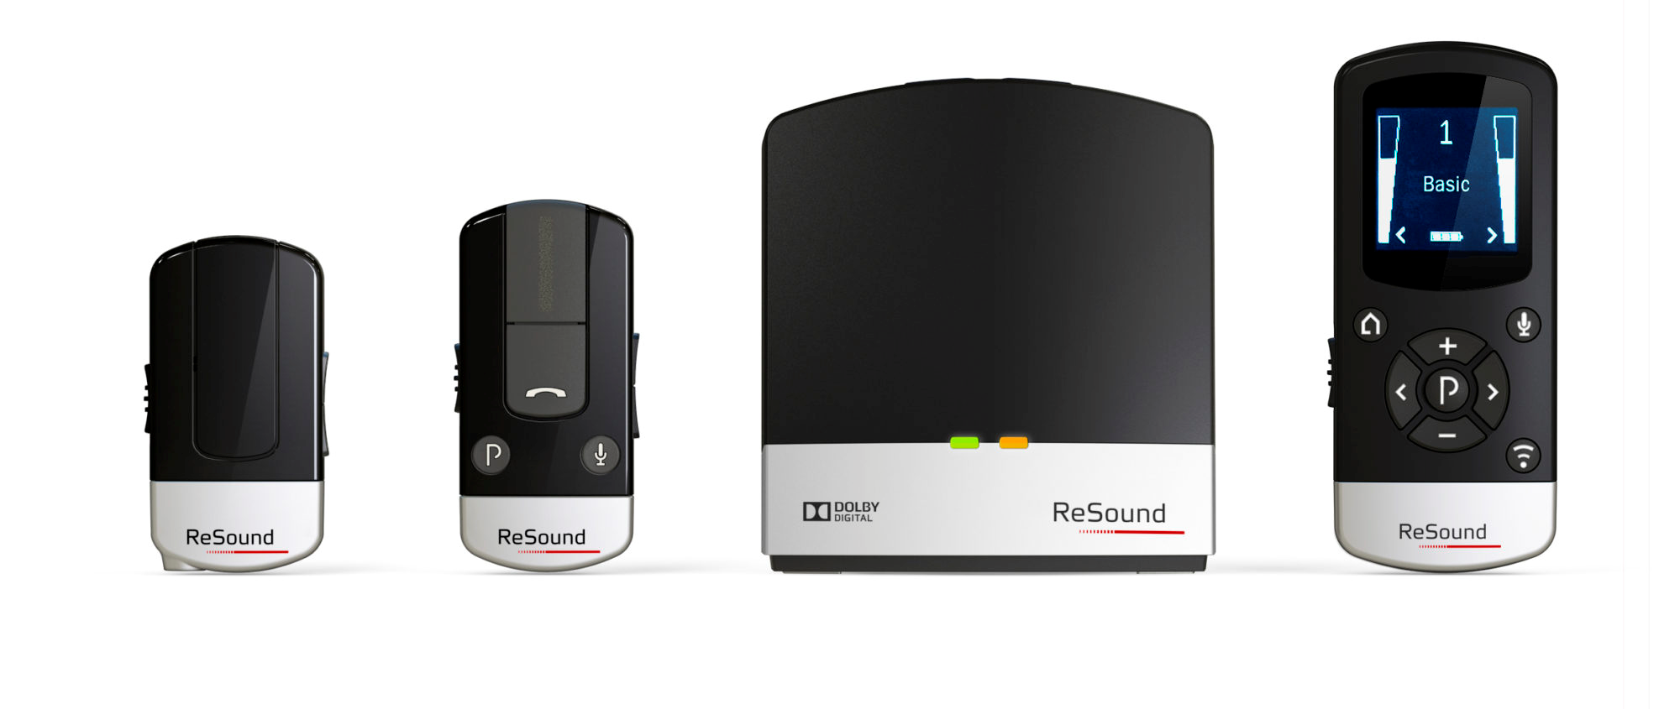
WATS Conformance Reporting
Conformance Reporting in WATS helps ensure test data is complete, traceable, and trustworthy. It verifies that all expected test reports are present in WATS and checks that WATS matches the validated reporting system. When all reports align, users can confidently use WATS for search and analysis while still linking back to the official validated reports.

Slide 37
WATS Conformance Reporting
Building Confidence that WATS data is complete, tracible, and aligned with our quality expectations.
Completeness
Traceability
Trust
Confirms expected test reports are present
Links WATS reports to the original validated source
Gives confidence to use WATS for reporting and investigation
Expected Reports /
Validated Source
Conformance Check
Trusted WATS reporting
Conformance Reporting makes WATS easier and safer to use by proving that the required reports are present and traceable

Slide 38




Completeness Check
Confirming that all expected machine test reports exist in WATS
Machine Output
Search WATS
Compare Count
Machine counts number of tests
Find matching WATS reports
Expected vs found
Conformance reporting gives confidence that WATS has received the complete set of expected reports

Slide 39
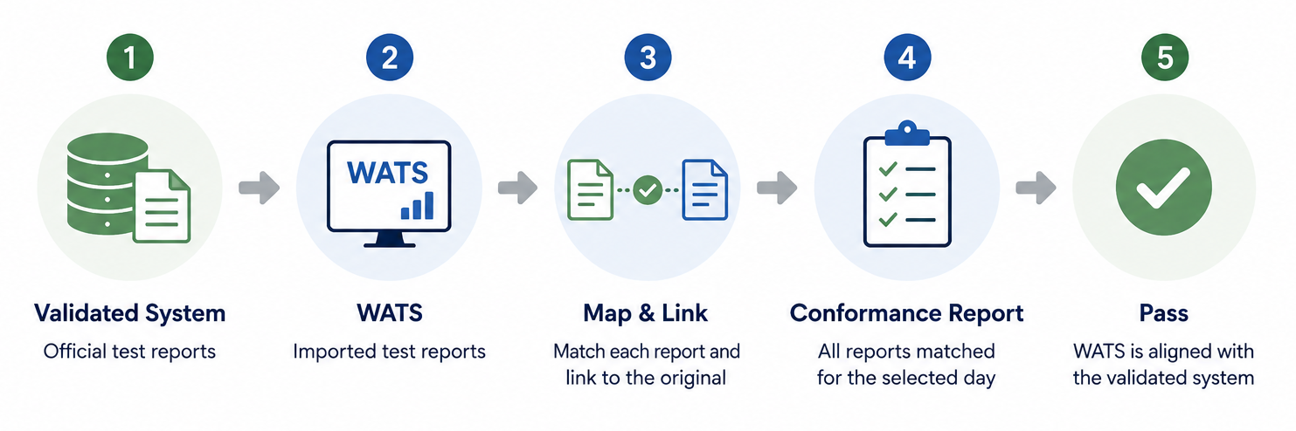
Alignment With Validated System
Ensure WATS content matches the validated report system
Every Report in WATS is linked to the original validated report
Users can access the official source

Slide 40
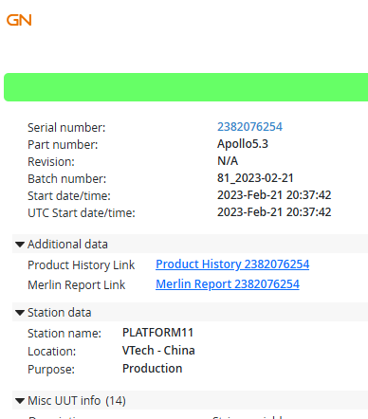
Source Linking In WATS
Insert links into Additional data
HTML link is formatted
No unauthorized access to source
Extra Misc Info added to show the report has been processed

Slide 41
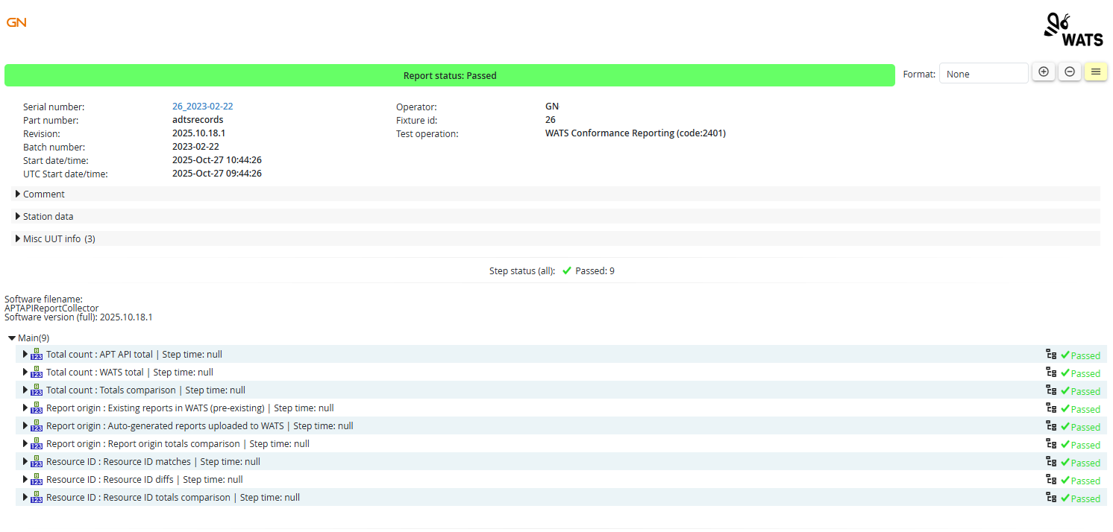
Conformance Report In WATS

Slide 42
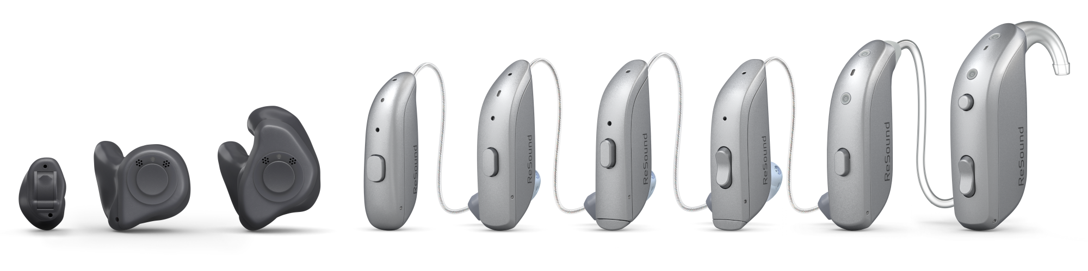
WATS Management Reporting
The Standard UI is not for everyone

Slide 43
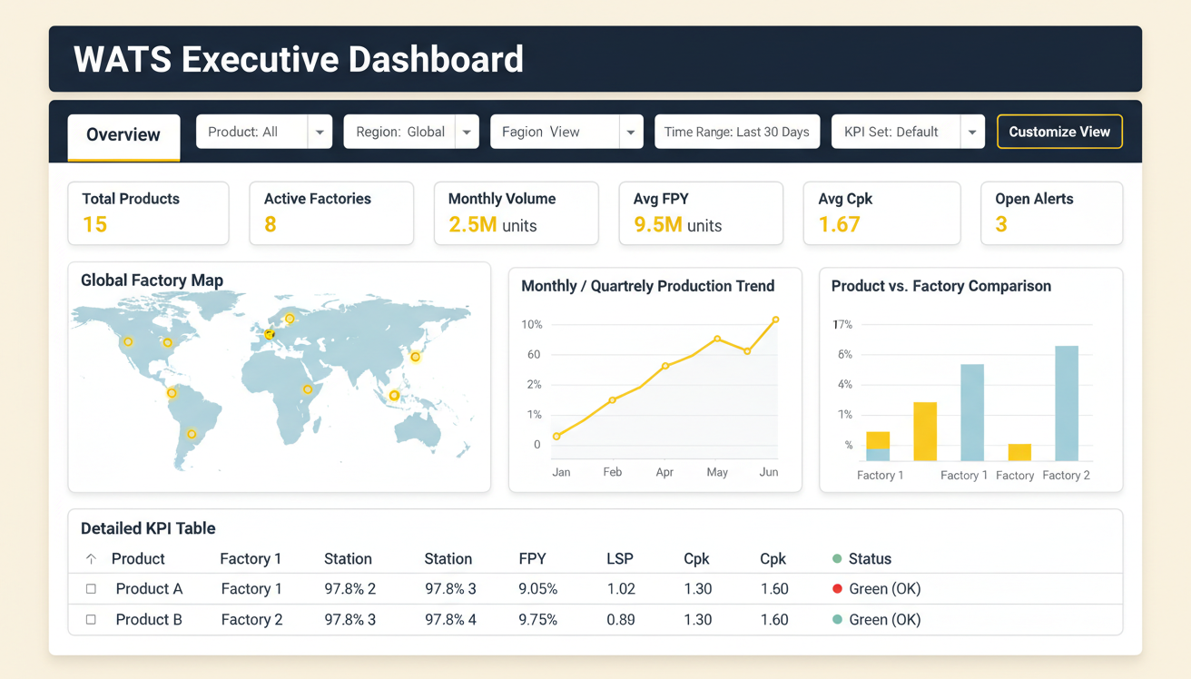

User Experience
UI LAYOUT
WATS – PowerBI Interactive UI for Management reporting
Management focus is not the unstable DC Voltage
WATS BI Portal

Slide 44
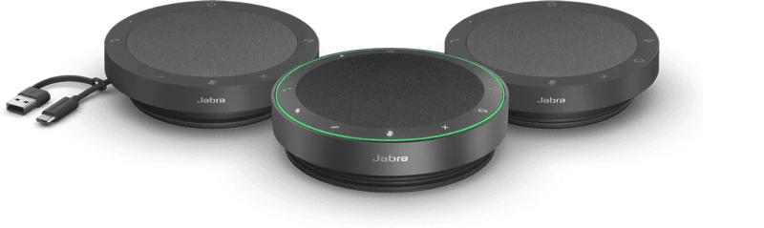
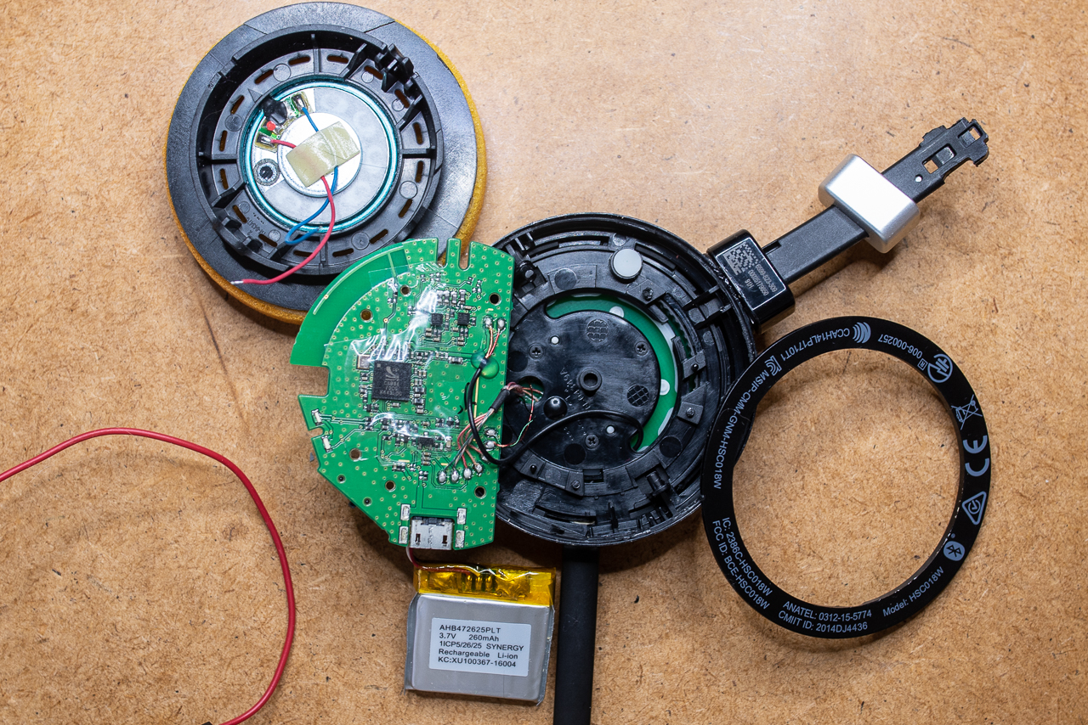
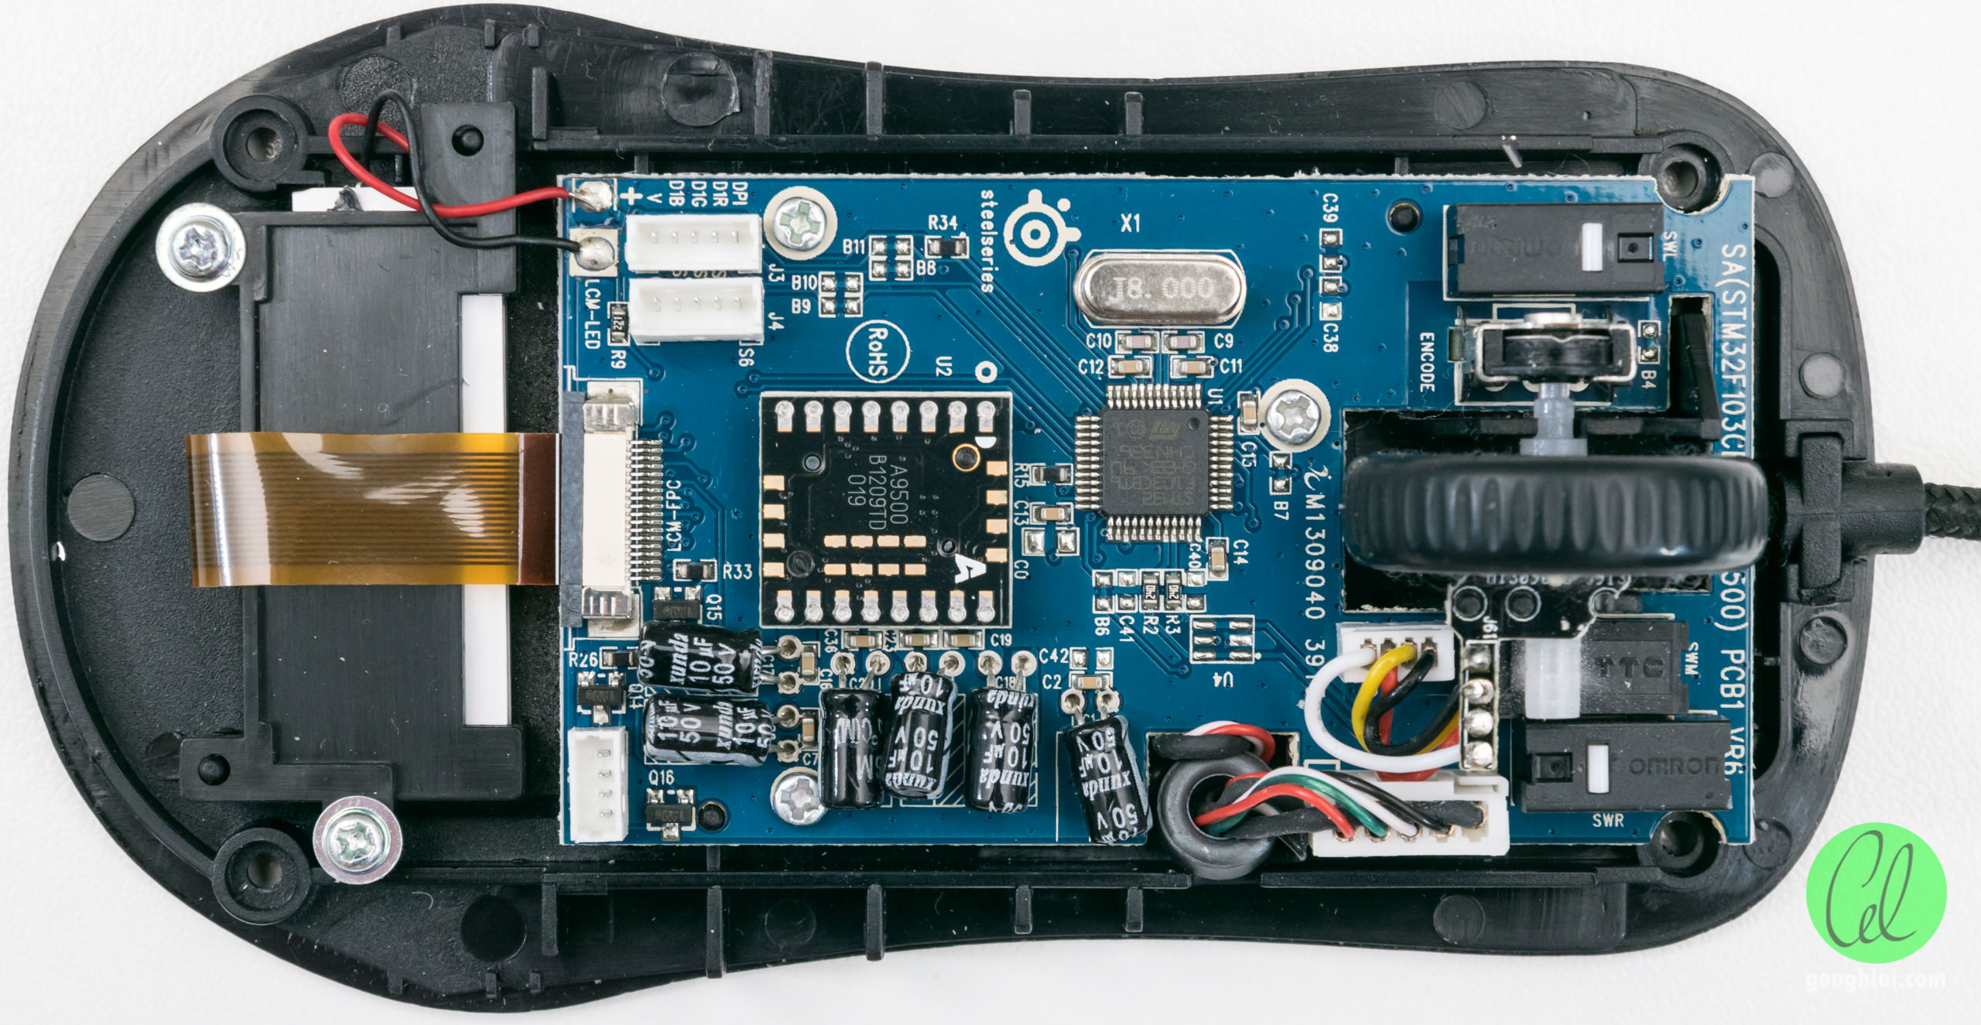
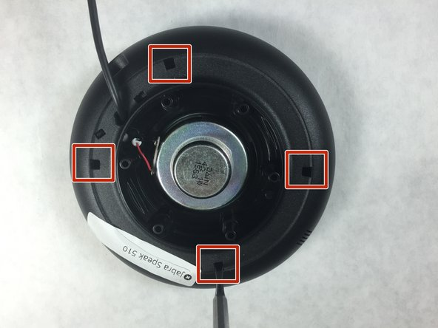
Repair overview

Slide 45



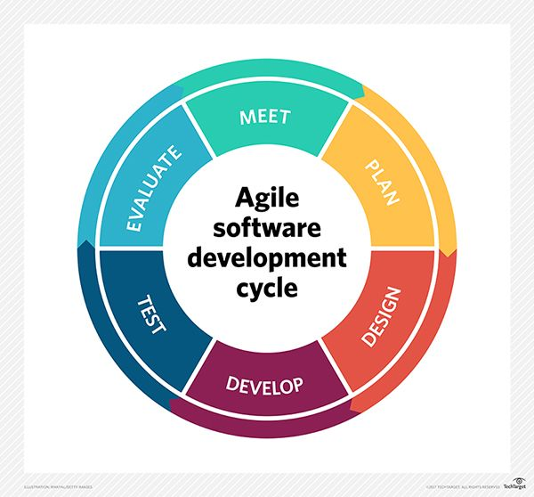
R&D
(PRODUCT CREATION)
CONCEPTUALIZE
REPAIR CENTRE
(AFTER MARKET)
MARKET RETURN
DEFECT ANALYSIS
PRODUCT DESIGN
CONCEPT
DESIGN
REPAIR DATA COLLECTION
TRACEABILITY
IN
REPAIR
REPLACED COMPONENT
DFA
DFR
DFT
Lesson Learn from repair
Design for repairability
Repair data collected
Uploaded to WATS
Data share with R&D
REPAIR MGMT
REPAIR CENTRE
CONTINUOUS
IMPROVEMENT
RETROSPECTIVE
TECH
LEARNINGS
DATABASE

Slide 46
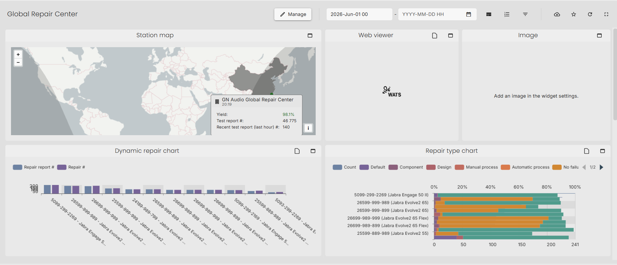
Repair Dashboard

Slide 47


AI with MCP

Slide 48

IT - AI Integration – MCP Server for the rescue

Slide 49

Wishes for The WATS Company
Assembly line focus
  Integrated “Key Component BOM” system linking parts like battery serial number to final product
  Better integration of sub-units for full process flow visualization (Final unit is build of multiple sub units)
  Image analysis throughout the line
  Line balancing help, all active and passive stations
    Passive stations = manual or automated assembly stations operated by people or robots

Slide 50

Game-Over
Thank you for listening

Slide 51


