Slide 1
Asset management
WATS UP 2026
Mads Dahl
Drammen, September 2026

Slide 2

Agenda
Why Asset management
Asset types & Setup
WATS Asset reporting
Alarms & Notifications
Quick demo

Slide 3
Why asset management
Primary:
Wear on test equipment may affect the result of the test.
  Test probes, connectors & other fixture parts will fail without maintenance
Electronics in measurement circuits change over time and may affect the result of the test.
  Calibration must be done at specific interval to check quality of the measurement.
Secondary:
Where is the asset located?
In production, storage, factory location?
Is it operational?
  Under repair?
  Under maintenance?
What is the age of the equipment?
  How many times has it been used?
Full Traceability
Easy Access to Data

Slide 4
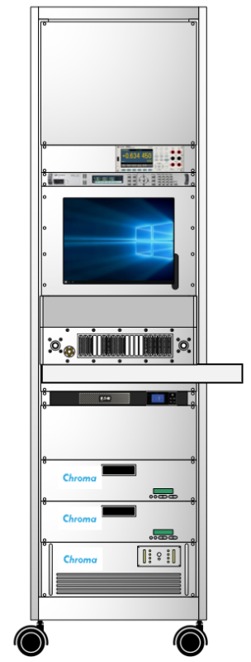

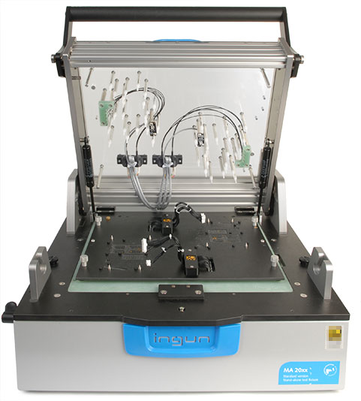
Asset types
Useage
Calibrations
DMM
Mechanics
Power supply
Connectors
PXI modules
Test probes
Mass interface
Measurements
Pneumatics
Light guides
DC Load
DC power
AC power

Slide 5
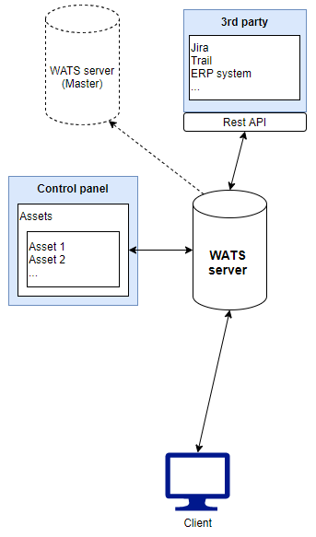
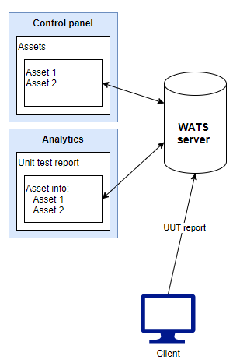
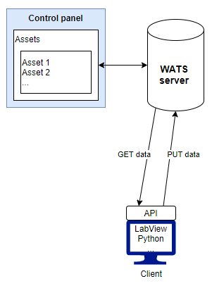
WATS Asset - Architecture
API
Unit test report
Notes:
API – Online
UUT report – Offline
New REST API endpoints introduced for external system integration: o Asset/Calibration/External – Enables calibration updates with custom date ranges. o Asset/Maintenance/External – Enables maintenance updates with custom date ranges. o Asset/SetRunningCount and Asset/SetTotalCount – Allow external systems to update count values. o Asset/ResetRunningCount – Backend endpoint for controlled running count resets. • Existing API calls have been verified and extended to support External calibration and count scenarios.

Slide 6
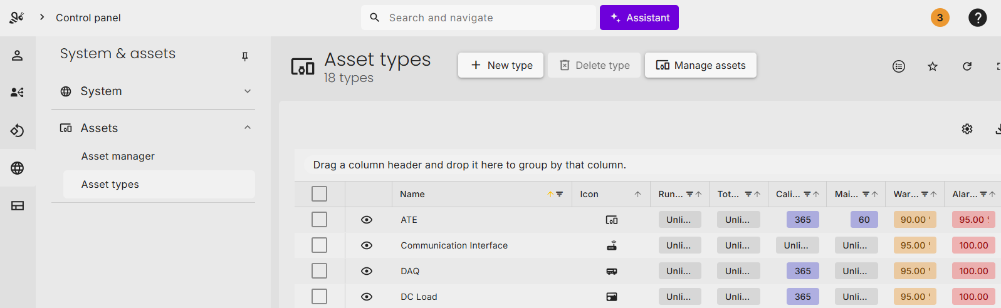
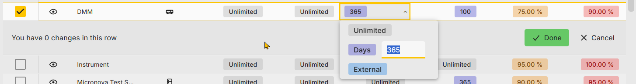
WATS Asset setup
Requires Admin or Manager login permissions
Notes:
Editing Total Count requires the new “Edit Total count” permission, found under Control Panel -> System & Assets -> Asset Manager -> Edit counters and limits. Administrators and Managers will get this permission by default.
New dropdown options have been added for Running Count Limit, Total Count Limit, Calibration Interval, and Maintenance Interval, allowing for enhanced configuration. You can now set Running Count Limit and Total Count Limit to Unlimited, while Calibration Interval and Maintenance Interval offer both Unlimited and External options. This upgrade makes it easier to integrate with external calibration and maintenance systems.

Slide 7
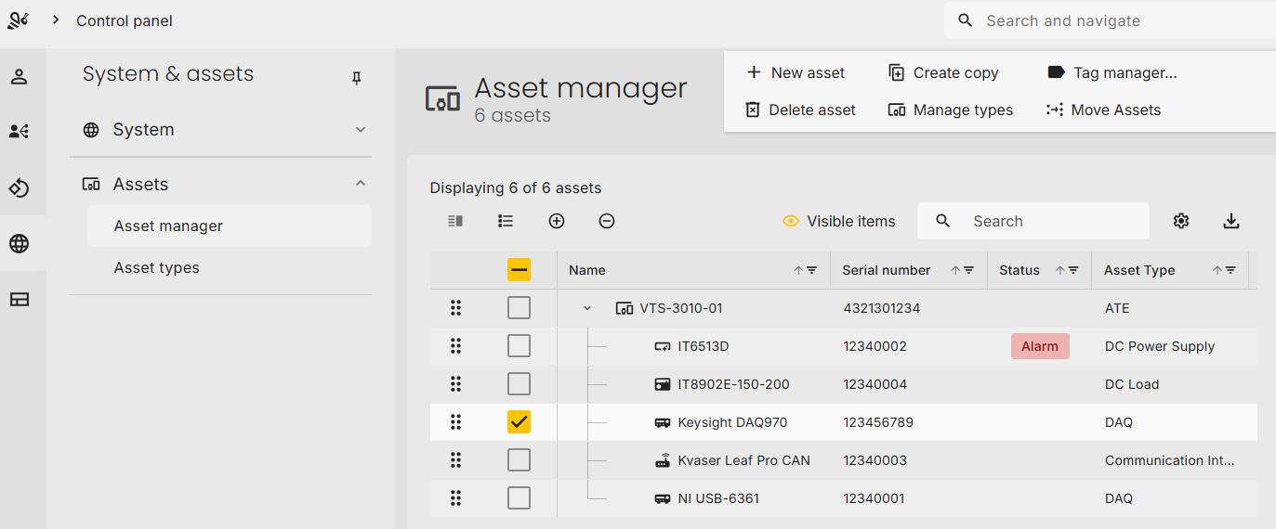
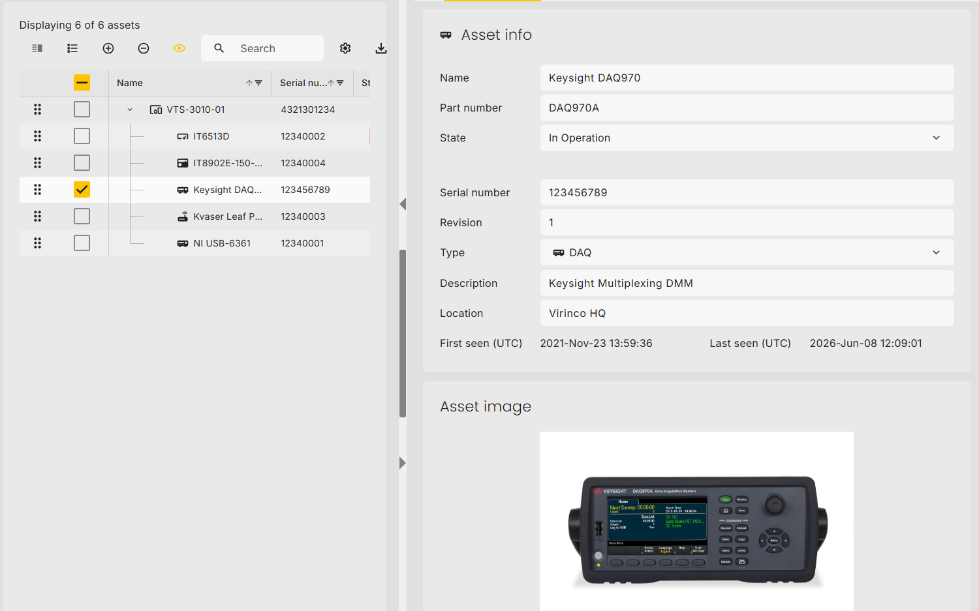
WATS Asset setup
Name
Part number
Serial number
State
Asset type
Description
Location
Revision
Notes:
The Asset SN is the ID to identify the asset

Slide 8
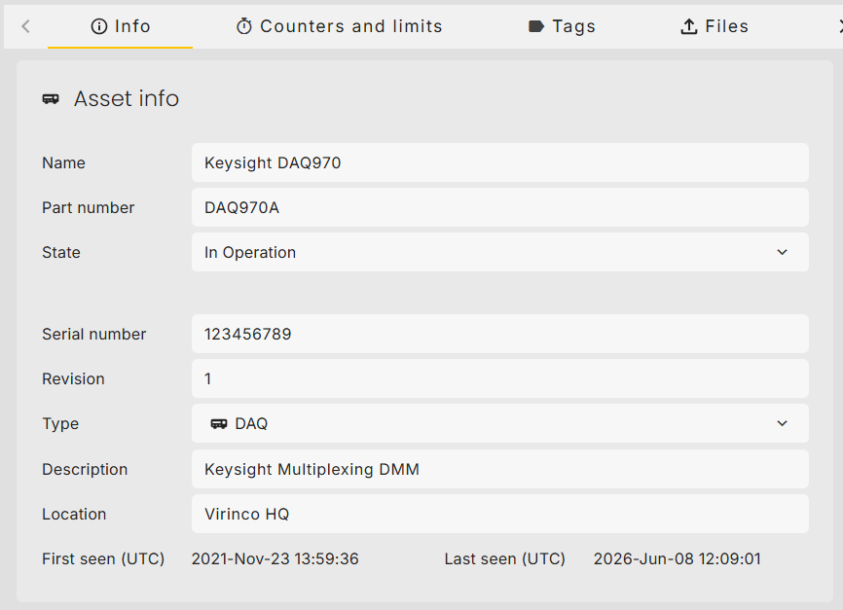
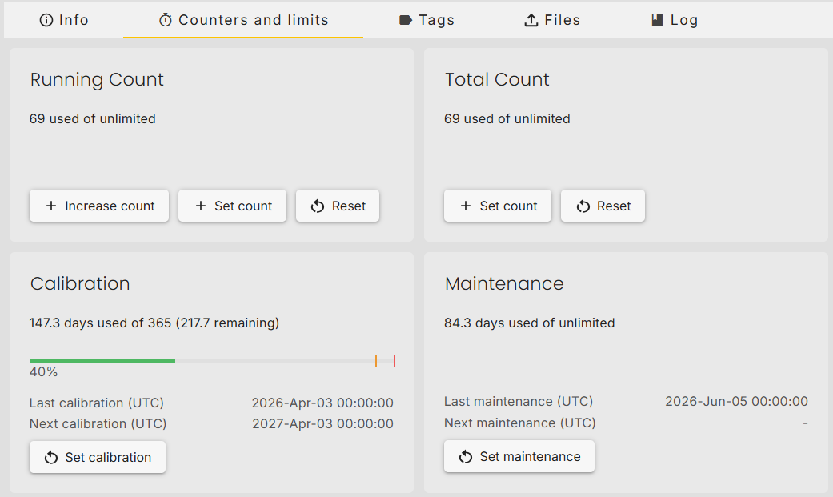
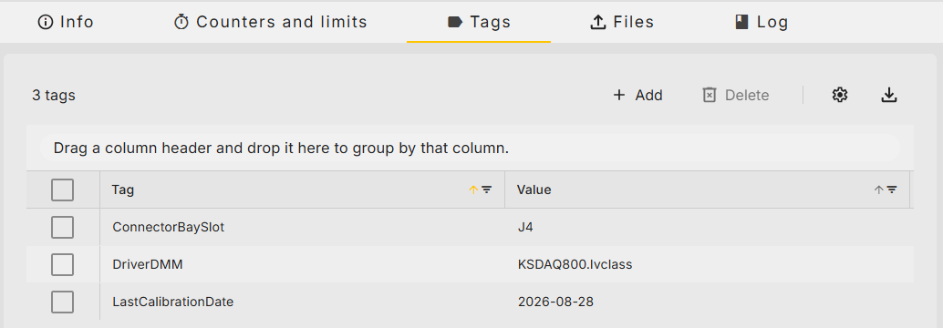
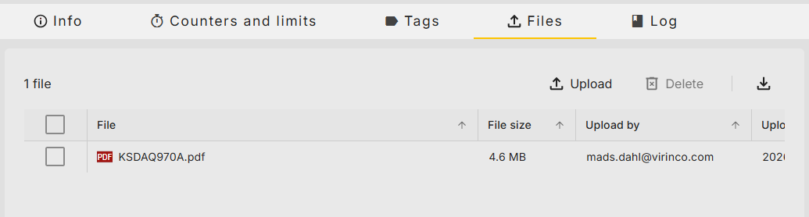
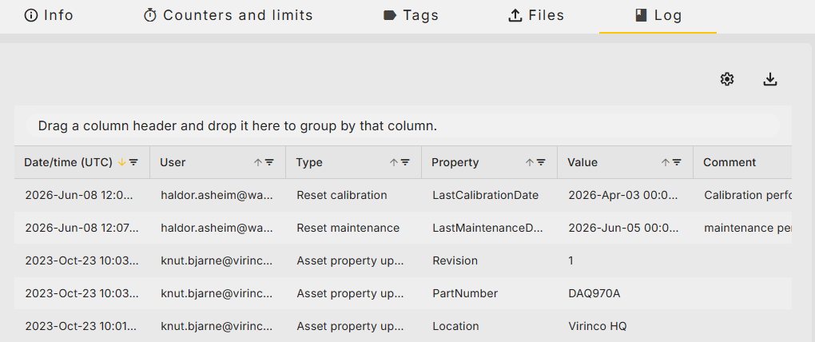
WATS Asset setup - instrument
Notes:
The Calibration interface has been redesigned with improved usability: • The Reset button has been renamed to “Calibrate” or “Set Calibration” for clearer function labeling. • A new “To Date” field has been added when the Calibration Interval is set to External. • A Total Count reset option has been introduced (with appropriate restrictions). o Editing Total Count requires the new “Edit Total count” permission, found under Control Panel -> System & Assets -> Asset Manager -> Edit counters and limits. Administrators and Managers will get this permission by default.

Slide 9
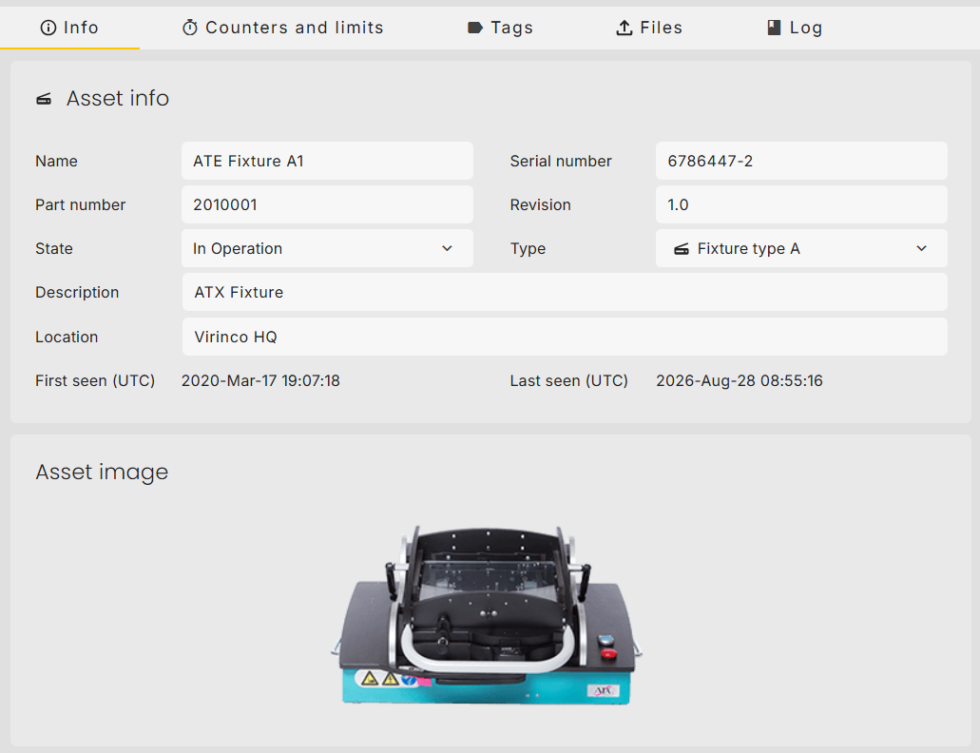
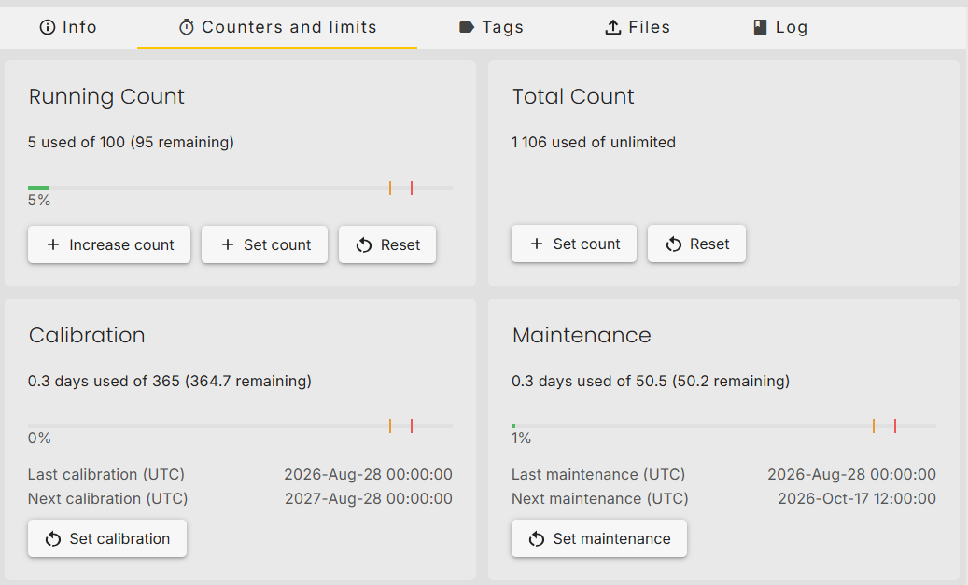
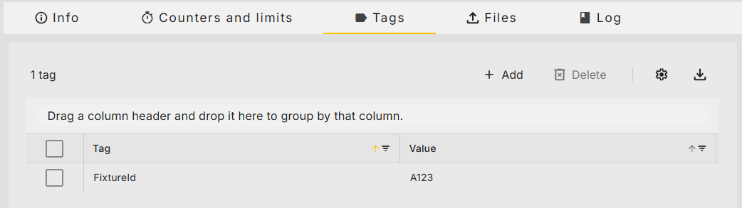
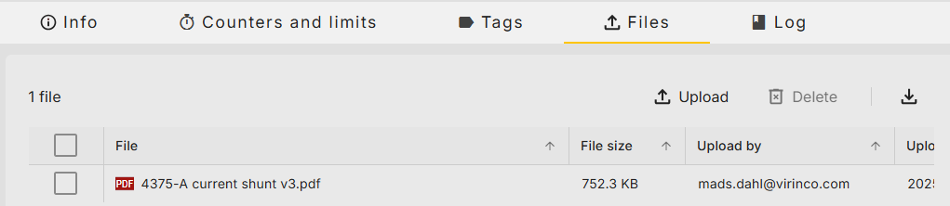
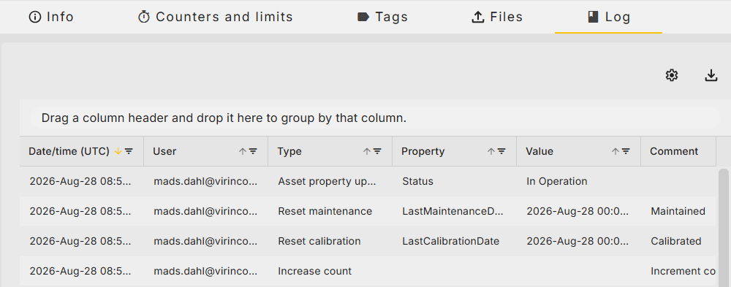
WATS Asset setup - fixture

Slide 10
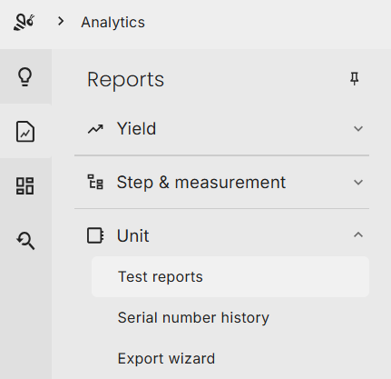
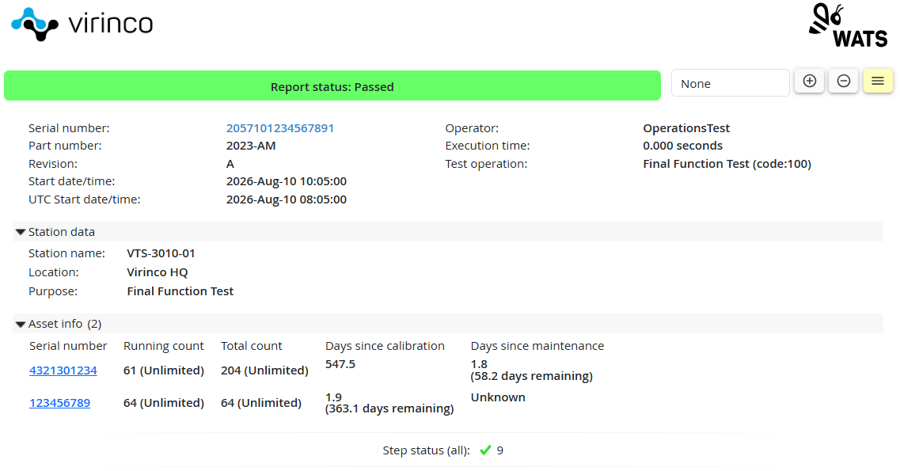
WATS Asset – Unit Test Report

Slide 11
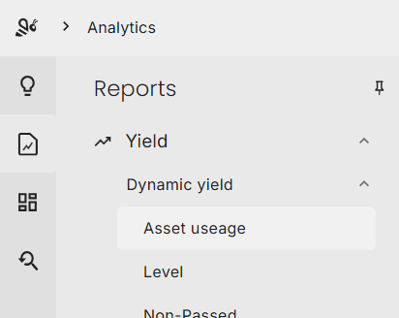
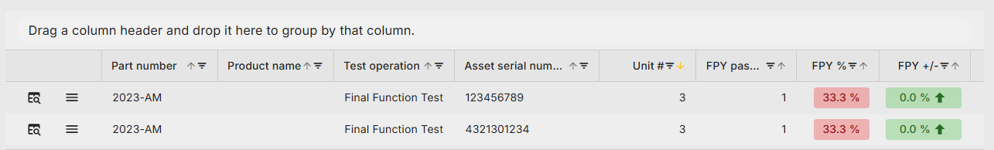
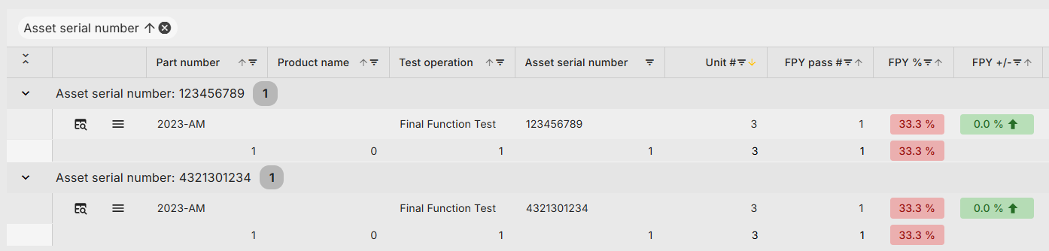
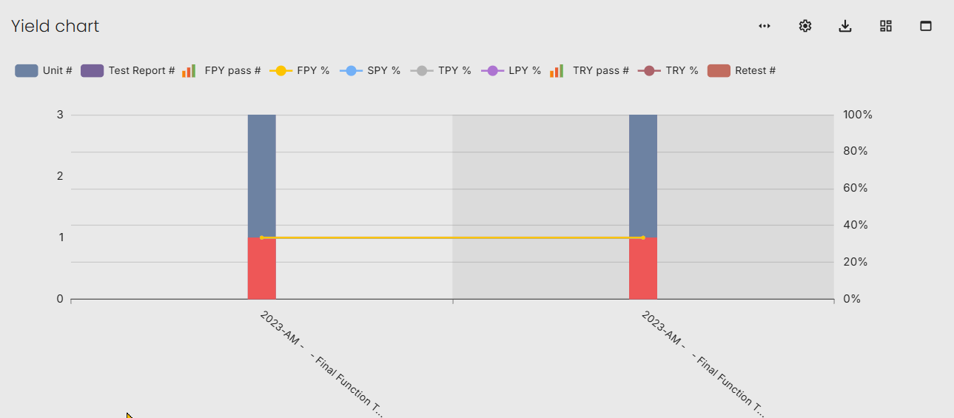
WATS Asset – Dynamic yield

Slide 12
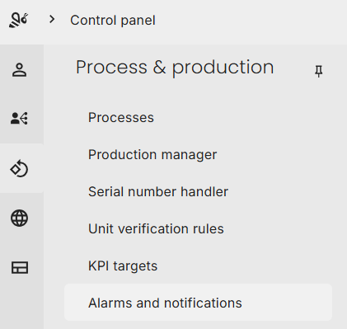
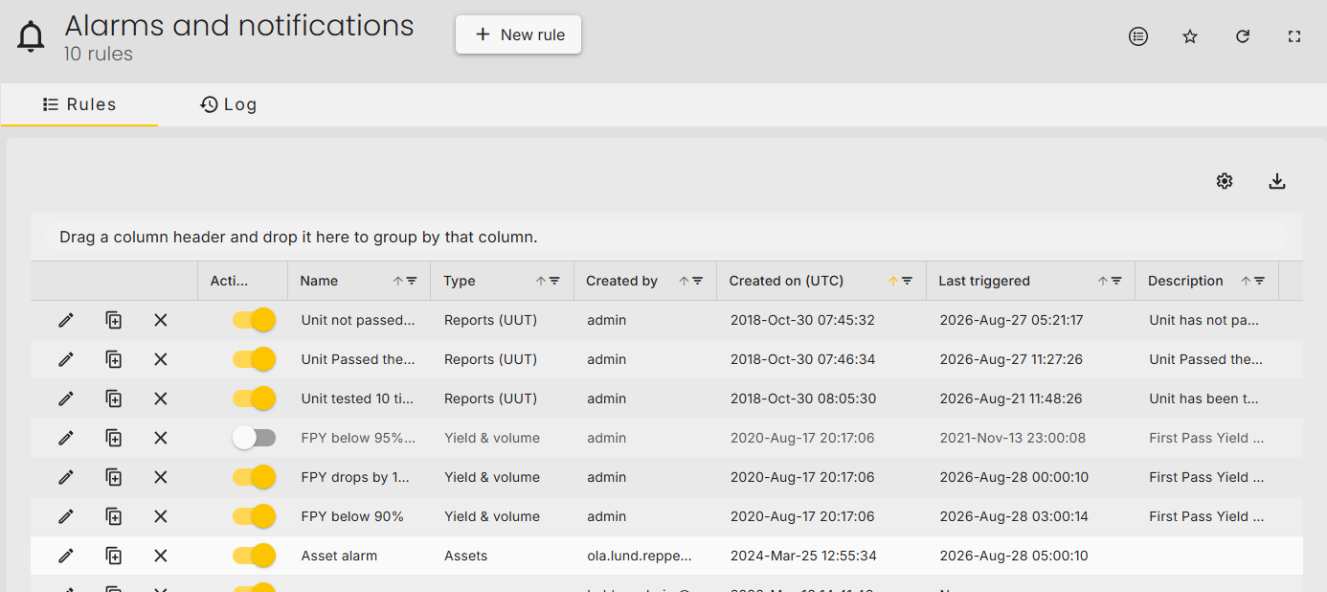
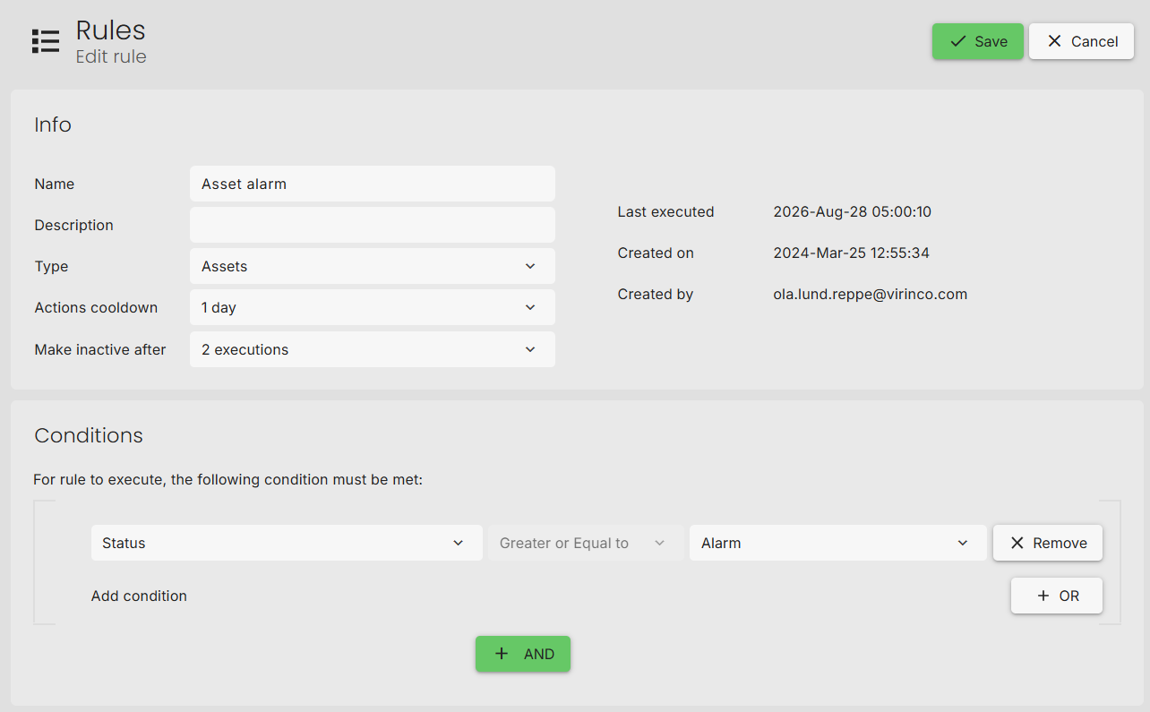
WATS Asset - Alarms & Notifications

Slide 13
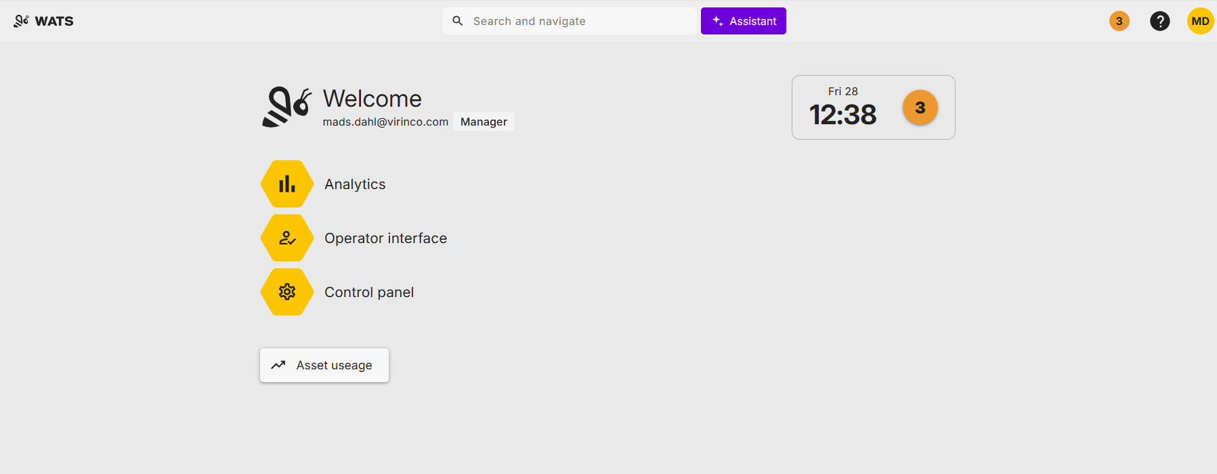
Quick WATS Demo

Slide 14


Virinco technology services
Test equipment development
Electronics development
WATS services
  SW distribution
  Asset management
  API services and solutions
  3rd party connections with WATS
  System manager control
  Client services

