Slide 1
WATS Software Distribution
Create SW packages, distribute to test stations
WATS UP, Drammen, September 2026
Notes:
Lets start, we have no time to loose!

Slide 2
Introduction
Brief on Software Distribution
New features
Demonstration
Questions
Notes:
I will give a top down brief on Software Distribution, and try to motivate why we should take SW Distr into our workflow.
We will look into the new features of the latest release
And maybe we got time for a demo and some questions at the end!

Slide 3
How does it fit together, and how does it work?
Brief on Software Distribution
Notes:
So: How does it fit together, and how does it work?

Slide 4

WATS at a glance
Store, analyse, visualize
Action
Support decisions
Gather data
“Gather, visualize, and act on your data. To improve yield, reduce costs, and gain control of your manufacturing process.”
Notes:
This is WATS at a glance: Its purpose is to “Gather, visualize, and act on your data, to improve yield, reduce costs, and gain control of your manufacturing process.”
It looks quite simple right?
But we know that this is just a part of the truth.

Slide 5
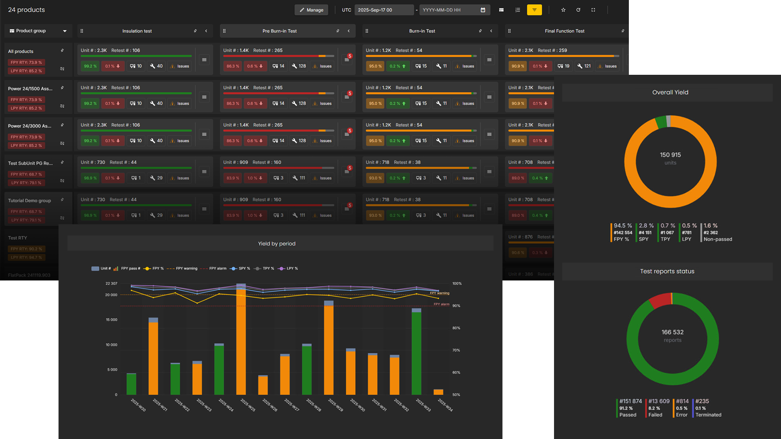
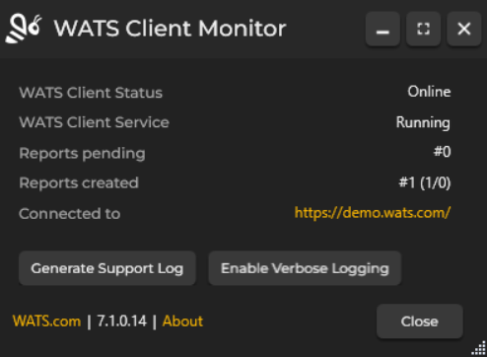

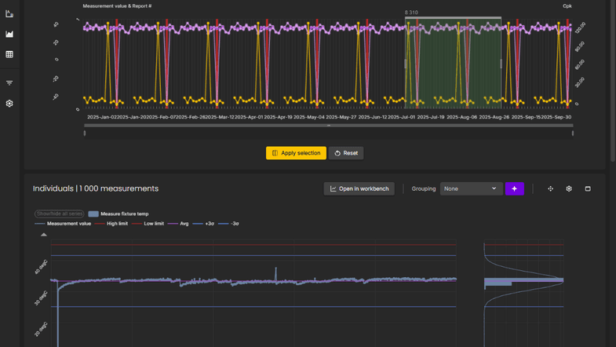
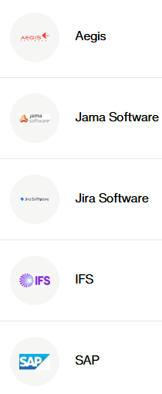
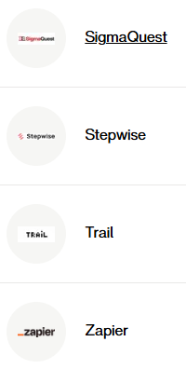
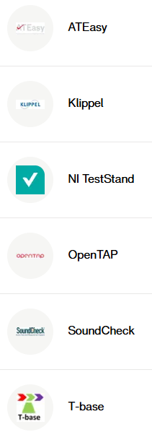
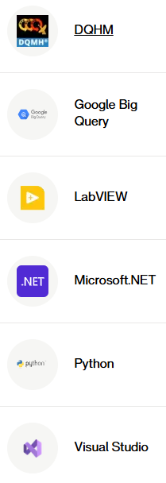
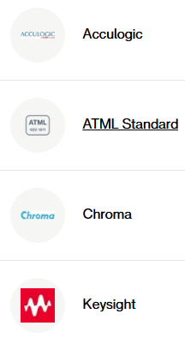
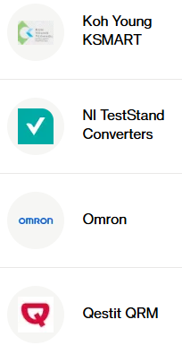
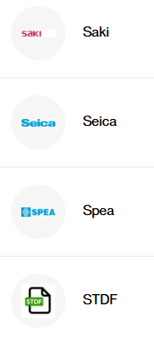
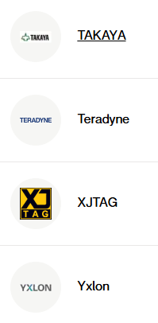



The machinery
WATS Client:
Azure cloud
Store, analyse, visualize
Action
Support decisions
Gather data
Integrations and Client
converters:
Notes:
There is a whole machinery behind:
The WATS Client gathers test reports
It is uploaded to some Azure database
The WATS web application organizes data and provides excellent tools for analytics and visualization
This in turn creates the foundation for the process of finding the most effective improvement measures.
And all the parts comes along with an entire forest of converters and integrations
All to make it fit with the rest of your business applications and support your processes.
Different parts depending on each other: It’s an ecosystem!

Slide 6
Software Distribution??
WATS Client:
MS Azure
Store, analyse, visualize
Action
Support decisions
Gather data
Integrations and Client
converters:
Notes:
Where does Software Distribution belong in this ecosystem?

Slide 7
Software Distribution!!
WATS Client:
MS Azure
Store, analyse, visualize
Action
Support decisions
Gather data
Integrations and Client
converters:
Notes:
It is on the borderlines in this illustration
It’s maybe not even a part of WATS core functionality
Then why does it exist?
If we warp this linear representation: We can see that it is forming a …….

Slide 8


MS Azure
Store, analyse, visualize
Integrations and Client
converters:
Action
Support decisions
WATS Client:
Gather data
Notes:
Semicircle?
And eventually…

Slide 9




Closing the circle
Store, analyse, visualize
Gather data
Action
Notes:
A full circle!
But this circle looks kinda familiar, you say!
Yeah, what can it be….?

Slide 10
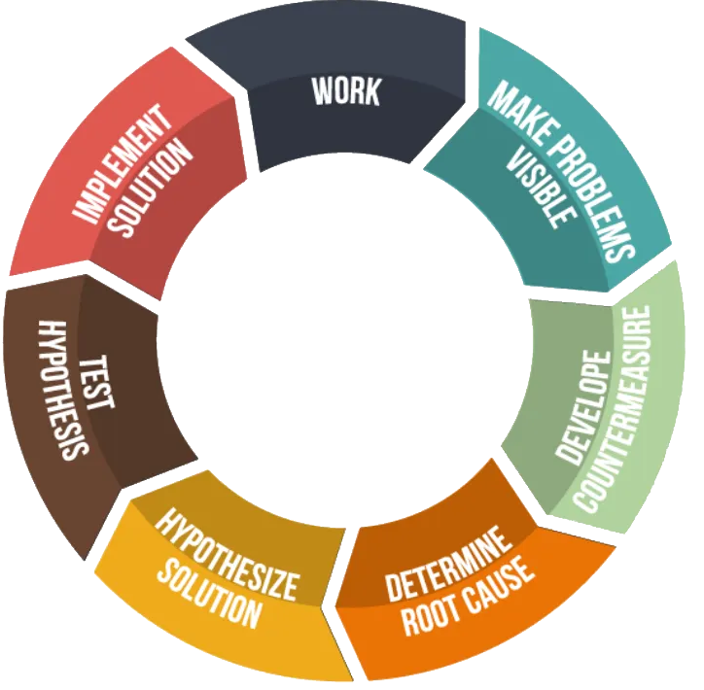
Closing the circle
Store, analyse, visualize
Gather data
Action
Notes:
Something like this? Maybe?
It comes in different forms and shapes

Slide 11
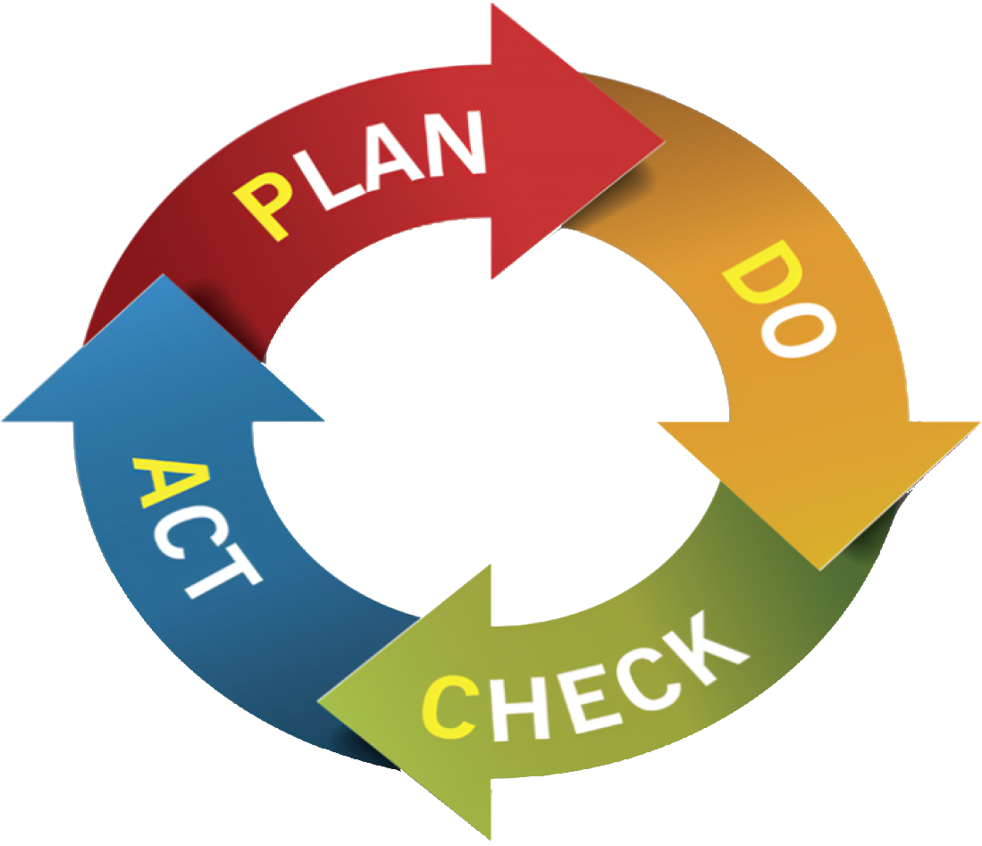
Closing the circle
Store, analyse, visualize
Gather data
Action
Notes:
…..from different frameworks and philosophies: LEAN, Six Sigma, Total Quality Management
It is the cycle of Continiuos Improvement!

Slide 12
Closing the circle
Store, analyse, visualize
Gather data
Action
Continous Improvement Cycle
Notes:
And it aligns very well with the WATS ecosystem, what a coincidence!
Software Distribution is a tool helping implementing improvements.

Slide 13
Analyze and plan Do something
Changes in files
Something must be done with the test!
Adjust test limits
Change test execution order
Change certain test steps
Update driver software
Something must be done with the product!
New product revision
Something must be done with equipment!
Calibration
Change instruments
Notes:
You do analysis and plan improvements
Then you DO something
With the test: Adjust limits, update drivers, etc
With the product, and this might invoke a new HW or FW revision.
Or with the test equipment
At least for the first two, this drills down to doing changes in certain files.
And for these changes to come into effect, they must be done in the local files on the test computers.

Slide 14
How is that done practically?
We replace the files
Copying files manually remote
Test developer logs in on test computer using Remote Desktop, TeamViewer etc. and copy over changed files manually.
Custom made automated solution
  A custom made script or pipeline uses something like SFTP and transfer files.
  Can be demanding to set set up, and maintain, properly.
Copying files manually local
Technician at production site copies files into test computer from some local storage medium or shared filesystem.
Works OK-ish for a few computers
Quickly becomes a pain to administrate
Notes:
So how do we do that in practical terms? Yes, we replace old files with updated ones.
Either by
accessing the test computer from remote, via some Remote Desktop or whatever, copying files over manually,
or letting a Technician at the production site copy over the new files, from some local storage medium or shared filesystem.
This works kinda OK for a few computers, BUT as the number of stations grows, it will become a real nightmare.
Maybe you are thinking of making a custom script or pipeline, that do the job for you? But this again can be challenging to set up and maintain properly.

Slide 15
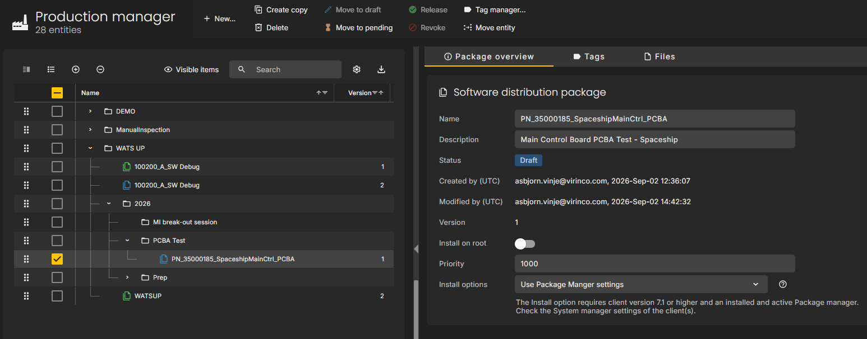
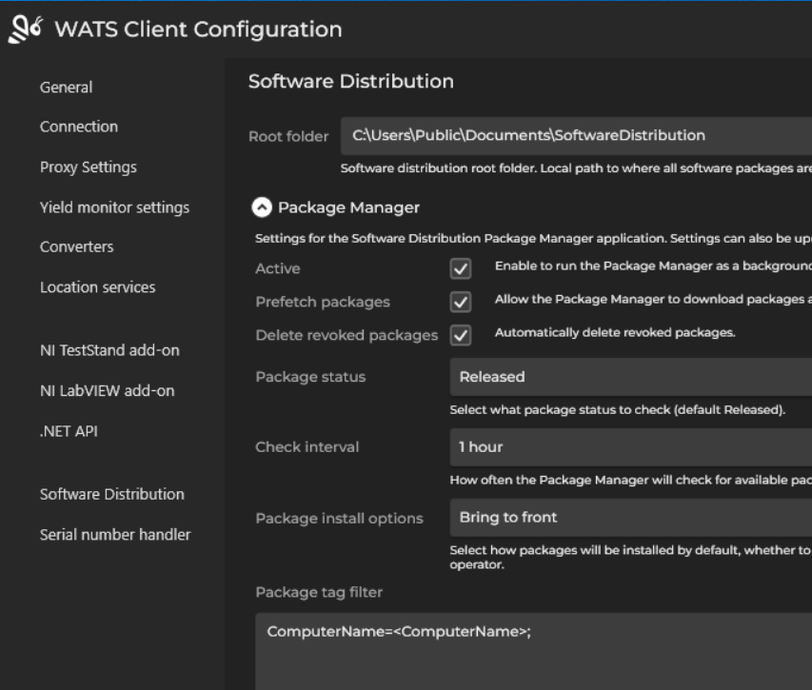
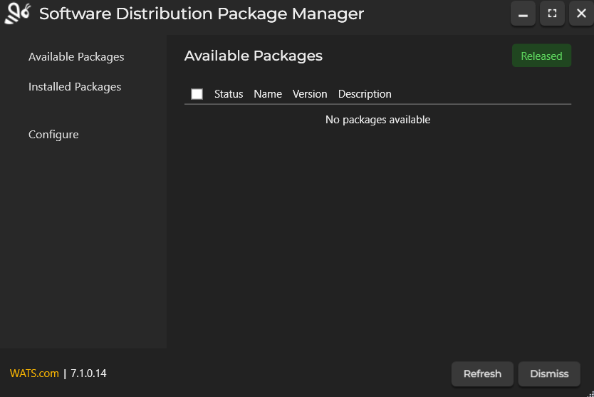
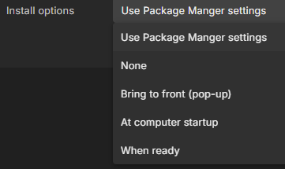
WATS Software Distribution
A helpful tool
Packages are created in WATS web application
Settings control how the distribution happens
Downloaded by WATS Client on the test computer
Little human interaction on test computer
Notes:
The Software Distribution module is WATS answer to this challenge of putting updated files in the right place to the right time.
Software packages are created in Production Manager in the web application
The packages are distributed according to the Tag configuration
And little or no human interaction are required on the test computer side
It is a tool for Deploying software from development into production and should be used together with versioning systems like SVN or GIT and not instead of them.
I plan to show you some functionality LIVE in a few minutes.

Slide 16
The new stuff in
WATS Client 7.1 and Server version 2026.2
New features
Notes:
But first we’re gonna have a look at the new features in the latest release!

Slide 17
Ordered by significans – My personal opinion ☺
Really valuable stuff:
Package Manager settings available in System Manager
New auto-install options
Allow background downloads
Multithreaded downloads
Package manager settings moved into Client
Nice to have:
New “map view”
A number of minor improvements
Package manager GUI is modernized
Notes:
The Package manager settings are now available in System Manager in the web application
There are new auto-install options available
Background downloads can be enabled
Downloads are now multithreaded with up to 10 parallel processes.
And the Package manager settings are moved into the Client
We have got a new “map view” alongside the split-screen and list-view
There has been done several minor improvements
And the Package manager GUI is modernized!
If you ask me: Those last ones aren’t really a new features, more what is generally expected from a licenced SW tool in 2026, but anyway!
We’re gonna dive in and look at them one by one!

Slide 18
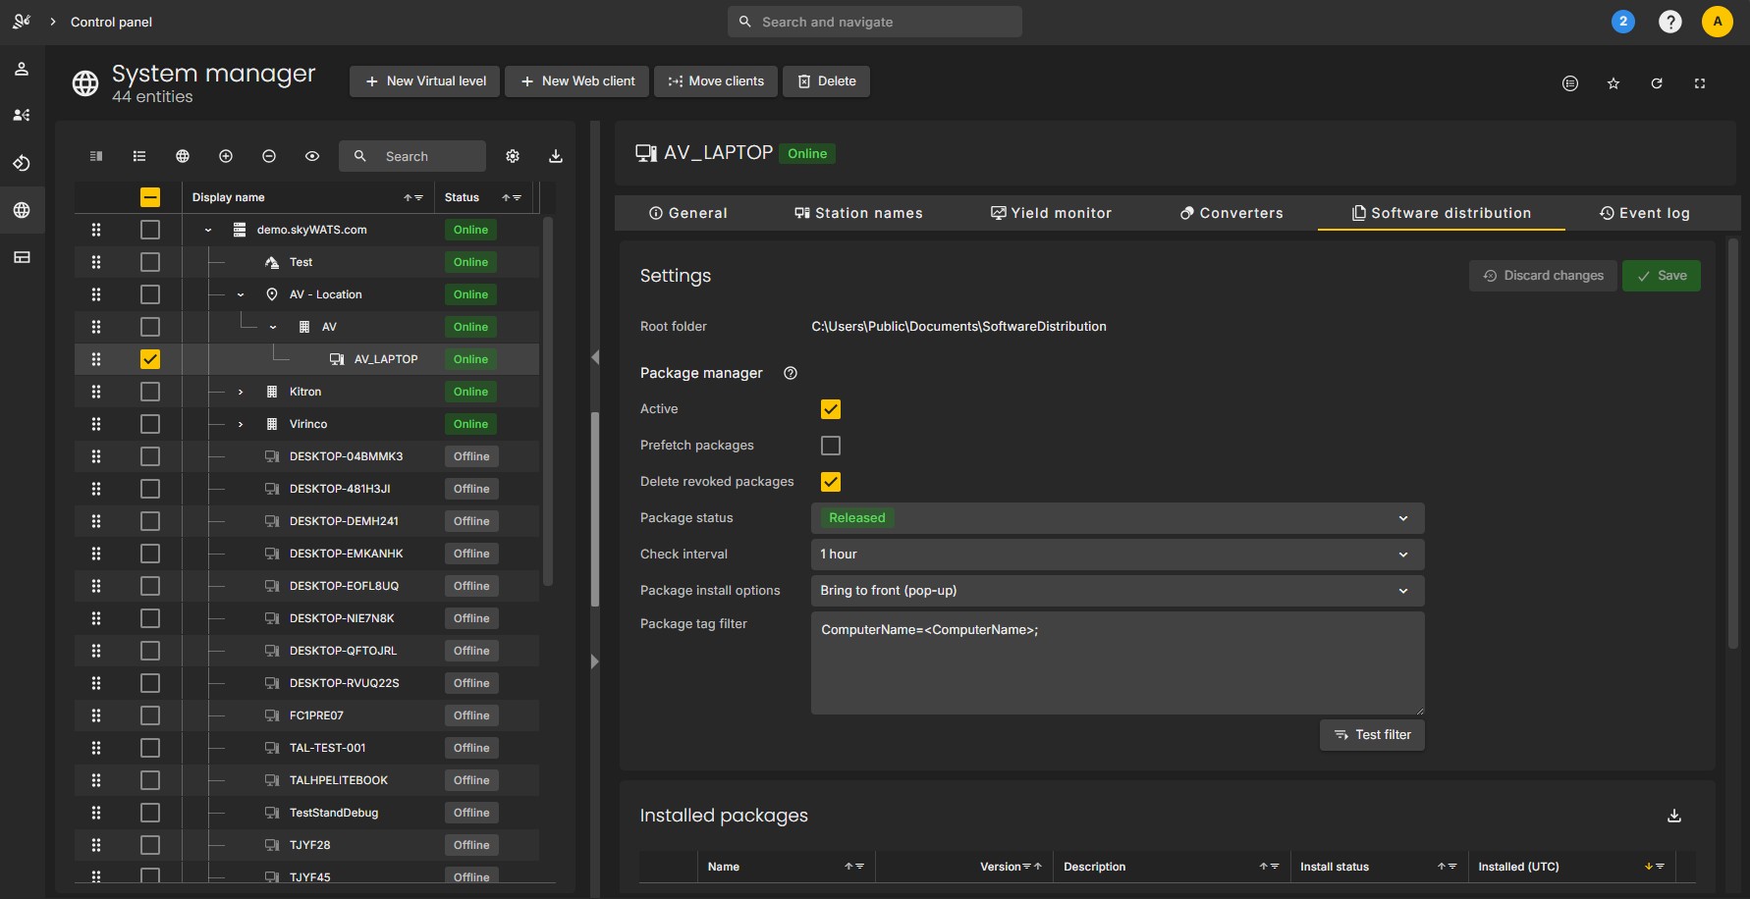
Package Manager settings available in System Manager
Notes:
Now, you can edit the SW Distribution Package Manager settings from the System Manager
This allows you to make changes to all your globally connected WATS Clients from the web application Control panel.
So we no longer have to log into each and every test computer when we want to change those settings.
Changing Package tag filter, Package install options etc, it can all be done in System Manager.
Together with the existing functionality Download history and Installed packages this gives a new level of control.

Slide 19
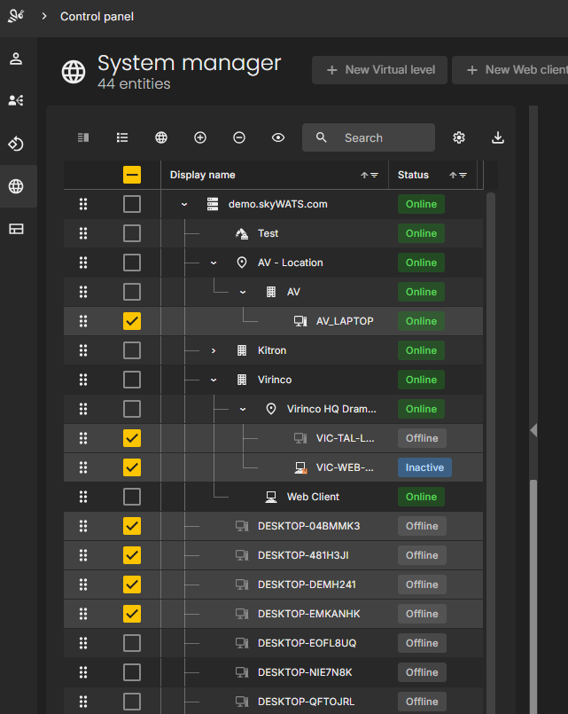
Package manager settings available in System Manager
?
Notes:
I see the use case of selecting several clients at the same time, and let settings apply to them all.
But this is not supported yet. Maybe something to look into for the development team?
If you guys want it, put it into the WATS idea exchange and vote for it!
Anyway this is a great improvement!

Slide 20
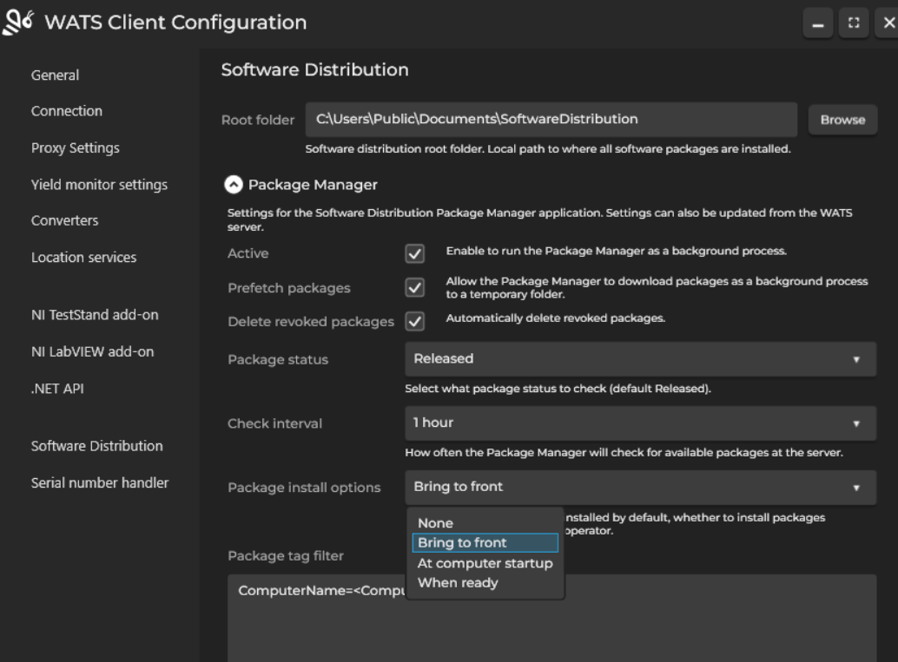
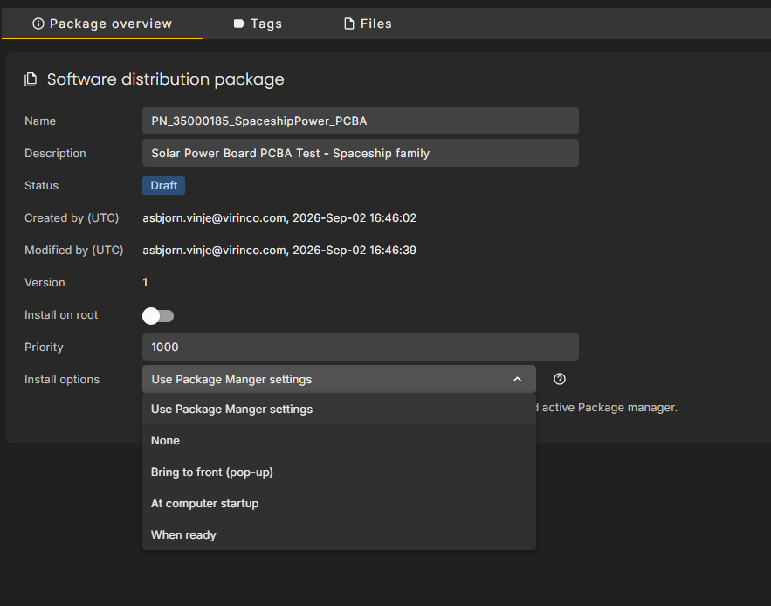
New auto-install options
Notes:
Not only are the setting easier to manage: Now we can set up an installation-action, either per Client or per package.
None, means you install it manually as before, from the Package Manager
Bring to front (pop-up), opens the Package Manager automatically as soon as a new package is available for installation,
At computer startup, automatically starts installation if there are new packages available (in temporary storage), or
When ready, which starts installation as soon as a new package is downloaded.
In the package settings, to the right, you have the option of letting the package obey Client settings
In combination with the next new feature, these auto install option are quite effective!

Slide 21
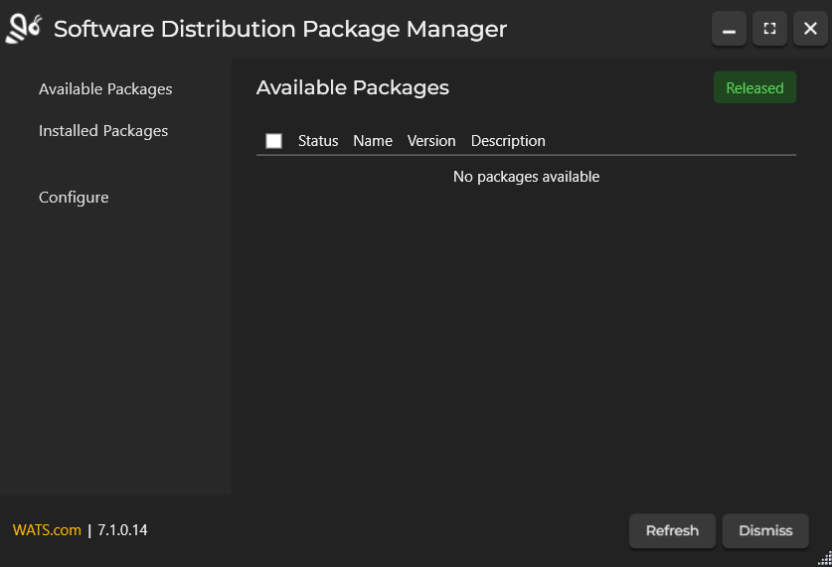
Allow for background downloads
Notes:
Now, if you enable the Prefetch packages flag, packages will be downloaded as soon as the Client are aware of new packages (of course matching the tag filter and with right status).
This means, they’re not only listed in the Available Packages list, they are actually downloaded to a temporary storage, so you can click Install and it will start installation immediately.
This saves you from being forced to watch and wait for the packages to be downloaded before installation starts.
I imagine it can be quite helpful if you’re dealing with packages of several hundred MBs or even GBs.
But in th case, I think It would be a good idea to review your software update approach, maybe package size could be reduced.

Slide 22
Multithreaded downloads
10 x
Notes:
Earlier versions downloaded files sequentially, one by one.
But now, they’re downloaded in parallel with up to 10 threads, so you have potentially 10x improvement in download time.

Slide 23
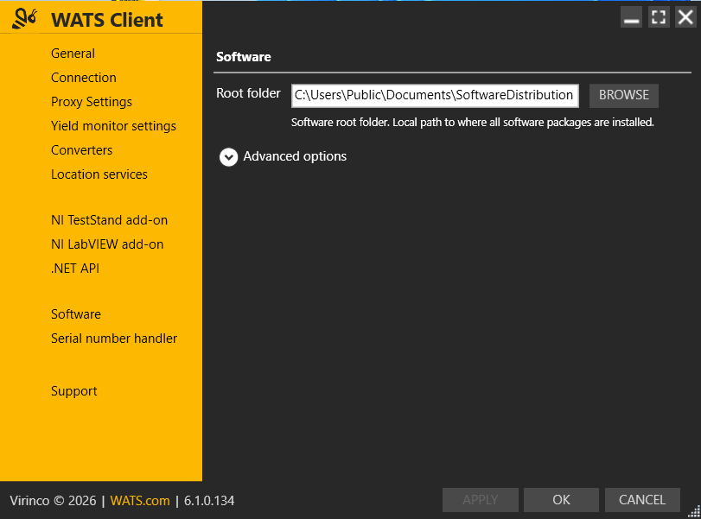
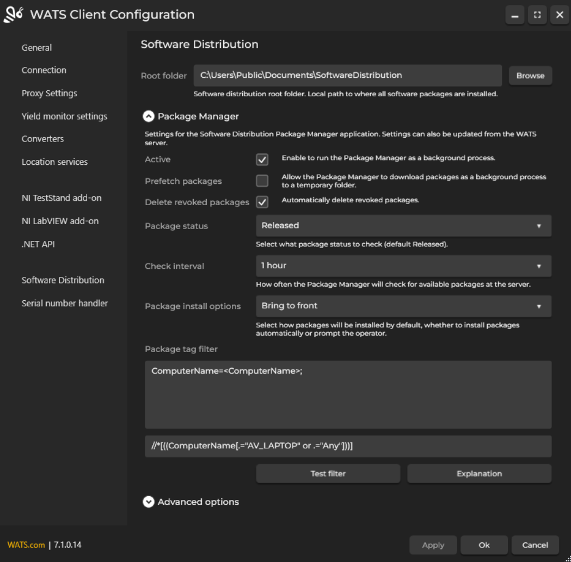
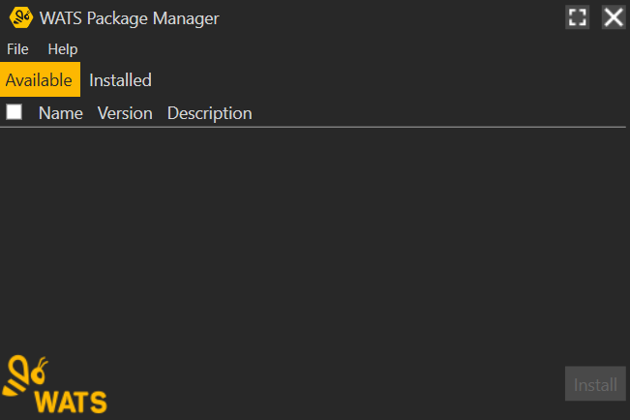
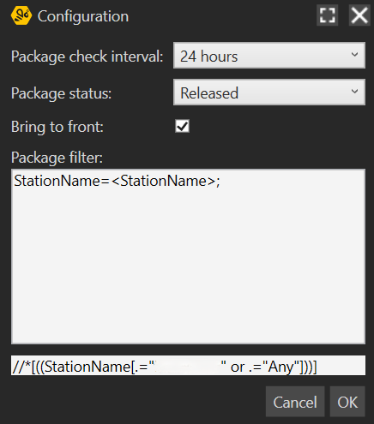
Package manager settings moved into Client
Notes:
Another change is that the Package Manager Configuration window is moved into the client GUI.
I think this improves user experience, and it makes Package Manager GUI cleaner.
Not a big deal, but good to be aware of!
So, this was the most useful new features. In addition, we get some nice (but less important) improvements:

Slide 24
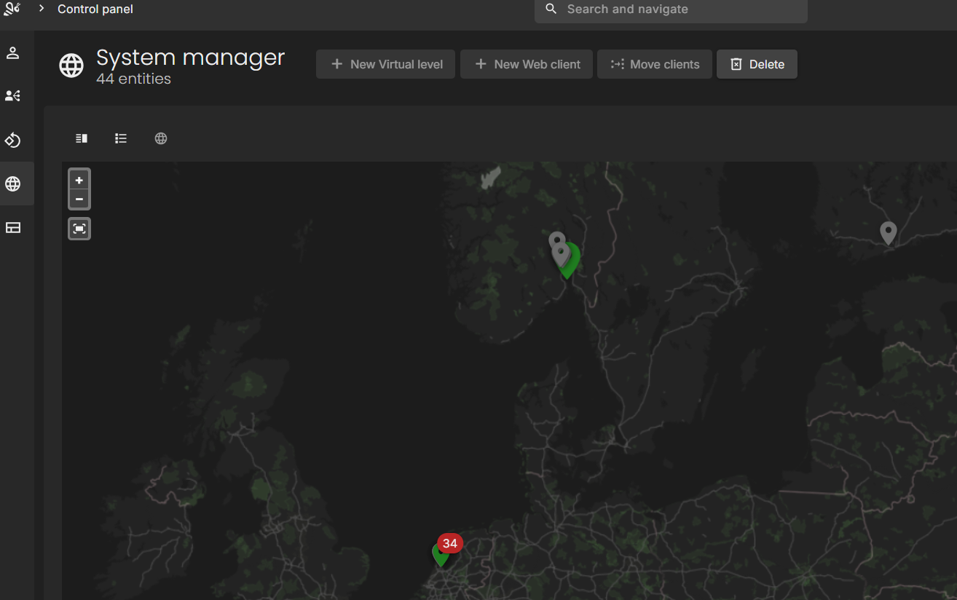
New “map view”
Notes:
Option to see all connected WATS Clients in a map in addition to the default split-view or list-view.
This might simplify navigation for some users, it works like an intuitive Location filter.
Double clicking on a computer takes you to the spilt-view with that computer selected.
AND of course you have these minor improvements and modernization.

Slide 25
An example of how
Demonstration
Notes:
OK, so time to see how this all plays out.

Slide 26
Feel free to ask!
I will point towards the person from WATS RnD team present ….
Questions?
Notes:
Any questions?

Slide 28
Next up:
Break in the lobby until 14:35:
Analyze Test Steps with Test Step Analysis
Ola Reppe,
Integration Architect
The truth behind WATS Cloud
Tommy Egeberg,
CTO
Improve yield faster with AI-powered suggestions for Root Cause Analysis
Tommy Natanya Sukkot,
Area Sales Manager
Cybersecurity and Connecting Manufacturing floor
Joel Avrunin,
CCO Circuit Check

